Slide 1
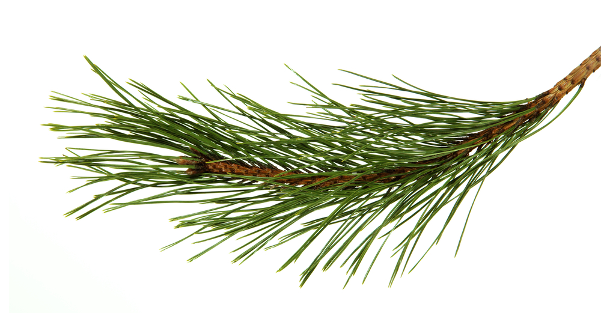
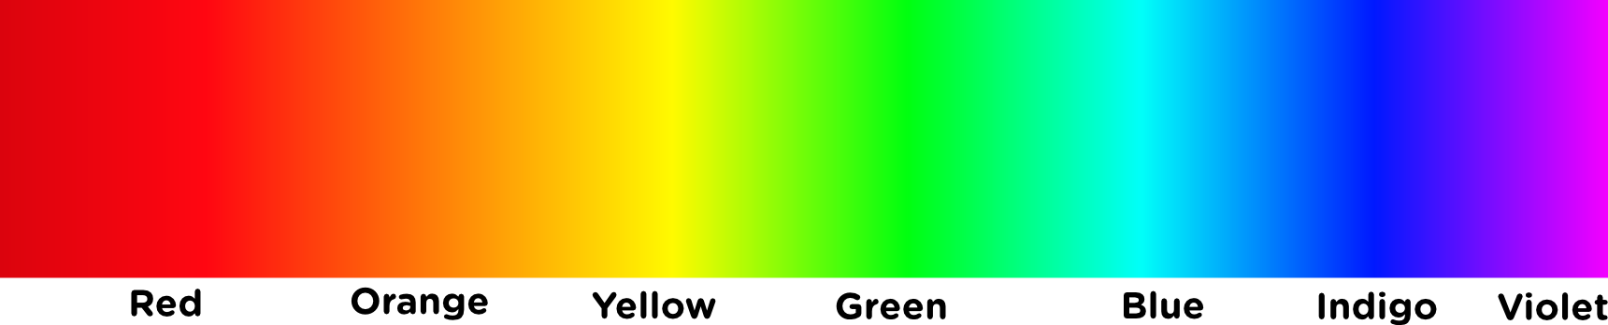

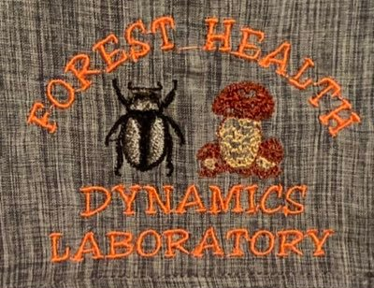

Assessing near-infrared spectroscopy coupled with a chemometric model for Lecanosticta acicola detection in loblolly pine
Christian Rivera, Brea Thomas, Astrid Rojas, Laura Nieto,
Iris Vega, Lori Eckhardt, Brian Via
College Forestry, Wildlife and Environment
Auburn University
2023

Slide 2
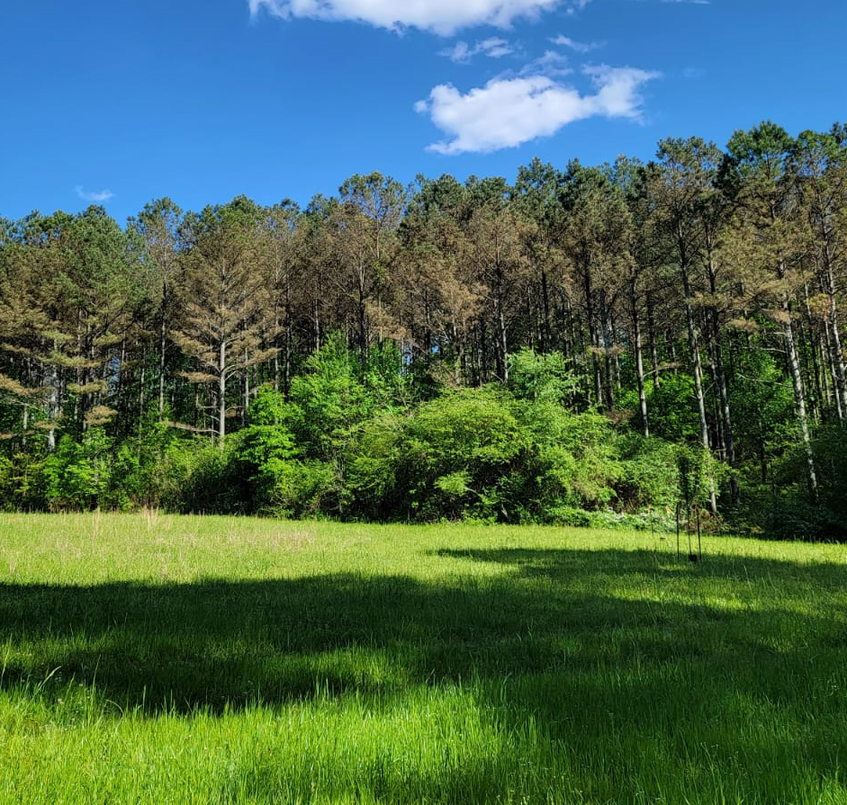



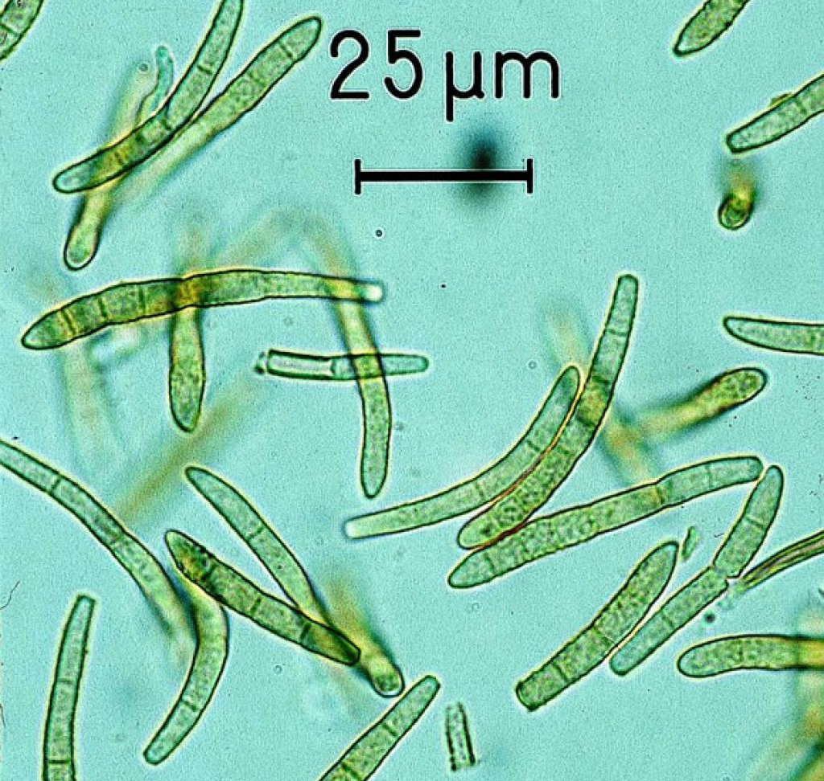

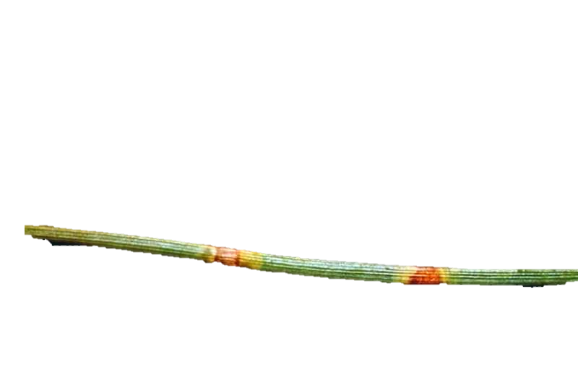
Results in growth reduction and even possible death of infected trees.
Has expanded rapidly in several countries around the world.
Molecular methods such as PCR have been used for its detection.
Pathogen detection using NIR.
1

Slide 3
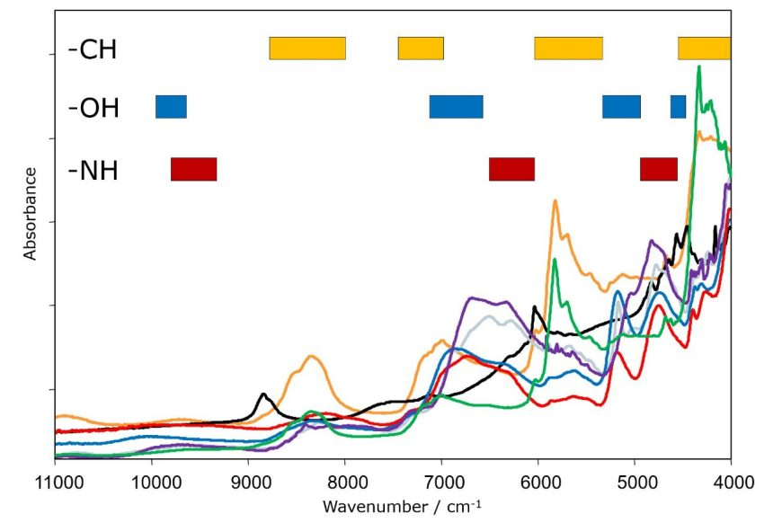
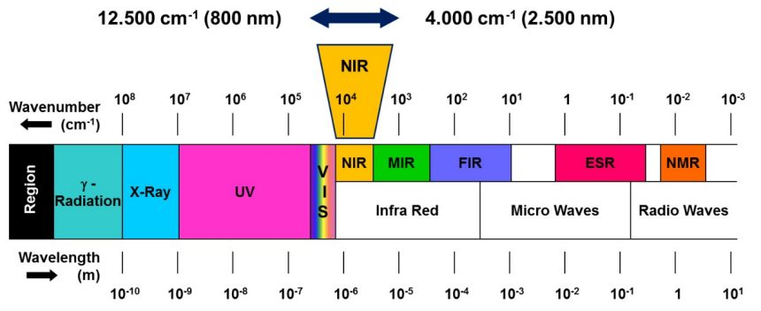
HYPOTHESIS
Visible-Near infrared (VIS-NIR) spectroscopy coupled with a chemometric model can be used as a non-destructive and rapid method that provides information about the chemical composition of the sample.
800 nm
2500 nm
2
https://aub.ie/spectrumNIR

Slide 4
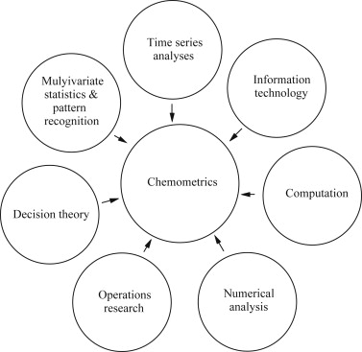
HYPOTHESIS
NIR coupled with the chemometric model can detect the presence of Lecanosticta acicola
Non destructive
Rapid screening
Non-invasiveness
High speed
High sensitivity
Specificity (for particular disease)
https://aub.ie/chemometrics_advantages
3
https://aub.ie/chemometric
Chemometrics is an area that has allowed through statistical and mathematical analysis of data the development of methods for identification of molecules and analytes of interest in various areas, design of models for the identification of molecules and analytes of interest (Kapoor et al., 2023).

Slide 5
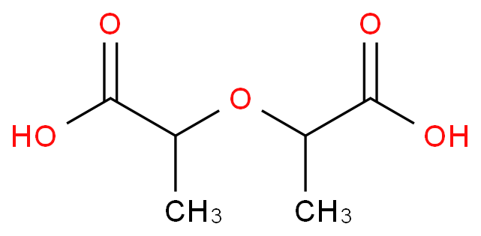


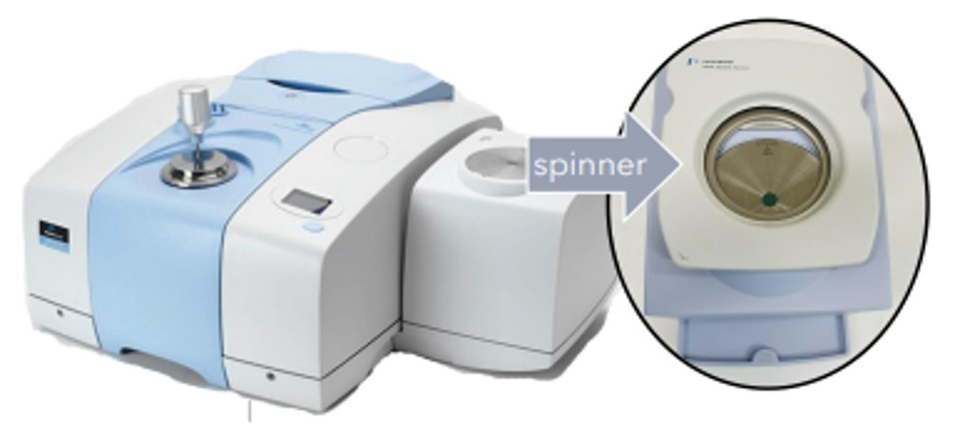


Biomarker
Dilactid acid
CAS Number | 19201-34-4
Molecular Formula | C₆H₁₀O₅
Appearance | White to Pale Yellow Solid
Melting Point | 90 - 97°C
Molecular Weight | 162.14 g/mol
Storage | -20°C, Hygroscopic
Stability | Hygroscopic
Solubility | DMSO (Slightly), Ethyl Acetate (Slightly), Methanol (Slightly), Water (Slightly)
Dilactic (MP 121…)
Transform Infrared (FTIR) Instruments offer flexibility and superior spectroscopic performance across a wide range of applications in chemicals, and materials.
PCR
4
https://aub.ie/FT-IR_EQUIPMENT_Seminar_CRC https://aub.ie/FTIR_NIR_MIR_FIR_Semianar_CRC

Slide 6




GOALS
Colorimetric method
Sample collection (standards)
Detect the presence of Lecanosticta acicola
Chemometric model
5

Slide 7
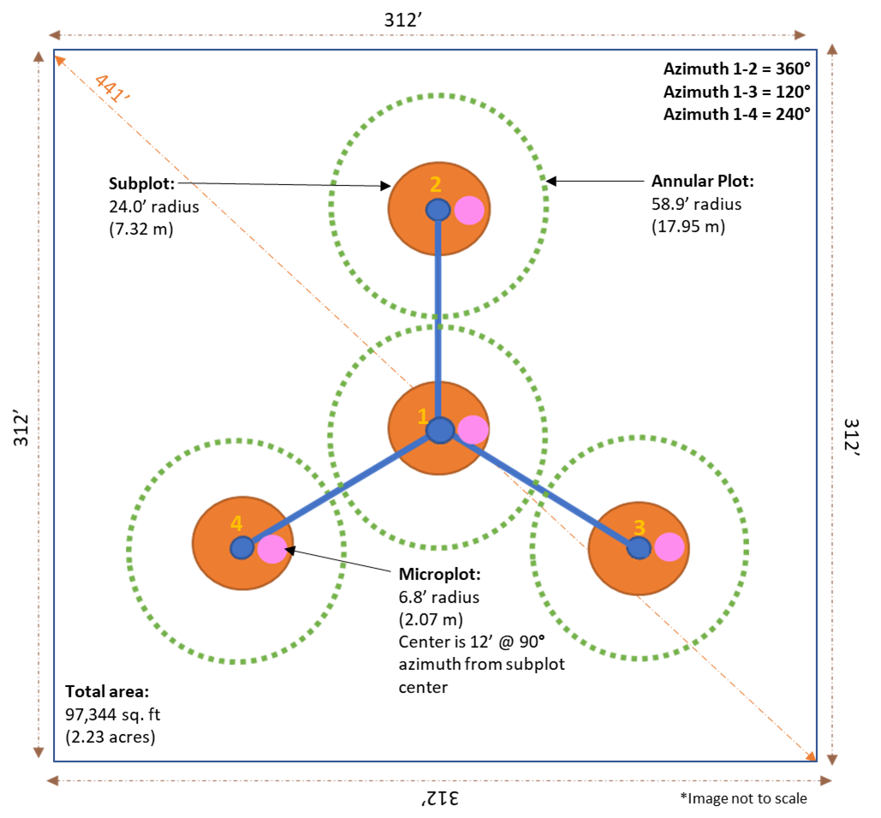
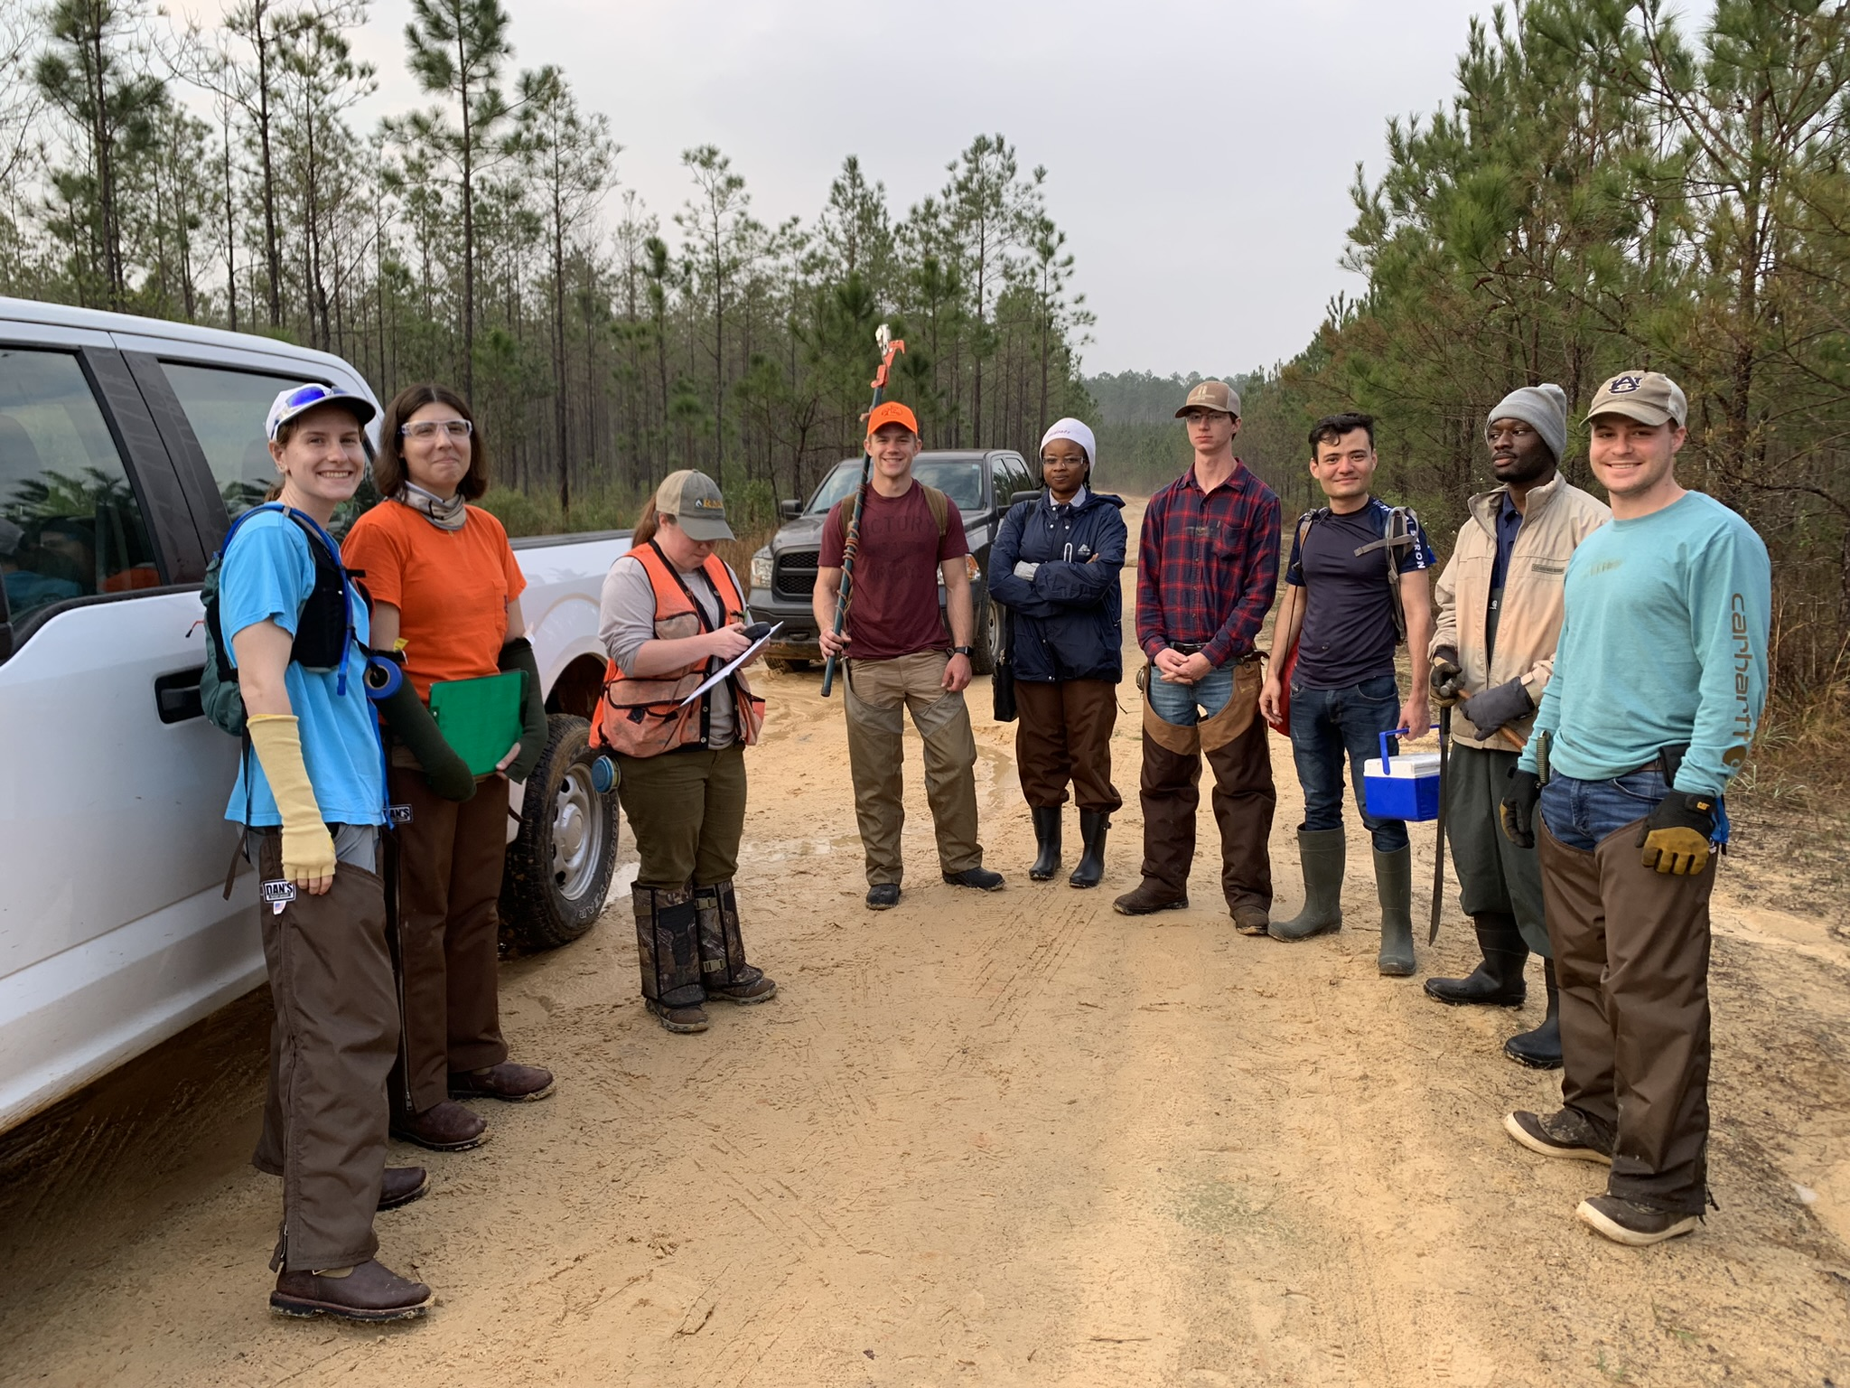
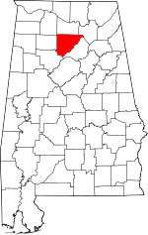
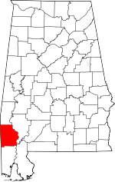
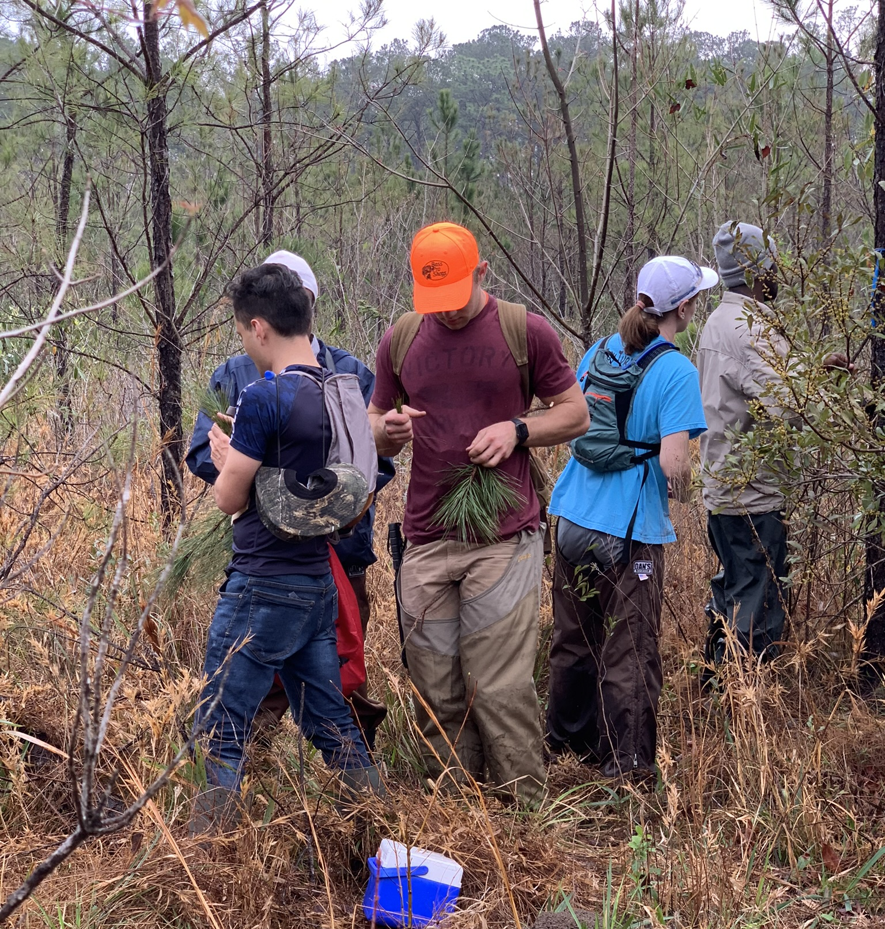
SAMPLE COLLECTION
Alabama
56
SAMPLES MONTHLY
Cullman county
NORTH
5 PLOTS
4 SUB PLOTS
20 SAMPLES
SOUTH
9 PLOTS
4 SUB PLOTS
36 SAMPLES
6
Washington county

Slide 8
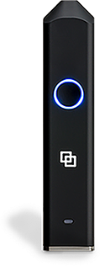

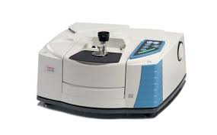
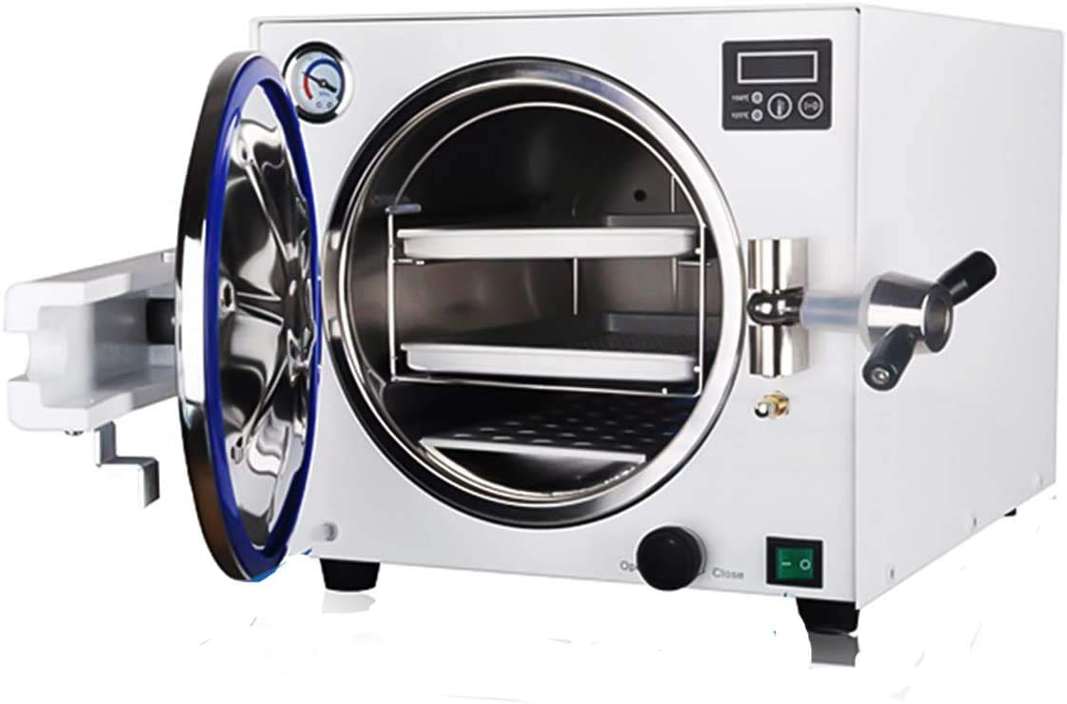
METHODS OF ANALYSIS
NIR
(Portable)
NIR
(Laboratory)
Lignin
content
Chemometrics
7

Slide 9
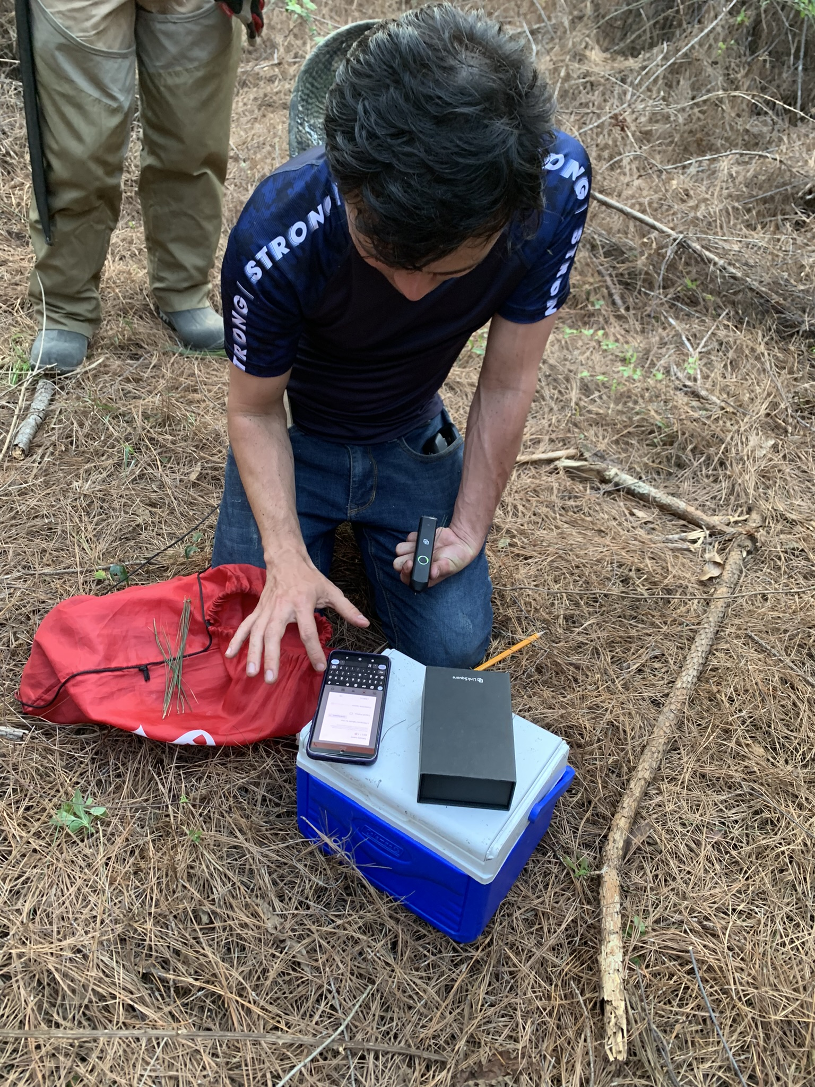

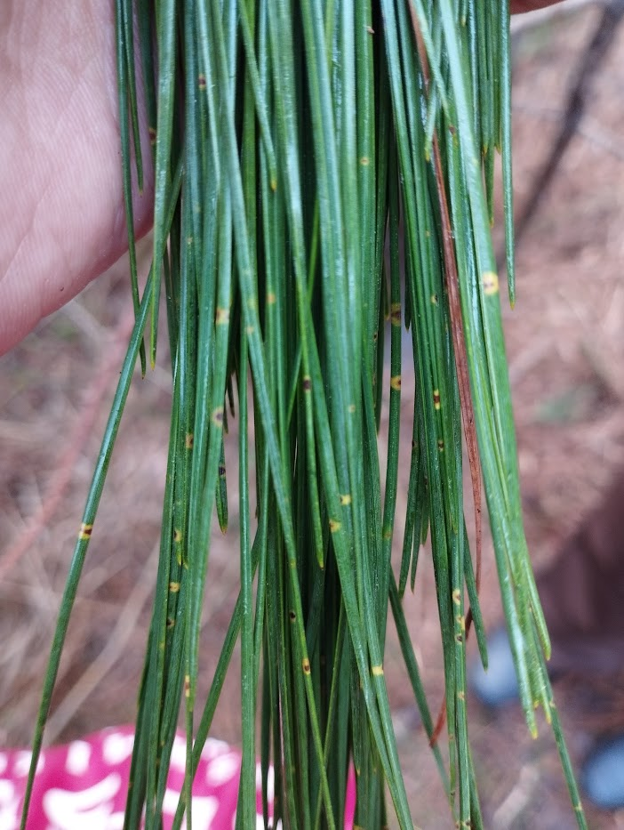
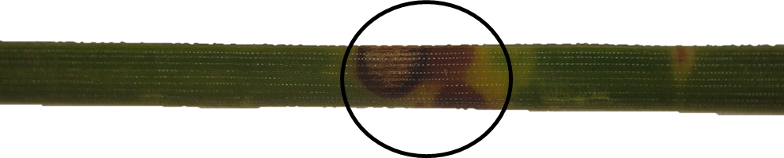
VIS-NIR measurement
https://aub.ie/VIS-NIR
Wavelength (nm)
8

Slide 10
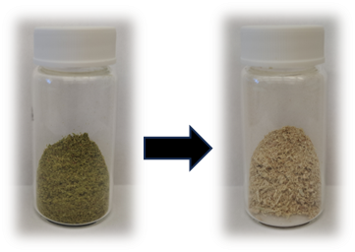
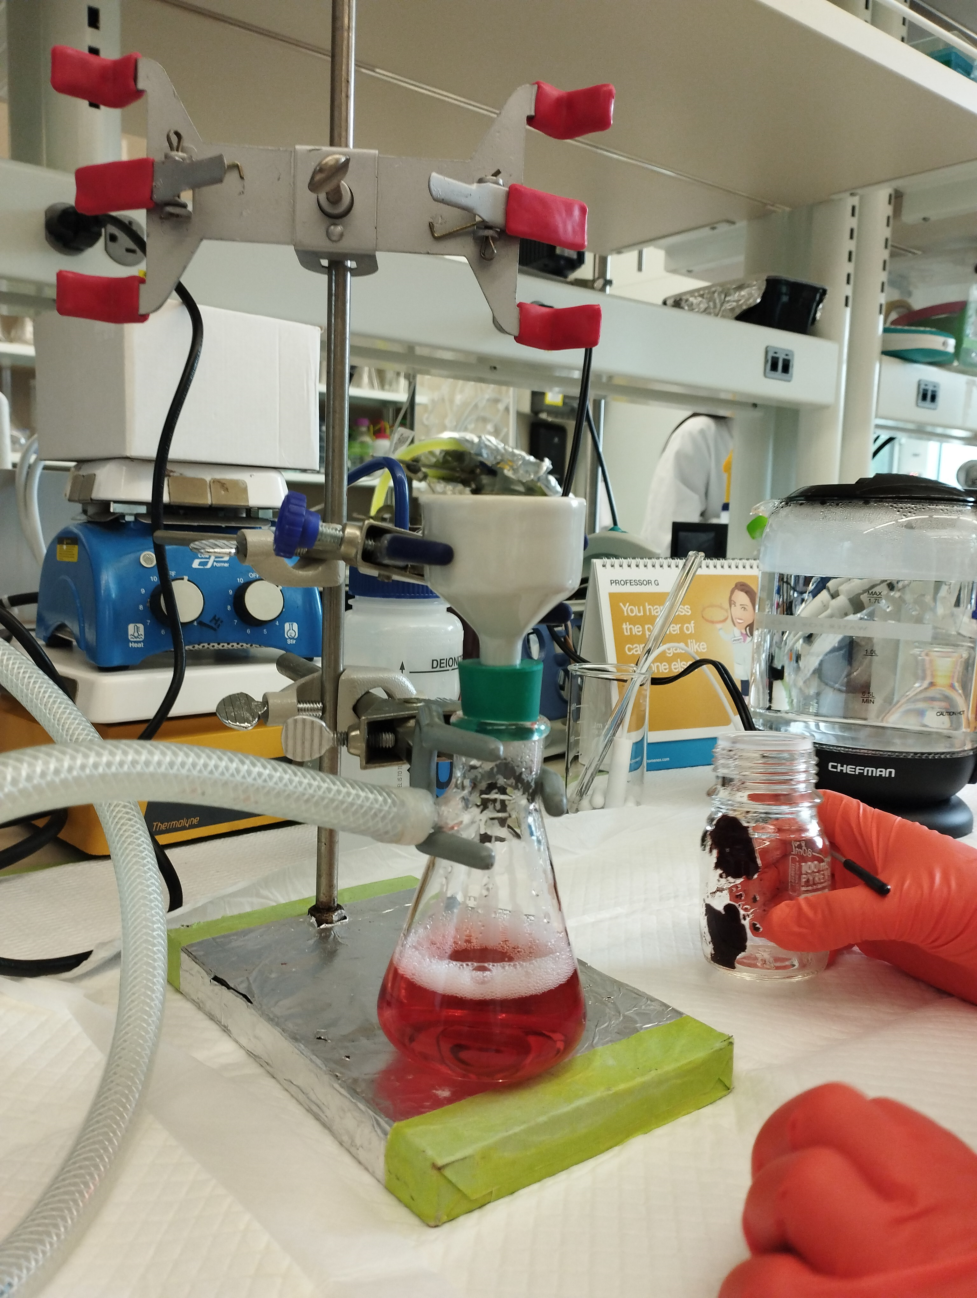
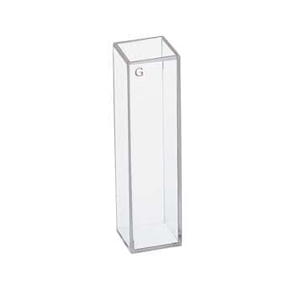

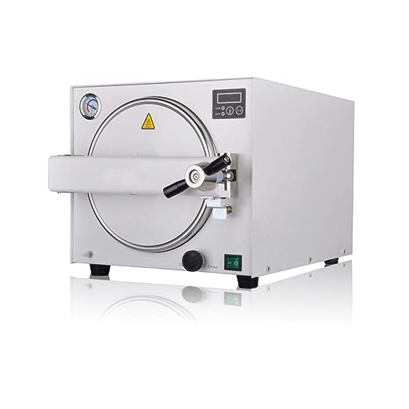
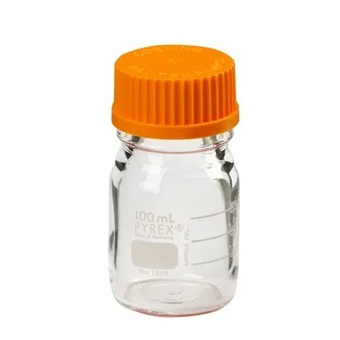
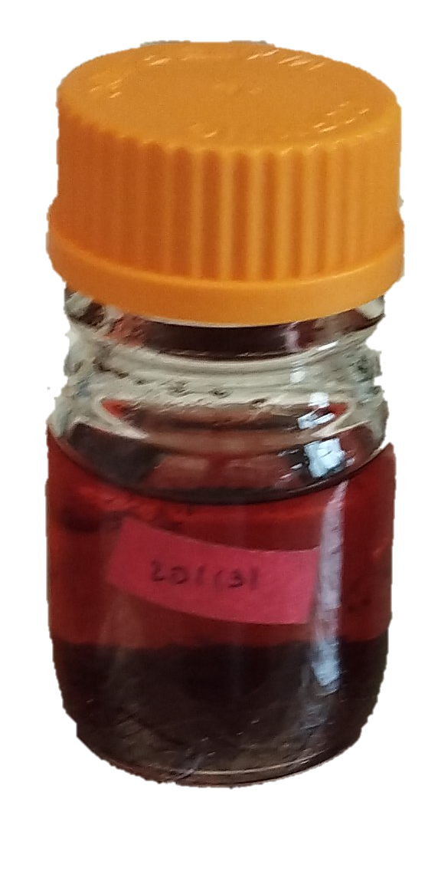
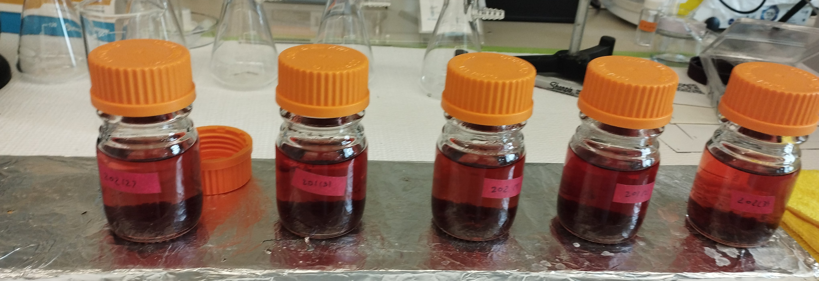

LIGNIN CONTENT
Extractive free samples
1
3
4
2
TOTAL LIGNIN
ASL%
AIL%
ASL(%): acid-soluble lignin (UV-VIS)
AIL(%): acid-insoluble lignin (gravimetric)
Determination of Structural Carbohydrates and Lignin in Biomass Laboratory Analytical Procedure (LAP)
9

Slide 11
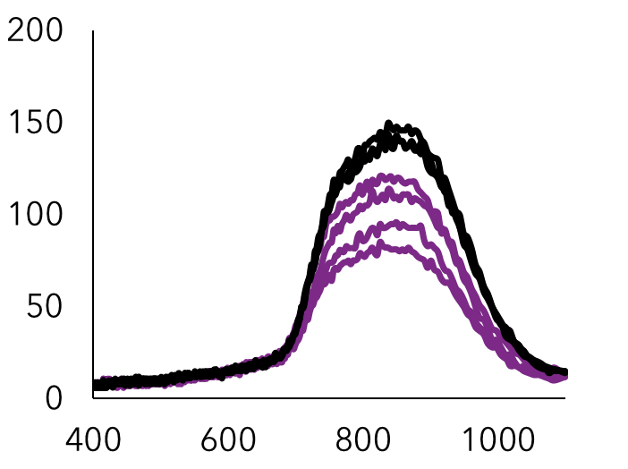
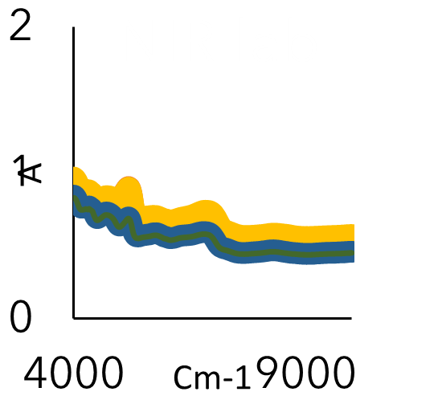
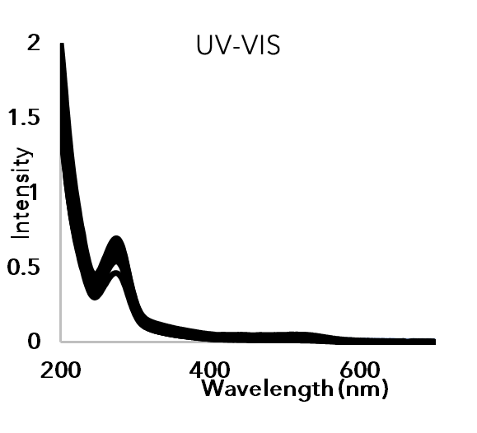
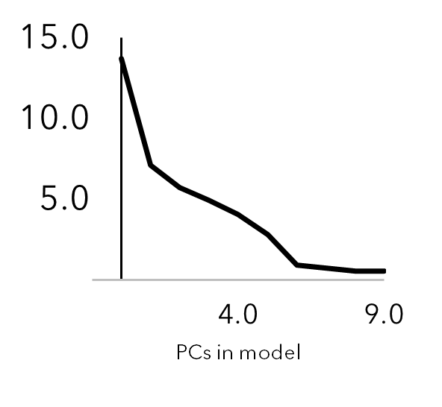
PRELIMINARY RESULTS
Spectra
(Portable)
Spectra
(Laboratory)
Lignin
content
Chemometric model
10

Slide 12
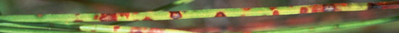
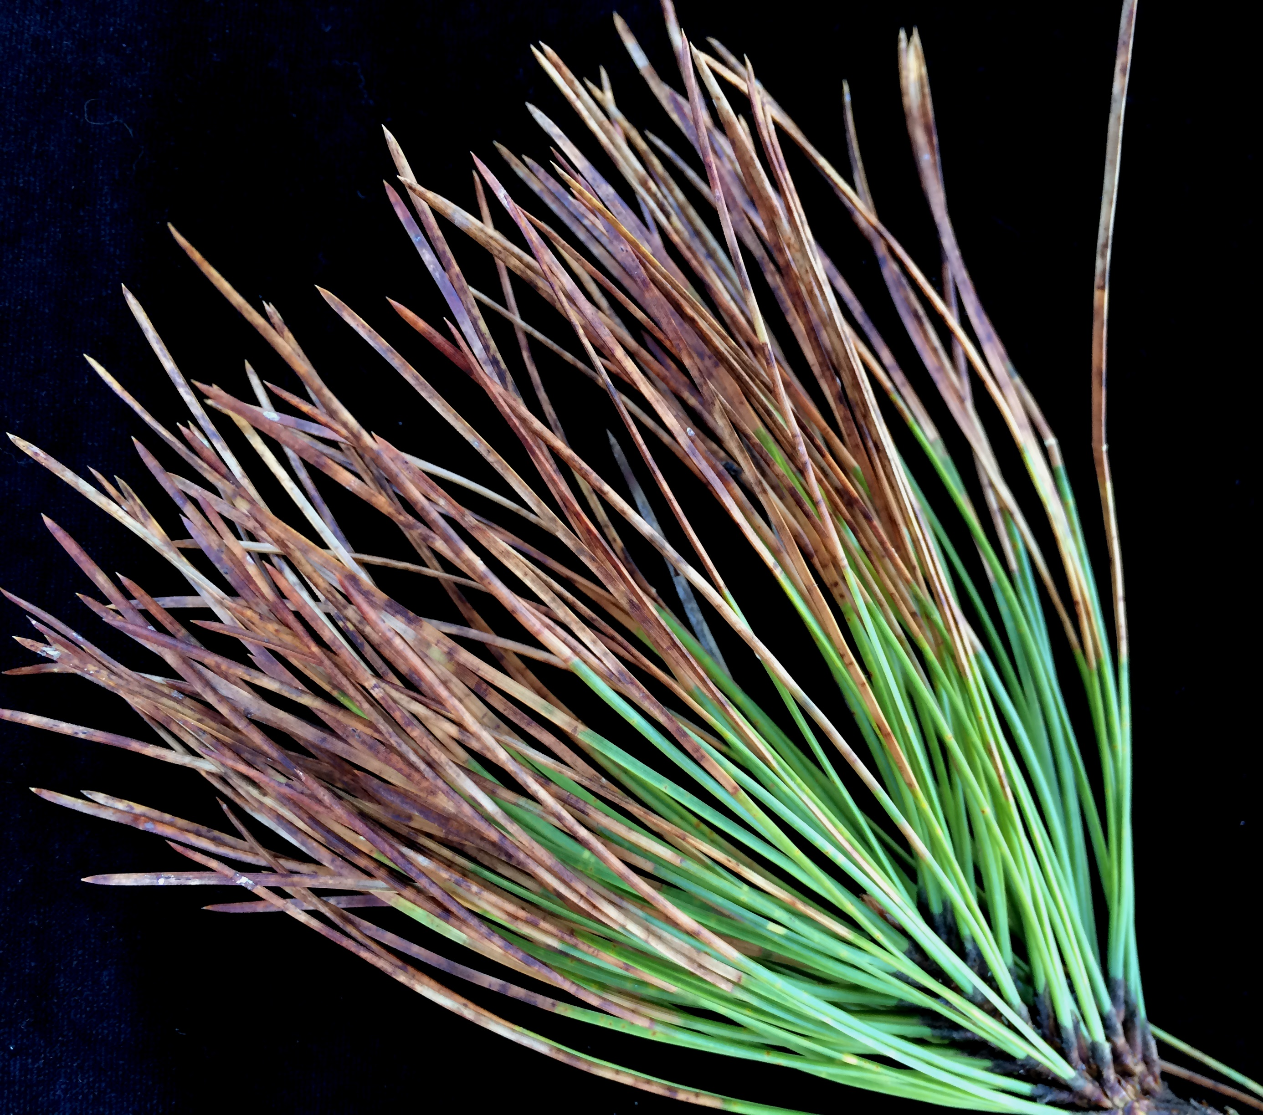
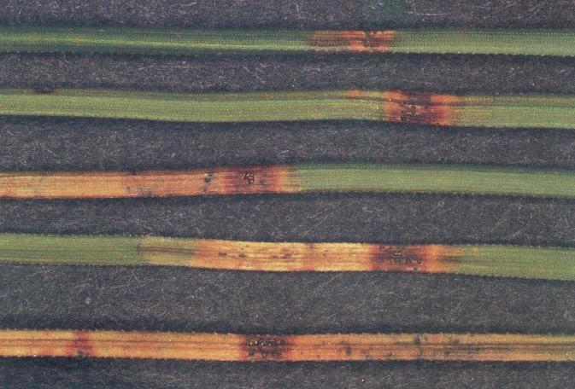
INFECTION LEVEL (IL)
Level of infection (0-5):
Brown spots
0
1
2
3
4
5
Dead needles
Yellowish patches
Necrosis
Needle blight
11
https://aub.ie/NeedleSymptoms,

Slide 13
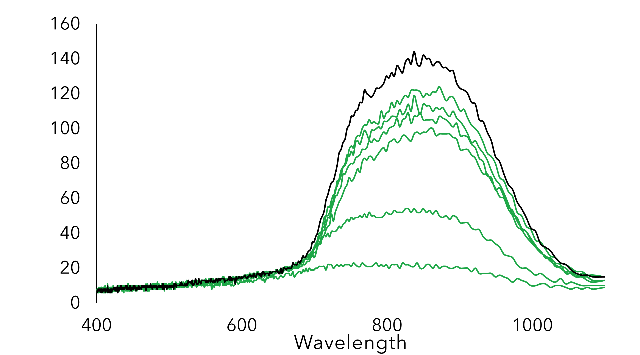

NIR SPECTRA (PORTABLE)
Level of infection (0-1):
Brown spots
Dead needles
Yellowish patches
Necrosis
Needle blight
0
1
(nm)
12

Slide 14
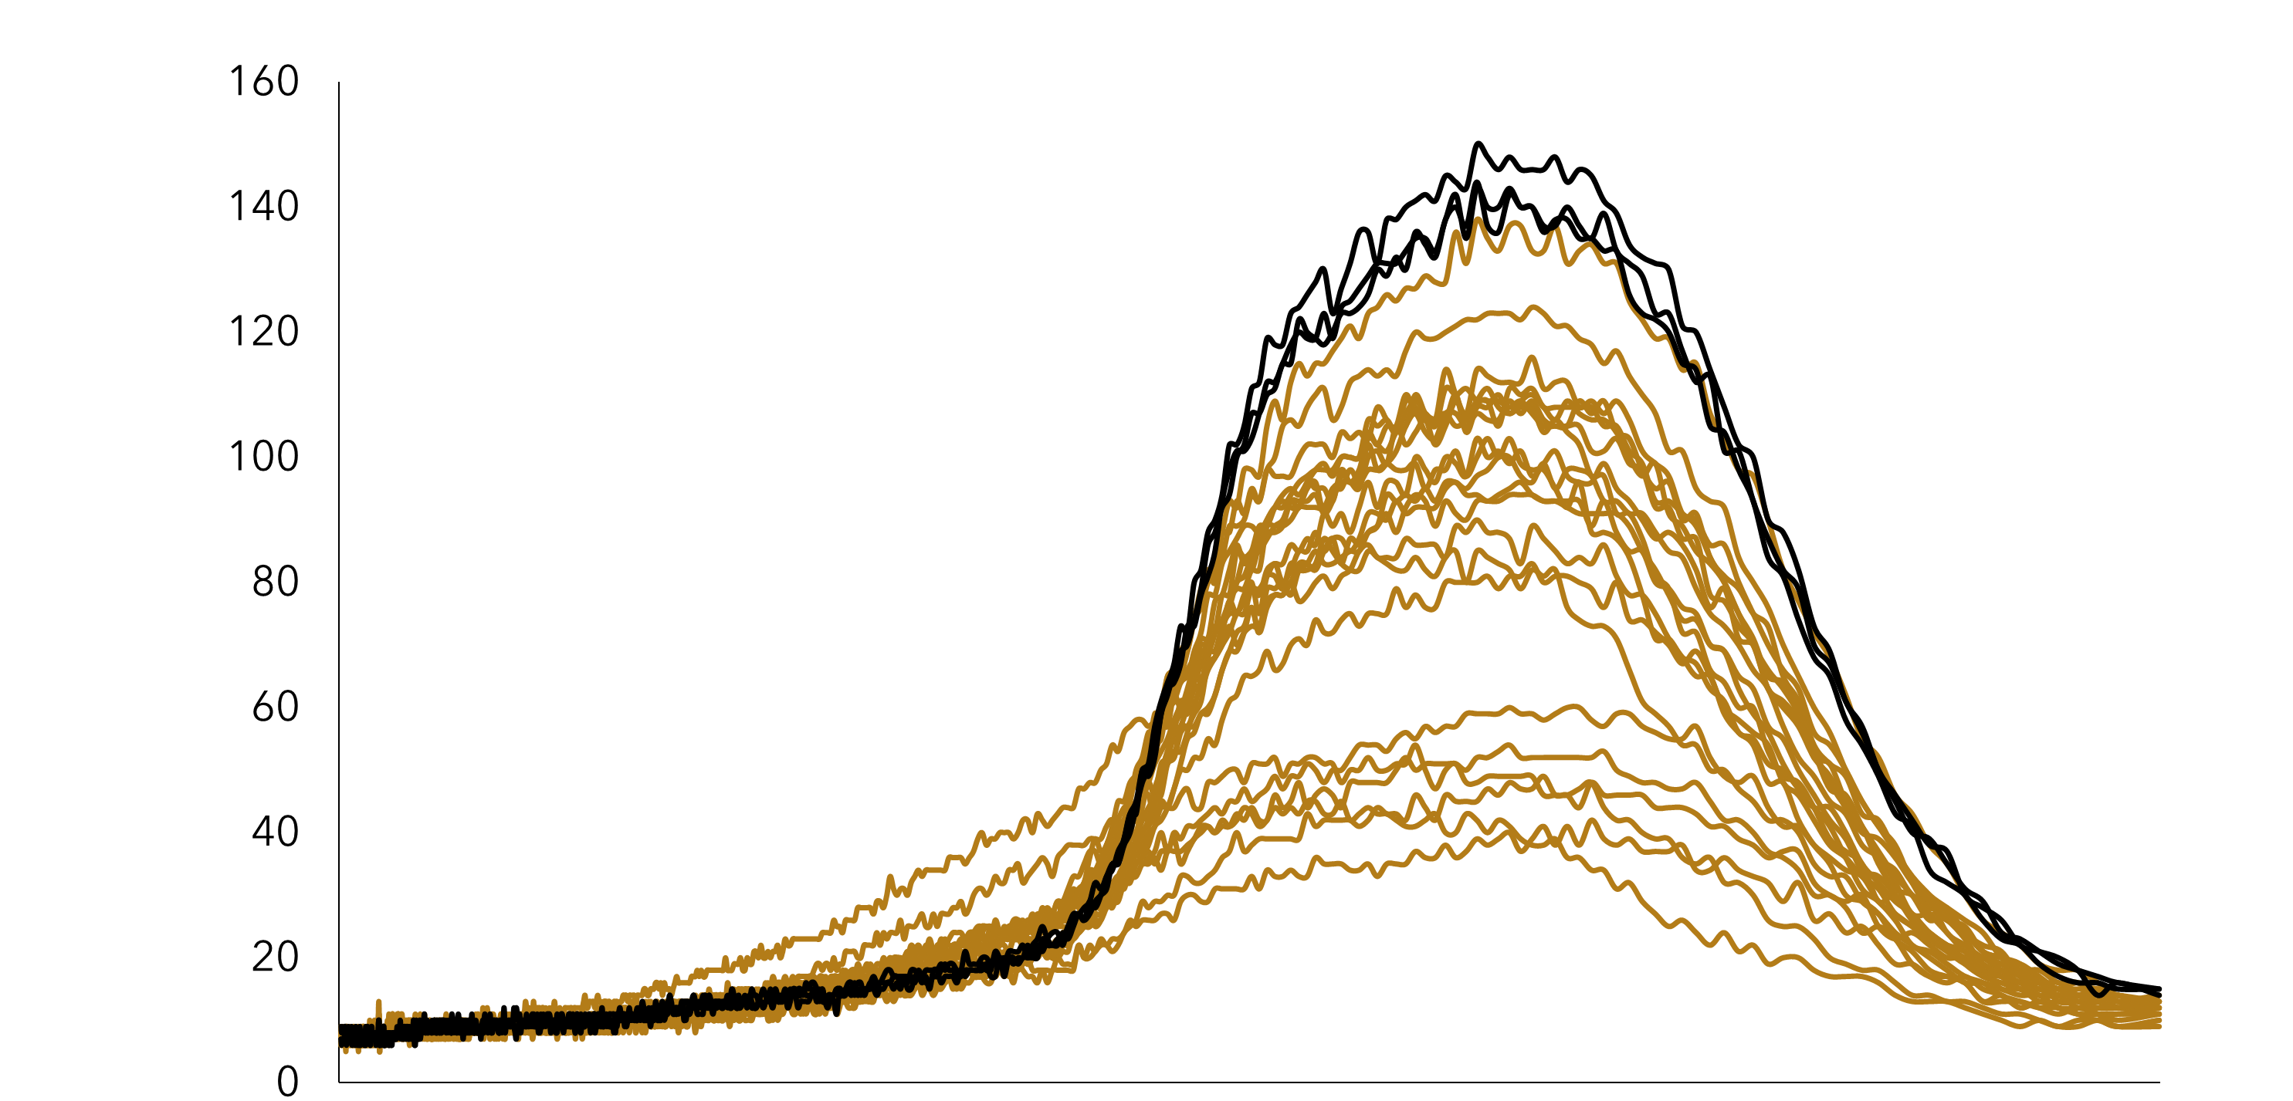
NIR SPECTRA (PORTABLE)
Level of infection (0-2):
Brown spots
Dead needles
Yellowish patches
Necrosis
Needle blight
0
1
2
(nm)
12

Slide 15
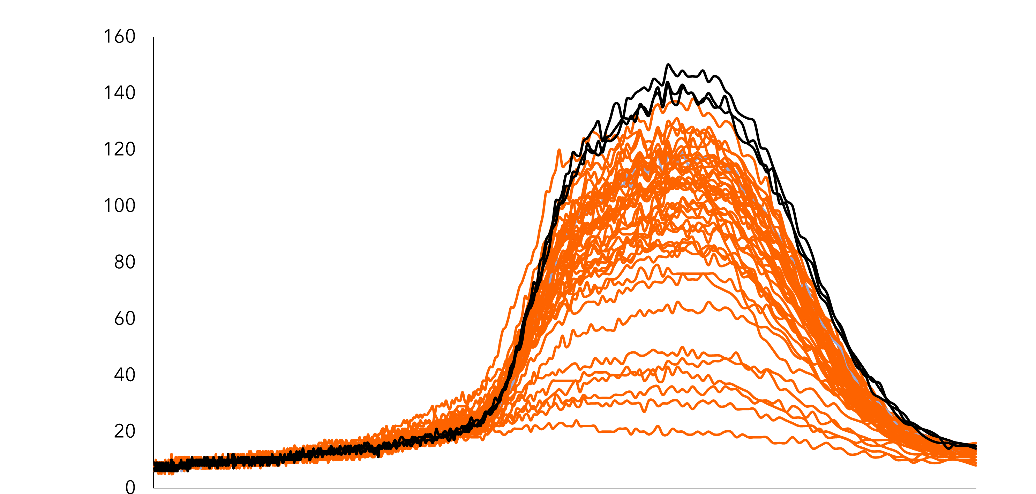
NIR SPECTRA (PORTABLE)
Level of infection (0-3):
Brown spots
Dead needles
Yellowish patches
Necrosis
Needle blight
0
1
2
3
(nm)
12

Slide 16
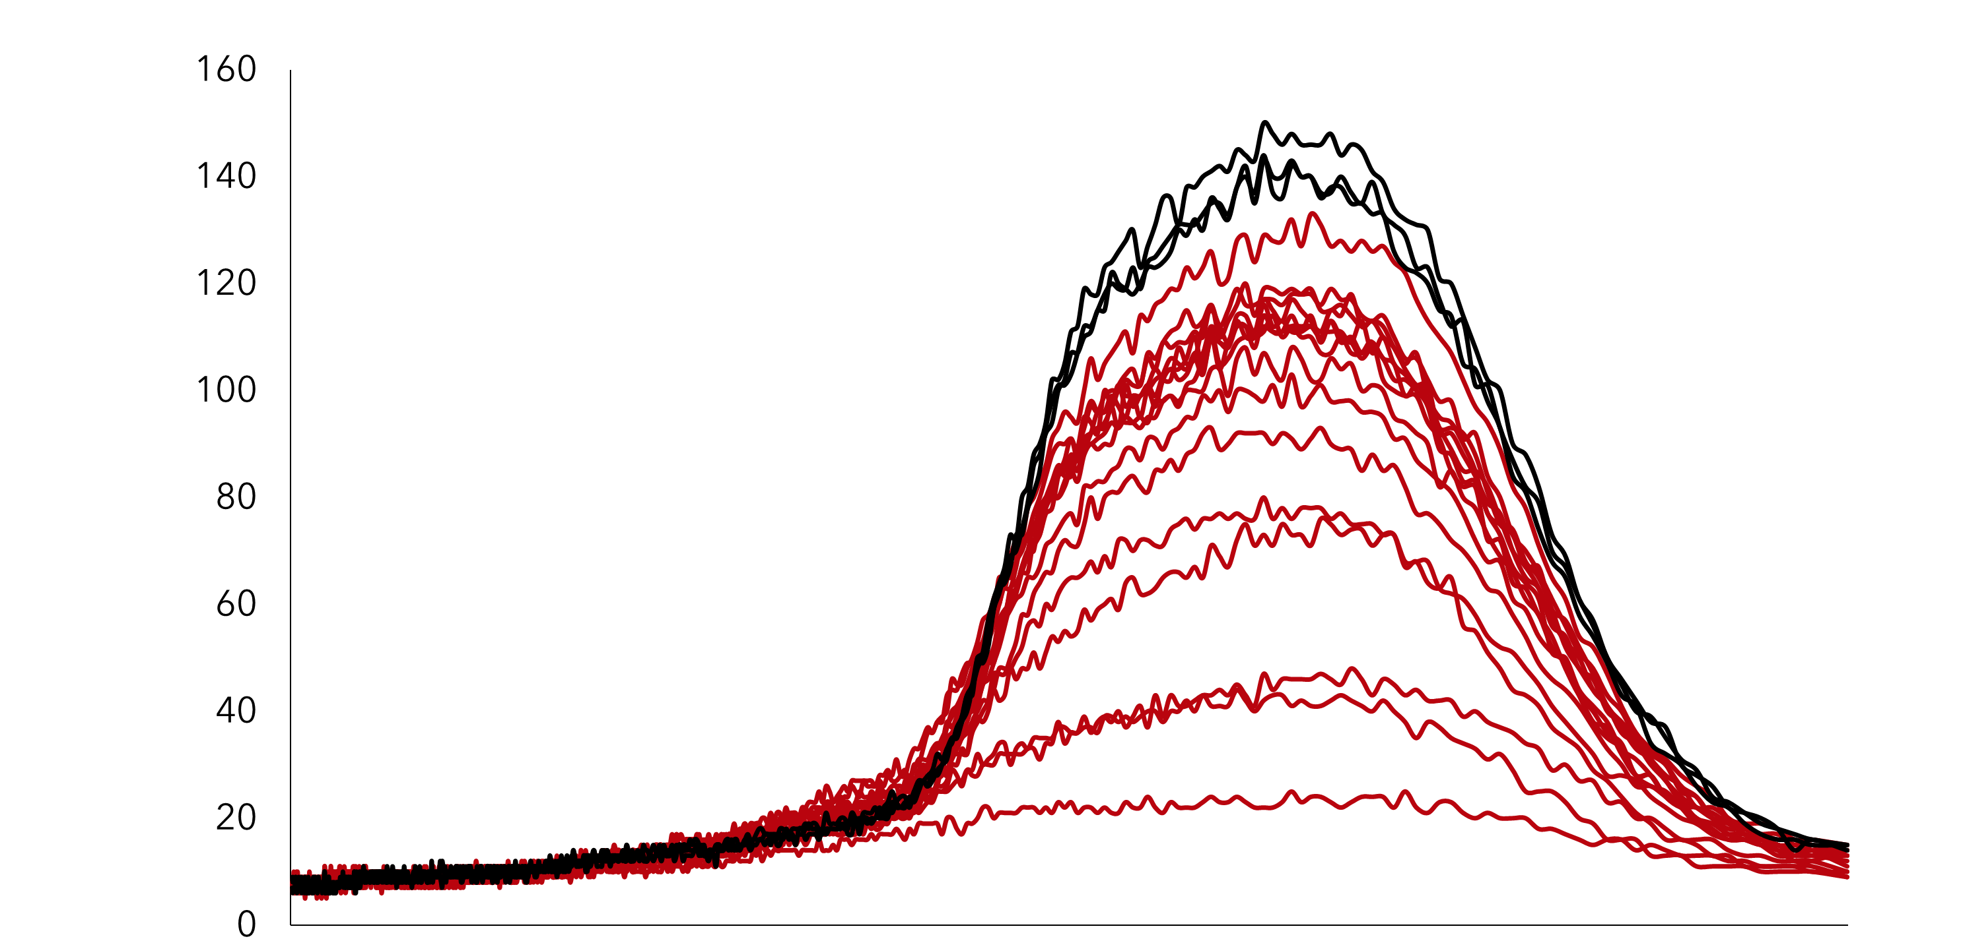
NIR SPECTRA (PORTABLE)
Level of infection (0-4):
Brown spots
Dead needles
Yellowish patches
Necrosis
Needle blight
0
1
2
3
4
(nm)
12

Slide 17
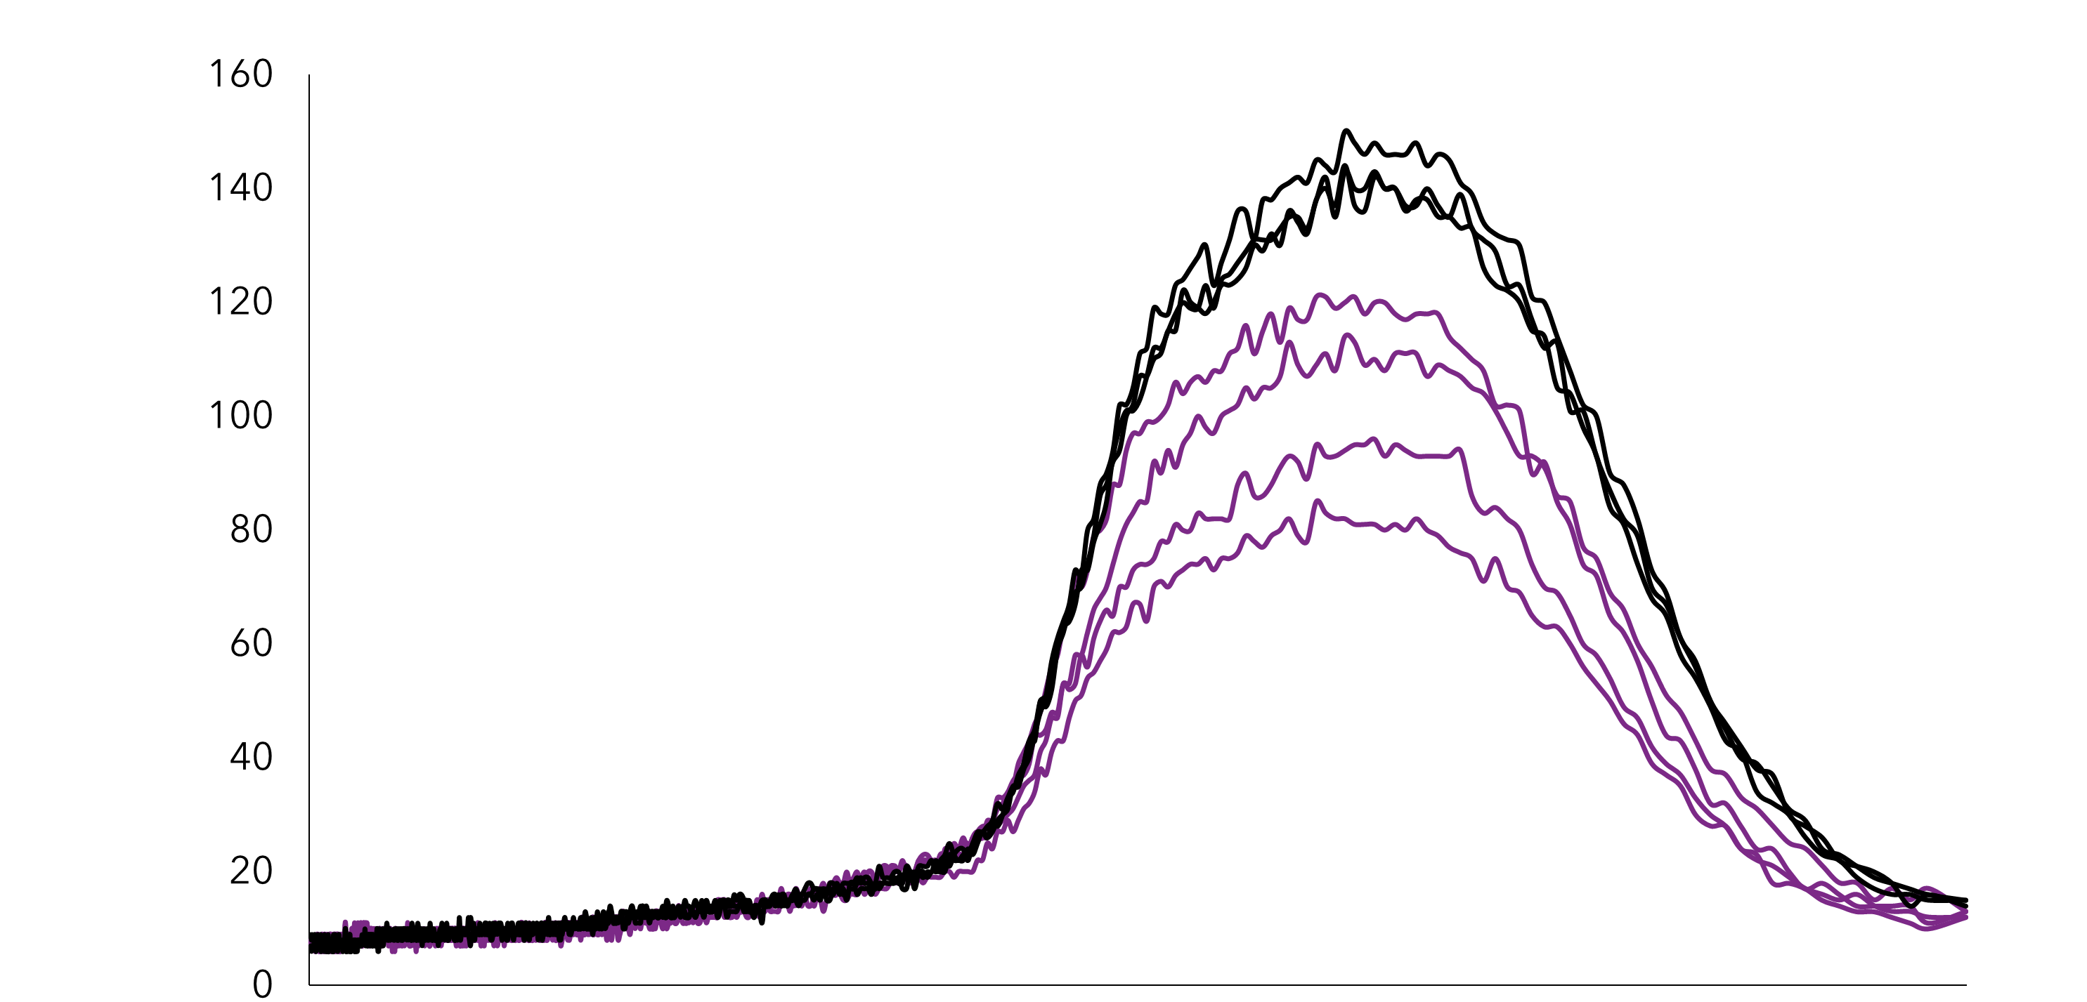
NIR SPECTRA (PORTABLE)
Level of infection (0-5):
Brown spots
Dead needles
Yellowish patches
Necrosis
Needle blight
0
1
2
3
4
5
(nm)
12

Slide 18
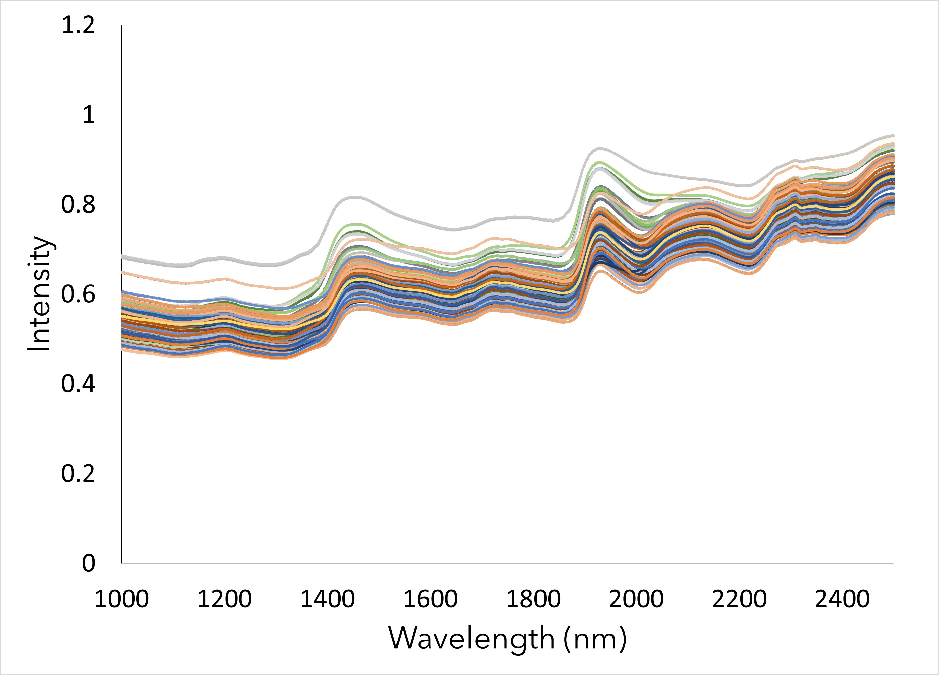
NIR SPECTRA (LAB)
CH(II)
H₂O
OH(I)
CH(I)
OH
OH
OH
CH^{s}/CH^{d}
13
NIR spectra of freeze-dried needles

Slide 19
LIGNIN CONTENT
ASL%
Lignin
TOTAL LIGNIN
UV-Vis spectra of acid soluble lignin in water (NREL)
Total lignin obtained by the sum of AIL + ASL
14

Slide 20
CHEMOMETRIC MODEL
TOTAL LIGNIN
Estimated lignin content (chemometric model) vs total lignin (NREL)
15

Slide 21

FUTURE STEPS
Chemical analysis (lignin, carbohydrates, extractive) and elemental analysis
Chemometric model
Exchange information with other teams in order to optimize our model
16

Slide 22
CONCLUSIONS
There is a remarkable difference between the collected spectra (portable/laboratory) that will be complementary
A method for the quantification of the infection level is needed
The preliminary results using lignin content are promising
17

Slide 23

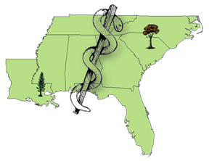




Acknowledgements
Forest Health Dynamics Laboratory
Lab manager
Jessica Baldwin
Graduate Students
Jaden King
Emmanuel Nyarko
Temitope Folorunso
Gabriel Silva
Swati Singh
Undergraduates
Angel Cagle
Maddox Golden
Andrew Howard
Drew Conway
Gavin Kerr
Nathan Kurtz
Garrett Gaar
Brea Thomas
Collaborators
Dr. Lori Eckhardt
Dr. Brian Via
Dr. Beatriz Vega
Dr. Janna Willoughby
Dr. Lana Narine
Dr. Joseph Fan
Dr. Annakay Newell
Ryan Mitchell
Kris Bradley
Landowners
Stallworth Land Company
Longleaf Land & Timber Co.
Osco Forest – Glover Family
US Forest Service
Facilities
Forest Health Dynamics Lab
Molecular Mycology Lab
Conservation and Genomics Lab
Geospatial Analytics Lab
Forest Products Lab
Forest Health Cooperative
College of Forestry, Wildlife and Environment, Auburn University

Slide 24

QUESTIONS, COMMENTS?
Thanks for your kind attention!!
21

Slide 25
References
Rajendran, H. K., Fakrudeen, M. A. D., Chandrasekar, R., Silvestri, S., Sillanpää, M., & Padmanaban, V. C. (2022). A comprehensive review on analytical and equation derived multivariate chemometrics for the accurate interpretation of the degradation of aqueous contaminants. Environmental Technology and Innovation, 28. https://doi.org/10.1016/j.eti.2022.102827
Kapoor, A., Krishnamoorthy, N., Pathy, A., & Balasubramanian, P. (2023). Chemometric analysis unravelling the effect of key influencing factors on algal biochar yield. Algal Research, 69. https://doi.org/10.1016/j.algal.2022.102908
Rebiai, A., Hemmami, H., Zeghoud, S., Ben Seghir, B., Kouadri, I., Eddine, L. S., ... & Abbas, N. (2022). Current Application of Chemometrics Analysis in Authentication of Natural Products: A Review. Combinatorial Chemistry & High Throughput Screening, 25(6), 945-972.
Van Der Nest, A., Wingfield, M. J., Janoušek, J., & Barnes, I. (2019). Lecanosticta acicola: A growing threat to expanding global pine forests and plantations. Molecular Plant Pathology, 20(10), 1327-1364.

Slide 26
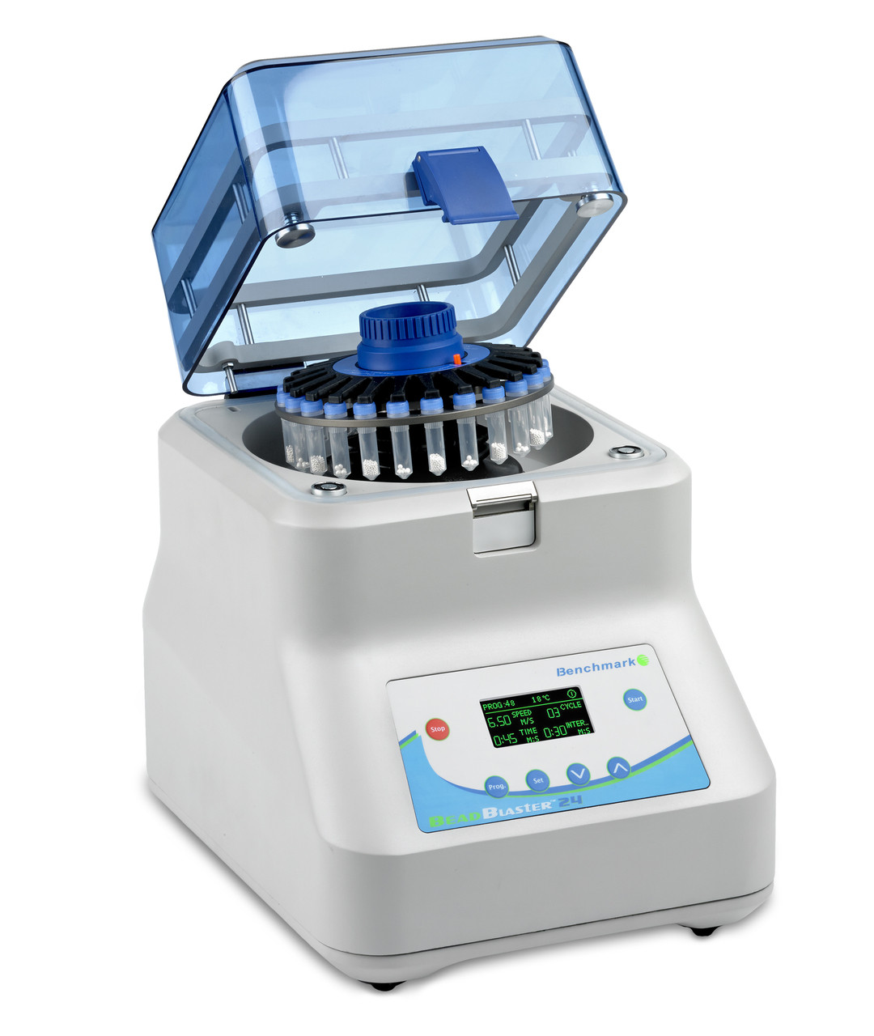
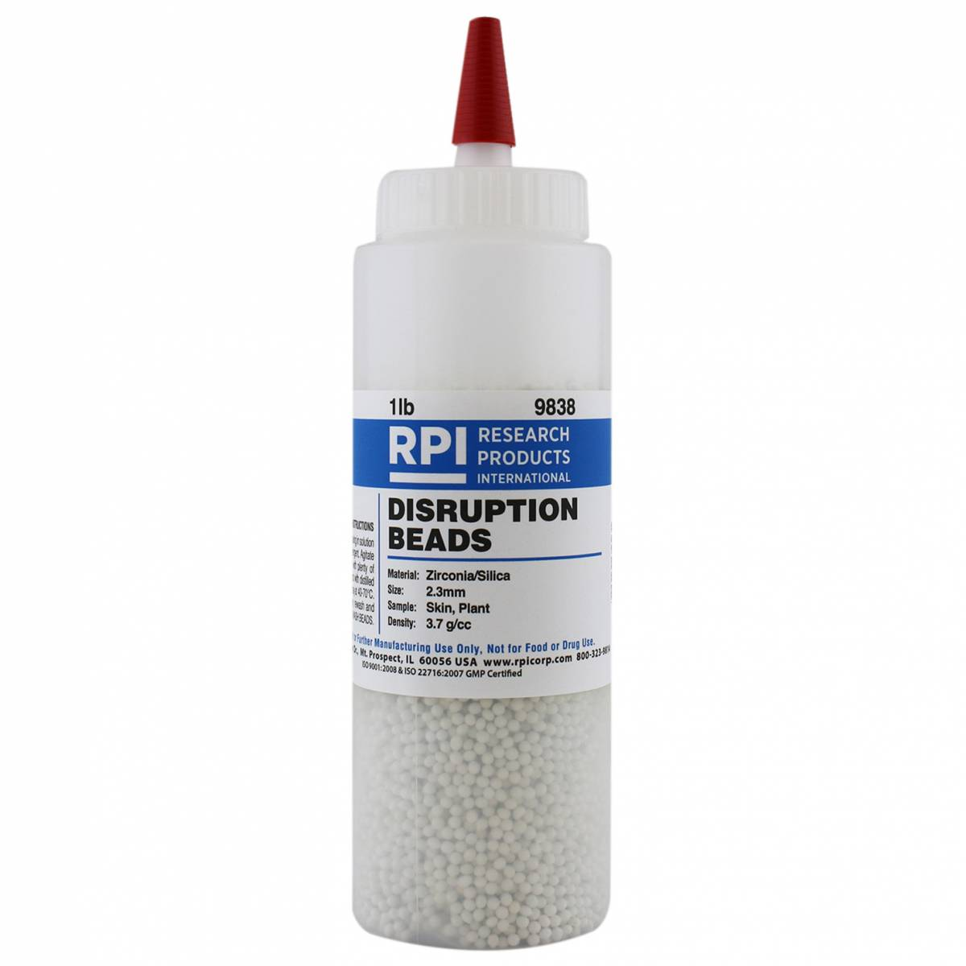

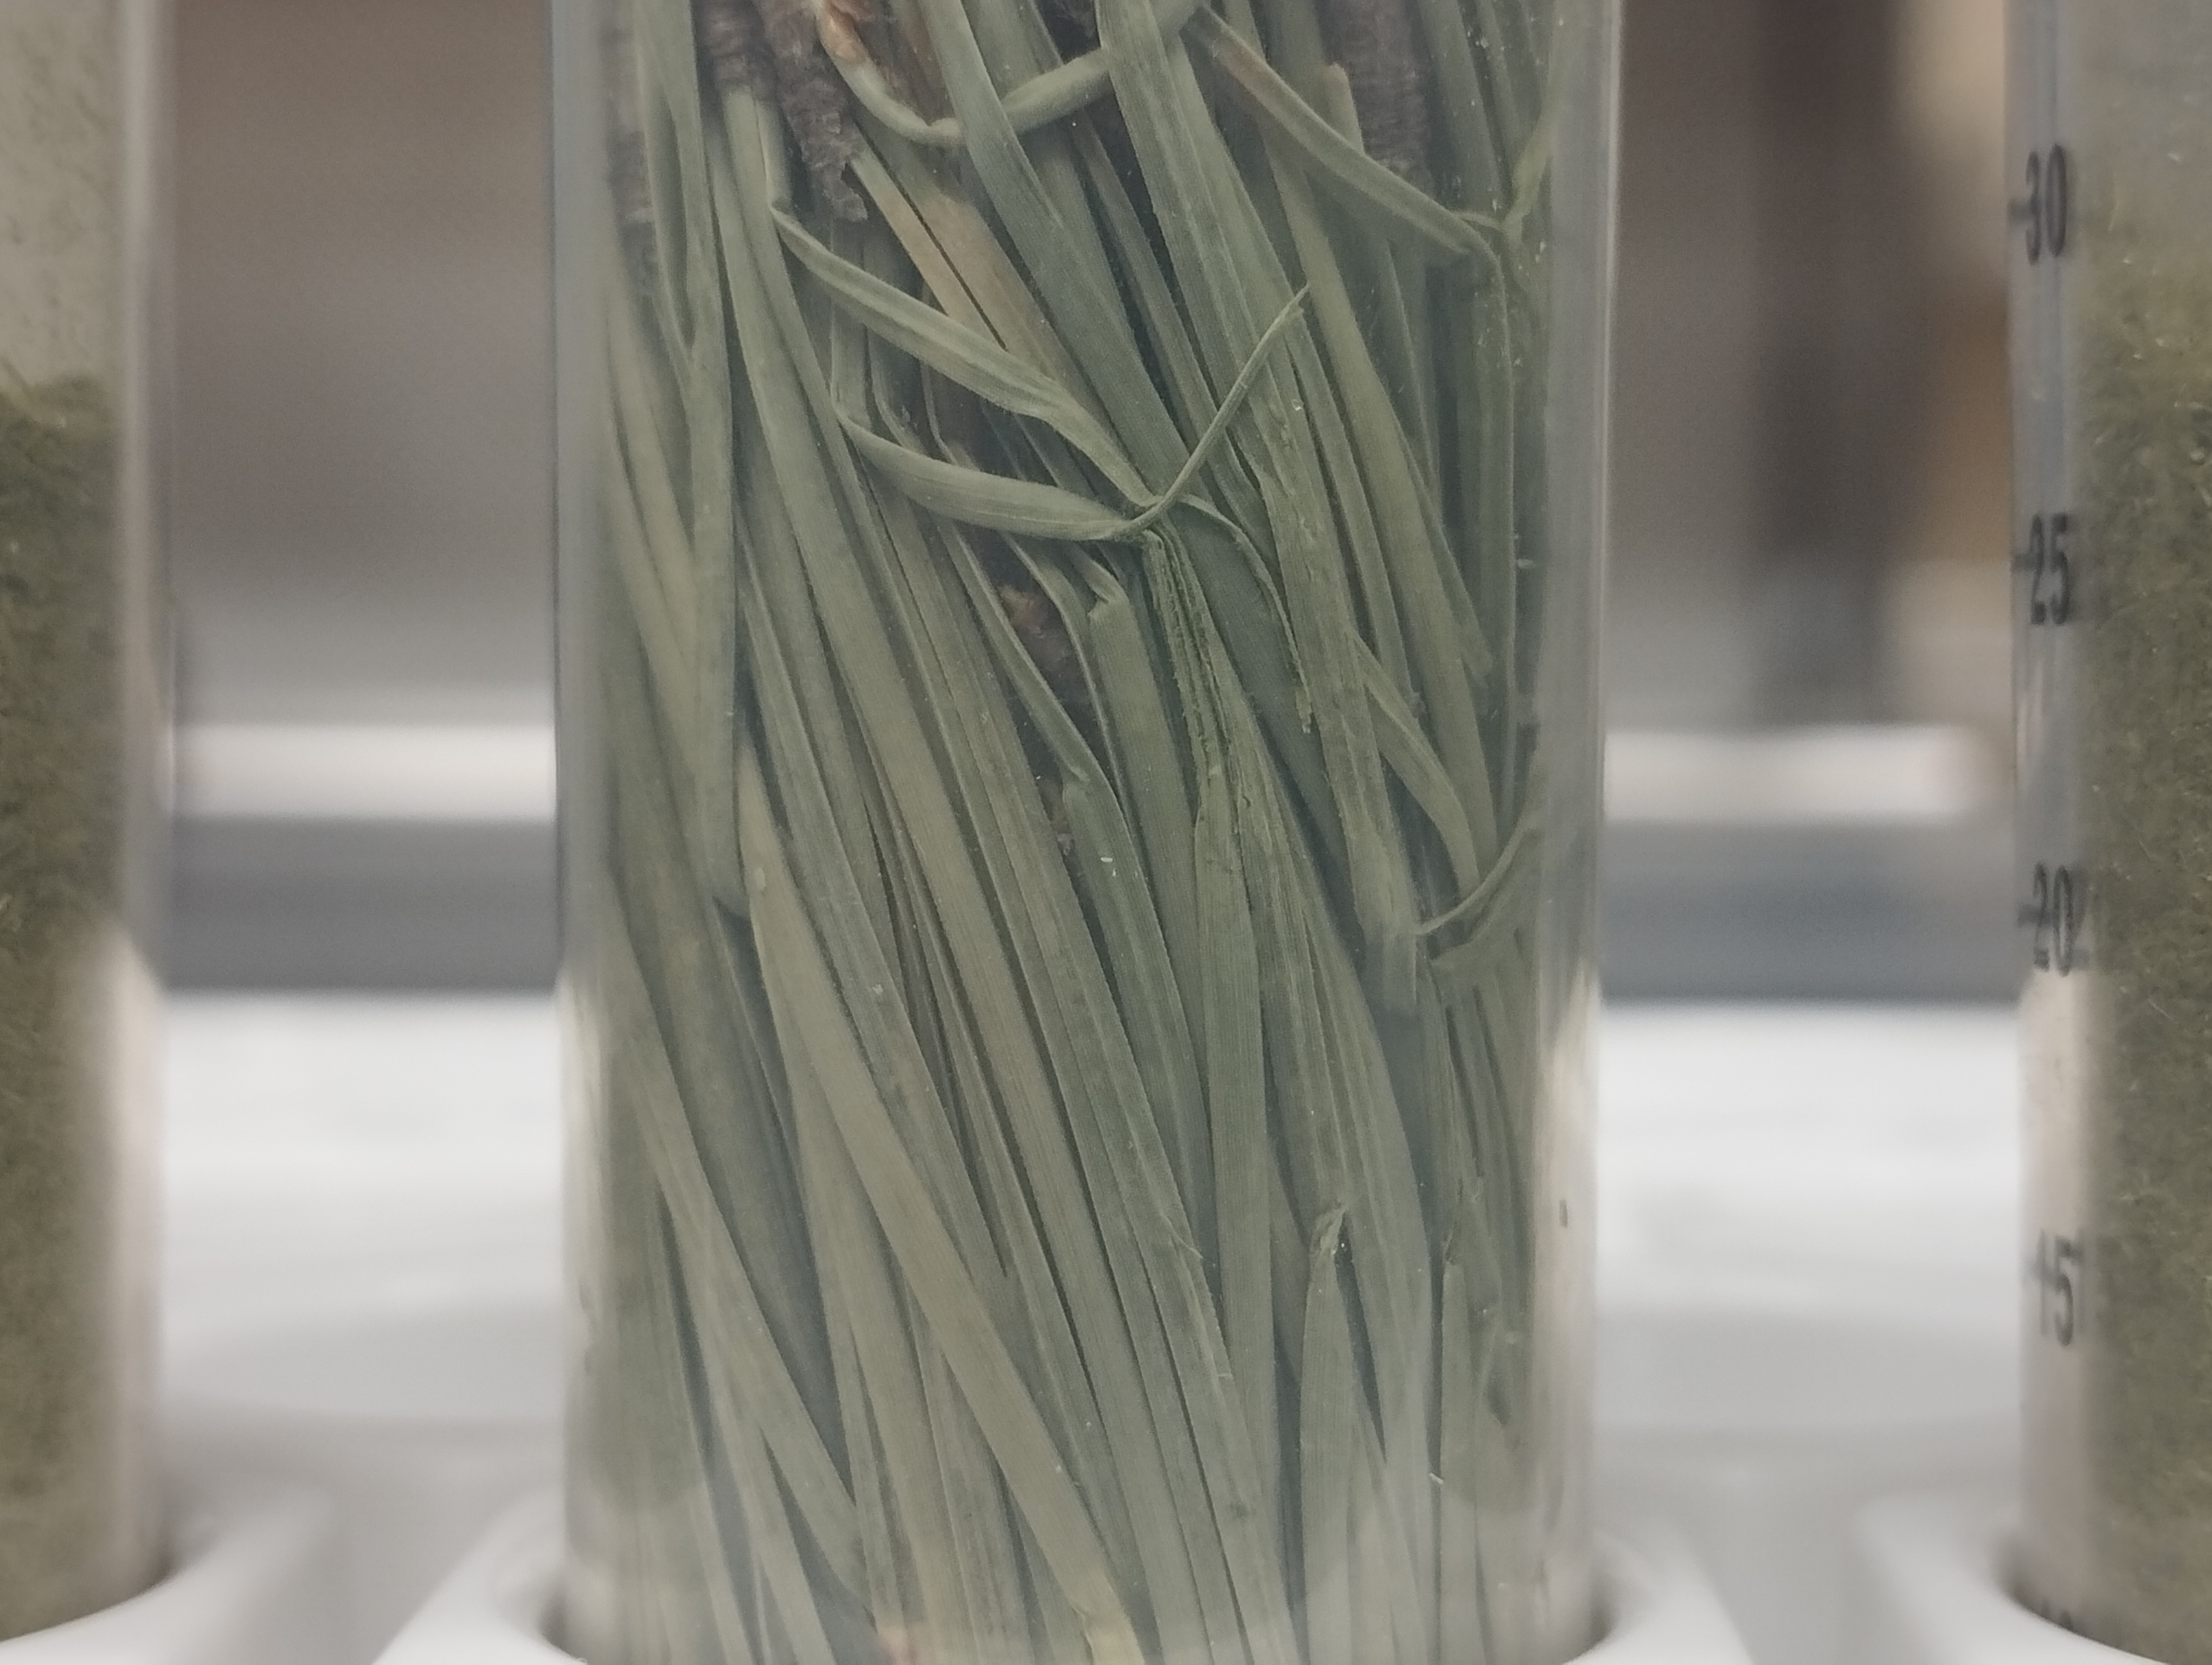
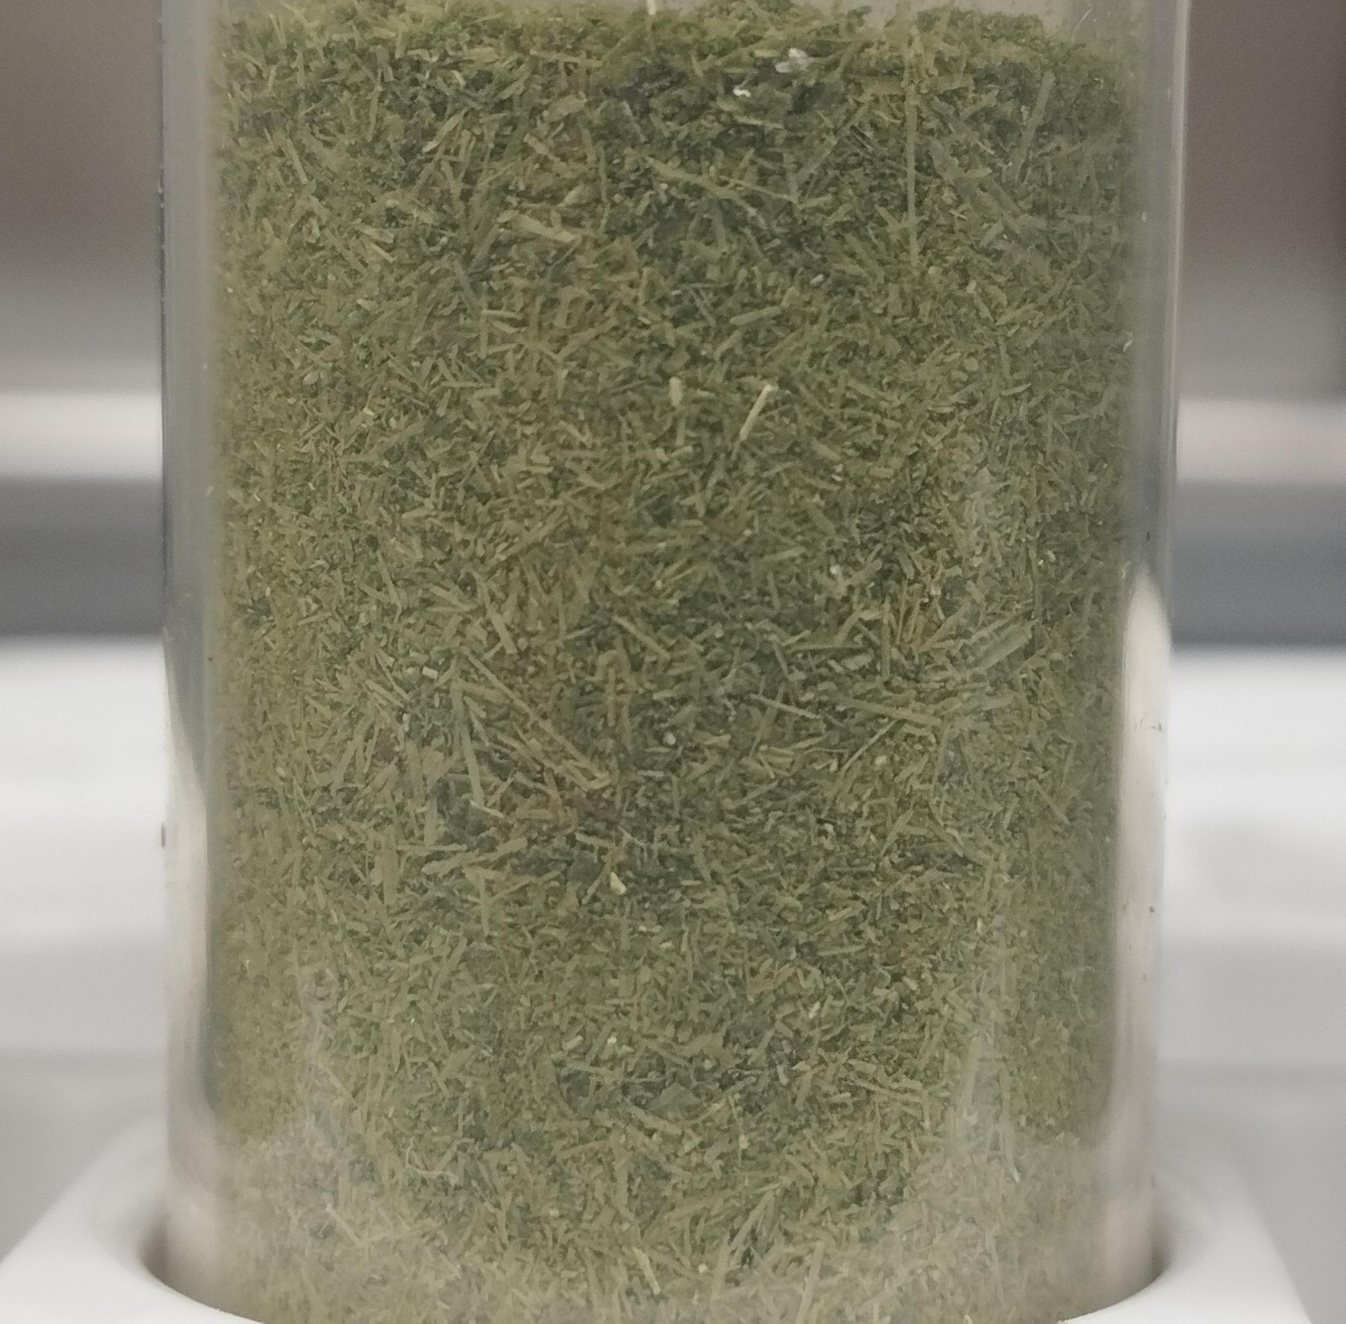
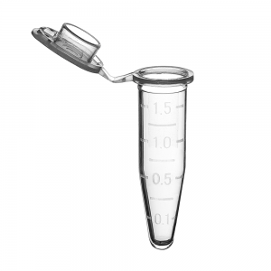
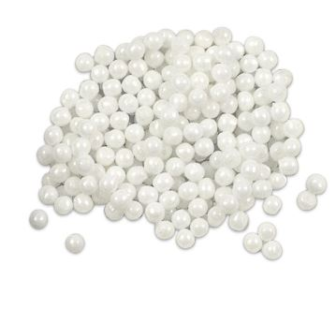
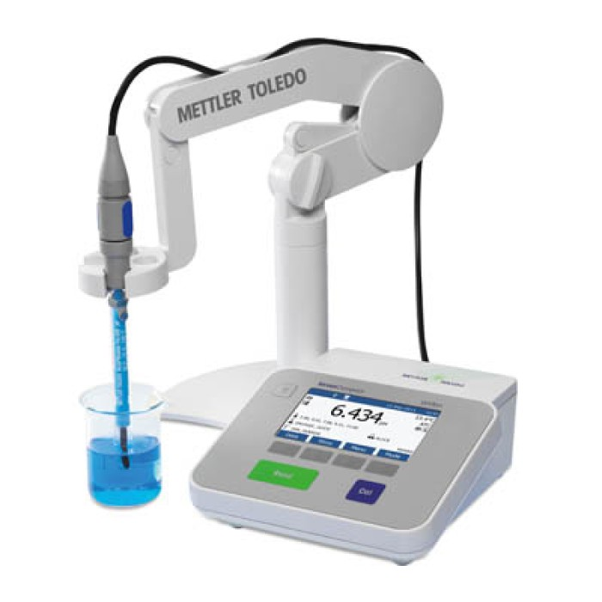

pH VALUE
Annex
pH
Value
9

Slide 27
pH values
Annex
16

Slide 28
Annex
Moisture content
16

Slide 29
CHEMOMETRIC MODEL
18

