Slide 1

Isolation and Identification of Lecanosticta acicola and other Foliar Pathogens
Emmanuel Nyarko, Annakay Newell, Rabiu Olatinwo and Lori Eckhardt
Forest Health Dynamics Laboratory
College of Forestry, Wildlife and Environment
Auburn University, Auburn AL
Forest Health Dynamics Laboratory
College of Forestry, Wildlife and Environment - Auburn University

Slide 2
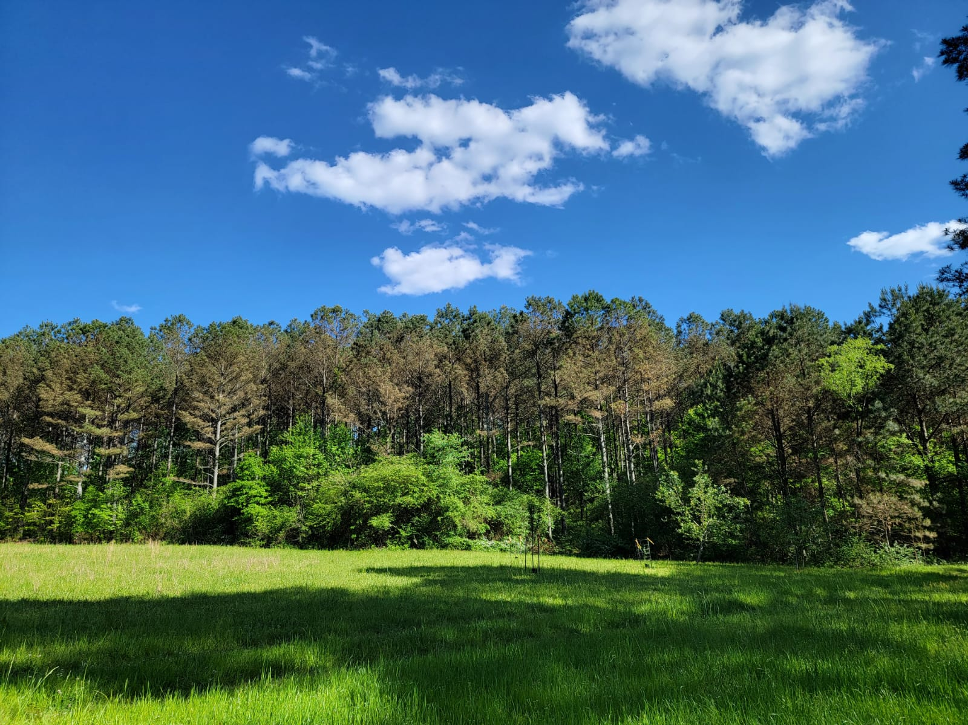
Background
Forest Health Dynamics Laboratory
Loblolly pine (Pinus taeda) is the most abundant pine found in Alabama
Makes up about 80% of the 12.2 million hectares of pines in southern U.S.
College of Forestry, Wildlife and Environment - Auburn University

Slide 3
Background
Forest Health Dynamics Laboratory
Grows rapidly and it is widely used for lumber,
construction timbers, pulp and plywood
Economically important
Loblolly pine is at risk of huge economic loss if brown spot needle blight infection continues to spread at the current rate
College of Forestry, Wildlife and Environment - Auburn University

Slide 4
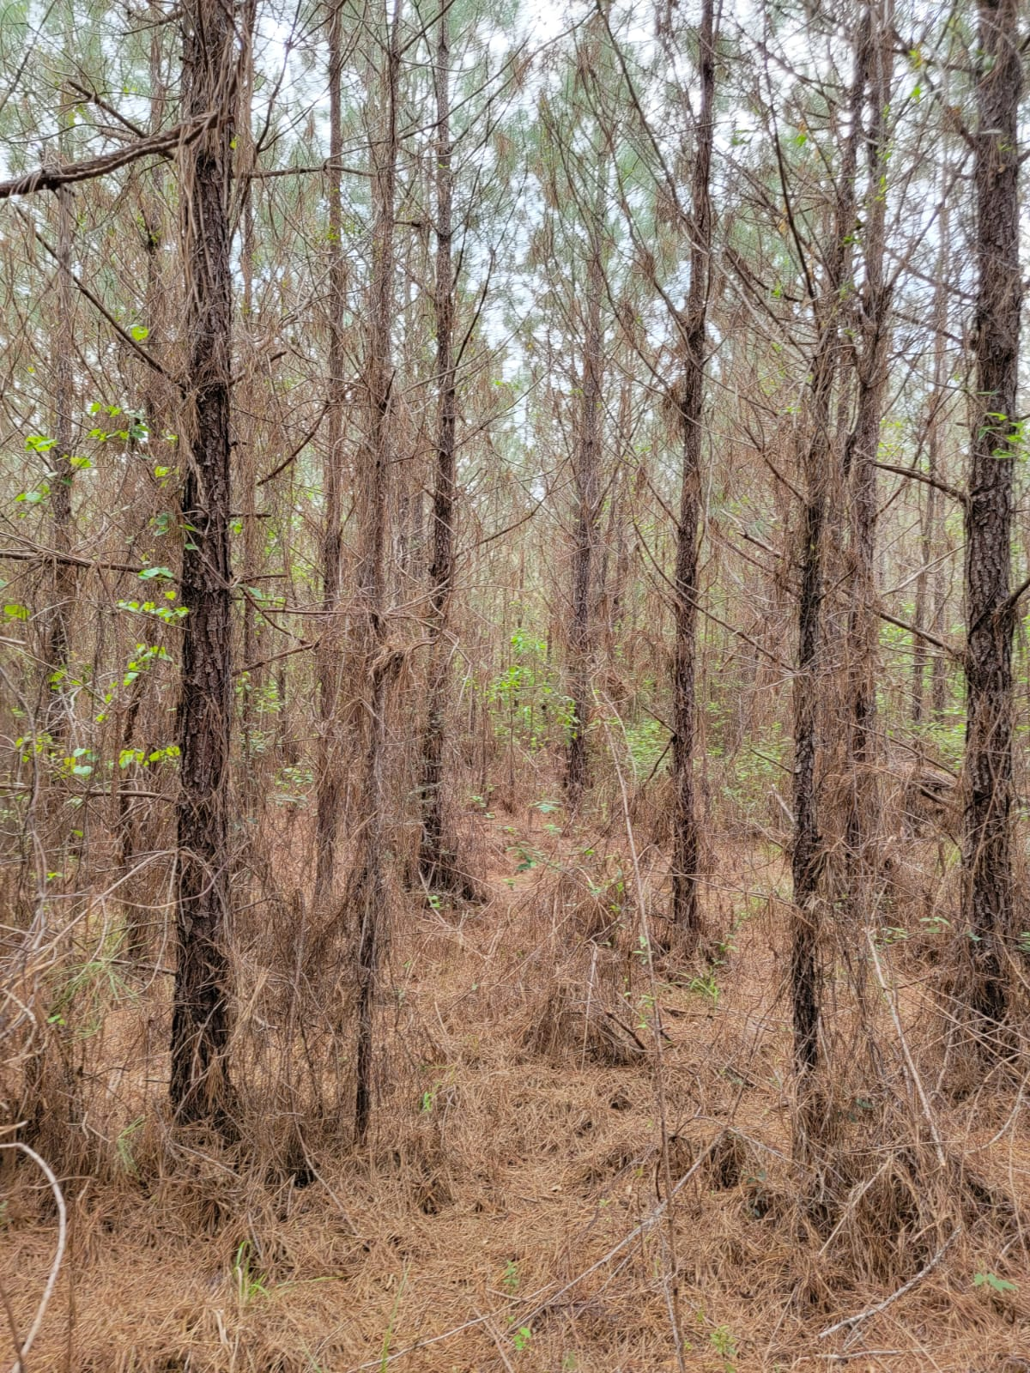
Problem
Forest Health Dynamics Laboratory
Over the past decade, Loblolly has been faced with brown spot needle blight, caused by the fungus Lecanosticta acicola
College of Forestry, Wildlife and Environment - Auburn University

Slide 5
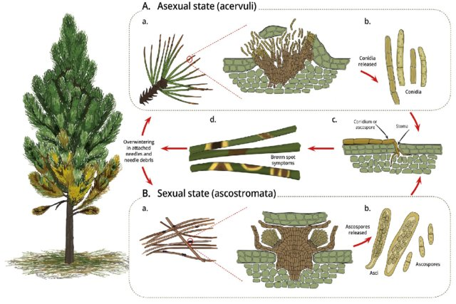
Life cycle of L. acicola
Forest Health Dynamics Laboratory
College of Forestry, Wildlife and Environment - Auburn University

Slide 6
Objectives
Forest Health Dynamics Laboratory
To determine the best media for culturing Lecanosticta acicola
To develop an inoculation protocol for Lecanosticta acicola
To develop a screening method which will be used to assess and determine strain aggressiveness and seedling tolerance
College of Forestry, Wildlife and Environment - Auburn University

Slide 7
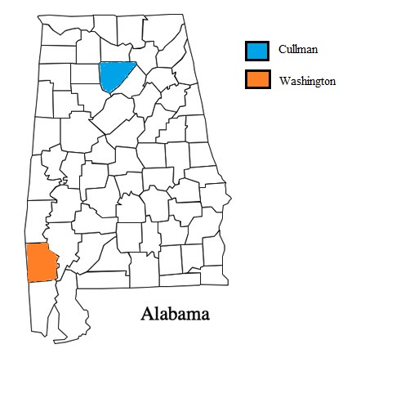
State map (County)
Forest Health Dynamics Laboratory
College of Forestry, Wildlife and Environment - Auburn University

Slide 8
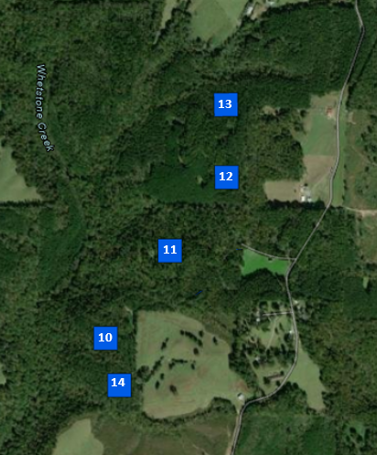
North plots (Cullman County)
Forest Health Dynamics Laboratory
College of Forestry, Wildlife and Environment - Auburn University

Slide 9
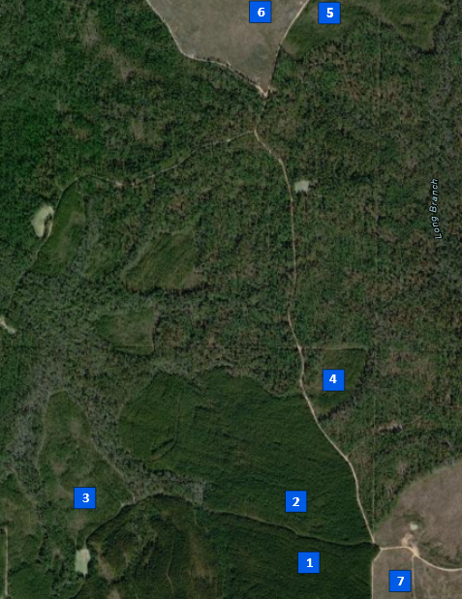
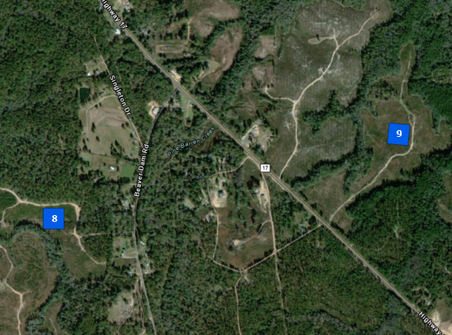
South plots (Washington County)
Forest Health Dynamics Laboratory
College of Forestry, Wildlife and Environment - Auburn University

Slide 10
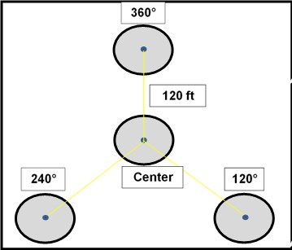

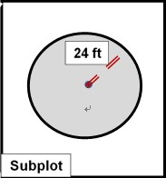
Plot layout
Forest Health Dynamics Laboratory
College of Forestry, Wildlife and Environment - Auburn University

Slide 11
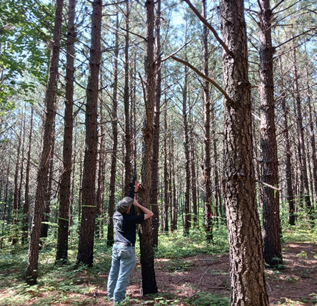
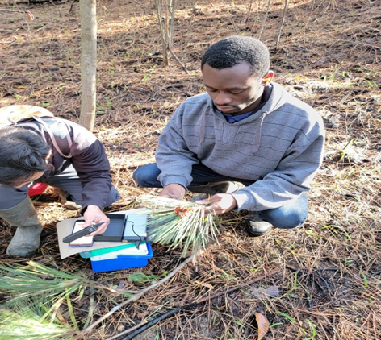
Needle collection
Forest Health Dynamics Laboratory
College of Forestry, Wildlife and Environment - Auburn University

Slide 12
Forest Health Dynamics Laboratory
Forest Health Dynamics Laboratory
Processing and Identification
Needle Samples
Needle Examination
Incubated Needles
(Sporulation Chambers)
Plated Needles
DNA Extraction
Surface Sterilization
Surface Sterilization
PCR
Incubated with Filter paper, 500 ul dd H₂O
Plated onto Isolation Media
Molecular Identification
Morphological Identification
Incubation (20-25ºC for 5 days to 2 Weeks)
Transfer to Identification Media
Morphological Identification
College of Forestry, Wildlife and Environment - Auburn University

Slide 13
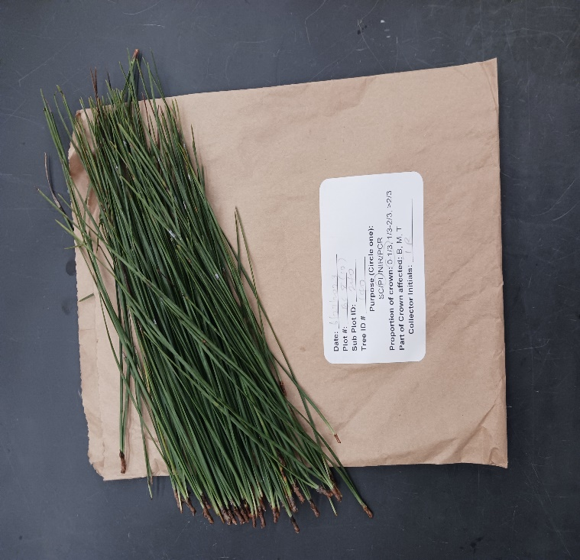
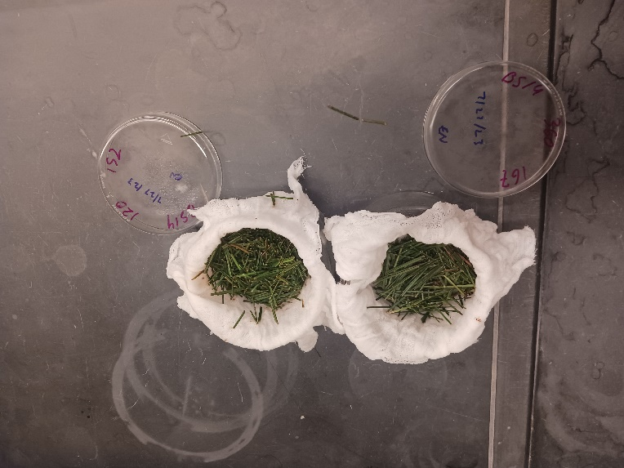
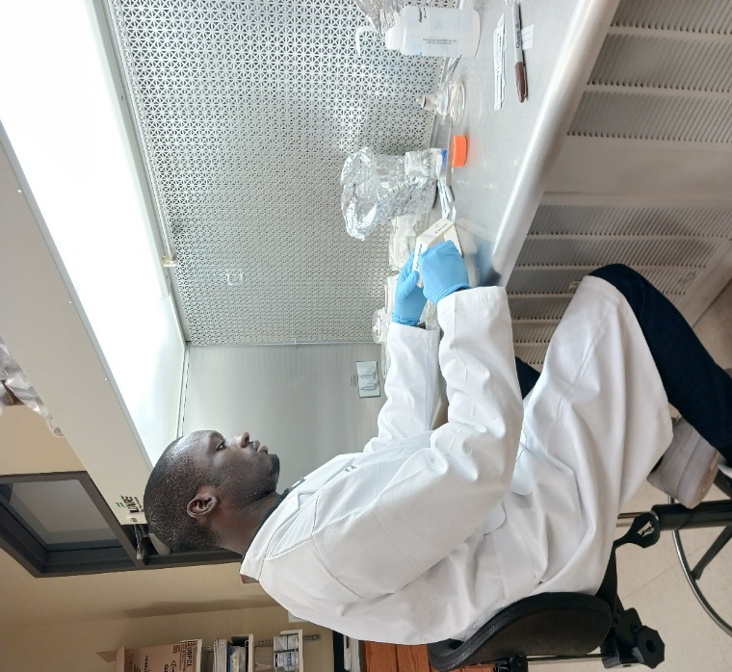
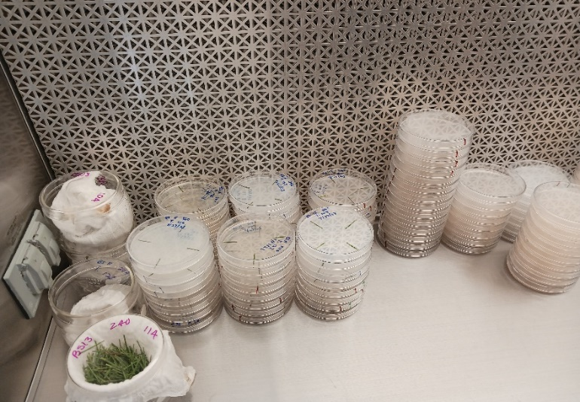
Forest Health Dynamics Laboratory
Sample processing
College of Forestry, Wildlife and Environment - Auburn University

Slide 14
Inoculation study
Forest Health Dynamics Laboratory
Assess tolerance of loblolly pine families to BSNB
5 plots (North site, Cullman, AL)
Potted seedlings to be set in the subplots
No. of families, n= ?
College of Forestry, Wildlife and Environment - Auburn University

Slide 15
Inoculation study
Forest Health Dynamics Laboratory
Forest Health Dynamics Laoatory
For example:
3 families (X,Y,Z)
2 seedlings per family per subplot
8 seedlings per family per plot
40 seedlings per plot
360
X Y Z
Y Z X
C
X Y Z
Y Z X
X Y Z
Y Z X
X Y Z
Y Z X
240
120
College of Forestry, Wildlife and Environment - Auburn University

Slide 16
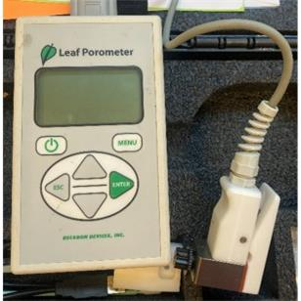
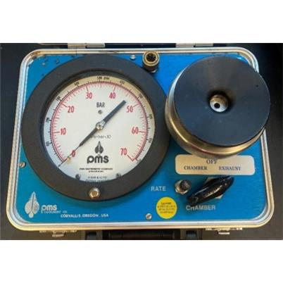
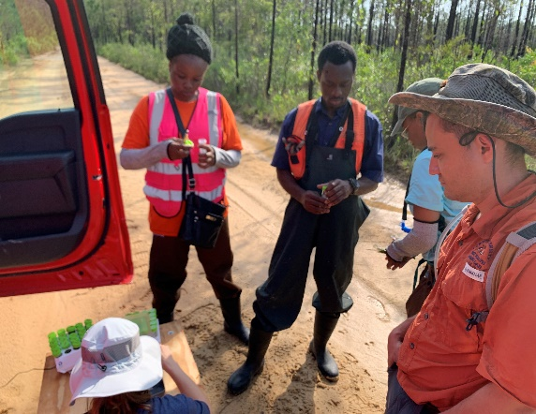
Inoculation study
Forest Health Dynamics Laboratory
Disease rating
Needle sampling
Physiology
Stomatal conductance
Water potential
College of Forestry, Wildlife and Environment - Auburn University

Slide 17
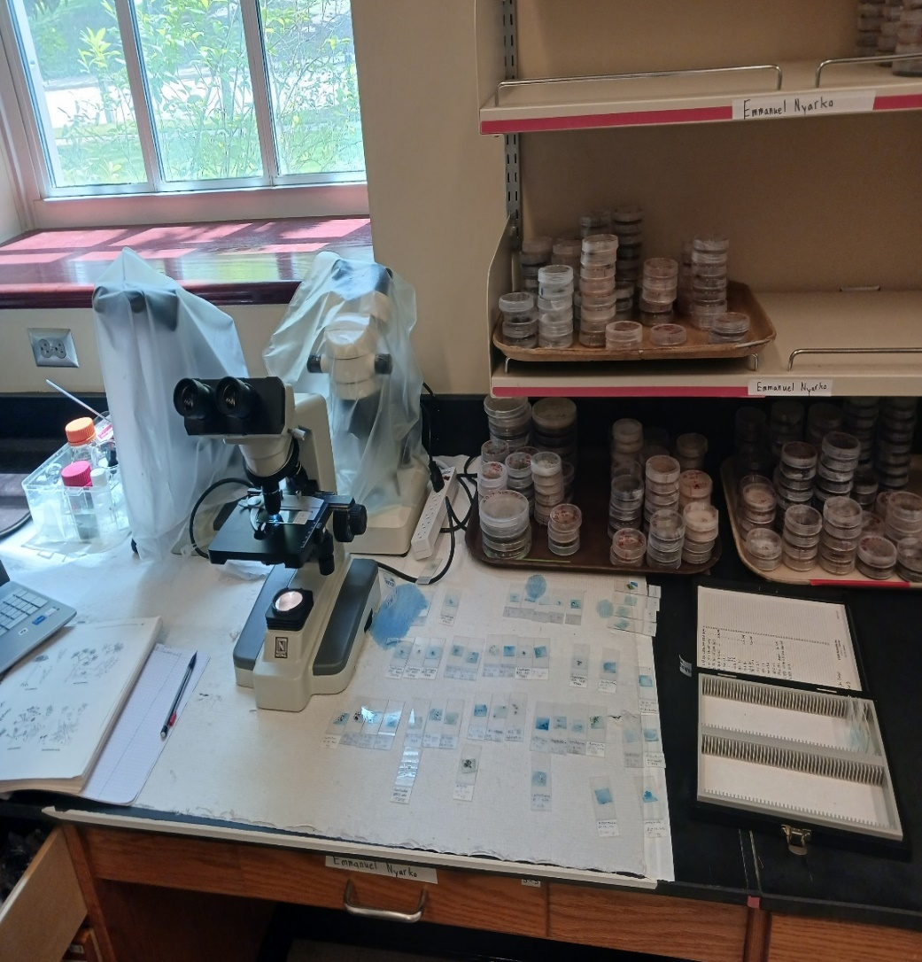
Preliminary results
Forest Health Dynamics Laboratory
Predominant fungi identified:
Pathogens
Lecanosticta acicola
Endophytes
Pestalotiopsis sp.
Alternaria sp.
Hendersonia
Flagellospora
Cladosporium sp.
College of Forestry, Wildlife and Environment - Auburn University

Slide 18
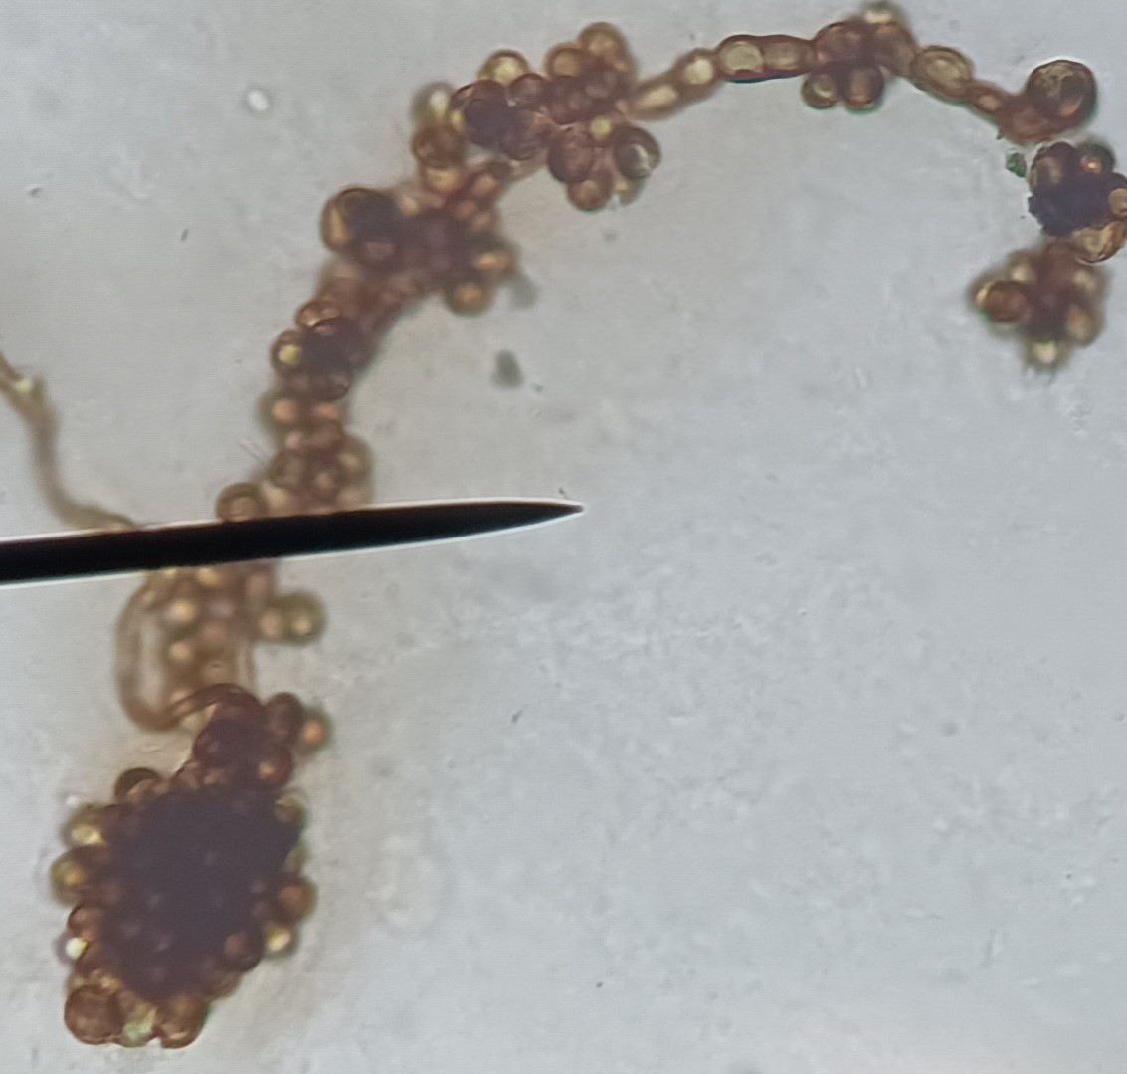
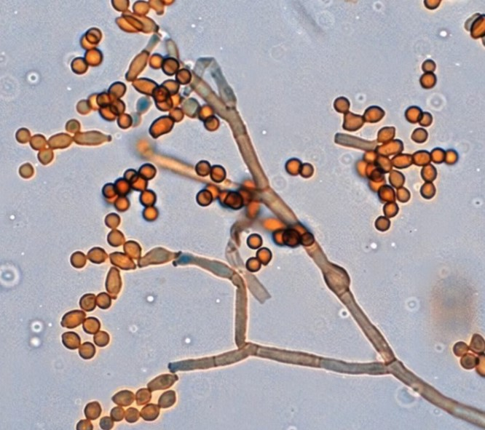
Cladosporium sp.
Forest Health Dynamics Laboratory
College of Forestry, Wildlife and Environment - Auburn University

Slide 19
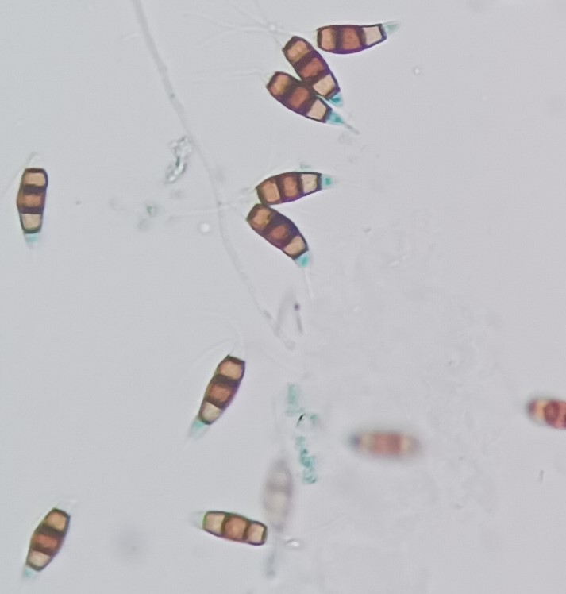
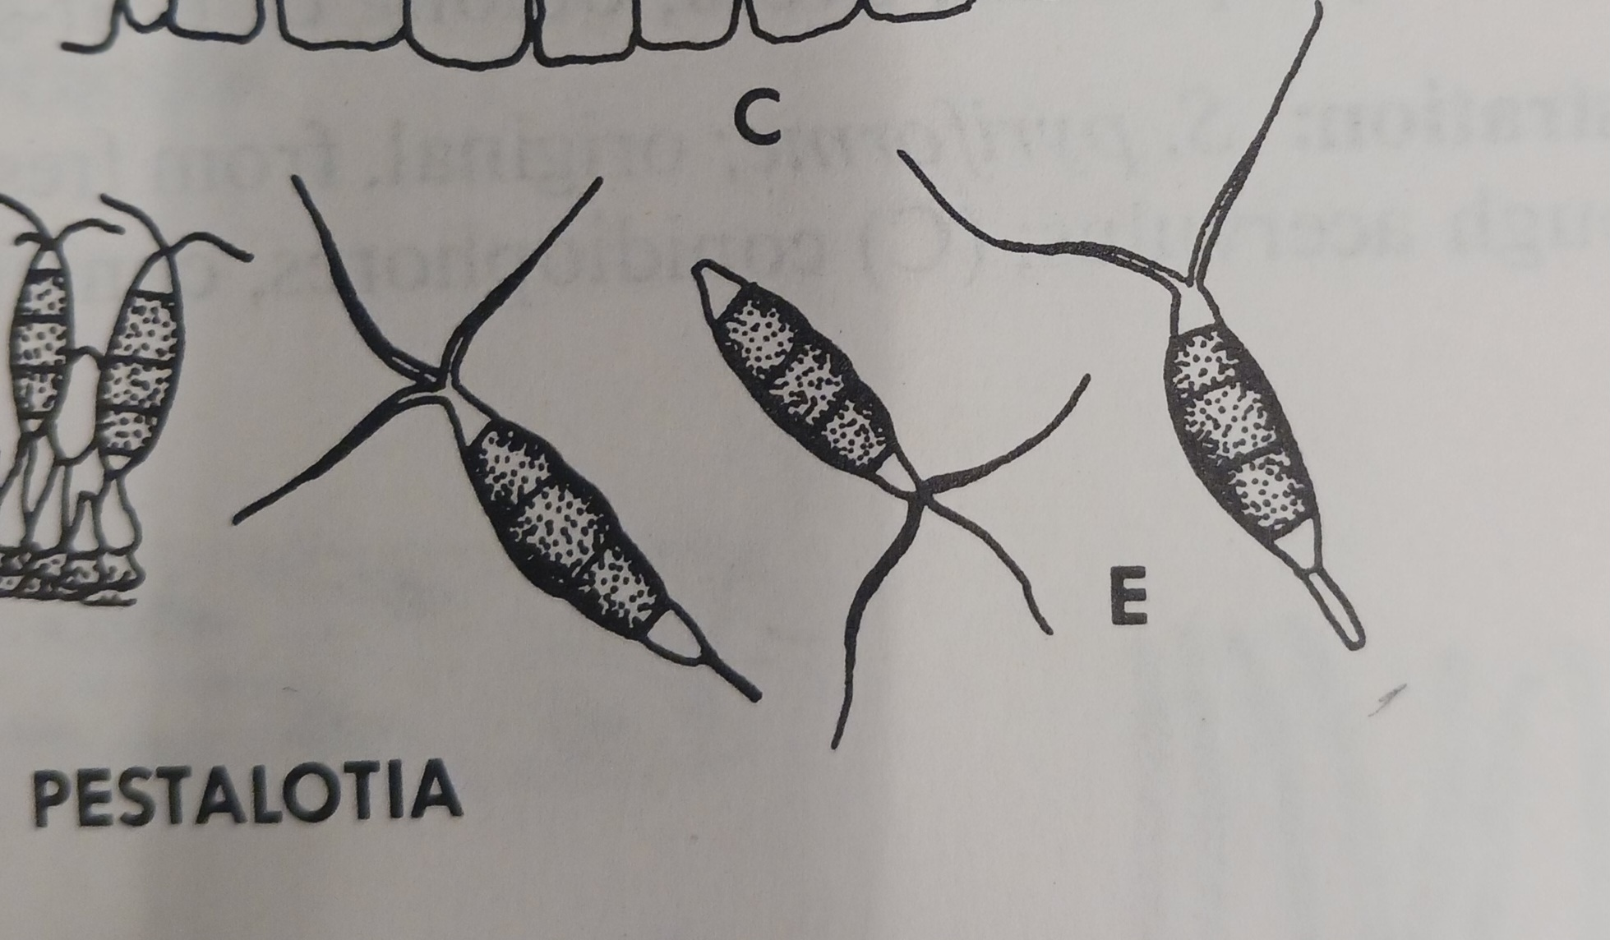
Pestalotiopsis sp.
Forest Health Dynamics Laboratory
College of Forestry, Wildlife and Environment - Auburn University

Slide 20
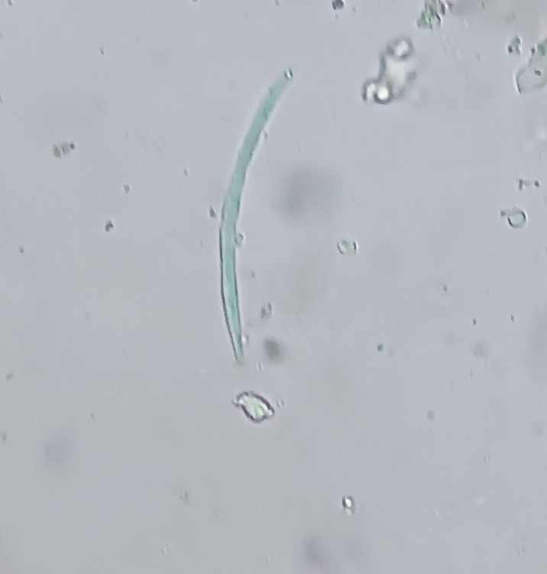
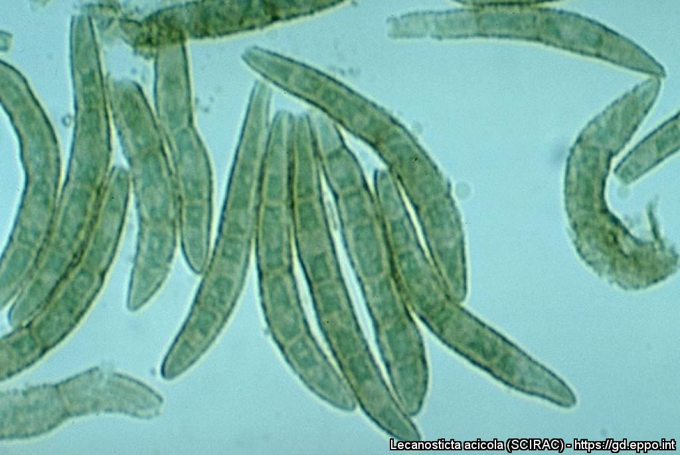
L. acicola
Forest Health Dynamics Laboratory
College of Forestry, Wildlife and Environment - Auburn University

Slide 21
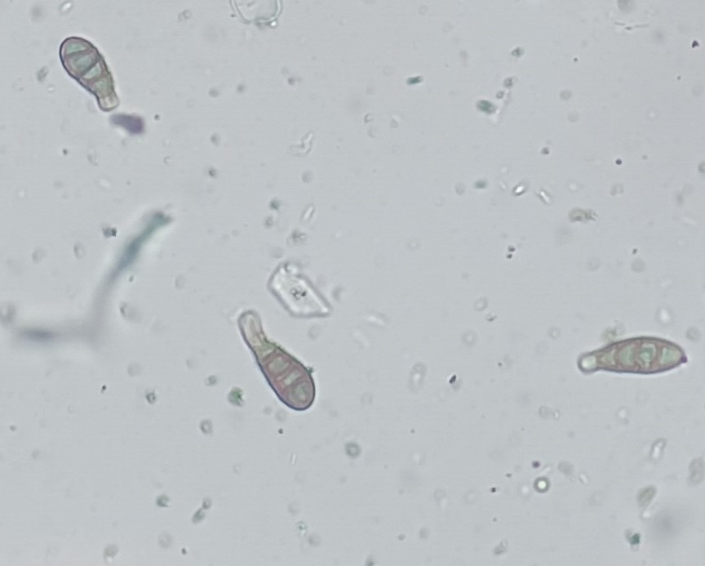
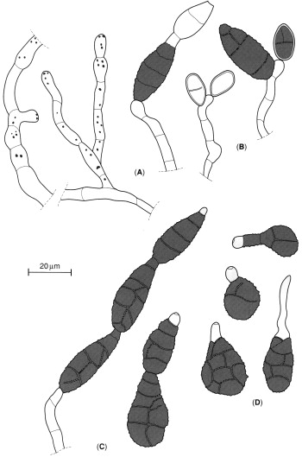
Alternaria sp.
Forest Health Dynamics Laboratory
College of Forestry, Wildlife and Environment- Auburn University

Slide 22
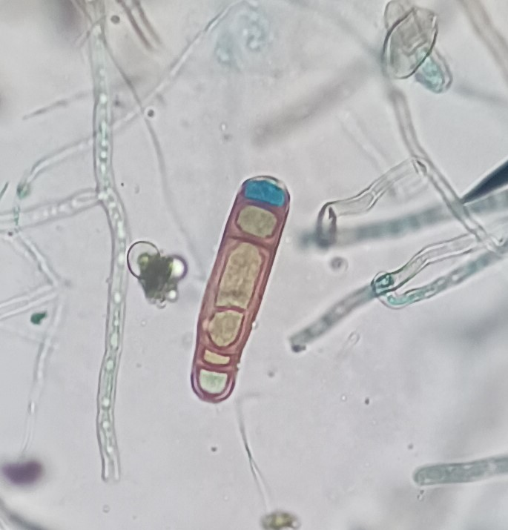
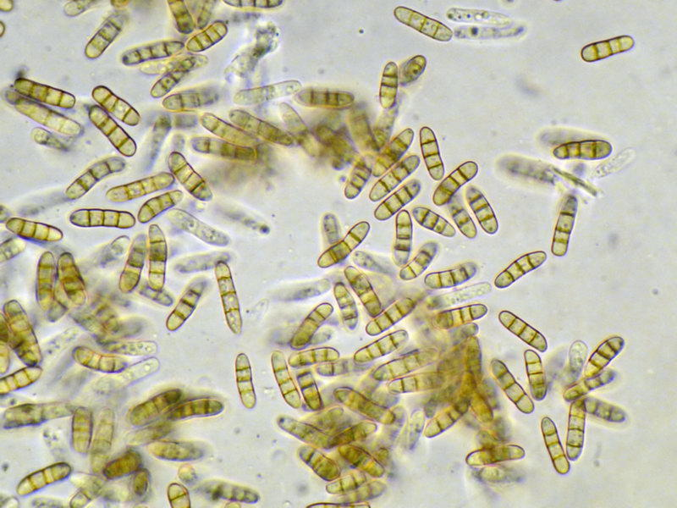
Hendersonia sp.
Forest Health Dynamics Laboratory
College of Forestry, Wildlife and Environment - Auburn University

Slide 23
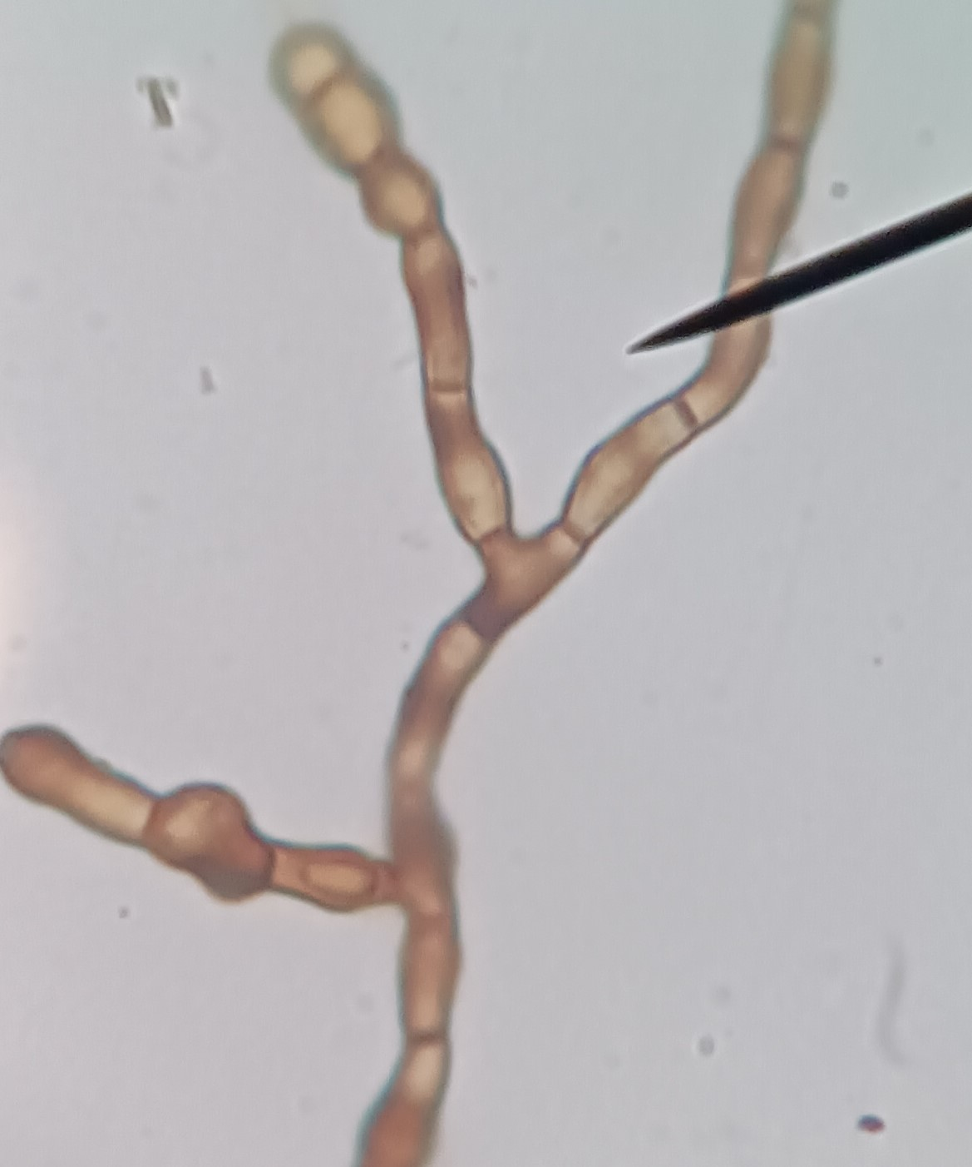
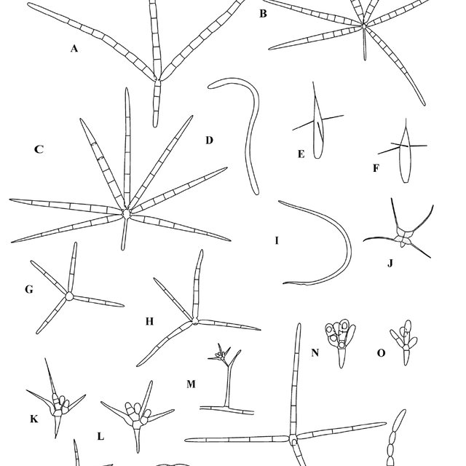
Flagellospora sp.
Forest Health Dynamics Laboratory
College of Forestry, Wildlife and Environment - Auburn University

Slide 24
Forest Health Dynamics Laboratory
College of Forestry, Wildlife and Environment - Auburn University

Slide 25
Forest Health Dynamics Laboratory
College of Forestry, Wildlife and Environment - Auburn University

Slide 26
Analysis and expected outcomes
Forest Health Dynamics Laboratory
The data would be analyzed using R software data analysis tool to determine the level of association between the measured parameters
We expect to identify the family of loblolly pine that has a high tolerance to BSNB
Useful technical information for landowners and plantation managers
College of Forestry, Wildlife and Environment_ Auburn University

Slide 27

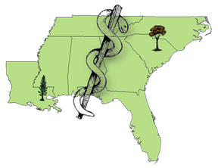


Forest Health Dynamics Laboratory
Acknowledgements
Prof. Lori G. Eckhardt
Committee Members
Forest Health Dynamics Lab members
Kris Bradley
Dr. Glenn Glover (Osko Forest – Glover Family)
Stallworth Land Company
Longleaf Land & Timber Co.
Forest Health Cooperative
College of Forestry, Wildlife and Environment - Auburn University

Slide 28
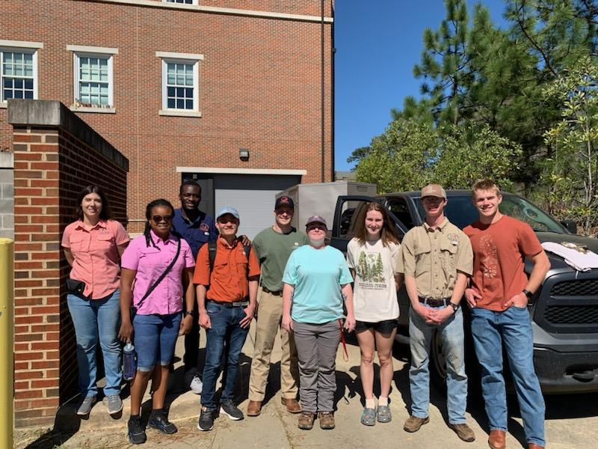
THANK YOU
Forest Health Dynamics Laboratory
College of Forestry, Wildlife and Environment - Auburn University

