Slide 1
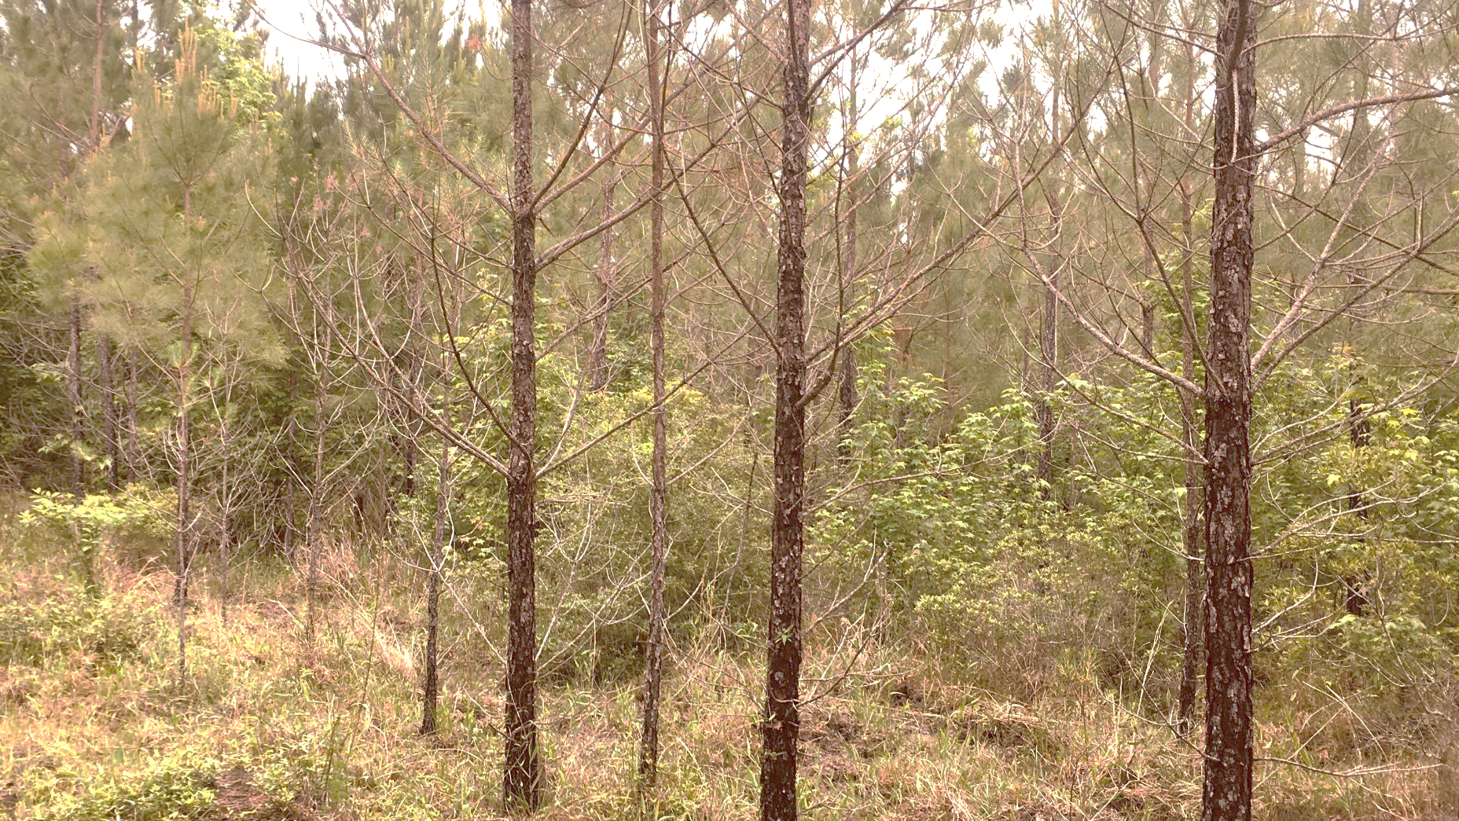


Southeast update of brown spot needle blight on loblolly pine across the southeast
Rabiu Olatinwo
Research Plant Pathologist
US Forest Service, Southern Research Station

Slide 2
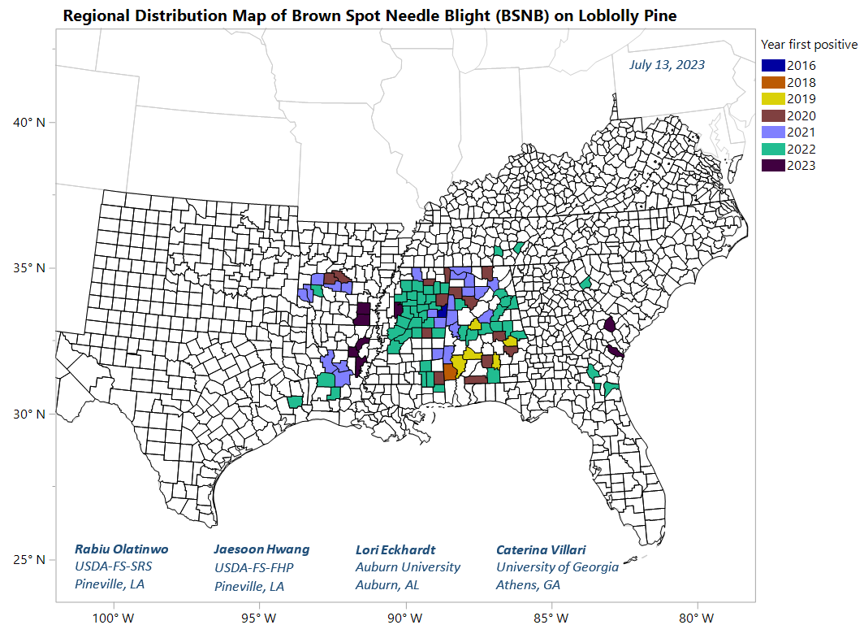
Research partnerships across the southeast
Positive confirmations of the causal pathogen on loblolly pine needles, using species-specific molecular markers, have been reported in AL, AR, FL, GA, LA, MS, SC, and TX since 2016.
Concerns about this new emerging threat to loblolly pine stands have increased, especially in parts of the region where, the viable pathogen is available all year.

Slide 3
Mitigating Needle Blight: A Growing Economic Threat to Pine Forests
Auburn University – Lead PI – Lori Eckhardt
Inoculation protocol development for Lecanosticta acicola to develop a screening method to determine strain aggressiveness and seedling tolerance
Environmental factors that drive the emergence and severity of infection from Lecanosticta acicola across Alabama
Detection and movement of Lecanosticta acicola with remote sensing
Genetic diversity of Lecanosticta acicola, pathogen origins, and invasion history
Extension and Outreach Activities

Slide 4
Expanding research partnerships across the region
Establishing a regionwide research approach to help address the threat to loblolly pine by needle diseases/pathogens and research partnerships across the region.
Three primary objectives:
Establish region-wide plots to enable long-term evaluation of changing climate and impacts on pine hosts,
Develop timely detection capacity across the region; and
Assess the impacts on commercial pine plantations based on site information, diversity of needle pathogens, host genetics, and economic analysis.

Slide 5
Research partnerships across the region
Building on the Forest Service - SRS collaboration with Auburn.
Work with partners to address the needle pathogens issue (regionwide).
Set-up a regional Needle Pathogens Research Network collaboration.
Identify short and long-term research needs (archivable priorities).
Research focus - detection, field plots, climate, genetic screening, management.
Prevent duplication of efforts and work together to develop useful tools.

Slide 6
Discussions with research partnerships
AL - Lori Eckhardt (AU)
GA - Caterina Villari (UGA)
MS - John J. Riggins (MSU)
FL - Jason Smith (UF)
LA - Laura Simms (LTU)
GA - P4/Jones Center/UGA
CO - Jane Stewart (CSU)
Tyler Dreaden (SRS)
AR - Chandler Barton
MS - Garron Hicks
LA - Tyler Cloud
LA - Jaesoon Hwang (FHP)
NC - Ryan Blaedow (FHP)
NC - Kathleen Mckeever (FHP)

Slide 7
Advancing the understanding, detection, and host resistance selection of fungi associated with loblolly pine needle disease
University of Georgia – Lead PI – Dr. Caterina Villari
Sequencing-based diagnostic tool
Identification and pathogenicity
Long-term monitoring study
Lecanostica acicola virulence factors and loblolly resistance to BSNB
Participate in a regionwide network of researchers and managers

Slide 8
Etiology and disease biology of Lecanosticta acicola on Pinus taeda in the southeastern United States
University of Florida – Lead PI – Dr. Jason Smith
Monitor spore production of L. acicola in affected stands
Host phenology, weather variables and stand management.
Etiology and phenology on loblolly pine caused by L. acicola.

Slide 9
United Against Brown Spot Needle Blight: Collaborative Strategies for Protecting Southeastern Loblolly Pine Forests
Mississippi State University – Lead PI – Dr. John J. Riggins
Establish long term monitoring plots.
Risk of secondary pine pest attacks on infected trees/stands.
Investigate prescribed burns as a BSNB control method.
Develop fungicide recommendations for loblolly pine plantations.
Detect/delineate infected stands using remote sensing.
Identify environmental drivers in the Southeast.
Engage in landowner outreach.

Slide 10
Combating needle pathogens and forestry professional worker shortages in the southern region through a network effort of research, teaching, and service
Louisiana Tech University – Lead PI – Dr. Laura Sims
Create service environment for foresters and landowners, industry, government, and academic partners to collaborate
Provide forestry students with access to network on research projects
Industry-focused survey approach to sampling across the region
Establish long-term monitoring plots for needle pathogens
Evaluate the ecological and economic damage caused by needle

Slide 11
Pine Needle Diseases in the Southeast: A Test Case for the Pine Pandemic Preparedness Plan and Development of a Surveillance System to Aid in Early Detection
University of Georgia/Jones Center GA – Lead PIs – Drs. Kamal Ghandhi, Bronson Bullock, Caterina Villari, and Kier Klepzig
Focus gaps in knowledge, and future directions for research and outreach for the needle disease issue.
Provide a platform and structure to facilitate communication within and across scientists, agencies and
Assist with collaborative network building to maximize resources, and to provide a larger framework for research on needle diseases.
Integrate spatial data on detection into the P4 database
Establishment of monitoring plots for needle diseases and standardize protocols.

Slide 12
Characterize biotic and abiotic factors driving emergence in brown spot needle blight on Loblolly pine in the southeastern USA
Colorado State University – Lead PI – Drs. Jane Stewart/Olga Kozhar,
Evaluate whether microbial communities in needles from loblolly pine plantations are genetically and functionally distinct from natural forest populations - genetic/microbial variants and with dynamics in microbial genes expression (metatranscriptome).
Understand how microbial communities of pine needles changes throughout growing season.
Integrate microbial community changes (1 and 2) with potential local environmental changes over three years to determine if there is correlation among biotic-host-environmental effects leading to the increase in the disease severity of BSNB.
Integrate microbial community and disease severity changes (1 and 2) with local environmental effects (3) for the development of a rapid risk assessment management tool as part of the disease mitigation efforts.

Slide 13
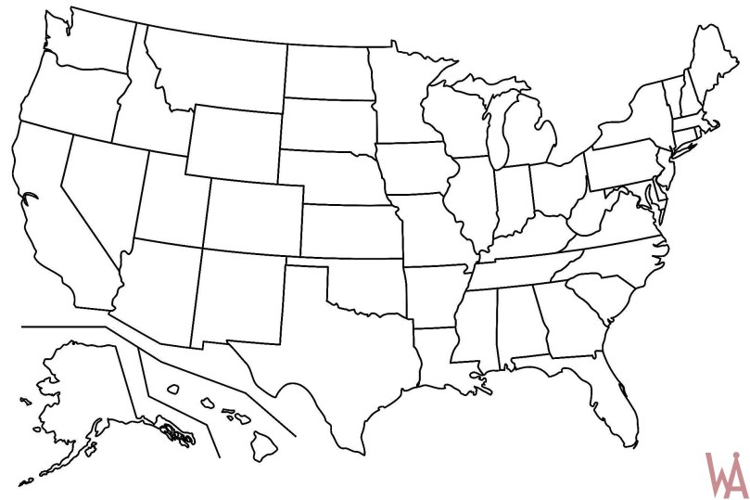
Research partnerships across the region
Auburn University
University of Georgia
University of Florida
Mississippi State University
Louisiana Tech University
Colorado State University
Pine Pandemic Preparedness Plan (P4) Team/UGA/Jones Center, GA

