Slide 1
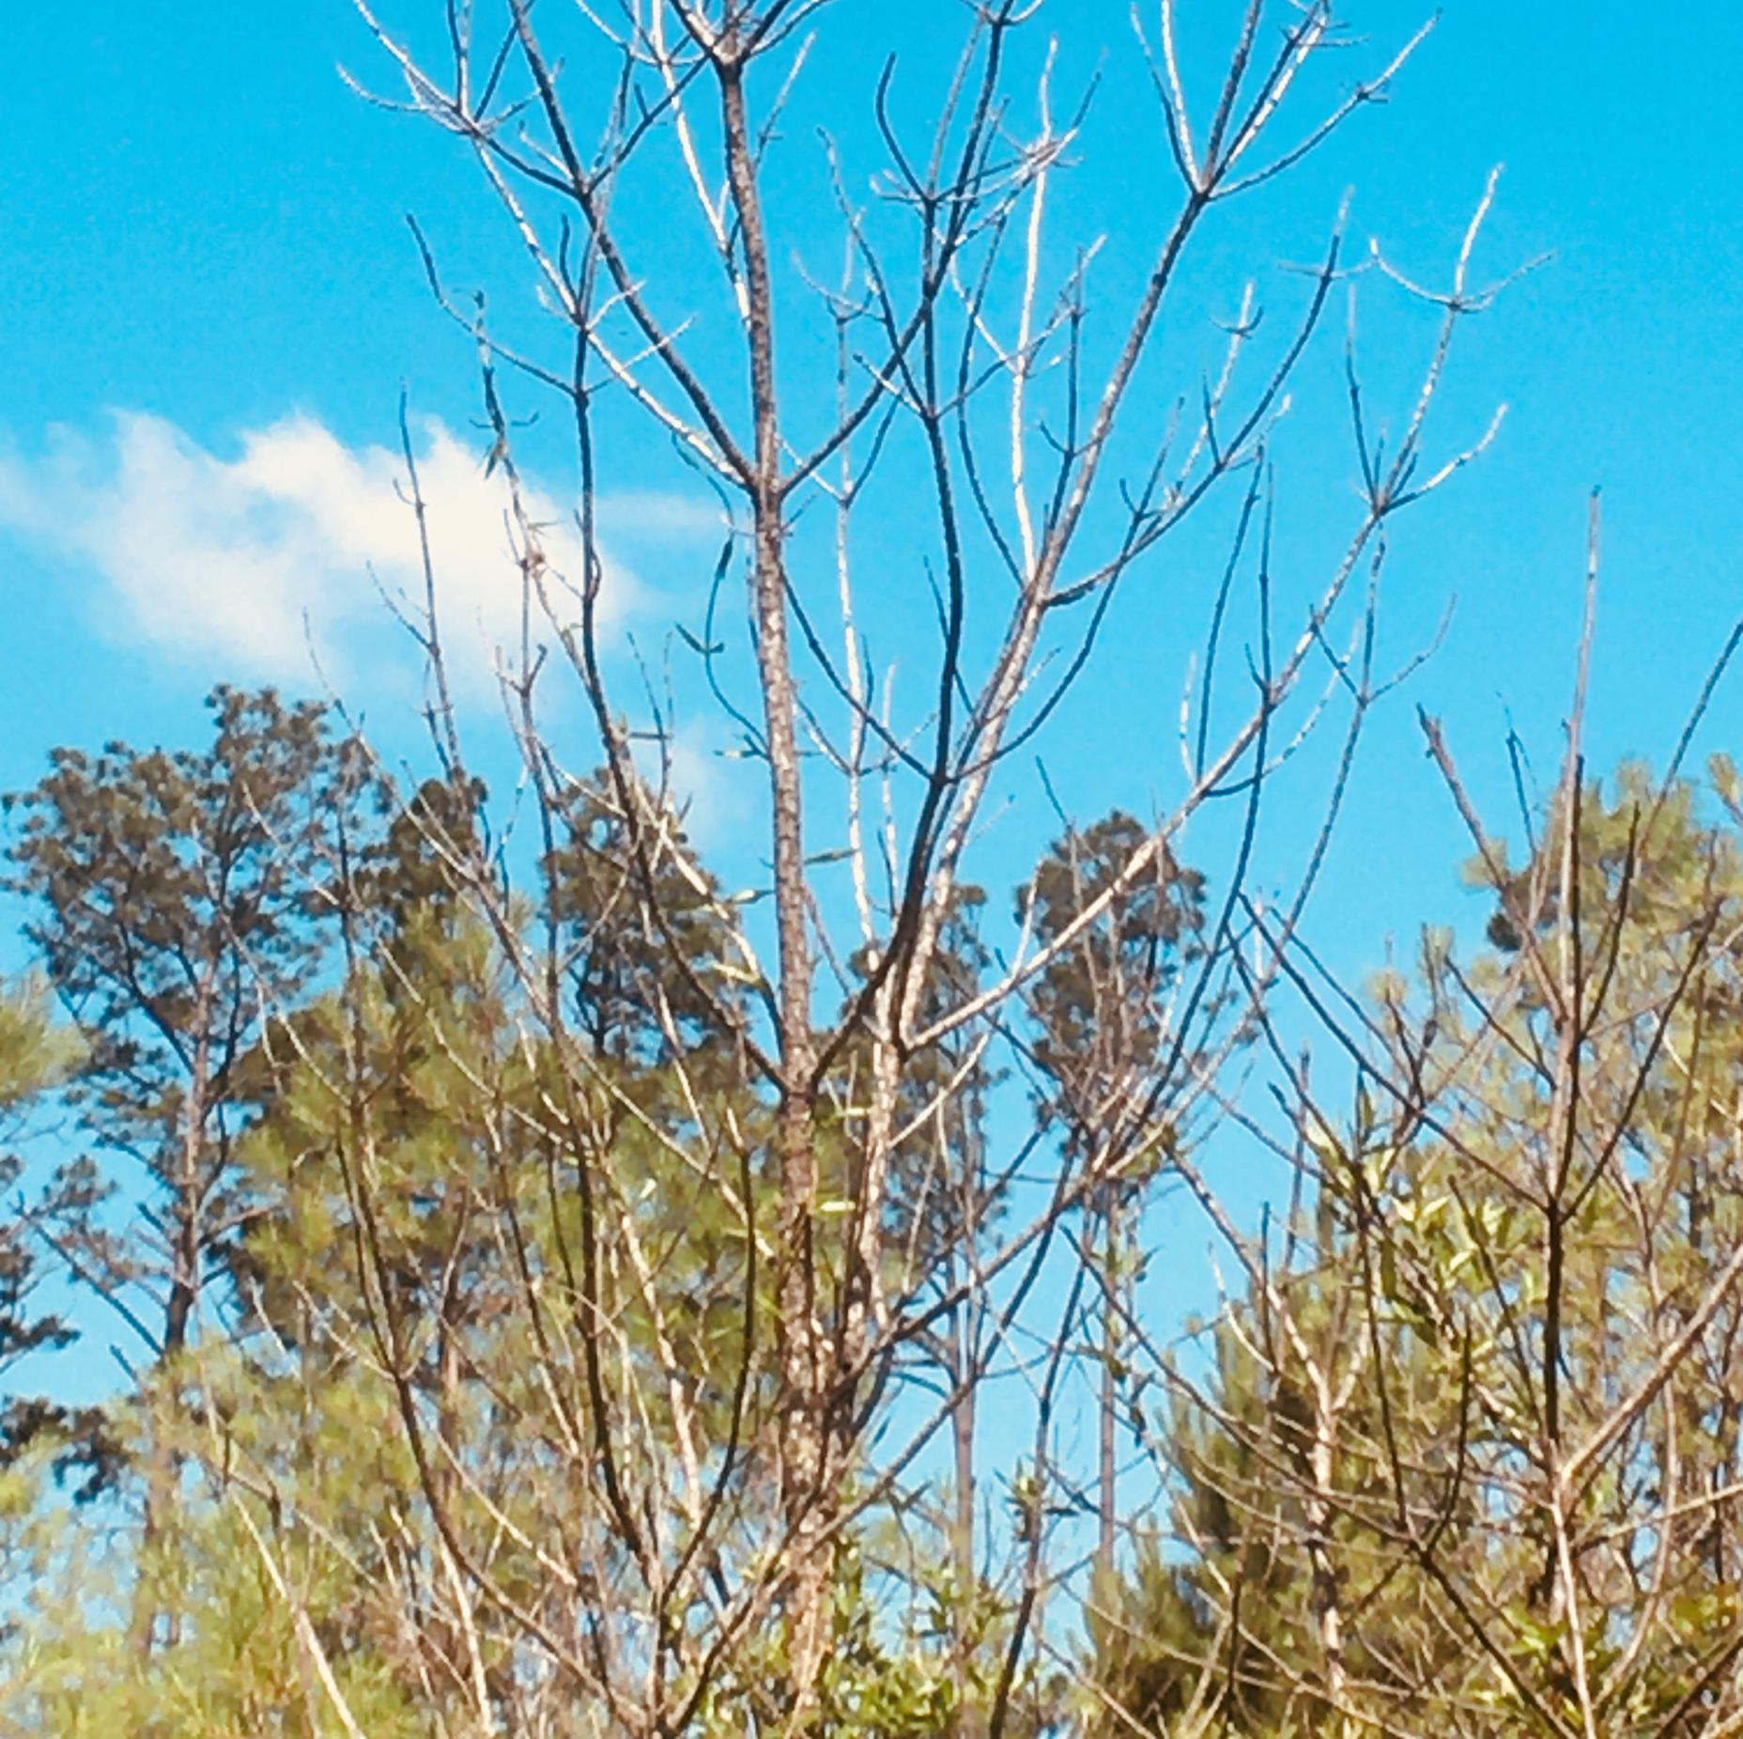


Environmental triggers and seasonal changes in the mycobiome on symptomatic and asymptomatic loblolly pine needles
Rabiu Olatinwo ¹, Jaesoon Hwang ², and Wood Johnson ²
¹ USDA, Forest Service Southern Research Station, Pineville, LA 71360, USA
² USDA, Forest Service Forest Health Protection, Pineville, LA 71360, USA

Slide 2
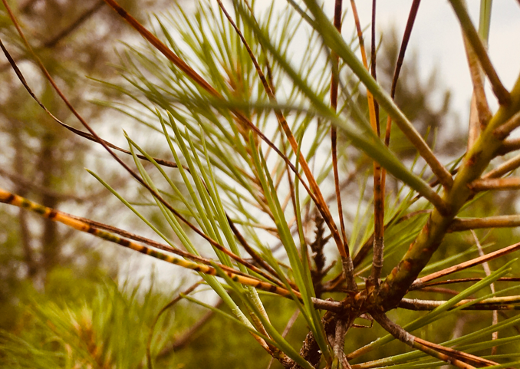
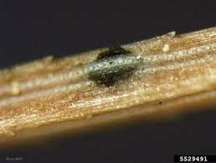
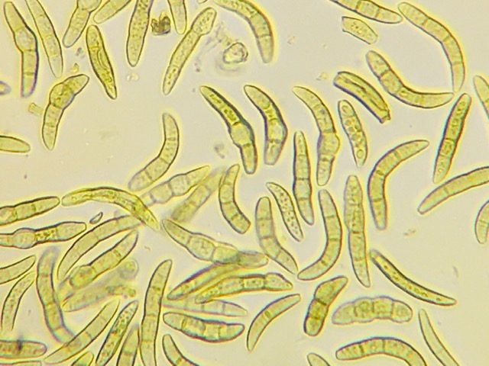
Brown spot needle blight, caused by the fungal pathogen Lecanosticta acicola, which typically affects longleaf pine (Pinus palustris Mill.) at the early grass stage of development, started causing significant damage on loblolly pine in the past few years.

Slide 3
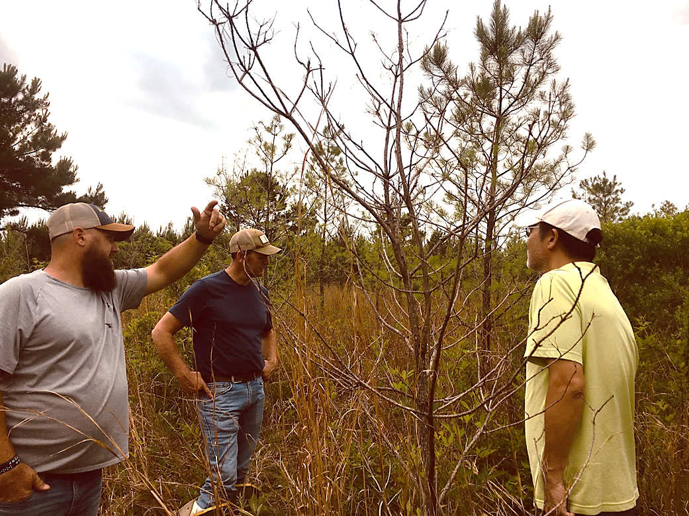
Incidence of brown spot needle blight (BSNB) associated with loblolly pine (Pinus taeda L.) in commercial plantations have increased significantly across the southeastern United States in recent years.

Slide 4
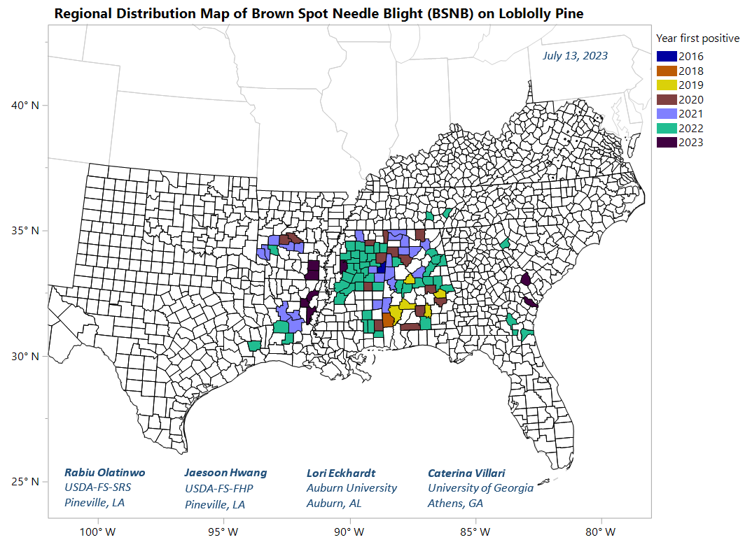
Distribution
Positive confirmations of the causal pathogen on loblolly pine needles, using species-specific molecular markers, have been reported in AL, AR, FL, GA, LA, MS, SC, and TX since 2016.
Concerns about this new emerging threat to loblolly pine stands have increased, especially in parts of the region where, the viable pathogen is available all year.

Slide 5
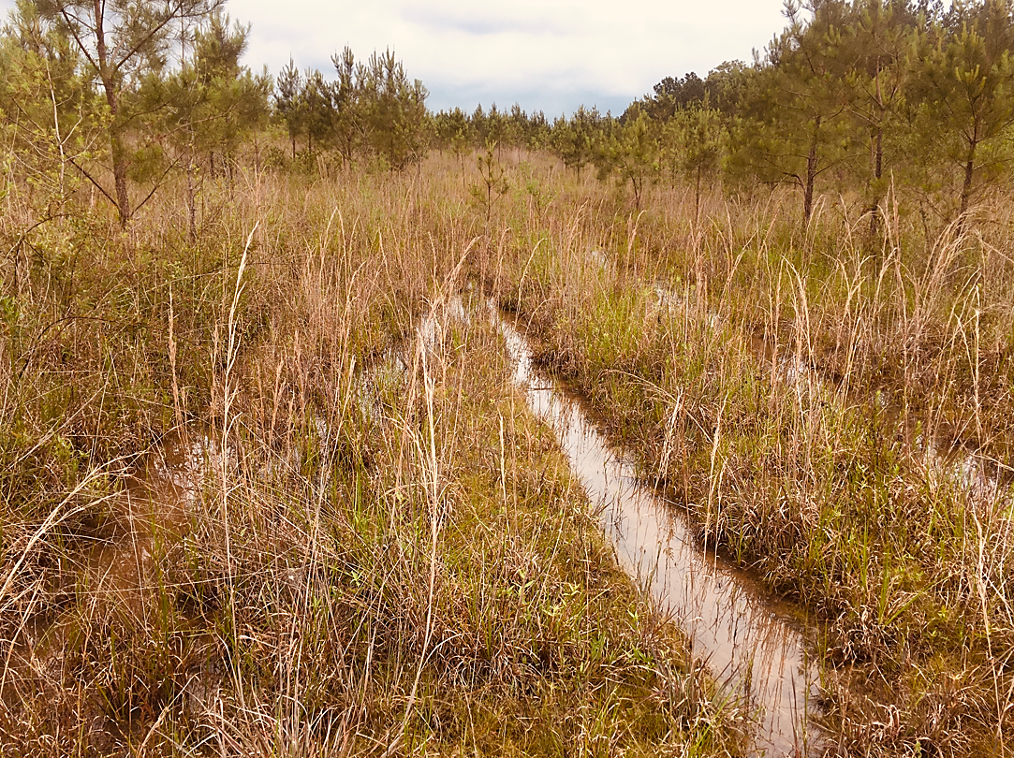
The key objective is to identify climatic factors or environmental triggers associated with recent reports of BSNB across the southeast since 2016, using the geographic distribution of positive confirmations and the historical climate data.

Slide 6
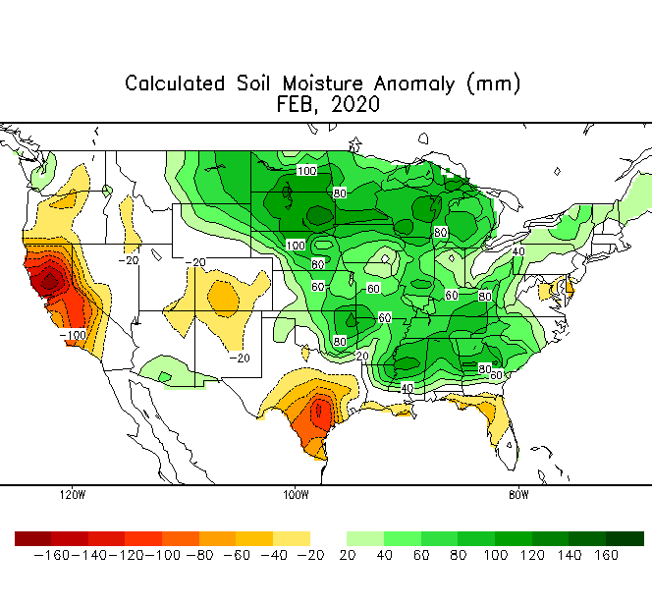
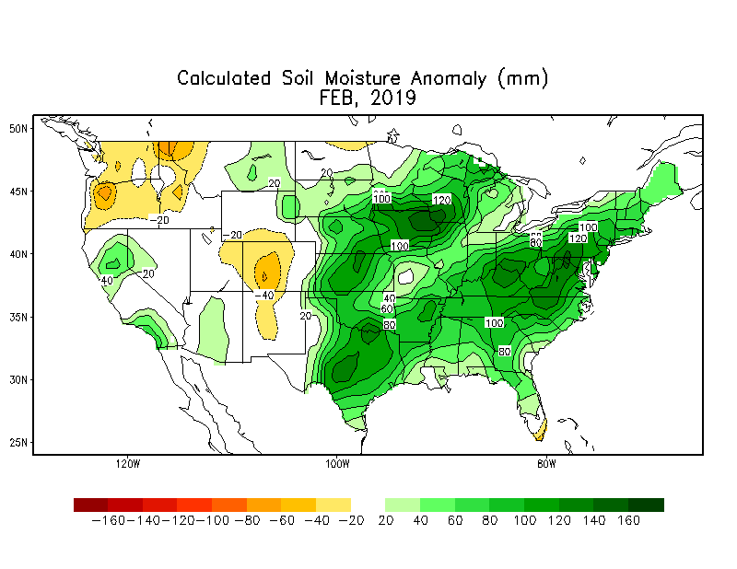
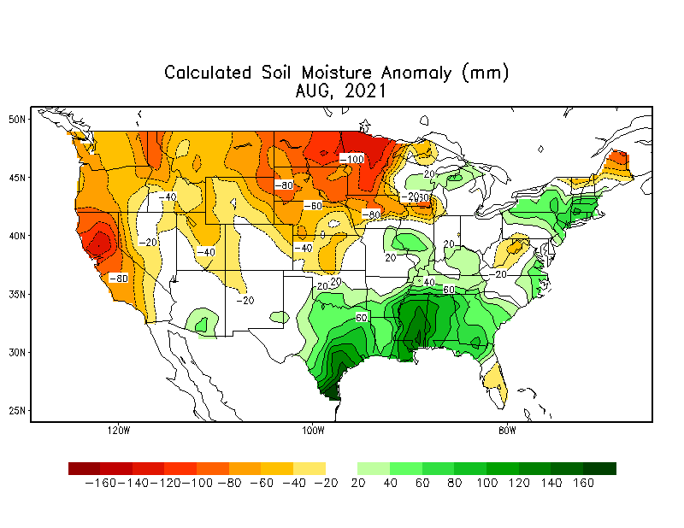

Slide 7
Climate/BSNB
The regional distribution map of confirmed cases. Three study areas include;
Boundary A - covering north Mississippi and north Alabama with high count of BSNB positive counties ;
Boundary B- covering north Georgia and east South Carolina with low count of BSNB positive counties, and
Boundary C- covering south Arkansas, north Louisiana, west Mississippi, and northeast Texas with moderate count of BSNB positive counties.
A
B
C

Slide 8
Climate
Historical data corresponding to the three study areas were obtained from the National Oceanic and Atmospheric Administration & Climate Prediction Center
Climatic factors - Soil Moisture Anomaly, Standard Precipitation Index (SPI), Last Spring Freeze Day, minimum temperature from February to April and others.
A
B
C

Slide 9
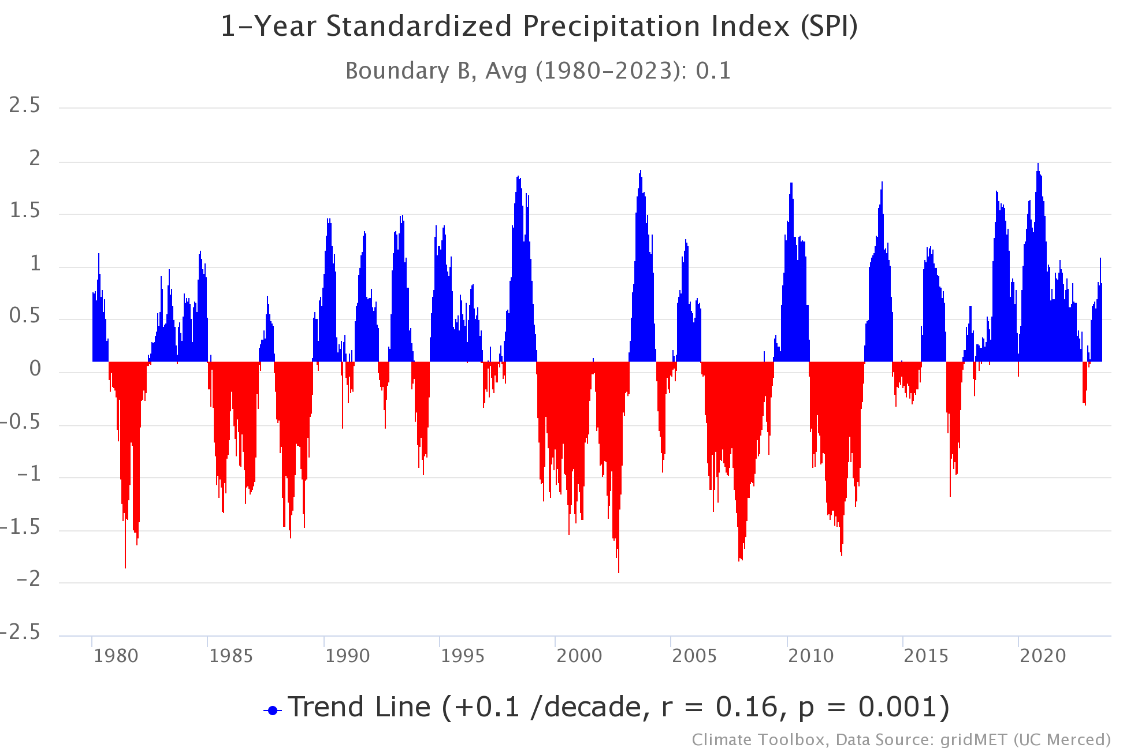
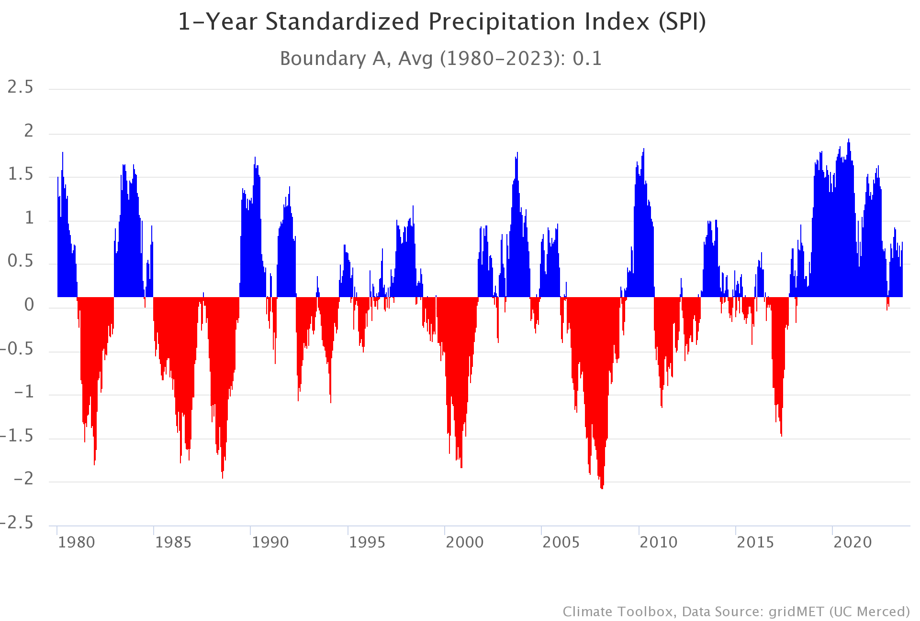
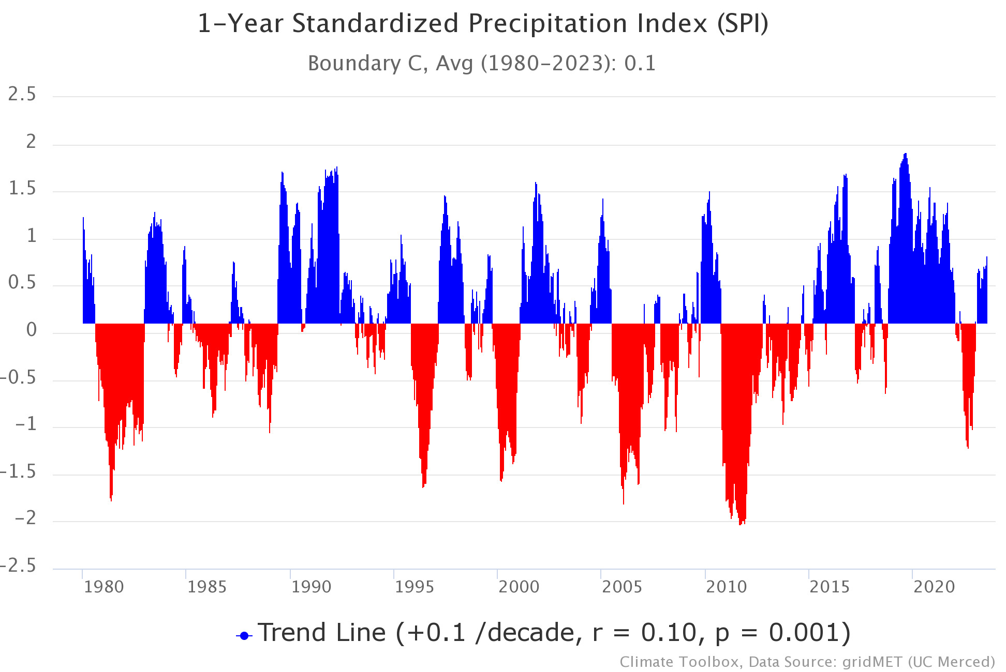
Standard Precipitation Index (SPI: drought index that captures how observed precipitation deviates from the climatological average over a given time period) for the three study areas evaluated between 1980 and 2023.

Slide 10
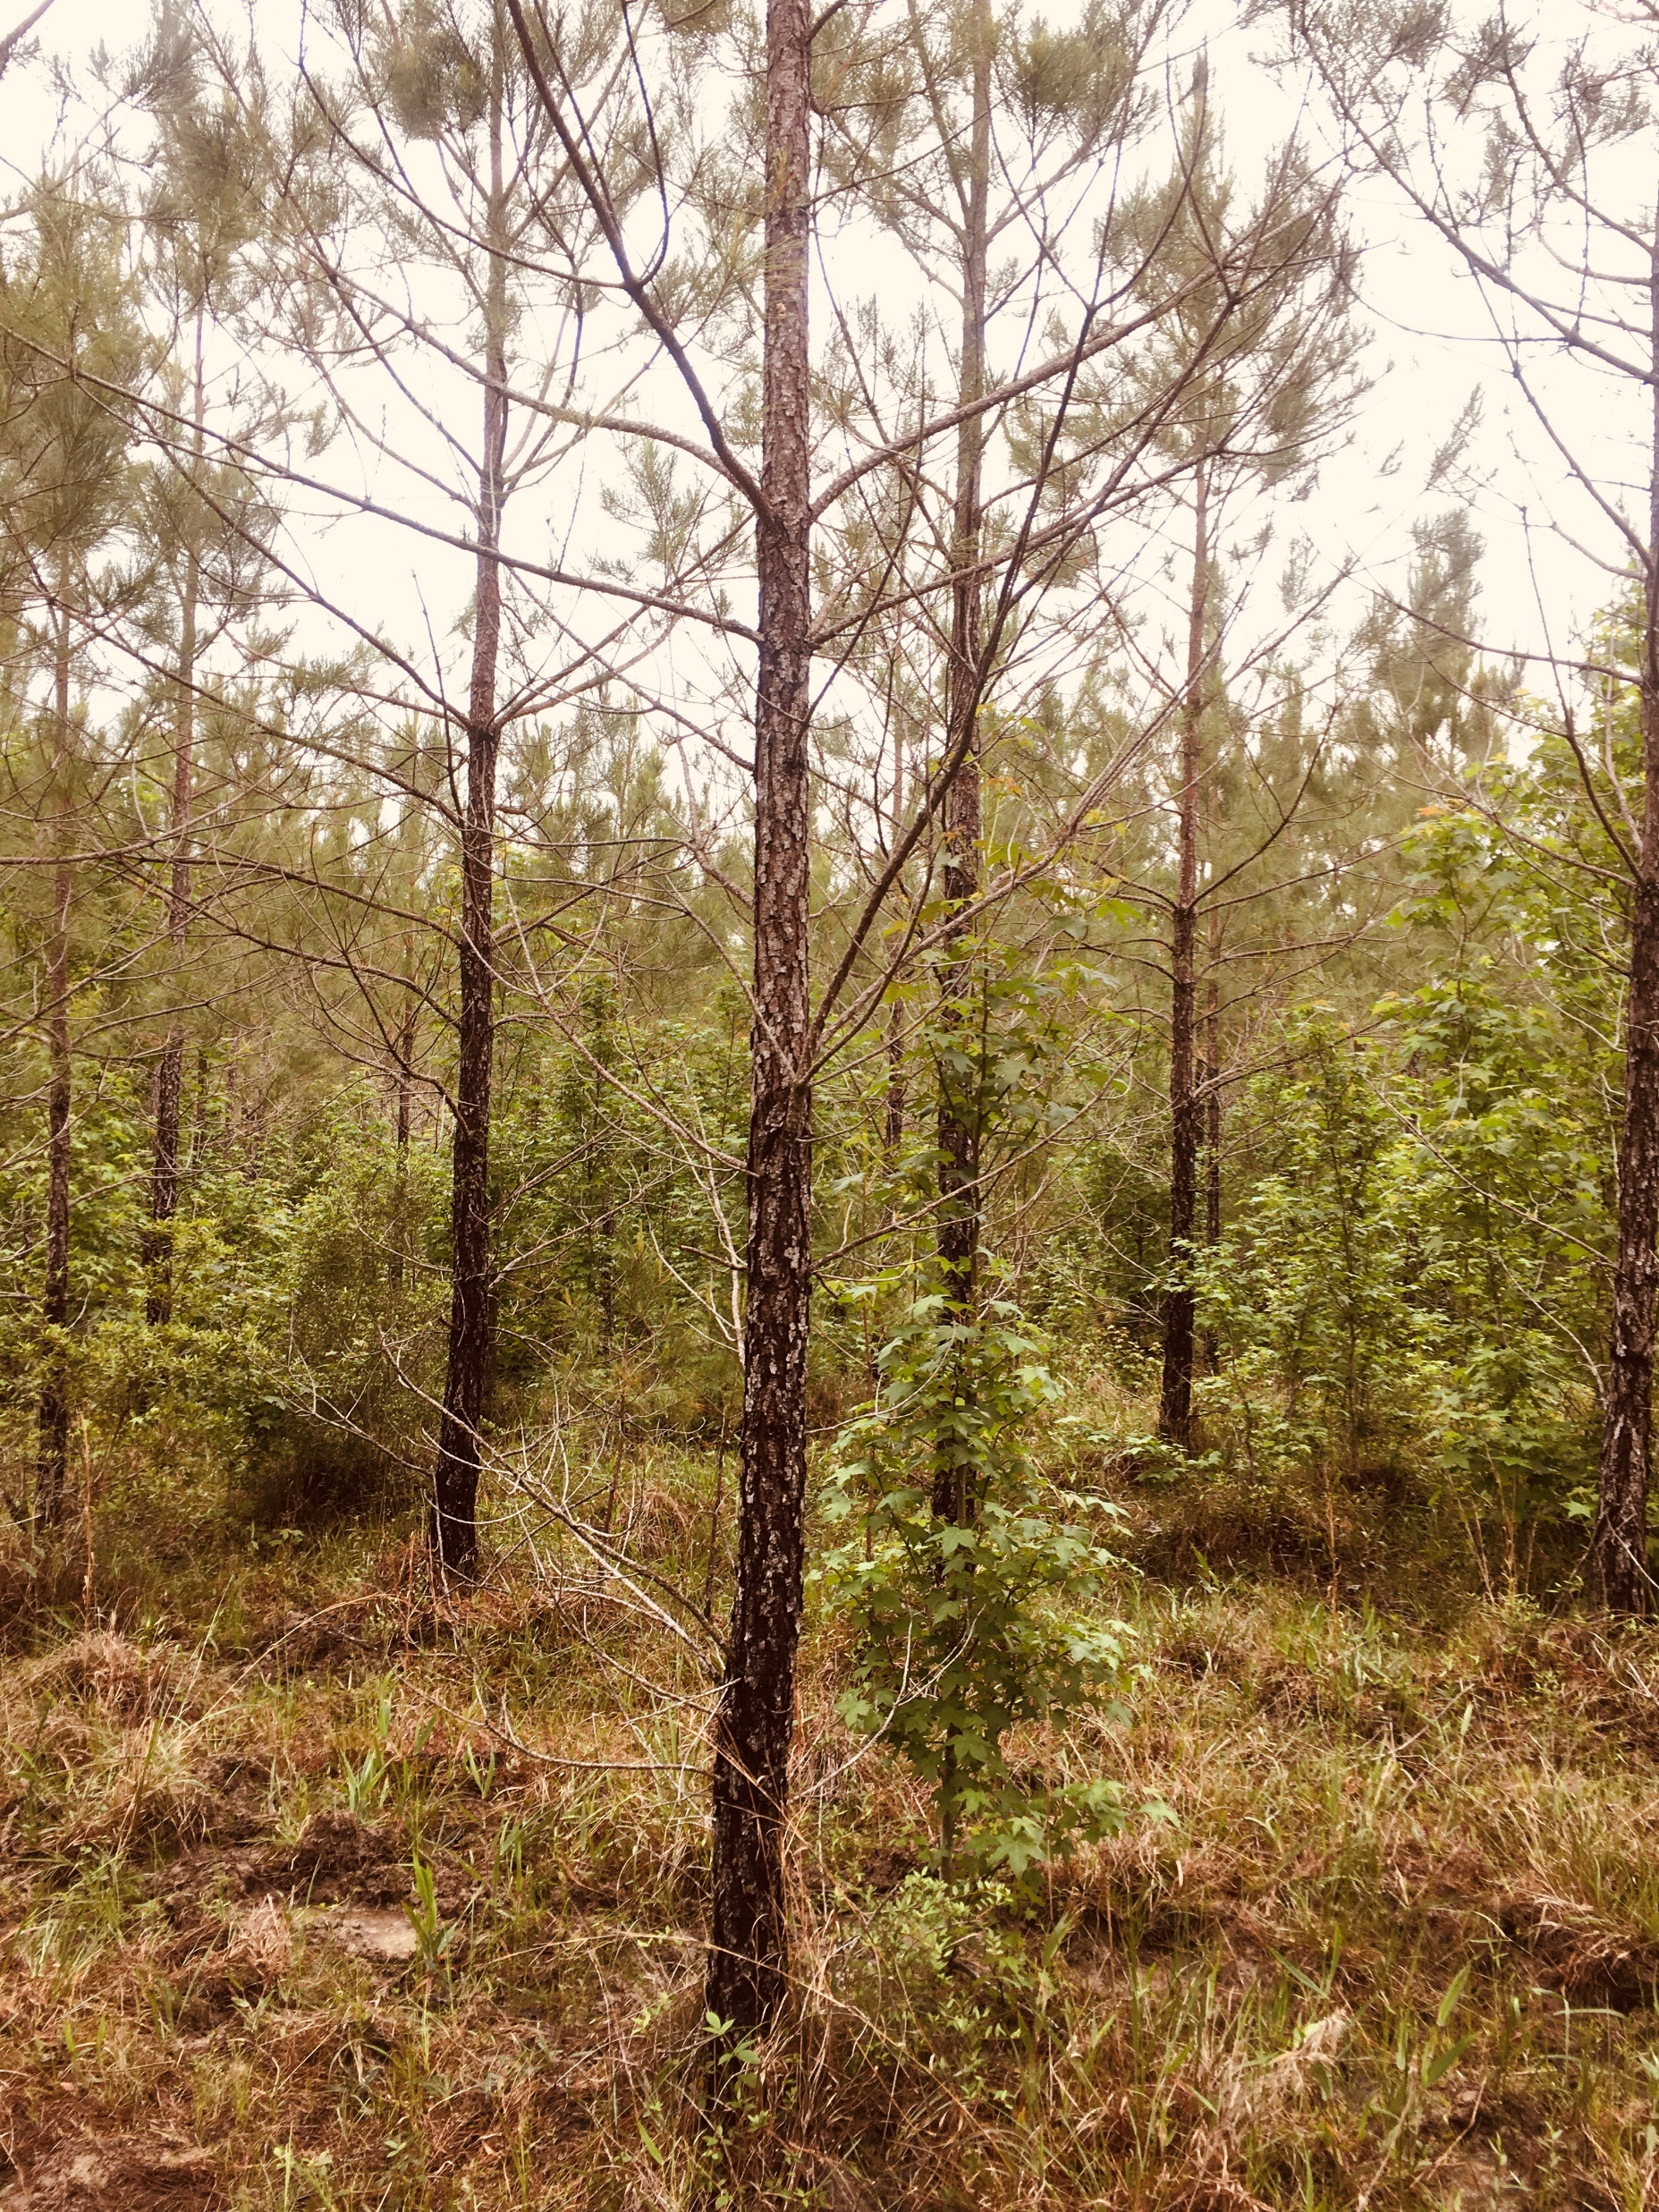
Historical data indicate a consistently higher soil moisture content in parts of the southeastern United States during the early spring period in February from 2019 to 2021, particularly in AL, AR, MS and LA where BSNB has been widely reported in recent years.
According to the 1-year Standard Precipitation Index, Boundary A experienced a sustained above normal precipitation total from 2016 to 2023, compared to Boundary B and C.

Slide 11
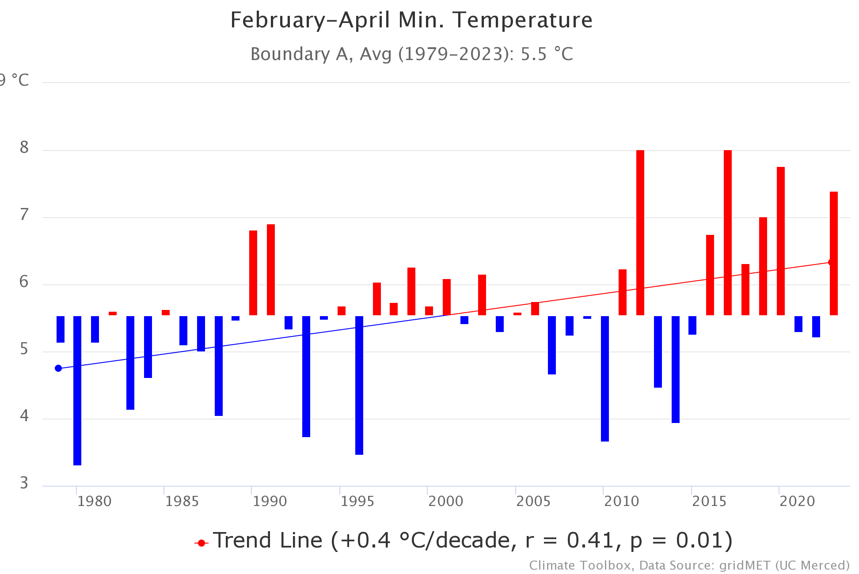
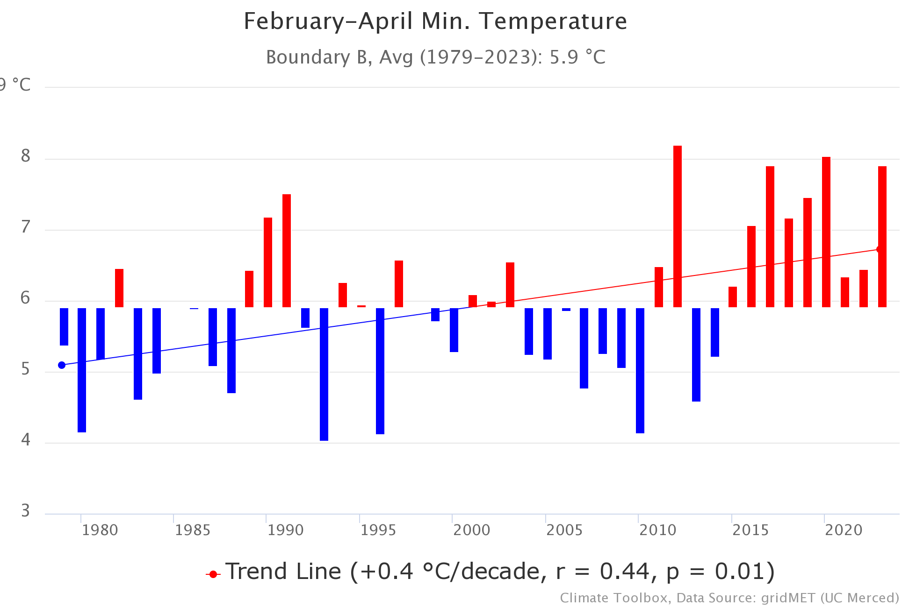
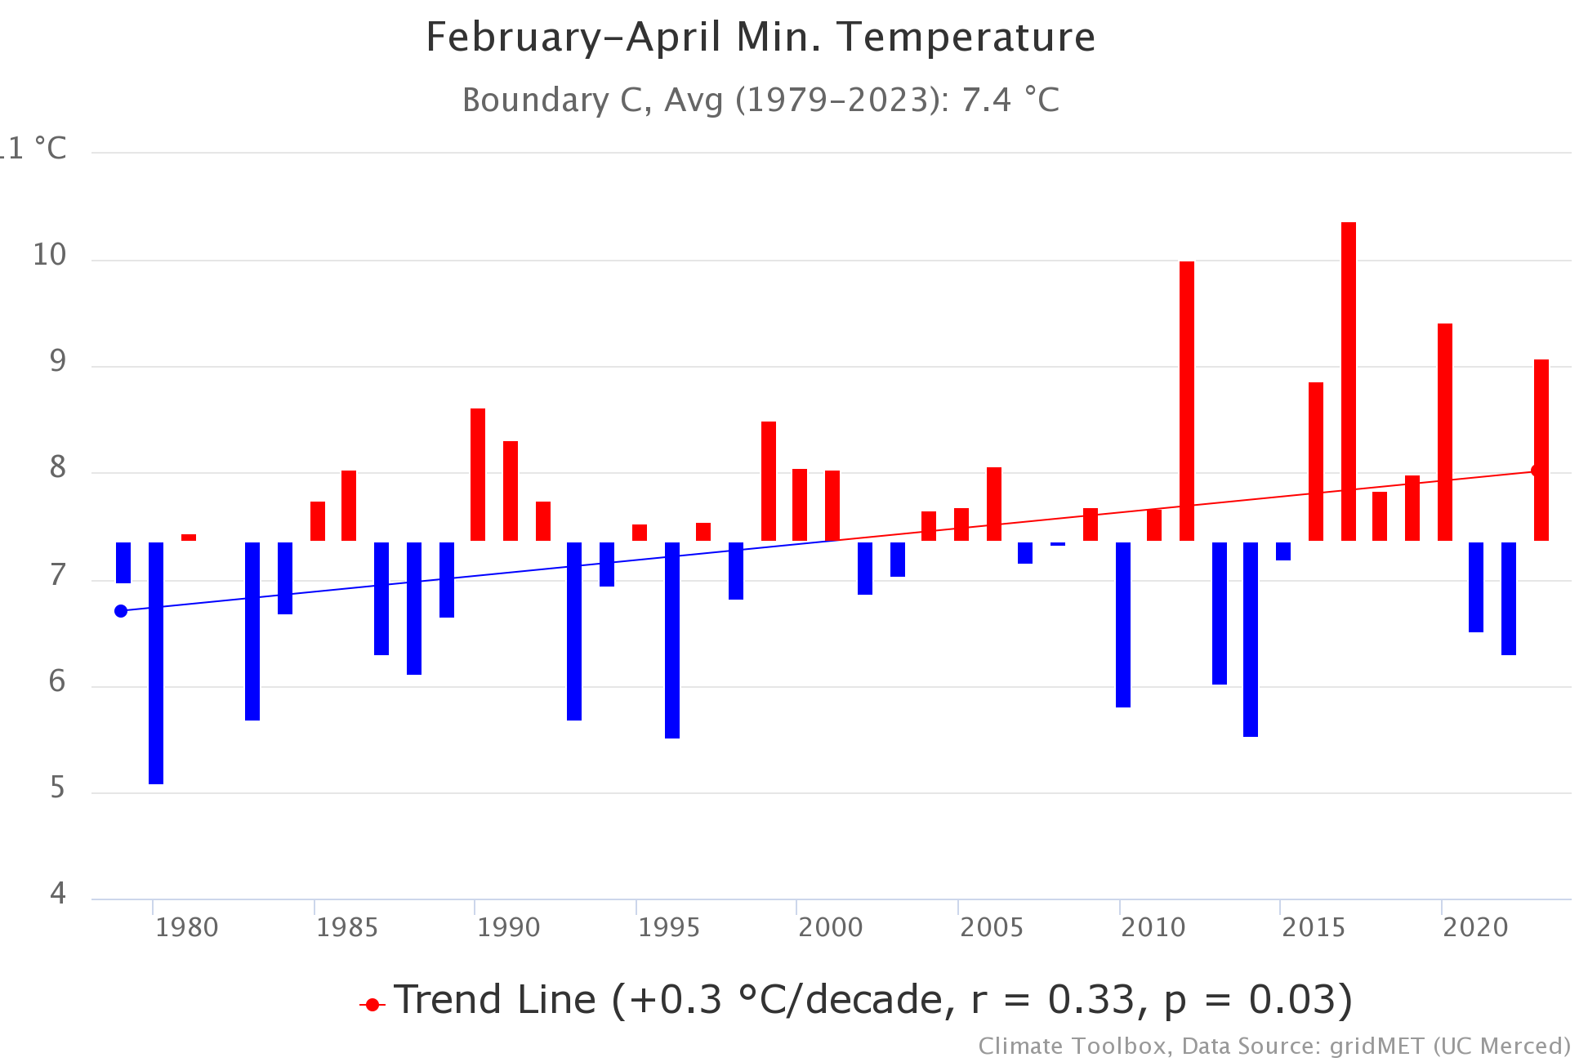
Differences in the February to April minimum temperature to highlight the variability in temperature pattern between 1979 and 2023 for the three study areas A, B, and C.

Slide 12
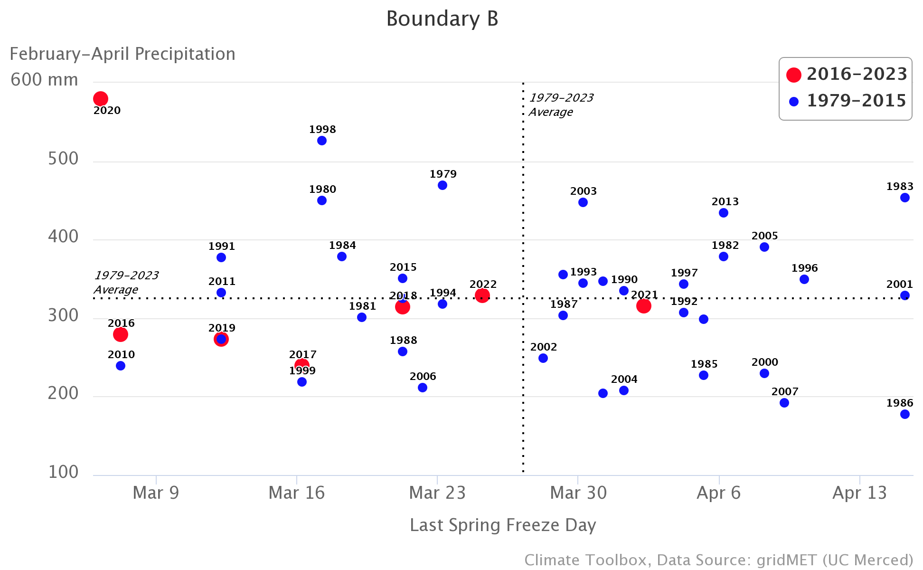
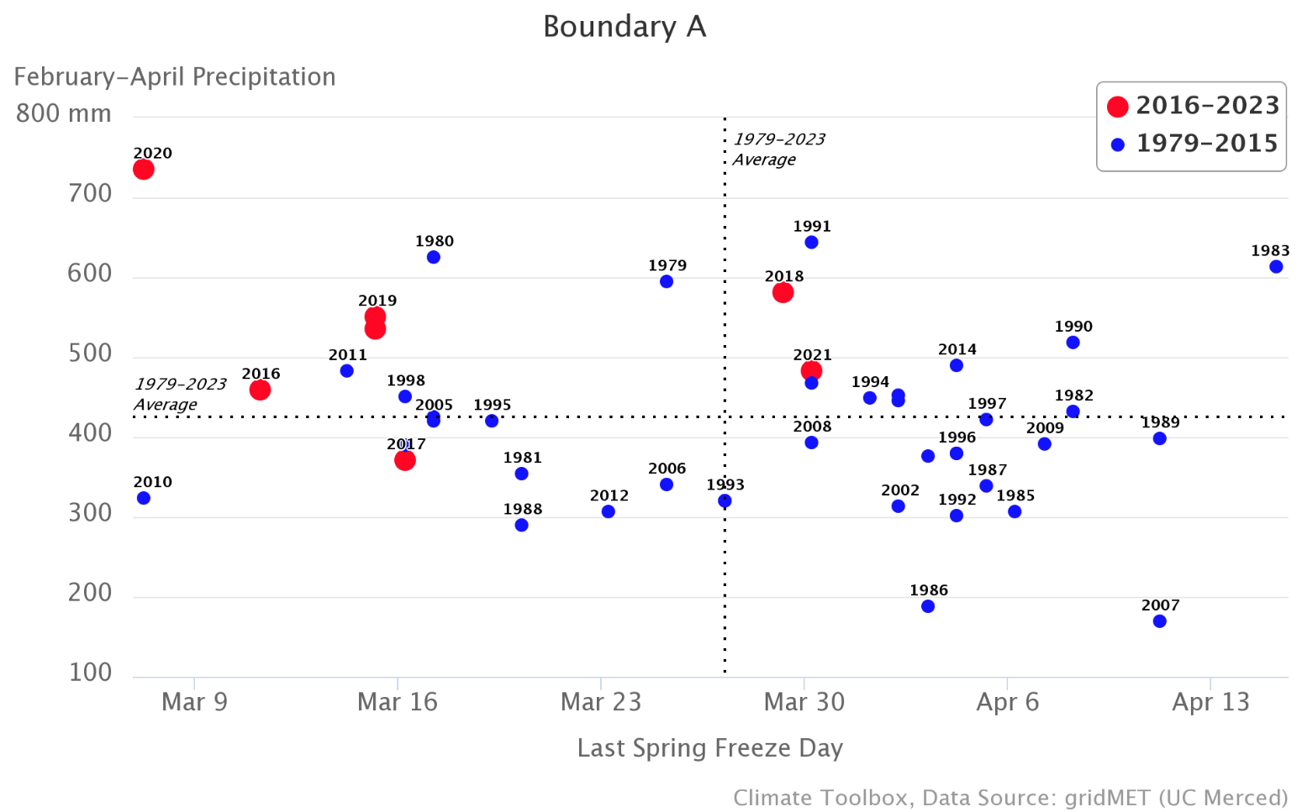
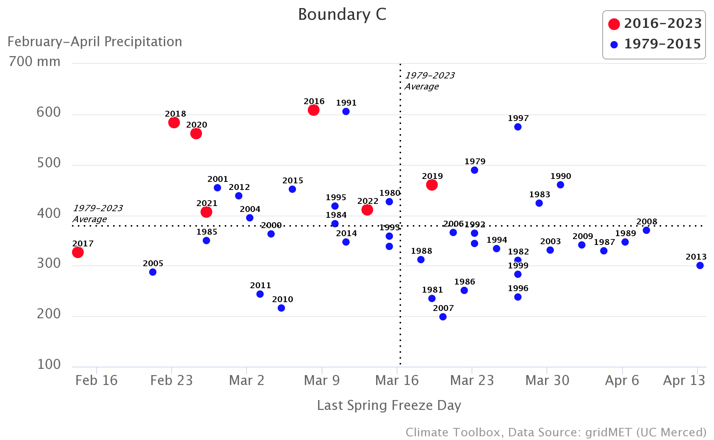
Scatterplots of recent years (2016-2023) with brown spot needle blight versus historical (1979-2015) based on the interactions between the total precipitation from February to April and the Last Spring Freeze Day for the three study areas A, B, and C.

Slide 13

The minimum temperature from February to April was also higher than the average in most years since 2016 in Boundary A and C, and in all years since 2016 for Boundary B.
Recent years (2016-2023) - above normal spring total precipitation and early last spring freeze days, perhaps indicating the recent trend of mild springs in Boundary A and C compared to Boundary B.

Slide 14
Conclusions
The extended period of flooding or water saturation in poorly drained sites across the region could affect soil nutrient movement, transpiration rate, stomatal functions, and other host physiological activities.
Inadequate tree response to precipitation and temperature anomalies may predispose stressed trees to subsequent infections by pathogens such as L. acicola.
A better understanding of interactions between abiotic and biotic factors associated with the recent surge in BSNB will be critically important in mitigating further loss of loblolly pine to BSNB in commercial plantations in the southeastern US.

