Slide 1

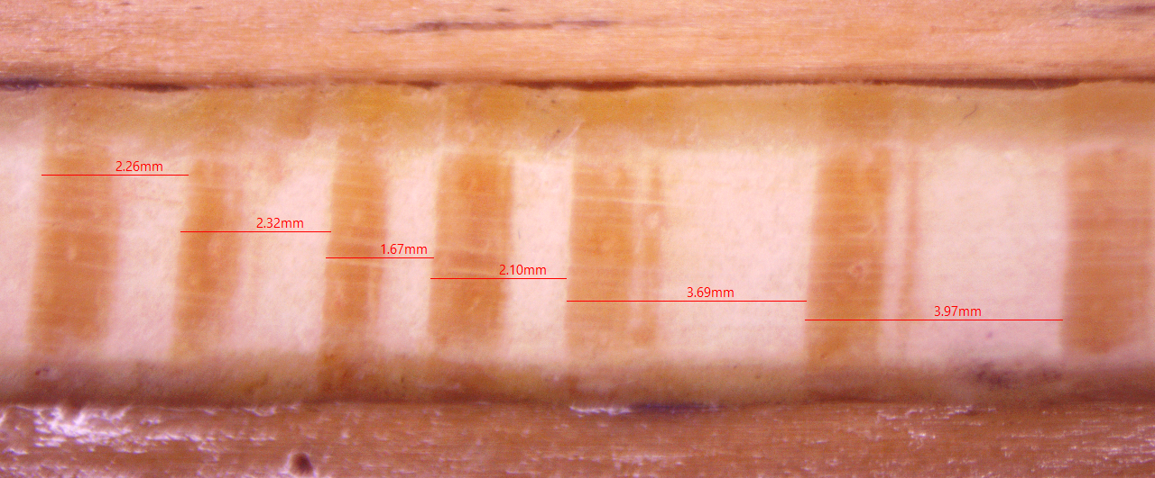
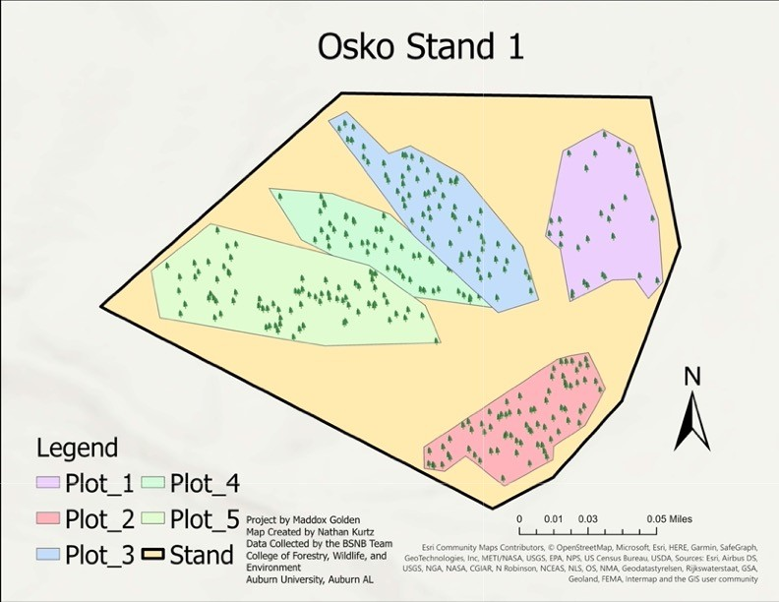
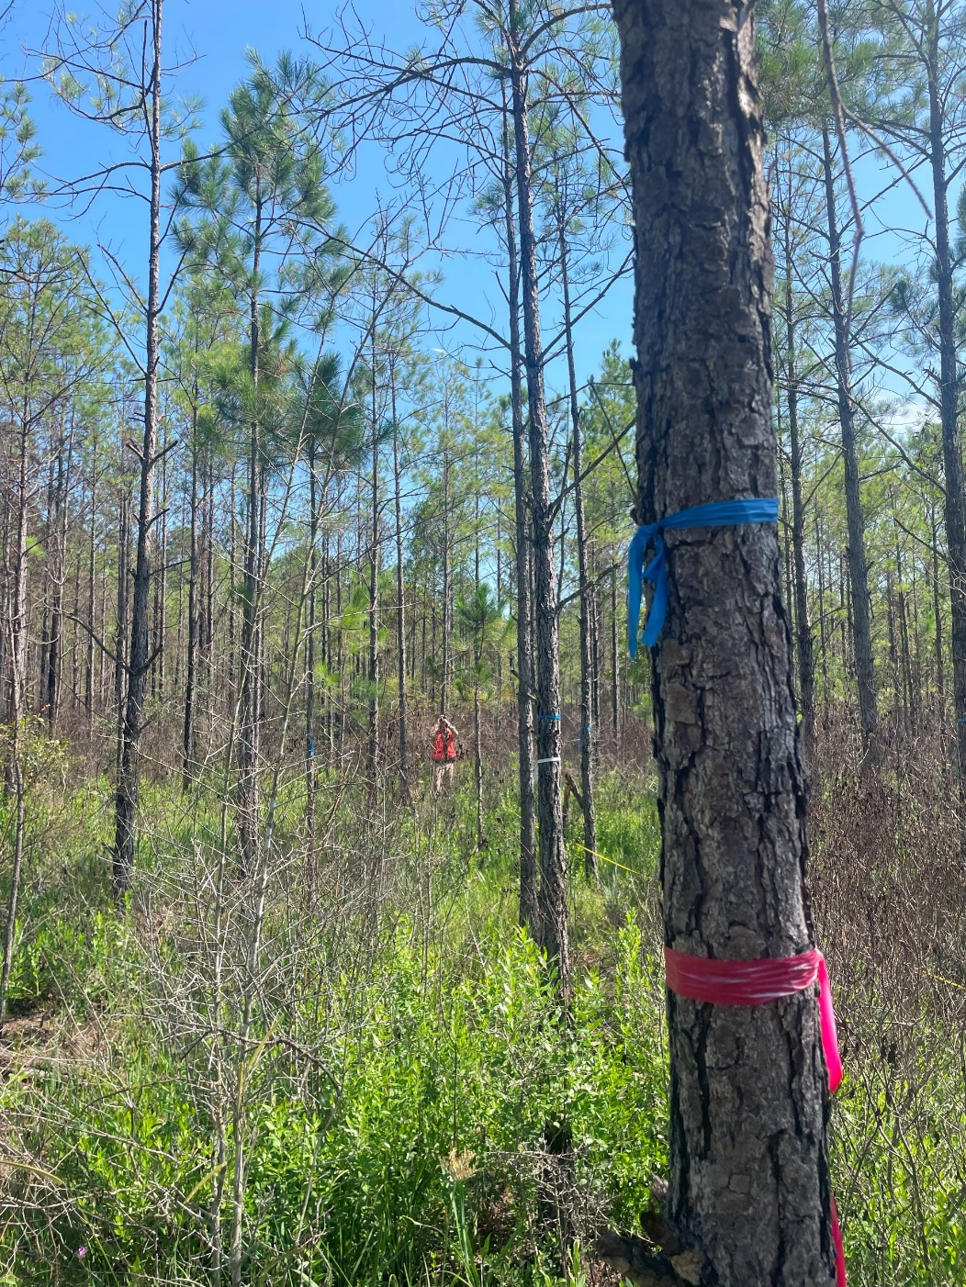
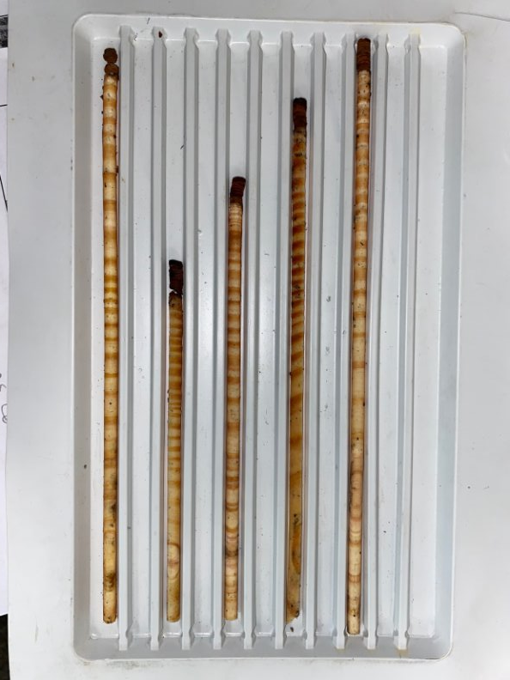
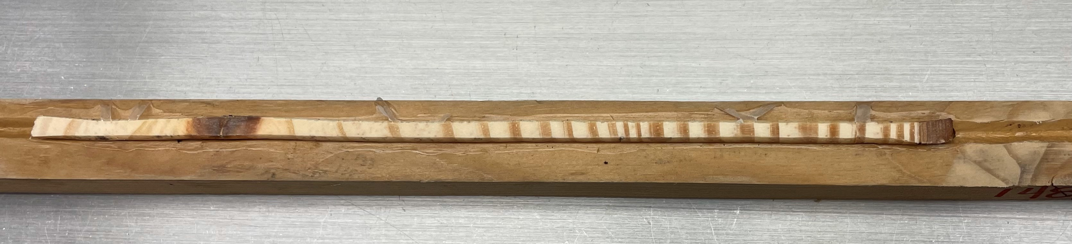
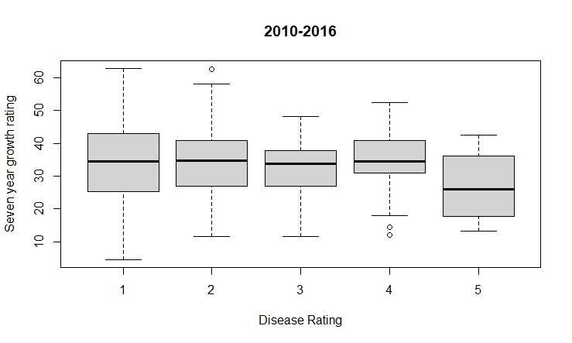
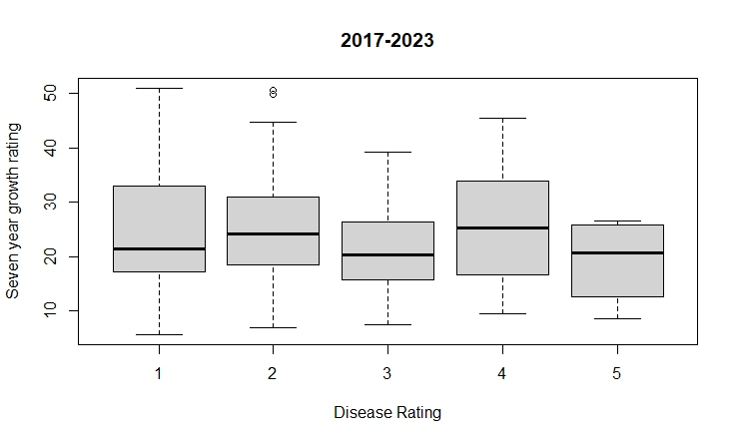
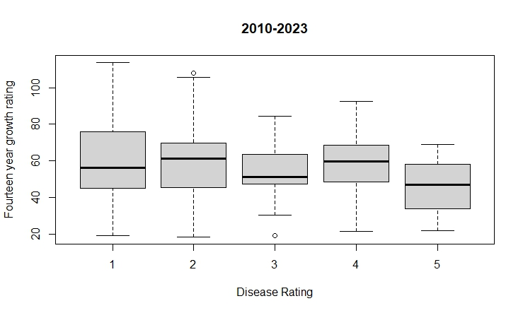

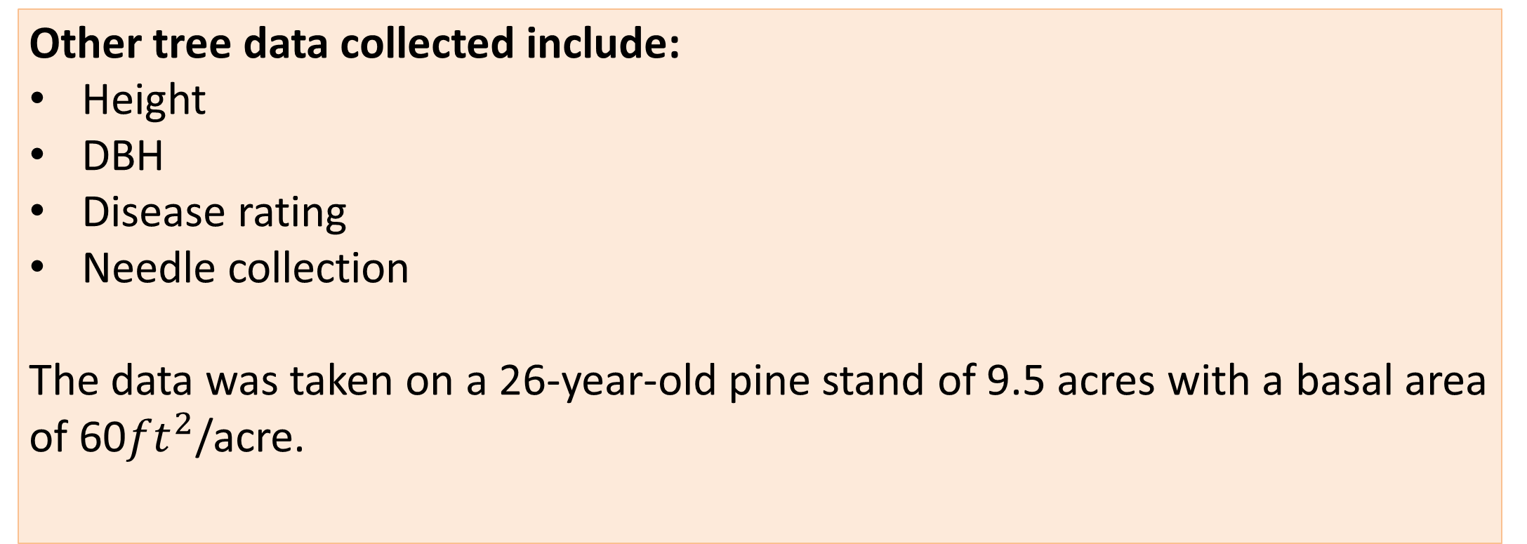
Using Dendrochronology to Assess the Effects of Brown Spot Needle Blight on Loblolly Pine Growth
Gracey Goldsby, Jaden King, Maddox Golden, Lori G. Eckhardt
Introduction
What is dendrochronology?
Dendrochronology is the scientific use of tree rings to determine the age of trees.
How is dendrochronology relevant to brown spot needle blight?
Tree rings can give insight into annual environmental conditions and severity of disturbances in the past, such as brown spot needle blight [1] (L. acicola).
A correlation between infection severity and growth of loblolly pine was investigated using tree cores. We predict that loblolly pine growth decreases as infection severity increases.
C
D
Methods
The annual growth rings of tree cores were measured using a digital microscope software.
Other tree data collected include:
Height
DBH
Disease rating
Needle collection
The data was taken on a 26-year-old pine stand of 9.5 acres with a basal area of 60${ft}^{2}$/acre.
A
F
A
E
Source: http://upload.wikimedia.org/wikipedia/commons/a/a5/Mycorrhizal_root_tips_(amanita).jpg
Figure 1. Tree core at 0.7x magnification through digital microscope software Amscope.
Data collection consists of:
333 cores from Osko Forest
7-year growth increments
14-year growth increment
Year to year ring measurements
Source: http://dnr.state.il.us/stewardship/cd/images/768x512/3970057.jpg
A
2010-2023
Figure 2. Osko Forest stand where cores were collected from.
Figure 3. Undergraduate research assistant taking the height of a tree.
Source: http://images.harc.edu/Sites/GalvBayInvasives/Species/Photos/IMCY_2307196.jpg
Before
Symptoms
2017
After
Symptoms
Discussion
A linear regression model was run on 139 cores.
We know that brown spot needle blight symptoms were first noticed in 2017.
Results indicate that there is no statistical significance in tree growth between the years 2010-2016 and 2017-2023. Although there is decline in tree growth, the results are not statistically significant for the past 14 years.
Thinning
A
Figure 5. 7-year and 14-year increments of tree core in which data was analyzed from.
Results
Figure 4. Tree cores of different ages
Source: Freefoto.com
C
Next Steps
We have completed core collection from Osko Forest, but data will continue to be taken from the remaining cores collected. This should give further insight into brown spot needle blight severity and its impact on the growth of loblolly pine.
n=139
n=139
n=139
References
[1] Clark, Stacy L., et al. “Dendrochronology of two butternut (Juglans cinerea) populations in the southeastern United States.” Forest Ecology and Management, vol. 255, no. 5–6, 2008, pp. 1772–1780, https://doi.org/10.1016/j.foreco.2007.11.040.
Acknowledgments
Forest Health Dynamics Laboratory
Forest Health Cooperative
Dr. Glover and Dr. Fan
Figure 6. Relationship between disease rating and annual growth rings from 2010 to before symptoms were noticed in 2016.
Figure 7. Relationship between disease rating and annual growth rings after symptoms were noticed from 2017 to 2023.
Figure 8. Relationship between disease rating and annual growth rings from the past 14 years.

