Slide 1


Environmental triggers and seasonal changes in the mycobiome on symptomatic and asymptomatic loblolly pine needles
USFS Component - Mitigating needle blight: A growing economic threat to pine forests
Rabiu Olatinwo
Research Plant Pathologist,
Insects, Diseases, and Invasive Plants RWU
Southern Research Station,
USDA Forest Service,
Pineville LA
Brown Spot Needle Blight Assessment Workshop
August 13-14, 2024
Holiday Inn Express & Suites, Cullman, AL

Slide 2
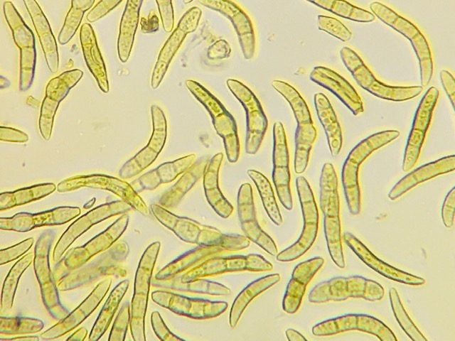
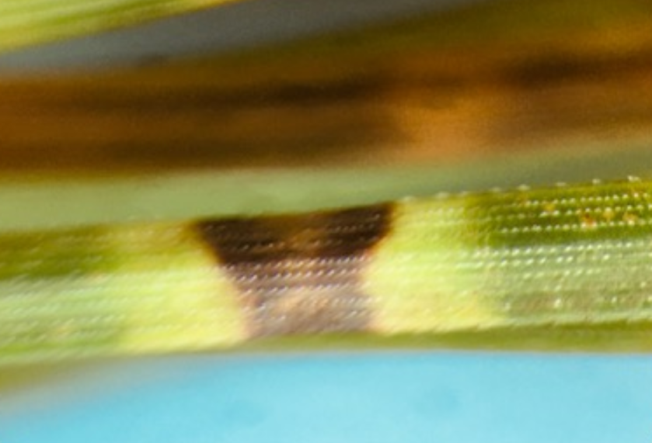
Brown spot needle blight, caused by a fungal pathogen (Lecanosticta acicola), which typically affects longleaf pine at the early stage of development, has been associated with significant damage and mortality on loblolly pine in the past few years.
Concerns about new emerging threat to loblolly pine stands in commercial plantations have increased, especially in parts of the region where, the viable pathogen is available all year.
Lecanosticta acicola
Infected pine needle with symptom

Slide 3
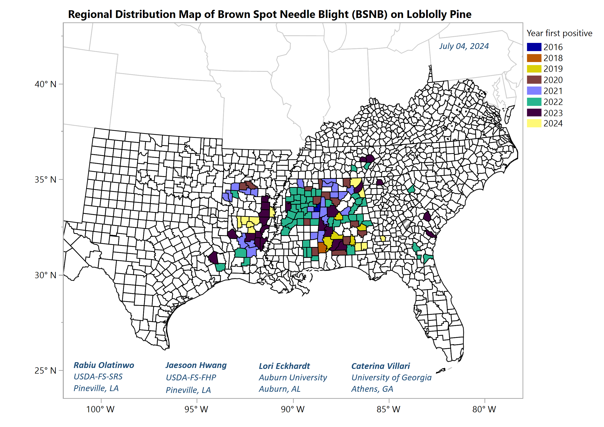
BSNB on loblolly pines has been confirmed in 116 counties from nine states (AL, AR, FL, GA, LA, MS, SC, TN, and TX)
Most severe cases were reported from AL, AR, LA, and MS with landscape scale damages on mature trees and/or localized damages on younger trees in commercial stands.
Mortality and growth loss have been observed from the younger trees after repeated infections over multiple growing seasons.

Slide 5


NPRN – Research Projects
Mitigating Needle Blight: A Growing Economic Threat to
Pine Forests
Auburn University, AL
Lead PI – Dr. Lori Eckhardt
Characterize biotic and abiotic factors driving emergence in brown spot needle blight on Loblolly pine in the southeastern USA
Colorado State University, CO
Lead PI – Dr. Jane Stewart

Slide 6
Long-term study plots at 6 sites in Central Louisiana in 2023
Plot evaluations and tree health assessments conducted in Oct. 2023 and July 2024
Loblolly pine samples were collected for mycobiomes analysis at CSU and isolates identification in USFS Pineville LA
Plant and soil nutrients analyses in Pineville LA

Slide 7
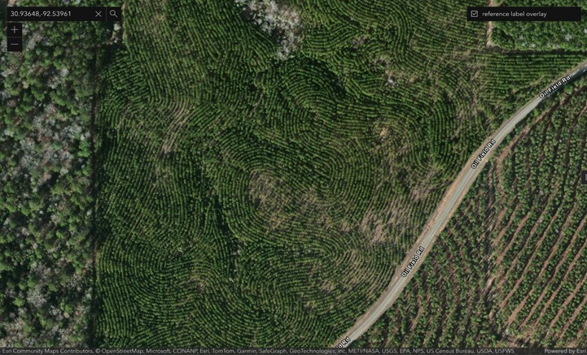
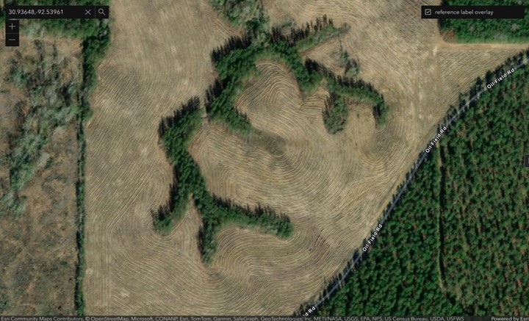
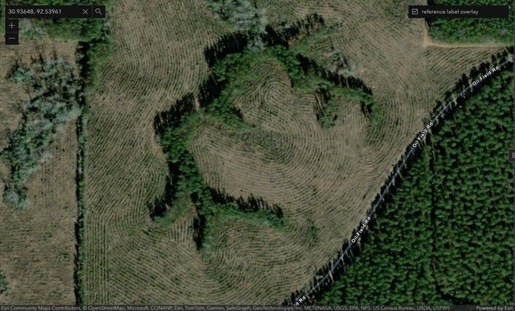
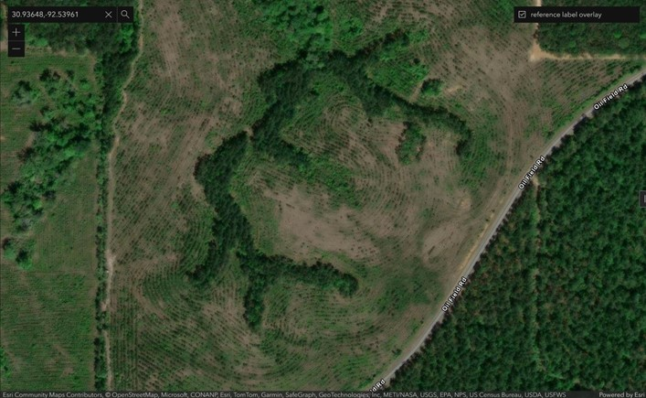
Site specific factors: Site #3
Mar 02, 2010
Dec 11, 2017
Dec 23, 2020
Apr 27, 2023

Slide 8
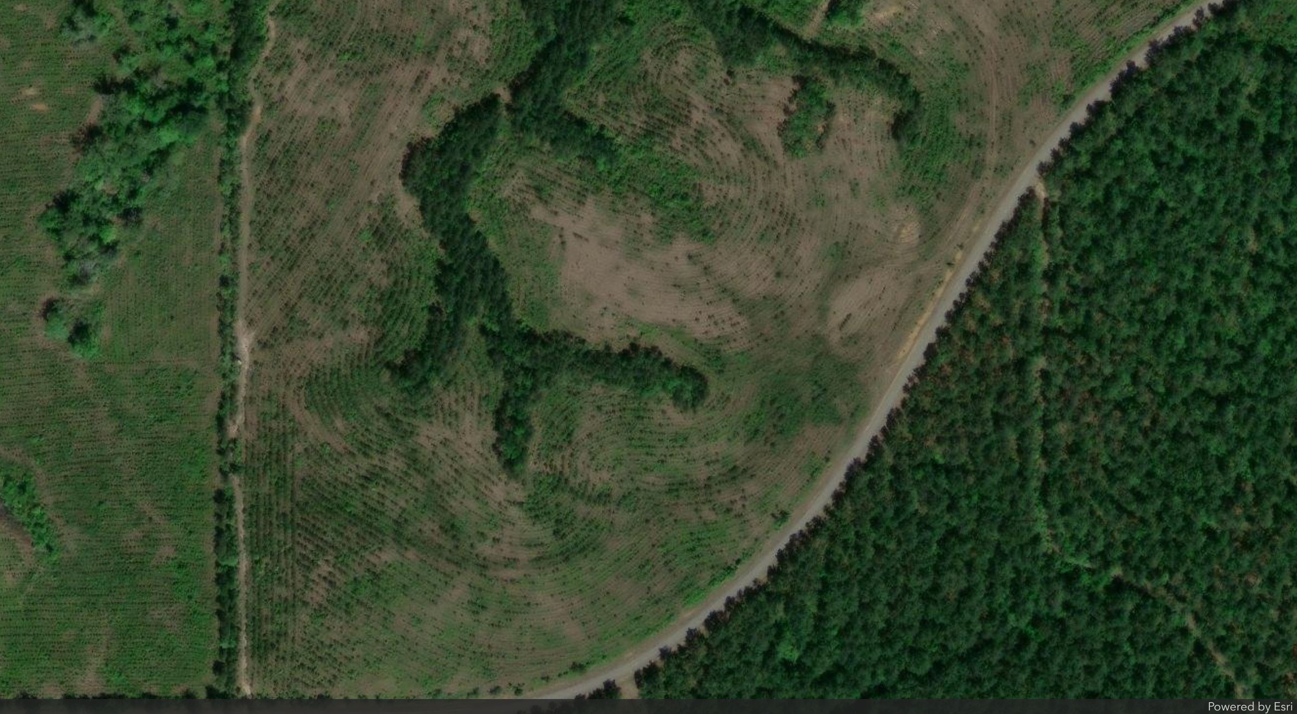
Site #3
Planted 2018
Arial view on Apr 27, 2023

Slide 9
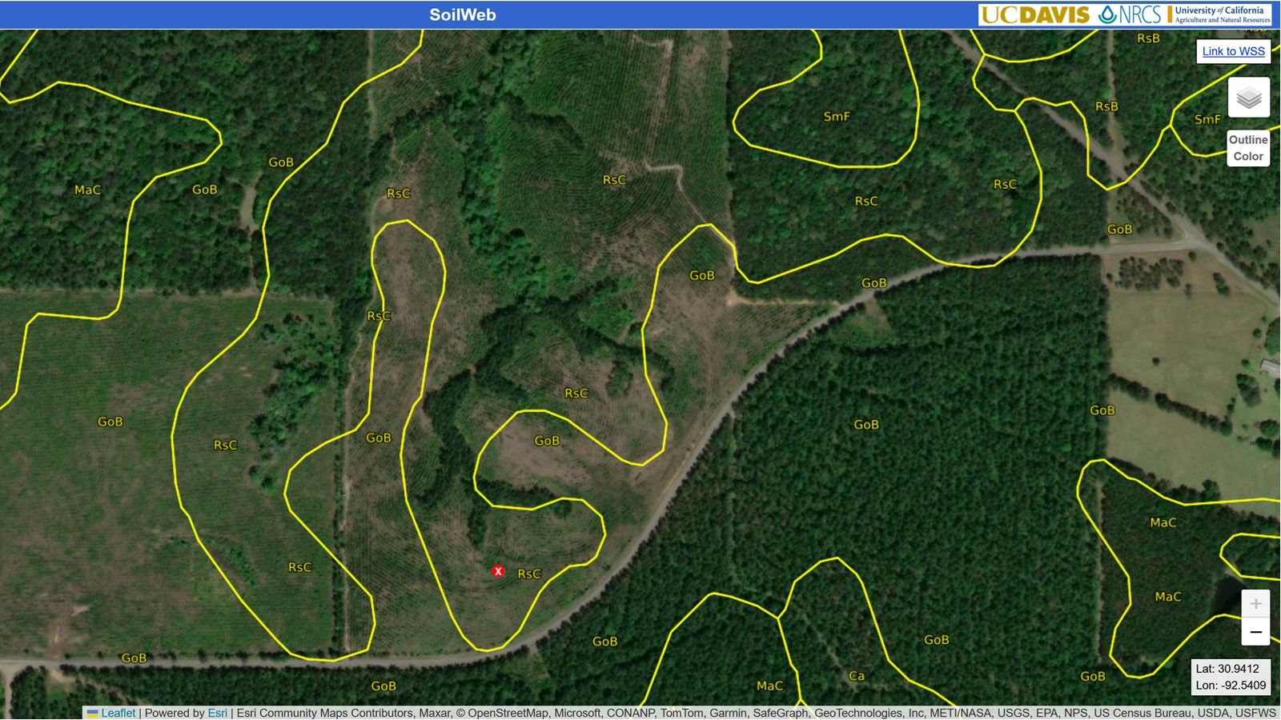
Site specific factors – RsC & GoB

Slide 10
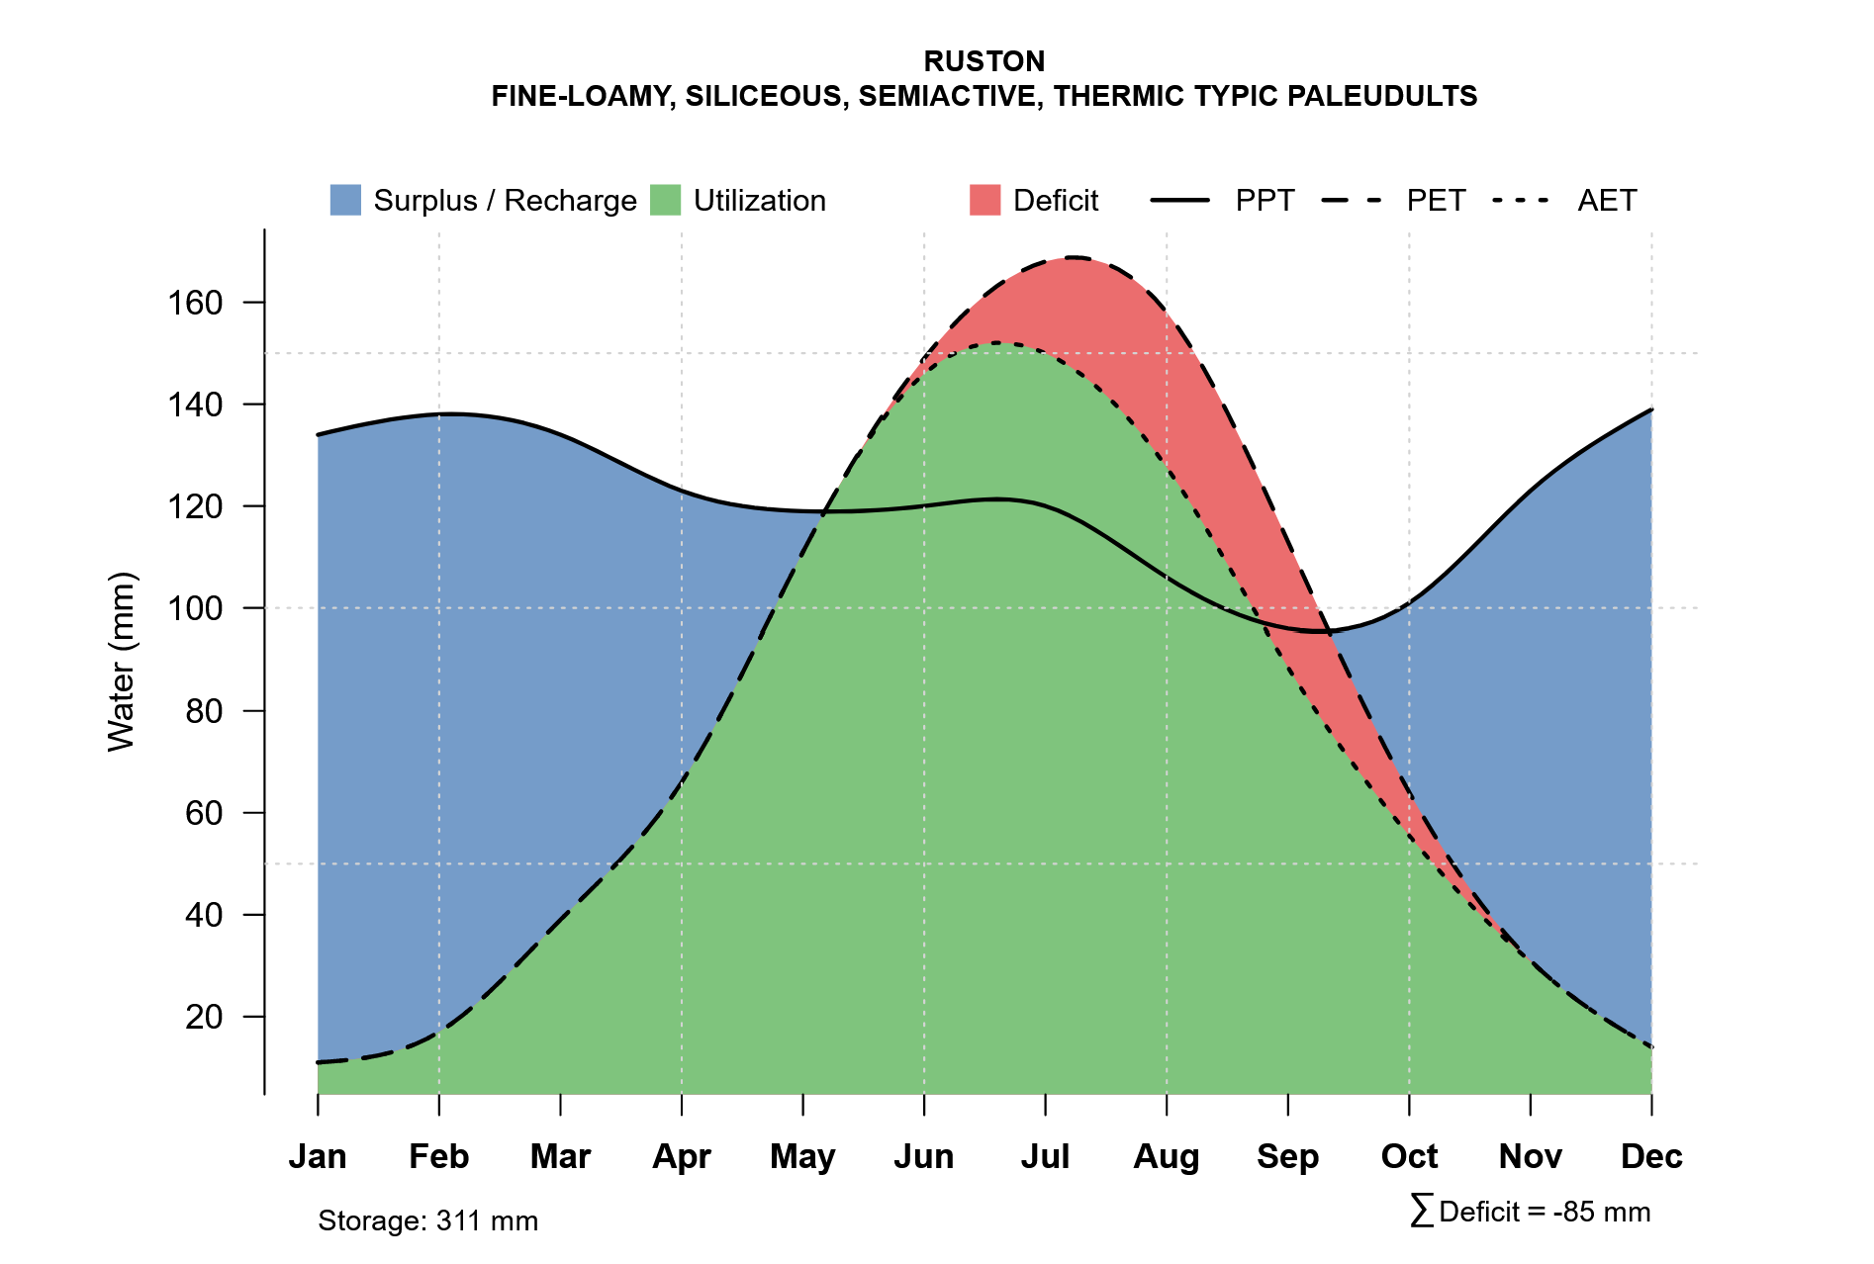
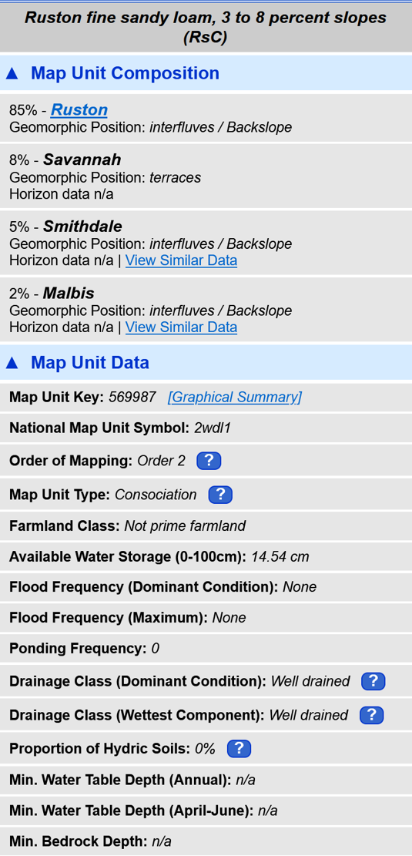
Soil variability

Slide 11
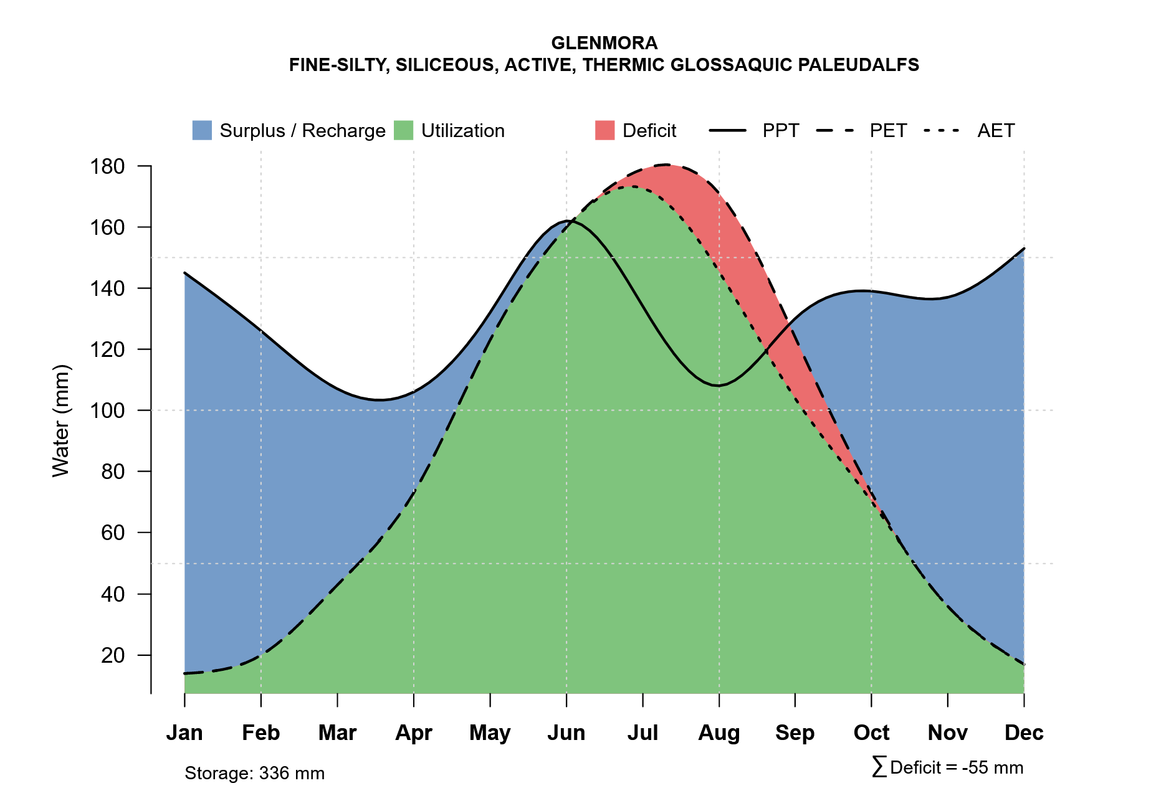
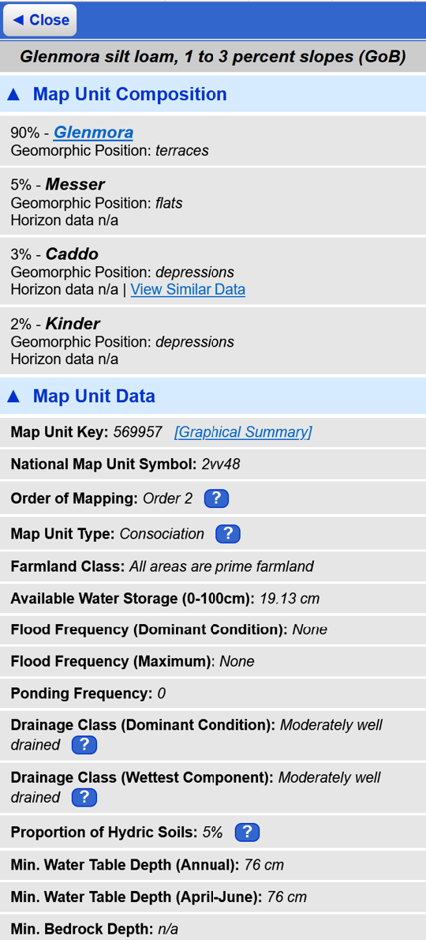
Soil variability

Slide 12
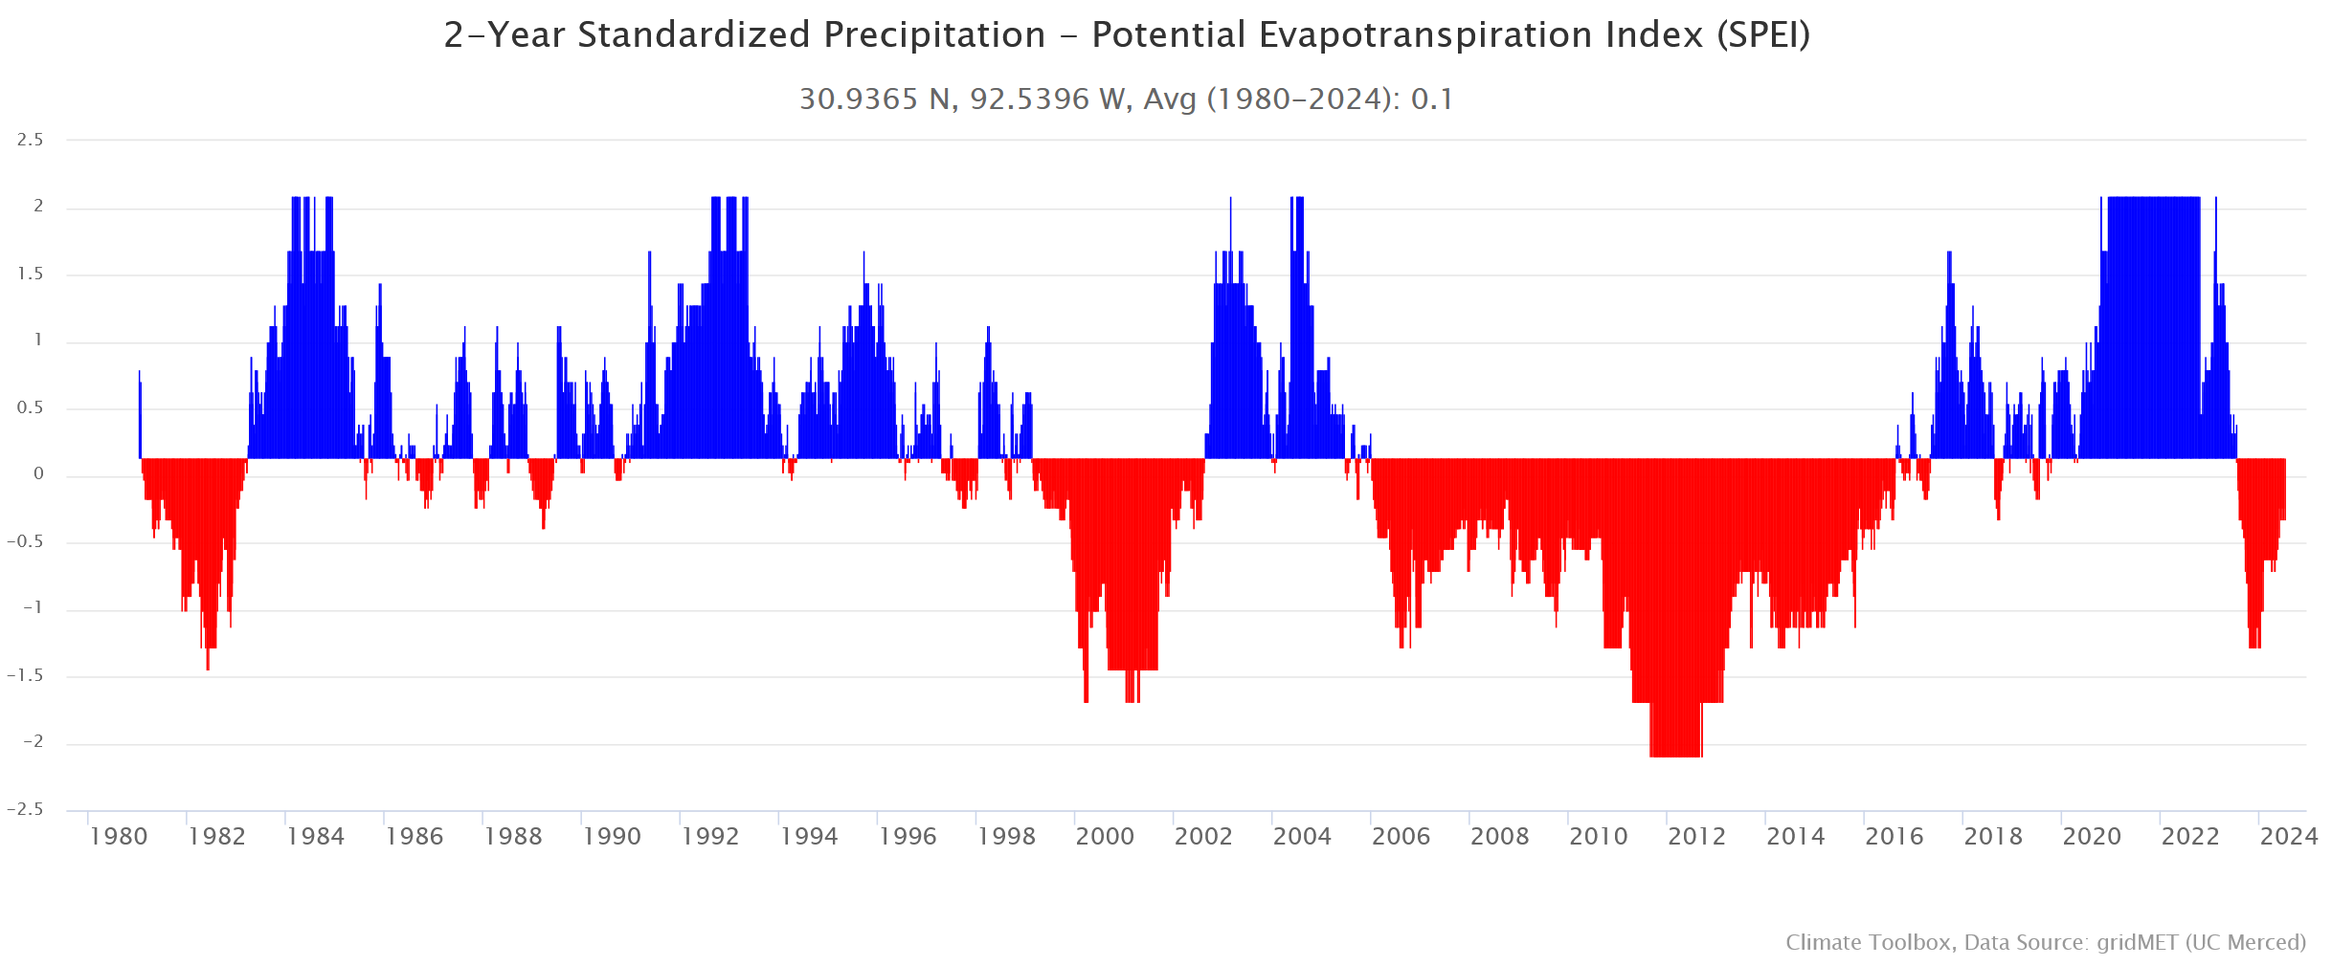
Climate variability

Slide 13
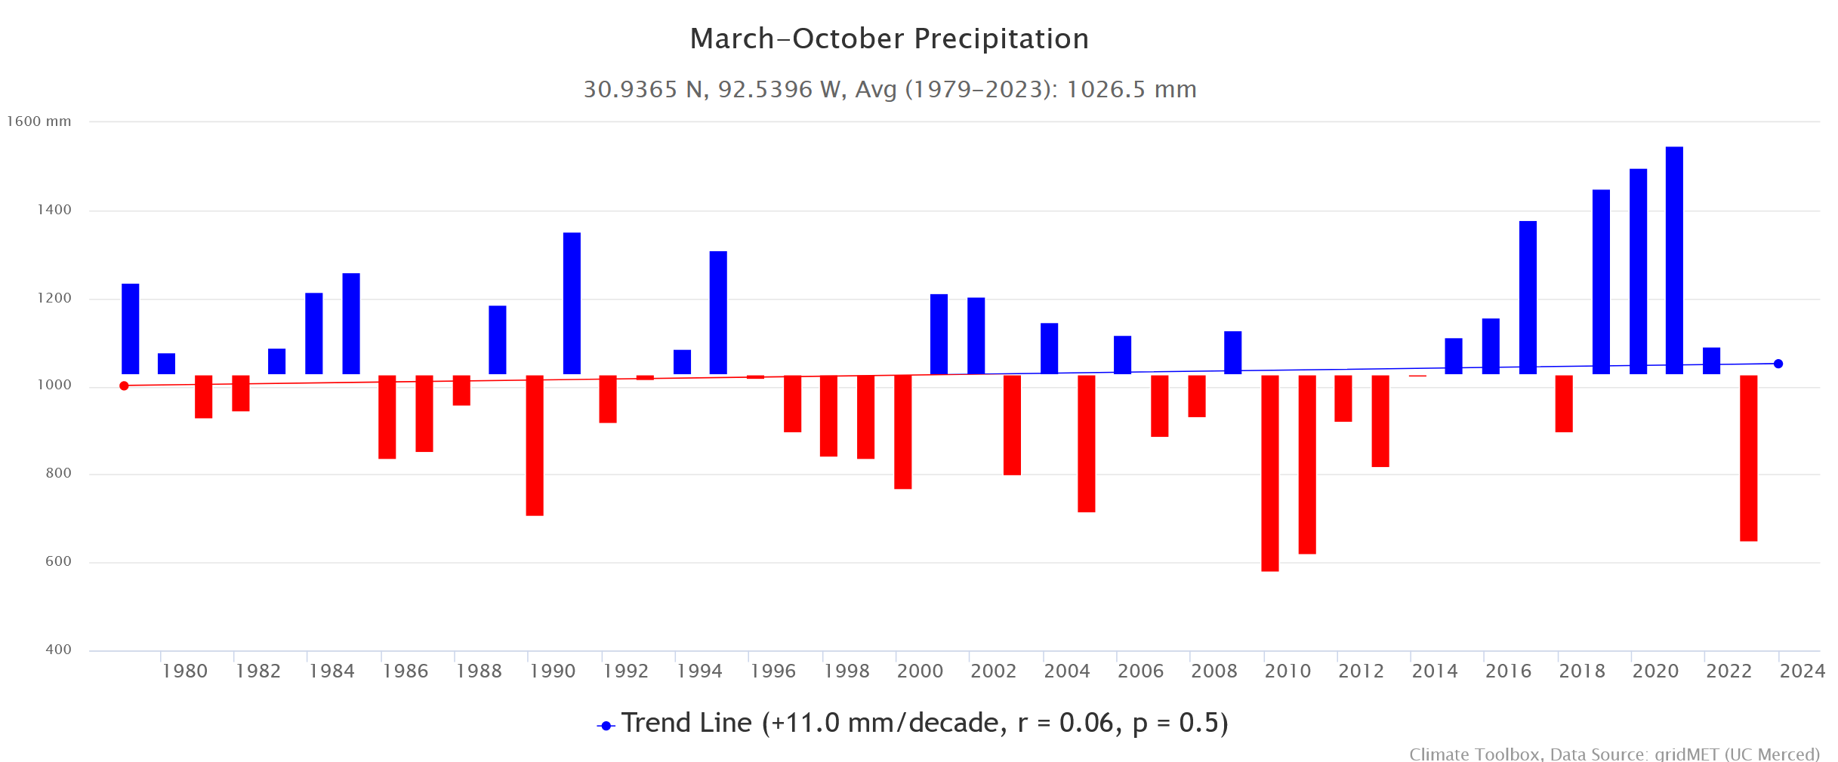
2020
2017
2010
2023
Climate variability

Slide 14
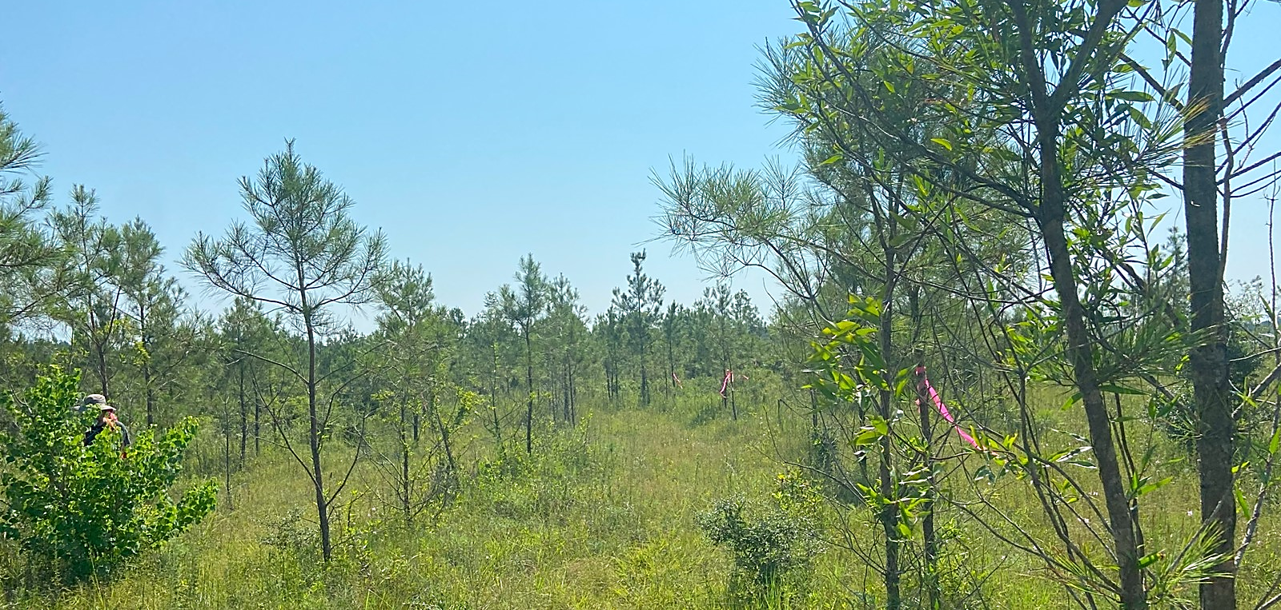
Variability in growth

Slide 15
Key observations (US Forest Service – FHP/SRS)
Severe infestation at industry plantations in LA. Worst cases often reported in younger age-classes (3 to 10-year-old) but is observed in older trees.
Often at its worst on poorly drained sites; clay, silty loam, fine sandy loam, sites with shallow A horizon.
Poor growing conditions (compacted, waterlogged soils) worsen situation for susceptible trees.

Slide 16
Nutrition - Preliminary results
Plant tissue and soil samples were collected twice, in October 2023 and July 2024 for nutrition analyses at six sites.
Overall, soil pH is very low across all the sites and iron concentrations are high.
Foliar nutrition is deficient to low in general, except zinc and iron, which are borderline low
Manganese is excessively high. Waterlogging -> manganese toxicity -> need breeding for tolerance to waterlogging.

Slide 17
Summary
Soil nutrients deficiency or toxicity may play role; unknown to what extent as this point.
Role of pine genetics? Only anecdotal evidence in loblolly thus far. Investigation is ongoing (NPRN project).
What impact does site*weather*cultural*genetics in combination play? (Focus of the NPRN projects).

Slide 18
Acknowledgements
USDA Forest Service-FHP /SRS
Jaesoon Hwang, Plant Pathologist, Pineville, LA
Wood Johnson, Entomologist, Pineville, LA
Kristi Wharton, Biological Science Technician
Bruce William, Biological Science Technician
Dr. Jane Stewart, Associate Professor
Dr. Olga Kozhar, ORISE Postdoctoral Associate

