Slide 1


Brown spot needle blight on loblolly pine across the southeast
A regionwide effort in understanding and addressing the threat needle pathogens southern pines.
Rabiu Olatinwo
Research Plant Pathologist,
Insects, Diseases, and Invasive Plants RWU
Southern Research Station,
USDA Forest Service,
Pineville LA
Brown Spot Needle Blight Assessment Workshop
August 13-14, 2024
Holiday Inn Express & Suites, Cullman, AL

Slide 2
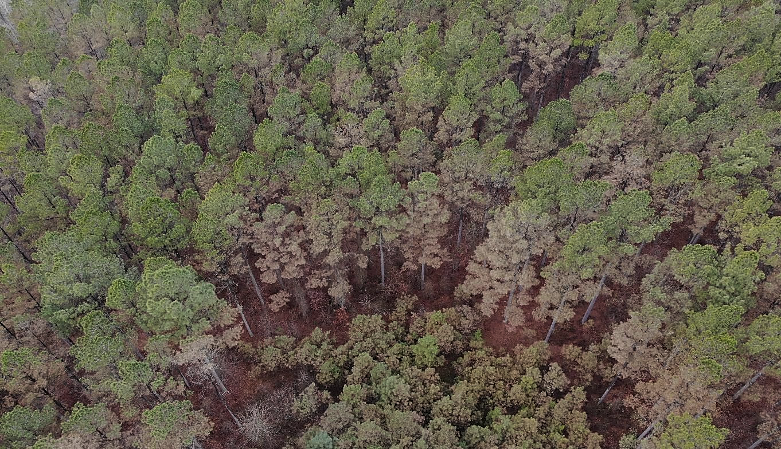
Mature loblolly pine
Pine stand affected by Brown Spot Needle Blight in Arkansas
Photo: Chandler Barton
AR Forestry Division

Slide 3
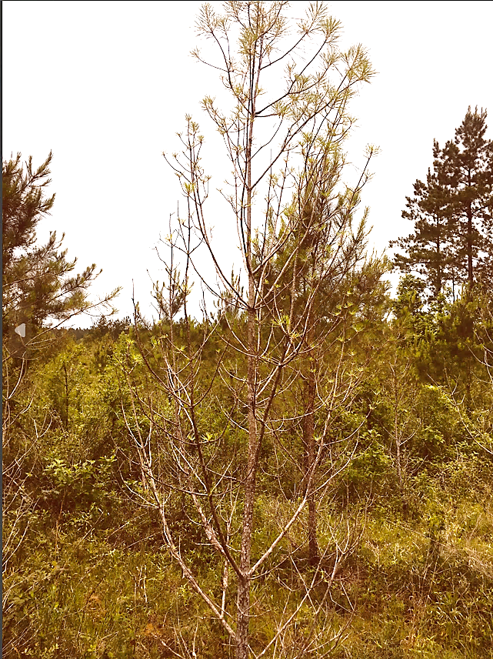
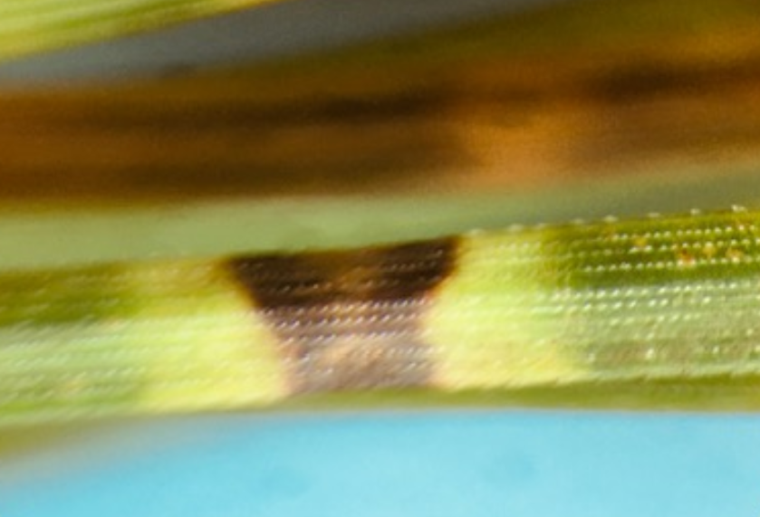
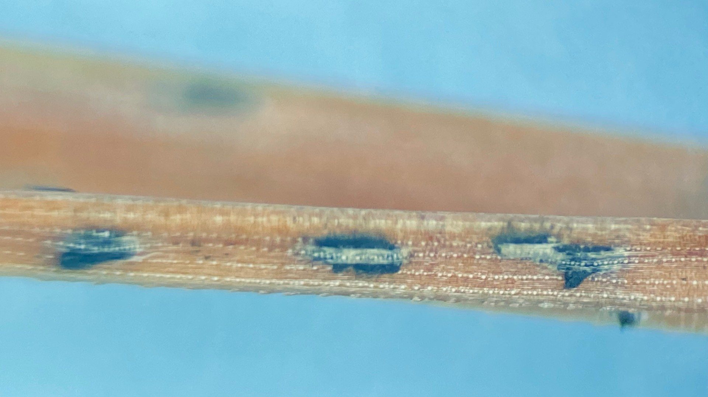
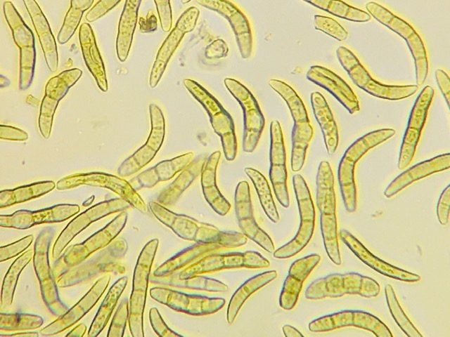
Infected pine needle with BSNB symptom
Lecanosticta acicola fruiting bodies on pine needles
Lecanosticta acicola spores (BSNB pathogen)

Slide 4
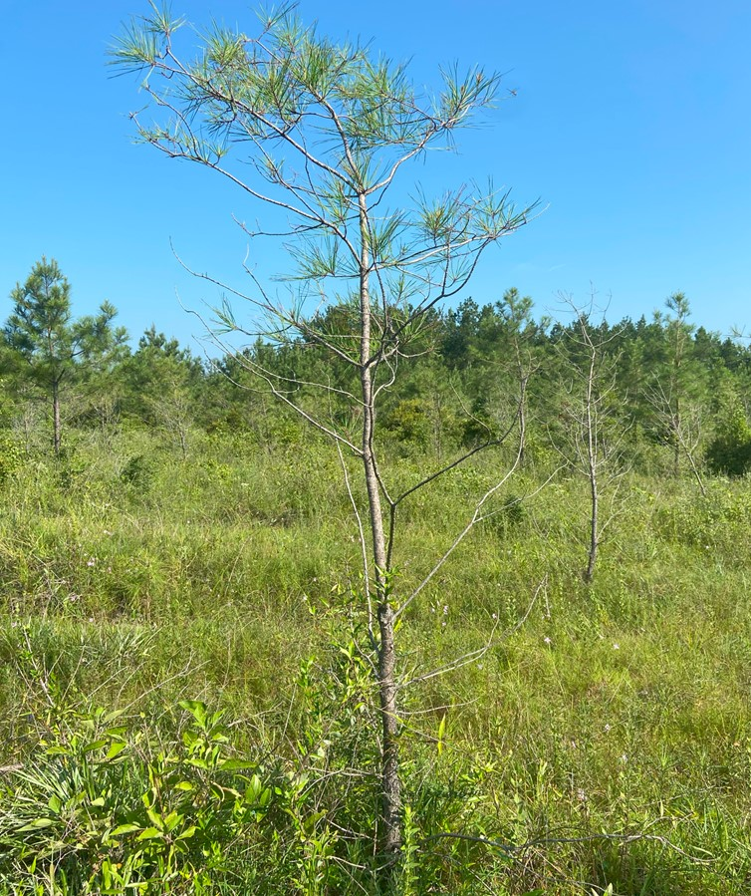
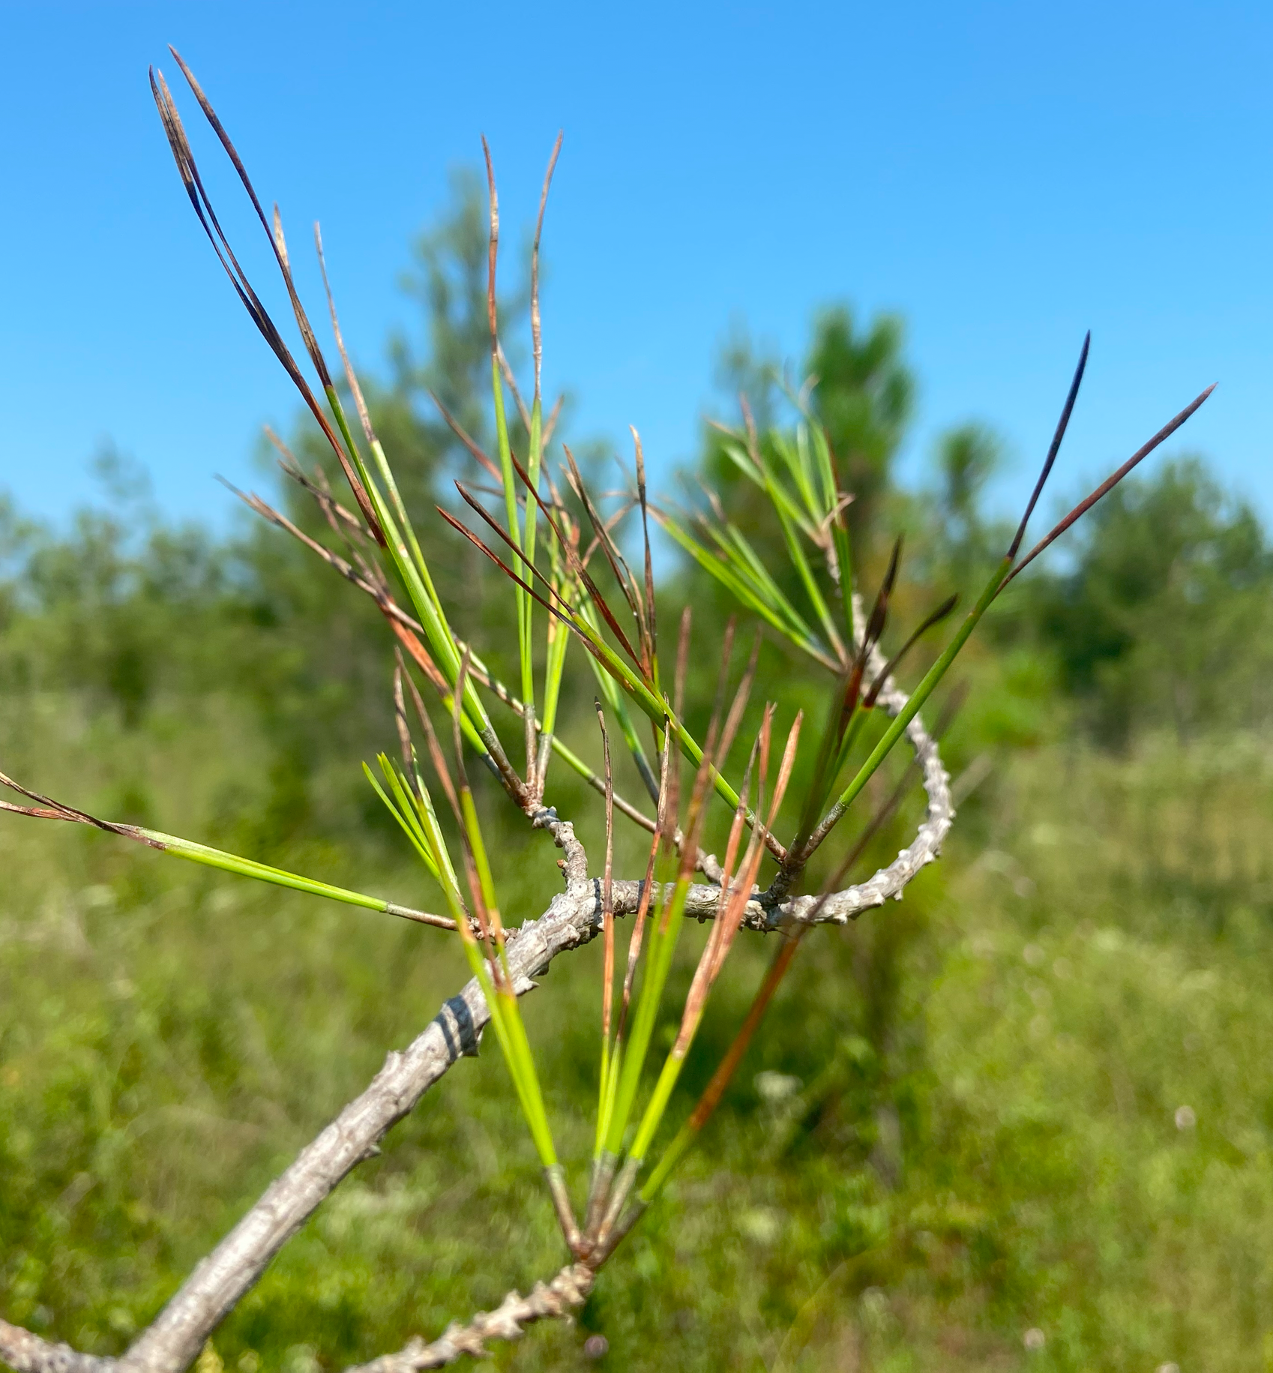
Young loblolly pine
Pine trees affected by Brown Spot Needle Blight at a study site in Louisiana

Slide 5
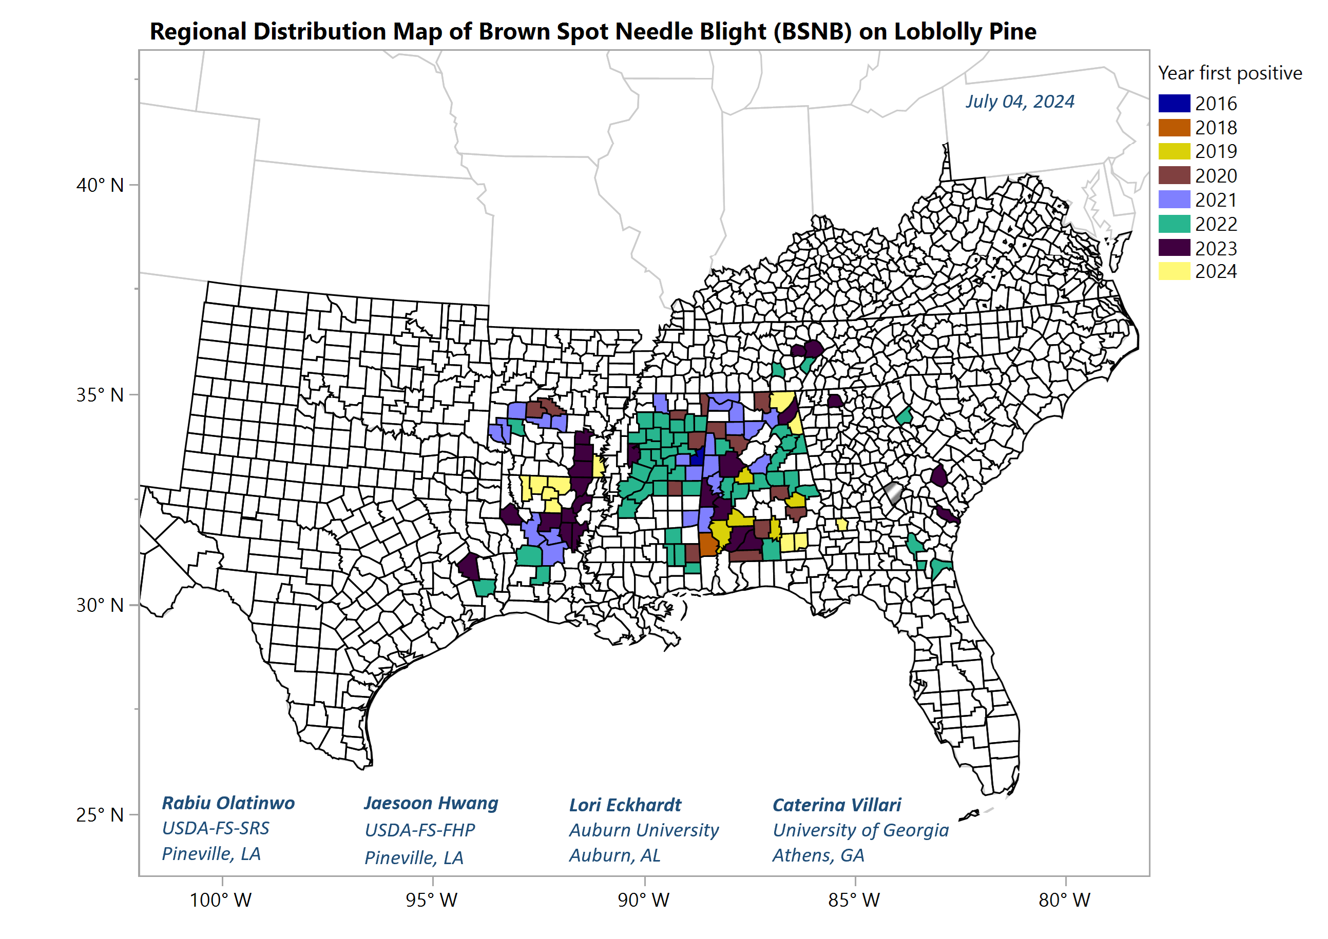
BSNB caused by Lecanosticta acicola has been confirmed in 116 counties from nine states (AL, AR, FL, GA, LA, MS, SC, TN, and TX)
Most severe reported from AL, AR, LA, and MS
Landscape scale damages on mature trees and/or localized damages on younger trees in commercial stands.
Mortality and growth loss in younger trees after repeated infections over multiple growing seasons.

Slide 7
SRS – Pine Needle Pathogens Research Network (NPRN)
USDA FS-SRS
Auburn University
Mississippi State University
University of Florida
University of Georgia
P4/Jone Center/UGA
Colorado State University
Louisiana Tech University
USDA-FS-SRS/FHP collaborating with partners across the region focusing on
Developing rapid detection methods
Identify site specific factors
Understand the role of climatic effect
Develop pine host resistance screening
Investigate pathogen population genetics
Silviculture/ management options

Slide 8
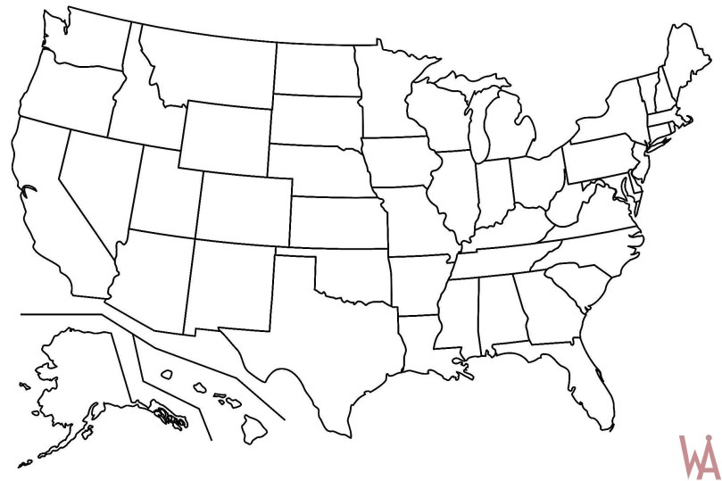
Pine Needle Pathogens Research Network Partners (NPRN)
University Partners
States Partners & FHP
AL – Dr. Lori Eckhardt (AU)
GA – Dr. Caterina Villari (UGA)
MS – Dr. John J. Riggins (MSU)
FL – Dr. Tim Martin (UF)
LA – Dr. Laura Simms (LTU)
GA – P4/Jones Center/UGA*
CO – Dr. Jane Stewart (CSU)
AR - Chandler Barton
MS - Garron Hicks
LA - Tyler Cloud
AL – Austin Reese
LA - Jaesoon Hwang (FHP)
LA - Wood Johnson (FHP)
NC - Ryan Blaedow (FHP)
NC - Kathleen Mckeever (FHP)
* Drs. Kamal Gandhi, Kier Klepzig and Bronson Bullock

Slide 9
NRPN objectives
Develop timely detection capacity across the region,
Assess the impacts on commercial pine plantations based on site information, diversity of needle pathogens, host genetics,
Assessment of the economic impacts, and
Establish regionwide study plots to enable long-term evaluation of changing climate and impacts on pine hosts.

Slide 10
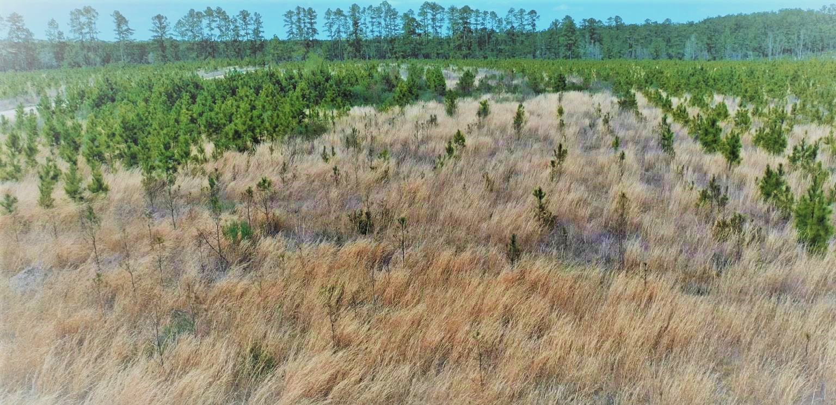
Genetic variability
Photo: Jaesoon Hwang
FHP, Pineville, LA

Slide 11
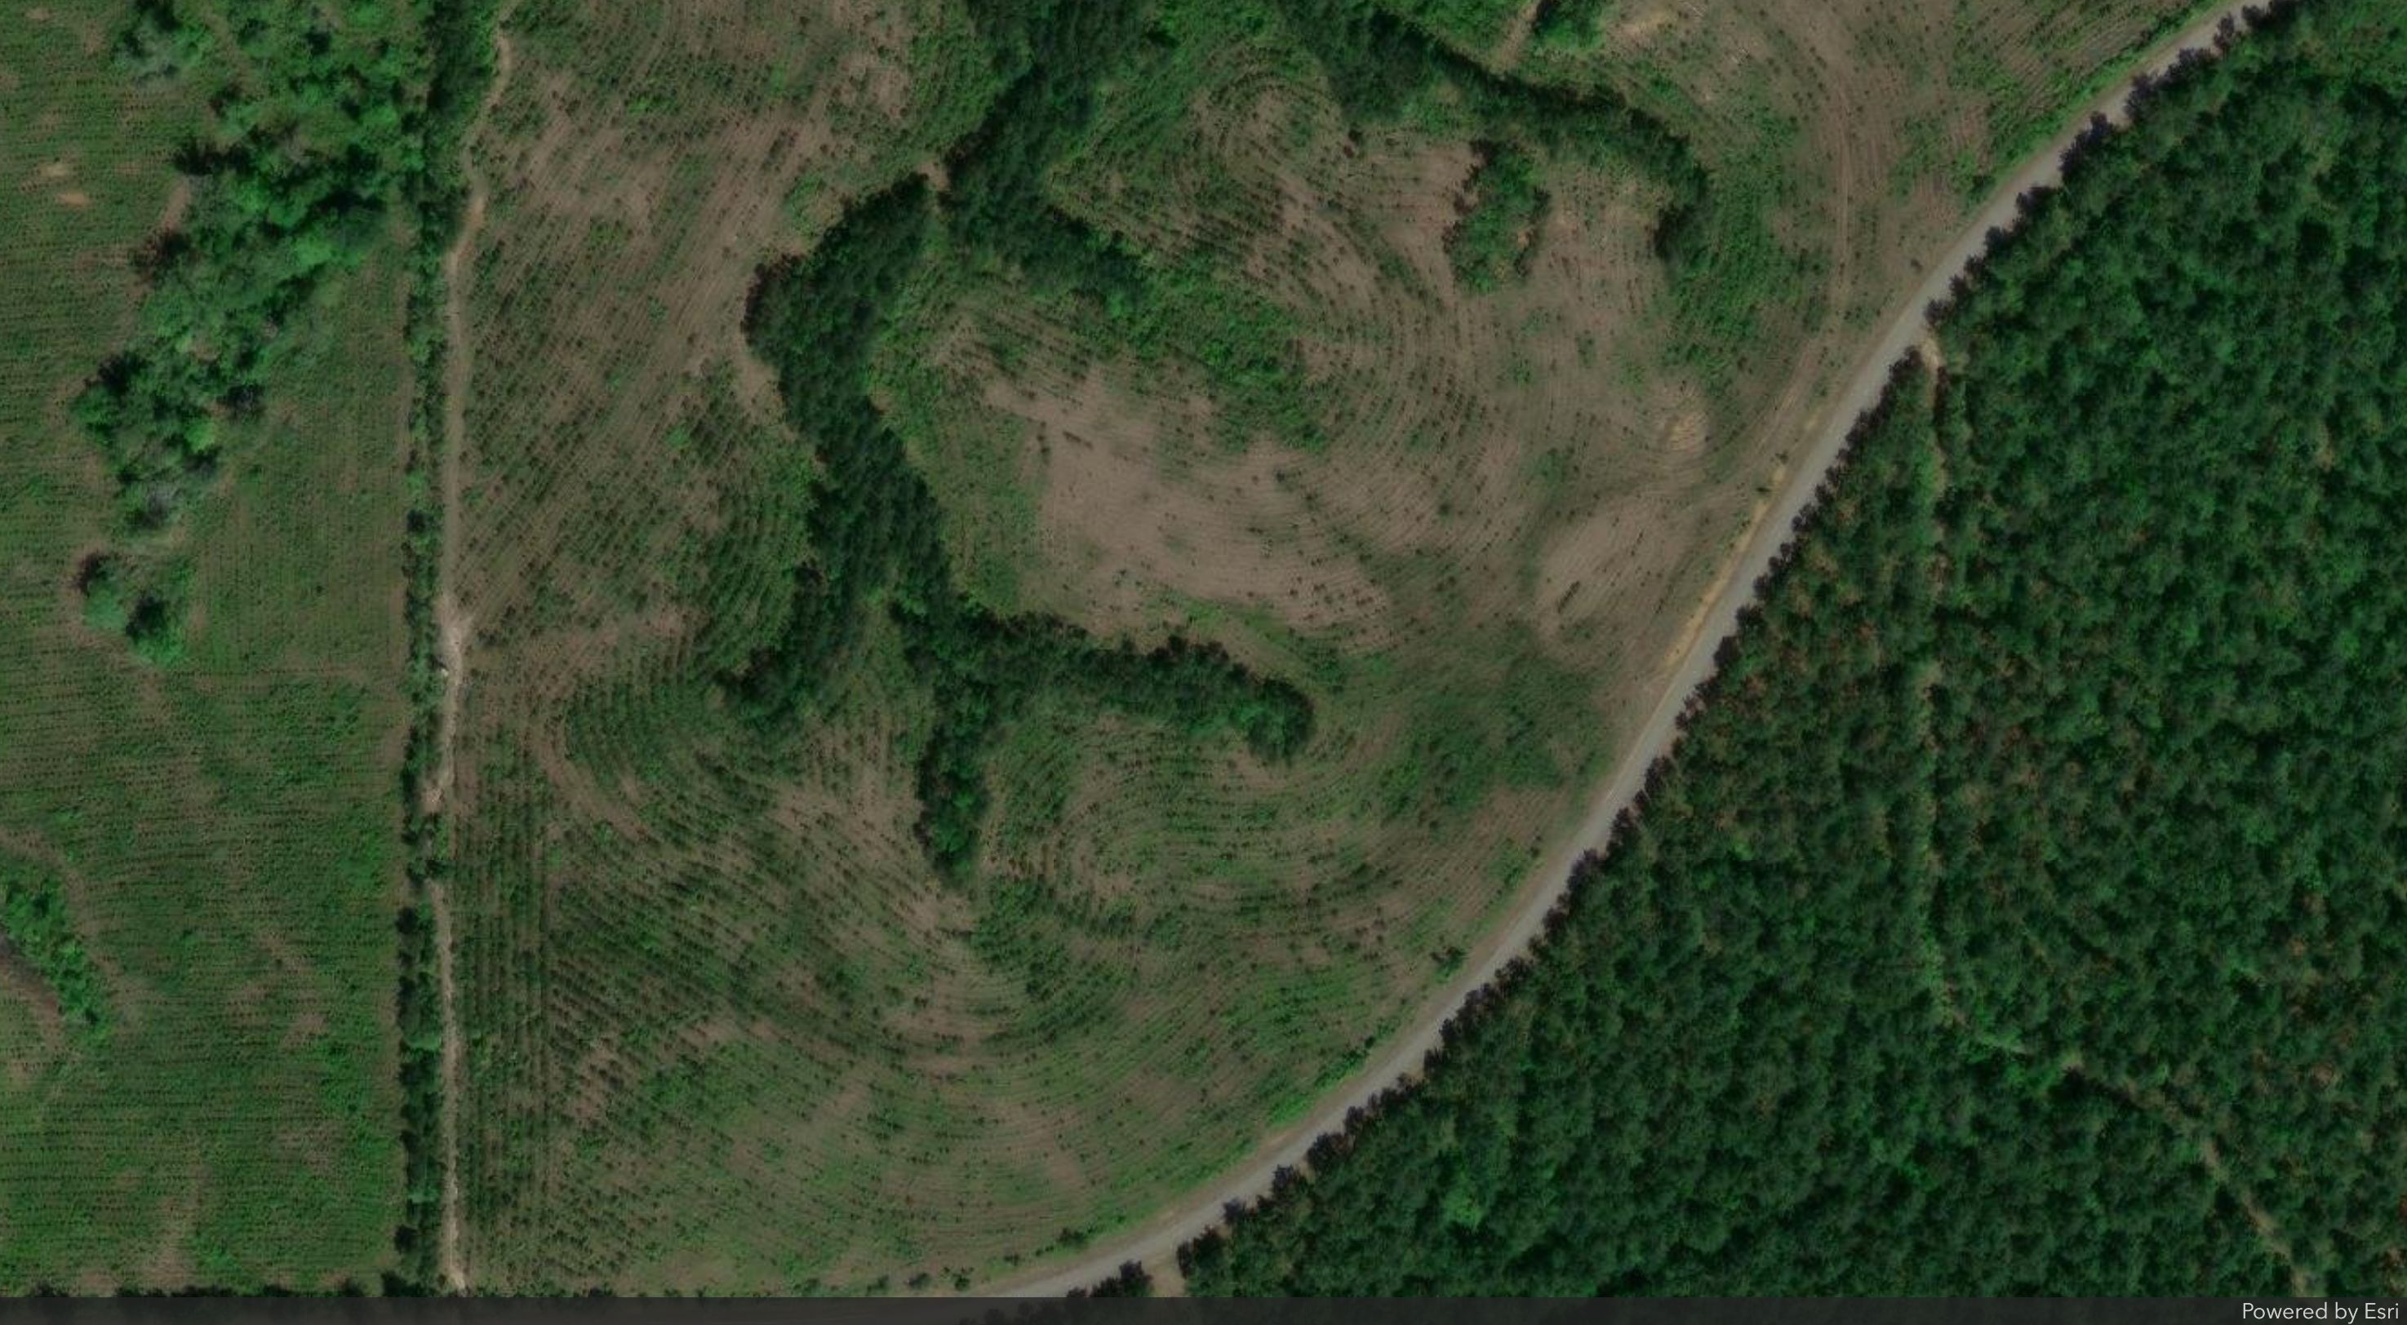
Site #3
Planted 2018
Arial view on Apr 27, 2023

Slide 12
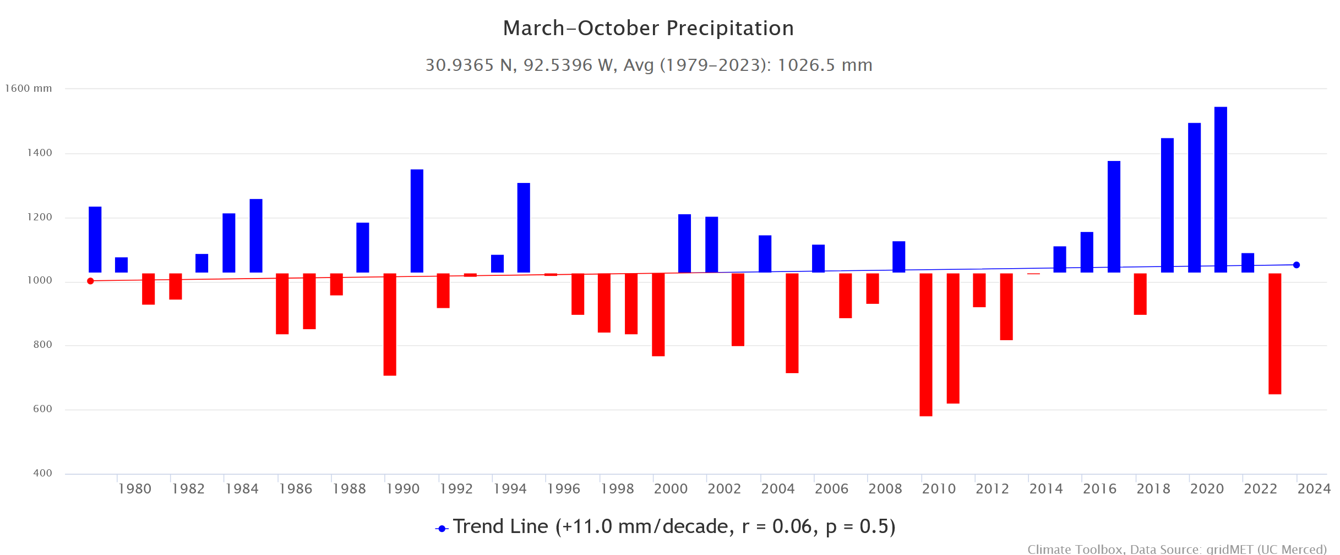
Climatic variability

Slide 13
NPRN – Ongoing projects
For the needle diseases on loblolly pines, U.S. Forest Service is involved in multiple projects on a region-wide scale, either by providing research funds, or by conducting actual research in collaboration with university and industry partners.
Research projects include population studies of the BSNB pathogen, utilization of remote sensing to identify affected areas, long term monitoring of infested stands, the effects of fertilization on disease severity, identification of pine families resistant to BSNB, and silvicultural options for BSNB management.
Industry involved by providing study plots, donating seedlings, and sharing information of which loblolly pine families are performing better (or worse) in their plantations. Most of these studies are just over 1 year old – may take a while to see results.

Slide 14
Disease severity and growth loss
Severity rating scale
  0 – healthy,
  1 – <30%
  2 – 30-60%
  3 – >60%
  4 – dead

Slide 15







NPRN – Ongoing Research Projects
Mitigating Needle Blight: A Growing Economic Threat to
Pine Forests
Auburn University, AL
Lead PI – Dr. Lori Eckhardt
Advancing the understanding, detection, and host resistance selection of fungi associated with loblolly pineneedle disease
University of Georgia, GA
Lead PI – Dr. Caterina Villari
United Against Brown Spot Needle Blight: Collaborative Strategies for Protecting Southeastern Loblolly Pine Forests
Mississippi State University, MS
Lead PI – Dr. John J. Riggins
Etiology and disease biology of Lecanosticta acicola on Pinus taeda in the southeastern United States
University of Florida, FL
Lead PI – Dr. Tim Martins
Retrospective study of Lecanosticta acicola: A growing threat to domestic and global pine forests
USDA Forest service SRS, KY
Lead PI – Dr. Tyler Dreaden
Pine Needle Diseases in the Southeast: A Test Case for the Pine Pandemic Preparedness Plan and Development of a Surveillance System to Aid in Early Detection
University of Georgia/Jones Center
Lead PI – Drs. Kamal Gandhi/
Kier Klepzig
Characterize biotic and abiotic factors driving emergence in brown spot needle blight on Loblolly pine in the southeastern USA
Colorado State University, CO
Lead PI – Dr. Jane Stewart
Combating needle pathogens and forestry professional worker shortages in the southern region through a network effort of research, teaching, and service
Louisiana Tech University, LA
Lead PI – Dr. Laura Sims

Slide 16
NPRN – Activities
Southeast Forest Health Work Conference – Session on “Pine needle diseases – regionwide efforts to address the issue” organized by USFS-SRS/FHP held in Greenville SC, July 2024.
Joint Annual Meeting, Southern and Northeastern Forest and Conservation Nursery Associations, Little Rock AR, July 22-25, 2024.
Meeting/ workshop on Pine Needle Disease by SRS, UGA/Jones Center through the Southern Group of State Foresters was held on October 2023. Next in Athens GA, August 2024
Virtual workshop by SRS, UGA/Jones Center/the Southern Group of State Foresters on communication, detection/ diagnosis, delimitation/ assessment, and response March 2024.

Slide 17
Acknowledgements
USDA Forest Service-FHP scientists
Jaesoon Hwang, Plant Pathologist, Pineville, LA
Wood Johnson, Entomologist, Pineville, LA

