Slide 1
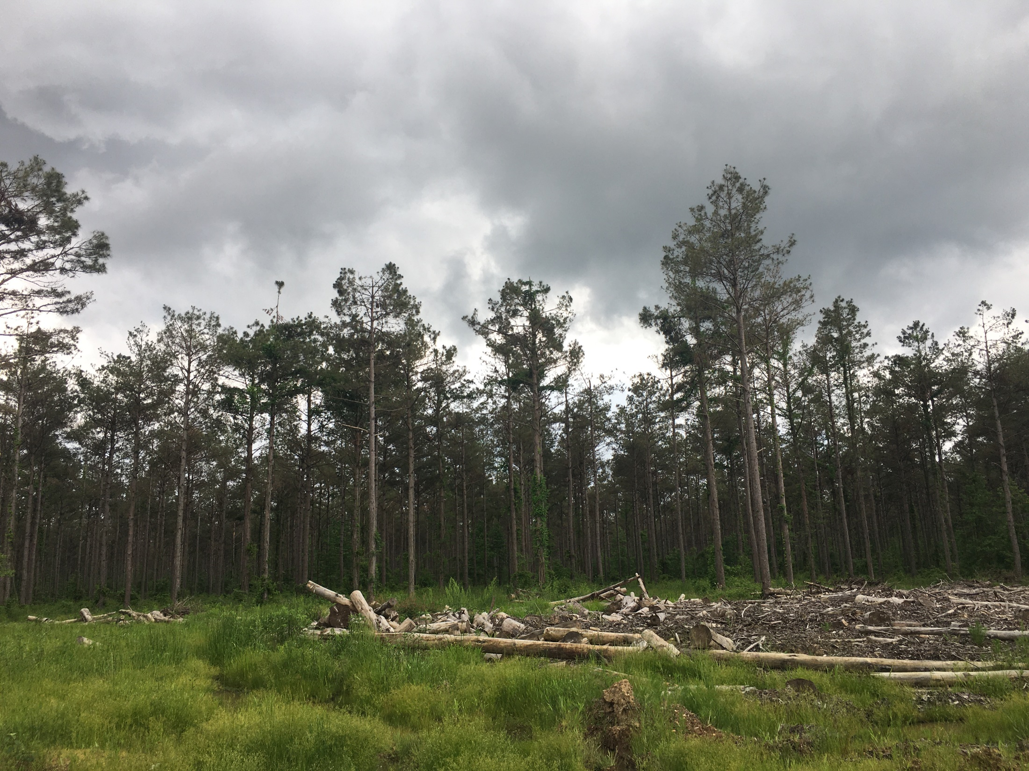


Brown spot in arkansas
Michael Blazier
Arkansas Forest Resources Center
UAM College of Forestry, Agriculture, and Natural Resources
August 2, 2023

Slide 2
Timeline of Brown Spot
2022: Brown spot confirmations by Arkansas Forestry Division in south-central Arkansas
  Hot Springs area
  2023 follow-up indicating affected forests looking better

Slide 3
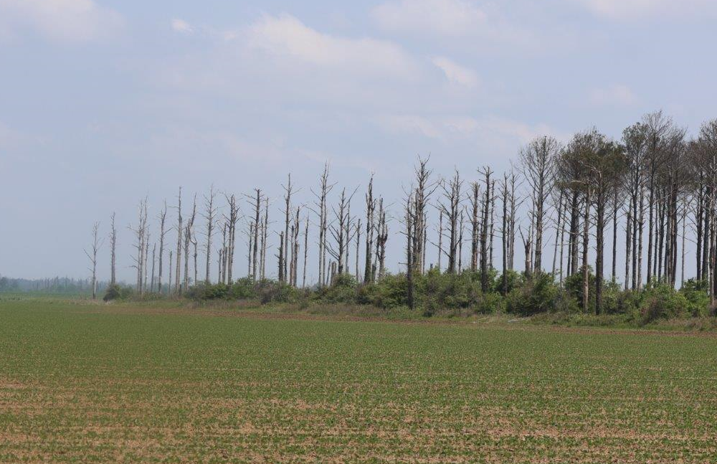
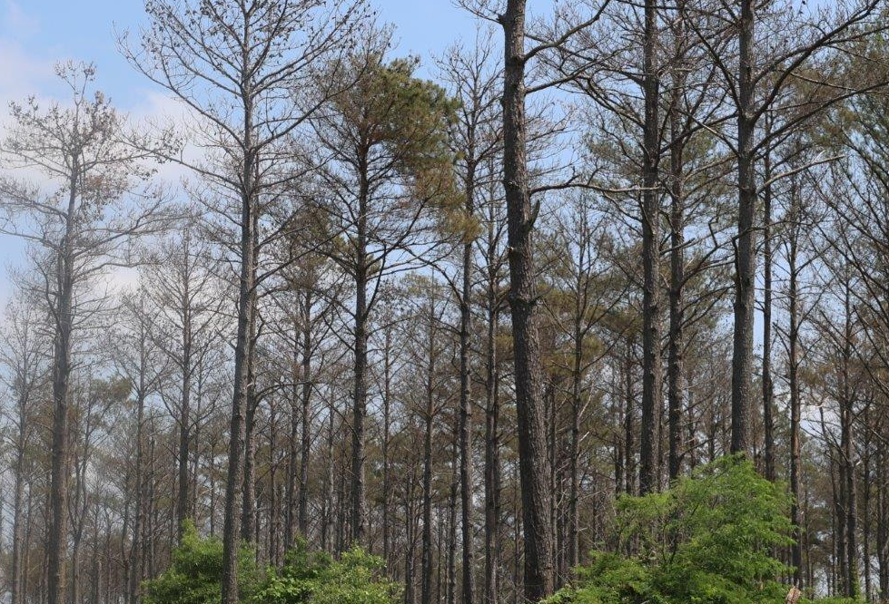
Timeline of Brown Spot
Summer/fall 2022
  Broad mortality of loblolly pine within Southeast Arkansas
  Trees within and around farming communities of Mississippi River delta region

Slide 4
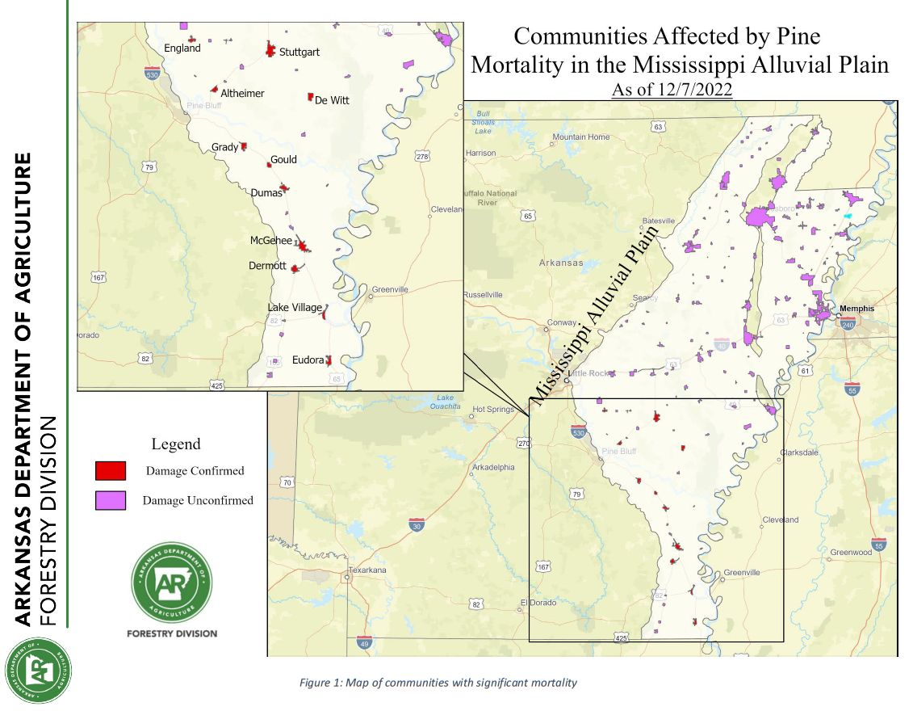
Timeline of Brown Spot

Slide 5
Timeline of Brown Spot
Symptoms:
  Brown spots on leaves with yellowing at edges and resin exudation
Arkansas Forestry Division investigation:
  Felling and uprooting trees
  Disease and herbicide analyses
Investigation results:
  Negative for brown spot and needleblight
  Inconclusive for herbicide
  Ascribed as pine decline from confluence of offsite pines and climate stresses

Slide 6
Timeline of Brown Spot
March 2023:
  Reports of loblolly pine forests in Southeast Arkansas with escalating mortality
  Symptom patterns:
    Brown spots on foliage
    Browning of older foliage
    Browning of newer foliage
    Increased cone production
    Most prominent in thinned stands

Slide 7
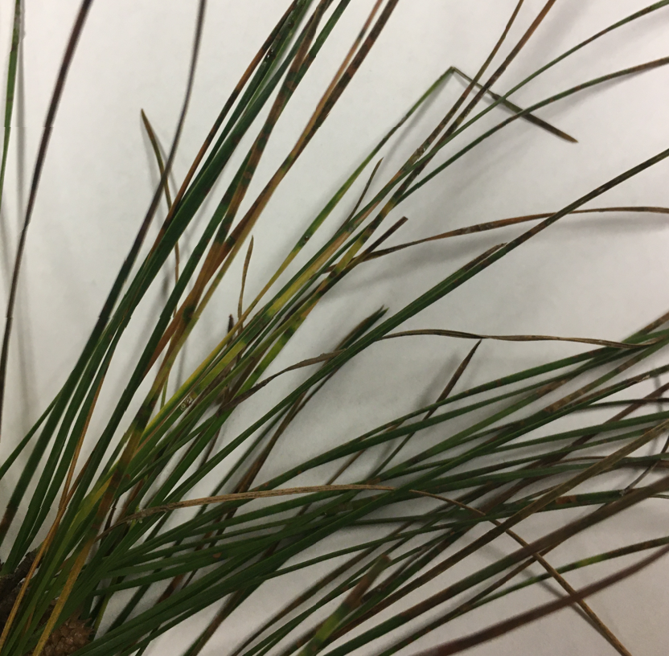
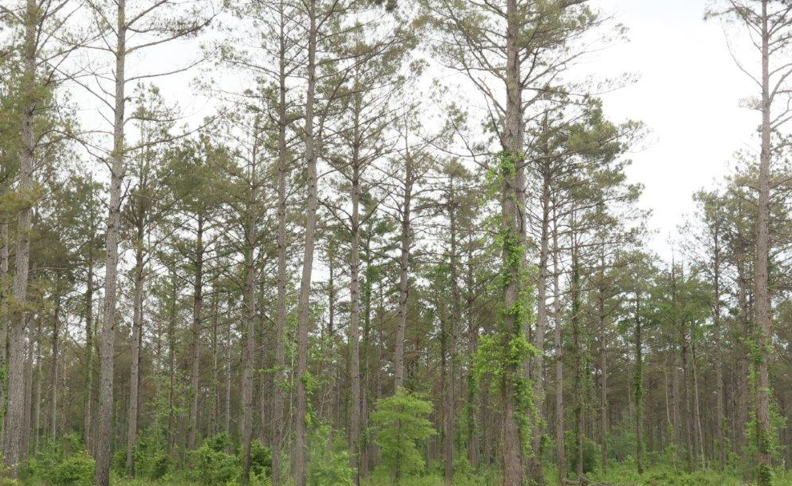
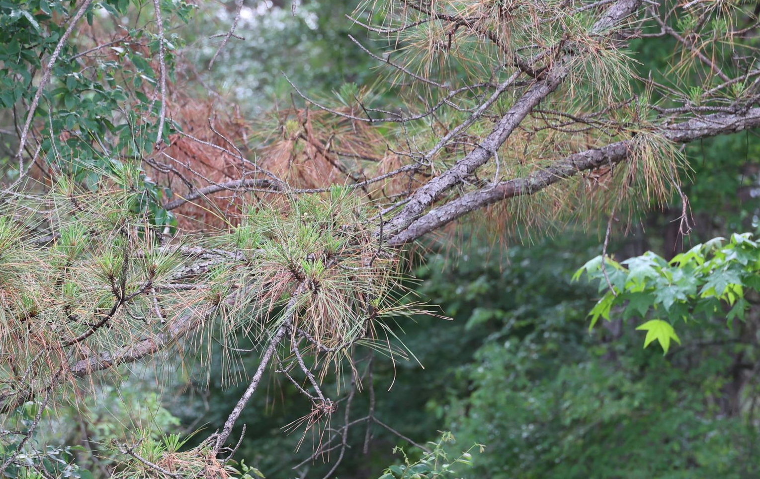

Slide 8
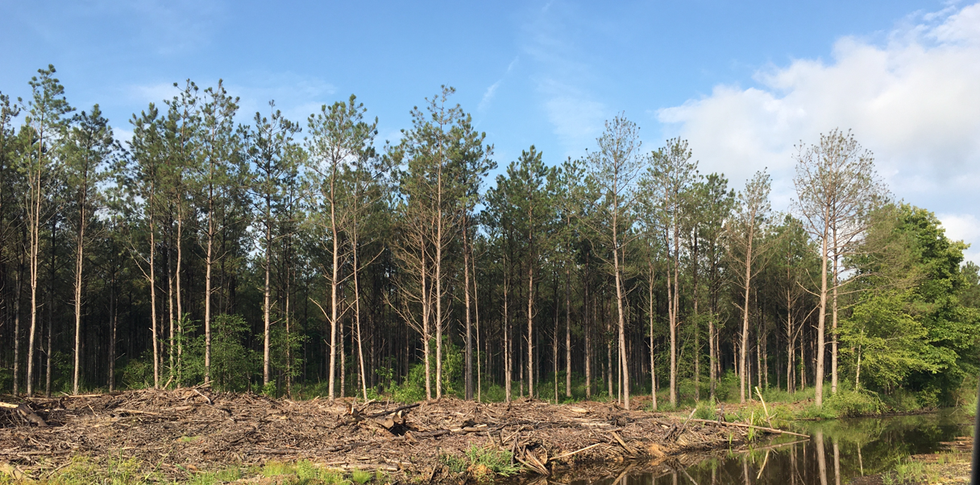
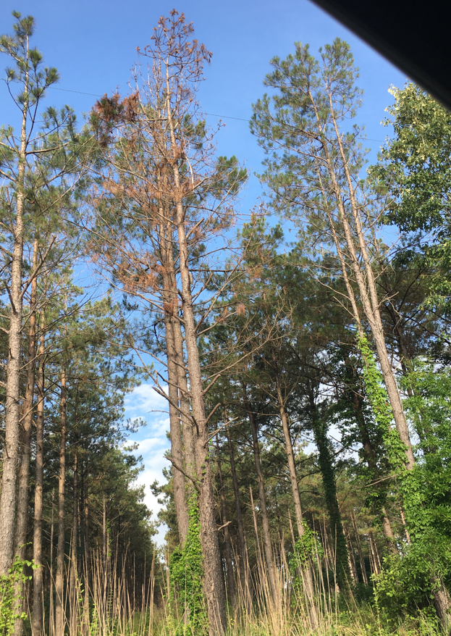

Slide 9
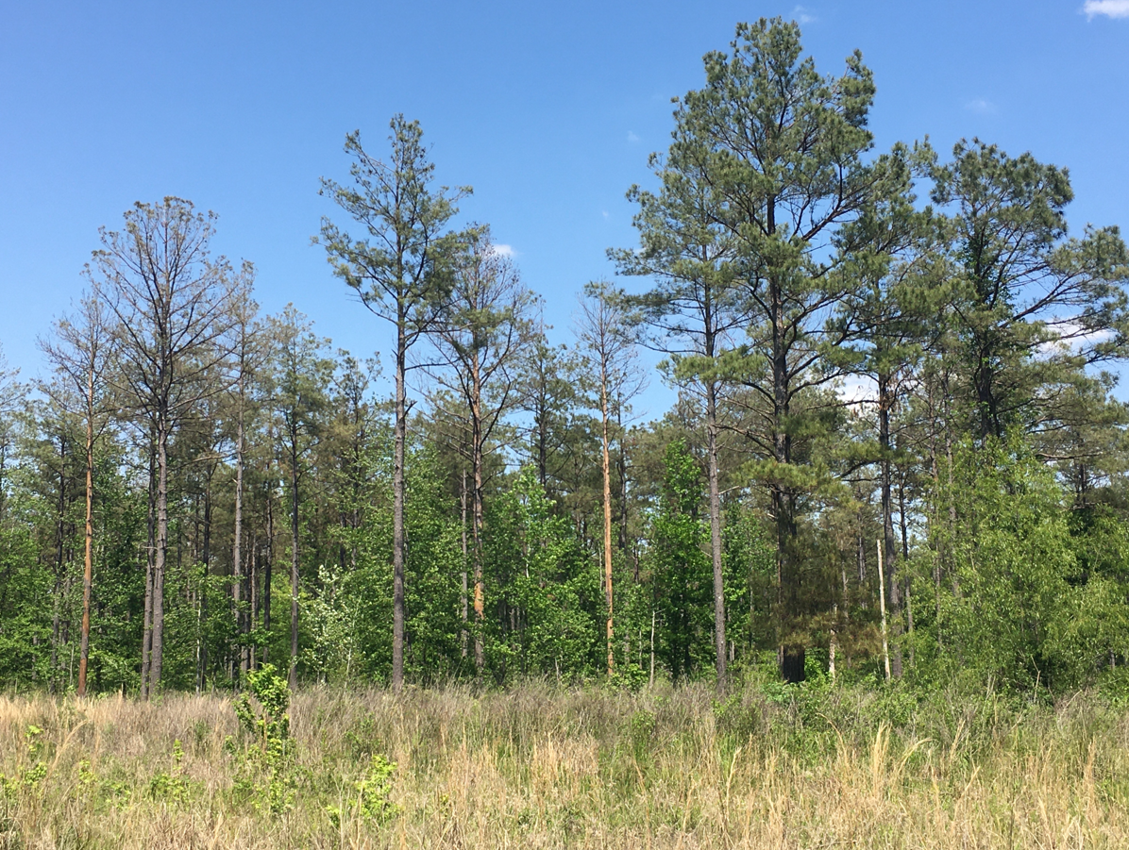
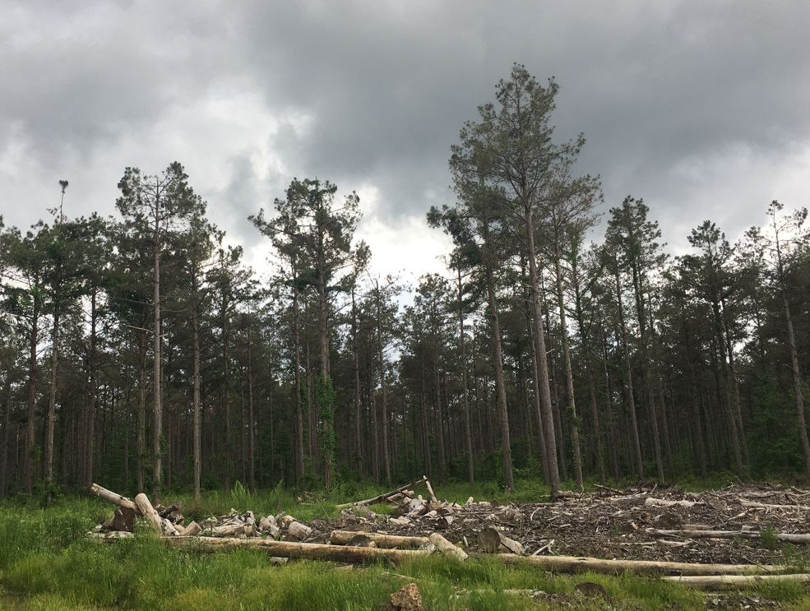

Slide 10
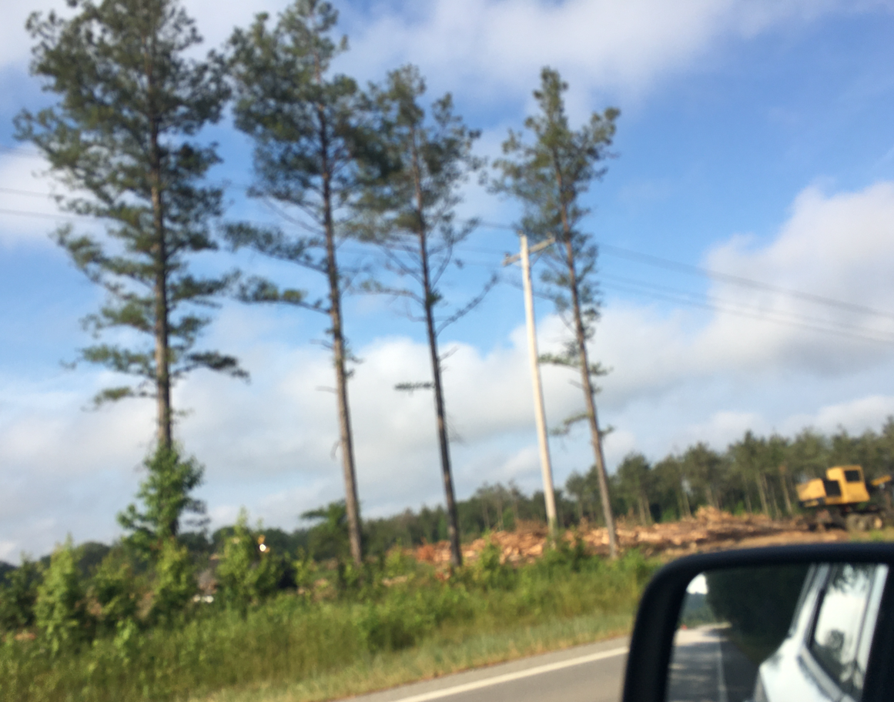

Slide 11
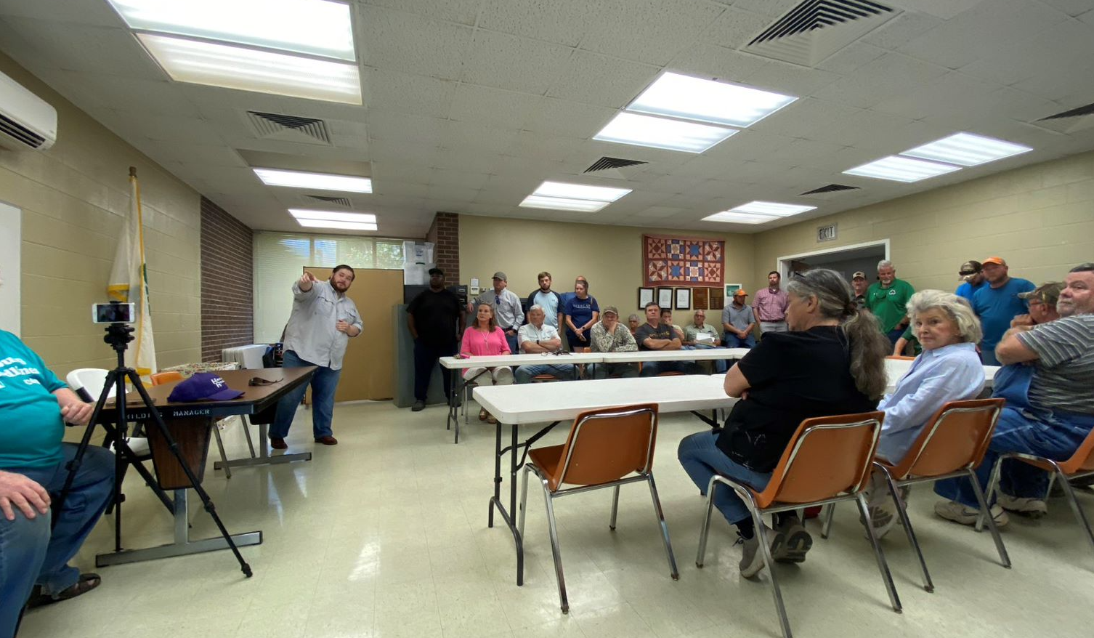
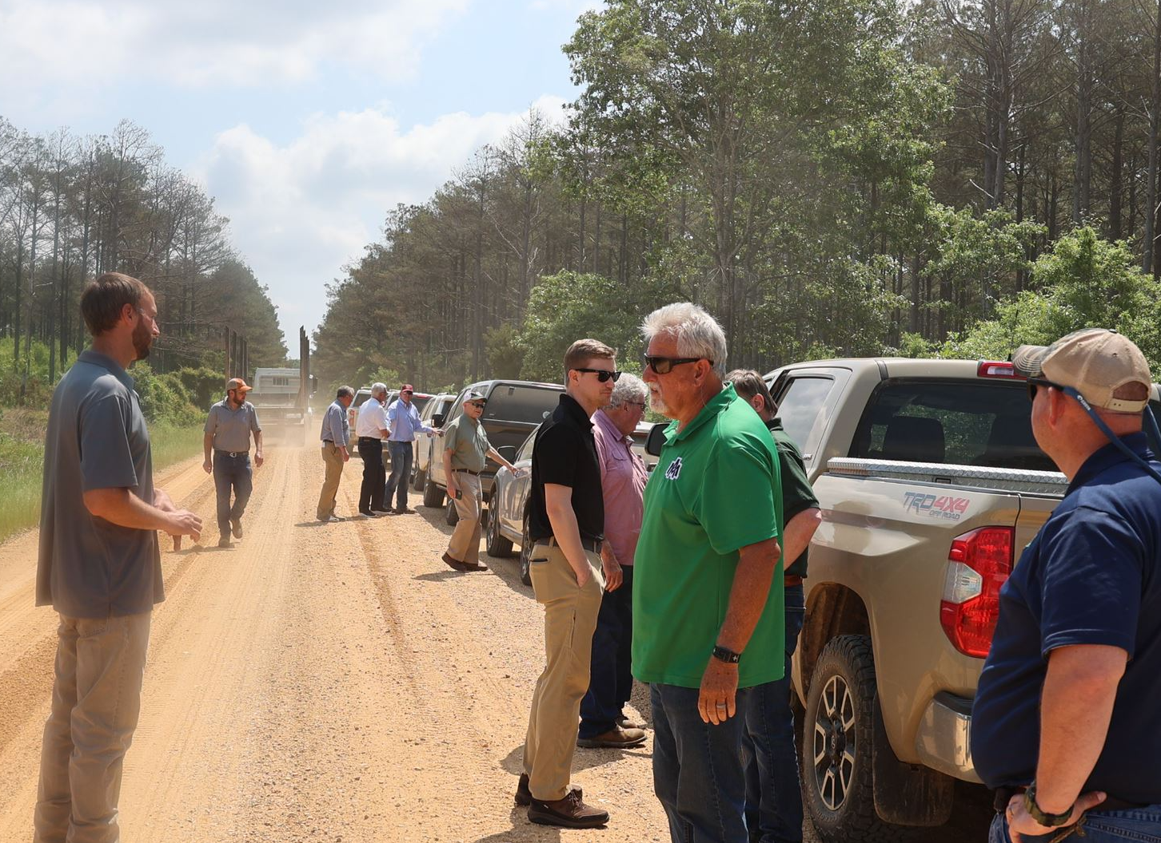
Timeline of brown spot
May 2023:
  State senator hosts listening session and tour about pine mortality in affected area
  High turnout and concern

Slide 12
Responses
Partnership of:
  University of Arkansas at Monticello
  Arkansas Forestry Division
  University of Arkansas Cooperative Extension Service
  Arkansas Forestry Assocation

Slide 13
Responses
Data collection:
  Public and professional reporting
    Arkansas Forestry Division
    UA Cooperative Extension Service
  Aerial surveys
  Tree biomass sampling for disease and herbicide analyses
    May-June
    Planned for September 2023 then resume monthly in February 2024
  Geospatial analyses – machine learning

Slide 14
Responses
Brown spot and needlecast confirmations:
  Three counties in Southeast and South Central Arkansas
No detection of herbicides
  Half-life of 80 days or less

Slide 15
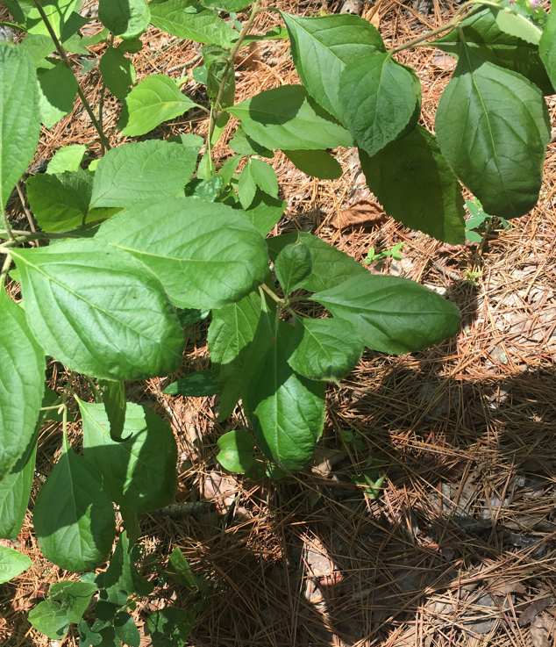
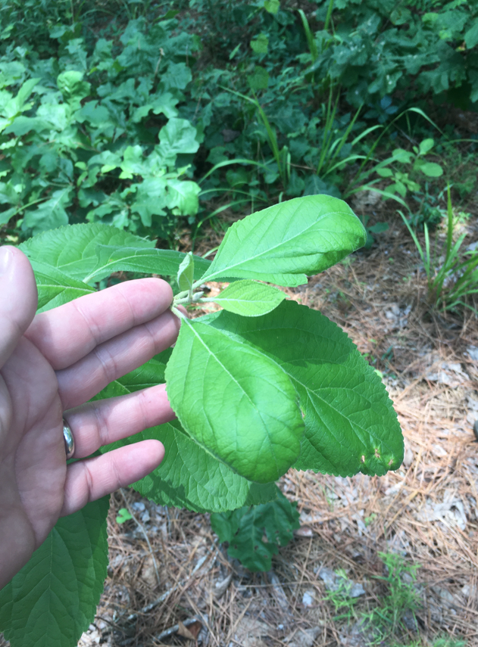
Confounding/contributing issues
Herbicide drift concerns
Climate
  200% long-term precipitation in winter/spring
    Root rot
    Weevils on roots
  Drought in fall 2022

