Slide 1
Brown Spot Needle Blight in Louisiana
Tyler Cloud, LDAF Forestry Program Director-Forest Health & Stewardship

Slide 2
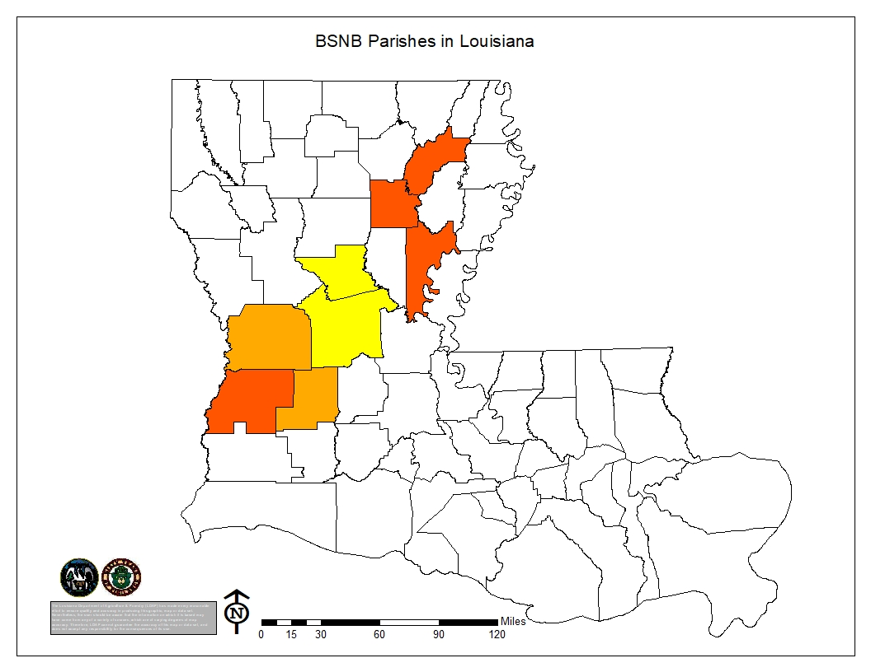
Known Parishes Affected
Rapides (2021) – 8 tracts
Grant (2021) – 2 tracts
Vernon (2022) – 4 tracts
Allen (2022) – 1 tract
Beauregard (2023) – 1 tract
Caldwell (2023) – 2 tracts
Catahoula (2023) – 1 tract
Richland (2023) – 1 tract

Slide 3
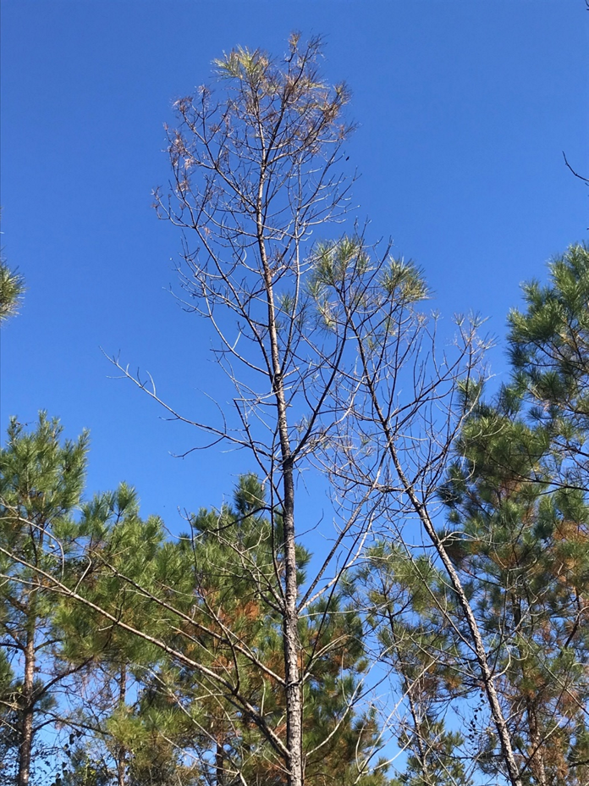
Tract Breakdowns
16 plantation sites, 2 volunteer sites, 2 roadside sites
15 industry, 1 private
  5 Roy O’Martin
  3 James Timber
  4 Crowell
  1 Crosby Resource
  1 Manulife/Hancock
  1 Crest Industries
Most sites aged 3-10 years, 1 site 15 years, 1 site 27 years
Mixed bag of results

Slide 4
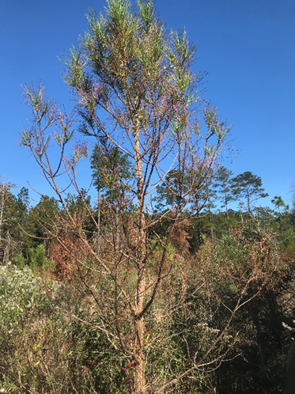
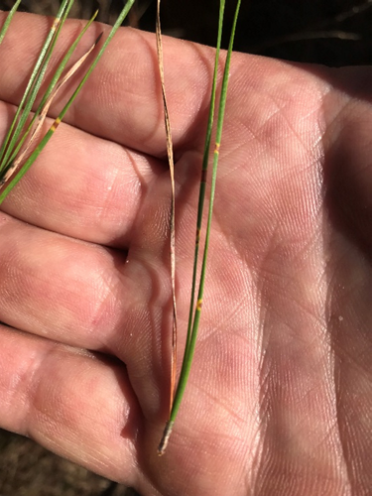
South Rapides Parish Tract

Slide 5
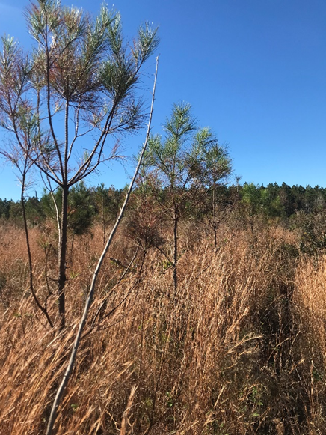
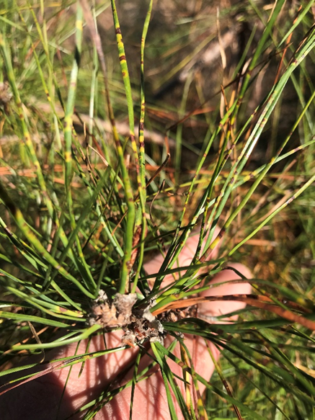
Grant Parish Tract

Slide 6
Going Forward
Monitor the situation
Work with local state universities
Work with USFS
Work with Region 8 states

Slide 7
References
Wood Johnson, USFS
Dr. Jaesoon Hwang, USFS

