Slide 1

Component 2 Update
Lori Eckhardt, PhD
Brown Spot Needle Blight Workshop
Auburn University
2-3 August 2023
Forest Health Dynamics Laboratory
College of Forestry, Wildlife and Environment – Auburn University

Slide 2
Component 2
Forest Health Dynamics Laboratory
Environmental factors that drive the emergence and severity of infection from Lecanosticta acicola across Alabama
Main Objectives:
  Determine how L. acicola affects the vigor of loblolly pine tree growth
  Understand environmental factors that may increase the spread of L. acicola
  Anatomical response of Loblolly pine to L. acicula
College of Forestry, Wildlife and Environment – Auburn University

Slide 3
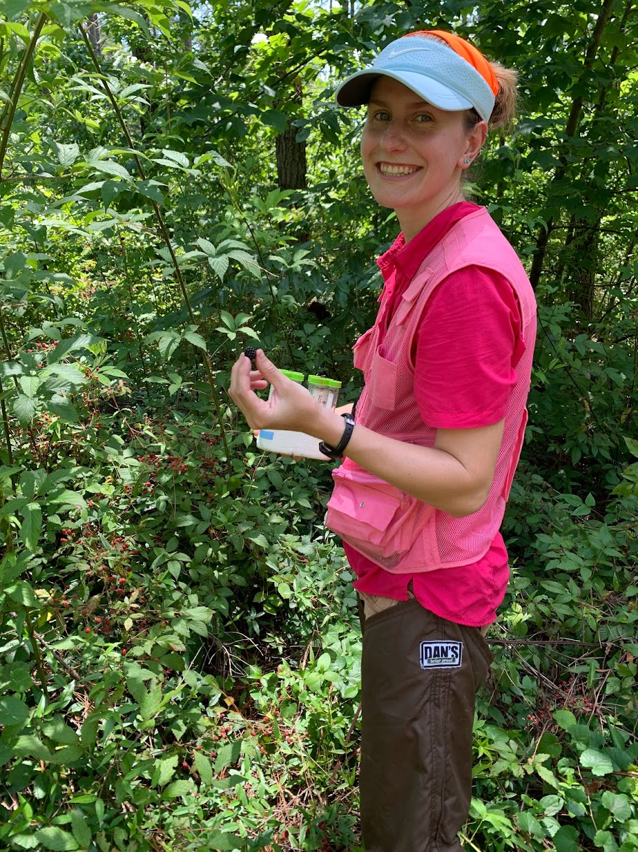
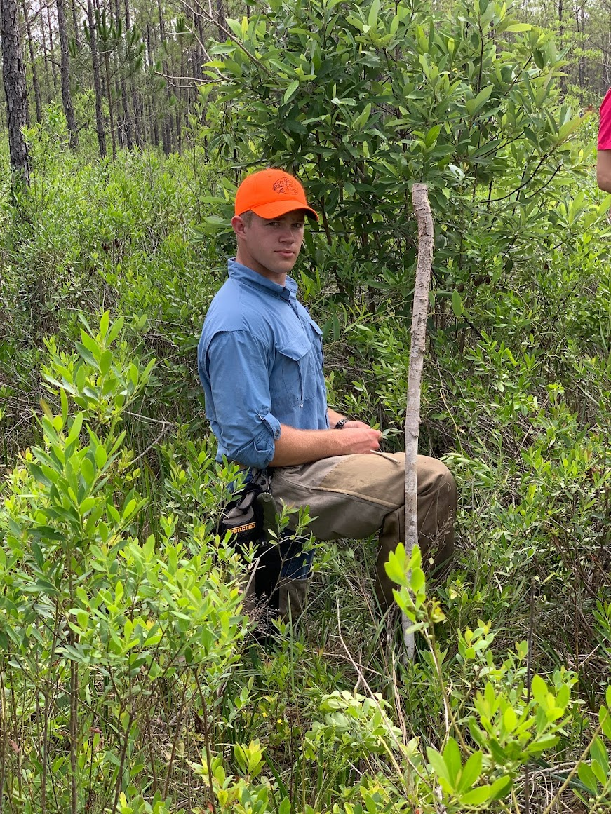
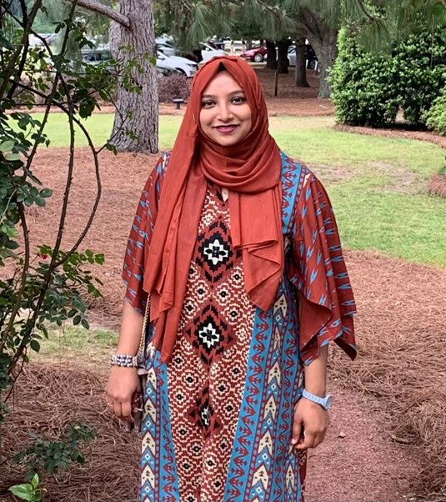
Component 2
Forest Health Dynamics Laboratory
Environmental factors that drive the emergence and severity of infection from Lecanosticta acicola across Alabama
Team:
Jaden King
Ph.D. Student
Maddox Golden
UG Research Assistant
Sharmin Toa
Ph.D. Student
College of Forestry, Wildlife and Environment – Auburn University

Slide 4
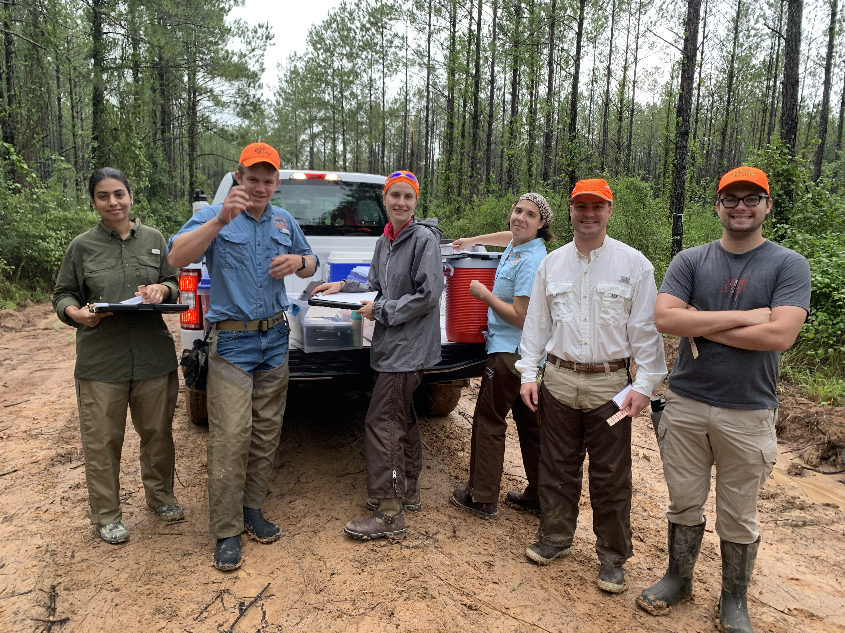
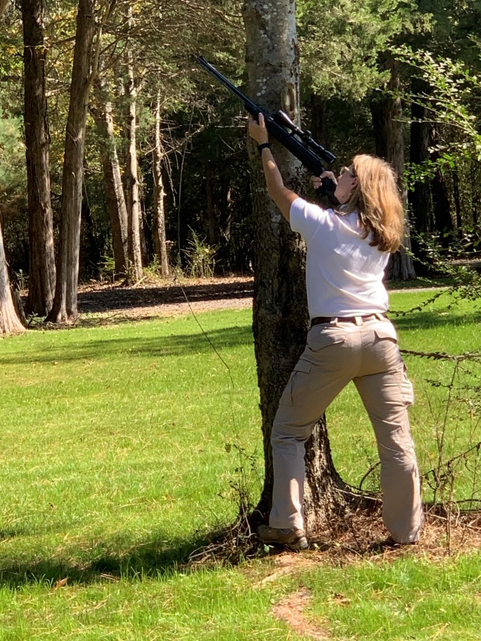
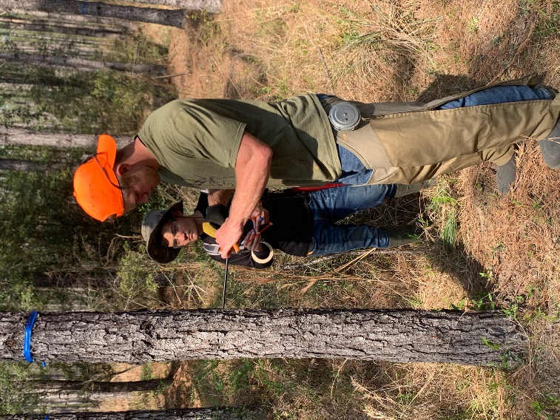
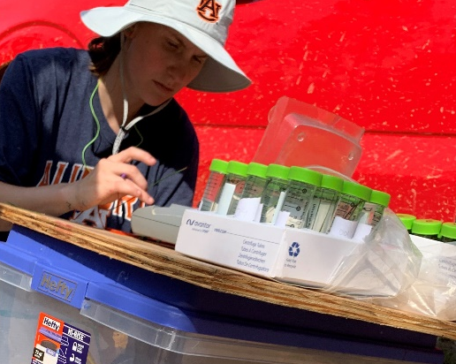
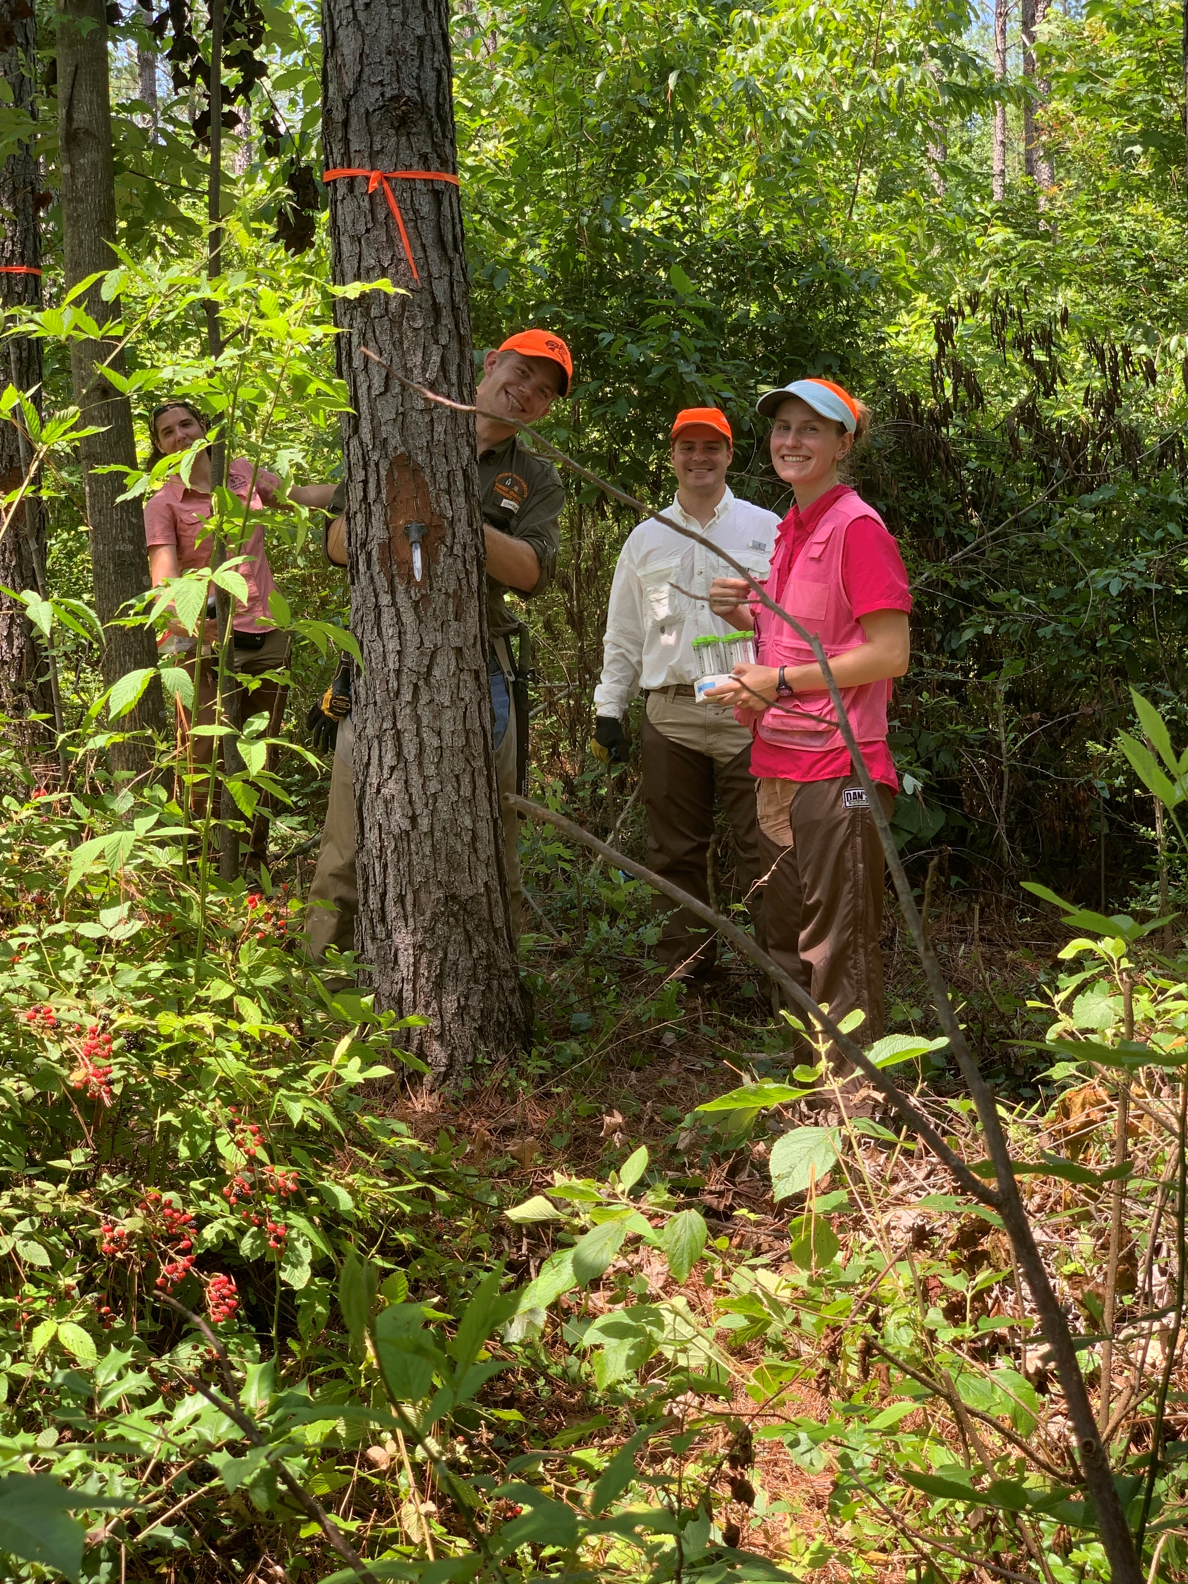
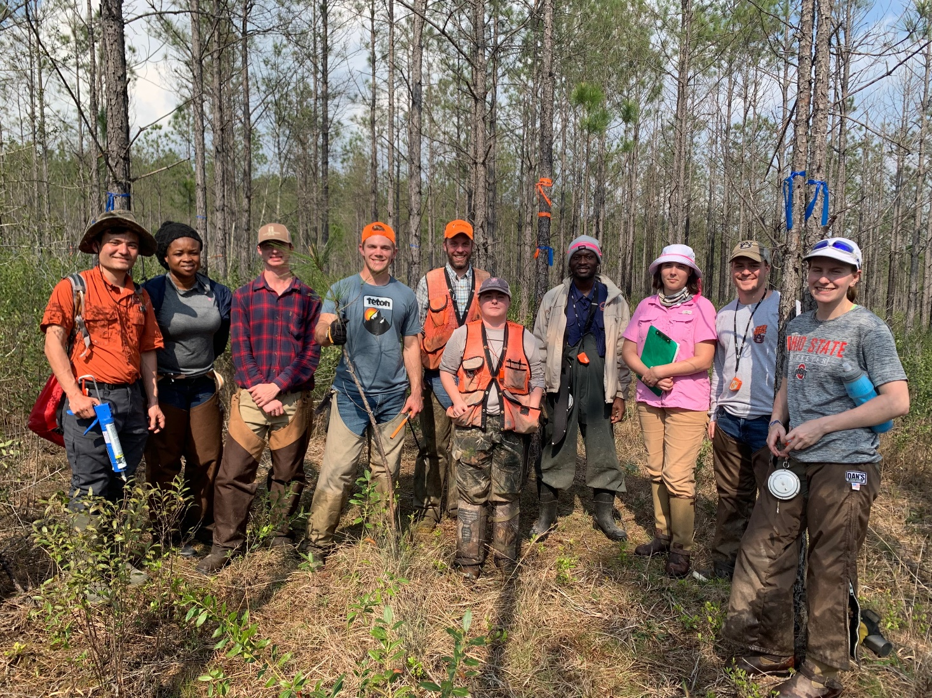
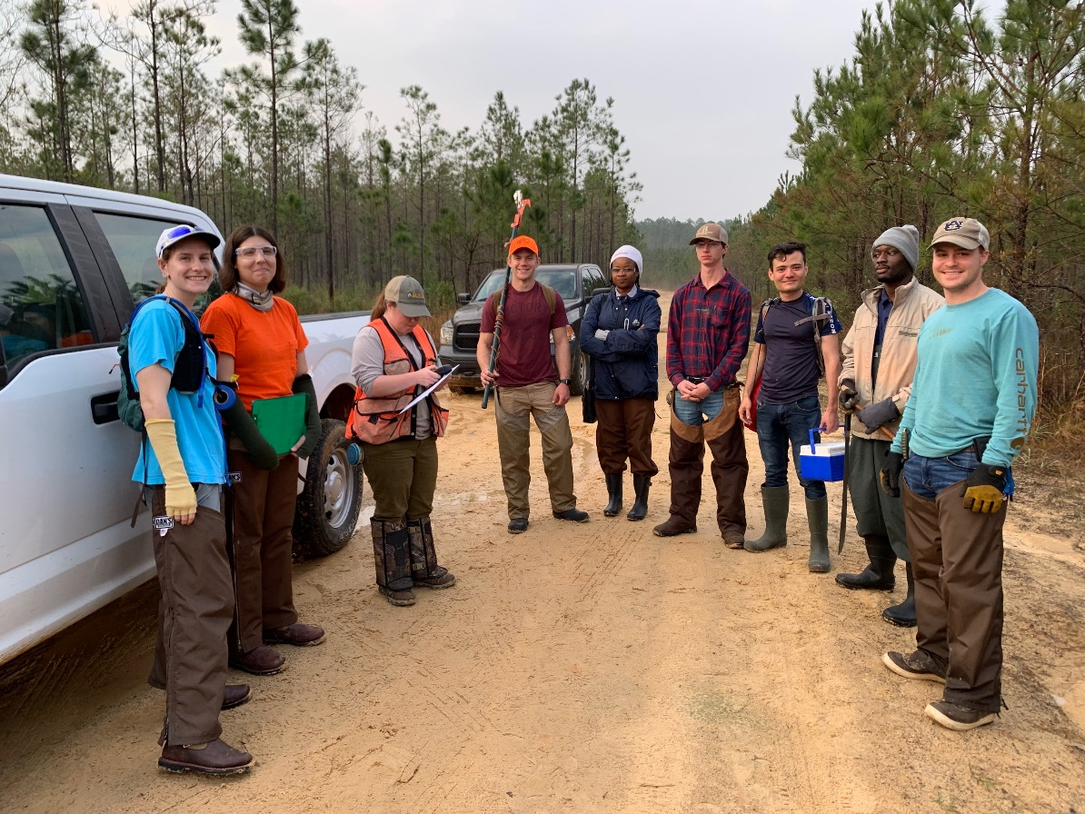
WORKING TO KEEP FORESTS HEALTHY
Forest Health Dynamics Laboratory
College of Forestry, Wildlife and Environment – Auburn University

