Slide 1

Mitigating Needle Blight: A Growing Economic Threat to Pine Forests – Project Overview
Lori Eckhardt, PhD
Brown Spot Needle Blight Assessment Workshop
Auburn University
2-3 August 2023
Forest Health Dynamics Laboratory
College of Forestry, Wildlife and Environment – Auburn University

Slide 2
Introduction
Forest Health Dynamics Laboratory
Pine forests and industrial wood plantations in the southeastern U.S.
- More than $11 billion
- Sustainability and profitability
- Non-native insect pests and pathogens
- Movement of native forest pests
- Damage approximately $4.2 billion annually
College of Forestry, Wildlife and Environment – Auburn University

Slide 3
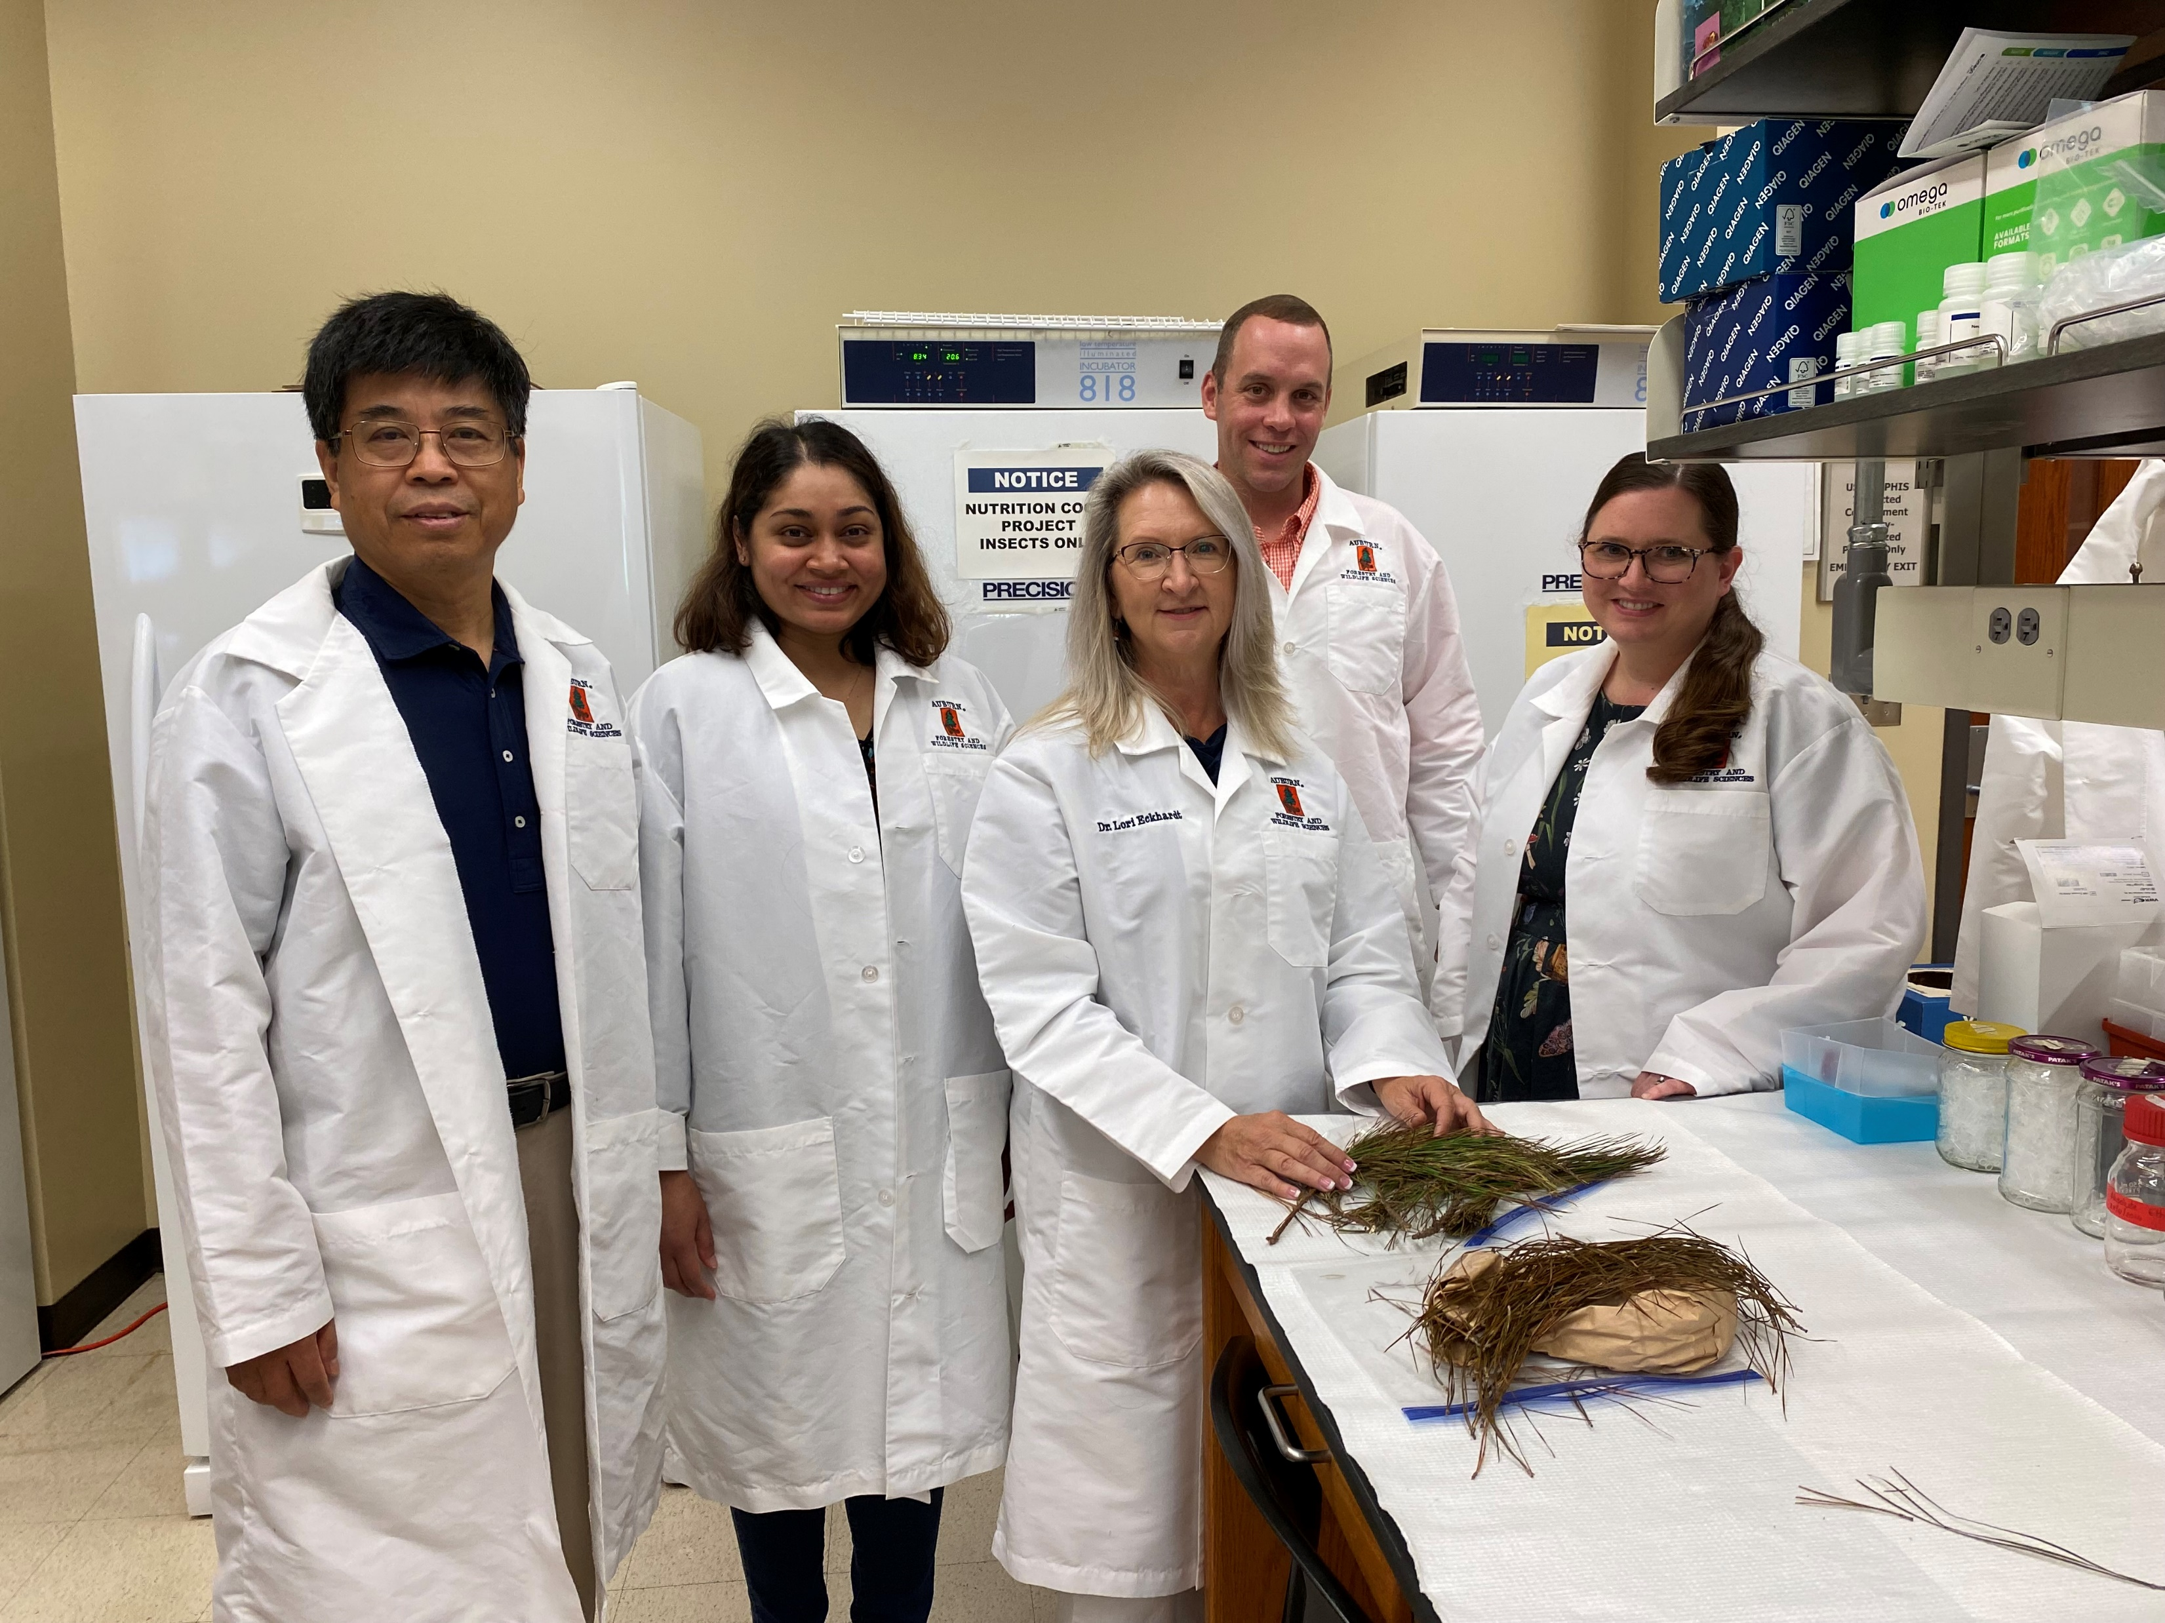
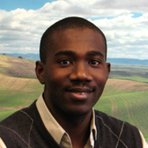
The Research Team
Forest Health Dynamics Laboratory
Dr. Lori Eckhardt (Auburn University, Integrated Forest Pathology and Entomology)
Dr. Lana Narine (Auburn University, Remote Sensing and Modeling)
Dr. Janna Willoughby (Auburn University, Genetics)
Dr. Joseph Fan (Auburn University, Statistician)
J. Ryan Mitchell (Auburn University, Alabama Cooperative Extension System)
Rabiu Olatinwo (USFS, SRS, Research Plant Pathologist)
College of Forestry, Wildlife and Environment – Auburn University

Slide 4
Current Partners
Forest Health Dynamics Laboratory
Dr. Annakay Newell (Auburn University, Plant Pathologist)
Dr. Brian Via (Auburn University, Wood Products)
Dr. Iris Erramuspe (Auburn University, Wood Chemistry)
Dr. Emily Carter (USFS-R, Soil Scientist)
Dr. Jon Cale (University of Northern British Columbia, Forest Pathologist)
Austin Reese (Alabama Forestry Commission, Forest Health Coordinator)
Clarissa Balbalian (Mississippi State University Extension Diagnostics Lab, Plant Pathologist)
Alan Wilson (Rayonier, R&D Coordinator)
Al Lyons (Manulife Investment Management, Silviculture Program Manager)
Kristopher Bradley (Regions, Vice President & Forester)
Jenny Leblanc (Weyerhaeuser, Forester)
Ryan Nadel (Weyerhaeuser, Research Silviculturist)
James Owens (The Westervelt Company, Forest Improvement Manager)
Paul Jeffreys (ArborGen Inc., Reforestation Advisor)
Susan Turner (The Wilcox Foundation)
Kozma Naka (Alabama A&M, Coordinator of Forestry, Ecology and Wildlife Program)
College of Forestry, Wildlife and Environment – Auburn University

Slide 5
Long-Term Goals
Forest Health Dynamics Laboratory
(1) To determine the distribution and movement of the needle pathogen(s)
(2) To understand the disease cycle and the environmental factors that drive the emergence and distribution of the needle pathogen(s)
(3) To determine if the appearance in loblolly is due to more aggressive strains of the pathogen(s)
(4) To determine the origins of the pathogen(s)
College of Forestry, Wildlife and Environment – Auburn University

Slide 6
Predicted Outcomes
Forest Health Dynamics Laboratory
A collection of factors to account for losses (tree death as well as predicted growth losses) from brown spot needle blight in loblolly in productivity models.
An improved understanding of the interactive effect of fungal infection, stand environment, and tree physiology on loblolly pine sustainability which is required for developing remedial actions and productivity models for trees and stands already affected.
The levels of infection that are acceptable (minimal growth loss and low probability of mortality) and those that fall above the damage thresholds.
An understanding of tree-level infection levels.
An understanding of the genetic variability of the fungus and how it is related to infection level and severity.
A screening protocol for testing seedlings to find families tolerant to the pathogen.
Distribution and movement of the pathogen across the southeast.
College of Forestry, Wildlife and Environment – Auburn University
Notes:
This work is not meant to replace any research that is currently underway focused on developing solutions, but rather is aimed at determining the actual impacts on productivity and biological cause(s) of needle blight so that landowners and forest managers may more precisely predict future timber revenues from affected stands and adjust management activities accordingly.
The knowledge produced by this project will be used to develop best management practices for areas affected by needle blight. It shall also help direct future research actions, especially when little is known regarding the impact of the pests/pathogens associated with loblolly pine in the southeastern United States.

Slide 7
Project Components
Forest Health Dynamics Laboratory
Component 1: Inoculation protocol development for Lecanosticta acicola to develop a screening method to complete Koch’s postulates, determine strain aggressiveness and seedling tolerance (Dr. Lori Eckhardt)
Component 2: Environmental factors that drive the emergence and severity of infection from Lecanosticta acicola across Alabama (Drs. Lori Eckhardt & Joseph Fan) & Environmental triggers and seasonal changes in the mycobiome on systematic and asymptomatic loblolly pine needles (Dr. Rabiu Olatinwo - USFS)
Component 3: Detection and movement of Lecanosticta acicola with remote sensing (Dr. Lana Narine)
Component 4: Genetic diversity of Lecanosticta acicola, pathogen origins, and invasion history (Dr. Janna Willoughby)
Component 5: Extension and Outreach Activities (J. Ryan Mitchell & Dr. Lori Eckhardt)
College of Forestry, Wildlife and Environment – Auburn University
Notes:
Our approach to this integrated project will consist of four research and one extension components. Research component one is specifically designed to determine strain aggressiveness and develop a screening protocol which addresses Objective 2 and 3. Research component two is specifically designed to determine the distribution and infection level per county across Alabama and what environmental factors drive its emergence and exacerbate the pathogen addressing portions of Objectives 1 and 2. Research component three is specifically designed to use remote sensing to detect the pathogen and determine environmental factors (i.e. Hurricanes) that facilitate its distribution which addresses portions of Objectives 1 and 2. Research component four is specifically designed to understand the genetic diversity and relatedness in and between L. acicola, Pinus hosts and other needle pathogens associated with BSNB infection and mortality, which addresses Objectives 3.

Slide 8
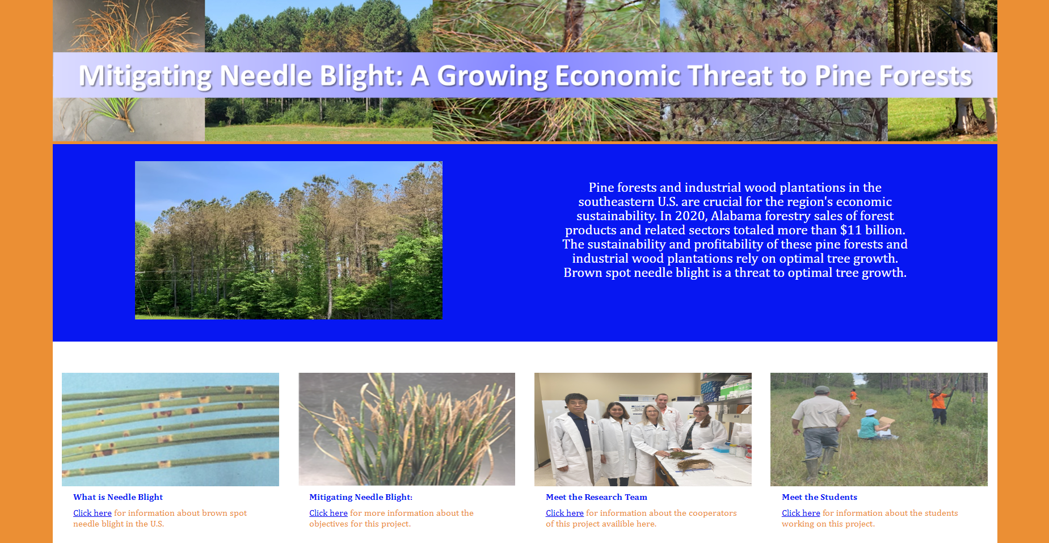
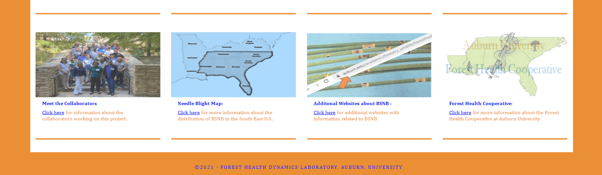
Project Webpage
Forest Health Dynamics Laboratory
https://www.auburn.edu/academic/forestry_wildlife/bsnb/index.html
College of Forestry, Wildlife and Environment – Auburn University

Slide 9

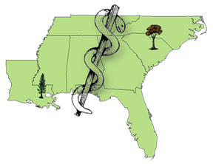




Acknowledgements
Forest Health Dynamics Laboratory
Lab manager
Jessica Baldwin
Graduate Students
Jaden King
Emmanuel Nyarko
Temitope Folorunso
Gabriel Silva
Swati Singh
Christian Rivera
Undergraduates
Angel Cagle
Maddox Golden
Andrew Howard
Drew Conway
Gavin Kerr
Jaquie Parker
Nathan Kurtz
Garrett Gaar
Brea Thomas
Collaborators
Dr. Lori Eckhardt
Dr. Brian Via
Dr. Beatriz Vega
Dr. Emily Carter
Dr. Janna Willoughby
Dr. Lana Narine
Dr. Joseph Fan
Dr. Jonathon Cale
Dr. Annakay Newell
Ryan Mitchell
Kris Bradley
Landowners
Stallworth Land Company
Longleaf Land & Timber Co.
Osko Forest – Glover Family
US Forest Service
Facilities
Forest Health Dynamics Lab
Molecular Mycology Lab
Conservation and Genomics Lab
Geospatial Analytics Lab
Forest Products Lab
Forest Health Cooperative
College of Forestry, Wildlife and Environment – Auburn University

Slide 10
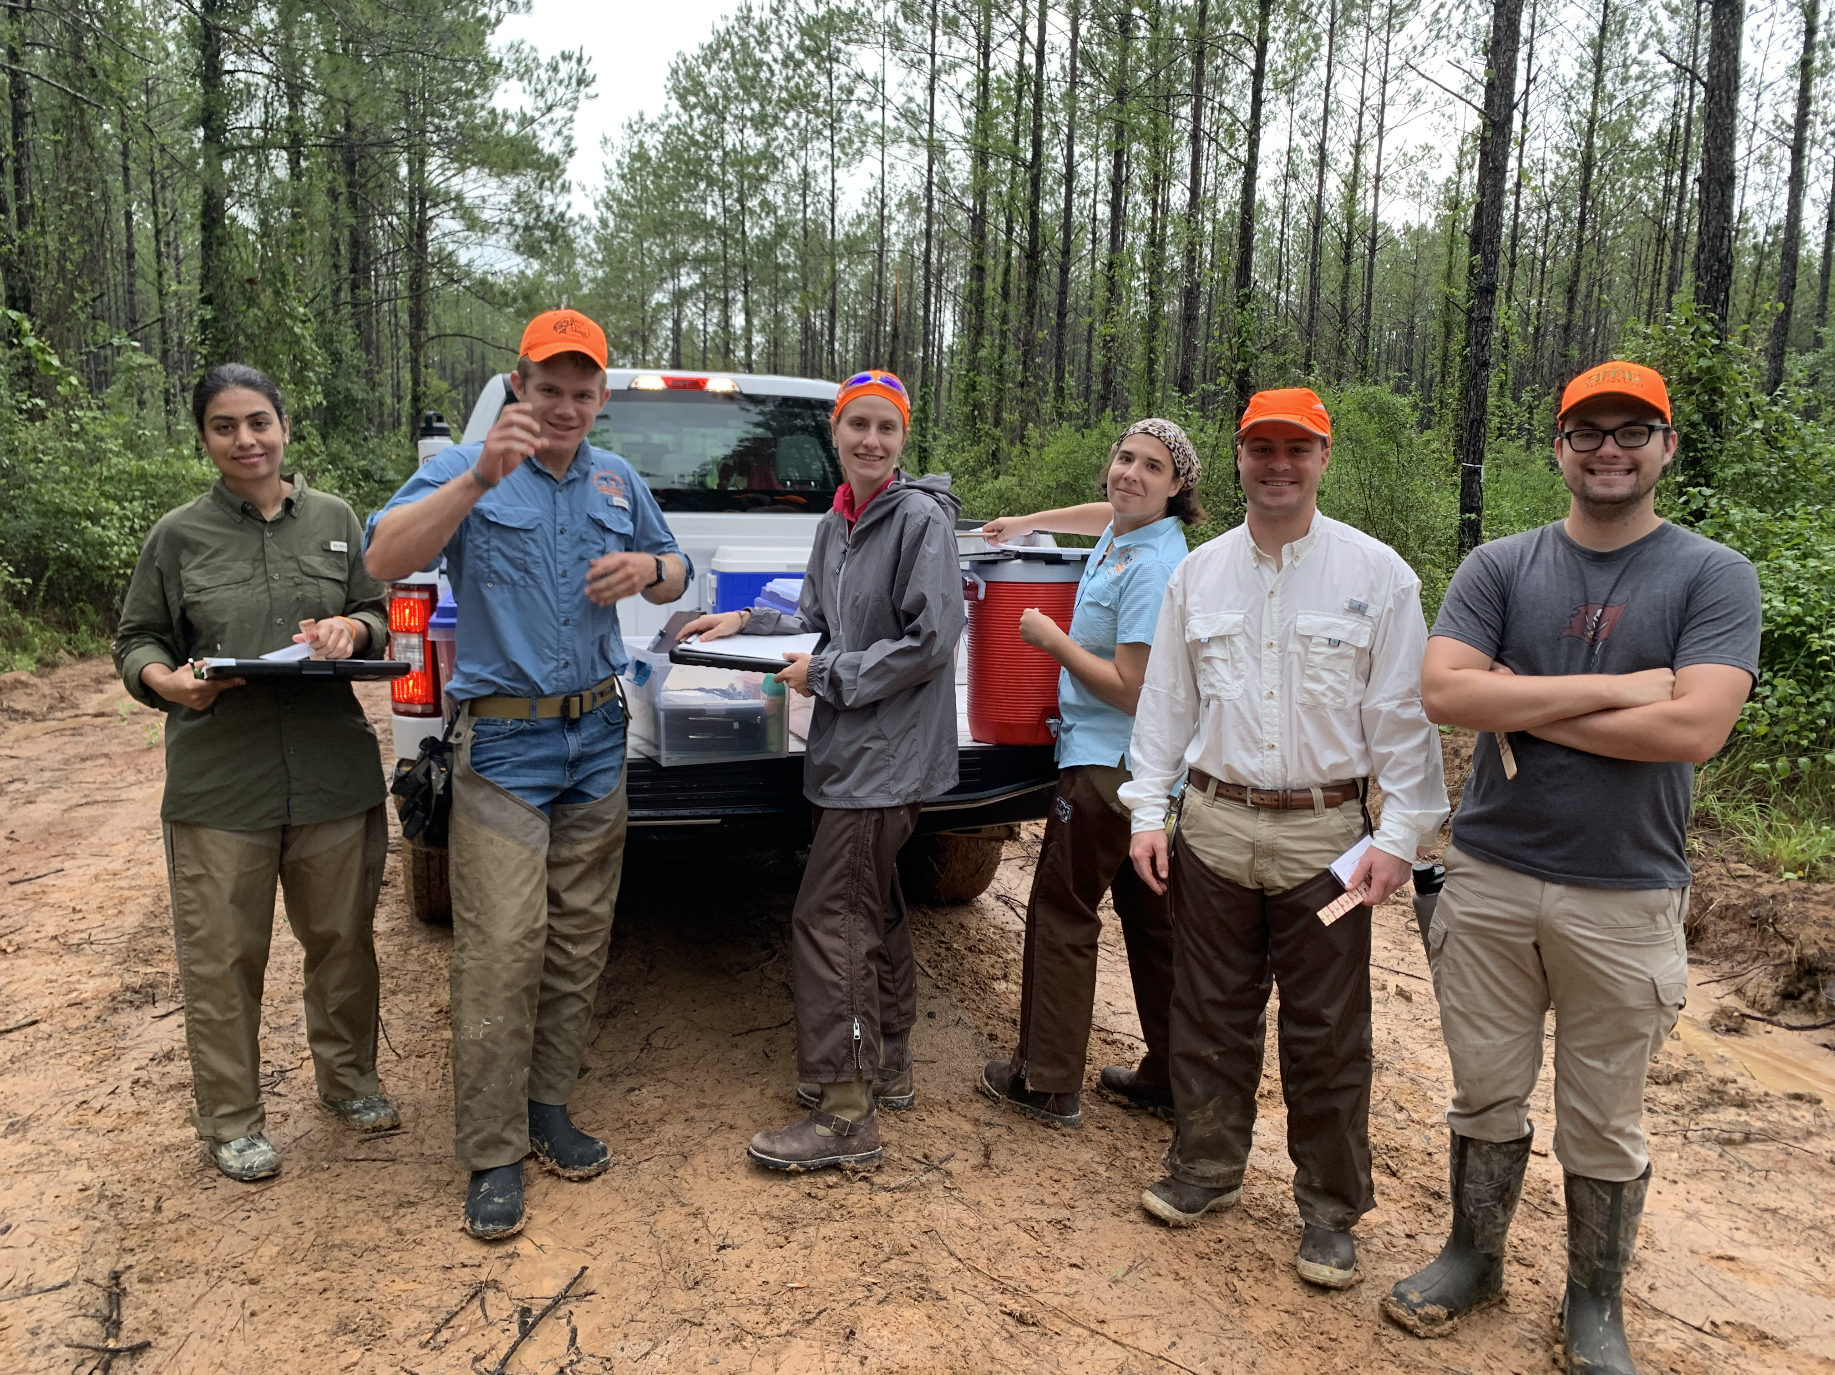
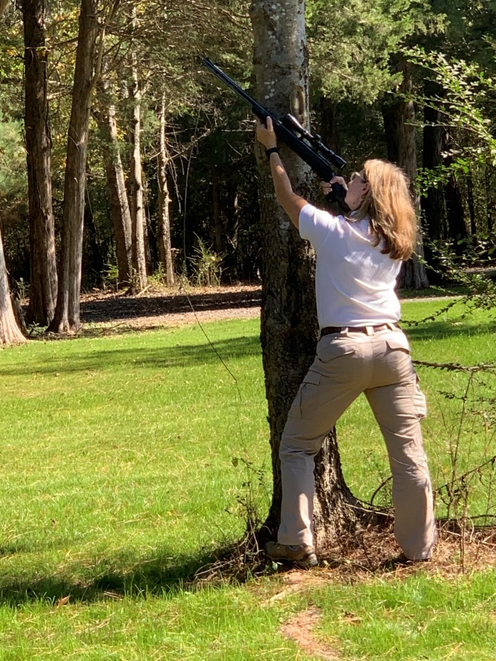
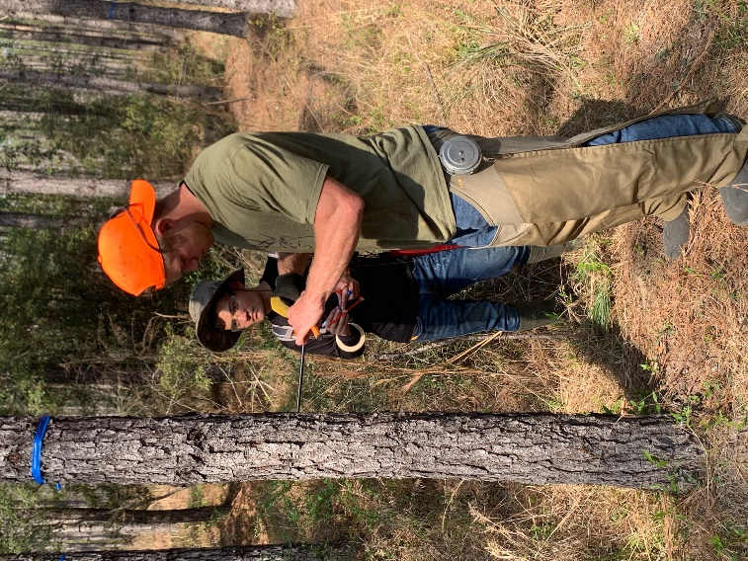
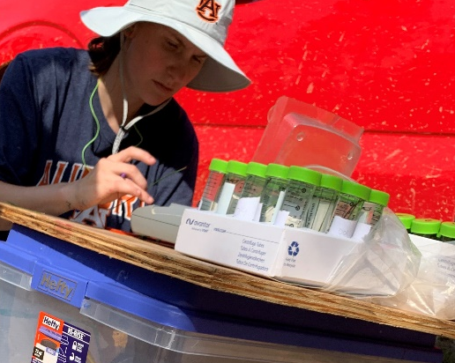
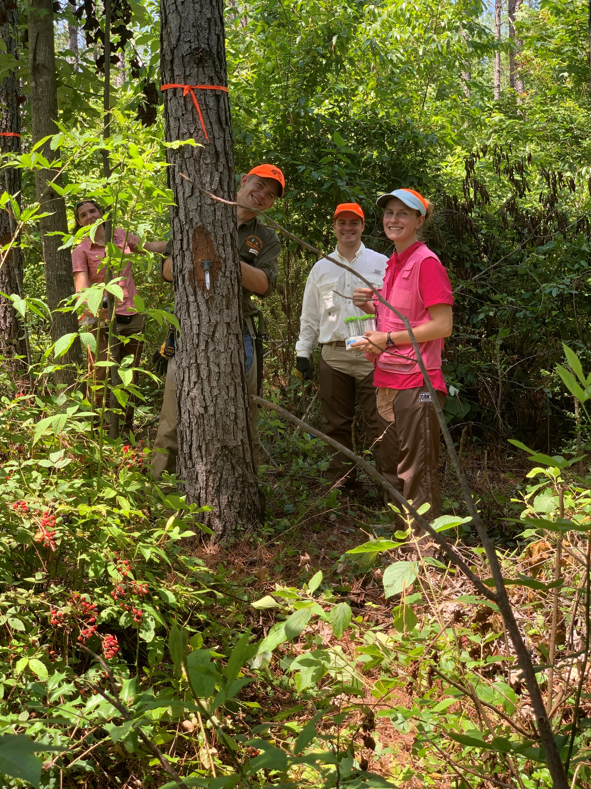
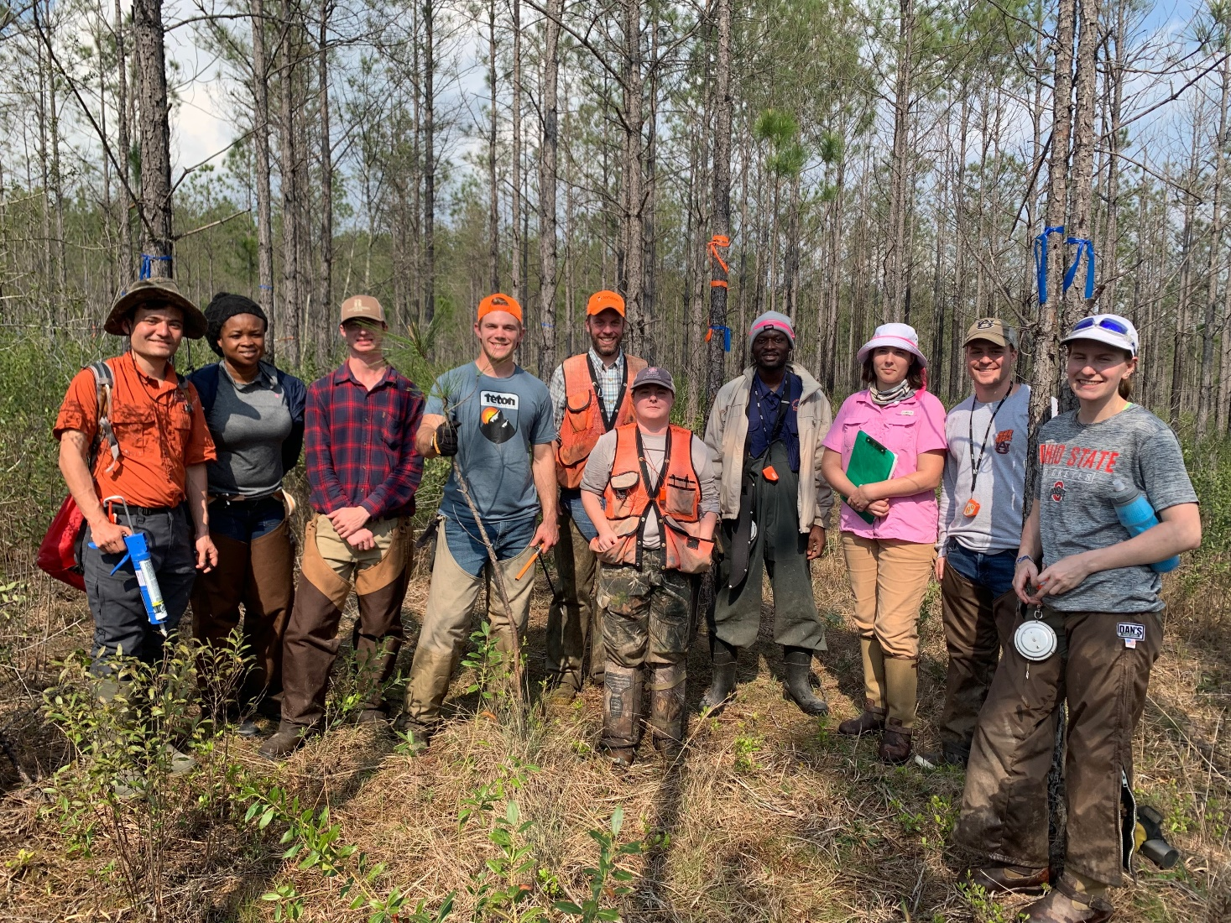
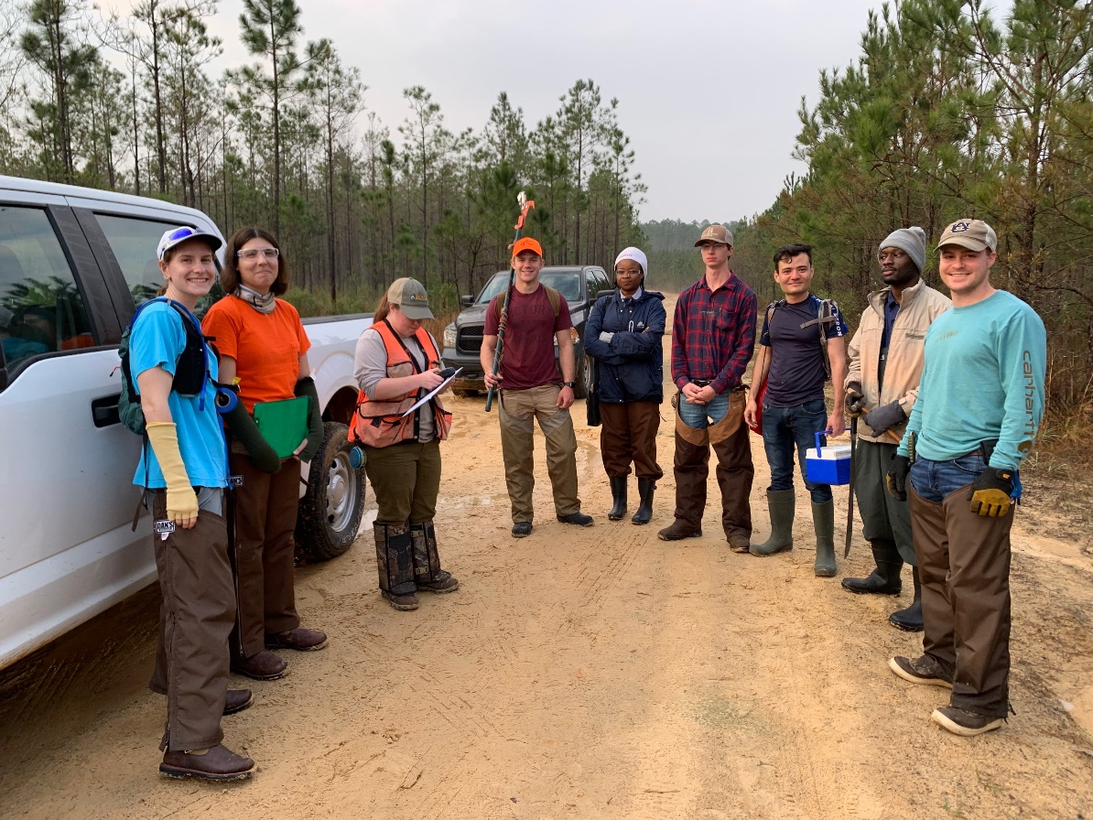
WORKING TO KEEP FORESTS HEALTHY
Forest Health Dynamics Laboratory
College of Forestry, Wildlife and Environment – Auburn University

