Slide 1

Does Brown Spot Needle Blight Affect Loblolly Pine Growth?
Maddox Golden, Jaden King, Lori Eckhardt
Forest Health Dynamics Laboratory
College of Forestry, Wildlife and Environment
Auburn University, Auburn AL
Forest Health Dynamics Laboratory
College of Forestry, Wildlife and Environment - Auburn University

Slide 2
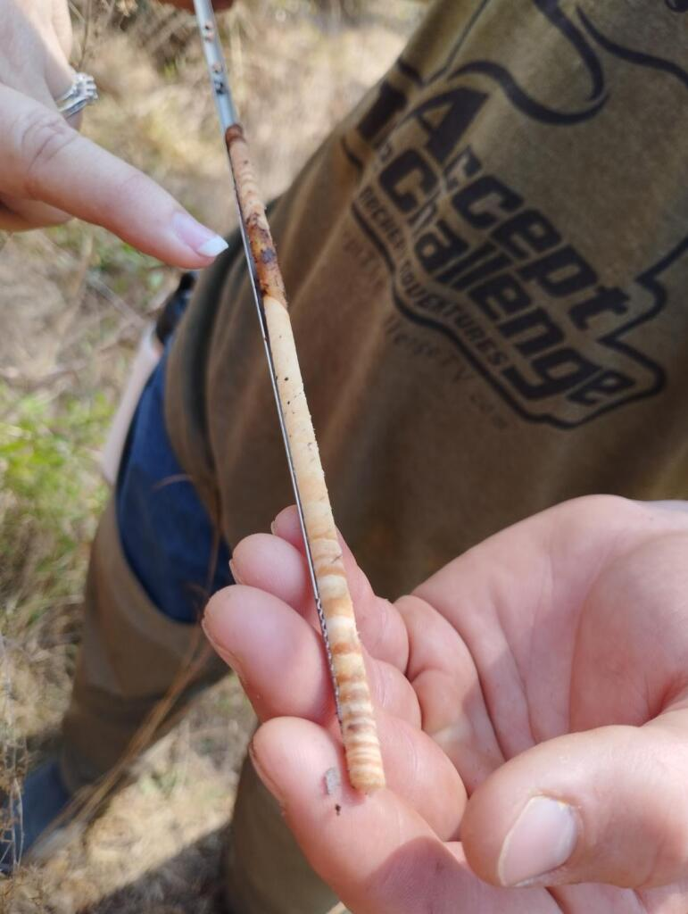
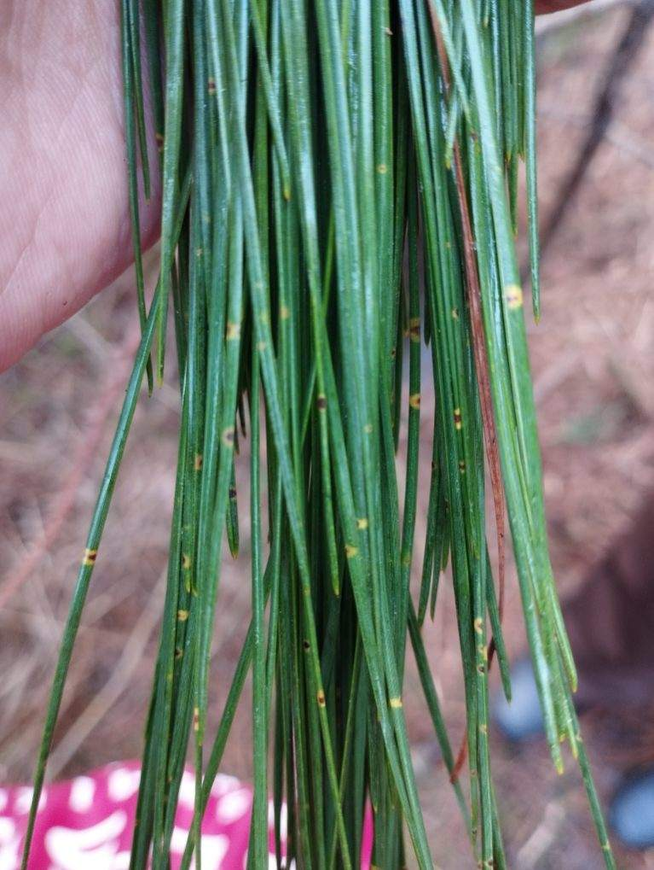
Background
Forest Health Dynamics Laboratory
Dendrochronology
BSNB affecting needles

Slide 3
Objectives
Forest Health Dynamics Laboratory
1. Determine a correlation between BSNB severity and tree growth
2. Use GPS points of trees to find patterns in BSNB emergence and spread

Slide 4
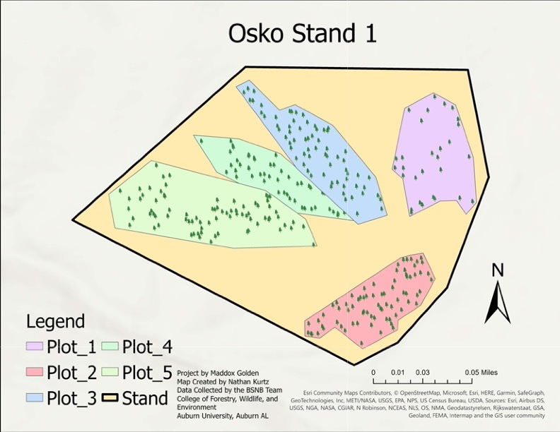
The Stand
Forest Health Dynamics Laboratory
5 plots
n=300 trees
Site data
Convexity
Slope
Elevation
Aspect
LAI
PAR
BA=60ft² 26y/o 9.5 acres

Slide 5
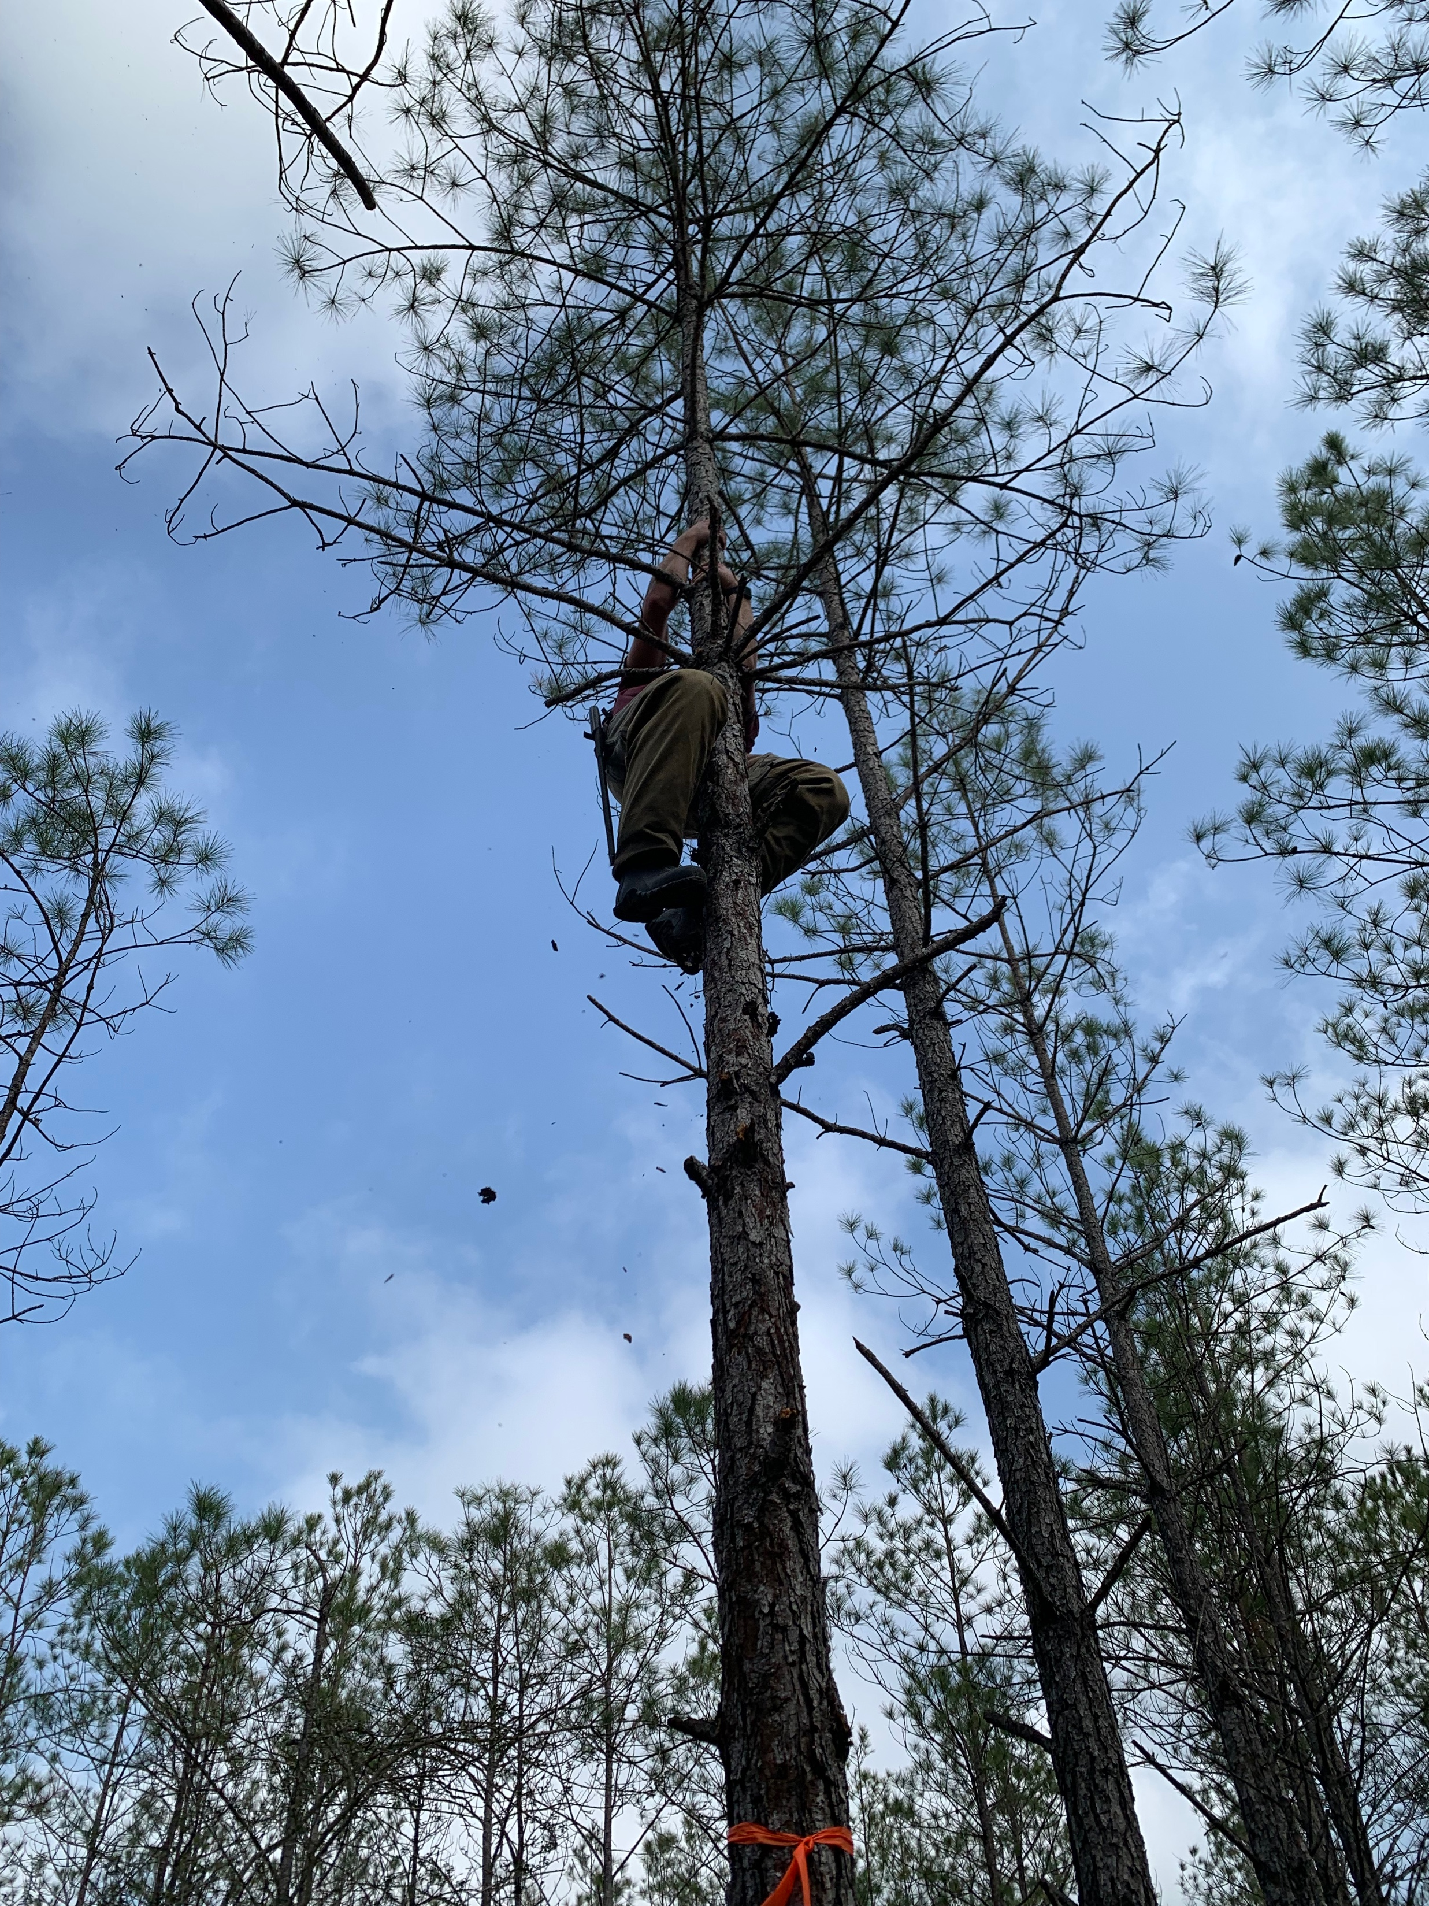
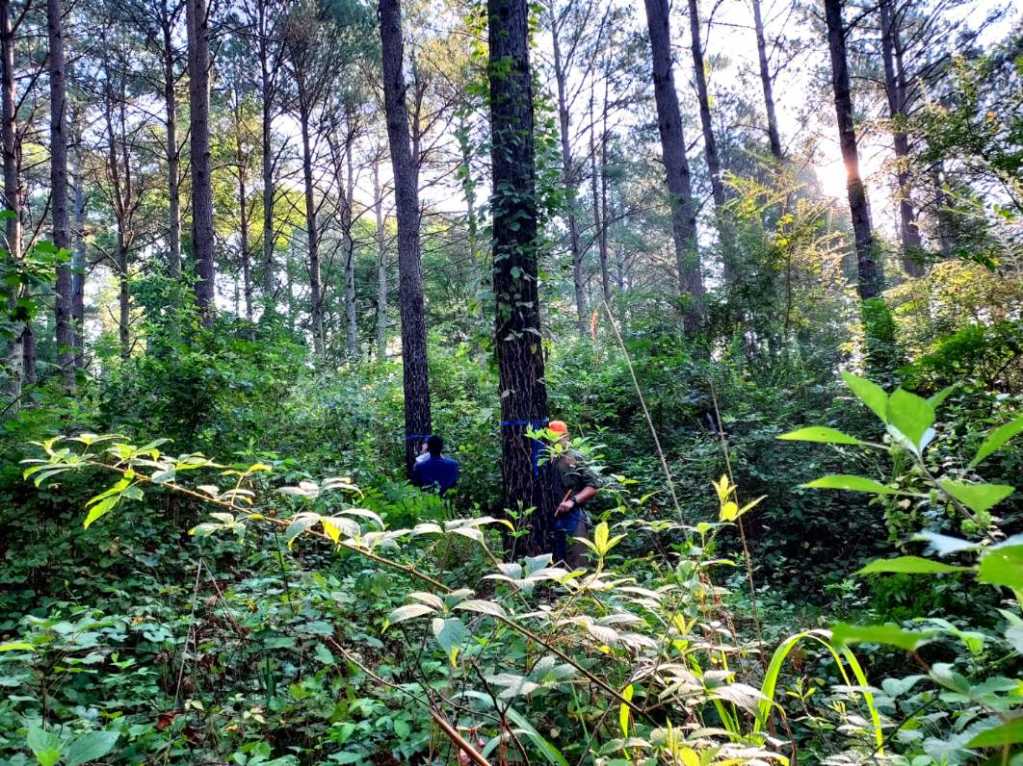
Data Collection
Forest Health Dynamics Laboratory
Tree Data - DBH & Ht
Disease Rating
Needle Collection

Slide 6
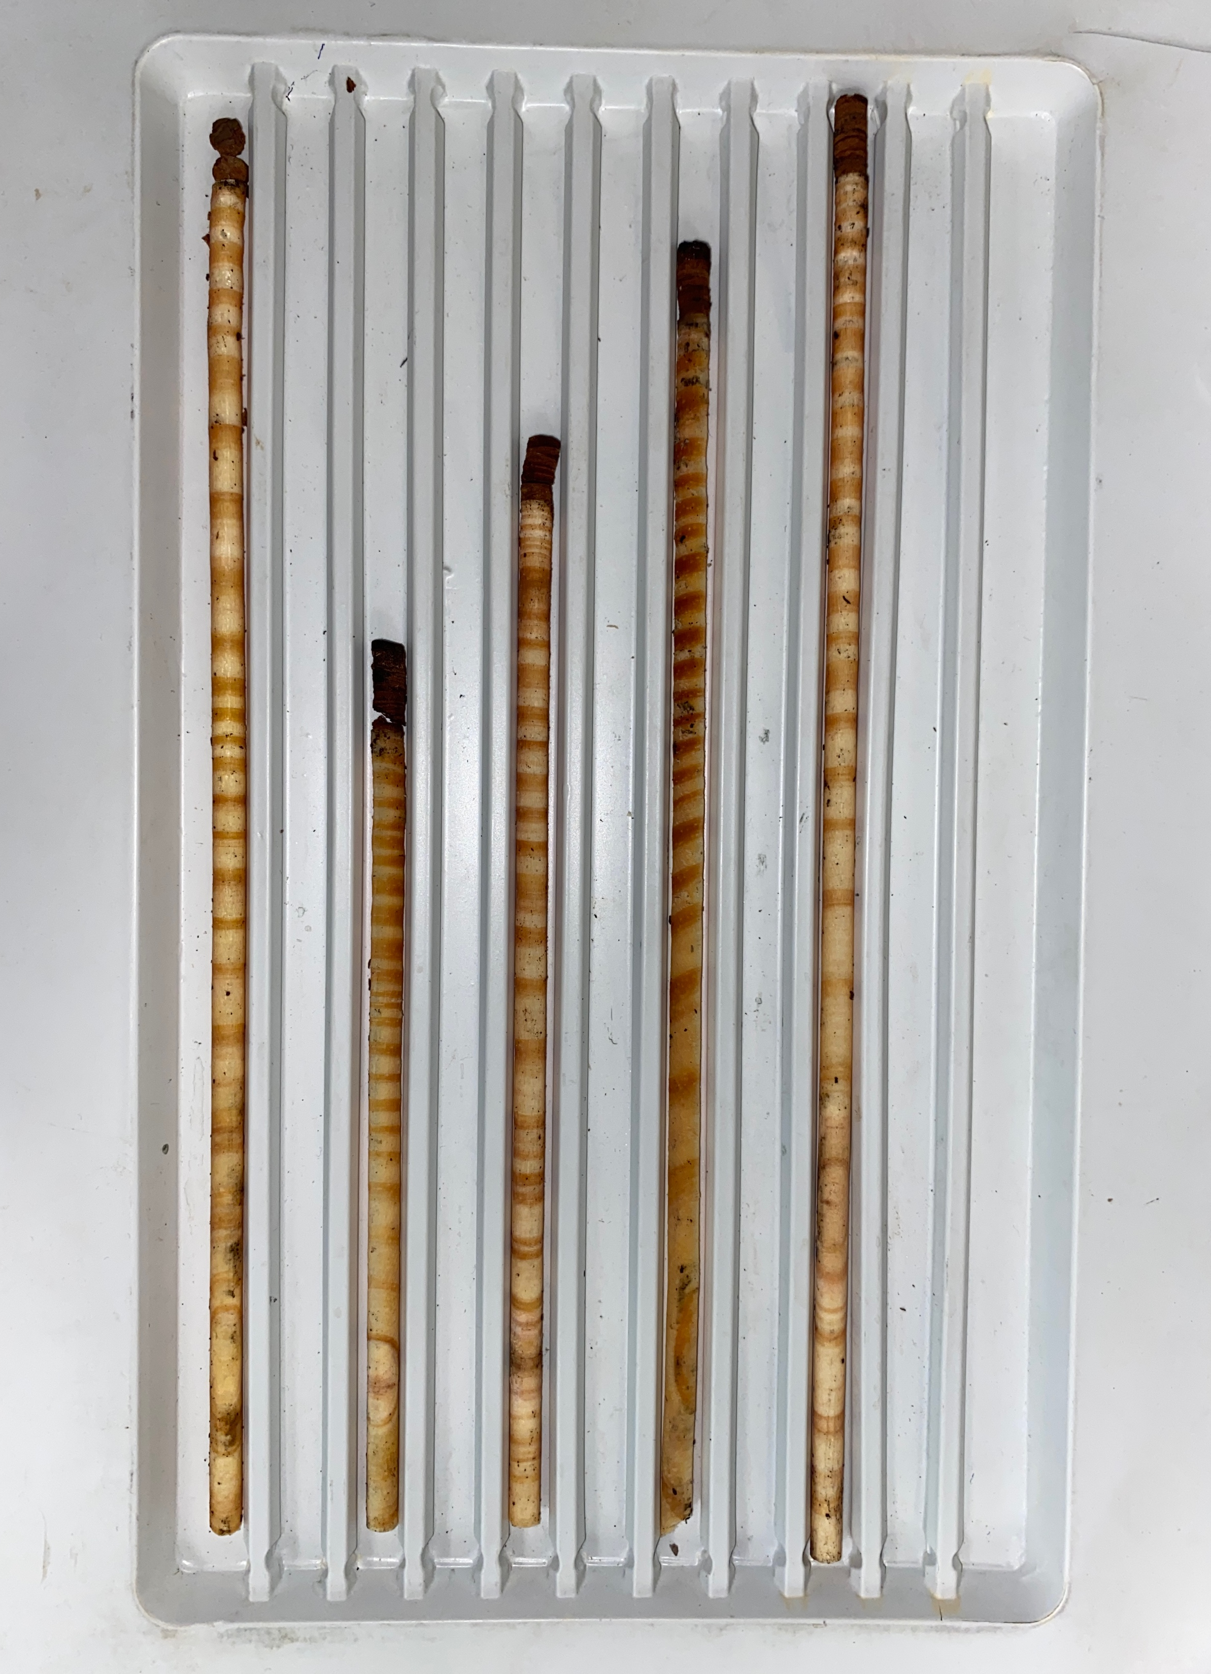
Tree Cores
Forest Health Dynamics Laboratory
Measure:
Year-to-year
5-year
10-year growth increments

Slide 7
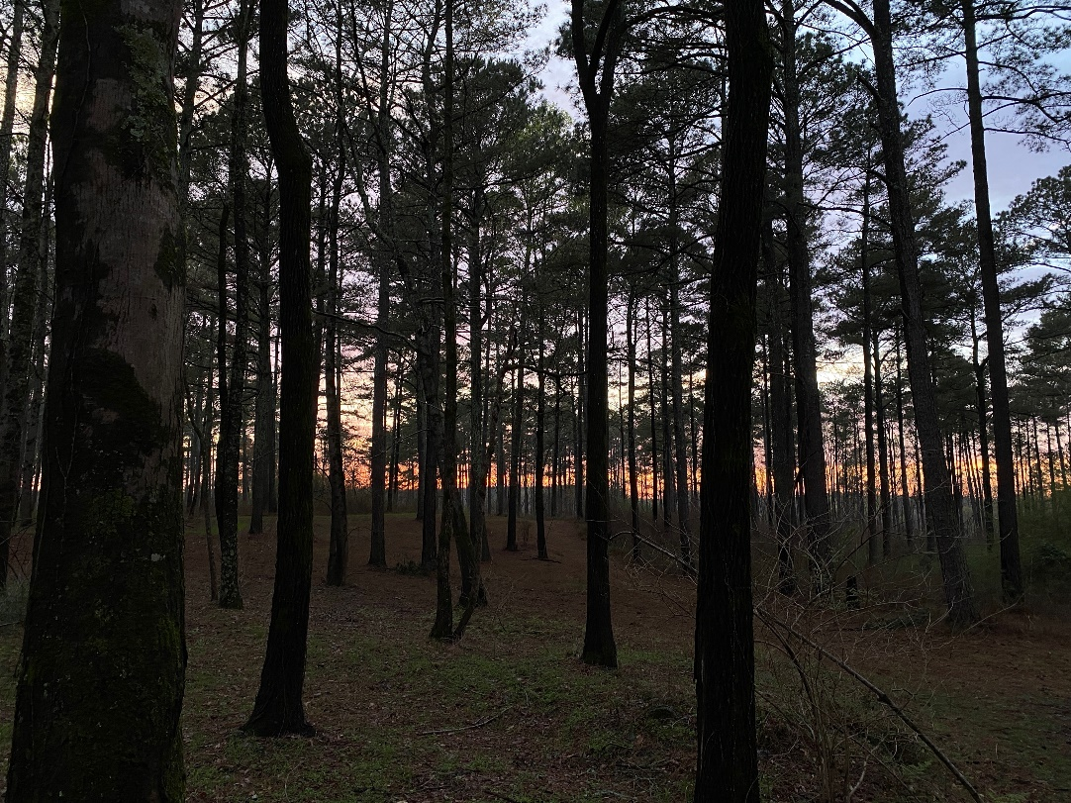
Expected Outcomes
Forest Health Dynamics Laboratory
We expect our results to provide further insights into the impact of increased BSNB on the growth of loblolly pine.

Slide 8

Acknowledgements
Forest Health Dynamics Laboratory
Advisor
Dr. Lori Eckhardt
Landowner
Osko Forest – Glover Family
Graduate Students
Jaden King
Emmanuel Nyarko
Facilities
Forest Health Dynamics Lab
Lab manager
Jessica Baldwin
Undergraduates
Andrew Howard
Drew Conway
Nathan Kurtz
Garrett Gaar

Slide 9
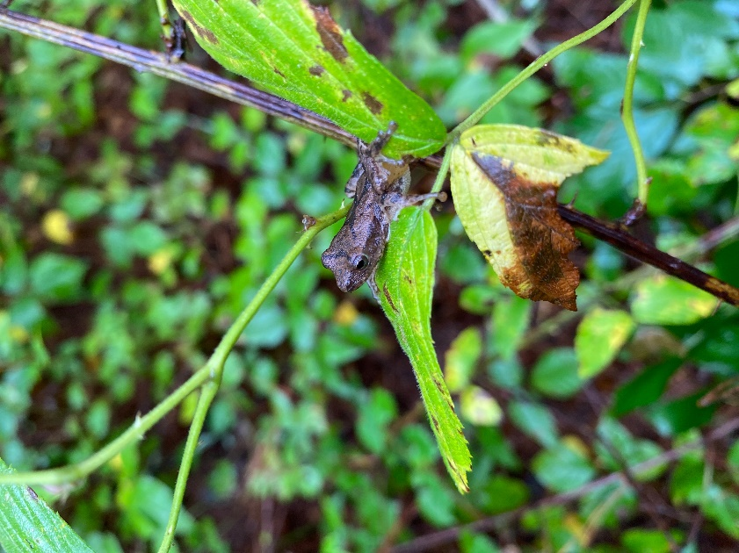
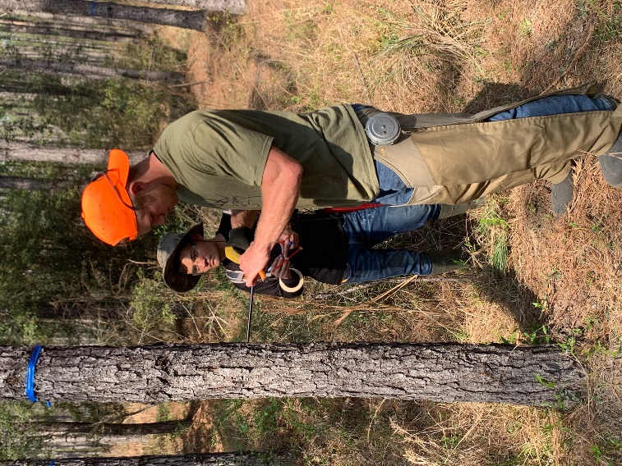
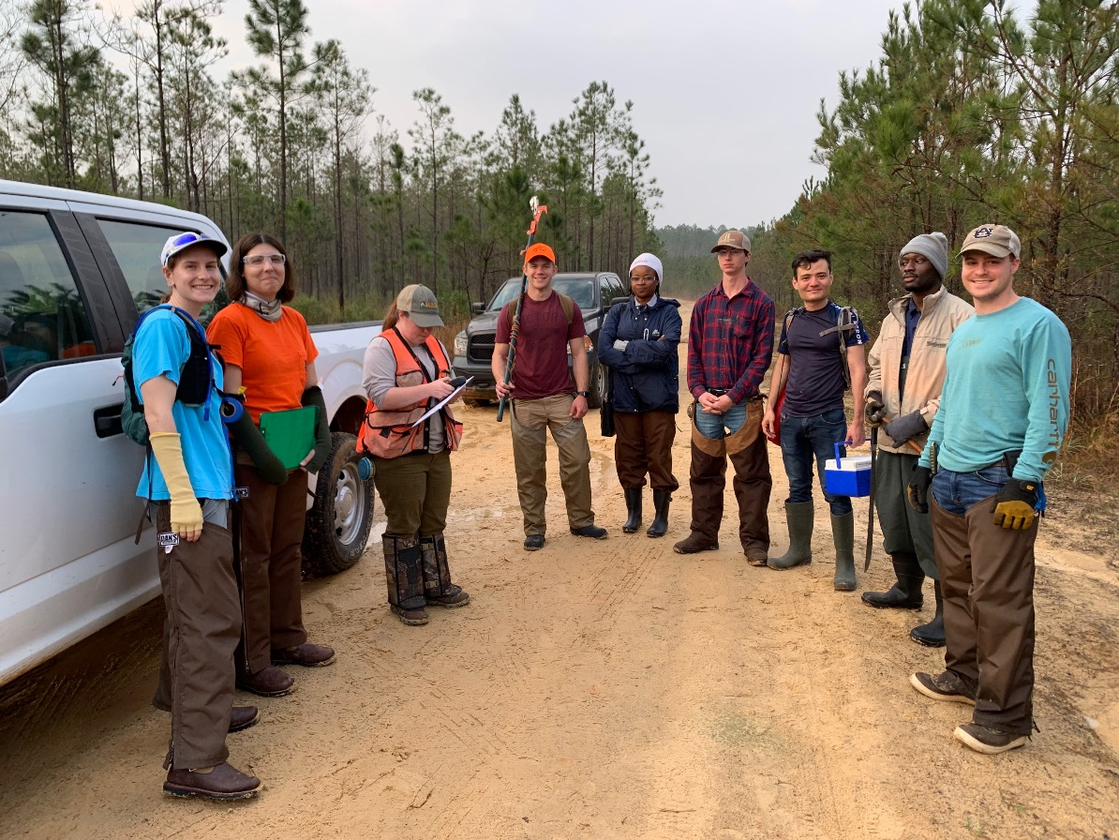
Questions?
Forest Health Dynamics Laboratory

