Slide 1

Using Sporulation Chambers to Study BSNB Infection Trends
Andrew Howard, Jaden King, Jessica Baldwin, and Lori Eckhardt
Forest Health Dynamics Laboratory
College of Forestry, Wildlife and Environment
Auburn University, Auburn AL
Forest Health Dynamics Laboratory
College of Forestry, Wildlife and Environment - Auburn University

Slide 2
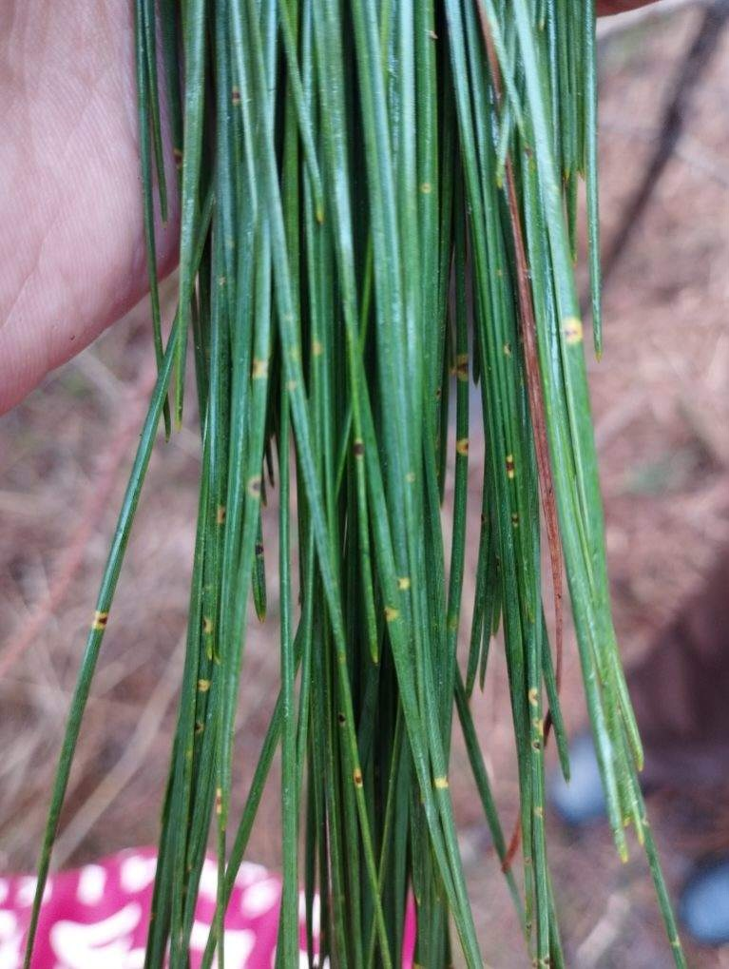
Background
Forest Health Dynamics Laboratory
Obligate parasite of pine needles
Sporulation chambers offer what L. acicola needs to survive

Slide 3
Objectives
Forest Health Dynamics Laboratory
Determine areas with highest BSNB infection rates
Determine months with highest instances of BSNB
Identify trends of other pathogens co-inhabiting needles

Slide 4
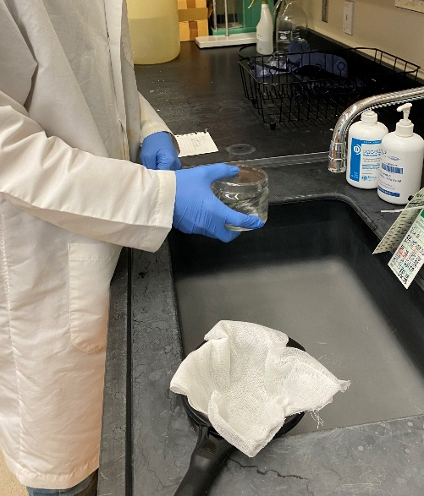
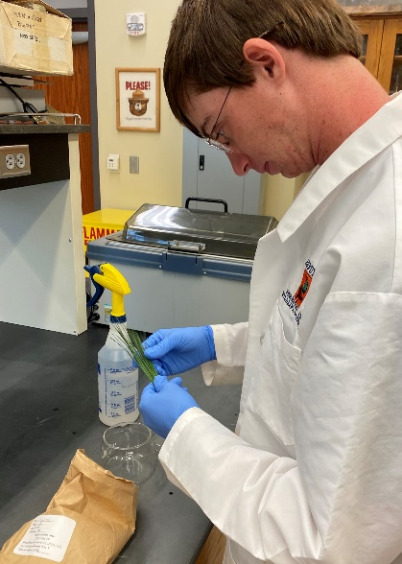
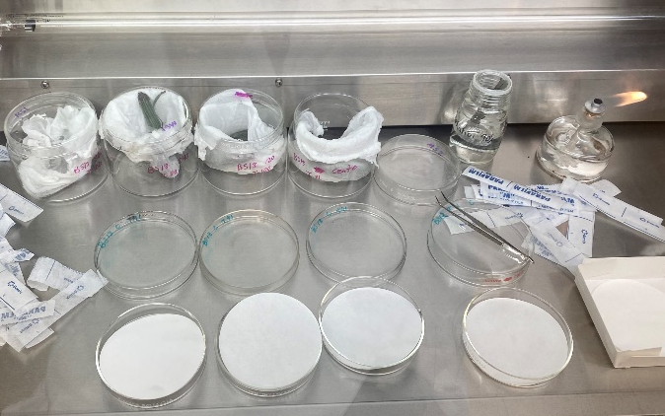
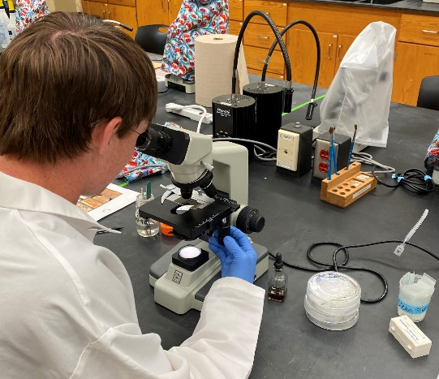
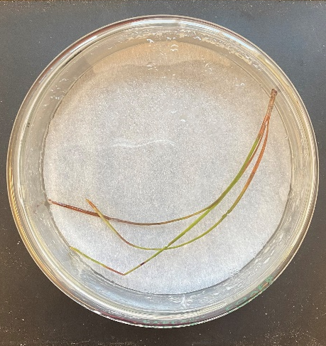
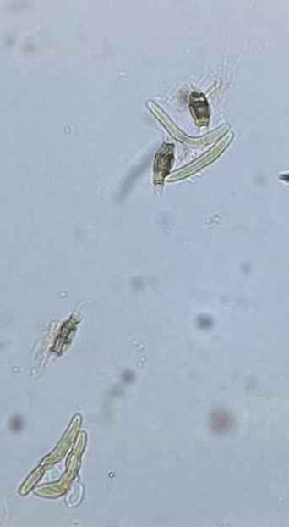
Methods- sporulation chambers
Forest Health Dynamics Laboratory

Slide 5
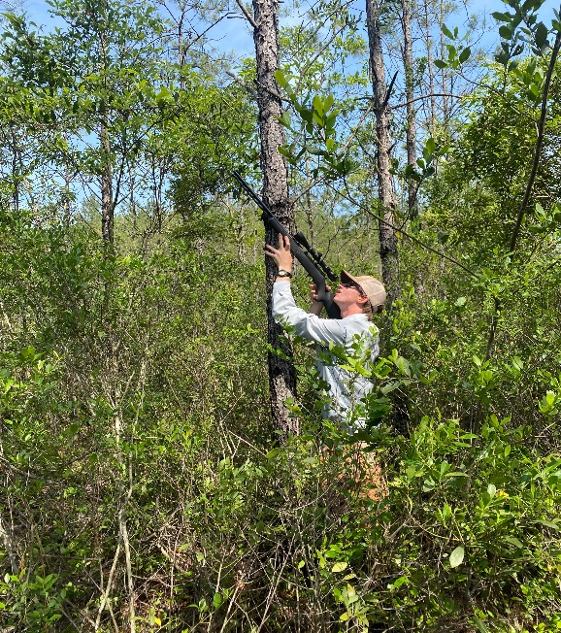
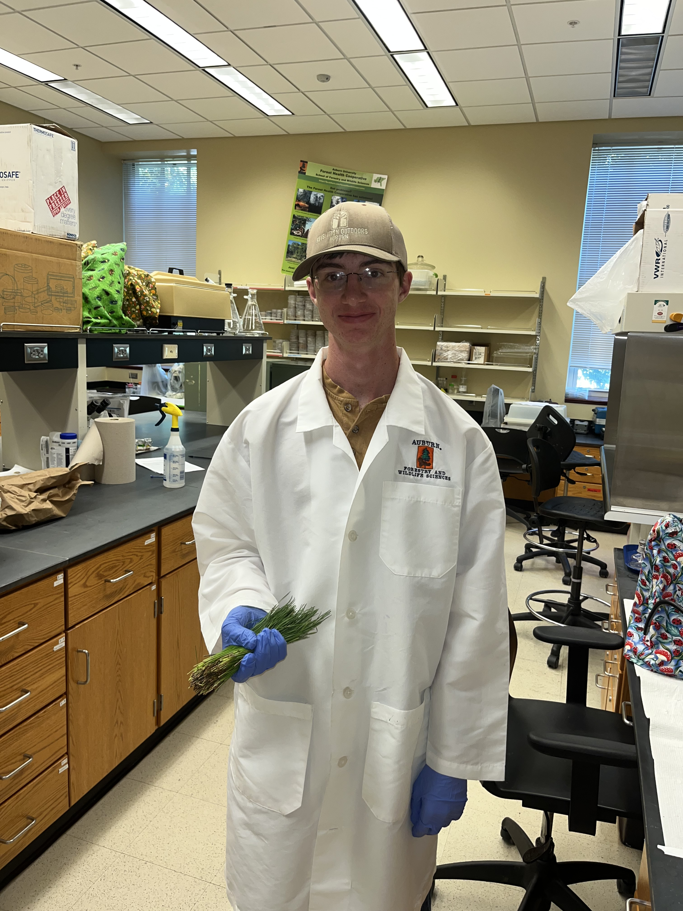
Collecting Needles
Forest Health Dynamics Laboratory
55g per tree
1 tree per subplot
4 chambers per tree

Slide 6
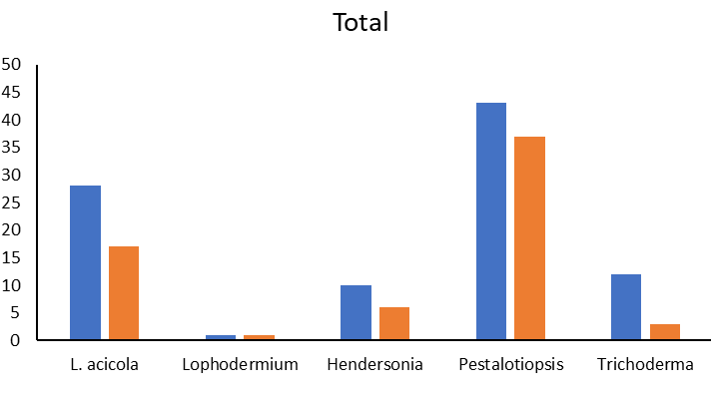
Results
Forest Health Dynamics Laboratory
Number of samples
Cullman
Washington

Slide 7
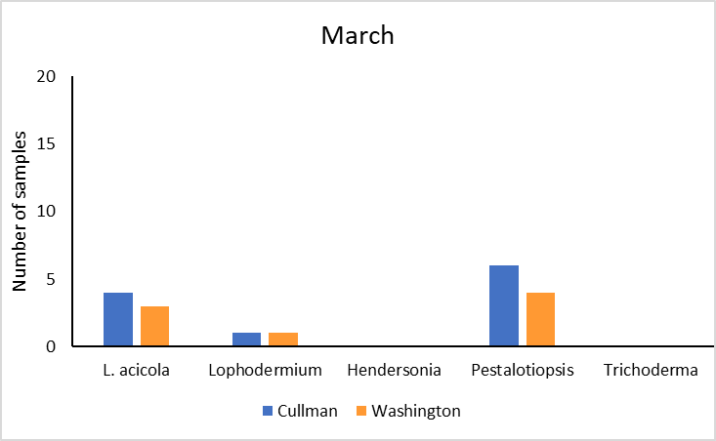
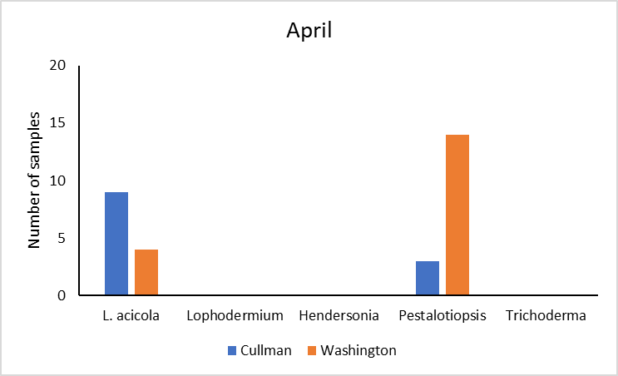
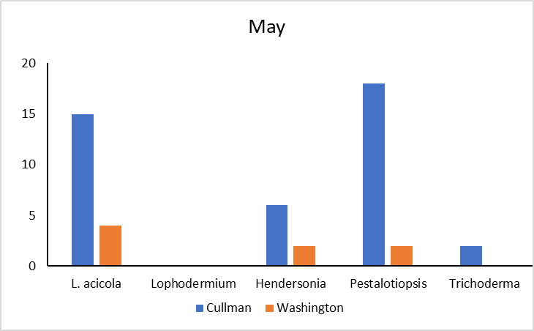
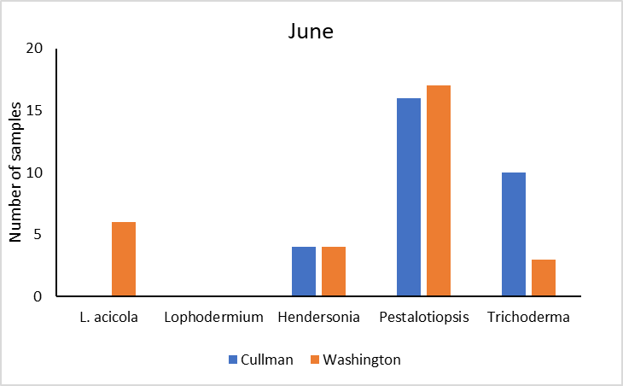
Results
Forest Health Dynamics Laboratory
Cullman
Washington
7

Slide 8
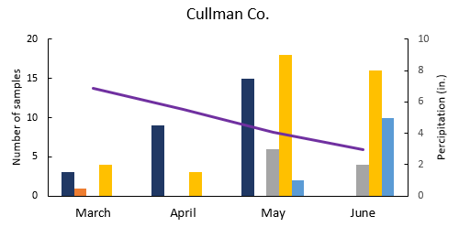

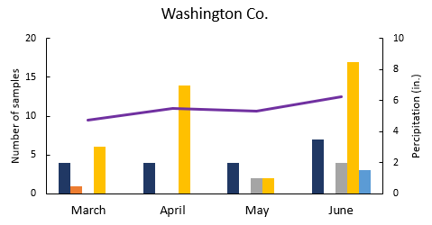
Forest Health Dynamics Laboratory
Results
Average temperature (F):
55.1 60.0 68.1 74.3
Trichoderma
Average temperature (F):
62.7 66.4 72.6 78.9

Slide 9


Acknowledgements
Forest Health Dynamics Laboratory
Forest Health Cooperative
Forest Service
Study Sites: Longleaf Land & Timber Co., Stallworth Land Company, Osko Forest (Glover Family)
Forest Health Dynamics Lab: Dr. Eckhardt, Jessica Baldwin, Jaden King, Emmanuel Nyarko, Temitope Folorunso, Christian Rivera, Angel Cagle, Maddox Golden, Drew Conway, Garrett Gaar, Nathan Kurtz
Kris Bradley

Slide 10
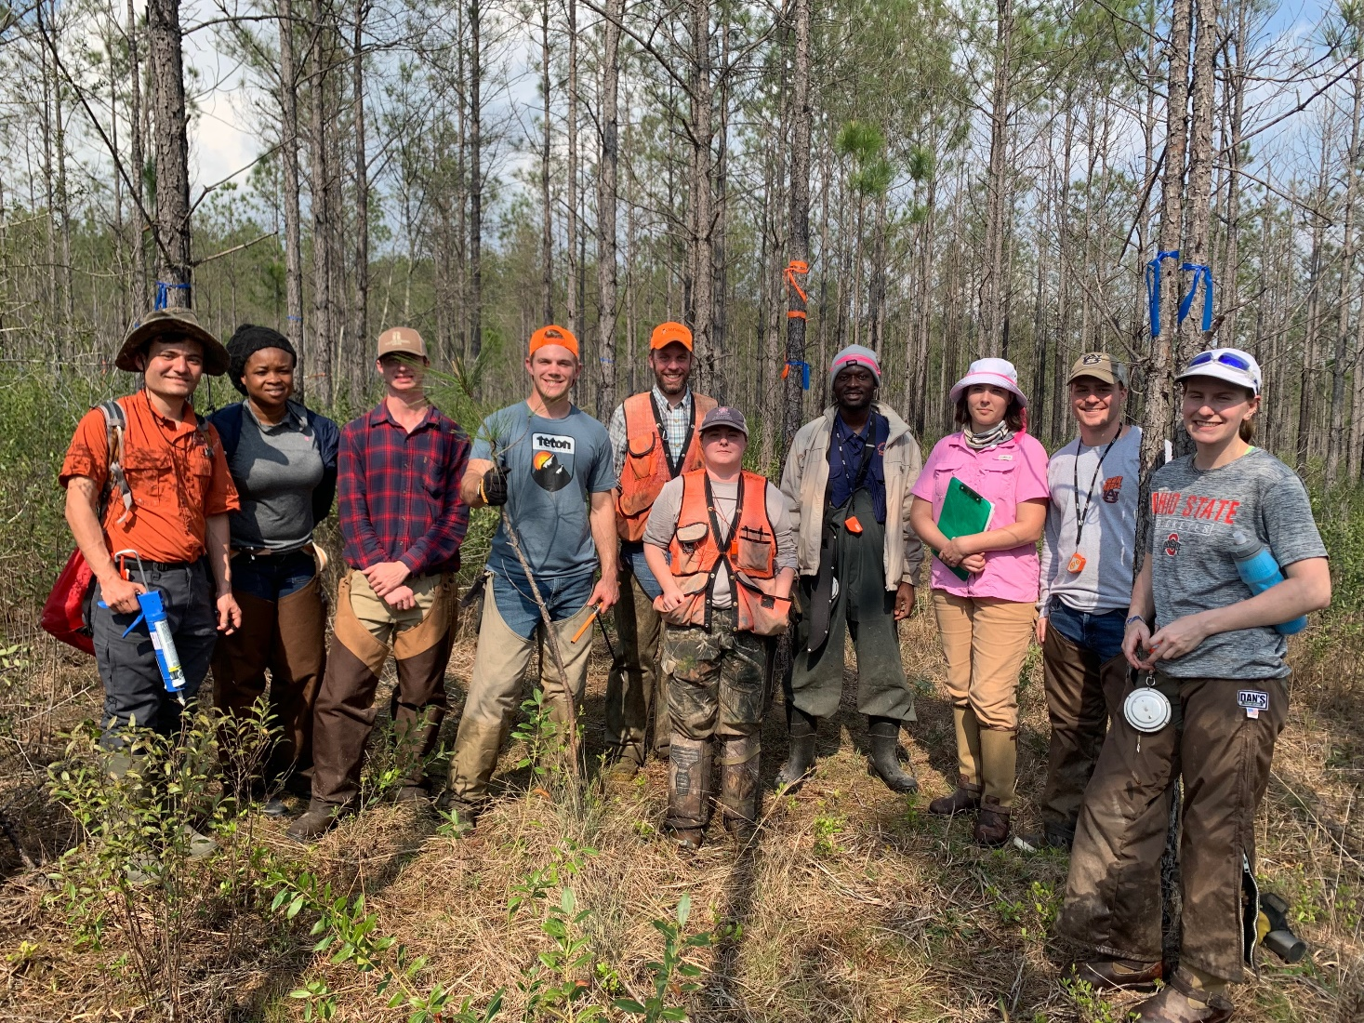
Questions
Forest Health Dynamics Laboratory

