Slide 1

Loblolly pine growth effects and response to the spread of
Lecanosticta acicola
Jaden King, Jonathan Cale, Heather Alexander,
Zhaofei Fan, and Lori Eckhardt
Forest Health Dynamics Laboratory
College of Forestry, Wildlife and Environment
Auburn University, Auburn AL
Forest Health Dynamics Laboratory
College of Forestry, Wildlife and Environment, Auburn University

Slide 2
Introduction
Forest Health Dynamics Laboratory
Loblolly pine is important within the state of Alabama and the Southeast as a whole
Brown spot needle blight recently started causing detrimental affects to loblolly pine
Little is known about the spread of disease and impact on loblolly pine growth

Slide 3
Background
Forest Health Dynamics Laboratory
Photosynthesis drives forest production
More needle disease could result in lower photosynthetic area
Less photosynthesis results in less energy supplied to growth

Slide 4
Objectives
Forest Health Dynamics Laboratory
Determine impacts on the vigor of loblolly pine tree growth from L. acicola
Understand environmental factors that may increase the spread of L. acicola
Anatomical response of Loblolly pine to L. acicola

Slide 5
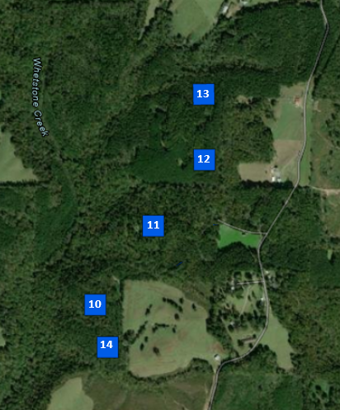
North (Cullman Co.)
Forest Health Dynamics Laboratory

Slide 6
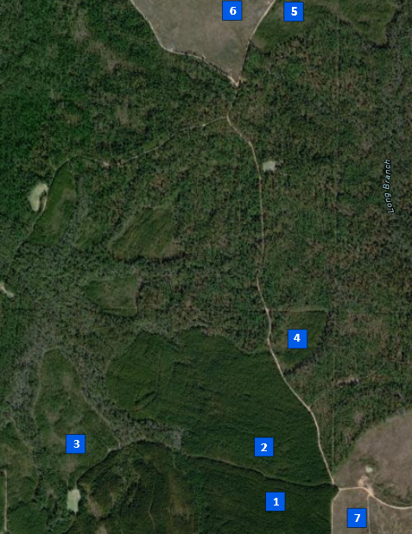
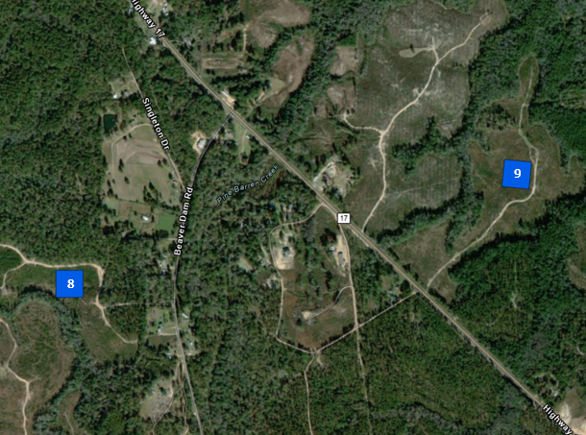
South (Washington Co.)
Forest Health Dynamics Laboratory

Slide 7
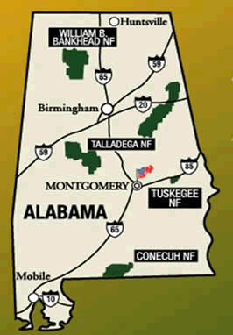
National Forest plots
Forest Health Dynamics Laboratory
USFS, 2022

Slide 8

Plot layout
Forest Health Dynamics Laboratory
*Image not to scale
Subplot
N
360°
24’
Ceptometer readings
120’
Physiology plot
312’
300°
66’
60°
Center
Soil sample
180°
240°
120°
312’

Slide 9
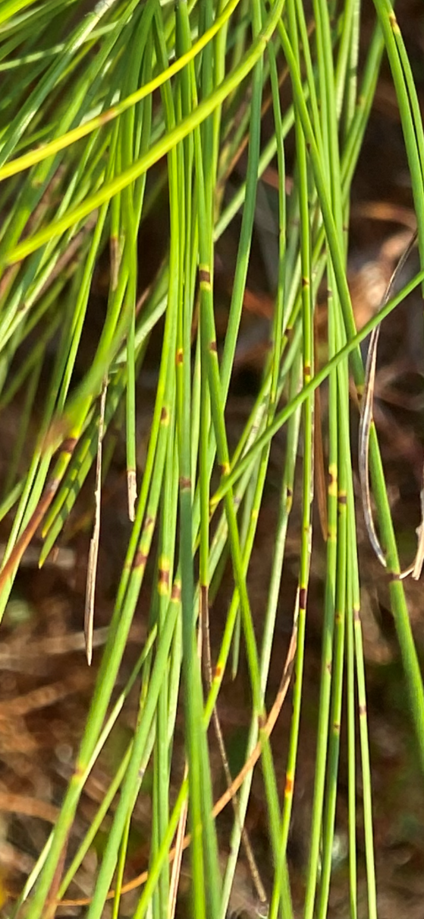
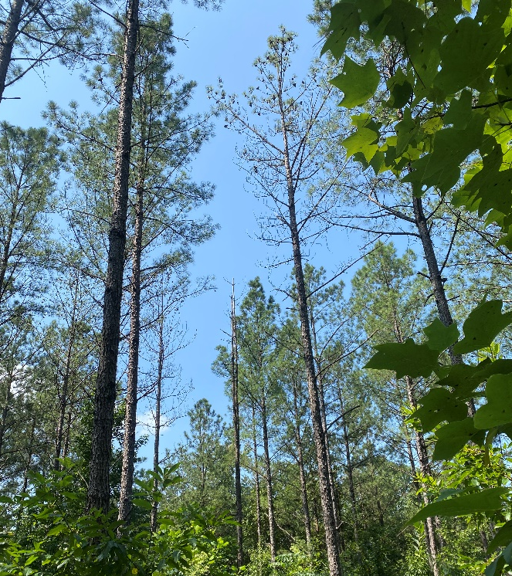
Tree vigor- seasonal measurements
Forest Health Dynamics Laboratory
Disease rating

Slide 10
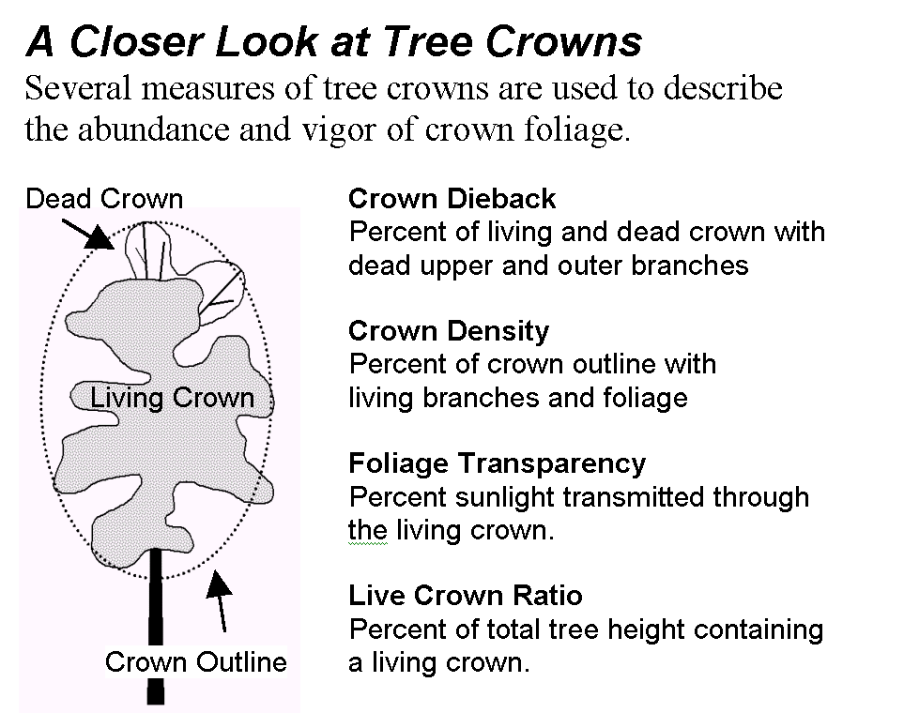
Tree vigor- yearly measurements
*seasonal on physiology trees
Forest Health Dynamics Laboratory
Crown rating:
Crown Dieback
Percent of living & dead crown with dead upper & outer branches.
Crown Density
Percent of crown outline with living branches & foliage.
Foliage Transparency
Percent sunlight transmitted through the living crown.
Live Crown Ratio
Percent of total tree height containing a living crown.
Crown Light
Percent of total tree receiving full light.
Crown Position
Relative position of each tree in relation to the main overstory canopy.

Slide 11
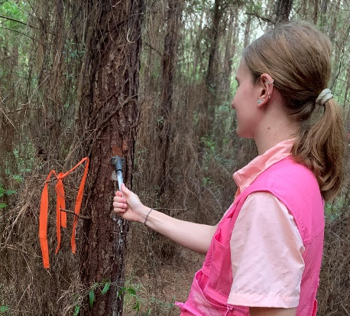
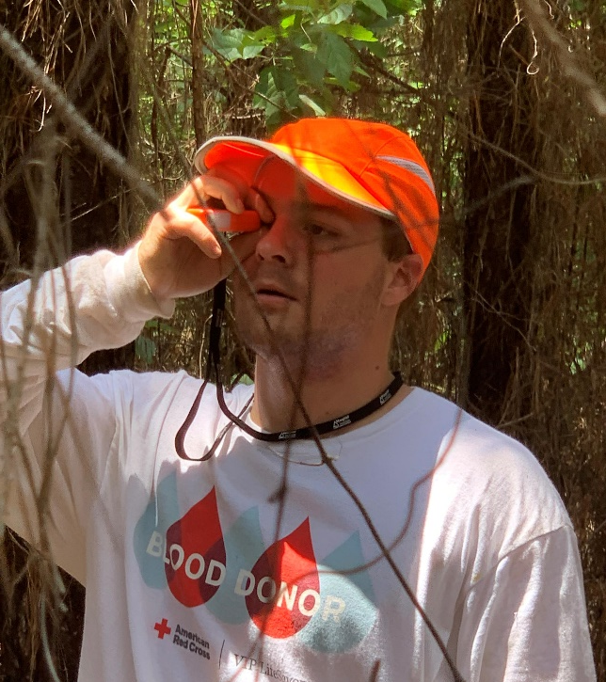
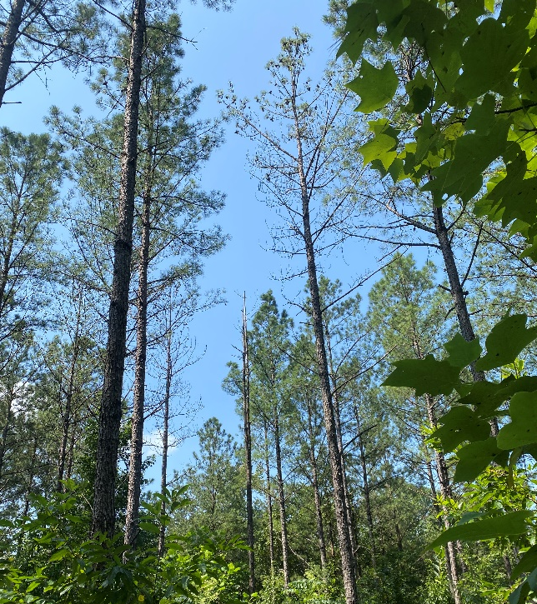
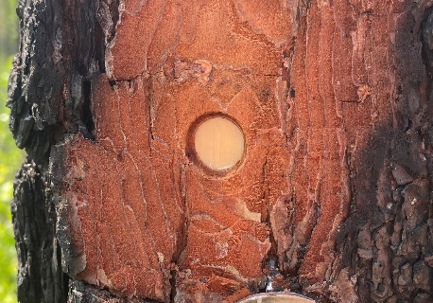
Tree vigor- yearly measurements
Forest Health Dynamics Laboratory
Physiology trees only
Height & DBH
Resin collection
Shoot & needle growth

Slide 12
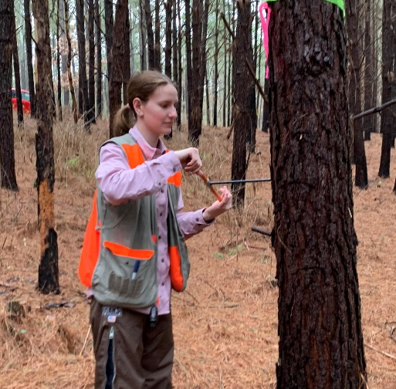
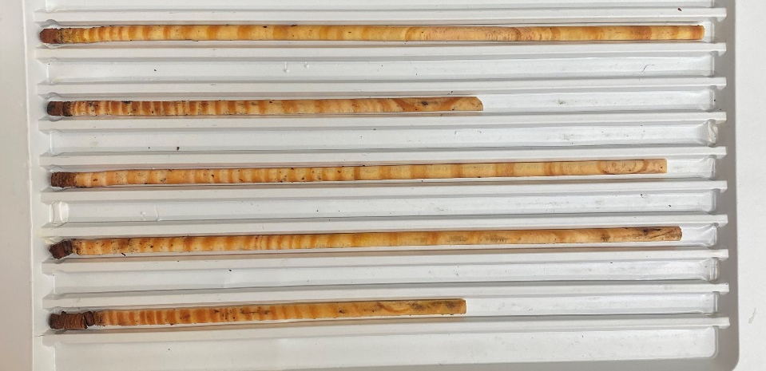
Tree vigor- 1st year measurement
Forest Health Dynamics Laboratory
Growth rates (cored trees with DBH 4”+)

Slide 13
Tree vigor- 2nd year measurement
Forest Health Dynamics Laboratory
Foliar nutrition analysis
physiology plots only- August 2024
Macronutrients
Micronutrients
N
P
Mn
K
Ca
Zn
B
S
Mg
Cu

Slide 14
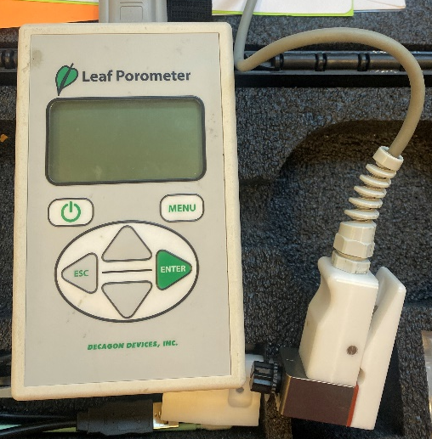
Physiology plots seasonal measurements
Forest Health Dynamics Laboratory
Stomatal conductance
mid-day
Opened Stoma
(increases uptake & loss)
Closed Stoma
(decreases uptake & loss)
CO₂
Guard cell
Pore
O₂ & H₂0

Slide 15
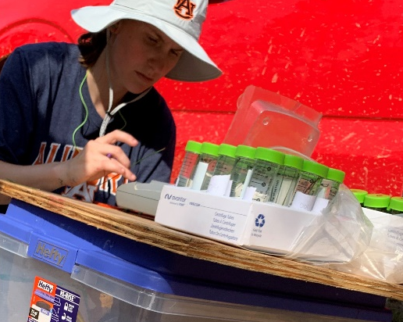
Physiology plots seasonal measurements
Forest Health Dynamics Laboratory
Relative water content
mid-day
Fresh weight – Dry weight
Turgid weight – Dry weight
x 100
RWC (%) =

Slide 16
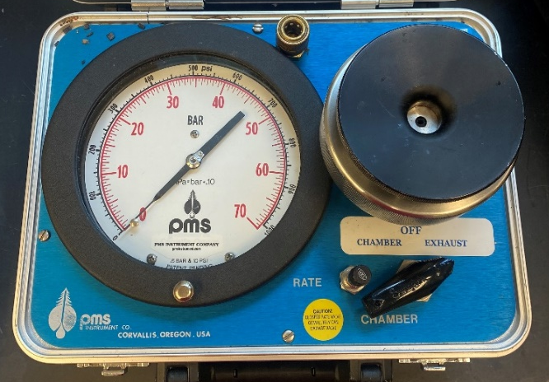

Physiology plots seasonal measurements
Forest Health Dynamics Laboratory
Pressure chamber
pre-dawn
Xylem movement
Insert fascicle with needle apex down
Xylem
Pressure
apex

Slide 17
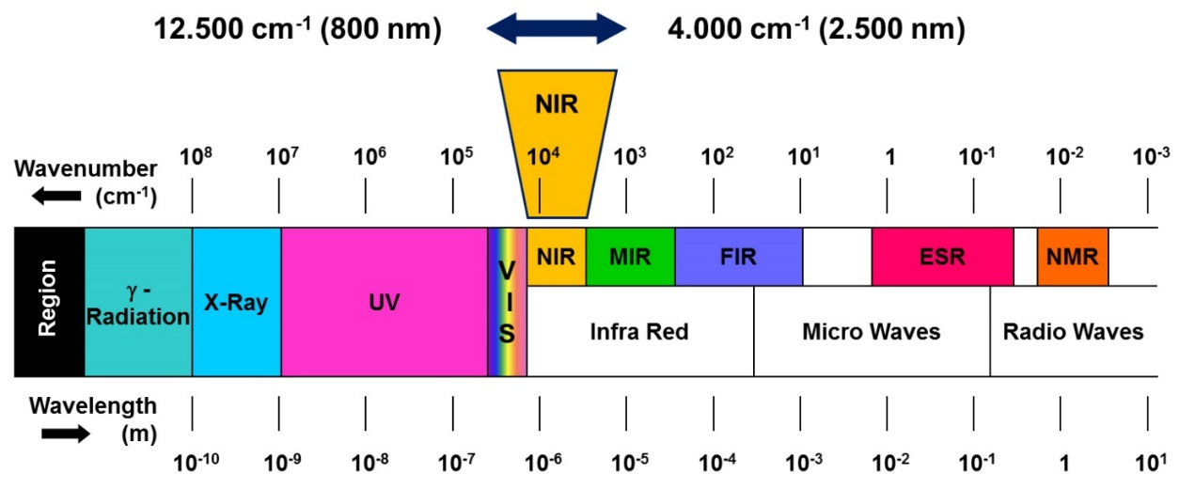
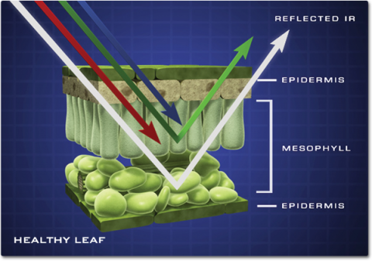
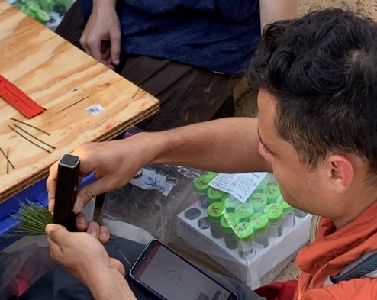
Reflected visible near-infrared radiation
Forest Health Dynamics Laboratory
Physiology plots
seasonally- pre-dawn & mid-day
NASA, 2016

Slide 18
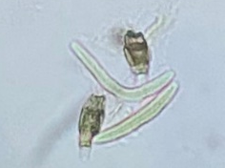
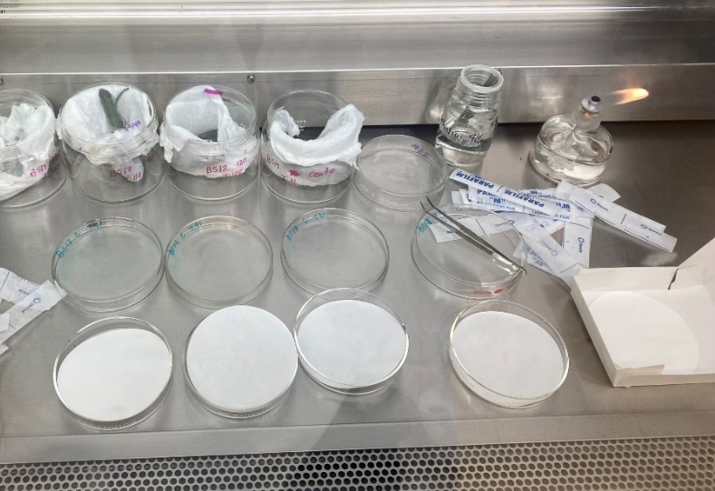
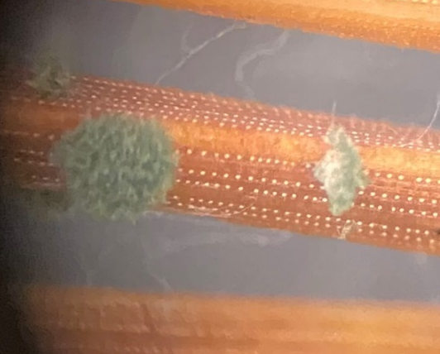
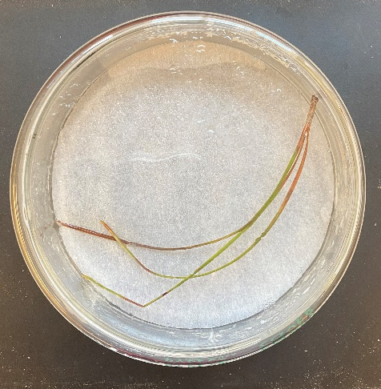
Physiology pairing – sporulation chambers
Forest Health Dynamics Laboratory
Sporulation chamber set up:
sampled 55 g from one branch on the tree
Pathogenic fungi under the microscope
Pestalotiopsis
BSNB
Non-pathogenic fungus under the microscope
Trichoderma

Slide 19
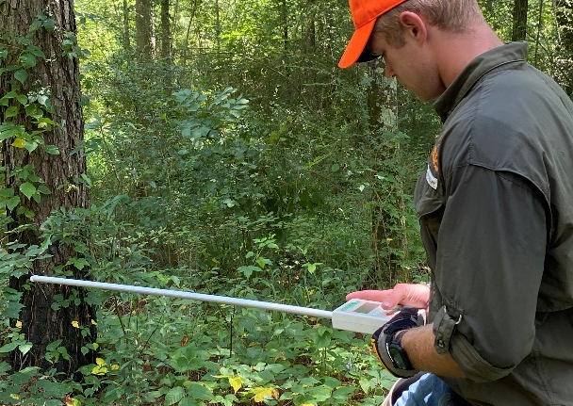

Whole plot
Forest Health Dynamics Laboratory
Ceptometer measurements
Climate history
Plot history
Plot measurements:
Basal area
Convexity
Slope
Elevation

Slide 20
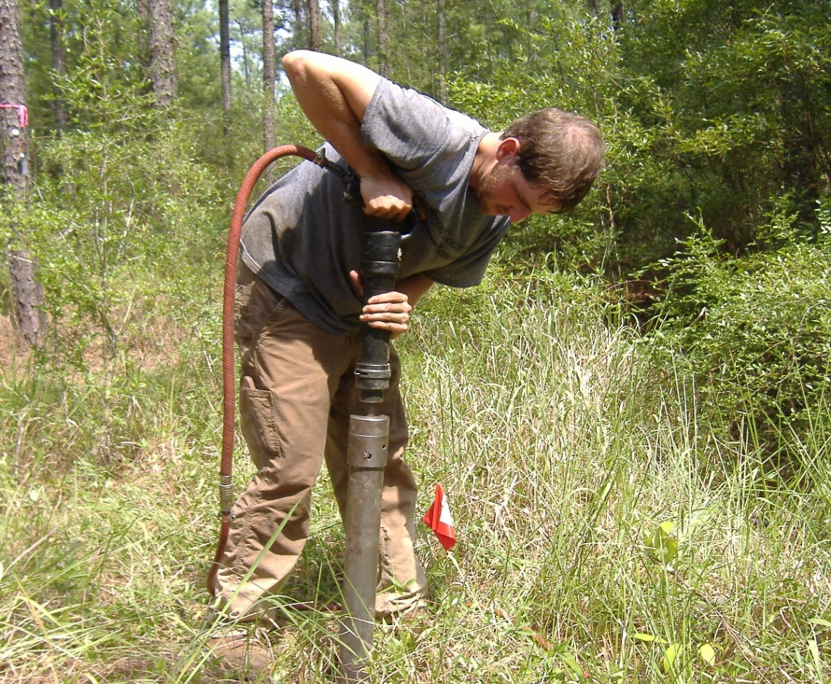
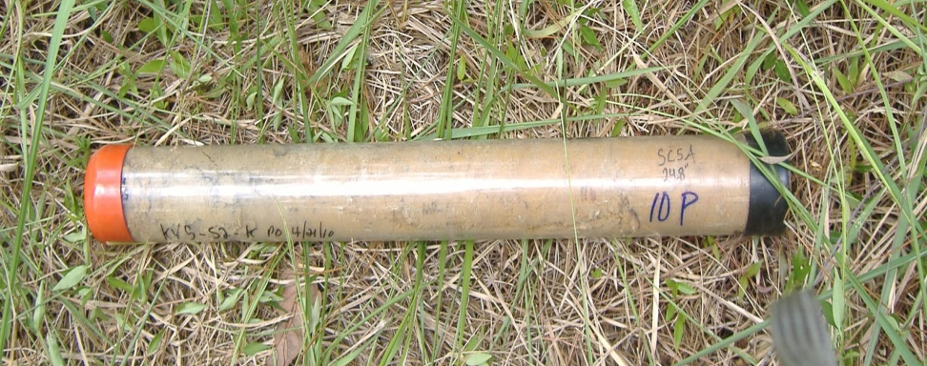
Soil data- 1st year only
Forest Health Dynamics Laboratory
Cardinal directions around center subplot
Dry weight
Soil moisture content
Chemical analysis
Soil pH
Penetrometer readings

Slide 21

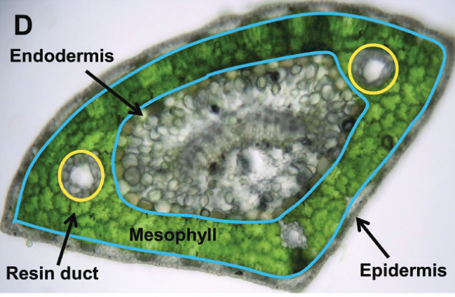
Effects on needle anatomy
Forest Health Dynamics Laboratory
Make cross-sections of needles and observe under a microscope
Stomata
Turner et al., 2019

Slide 22
Relative water content preliminary results
Forest Health Dynamics Laboratory
Fully turgid transpiring leaf
Severely desiccated and dying leaves

Slide 23
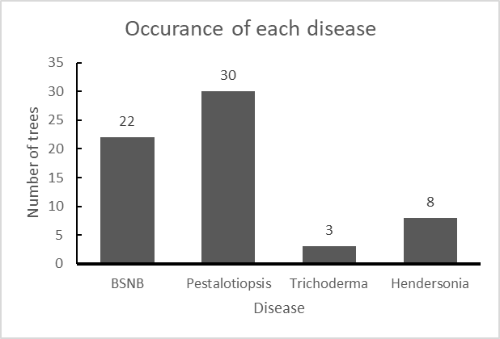
Results-physiology pairing
Forest Health Dynamics Laboratory
Samples with disease: 35
Samples with no disease: 10
Most on 1 samples: 3
Least on 1 sample: 0
n = 45
Number of samples

Slide 24
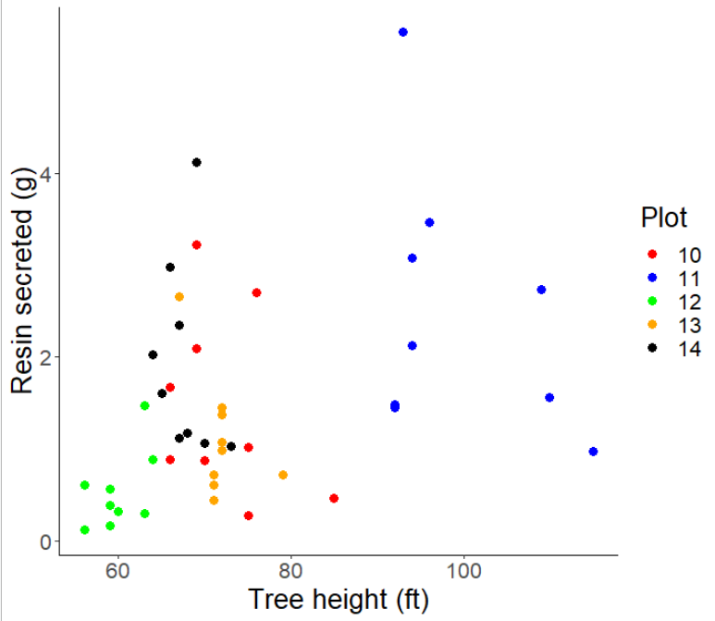
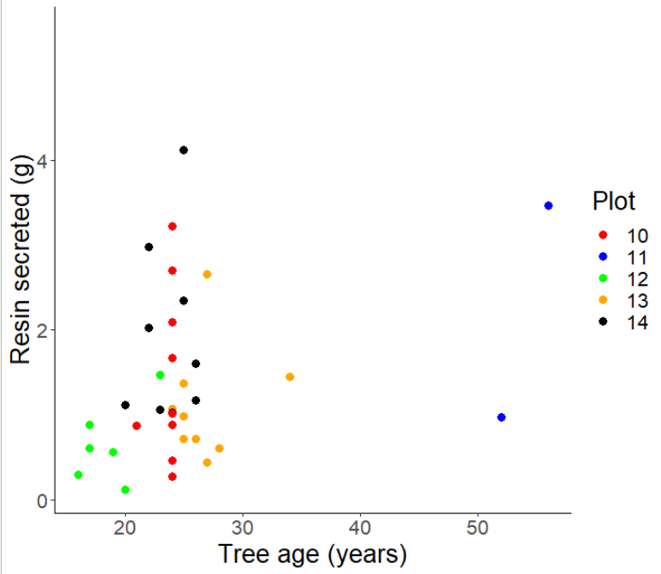

Results- resin
Forest Health Dynamics Laboratory
Resin secretion increases in trees with higher disease rating, height, and age

Slide 25
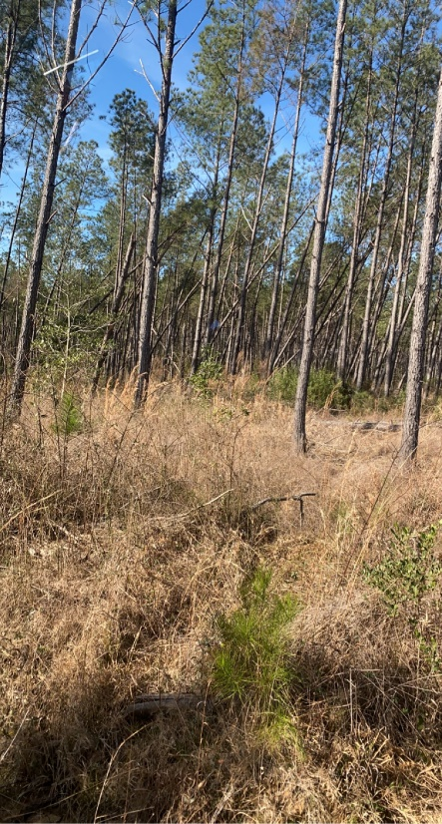
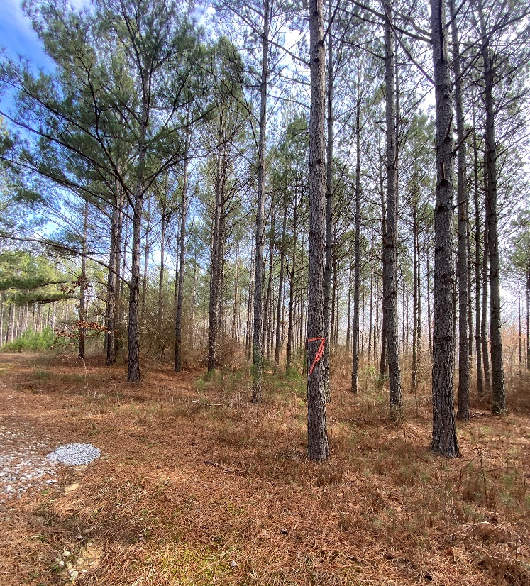
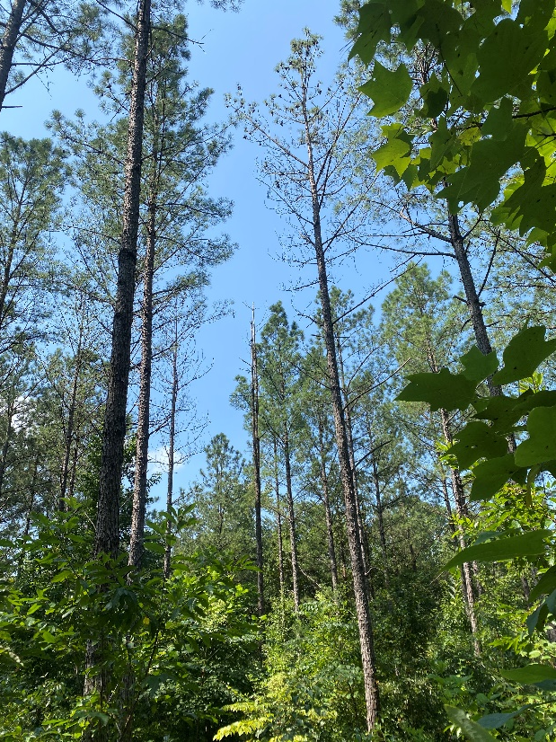
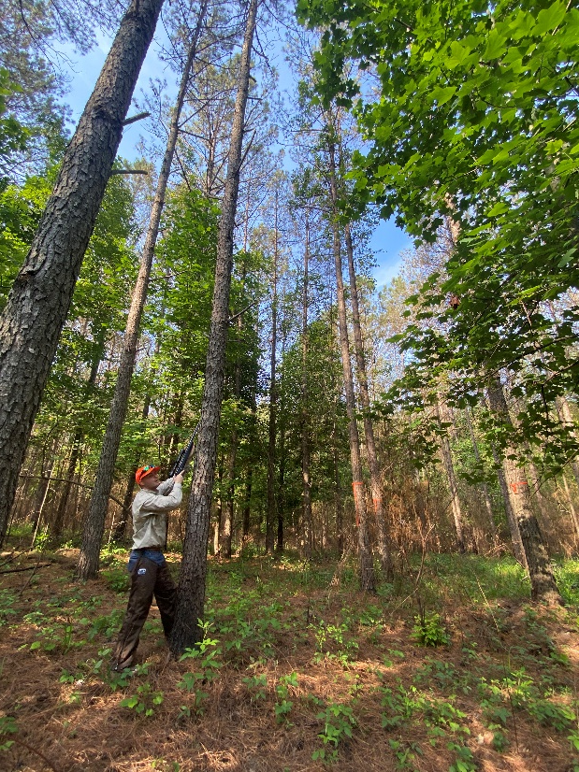
Summary
Forest Health Dynamics Laboratory
Discover the means of transmission of this disease and its impact on the growth and health of trees

Slide 26

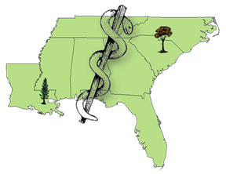


Acknowledgements
Forest Health Dynamics Laboratory
Committee
Dr. Lori Eckhardt
Dr. Jonathan Cale
Dr. Heather Alexander
Dr. Joseph Fan
Lab manager
Jessica Baldwin
Landowners
Stallworth Land Company
Longleaf Land & Timber Co.
Osko Forest – Glover Family
US Forest Service
Graduate students
Christian Rivera
Temitope Folorunso
Emmanuel Nyarko
Gabriel Silva
Swati Singh
Collaborators
Dr. Emily Carter
Dr. Brian Via
Dr. Iris Vega
Dr. Janna Willoughby
Dr. Lana Narine
Ryan Mitchell
Kris Bradley
Susan Turner
Undergraduates
Angel Cagle
Andrew Howard
Maddox Golden
Drew Conway
Nathan Kurtz
Garrett Gaar
Brea Thomas
Facilities
Forest Health Dynamics Lab
Geospatial Analytics Lab
Forest Products Lab
Forest Health Cooperative

Slide 27
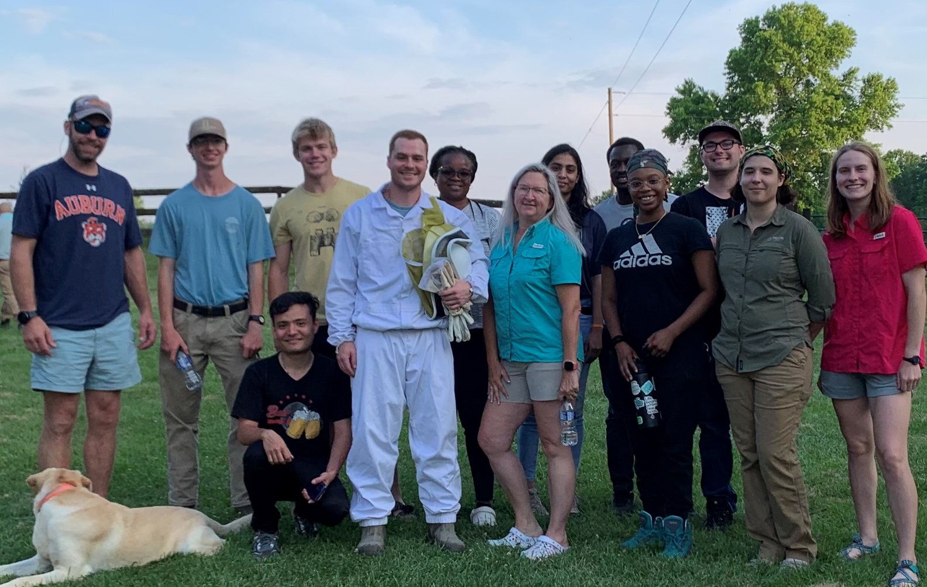
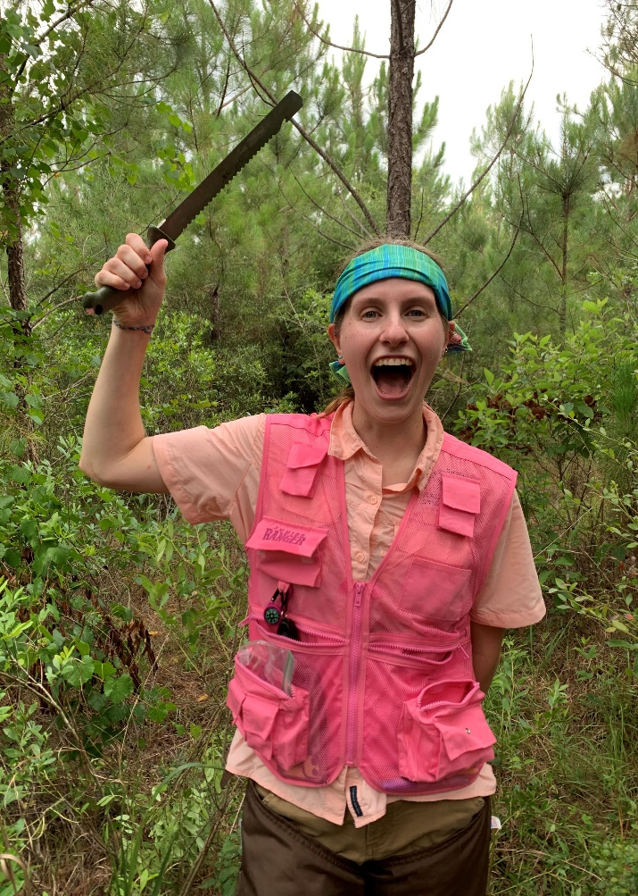
Thank you!
Questions?
Forest Health Dynamics Laboratory

Slide 28
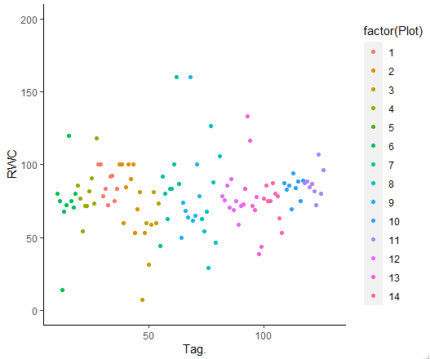
Relative water content preliminary results
Forest Health Dynamics Laboratory

Slide 29
Resin analysis
Forest Health Dynamics Laboratory
α-pinene
β-pinene
Camphene
Limonene
Limonene-α-phellandrene
β-myrcene
4-allylanisole
sandaracopimaric acid
isopimaric acid
neoabietic acid
palustric acid
merkusic acid
dehydroabietic acid
abietic acid

