Slide 1
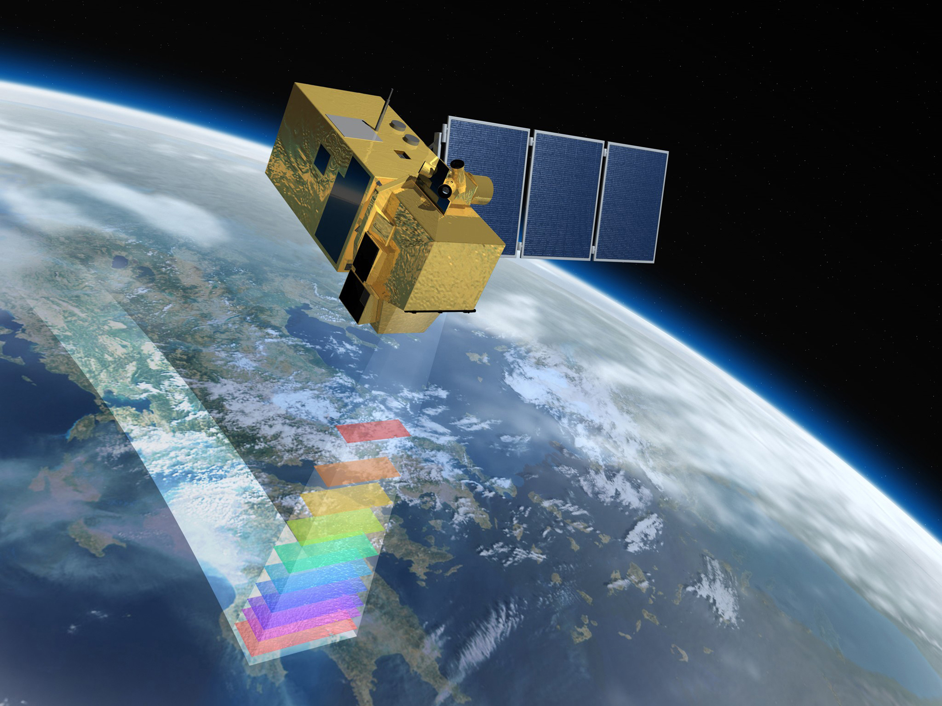
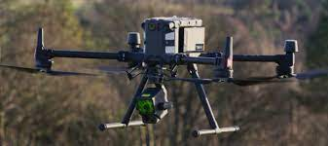
Brown Spot Needle Blight
Assessment Workshop
August 2-3, 2023
Mitigating Needle Blight: A Growing Economic Threat to Pine Forests
Detection and movement of Lecanosticta acicola with remote sensing
Lana Narine
Assistant Professor, Geospatial Analytics
Geospatial Analytics Lab: geospatial.auburn.edu
College of Forestry, Wildlife and Environment
Auburn University, Rm 4329
Email: lln0005@auburn.edu; Ph: 334-844-1105

Slide 2
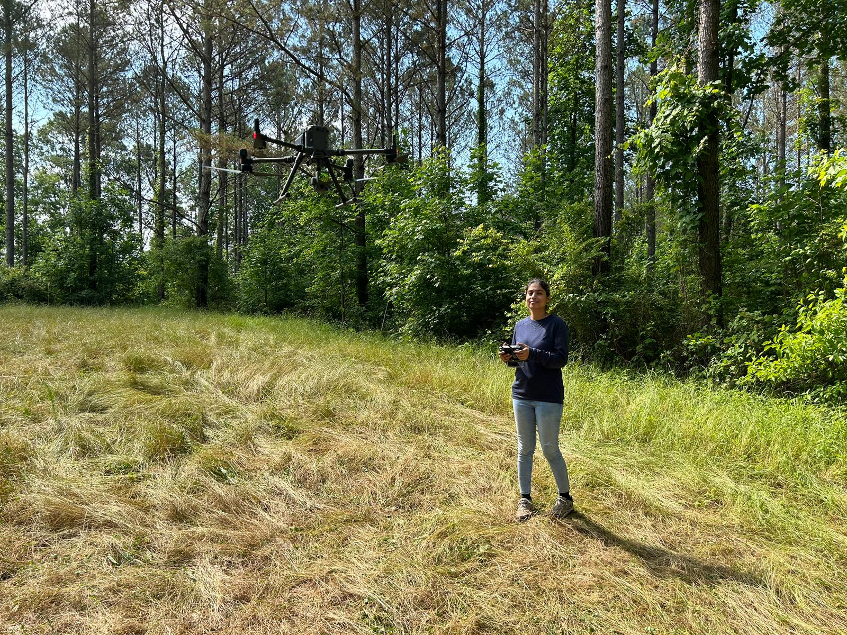
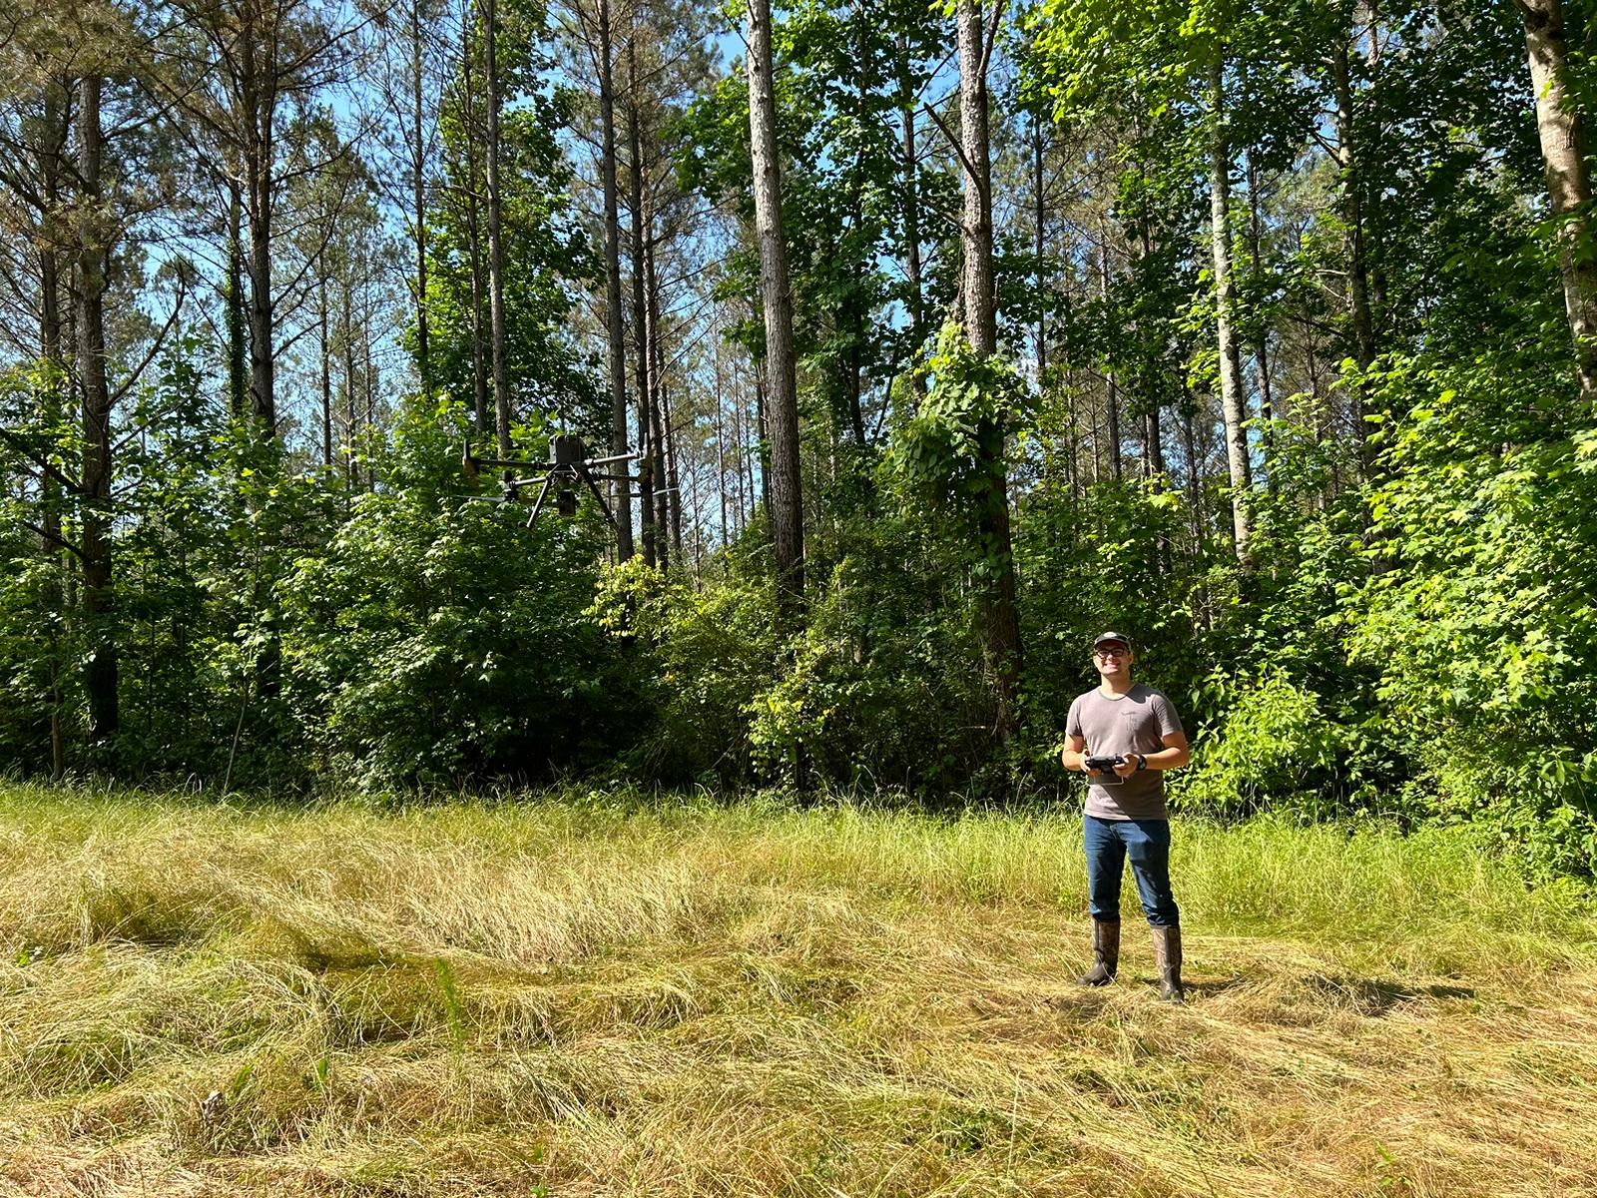
Research Component 3:
Detection and movement of Lecanosticta acicola with remote sensing
Apply remote sensing for detection and mapping of Brown Spot Needle Blight
Contribute to development of a framework for monitoring BSNB infections across landscapes
Swati Singh, PhD student
Nathan Kurtz, UG Research Fellow

Slide 3
Multi-scale analyses
Ground
Unmanned aerial vehicle (UAV)
Development of validation datasets
Airborne
Available Airborne laser scanning (ALS): sub-meter accuracy of terrain and canopy heights, plot and stand level information
Spaceborne
Pinus taeda sites with trees showing symptoms of brown spot needle blight
Tree-level measurements and observations
Landscape and regional scale mapping
UAV lidar and imagery: fine-scale canopy profiles over target sites, tree and plot-level analyses

Slide 4
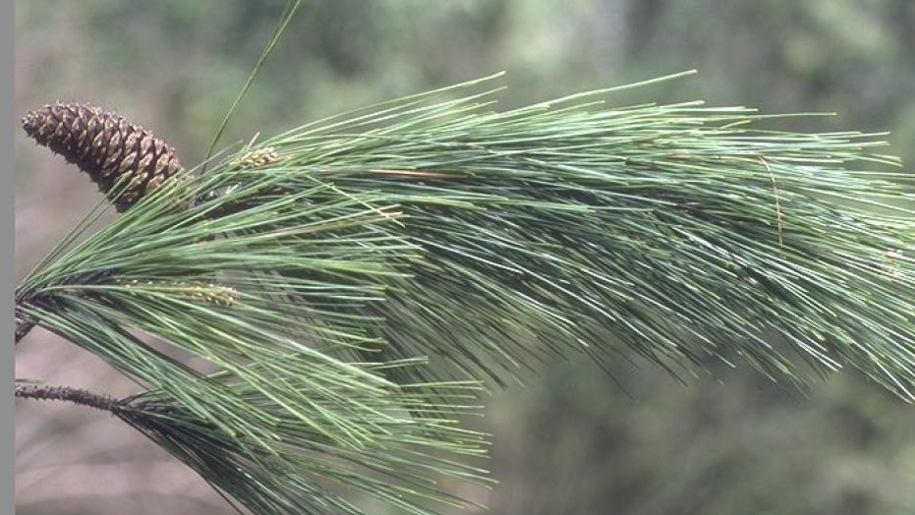
Constructing a framework with multi-source data
Imagery and imagery-derived products: changes in spectral response (e.g., discoloration) across visible and near infrared wavelengths
Lidar: structural changes in canopy structural information(e.g., defoliation)
Data sources:
  UAV-borne lidar and multispectral data- spectral, textural and structural properties at tree- and plot-levels
  Airborne lidar data from USGS 3D Elevation program
  European Space Agency’s Sentinel-2 mission data- high temporal and spatial resolutions (~10 days, 10-20 m)
Machine learning methods for detection:
  Random Forests, Stochastic Gradient Boosting, Neural Networks, maximum likelihood, and support vector machines

Slide 5
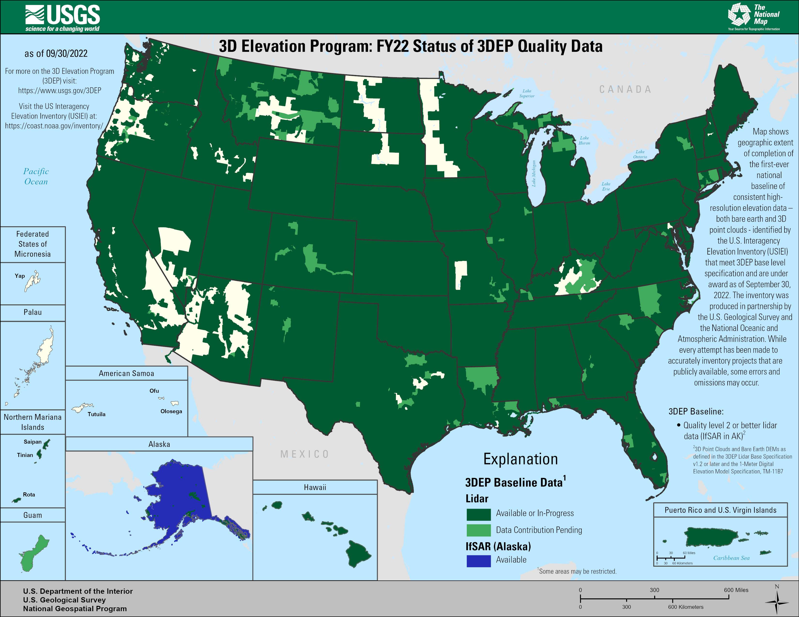
https://www.usgs.gov/media/images/fy22-status-3dep-quality-data

Slide 6
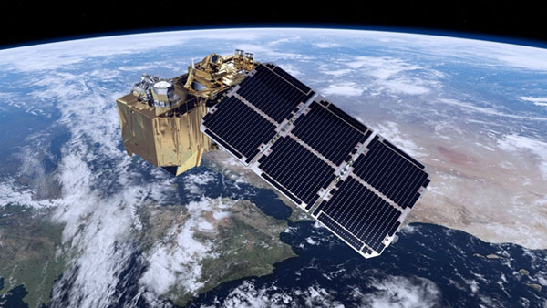
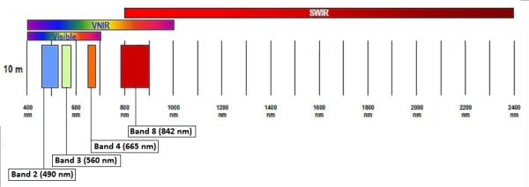
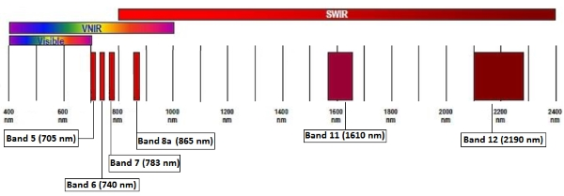
10-meter resolution
https://sentinels.copernicus.eu/web/sentinel/user-guides/sentinel-2-msi/overview
20-meter resolution

Slide 7
General Workflow
UAV-borne and ground (in-situ) data: tree-level infection detection, individual tree detection, training/reference dataset construction
UAV-borne datasets: develop criteria for detection (combined spectral and structural attributes), calibrate airborne lidar-derived information and assess broader scale classification performance
Airborne lidar: characterization of gridded landscape-level vegetation structural attributes, integration with satellite-derived parameters for extrapolation of variables of interest using satellite-derived variables
Satellite imagery: broad-scale BSNB classification with combined spectral, textural, structural and ancillary (topographic and climatic) predictors.

Slide 8
Expected results include:
Spatially explicit distribution and movement maps of Lecanosticta acicola across the southeast
An improved understanding of UAV-borne multispectral and lidar remote sensing of BSNB
Multi-scale approaches for BSNB assessment based on UAV, airborne and satellite data with machine learning
Criteria for detection of Lecanosticta acicola infection using remote sensing

Slide 9
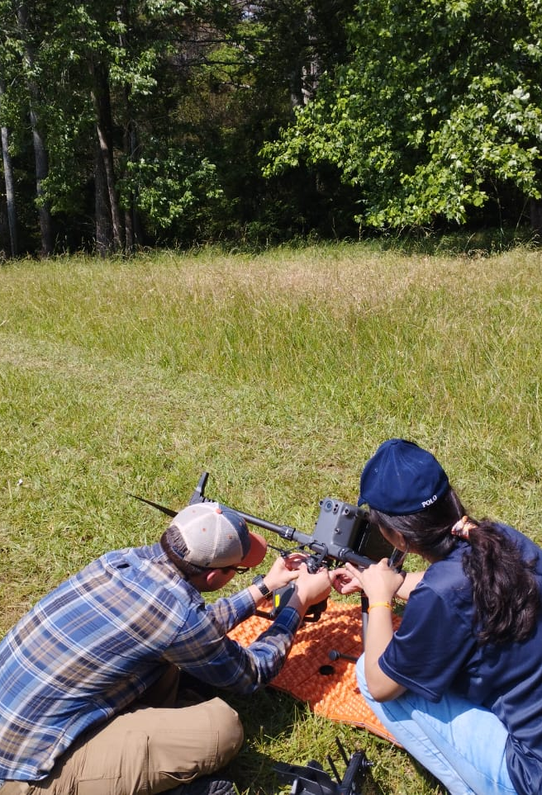
Geospatial Team
PhD student: Swati Singh
Post Graduate Diploma, Remote Sensing and GIS, Specialization in Forestry
Undergraduate Research worker Summer, 2023: Nathan Kurtz
Geospatial and Environmental Informatics major
MS Environmental Sciences

Slide 10
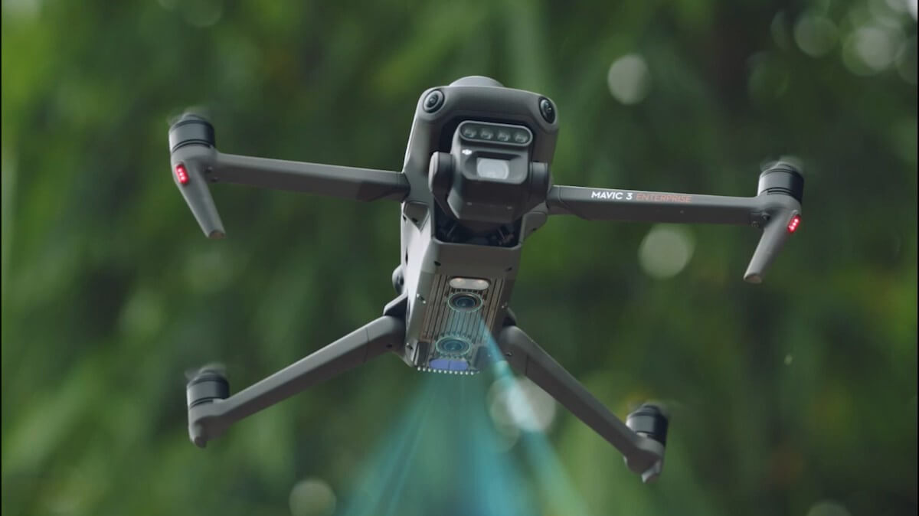
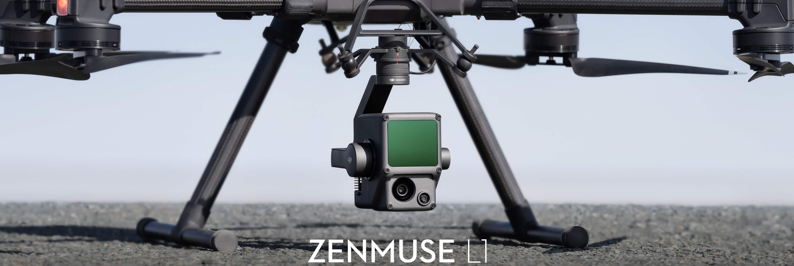
Thank you!
https://ag.dji.com/mavic-3-m
https://www.esa.int/ESA_Multimedia/Images/2008/04/Sentinel-2
https://www.dji.com/zenmuse-l1

