Slide 1
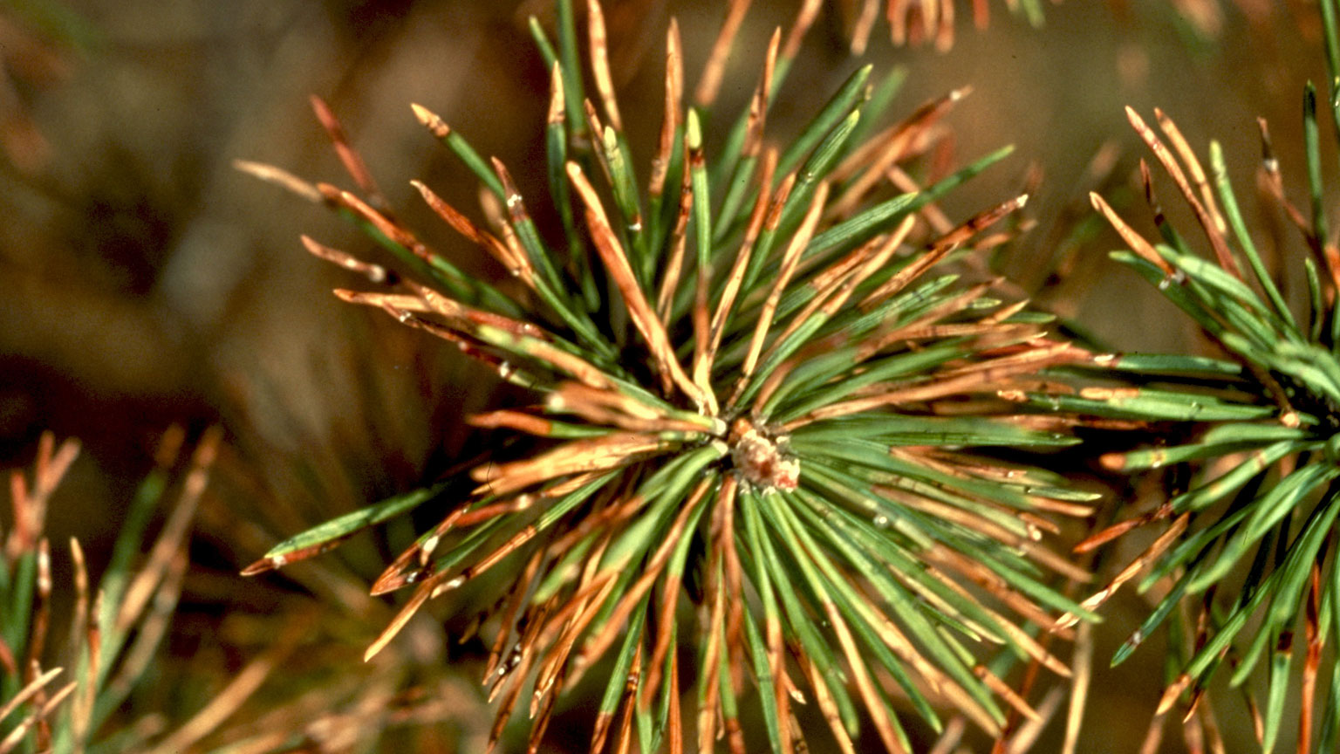


Genomic diversity and evolutionary history of Lecanosticta acicola on pine host species
Gabriel Silva

Slide 2
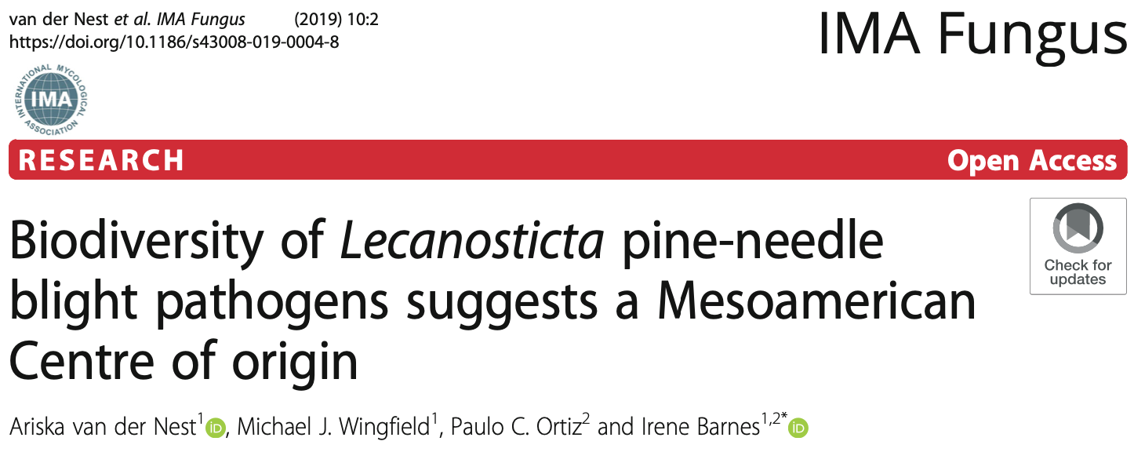
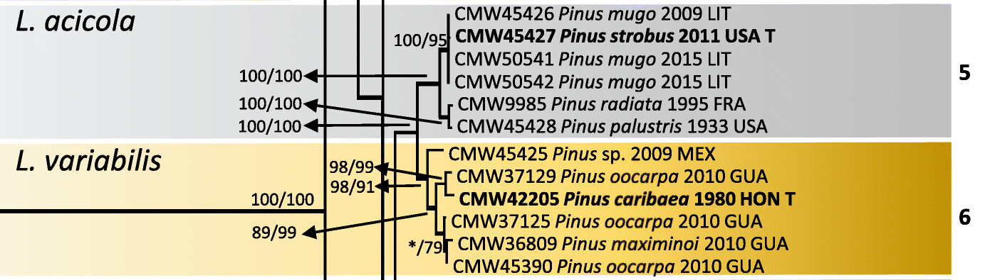
Diversity

Slide 3
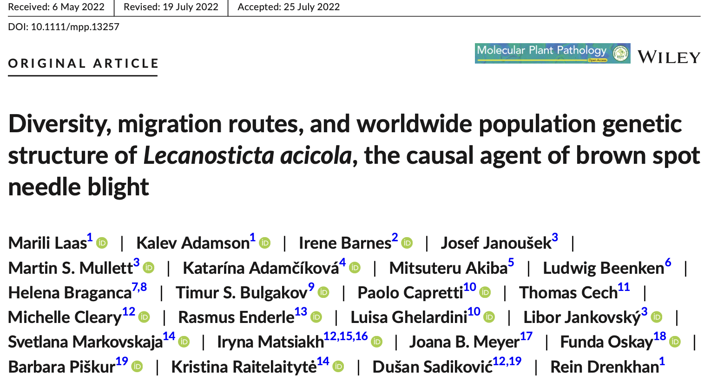
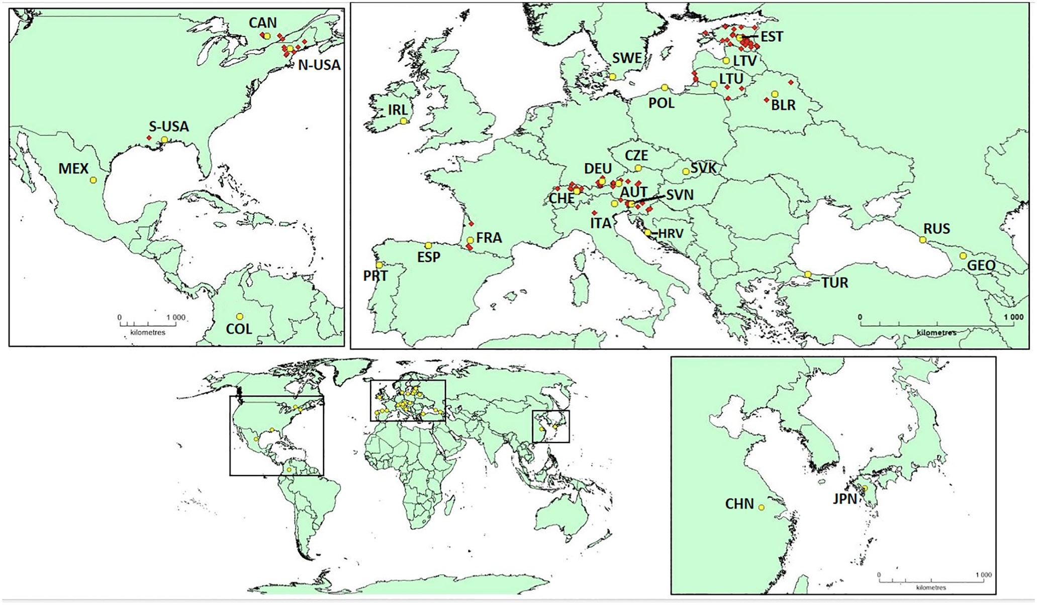
Distribution

Slide 4
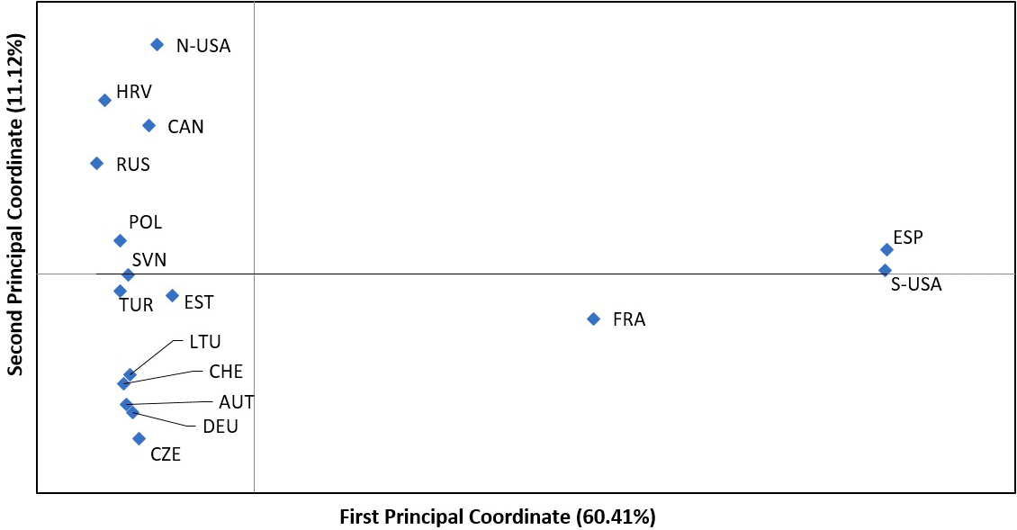
Distribution
Only from Mississippi

Slide 5
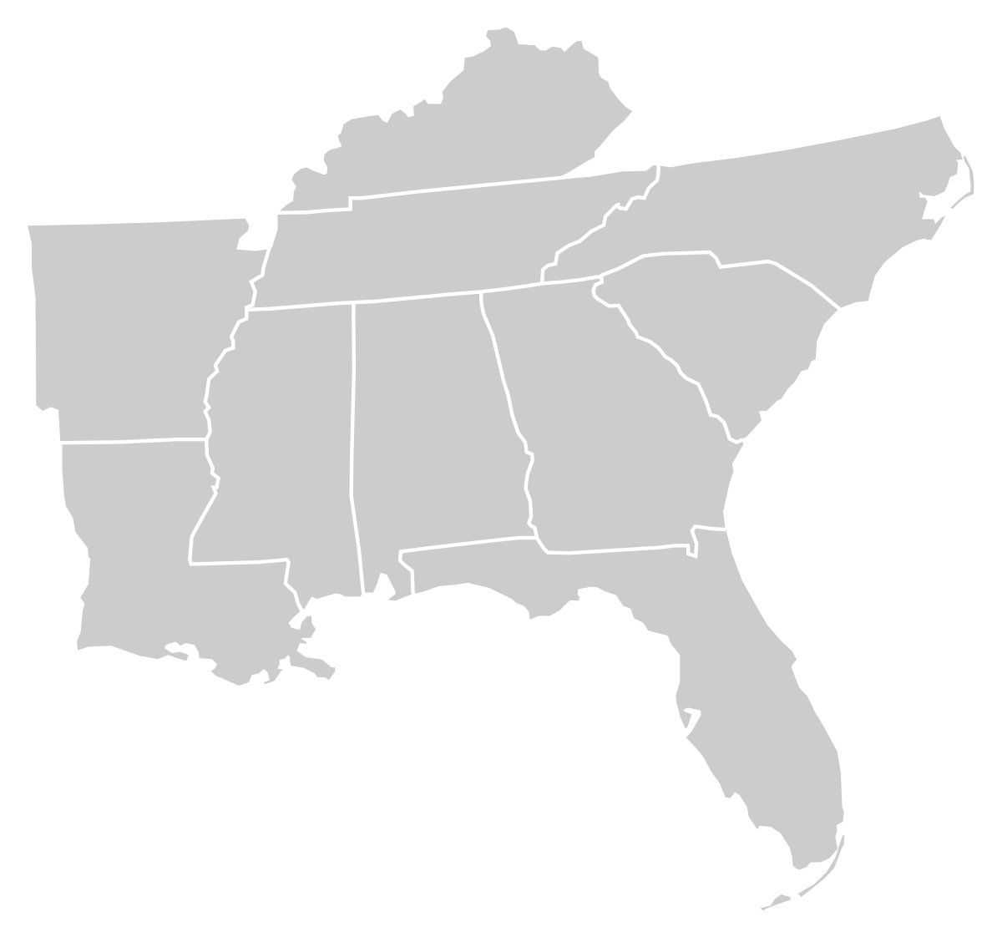
potential
New species
Different pathogenicity
Disease progression
Southern U.S. remains Unexplored

Slide 6
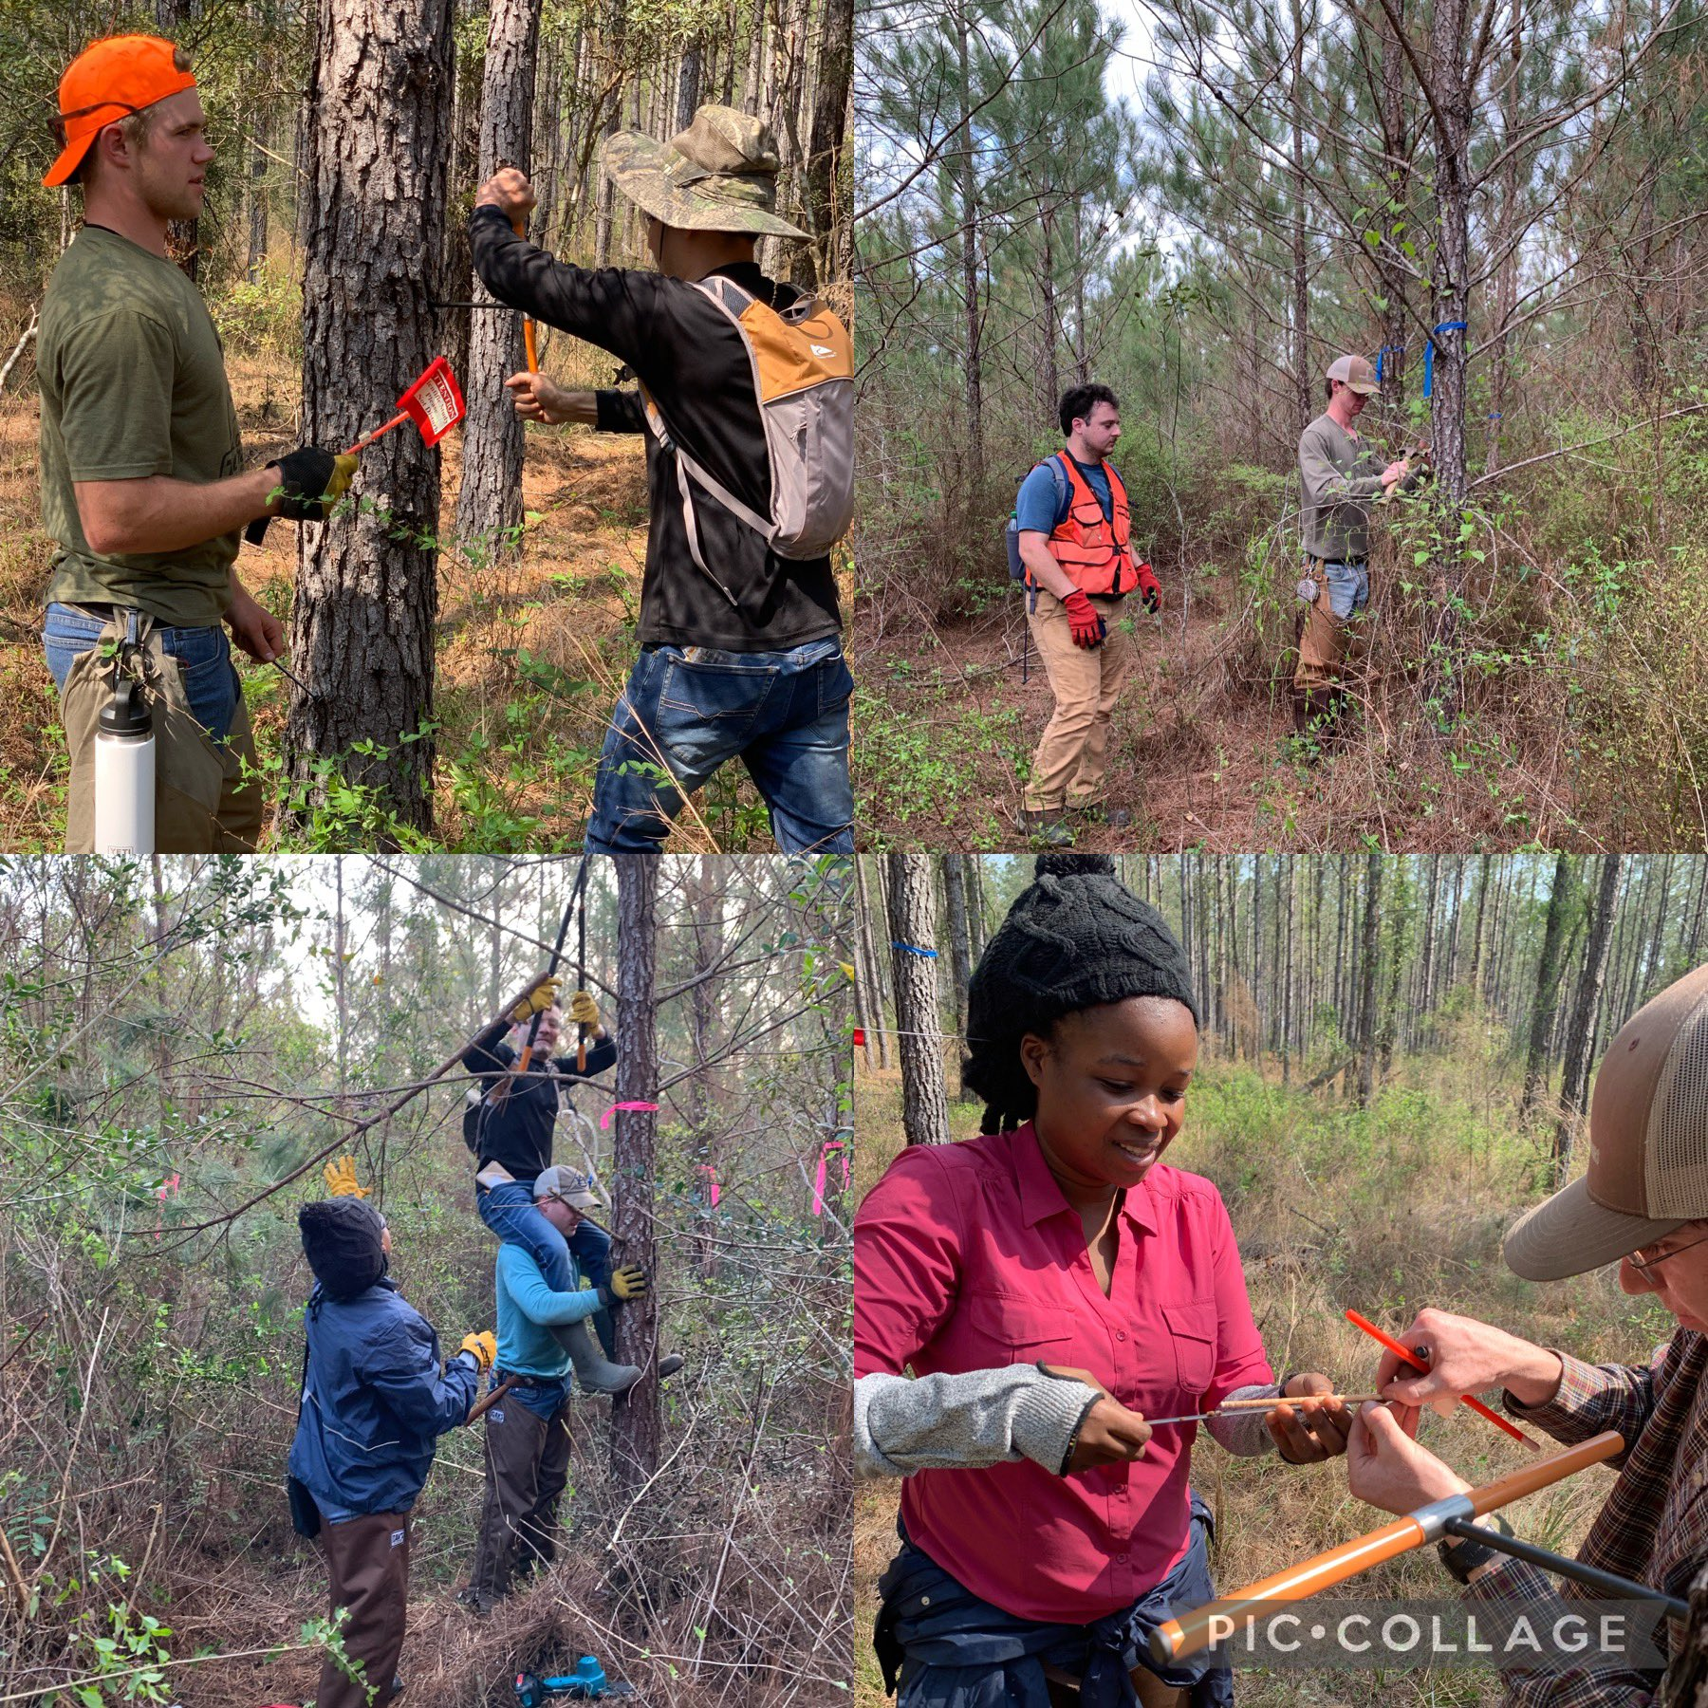
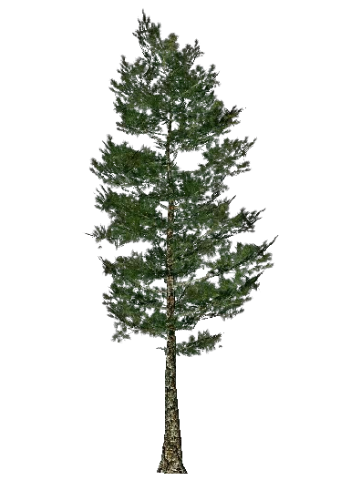
Sample diseased trees
Loblolly
Longleaf donated to the lab

Slide 7
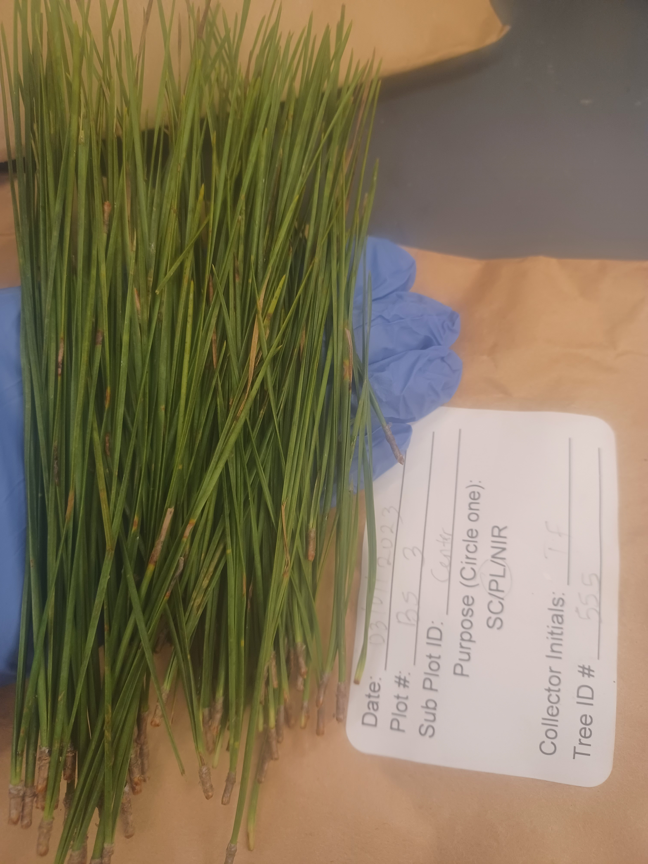
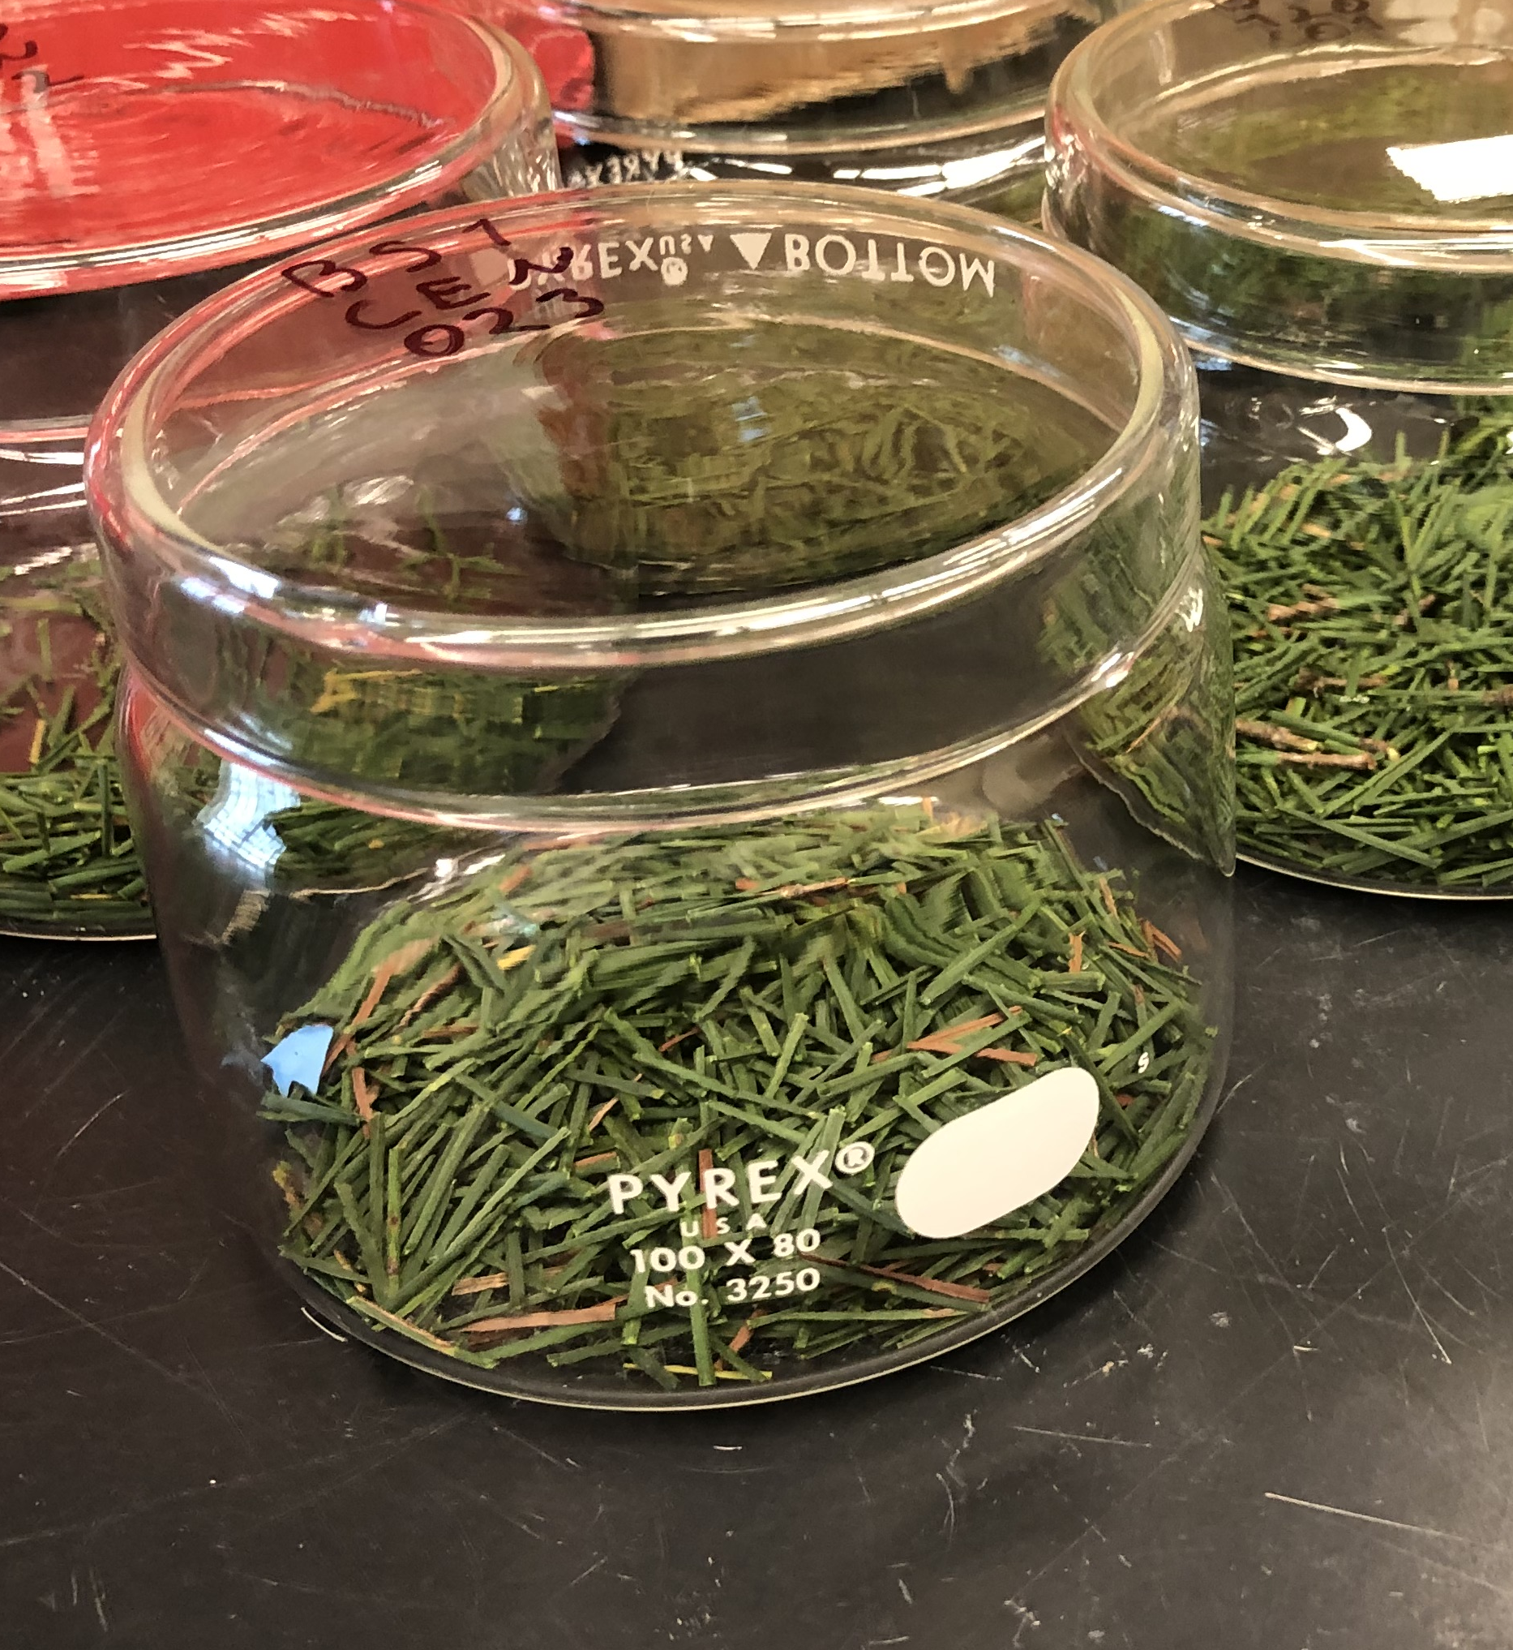




Sample surface sterilization
Bleach
Water
Ethanol
Water

Slide 8
fungus
Cultivation
Plating - Initially
PNA – Pine needle agar
MEA 1% – Malt extract agar
CMA – Corn meal agar
APDA – Acid potato dextrose agar

Slide 9
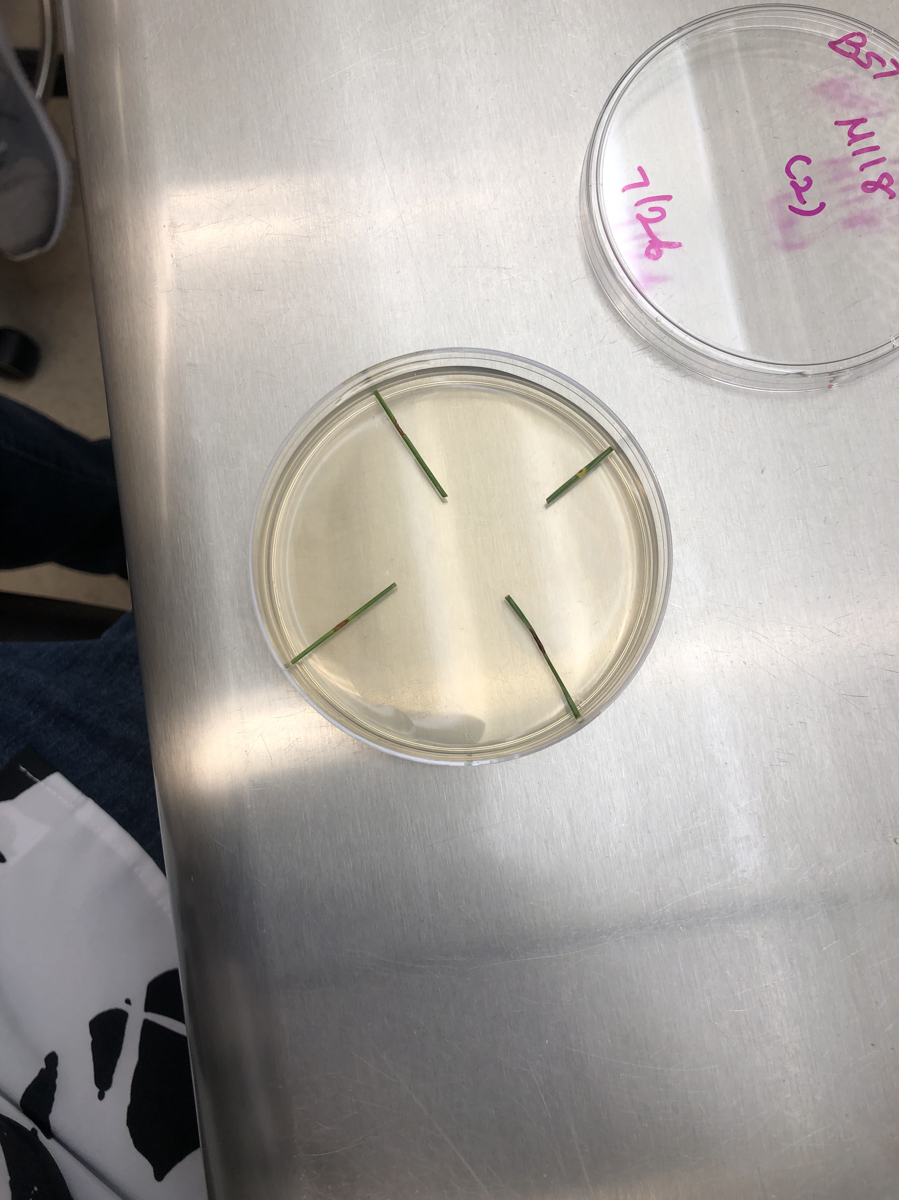
fungus
Cultivation
Plating
PNA + ME – Pine needle agar with 0.5% malt extract
MEA – 2% Malt extract agar

Slide 10
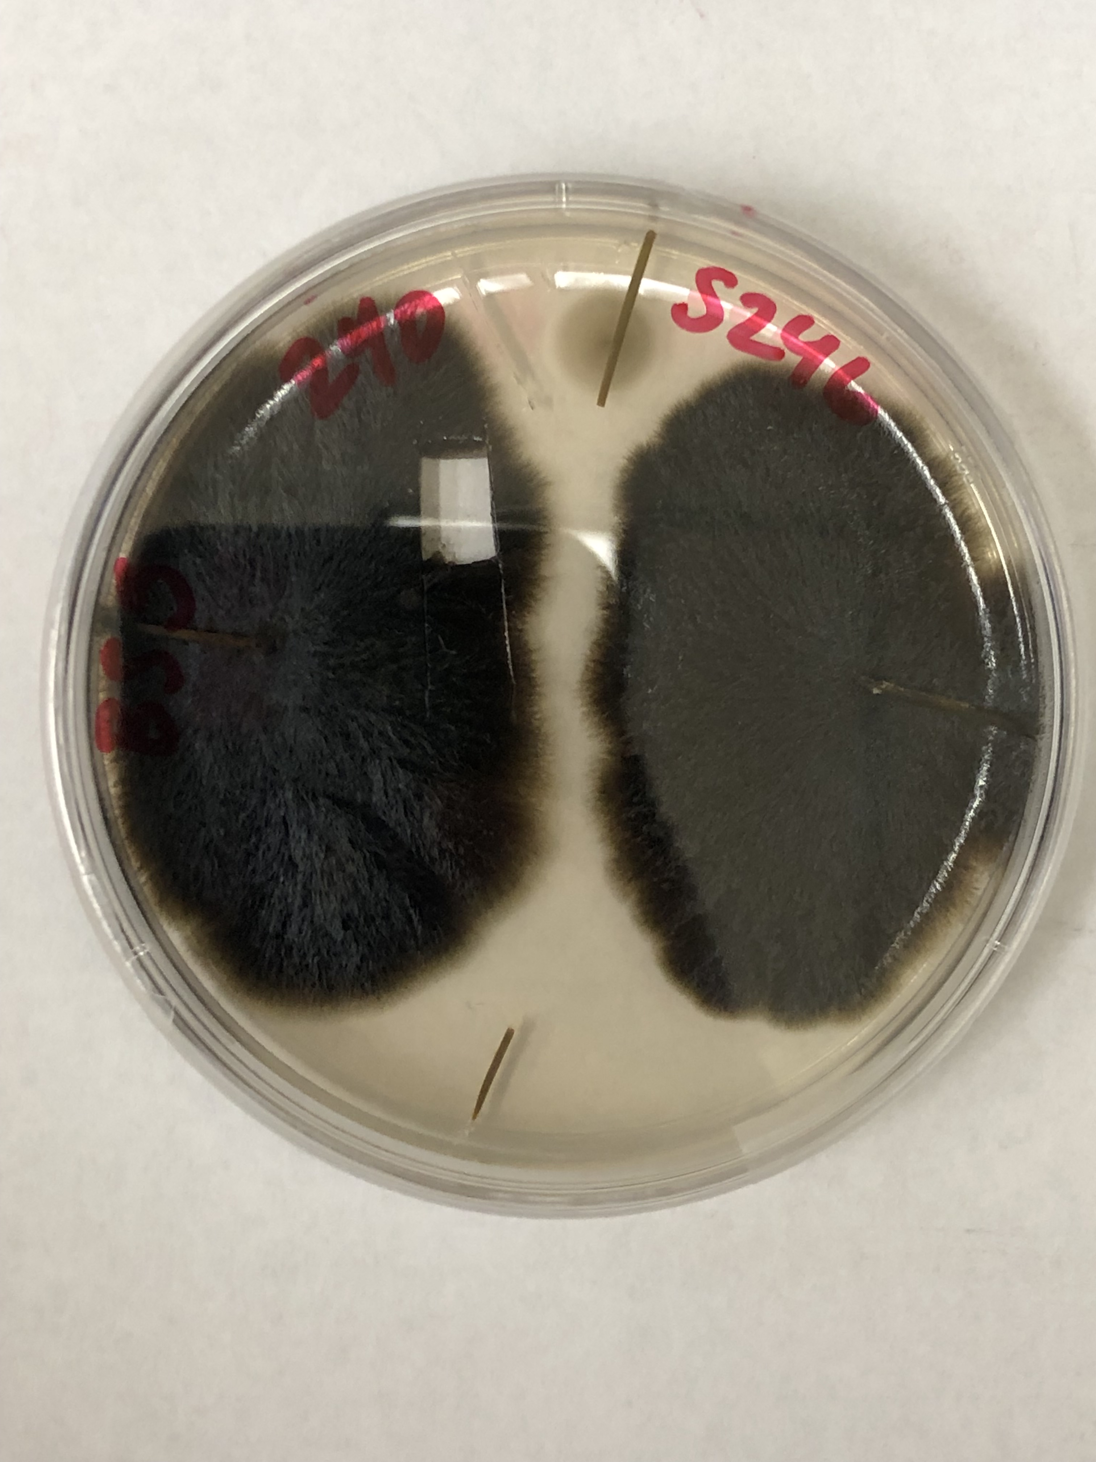
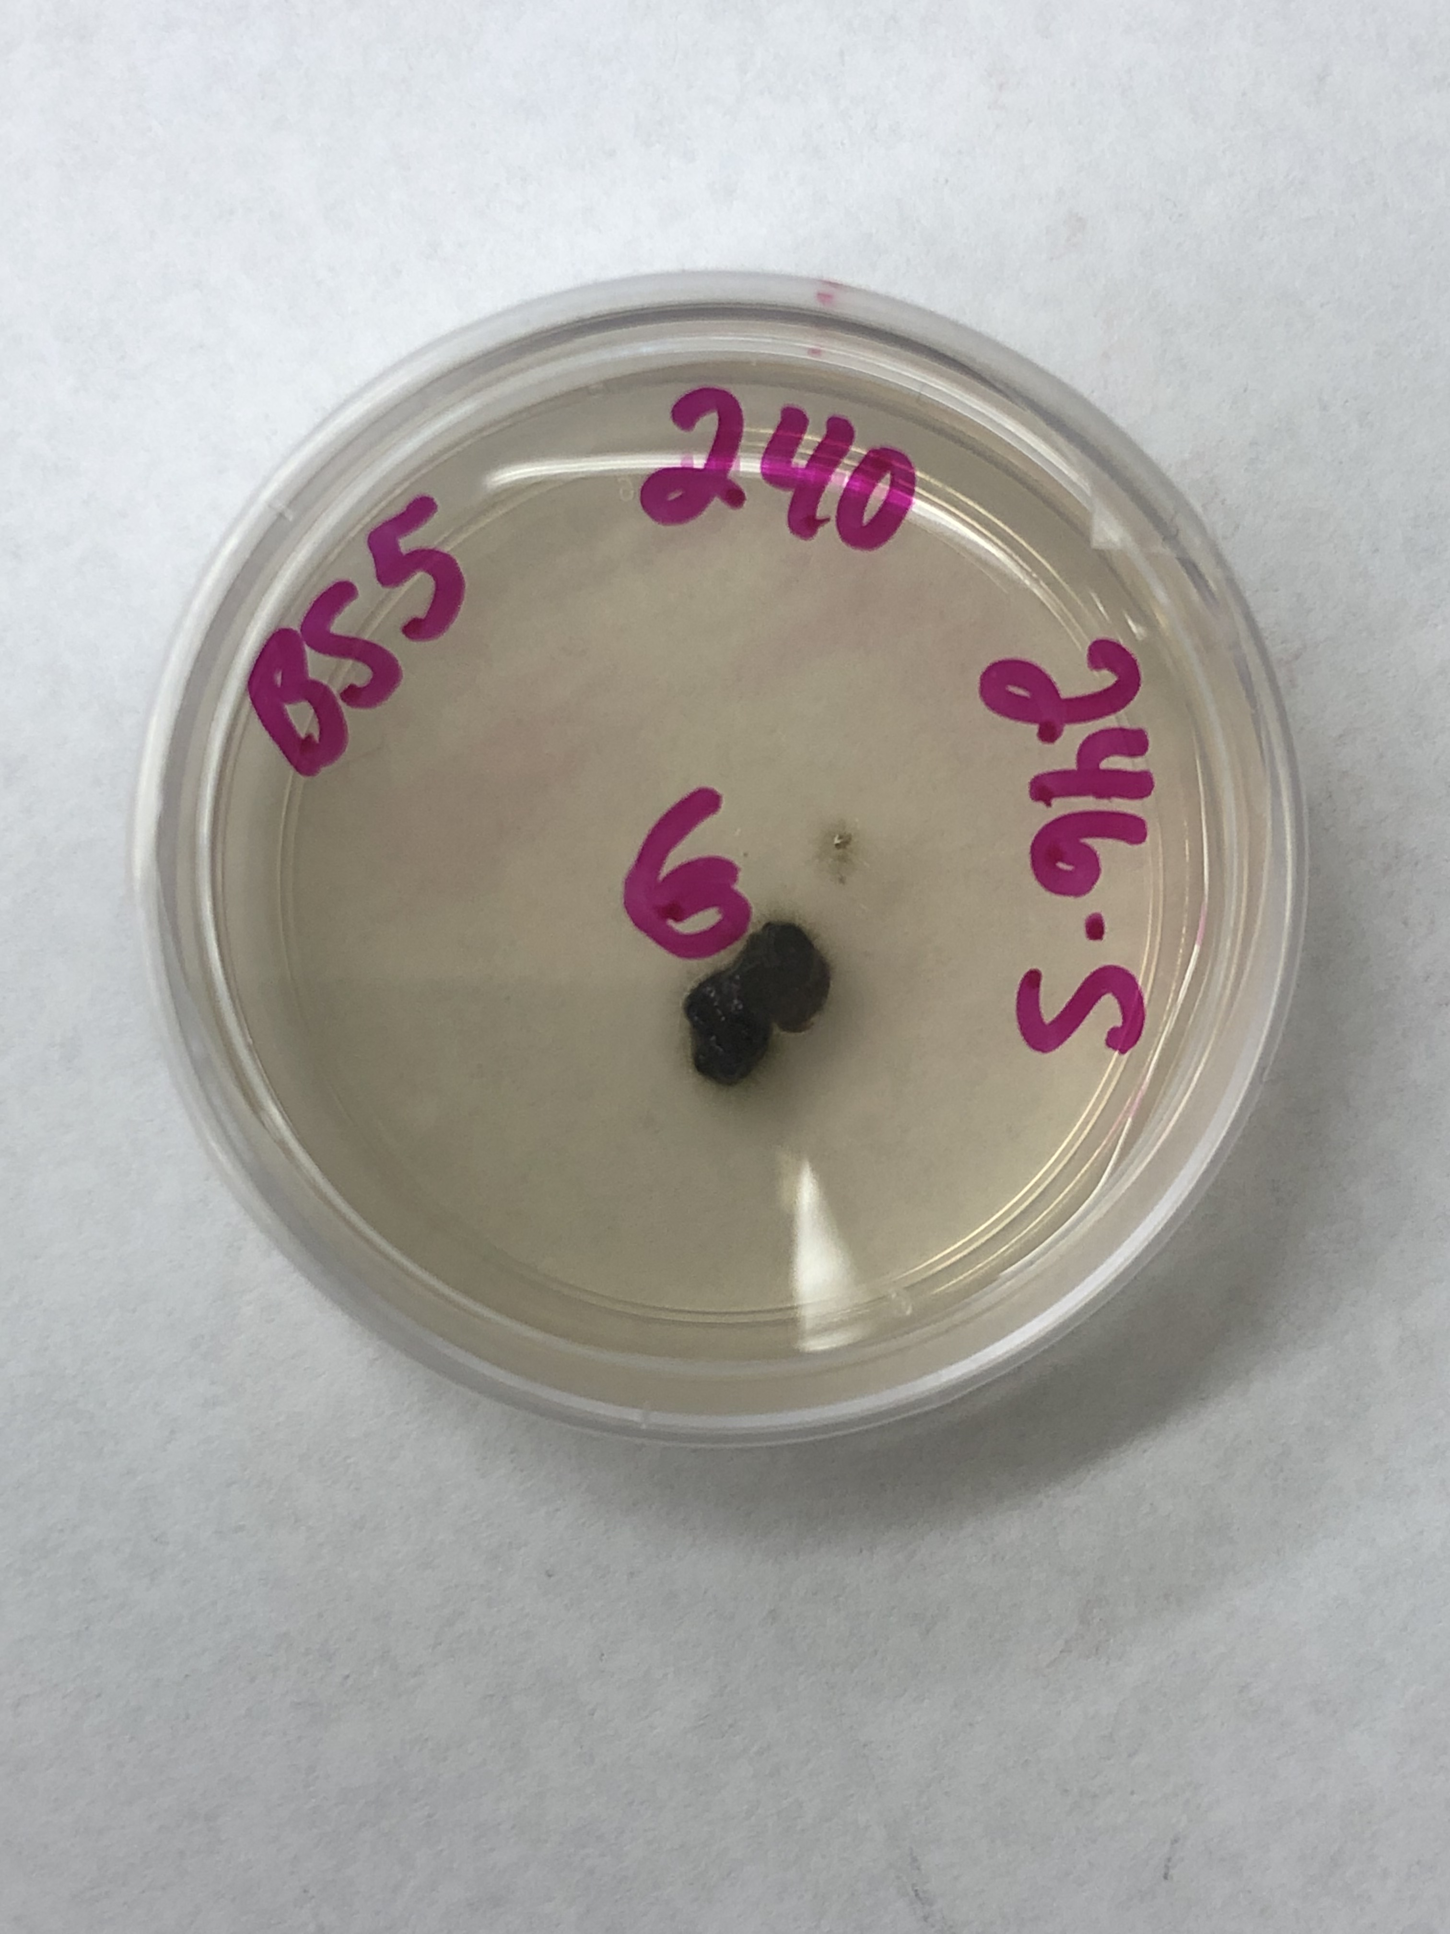
fungus
Cultivation
Subculturing
Look for colonies with suggestive morphology
Replate into same media
Notes:
Add pictures

Slide 11
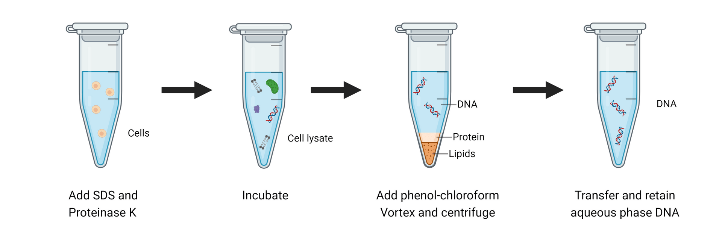

DNA EXTRACTION
https://www.aatbio.com/resources/assaywise/2022-11-1/overview-of-dna-extraction-methods

Slide 12
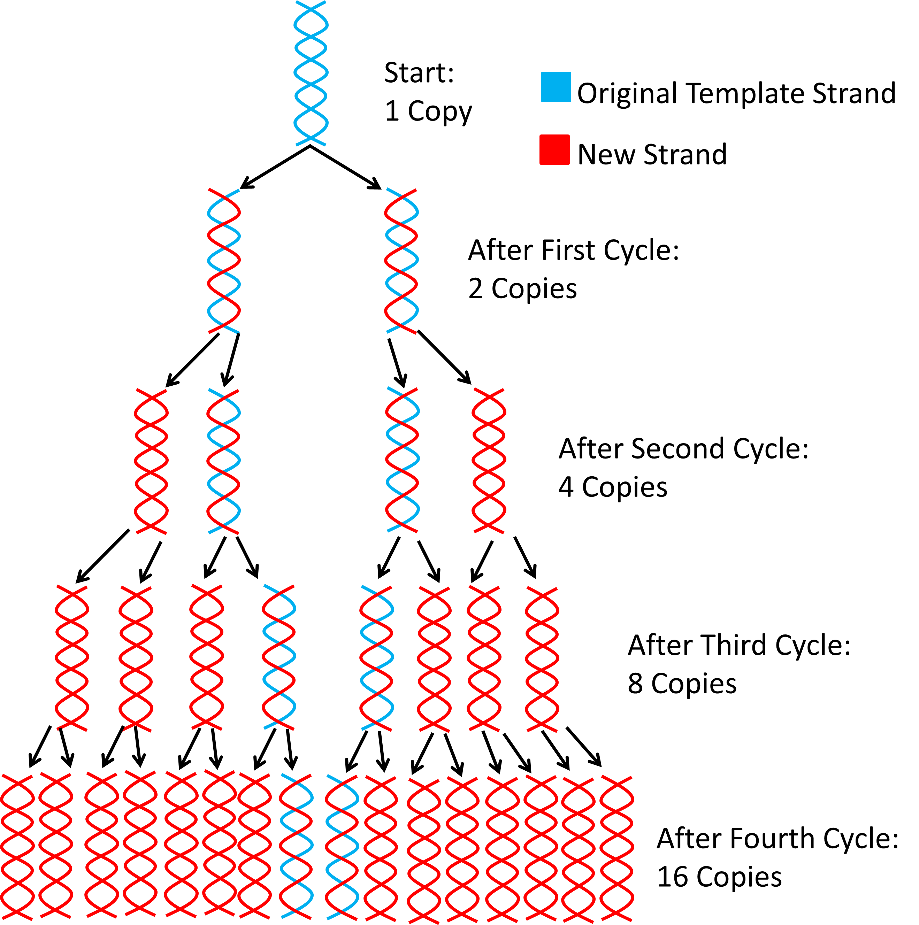

PCR Confirmation
TEF1 Region

Slide 13
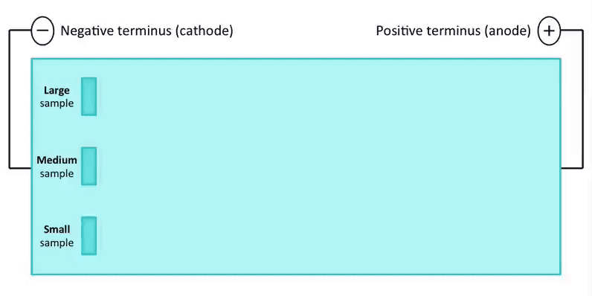
PCR Confirmation

Slide 14
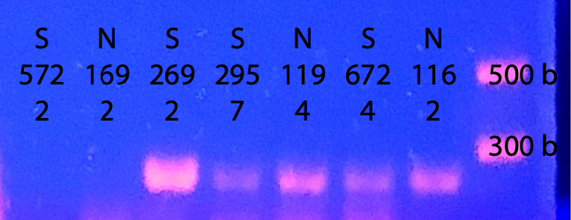
PCR Confirmation
❌
❌
✅
✅
✅
✅
✅

Slide 15
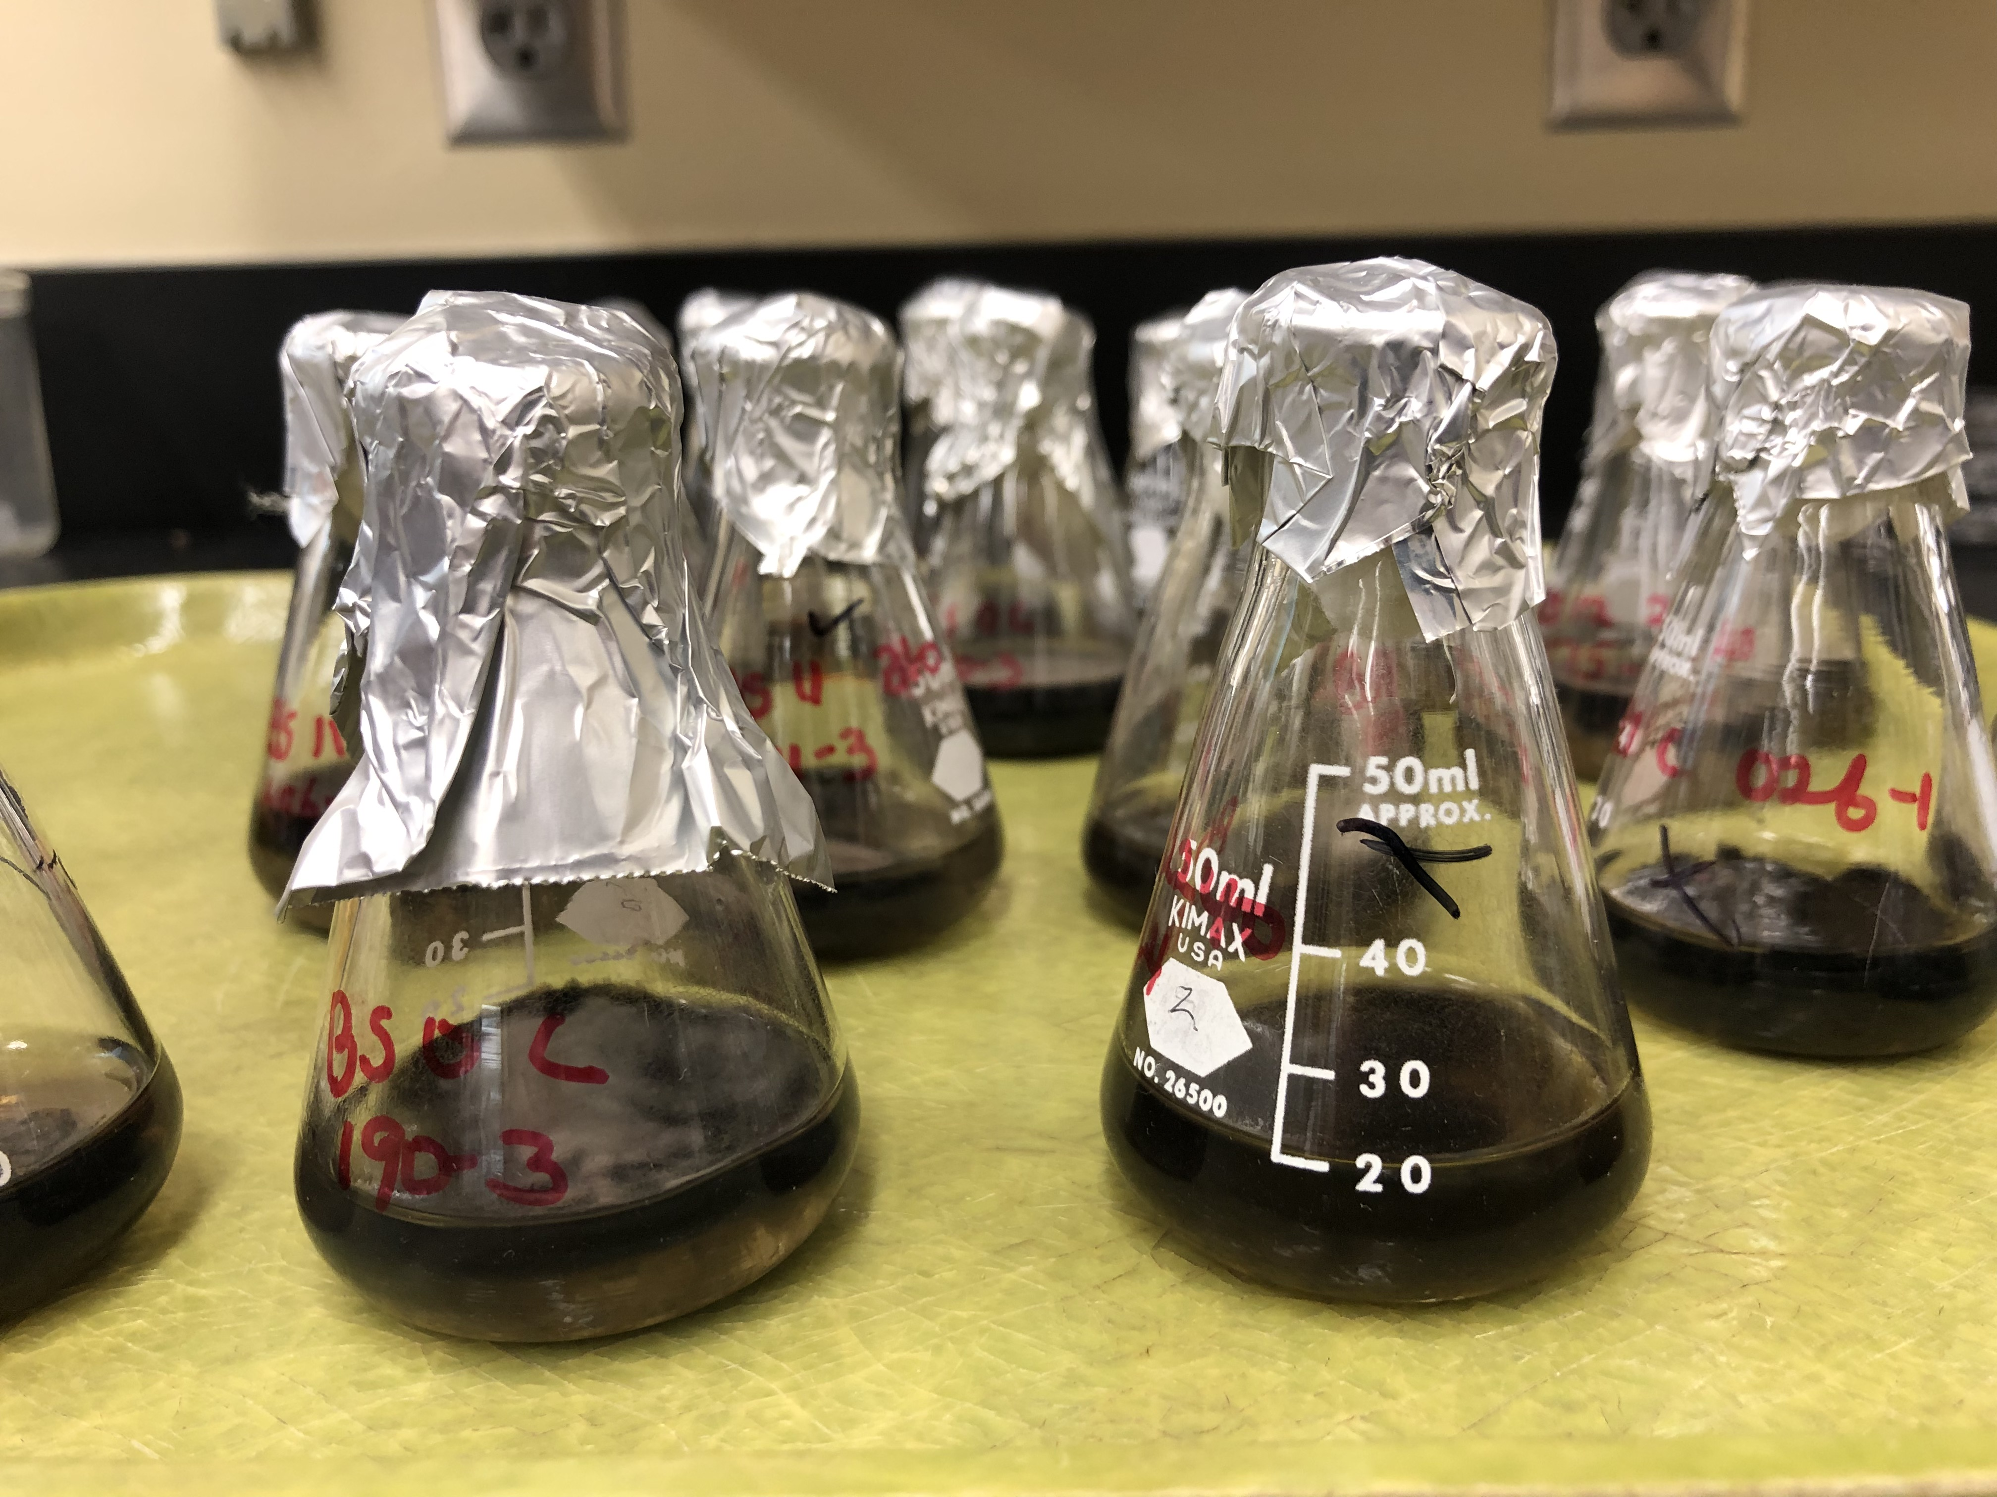
Liquid media
fungus
Cultivation
3% Malt Extract
Notes:
Add pictures

Slide 16

goalS
Fungus genetic variation
Correlation between variants and phenotypes
Notes:
We specifically target the southeastern US. and evaluate the pathogen’s whole genome to provide unprecedented insight into this emerging disease

Slide 17


DNA sequencing
Oxford nanopore MinION mk1c

Slide 18
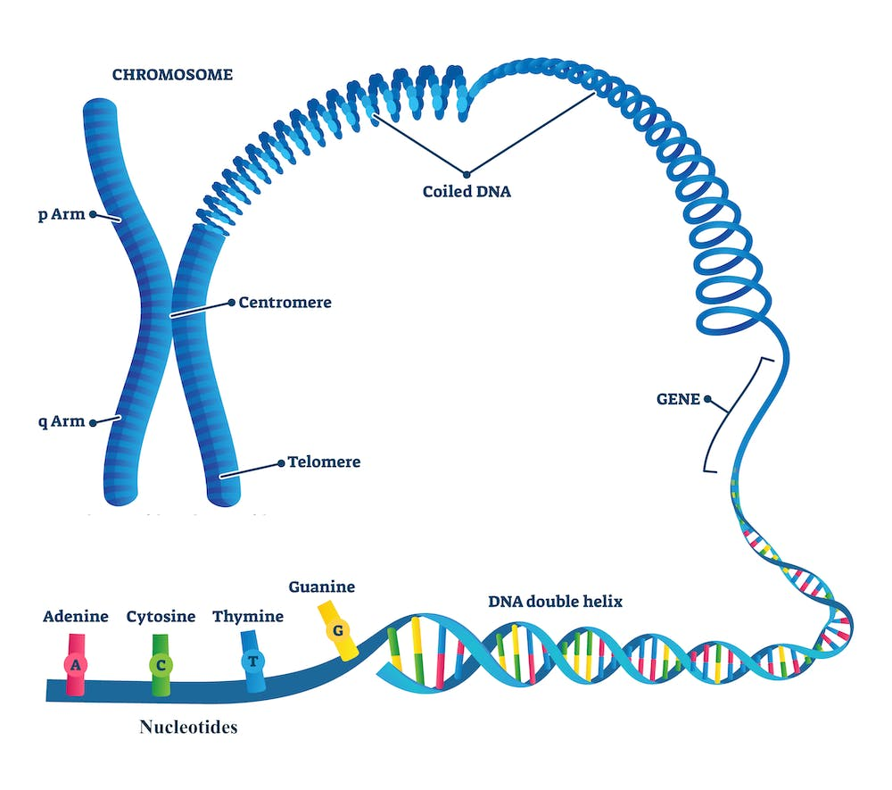
DNA SEQUENCING
Source: https://theconversation.com/the-human-genome-project-pieced-together-only-92-of-the-dna-now-scientists-have-finally-filled-in-the-remaining-8-176138

Slide 19
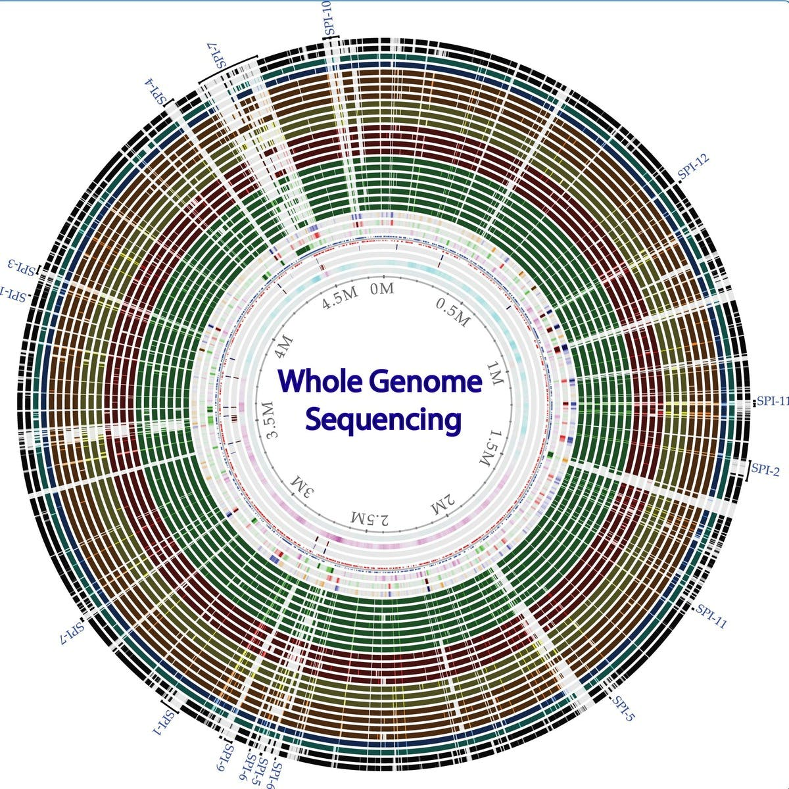
DNA SEQUENCING

Slide 20

Data analysis
What is a pipeline?
Notes:
Pangenome: Identification of genomic variants that are correlated with disease outcomes measured via an inoculation study
Evolutionary history: Quantify patterns of horizontal genetic transfer between pine and fungus, and infer duration of contact between them.

Slide 21
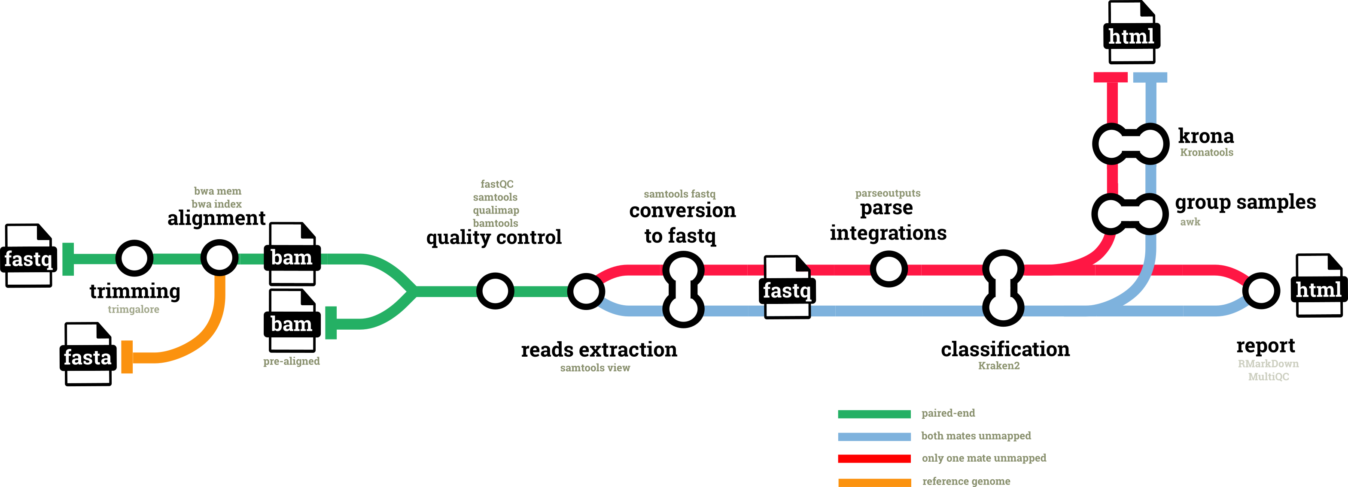
Data analysis
Pipeline!
https://nf-co.re/hgtseq/1.1.0
Notes:
Pangenome: Identification of genomic variants that are correlated with disease outcomes measured via an inoculation study
Evolutionary history: Quantify patterns of horizontal genetic transfer between pine and fungus, and infer duration of contact between them.

Slide 22
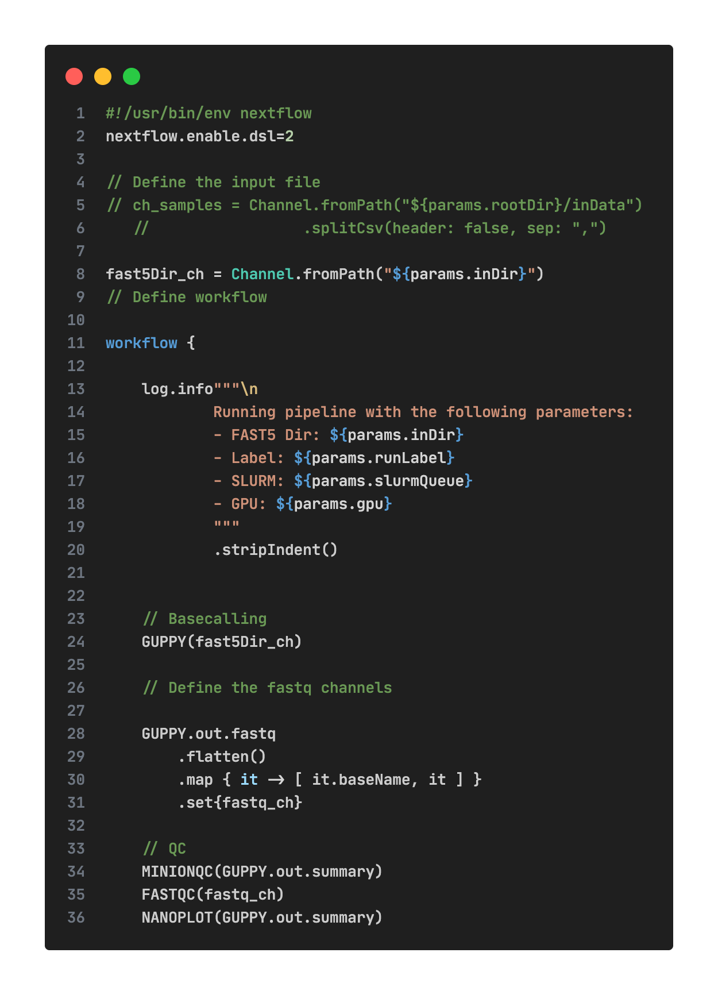
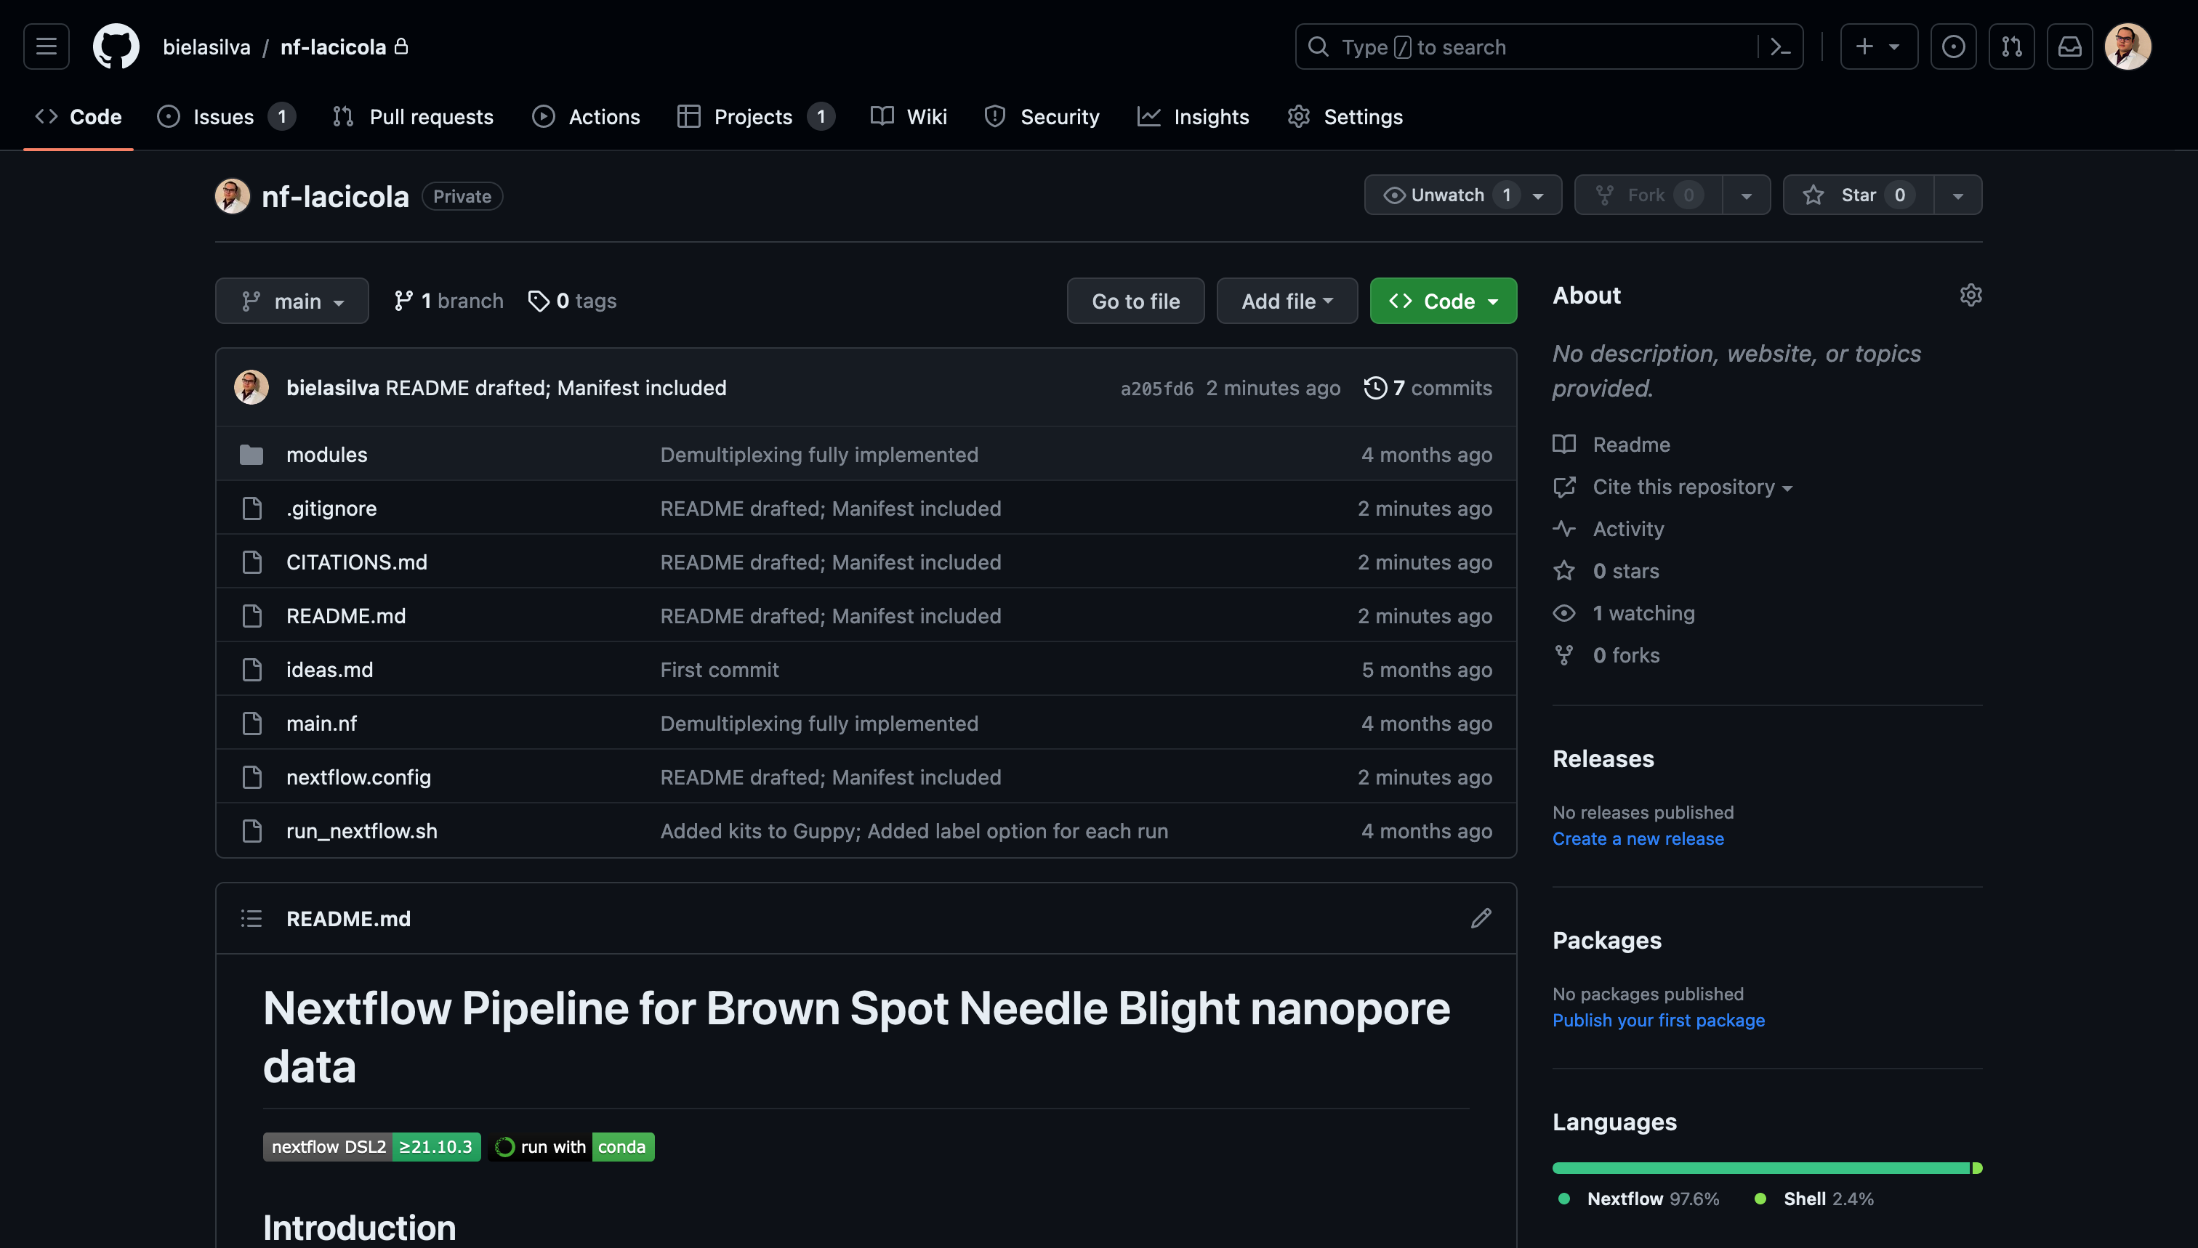

Bioinformatics
Notes:
Pangenome: Identification of genomic variants that are correlated with disease outcomes measured via an inoculation study
Evolutionary history: Quantify patterns of horizontal genetic transfer between pine and fungus, and infer duration of contact between them.

Slide 23
Bioinformatics
Quality Control
Assembly
Annotation
Analysis
Removal of low-quality data

Slide 24
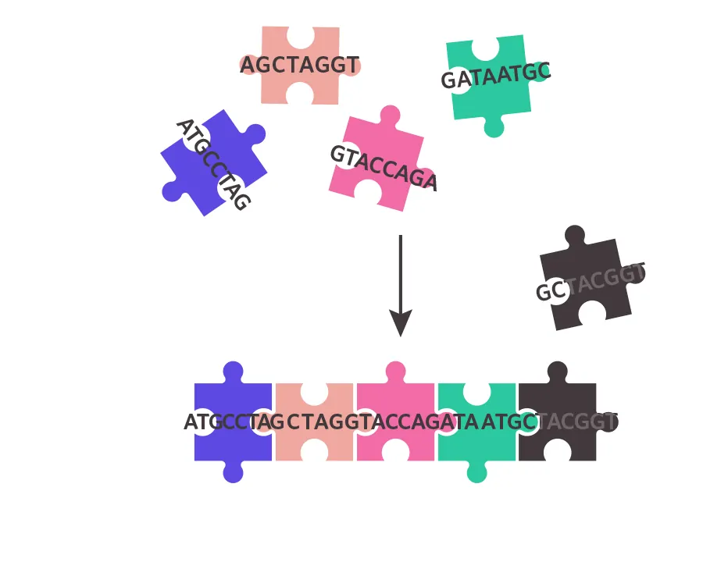
Bioinformatics
QC
Assembly
Annotation
Analysis
Source: https://www.the-scientist.com/infographics/infographic-the-sequencing-and-assembly-of-the-human-genome-70427
Notes:
Pangenome: Identification of genomic variants that are correlated with disease outcomes measured via an inoculation study
Evolutionary history: Quantify patterns of horizontal genetic transfer between pine and fungus, and infer duration of contact between them.

Slide 25
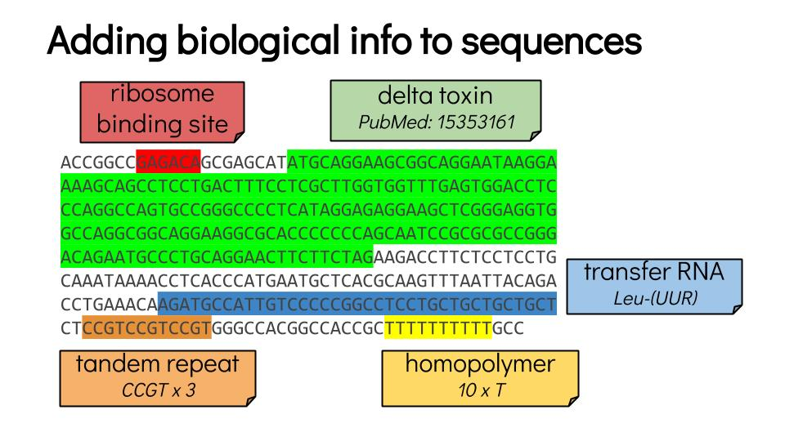
Bioinformatics
QC
Assembly
Annotation
Analysis
Source: https://training.galaxyproject.org/training-material/topics/genome-annotation/tutorials/annotation-with-prokka/slides-plain.html
Notes:
Pangenome: Identification of genomic variants that are correlated with disease outcomes measured via an inoculation study
Evolutionary history: Quantify patterns of horizontal genetic transfer between pine and fungus, and infer duration of contact between them.

Slide 26
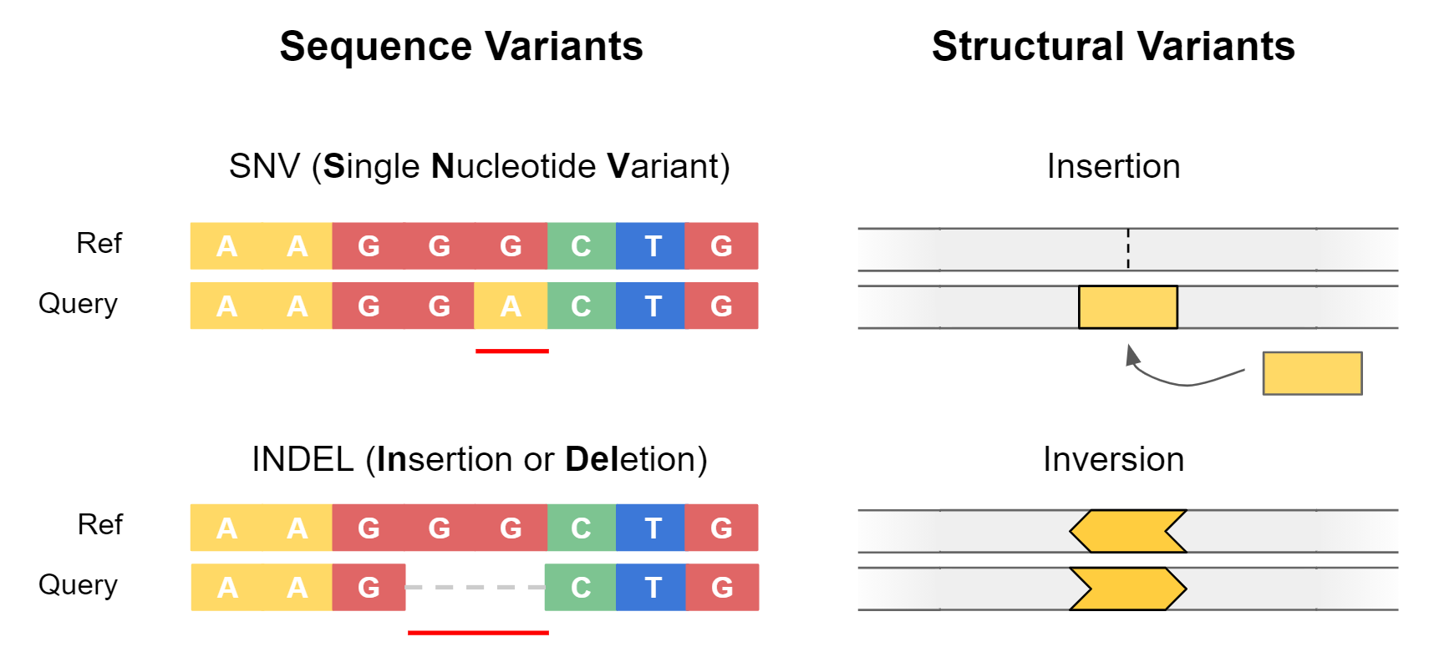
Bioinformatics
QC
Assembly
Annotation
Analysis
https://www.melbournebioinformatics.org.au/tutorials/tutorials/longread_sv_calling/longread_sv_calling/
Notes:
Pangenome: Identification of genomic variants that are correlated with disease outcomes measured via an inoculation study
Evolutionary history: Quantify patterns of horizontal genetic transfer between pine and fungus, and infer duration of contact between them.

Slide 27
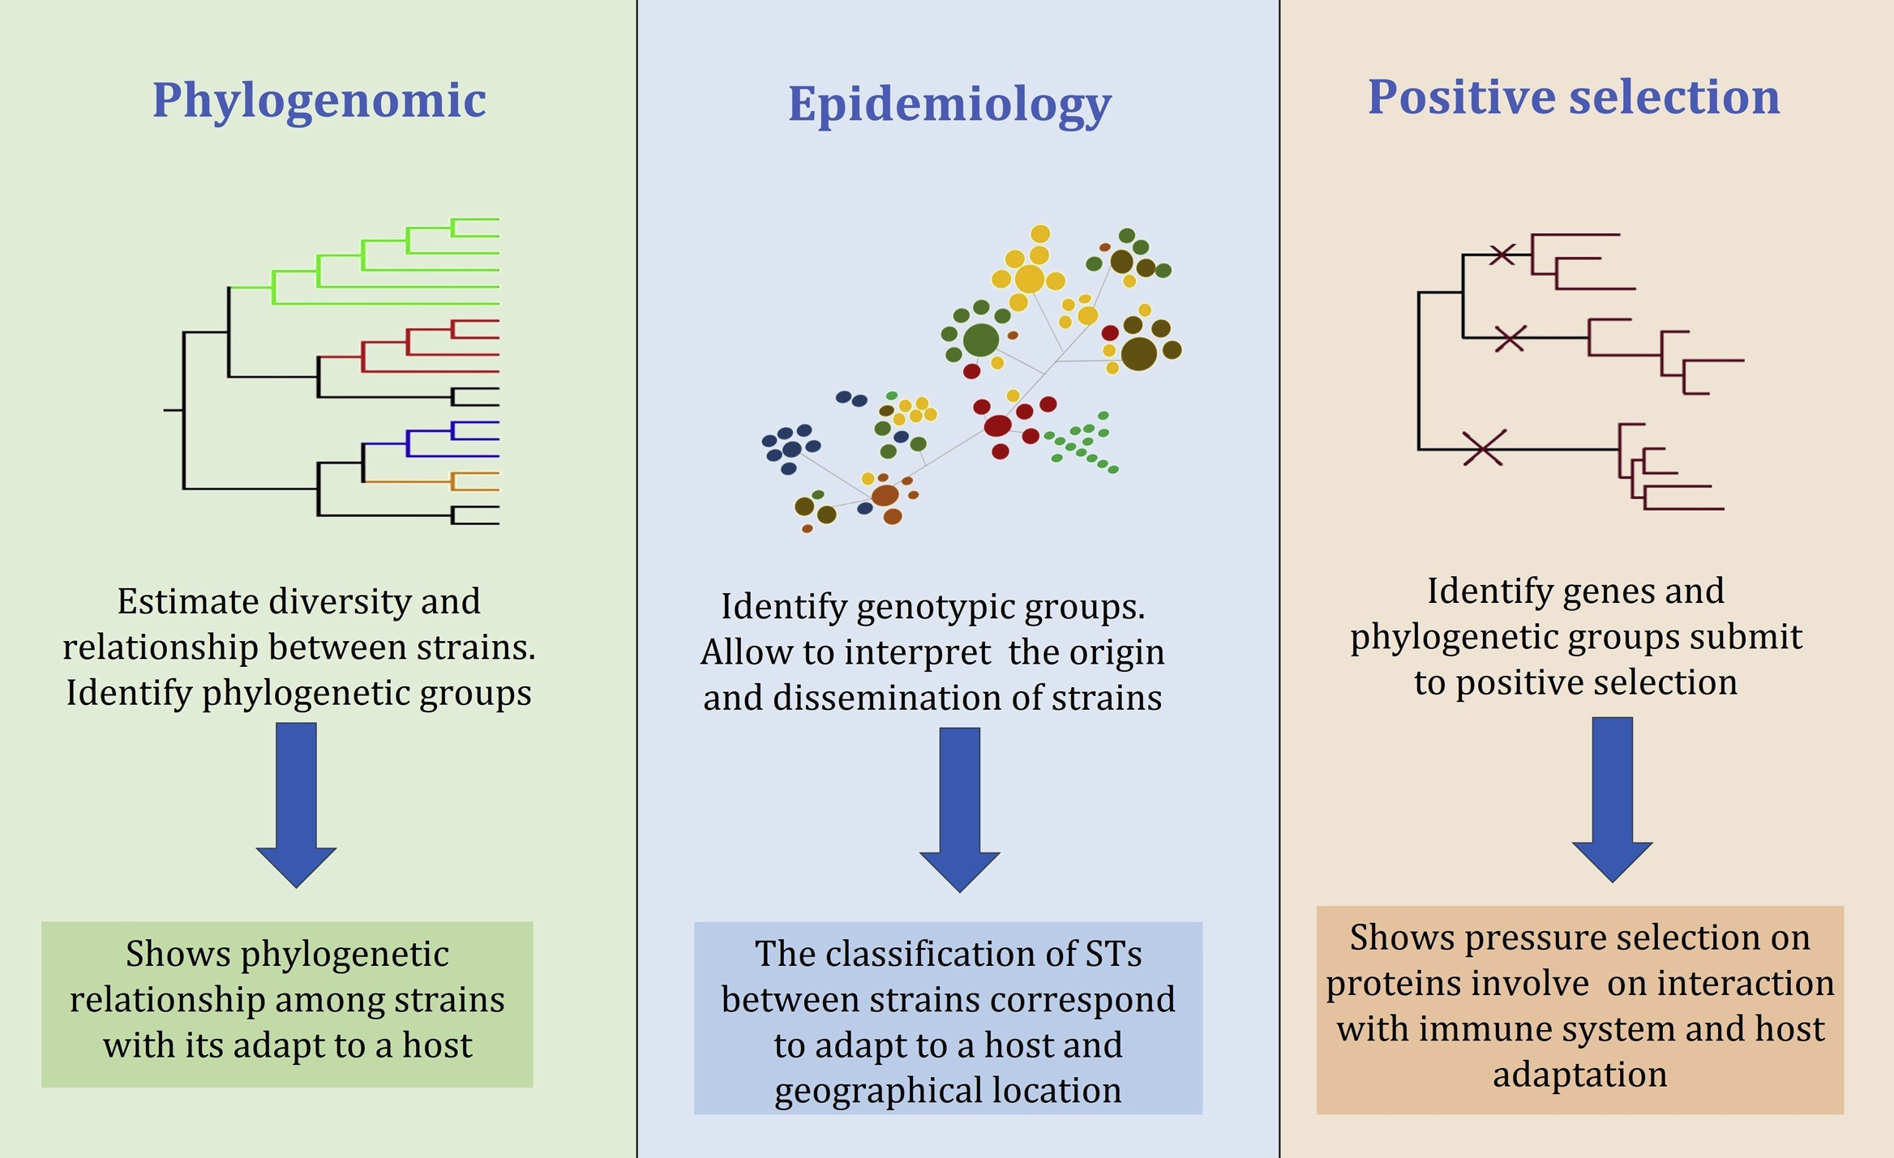
Hurtado, R., Maturrano, L., Azevedo, V., and Aburjaile, F. (2020). Pathogenomics insights for understanding Pasteurella multocida adaptation. International Journal of Medical Microbiology 310, 151417. doi: 10.1016/j.ijmm.2020.151417.
Notes:
Pangenome: Identification of genomic variants that are correlated with disease outcomes measured via an inoculation study
Evolutionary history: Quantify patterns of horizontal genetic transfer between pine and fungus, and infer duration of contact between them.

Slide 28
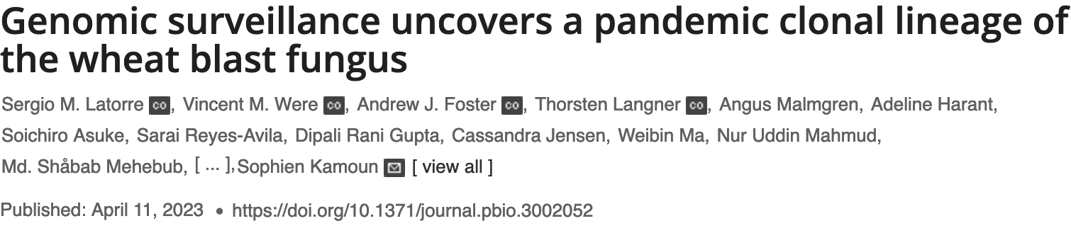
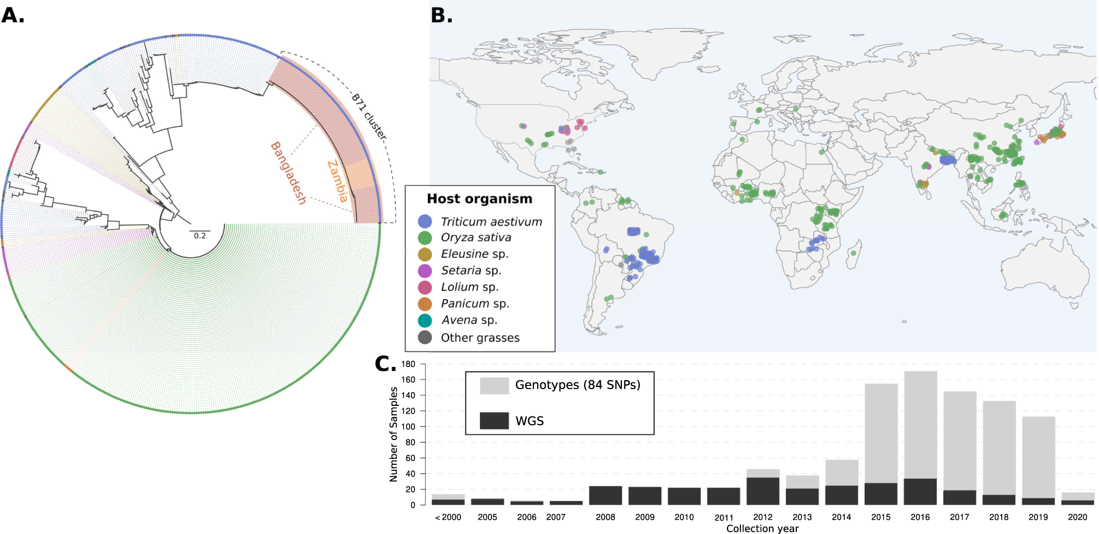
Why is this important?

Slide 29
Host jump

Slide 30
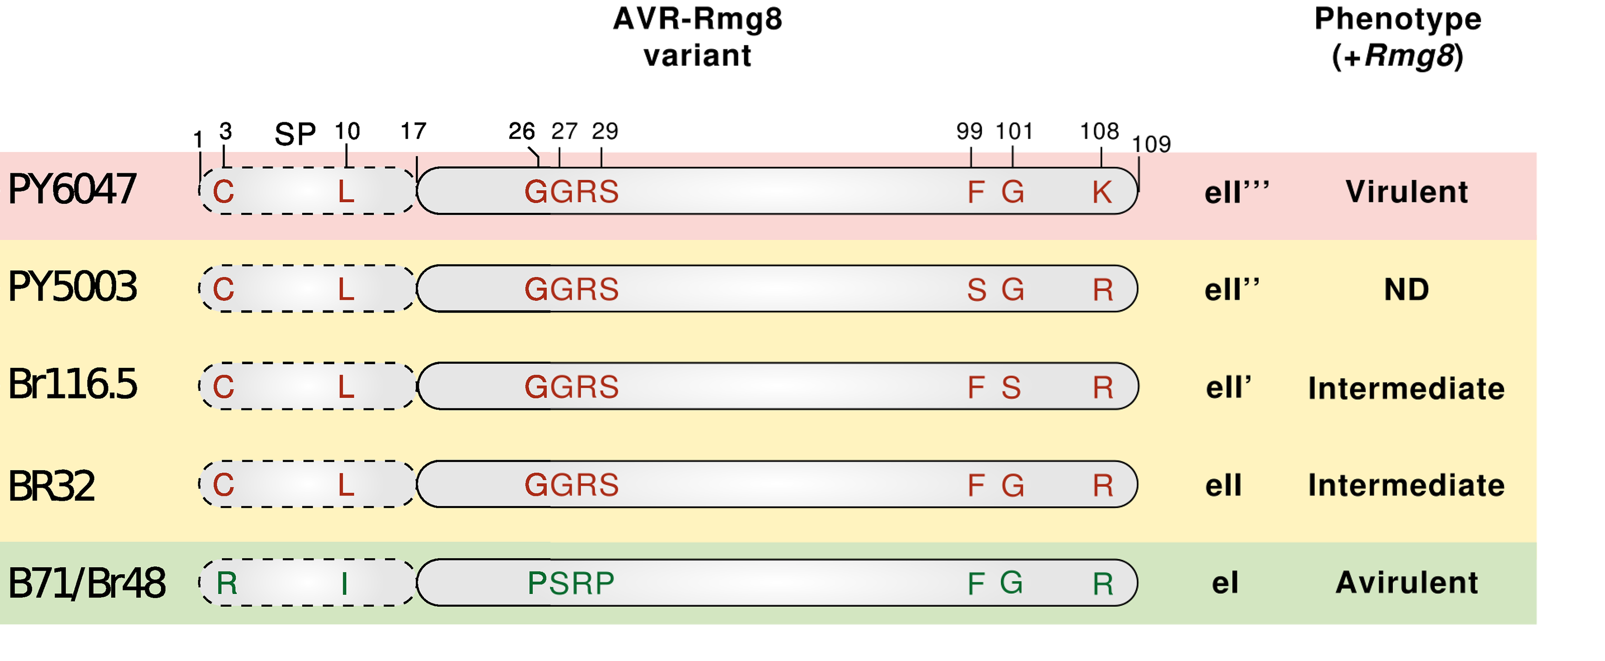
Resistant cultivars

Slide 31
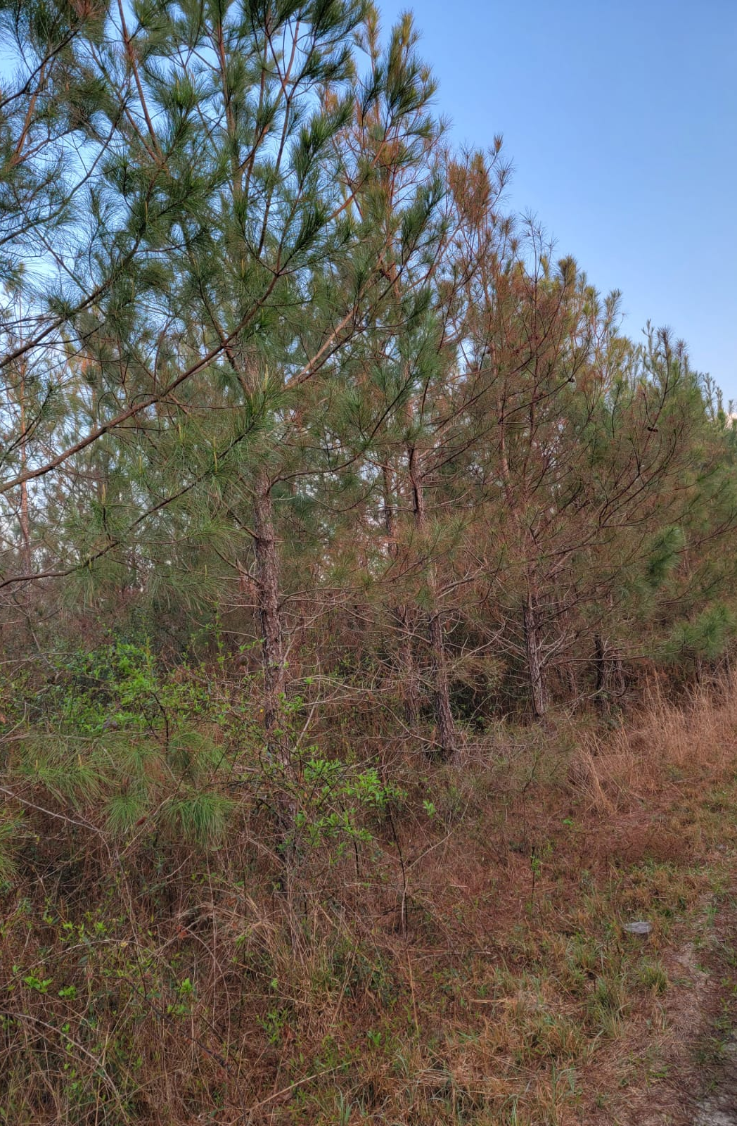
Understand L. acicola evolutionary history
Inform disease management strategies
Guide identification of treatment targets
Provide genetic context for preventive measures
Notes:
important for devising mitigation strategies to protect Alabama’s timberland investments.

Slide 32


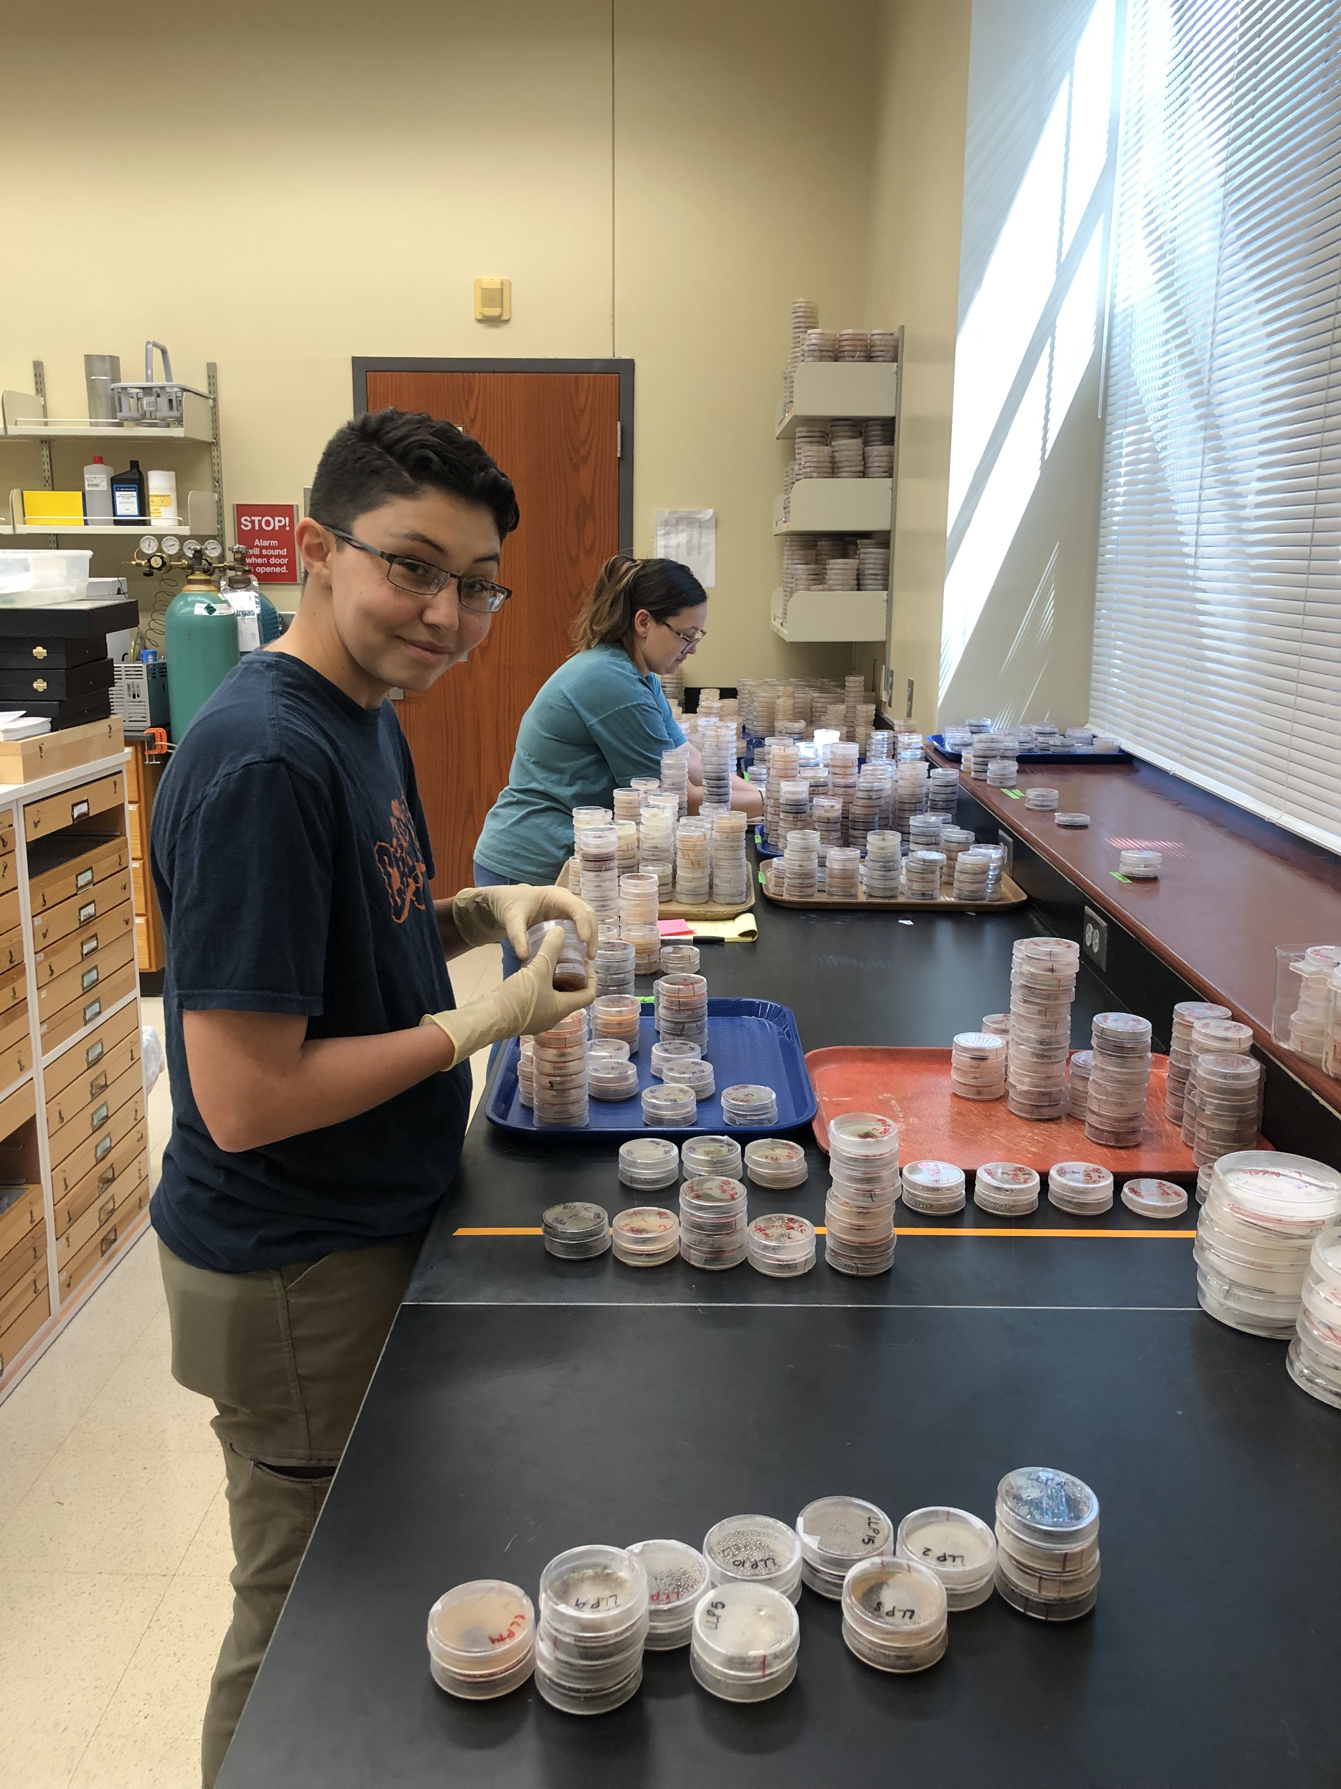
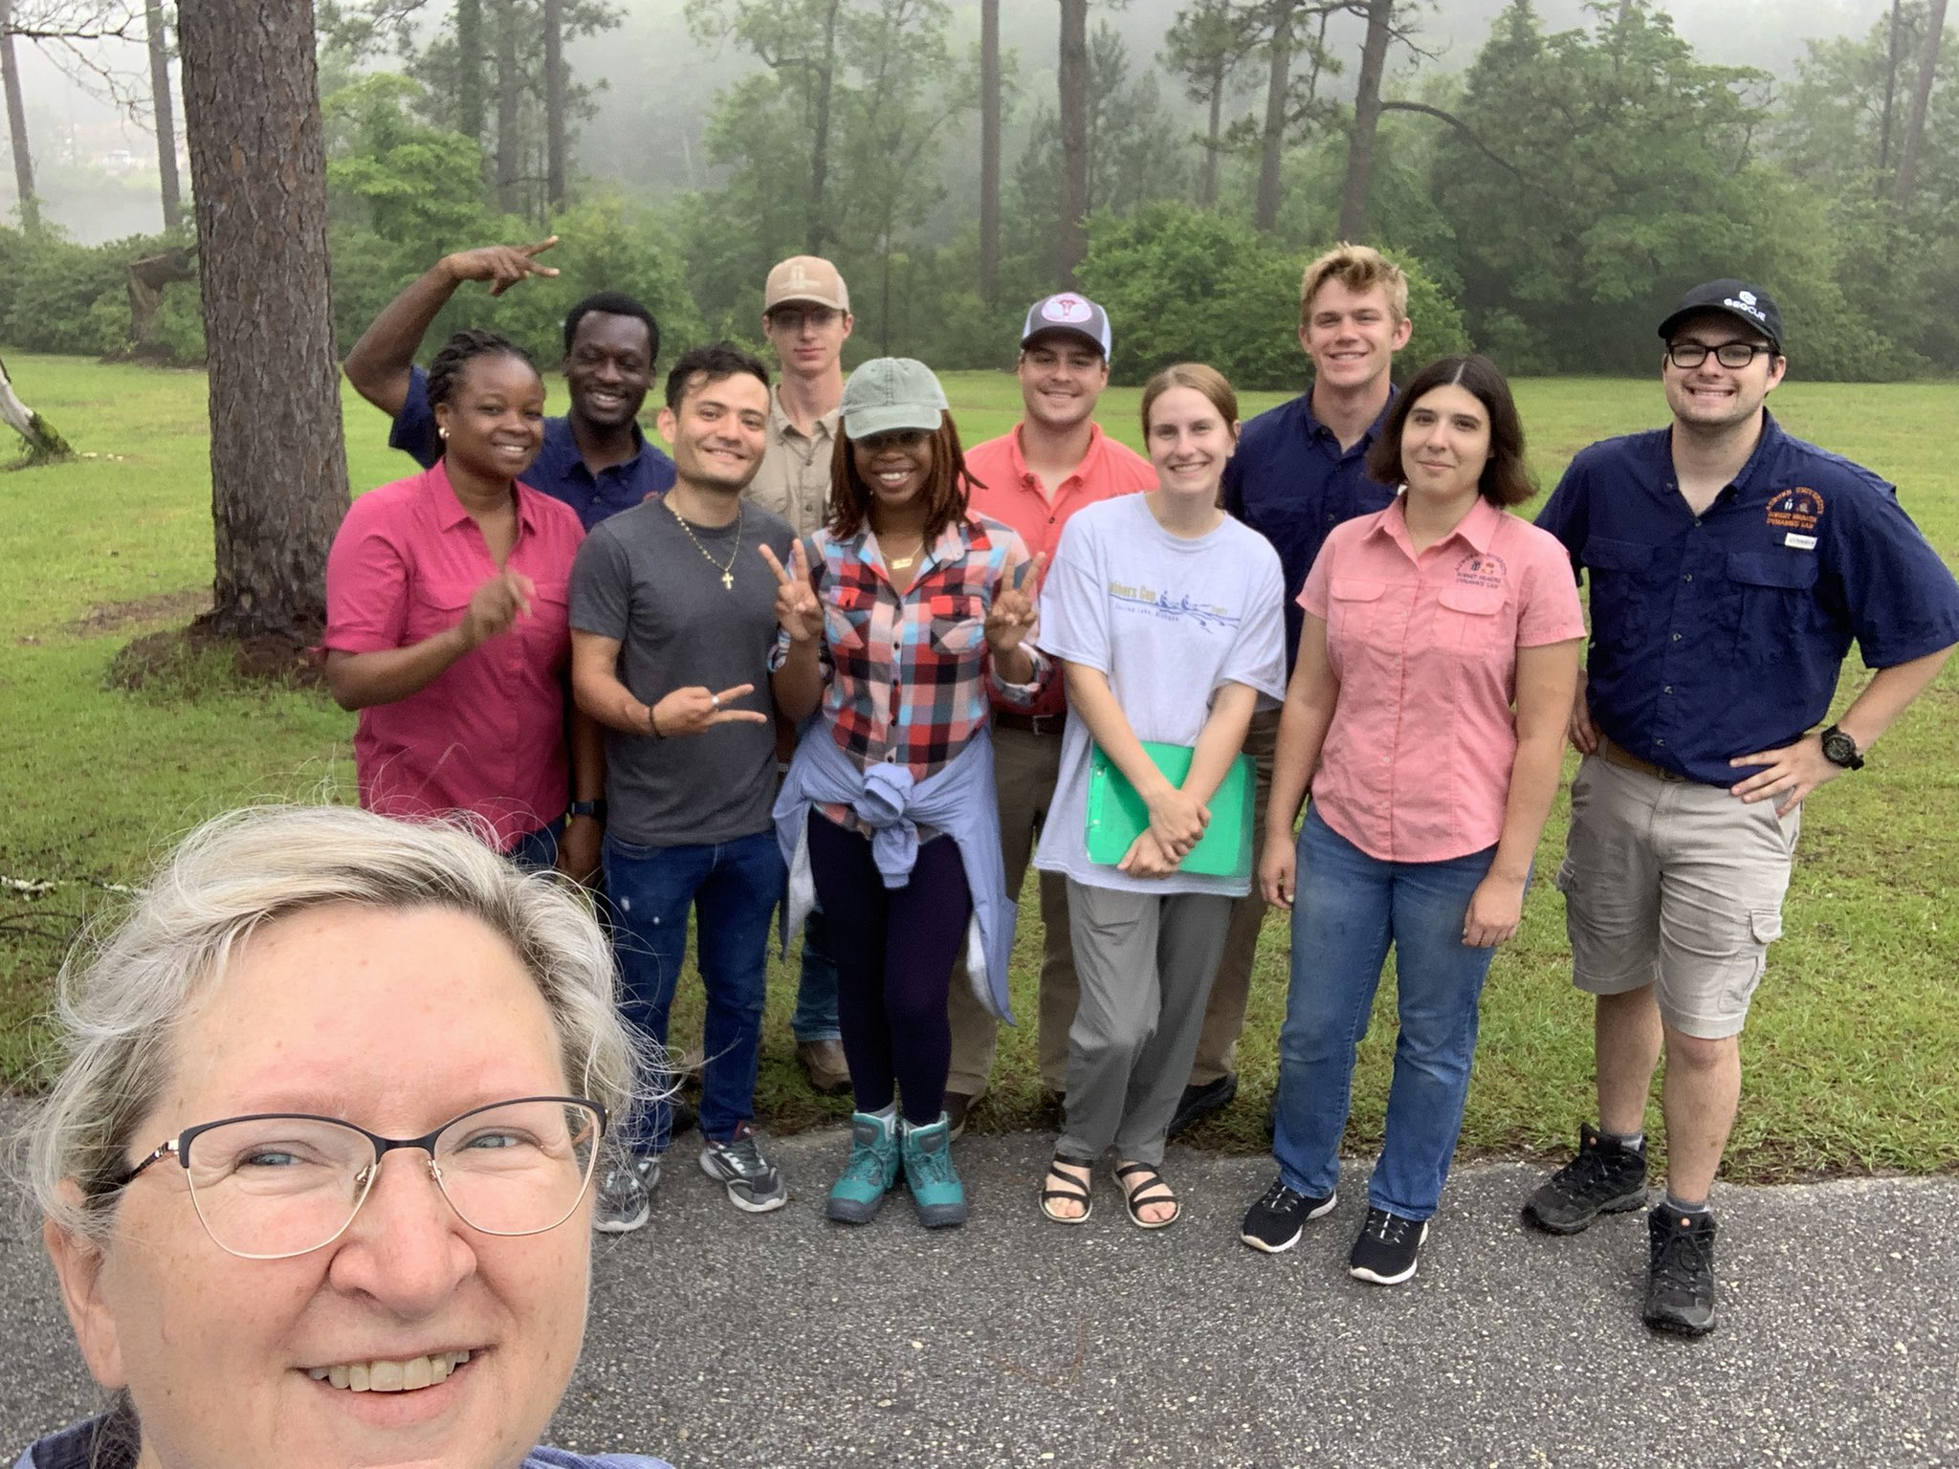


Acknowledgments
Forest Health
Dynamics Lab
Dr. Lori Eckhardt
Stallworth Land Company
Long Leaf Land & Timber Company
Osko Forest - Dr. Glenn Glover
Kris Bradley

Slide 33
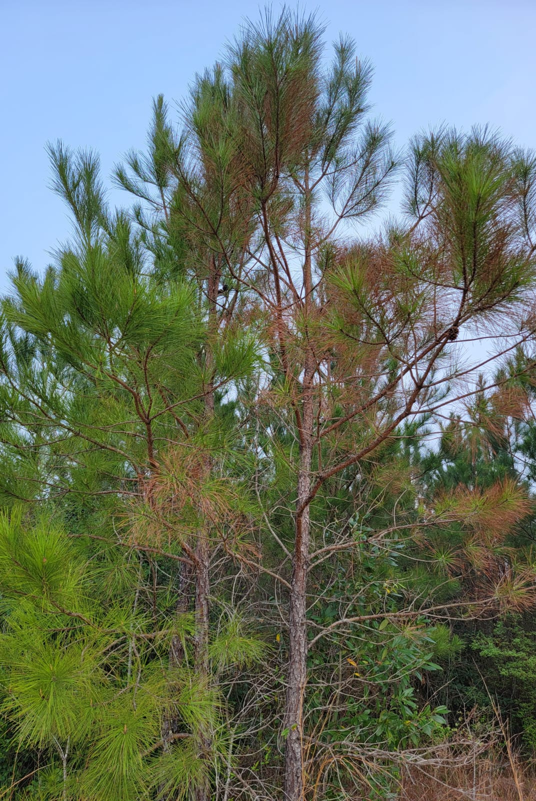
Questions?
Gabriel Silva
PhD Student
Conservation and Genomics Lab
Gabriel.silva@auburn.edu

