Slide 1
Mari Karm, Anu Sarv
University of Tartu, Estonia
Academic Development: The Journey from Soviet to Global Higher Education Traditions

Slide 2
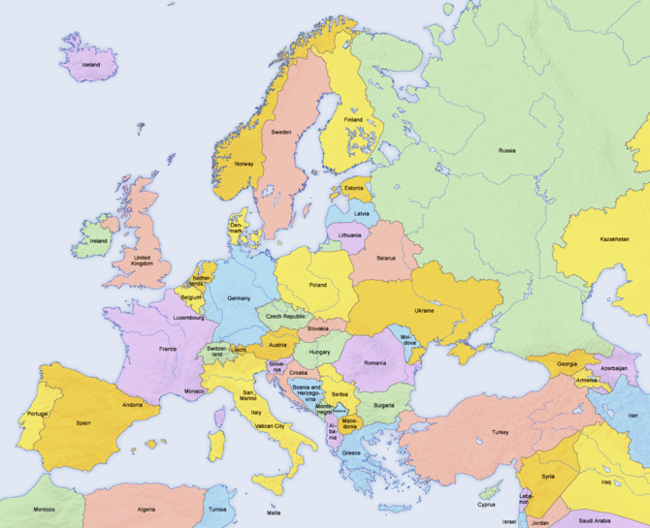

Slide 3
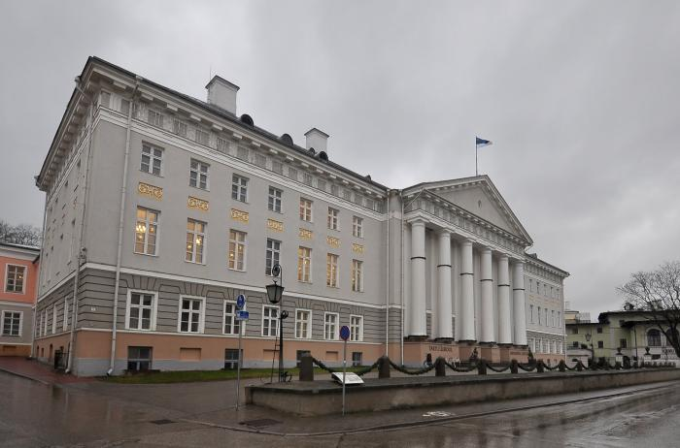
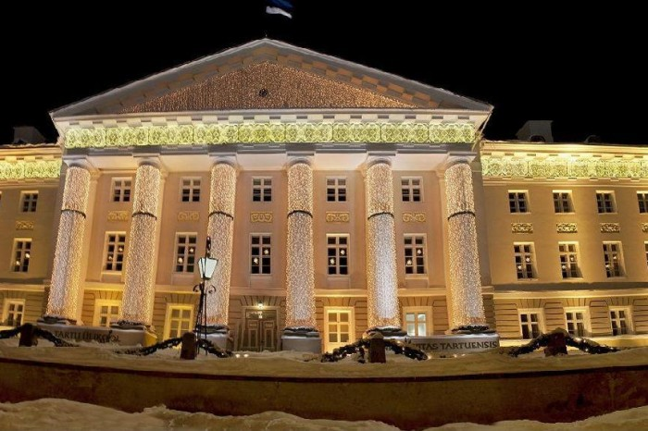
Established at 1632 AD
by Swedish King Gustav Adolph

Slide 4
Higher Education during Soviet occupation
Very limited possibilities for developing any independent education policy
Higher education was subject to the necessities of the planned economy
Curriculas= strict study plans
„Red“ subjects (e.g history of communist party), military sybjects
Soviet system favoured content-centred teaching and the lecturer’s main role was to be the imparter of the information, while the students were left with the role of passive listeners. (Raudsepp, 2006).

Slide 5
Higher Education during restoration of independence
perestroika at the end of 1980s, restoration of independence in 1991
The most acute aspects in HE, that needed solutions:
the ideology and paradigms of education;
the structure of education;
the relationship between different levels of education;
the quality of education;
the relative proportions of public and private initiatives and the supply of personnel and finances (Must, Kõrgesaar & Kala, 1995; 307).
Notes:
Political renaissance started with perestroika at the end of 1980s and reached fulfillment with the restoration of independence in 1991The most acute aspects were:
, which heralded a period of major changes at all levels in society.

Slide 6
Reforms since 1991 (including signing the Bologna Declaration in 1999)
Flexible curriculum (credit point system) instead of course system 1997
3 (BA)+2 (MA) curriculas instead 4 years BA+2 years MSc 2002
Outcome based curricula 2007
ECTS credit point system 2009
Criterion based assessment 2011
Notes:
After restoration of independence in 1991, Estonia has undertaken several extensive reforms in the field of higher education, including signing the Bologna Declaration in 1999. These reforms took into account the aim of integrating into the structures of the European Union. At the same time teaching in higher education faced multiple external pressures many of which were closely linked to the process of political and economic transition and the changes in society. As education became more democratic and more accessible higher education experienced rapid expansion in both HEIs and student numbers.
Estonia has become a part of global trends in society as well as in Higher Education .
That all has created new challenges for academic staff and quality of teaching has become more important. Increasing numbers of students, globalization, new media, development of IT tools, rapidly increasing amount of information demands also new ways of teaching. Therefore, the need for academics’ to enhance their teaching skills became obvious.

Slide 7
Starting academic development
As a result of Estonia joining the European Union in 2004 resources were given for academic development
Started systematic academic development activities and programs
In 2008, funding from the EU (PRIMUS program) allowed the establishment of two academic development centres, at the University of Tartu and the University of Tallinn
Notes:
As a result of Estonia joining the European Union in 2004 resources were given for developing academics’ teaching skills and these resources enabled universities to develop systematic academic development activities and programs. At this time, the University of Tartu initiated pedagogical training and academic development activities. In 2008, funding from the EU allowed the establishment of two academic development centres, at the University of Tartu and the University of Tallinn.

Slide 8
Learning from international experience
EU funding enabled to think about international co-operation strategically
Learning from the experiences of other universities in Norway, the UK, Ireland, Finland, and the US to find best practices of academic development
Joining international organizations of academic developers (ICED, Nordic-Baltic Network)
Participation in International conferences on higher education teaching and learning

Slide 9
What did we learn from International colleagues?
Background philosophy of pedagogical training
Design of the basic pedagogical course
New teaching strategies
Engaging colleagues as learners into active learning
Sustainable enhancement of pedagogical trainings based on collecting evidence
The principles and process of peer feedback
Concept of teaching-learning portfolio
SoTL

Slide 10
Conceptual background of academic development
To support learning-centered approach to teaching.
The conceptual background of pedagogical courses was designed in cooperation with colleagues such as Gunnar Handal (Norway), Sari Lindblom-Ylänne (University of Helsinki, Finland) and James Groccia (Auburn University, US)

Slide 11
Team of academic development
2008 - Central unit for academic development (2-3 academic developers for whole university)
2016 - Academic developer and instructional designer for every faculty (4+4) funded by EU programme ASTRA
We are considered more as partners for university leadership.
We are initiating new developments in enhancement of teaching-learning quality (e.g principles of good teaching, evaluation of good teaching, students’ feedback system).

Slide 12
Pedagogical trainings (since year 2006)
Basic pedagogical course (6 ECTS), 2 times a year
Short courses and workshops (1-3 ECTS)
Supervising skills (3 ECTS), every year
Summer academy (2 ECTS), every year
Conferences on university teaching, every year

Slide 13
The creation of Communities of Practice
Since 2009 In addition to pedagogical courses to support implementation of learned skills and methods into teaching
Important activity of communities of practice is peer review (peer observation) of teaching
Since 2014 broadly implemented in the university (CoP in every faculty, over 100 participants total in the year)

Slide 14
Goals of the Communities of Practice
To support reflection on teaching
Encourage collaboration between colleagues
Enhance the public discussion on teaching
Provide feedback on teaching
Support the increase of self-confidence of teachers.
Support the impelementation and discovery of new teaching methods

Slide 15
Activities of CoP
Reading club
Peer review of teaching
Case analysis (co-vision)
Sharing new teaching-learning strategies
Enhancing e-learning environments, e-courses

Slide 16
Conceptual background of the Communities of Practice
Peer to peer
Confidentiality (feedback is not publicly shared)
No assessment
Supportive, friendly attitude
Equal contribution to the process

Slide 17
Fears about peer review of teaching
Fear that this is hidden control over one’s teaching
Fear to show up incompetent before colleagues
Feeling incompetent in giving and getting feedback
Not knowing how to deal with feedback
Not knowing language, terminology of pedagogy and teaching
Fear that there is nothing to learn from colleagues
Fear that superiors don’t value the participation and contribution on teaching development

Slide 18
Results of CoP
CoP helped to improve teaching skills
New ideas and tips during observations
Supported self confidence
The circle of people to discuss teaching and to collaborate was broadening
Participation in CP should be taken into account in teachers career

Slide 19
Scholarship of Teaching and Learning
Since 2015
Each year 12 faculty members can apply for a Scholarship to develop and study their teaching.
2 year program with financial support to support the development of teaching
Application documents:
  Teaching portfolio
  Project of development (Action research plan on improving own teaching)

Slide 20
Goals of SoTL
To support the development of teaching:
To solve problem in teaching
Study it (action research) to get evidence based information about it
To share results with colleagues, public

Slide 21
Principles
2 year program
Not the price for the past results but for the future development
Financial support:
Every month extra money for the salary
Extra travel money (to participate conferences, share results)
Extra money for the department/unit development
Regular meetings for the participants to provide support for the action research

Slide 22
Good practice of teaching(2016)
Excellent teaching is learning-centred.
Excellent teaching is based on a scientific way of thinking.
Excellent teaching is based on cooperation.
Excellent teaching supports creativity and entrepreneurship.
Excellent teaching leads to self-analysis and supports individual development.
Excellent teaching links learning to real life.

Slide 23
Whath has changed during our journey?
Development of teaching is valued at our university (by leaders, among colleagues)
The teaching culture has changed
More colleagues from various institutions are contributing to development of teaching and learning
Informal and sophisticated discussions on teaching among university teachers and professor
Regular conferences on teaching (SoTL)
We as academic developers can contribute to university policy
Leaders are supporting academic development initiatives

Slide 24
Thank You!
mari.karm @ut.ee, anu.sarv @ut.ee

