Slide 1


Development and Delivery of the Intercultural Faculty Scholars Cohort Program
Judy Lightner
Teaching Associate, Center for Teaching and Learning
Jenny Marcinkiewicz
Director, Center for Teaching and Learning

Slide 2
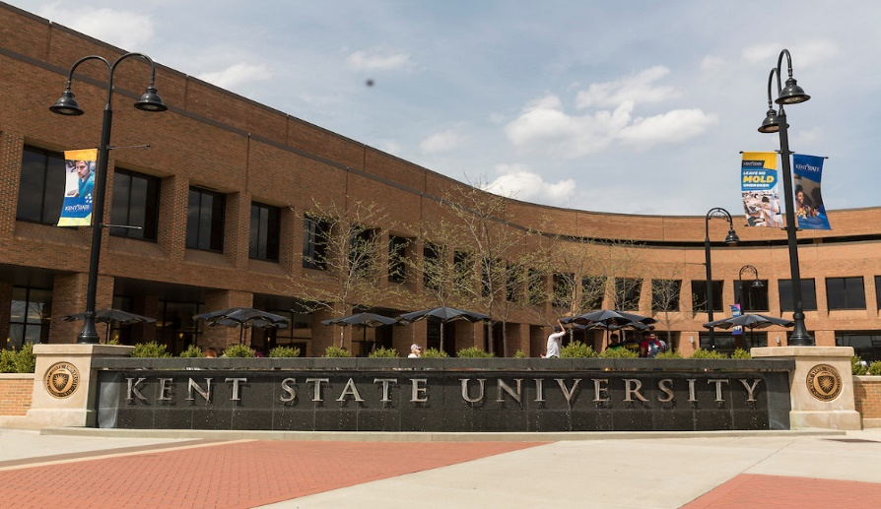
Institutional Context - Kent State University
Eight campus system
  Additional facilities
  College of Podiatric Medicine
  Regional Academic Center
  Florence, Italy
Student enrollment (all): 39,367
Faculty (all): 2,726
  Full-Time Faculty: 1,369 (TT: 793, NTT: 576)
  Part-Time Faculty: 1,357
https://www.kent.edu/sites/default/files/file/8%20Campus%20System%20Fall%2017.pdf

Slide 3
Establishing a Need for IFSC Program
Kent State International Student Context:
International student population trends
  Sharp increase
  First Cohort 2014-15
Colleges
  Arts and Sciences (e.g., CS, Physics)
  Business Administration (e.g., Accounting, Finance, MIS)
  Aeronautics and Engineering
  Communication and Information (e.g., Digital Sciences)
Top sending countries (Saudi Arabia, China, India, Oman)

Slide 4
Overview – Finding Support
Kent State University Strategic Plan
Office of the Provost
    Ensure that appreciation, service, and caring for our international students extends in all our teaching, learning, and support areas.
    Promote curricula that encourage the systematic understanding of cultural and other forms of international diversity.
Collaborative effort:
Institutional Partners: CTL, OGE, Office of Provost, DEI
Varied Formats:
    90 minute workshop for faculty: Teaching and Learning Across Cultures
    Semester-long faculty led program: IFSC Program

Slide 5
Faculty Learning Community Benefits
CTL’s perspective
    Organically developed (not top down)
    Faculty facilitated with discipline expertise
    Faculty as learners
    Peer support
    Individual development
    Change agents (“train the trainer”)
    Expectation to take back to dept/school and college

Slide 6
IFSC Faculty Learning Communities
2014-15 CTL as lead
      13 Faculty
        Multi-campus representation
        7 Colleges
2016-17 OGE as lead
      8 Faculty (5 Colleges)
2018-19 CTL as lead
      12 Faculty
        Multi-campus representation
        8 Colleges

Slide 7
Roundtable Participants
Brief Intro
Similar program or interest in establishing one?

Slide 8
Overarching IFSC Program Goals
Faculty are experts in their discipline, but may not have
substantial background in pedagogy of teaching across cultures
Participants will:
  Gain a better understanding of the potential conflict between one’s preferred teaching style and the range of learning styles and experiences international students may bring to the classroom
  Consider culturally responsive ways to modify and/or enhance teaching practices and assessment strategies.
  Develop skills in preparing and providing intercultural workshops for colleagues.
  Better understand Intercultural Communication theoretical frameworks

Slide 9
Moving the Idea to Implementation
Establish a Need
  Faculty input
  Demographics
  Link to strategic plan
Steps & Logistics
  Support, funding, collaborators
  Research best practices
  Select facilitator & participants
  Set expectations
  Logistics
  Track outcomes
Evaluate & Revise
  Identify challenges
  Identify successes
  Identify opportunities for improvement
Steps & Logistics
Evaluate & Revise
Establish a Need

Slide 10
Idea to Implementation
Lessons Learned
  Post program cohort meetings
  Program evaluation framework
  Continued reporting of ongoing program outcomes
      National and international conference presentations
      Department and College presentations, workshops
      Campus presentations, workshops
  Selection process

Slide 11
Roundtable Participants
Developing a Program
  Establish need
  Logistics
  Evaluate and Revise
Existing Program
  Steps as above
  Lessons learned

Slide 12
Thank You.
www.kent.edu/ctl

Slide 13
Idea to Implementation
Establish need
  University mission / Strategic Plan
  Student demographic data
  Intentional collaboration
Logistics
  Administrative Support / Funding / Collaborations
  Research Similar Programs, Resources
  Participant Selection
  Faculty Facilitator
  Expectations of Faculty Participants – “Train the Trainer” design
  Location and time, Facilitator, Faculty Incentive
  Evaluation plan
Evaluate and Revise
  Identify challenges
  Identify successes
  Identify further opportunities
  Ongoing evaluation and reporting

