Slide 1
Student Engagement:
A Multidimensional perspective
Dr. James E. Groccia
Professor Emeritus, Auburn University
Visiting Professor, University of Tartu

Slide 2
Workshop Outline
Introduction
What is Student Engagement?
My Model of Student Engagement
Why is Student Engagement Important?
Examples of Student Engagement
Future of Student Engagement
Conclusion

Slide 3
ME
Visiting Professor, 2016-2018, University of Tartu
Professor Emeritus, Administration of Higher Education, Auburn University
Fulbright Scholar, 2011-2012, University of Tartu
Former President, Professional and Organizational Development Network in Higher Education (POD Network)

Slide 4





Slide 5



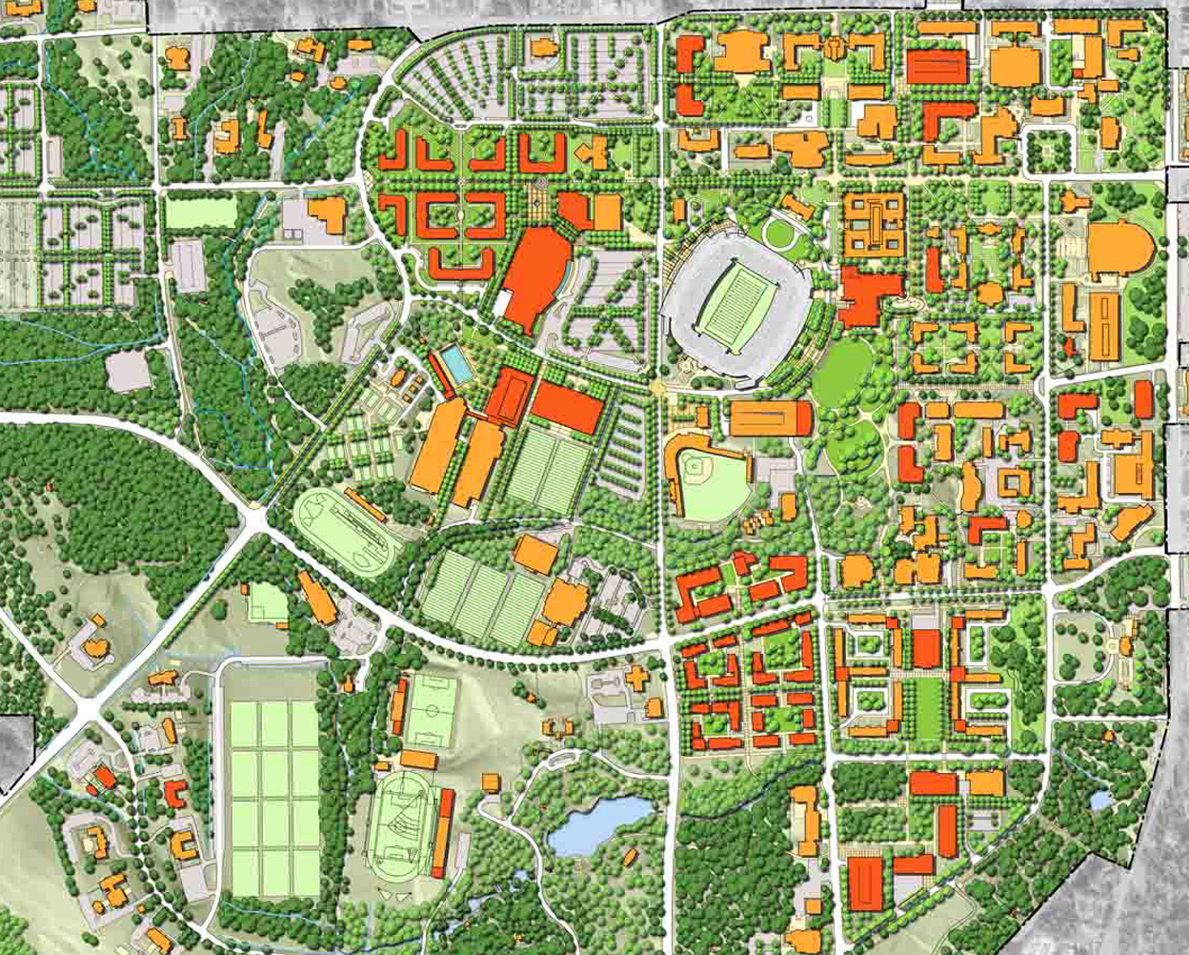


Slide 6
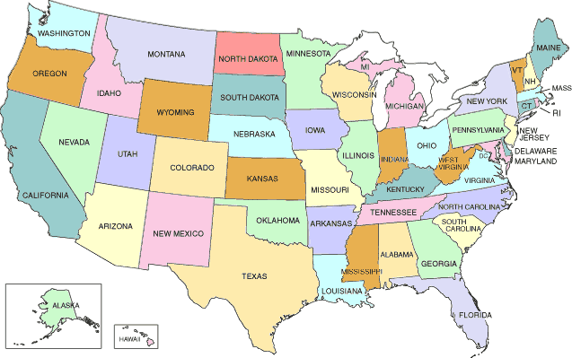
Auburn
URN

Slide 7


Slide 8
PLEASE WRITE YOUR ANSWER:
Who was your best university teacher and why?
After writing for 3 minutes share your answer with a partner

Slide 9
What is student engagement?

Slide 10
What is Student Engagement?
Please:
1. Write a definition
2. Share with a person sitting next to you

Slide 11
Definitions of Student Engagement
George Kuh (2009) “the time and effort students devote to activities that are empirically linked to desired outcomes of college and what institutions do to induce students to participate in these activities.”
Coates (2007) a “broad construct intended to encompass salient academic as well as certain non-academic aspects of the student experience.”

Slide 12
Definitions of Student Engagement
Axelson and Flick (2010) “how involved or interested students appear to be in their learning and how connected they are to their classes, their institutions, and each other.”
Fletcher (2015) “any sustained connection a learner has towards any aspect of learning, schools or education.”

Slide 13
Definitions of Student Engagement
Glossary of Education Reform (2016), “… the degree of attention, curiosity, interest, optimism, and passion that students show when they are learning or being taught, which extends to the level of motivation they have to learn and progress in their education.”

Slide 14
Definitions of Student Engagement
As the definitions above attest, student engagement takes many forms.
Graham Gibbs (2014) provocatively labeled student engagement as the latest higher education buzzword. According to Gibbs, student engagement is used to refer to so many different things that it is difficult to know what people actually mean by the term.

Slide 15
Definitions of Student Engagement
It is exactly the diversity of meaning of student engagement questioned by Gibbs that I believe is its strength and maximizes the potential of student engagement for positively impacting the quality of higher education and learning.

Slide 16
Definitions of Student Engagement
STUDENT ENGAGEMENT is multidimensional and extends the concept beyond learning behaviors to a broad range of campus activities within and beyond the classroom.

Slide 17
Definitions of Student Engagement
Learning requires “educational practices that engage students across disciplinary boundaries in learning experiences that tackle real problems, allow for application of course content to those problems, and lead to sustained intellectual growth and a heightened sense of personal responsibility” (Groccia and Hunter 2012).

Slide 18
Definitions of Student Engagement
To achieve these outcomes, a student must engage with the learning process on behavioral, affective, and cognitive levels.

Slide 19
Definitions of Student Engagement
To engage at a behavioral (DOING) level, the learner must have some degree of participation or effort, and be persistent in the learning process.

Slide 20
Definitions of Student Engagement
At the affective (FEELING) level of engagement, the learner must have a level of interest in the experience that results in improved motivation and enjoyment, thus establishing a level of commitment.

Slide 21
Definitions of Student Engagement
Lastly, the learner must engage on a cognitive (THINKING) level displaying a degree of mental activity, processing thought about the experience that should result in the ability to cognitively process the experience and establish linkages to previous experiences.

Slide 22
mULTIdIMENSIONAL model of student engagement
Engagement
Doing
Feeling
Thinking
With other students
With the community
In research
With faculty and staff
In learning
In teaching
(Groccia,2018)

Slide 23
Why is student engagement important?

Slide 24
Why is student engagement important?
The American psychologist Ralph Tyler was one of the first to focus on engagement with his pioneering work in the 1930s showing the positive effects of time on task on learning (Merwin 1969 as cited in Kuh 2009),

Slide 25
Why is student engagement important?
American scholars have associated student effort and time on task to various desired outcomes of college (Pascarella and Terenzini 2005; Pike 2006; Tinto 1987, 1993).

Slide 26
Why is student engagement important?
Trowler (2010): “a sound body of literature has established robust correlations between student involvement in a subset of ‘educationally purposive activities’, and positive outcomes of student success and development, including satisfaction, persistence, academic achievement and social engagement.”

Slide 27
Why is student engagement important?
National Survey of Student Engagement (Kuh 2002) highlighted the importance of student engagement by stating that “what students do during college counts more in terms of desired outcomes than who they are or even where they go to college.”

Slide 28
Why is student engagement important?
Kuh (2003) went on to state that the vast amount of research on college student development shows that student engagement is the single best predictor of learning and personal development.

Slide 29
mULTIdIMENSIONAL model of student engagement
Engagement
Doing
Feeling
Thinking
With other students
With the community
In research
With faculty and staff
In learning
In teaching
(Groccia, 2018)

Slide 30
Examples of student engagement
In small groups develop one example of student engagement that currently exists or could exist at your institution
-10 minutes

Slide 31
mULTIdIMENSIONAL model of student engagement
Engagement
Doing
Feeling
Thinking
With other students
With the community
In research
With faculty and staff
In learning
In teaching
(Groccia, 2018)

Slide 32
Student Engagement in Teaching
Engagement
Doing
Feeling
Thinking
In teaching
Peer Teaching
SAT/PLAs
Undergraduate Tas

Slide 33
Student Engagement in learning
Engagement
Doing
Feeling
Thinking
In learning
Active Learning
PBL
TBL
Jigsaw
Clickers
On-line Discussions

Slide 34
Corporate Logo Group Activity
I will show you a slide that contains a number of corporate logos for 30 seconds
After studying these for 30 seconds I will turn off slide
Then each person write down as many company logos as they learned
(1 minute)

Slide 35










































































Slide 36
Corporate Logo Group Activity
Each person write down as many company logos as possible (1 minute)
Add up and record the number on logos you remembered individually
Form a team of 3-5, integrate individual lists to come up with one team list
Count up the total number of logos for your team
Calculate the individual average
Compare individual average with team score
Which is greater and why?

Slide 37
Student Engagement in Community
Engagement
Doing
Feeling
Thinking
With the community
Service Learning

Slide 38
Student Engagement in Research
Engagement
Doing
Feeling
Thinking
In research
Undergraduate Research Fellowship Program

Slide 39
Student-Faculty Engagement
Engagement
Doing
Feeling
Thinking
With faculty and staff
Mentoring
Office Hours
Email/Social Media
Contact

Slide 40
Student Engagement with other students
Engagement
Doing
Feeling
Thinking
With other students
Social/Academic Clubs
Fraternal Organizations
Campus Leadership
Sports

Slide 41
The future of student engagement

Slide 42
Future of student engagement
Depends on the sense of shared responsibility of entire campus

Slide 43
Future of student engagement
Need for effective communication among students, faculty, staff, administrators, and community agency personnel to develop a fully integrated approach

Slide 44
Future of student engagement
More research is needed

Slide 45
Future of student engagement
More research is needed

Slide 46
Final thoughts

Slide 47
The engaged campus is the ultimate goal
Engagement
Doing
Feeling
Thinking
With other students
With the community
In research
With faculty and staff
In learning
In teaching

Slide 48
References
Axelson & Flick. 2010. “Defining Student Engagement”. Change: The Magazine of Higher Learning 43(1): 38-43.
Coates. 2007. “A Model of Online and General Campus-Based Student Engagement. Assessment & Evaluation in Higher Education 32(2): 121-141.
Fletcher. 2015. “Defining Student Engagement: A Literature Review.” Soundout: Promoting Meaningful Student Involvement, Student Voice and Student Engagement. https://soundout.org/defining-student-engagement-a-literature-review/
Glossary of Education Reform. 2016. Student Engagement. In Great School Partnership. http://edglossary.org/student-engagement/
Gibbs. 2014. “Student Engagement, the Latest Buzzword.” Higher Education Times. https://www.timeshighereducation.com/news/student-engagement-the-latest-buzzword/201901947.article
Groccia. 2018. In Groccia & Buskist, Student Engagement: A Multidimensional Perspective. NDTL No. 154, Wiley.
Groccia, & Hunter. 2012. The First-Year Seminar: Designing, Implementing, and Assessing Courses to Support Student Learning and Success: Volume II—Instructor Training and Development. Columbia, SC: The National Resource Center.
Kuh. 2002. The National Survey of Student Engagement: Conceptual framework and overview of psychometric properties. Bloomington, IN: Indiana University Center for Postsecondary Research and Planning. Retrieved April 28, 2017 from http://nsse.indiana.edu/pdf/psychometric_framework_2002.pdf
Kuh. 2003. “What We’re Learning about Student Engagement from NSSE. Change 35(2): 24–32.
Kuh. 2009. “The National Survey of Student Engagement: Conceptual and Empirical Foundations.” New Directions for Institutional Research, No. 141. Wiley Periodicals, DOI: 10.1002/ir.283
Pascarella & Terenzini. 2005. How College Affects Students: A Third Decade of Research. San Francisco, CA: Jossey-Bass.
Pike. 2006. “The Convergent and Discriminant Validity of NSSE Scalelet Scores.” Journal of College Student Development 47(5): 551–564.
Tinto. 1987. Leaving College: Rethinking the Causes and Cures of Student Attrition. Chicago, IL: University of Chicago Press.
Tinto. 1993. Leaving College: Rethinking the Causes and Cures of Student Attrition (2nd ed.). Chicago, IL: University of Chicago Press.
Trowler, Vicki. (2010). Student Engagement Literature Review. York, England: The Higher Education Academy.

