Slide 1

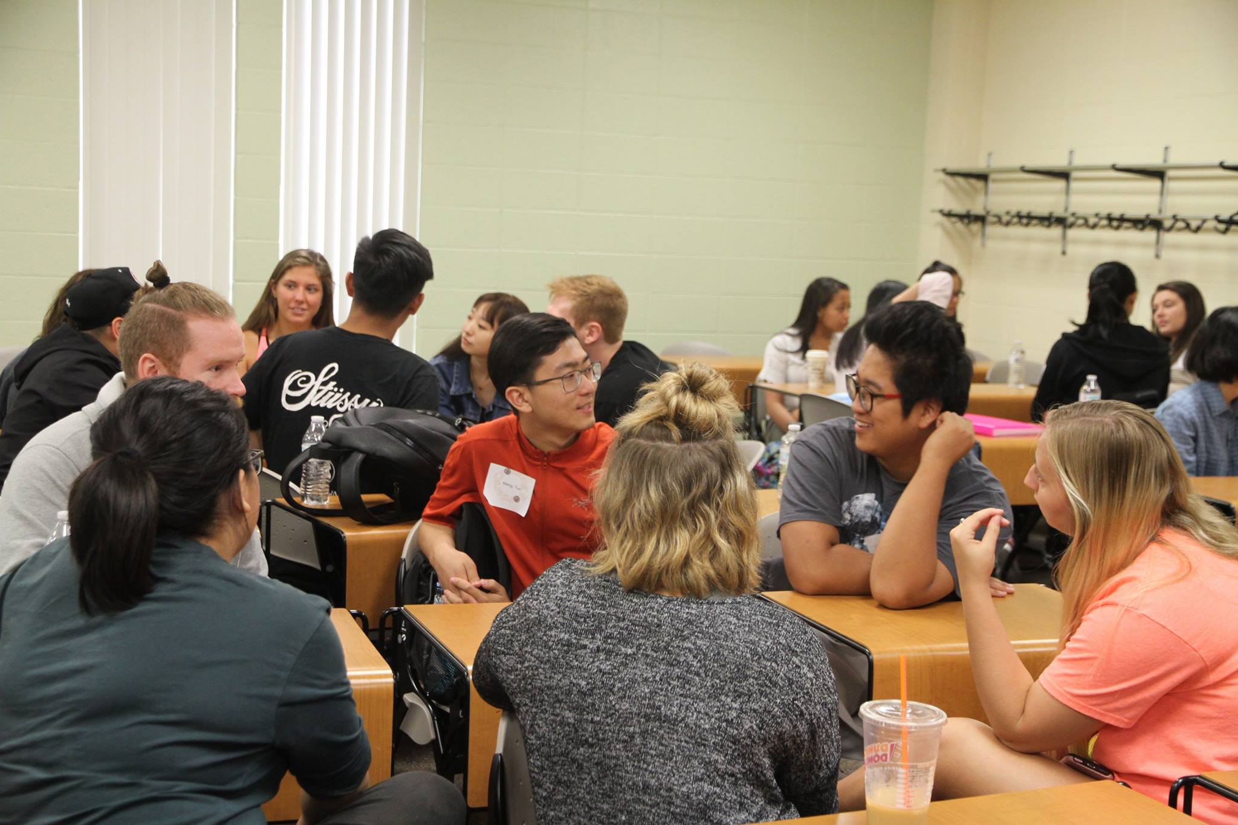
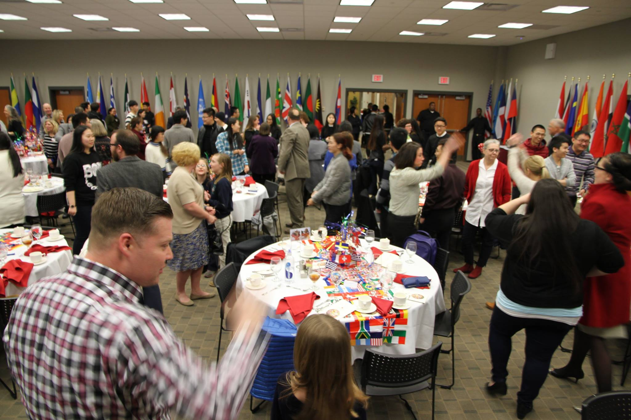


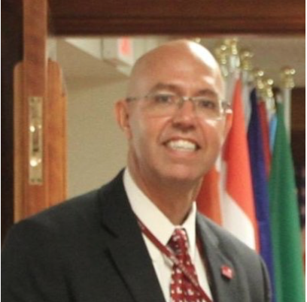

The “Crossing Borders” Service-Learning Program:
How Co-Curricular, Cross-Cultural Dialogues
Expand Comfort Zones & Break Barriers
Dr. Virginia Wickline, Dr. Jerry Martin, Ms. Kathryn Vogel
Ms. Kathryn Vogel - English Language Center Specialist (Miami Regionals)
Dr. Virginia Wickline - Social and Behavioral Sciences (Regionals)/Associate Professor of Psychology (Oxford)
Crossing Borders Program initiator
Dr. Jerry Martin - Director, Global Regional Programs & English Language Center (Miami Regionals)
BUILDING COMMUNITY

Slide 2






















Building Community

Slide 3
Session Learning Outcomes
By the end of this session, participants will be able to:
  Define intercultural competence and the Contact Hypothesis
  Describe a model of effective interdisciplinary partnerships between domestic and international students that takes place at Miami University called “Crossing Borders”
  Articulate the benefits (and challenges) of interdisciplinary partnerships for domestic and international students
  Apply “lessons learned” from the presenters in order to create more meaningful and effective interdisciplinary, co-curricular or
  extra-curricular partnerships between domestic and
  international students

Slide 4
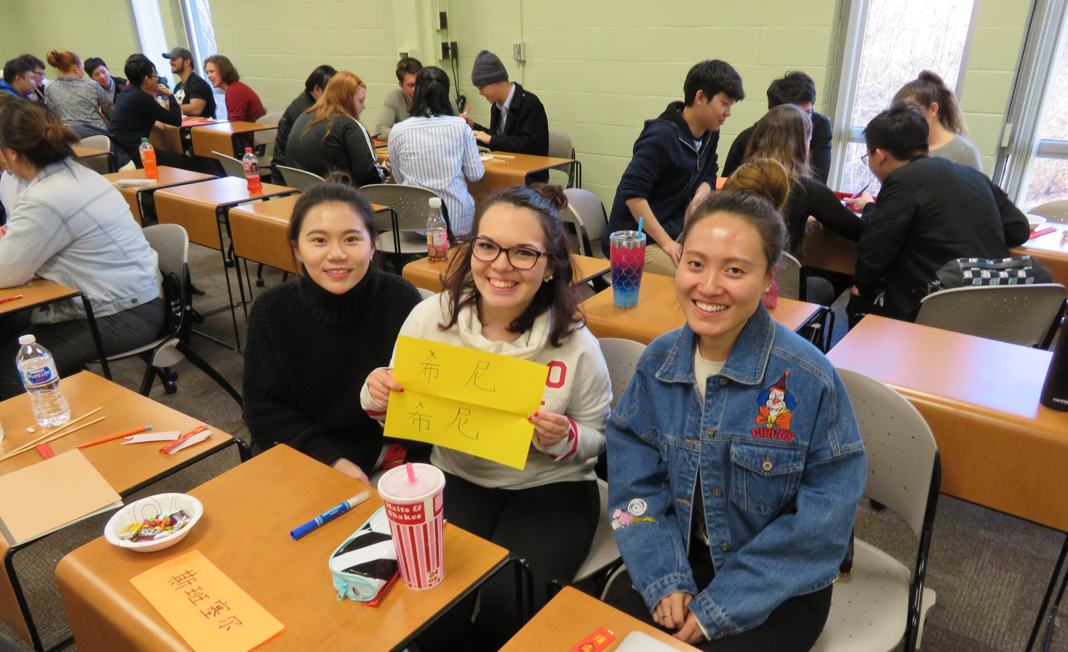
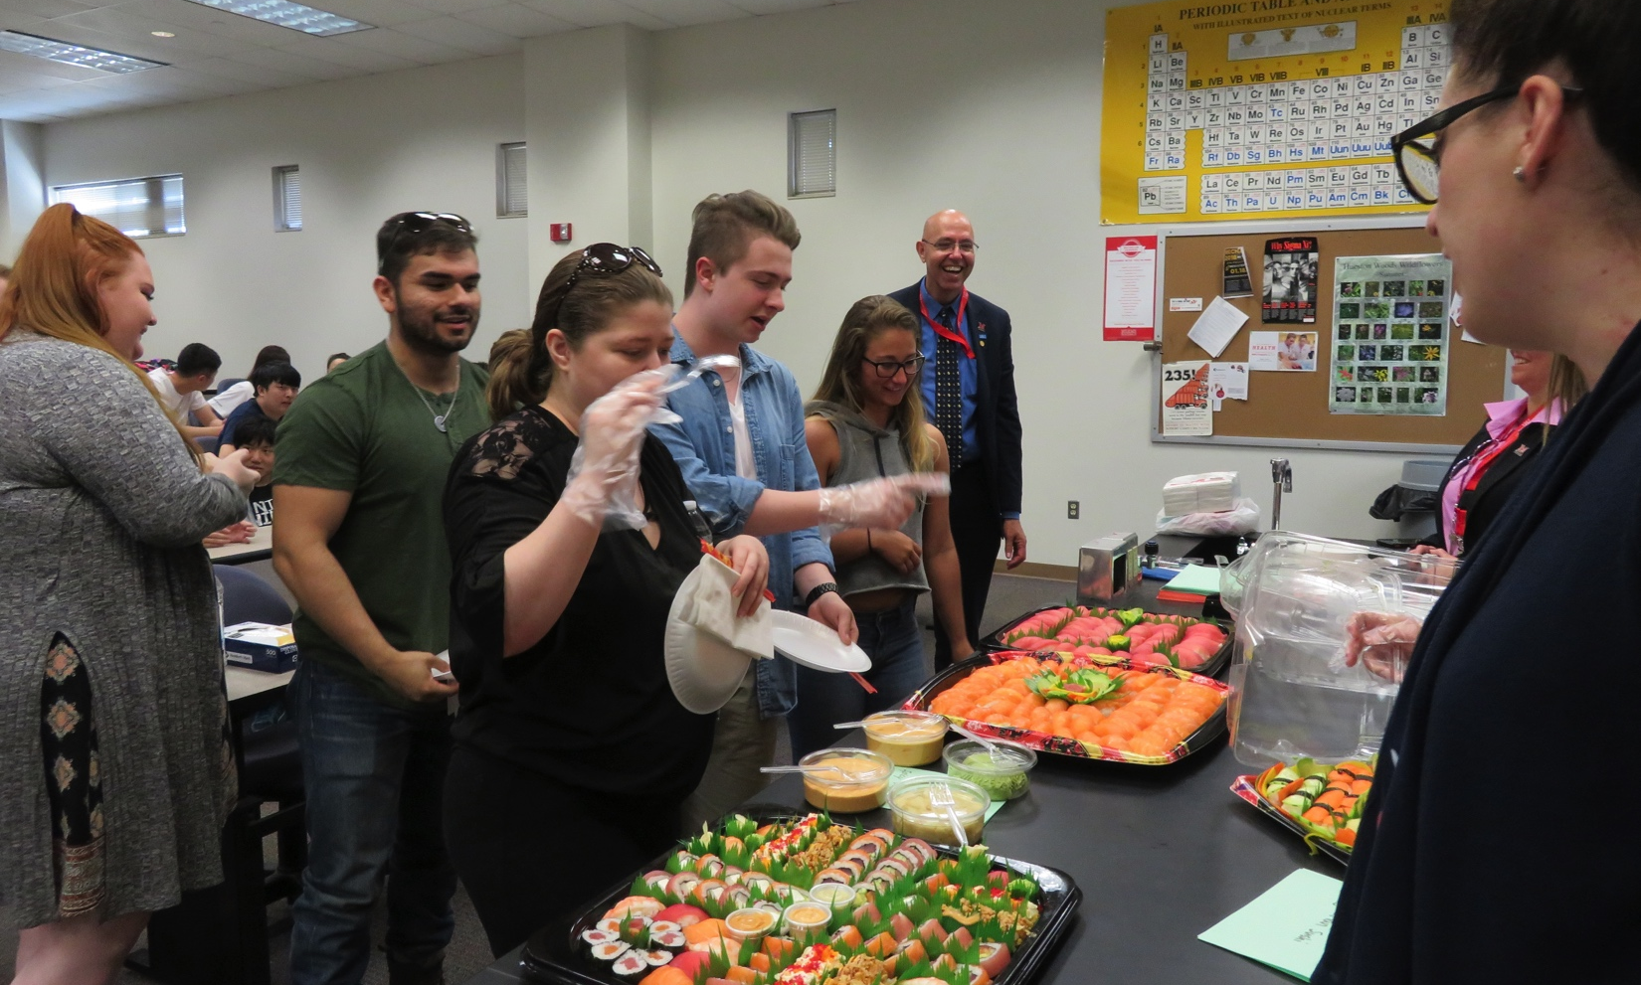
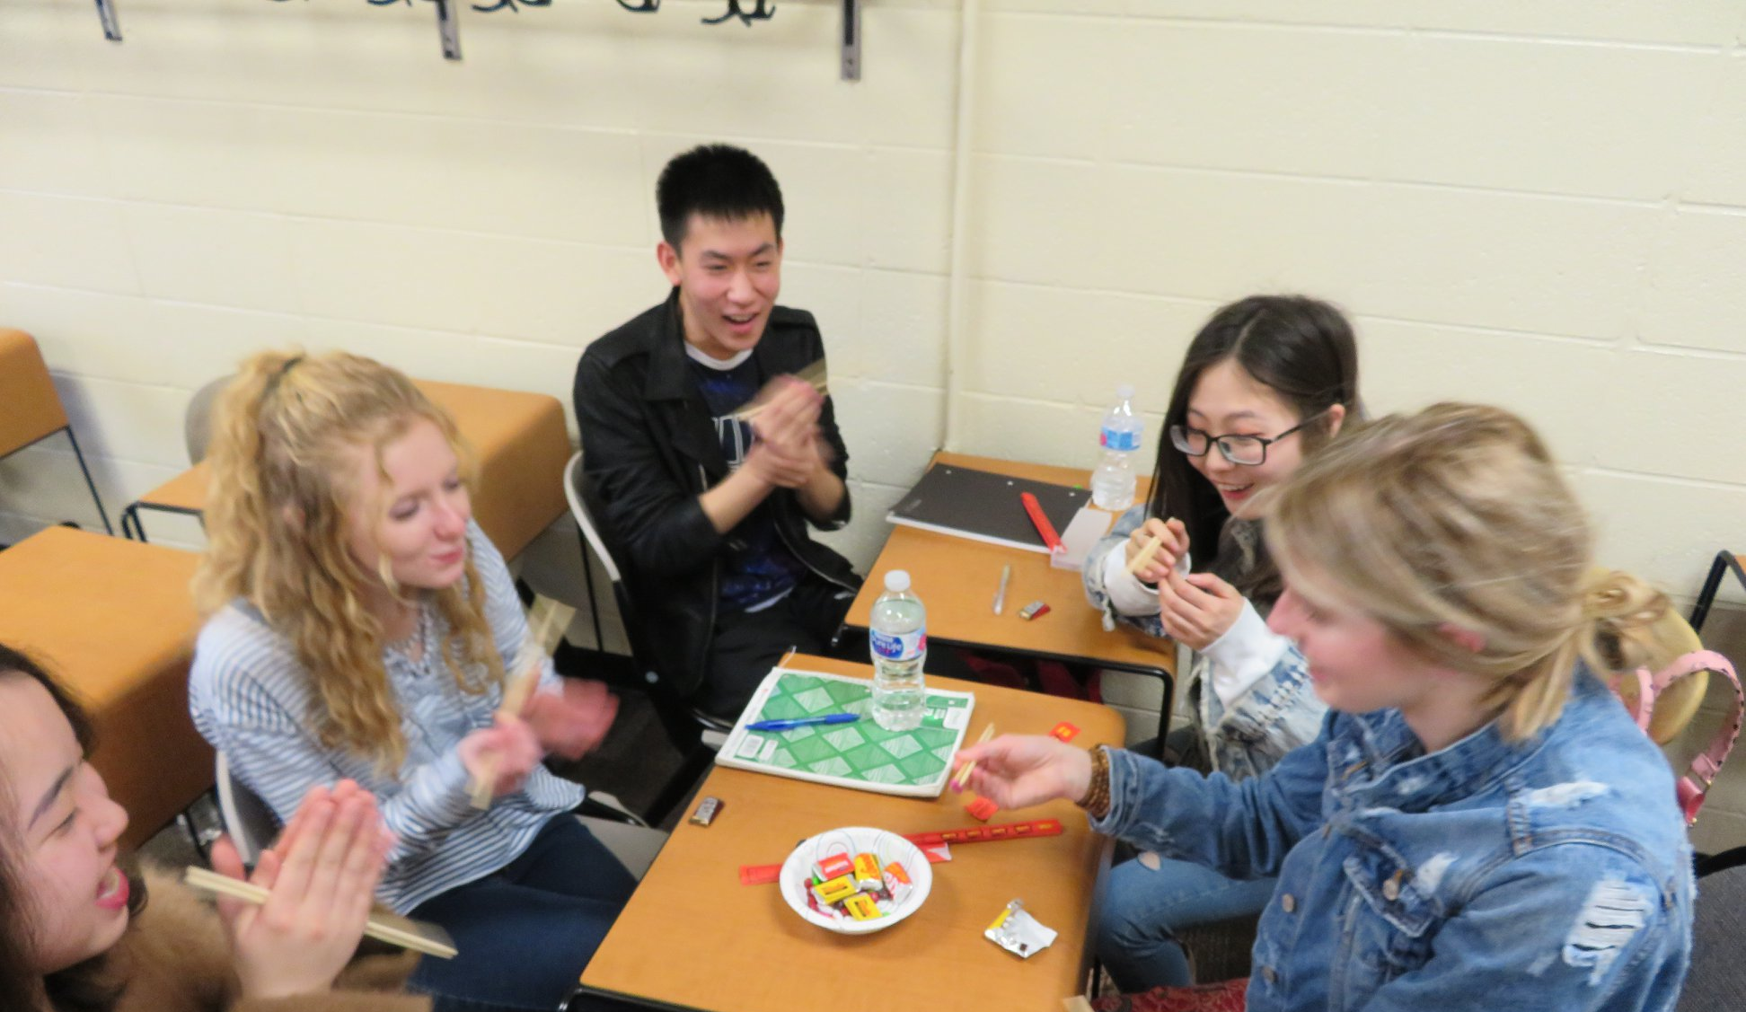

The Contact Hypothesis (Allport, 1954)
Stereotypes and prejudice reduce with equal status contact by an in-group with an out-group (Corrigan, 2005; Pettigrew & Tropp, 2006, 2008)
  Positive feelings (affect)
  Improving interactions (behavior)
  Enhanced knowledge (cognition)
The Contact Hypothesis can take students out of the classroom, away from textbooks, and into a “real-world” situation - learning by doing – via experiential learning (Kolb, 1984), including service-learning

Slide 5
KNOWLEDGE (Know What)
Social behavioral patterns
Cultural specifics (e.g., etiquette)
General cultural dimensions, for example:
  Individualism vs. collectivism
  High-context vs. Low-context
  Masculinity vs. femininity
Cultural self-awareness
SKILLS (Know How)
ICC
ATTITUDES (Care About)
Language ability
Behavioral flexibility
Initiative: Stepping out of comfort
zone
Interaction management
Verbal & non-verbal communication
Culturally appropriate behaviors
Self-confidence
Open-mindedness
Comfort: Lack of apprehension
Tolerating ambiguity & anxiety
Emotional stability
Emotional flexibility
Non-judgmental
Other focused, not self-conscious
Empathy
Figure 1. Tripartite model of intercultural competence (ICC; AAC&U, n.d.) –
important for effective and appropriate communication (Deardorff, 2006)

Slide 6
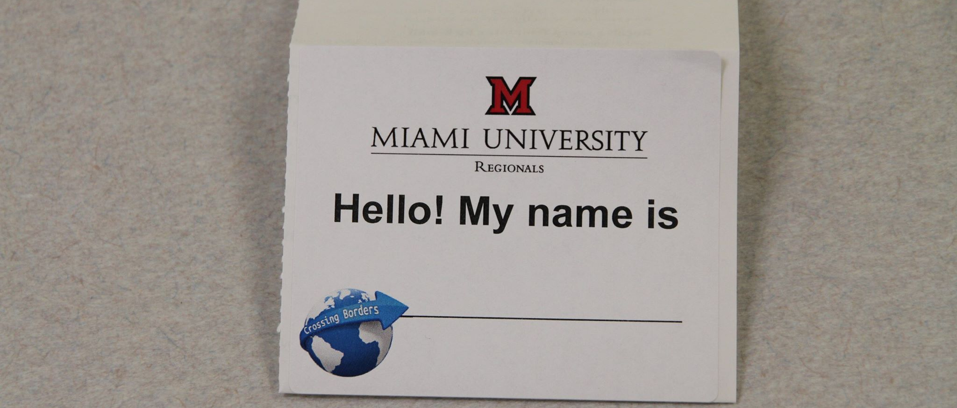
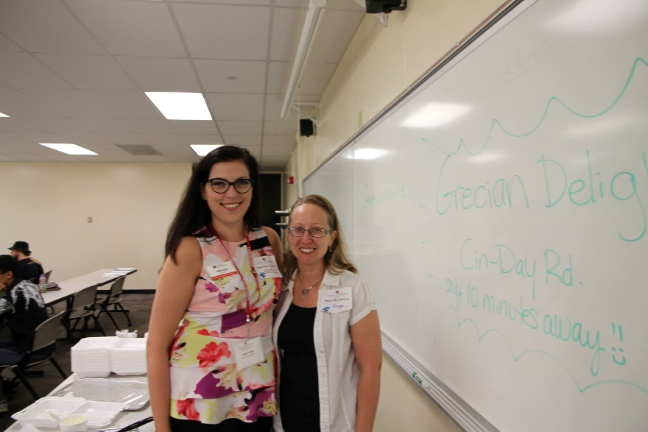
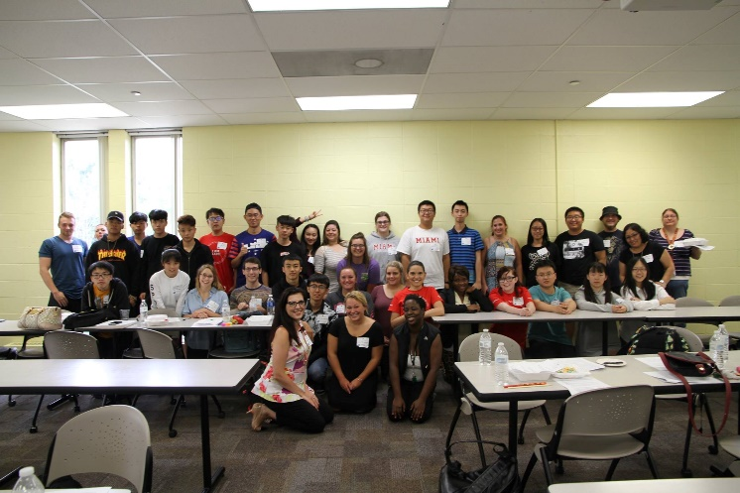
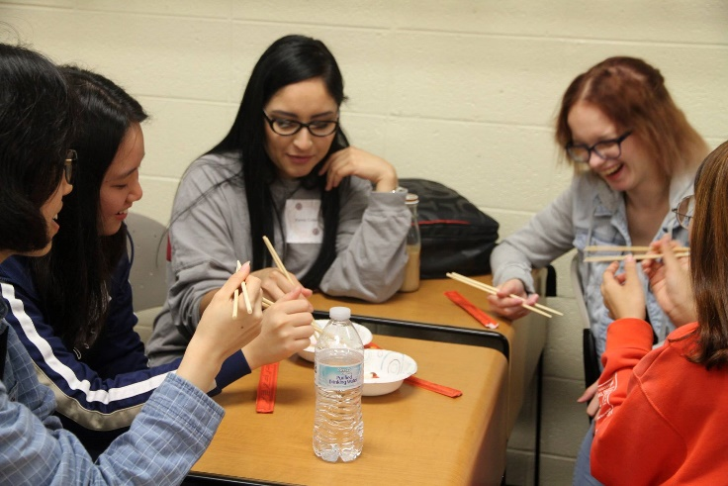
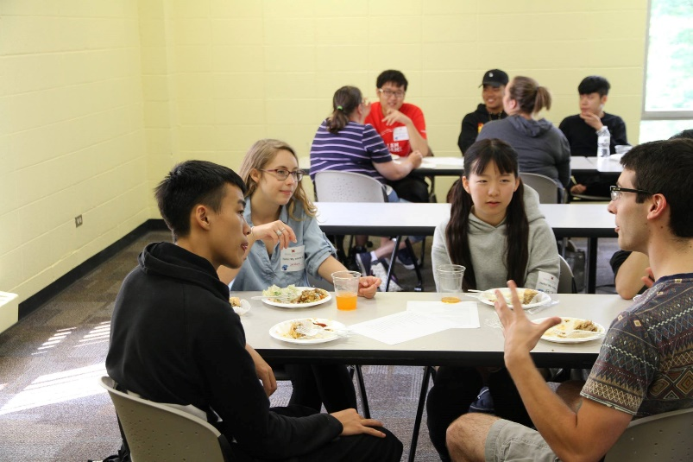
Crossing Borders: A History
Began at Miami in 2007 as a partnership between Felice Marcus (ACE program) & Ginger Wickline (Psychology/Social and Behavioral Sciences)
Miami’s growing international student population
  8.4% of 2017-2018 incoming class
  Oxford ACE program began 2011 - now at 237
  Regional ELC began in 2014 (30 students) - now at 440
Over 800 students and 10 professors involved in Crossing Borders since program inception
Synchrony with Miami 2020 Foundation Goal #2 and Global Miami Plan Experiential Learning requirement

Slide 7
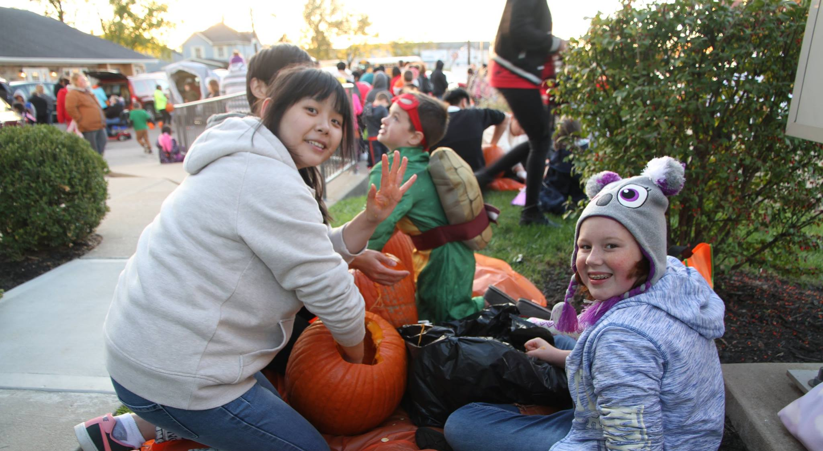
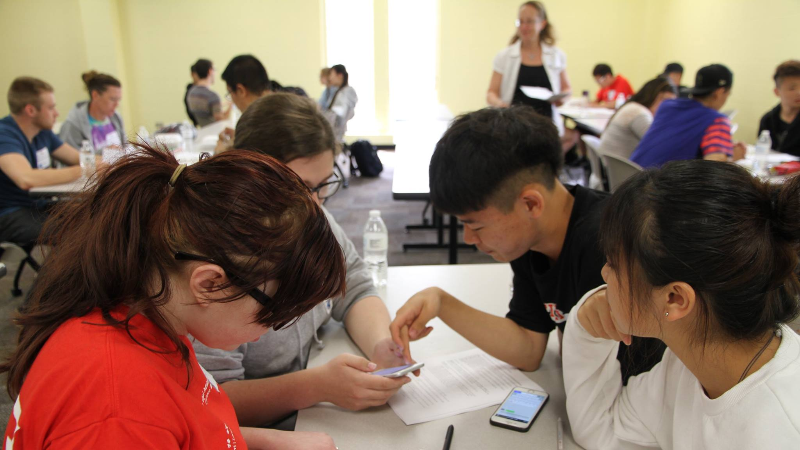
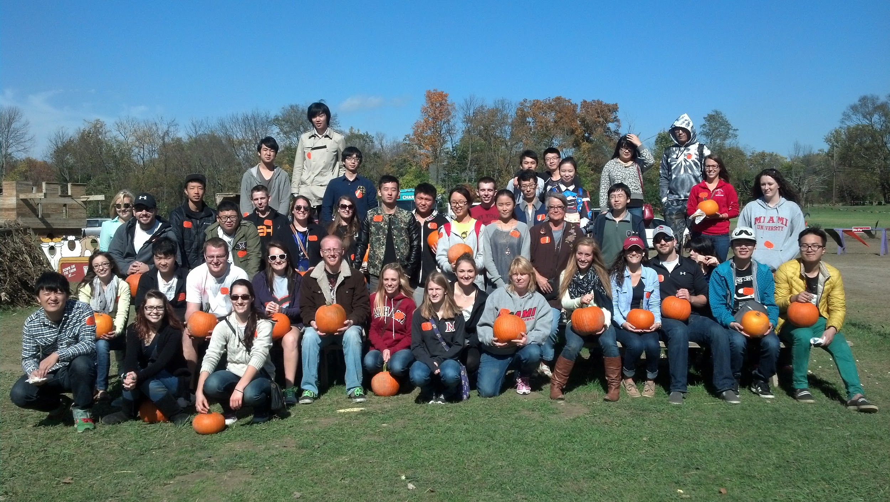
Crossing Borders: A History
Mutually beneficial partnerships
  International students practice English and learn about Americans
  Americans learn about their own and other cultures
  Partnerships between ACE or ELC instructors (3) and Psychology instructors (6)
Small group and/or large group events
  Repeated social interactions between students from both classes (at least 4 meetings per semester)
  Oral or written reflection on experiences
  Service-Learning designation for some course sections (e.g., PSY 111, PSY 210)
Published research regarding effectiveness (see handout)

Slide 8
Participants
2013-2016: Nine classes (N = 227) of international students & 7 classes of domestic students enrolled in various classes who participated in Crossing Borders
  American Culture and English, Advanced English, Learning Strategies for College Success
  Psychology Across Cultures, Introduction to Psychology, or Adult Psychopathology
Included both international (n = 130) and domestic (n = 97) students who chose to completed an end of semester
satisfaction survey

Slide 9
Participants
Survey responses were anonymous – with no demographics collected
Distribution of class sections
  Gender: Ranged from 23% - 42% female (international) and 52% - 86% female (domestic)
  Nationality (international): 90% - 100% Chinese
  Ethnicity (domestic): 53% - 95% Caucasian American (accurately represents campus demographics)
Current data are from a Regional, commuter campus in the Mid-West
  Campus population of roughly 4,700
  Rapidly expanding international student population in an
  Intensive English Program (IEP)

Slide 10
Mixed-Method Approach: Measures
Quantitative
  Students’ overall satisfaction with Crossing Borders: 1 = Very Dissatisfied to 5 = Very Satisfied
  Students rated the overall impact of Crossing Borders on nine personal or professional development items: 1 = Negative Impact to 5 = Positive Impact
Qualitative
  Did Crossing Borders increase your intercultural competence?
  What did you learn about self and others?
  What did you like/find helpful about Crossing Borders?
  What did you dislike/find unhelpful about Crossing Borders?
  Other comments/reflections

Slide 11

Table 1. Students’ Self-Reported Satisfaction and Impacts of Crossing Borders Program by Large and Small Group Activities
Survey Item | Large Group | Small Group | d.f. | t-test value
Overall satisfaction with Crossing Borders experience | 4.33 | 4.17 | 211 | 1.54
Awareness of international students’ issues during cultural adjustment | 4.44 | 4.05 | 216 | 3.33**
Ability to interact with people from other cultures | 4.64 | 4.28 | 217 | 3.94**
Comfort when interacting with people from other cultures | 4.57 | 4.25 | 220 | 3.18**
Understanding of other cultures’ beliefs & behaviors | 4.61 | 4.29 | 219 | 3.40**
Understanding of your own cultural context (beliefs, behaviors, etc.) | 4.53 | 4.20 | 216 | 3.16**
Feelings about people from other cultures | 4.64 | 4.29 | 219 | 3.75**
Personal development | 4.53 | 4.19 | 219 | 3.57**
Professional development | 4.38 | 4.01 | 219 | 3.41**
Critical thinking skills (looking at complex issues from various perspectives) | 4.53 | 4.20 | 217 | 3.22**
Note. *p < .05. **p < .01. Preliminary analyses. Ordinal items. Follow-up tests will review non-parametric statistics and 2 (international vs. domestic) x 2 (large vs. small group) comparisons. While ratings are extremely positive in both conditions, students reported significantly more impacts in large (as opposed to small) group activities.

Slide 12
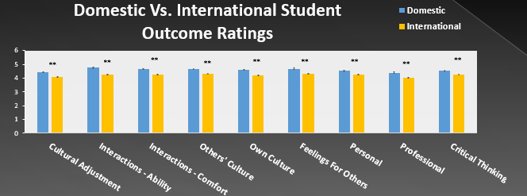
Figure 2. **p < .01. Factors consisting of satisfaction overall and impact on additional variables. Except for overall satisfaction, domestic students reported more positive impact from the Crossing Borders program than the international students. However, mean scores show that both international and domestic students reported positive impact from Crossing Borders. Satisfaction overall, t(210.51) = -.78, p = .44. Awareness of cultural adjustment, t(216) = 2.73, p < .01. Ability to interact with others, t(203.60) = 6.14, p < .01. Comfort when interacting with others, t(219.94) = 4.28, p < .01. Being aware of others’ culture, t(218.85) = 3.72, p < .01. Being aware of one’s own culture, t(215.08) = 4.03, p < .01. Feelings about others from other cultures, t(218.83) = 4.29, p < .01. Personal development, t(219) = 2.95, p < .01. Professional development, t(219) = 2.98, p < .01. Critical thinking skills, t(217) = 2.56, p < .05.

Slide 13
Qualitative Themes: Positive
Openness and Pushing Comfort Zone: Apprehension is a normal part of the beginning of this project but generally faded by the third meeting. Some students felt they have a hard time relating and opening up to someone new, especially someone of a different culture. Students expressed accomplishment at the end of the semester, having pushed to “put themselves out there” and really get to know people different than themselves. The experience helped students to feel more open to learning about other cultures in the future.
Changing Attitudes Through Interaction: Along with bringing two (or more) different cultures together, many domestic students
reported that getting to know the international students allowed
them to realized that their stereotypes were incorrect. Many
students said the best way to learn about another culture is
learning from a person.

Slide 14
Qualitative Themes: Positive
Gaining Knowledge and Developing Skills: Some students described how this experience was very helpful because it took learning out of the classroom and into a real-world setting. Students developed professional skills they could take and apply in future careers (e.g., translating ideas, initiating conversations, handling staring or comments from community members, using chopsticks, advocacy for international students, language skills). Students indicated that they mutually learned from each other and truly understood their own cultures and other cultures better, including similarities and differences.

Slide 15
Qualitative Themes: Negative
Logistic Limitations: The meetings being almost always outside of class time made for some scheduling challenges, apprehension, decreased willingness to work hard to make connections, and frustration regarding the “extra time” out of their week. Some students indicated they wanted more meetings. The limited number of meetings through the semester (4) made it hard for them to make real and deep connections.
Cultural and Personal Frustrations: Awkward first meetings or pauses and language barriers were challenges stated by some students. Not everyone was engaged in the process (e.g., students on their cell
phones, not attending all of the events, treating other students
with a lack of respect, or infantilizing the international
students with their tone of voice).

Slide 16
Facilitators’ Perceived Benefits for all Students
Expansion of comfort zones
Reduction of intercultural apprehension (nervousness)
Awareness of self and others as cultural beings
Increasing curiosity about self and other
Lowering barriers that inhibit cross-cultural interactions (fears, biases, stereotypes)
Cognitive flexibility (see similarities AND differences)
Empathetic advocacy for people changing cultures
Sustainable friendships/social media contact
Cultural context and perspective of course content

Slide 17
Challenges & Barriers
Reflection assignments: Address learning & increase accountability for all students
Cost to departments and/or students
Effective collaboration between course instructors
Time investment to organize/execute events and related assignments
Logistical arrangements
  Can minors in your class go off-campus? Do they need permission slips?
  Can students transport each other? (Legal counsel says no)
  Will students follow through on meetings?
  What do you do if students do not show up as assigned?
It takes time to establish and maintain relationships well
Disengaged students
Language barriers

Slide 18
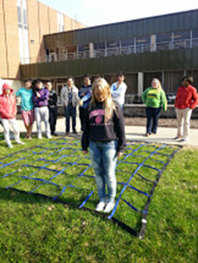
Lessons Learned: Do…
Frame partnership as mutually beneficial
  Not just a buddy/mentoring program for helping internationals
Develop shared cultural activities
  Festivals, bowling, new foods & activities
Require multiple meetings
  Third time’s a charm!
Model appropriate behavior
  Nervous is the new normal!
Require accountability
  Graded assignments help a lot
Consider creative funding alternatives
  International or Diversity office, Center for Teaching & Learning,
  Dean’s Office, student organizations, departmental grants

Slide 19
Lessons Learned: Do Not…
Allow gratuitous cell phone use
Expect cultural experts in a few hours
  Baby steps to bigger comfort zones and smaller bubbles
Fail to consider risk management: Safety, worse-case scenarios, and liability
  Public places
  Small groups
  Minimal risk activities
  Marginalized groups
  Cultural gender norms
  Underage students (legal minors, high school students)
  Carpooling

Slide 20
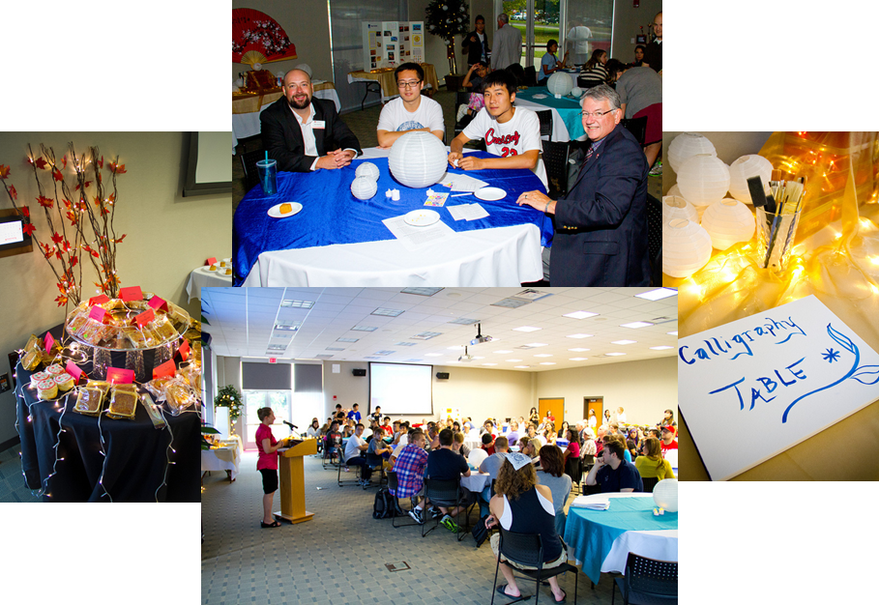

Questions?
wicklivb@miamioh.edu
marti246@miamioh.edu
vogelka3@miamioh.edu

Slide 21
References & Resources
AAC&U: American Association of Colleges & Universities (n.d.). Intercultural knowledge and competence VALUE Rubric. Retrieved September 29, 2016 from https://www.aacu.org/value/rubrics/intercultural-knowledge
Allport, G. W. (1954). The nature of prejudice. Cambridge: Addison-Wesley Publishing Company, Inc.
Deardorff, D. K. (2006). Identification and assessment of Intercultural competence as a student outcome of internationalization. Journal of Studies in International Education, 10(3), 241-266.
Gloria, A. M., Rieckmann, T. R;., & Rush, J. D. (2000). Issues and recommendations for teaching an ethnic/culture based course. Teaching of Psychology, 27, 102-107.
Kolb, D.A. (1984). Experiential learning: Experience as the source of learning and development. Upper Saddle River, NJ: Prentice-Hall.
Ramiah, A. A., & Hewstone, M. (2013). Intergroup contact as a tool for reducing, resolving, and preventing intergroup conflict. American Psychologist, 68(7), 527-542.
Wickline, V. B. (2012). The Crossing Borders Program: Increasing intercultural competency via structured social interactions. Psychology Learning and Teaching, 11(3), 374-381.
Wickline, V.B., Klinefelter, C. House, K., Shackson, C., Carrion, M. & Vogel, K. (2016, October 21). The “Crossing Borders” program: Developing intercultural competence for both domestic and international students. Poster presented for the Society for Teaching of Psychology’s Annual Conference on Teaching (STP-ACT), Decatur, GA.

Slide 22

Sample Reflections from Students
“Meeting with the international students was an experience I have never had. It was like nothing I have ever experienced, considering I have never been out of the country. It gave me a different perspective on the world, and made me want to learn more about different cultures.”
“I really liked talking with the international students. It was interesting learning their perspectives on things we don't necessarily think about.”
“Overall... I found the experience to be a fairly positive one that might make me more inclined to speak to more international students around campus.”
“Overall, this experience was very enriching for me. Being at Miami for two years now, I have never really had an opportunity to engage with the international students on campus. After this activity I feel a lot more comfortable interacting with them when I am on campus and am more likely to stop and have a conversation with them.”

Slide 23
Sample Reflections From Students
“...this activity helped me to better understand why it is important to understand a person’s values when attempting to understand their behaviors. By the end, it seemed like we shared core values, even if we expressed them differently.”
“Before our experiential learning, I will admit I had expectations for it to be uncomfortable and weird. However, I was pleasantly surprised, and can honestly say that I have a new view of the international students on campus.”
“...this experience with the international students was very new for me. It really opened my eyes and inspired a deeper desire to study the culture of other regions. I’d be lying if I said that I wasn’t intimidated at first, and at times somewhat difficult because of the language barriers between our cultures, but my anxieties quickly dissipated as I found it fascinating to find the similarities and differences in our cultures and lifestyles.”

