Slide 1
Curricular Practical Training (CPT)
International Student and Scholar Services (ISSS)

Slide 2
Description
  Curricular Practical Training (CPT) is temporary training for an F-1 student in their major. This practical training MUST be "an integral part of an established curriculum" and "directly related to the student's major area of study.” This establishes a basic principle that CPT should be required by the curriculum and done for academic credit.

Slide 3
Eligibility
The student must be in valid F-1 status at the time of application and have been in full-time status for one academic year preceding the application.
  Graduate students whose programs require immediate participation in an internship/practical training may apply at any time.
Required part of the degree program - proof of academic requirement must be submitted with the CPT application (Example: copy of undergraduate or graduate bulletin page listing the requirement)
OR
Optional part of the degree program - student must first be enrolled in a credit bearing course prior to requesting CPT authorization. (Example: Internship, Directed Study).

Slide 4
Location
Students may engage in CPT only for the specific employer, location and period approved and recorded by their International Student Advisor in SEVIS

Slide 5
Duration
CPT employment authorization is tied to the academic calendar and/or the internship requirements:
  CPT authorization may begin no earlier than the day after the previous semester.
  CPT must end no later than the day before the next semester begins.

Slide 6
Hours
CPT can be approved for part-time or full-time
Full-time CPT
Part-time CPT
21 hours or more per week
12 months or more of full-time CPT, you are ineligible for OPT for that educational level.
20 hours or less per week
part-time CPT is acceptable and will not stop you from doing OPT.

Slide 7
Salary
CPT can be paid or unpaid. SEVP guidance states that "compensation is not a consideration when determining whether an opportunity qualifies as CPT," but federal and state labor and wage/hour laws do still apply.

Slide 8
Field & Level of Work
Must be an integral part of an established curriculum, and be related to the student's major field of study.

Slide 9
Offer of Employment
Any offer of employment letter is required to apply for CPT
The letter from the employer (hardcopy or electronic copy), must be on company letterhead, with a signature, and contains the following information:
  Student’s name
  Job title
  Company name and address
  Start and end dates of employment
  Work hours per week
  Description of work to be performed

Slide 10
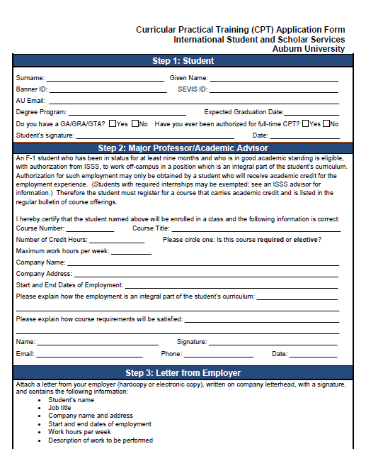
How to apply for
CPT
Watch and review CPT PowerPoint. Contact ISSS Advisor for additional questions.
Register for the appropriate CPT course.
The student and their major professor should complete the application form. Attach the employer letter and turn in the complete application to an ISSS Advisor.
The ISSS Advisor will review the documents to determine if the criteria have been met. If CPT is approved, the student will be notified by email.

Slide 11
FYI
For your information
While on CPT a F-1 students must attend school full-time except during the vacation period or if they have been preauthorized by an ISSS Advisor for a reduced course load ( Gold Form)
CPT employment authorization is tied to the academic calendar and/or the internship requirements: students will not be able to work past the authorized days on CPT. CPT extensions may be requested. Please contact your ISSS Advisor for more information on extensions.
Graduate students holding any type of assistantship on campus will be limited to part-time CPT and part-time assistantship for a maximum of 20 hours per week during the fall and spring semesters.
You must be authorized for CPT by an ISSS Advisor before beginning any employment.
Points to keep in mind before and while on CPT

Slide 12
ISSS Advisors
If you have any questions or need to request a CPT extension from your ISSS Advisor, please send an email to:
  F-1 students whose last name begins with the letters A-J
  Jennifer Jackson (jrj0018@auburn.edu)
  F-1 students whose last name begins with the letters K-S
  Swati Kukreja (ssk0010@auburn.edu)
  F-1 students whose last name begins with the letters T-Z
    Carol Lovvorn (lovvocs@auburn.edu)
  If you are unsure who to email, please contact the OIP Front Desk by phone (334-844-5001) or by email (intledu@auburn.edu).

