Slide 1
STEM OPT Extension
International Student and Scholar Services (ISSS)

Slide 2
Description
  The Department of Homeland Security published a final rule allowing certain F-1 students who receive science, technology, engineering, and mathematics (STEM) degrees, and who meet other specified requirements, to apply for a 24-month extension of their post-completion OPT.
  Students may be eligible for up to two STEM OPT extensions based on two STEM degrees at different degree levels in a student’s lifetime, instead of just one.

Slide 3
Students now have the ability to apply for a STEM OPT extension based on a previously earned STEM degree from an accredited U.S. institution within 10 years under which the student has not previously applied for a STEM OPT extension.
New expanded list of DHS STEM Designated Degree Program List.
Student and employer are required to complete the new Form I-983, Training Plan for STEM OPT Students, to begin the STEM OPT extension application process.

Slide 4
Students have additional reporting requirements to maintain the STEM OPT authorization.
Employers have additional reporting requirements and may be subject to DHS site visits.
Volunteering and self-employment are not permitted during the STEM OPT extension.
Students must work at least 20 hours per week to qualify for the STEM OPT extension.
Students are permitted an additional 60 days of unemployment (previous rule allowed an additional 30 days) under the STEM OPT period in addition to the current 90 days of unemployment allowed under the initial 12 month post-completion OPT period; up to 150 days of total unemployment.

Slide 5
Eligibility
To qualify for the 24-month STEM extension, individuals must meet all of the following eligibility requirements:
  Is participating in post-completion OPT in a field that is based on your most recent degree.
  Must have earned a Bachelor’s, Master’s, or Doctoral degree in a field that is currently on the on the DHS STEM Designated Degree Program List within the last 10 years.
  Employed/have a job offer from an employer registered in the E-Verify program; STEM OPT restricts work to E-Verify employers only.
  Be able to complete the Form I-983, Training Plan for STEM OPT Students, with your employer.
  Accumulated no more than 90 days of unemployment during the current post-completion OPT authorization.
  Employment during the 24-month STEM OPT extension must be directly related to your AU primary/major field of study and the STEM degree in which you qualify for the STEM OPT extension.
  Have not previously received more than one STEM OPT extension in total and have not yet received an extension under this STEM degree.
  Be within 120 days of the end of the current OPT approval period.

Slide 6
STEM-Designated Degree Program List
Students may verify if their current degree is eligible for the extension by the CIP code. To determine your CIP code, look at page 1 of your I-20. The CIP code is the 6 digit numerical code (xx.xxxx) listed under “Major 1” under the Program of Study section of your I-20.

Slide 7
Application Timeline
Students must apply for the OPT STEM extension before the expiration date listed on their current Employment Authorization Document (EAD) issued by the U.S. Citizenship and Immigration Service (USCIS).
USCIS recommends that students apply 90-120 days prior to their EAD expiration date.
International Student and Scholar Services (ISSS) advises eligible students apply no later than one month prior to the EAD expiration date to allow time for USCIS to receive your application.

Slide 8
Application Process
To apply for the STEM OPT Extension, you must first request an updated I-20 from your ISSS Advisor. To request the new I-20 please submit the following to ISSS:
    Completed ISSS STEM OPT Extension Request Form
    Completed USCIS Form I-765, Application for Employer Authorization
    Complete DHS I-983 Form, Training Plan for STEM OPT Students
    Completed USCIS Form G-1145, E-Notification of Application/Petition Acceptance
    Letter (on company letterhead) from your employer verifying your employment. This letter should include the employer’s E-verify number.
    Payment of the OIP International Student Fee. Submit a check or money order payable to Auburn University in the amount of $780.00.
Your ISSS Advisor will review and send you a new I-20 reflecting your STEM OPT Extension request. The STEM OPT Extension request will appear on page two of the I-20.
Once you receive the new I-20 from your ISSS Advisor, review it for accuracy and mail the documents listed on the next slide to USCIS.

Slide 9
Application Process
To apply for STEM OPT Extension, the following documents must be mailed to USCIS:
    Check or money order for $410.00, payable to Department of Homeland Security
    Completed Form I-765
    Completed Form I-983
    Completed Form G-1145
    Copy of passport pages(s) showing your picture, biographical information and expiration date
    Copy of most recent I-94
    Copy of visa
    Copy of current Employment Authorization Document (EAD) (front and back)
    Copy of diploma
    2 passport size photos (must meet Department of State guidelines)
    Letter from employer verifying employment
    I-20 with OPT STEM Request (obtained by ISSS)
ISSS strongly recommends you make copies of all documents you send to USCIS for your records

Slide 10
USCIS Filing Fee
MM/DD/YYYY
U.S. Department of Homeland Security
$410.00
Seven hundred and eighty dollars
SEVIS ID #
Your signature
Use a personal check or money order made payable to “U.S. Department of Homeland Security.”
Money order can be purchased at banks, the post office and some grocery stores.
Make sure a name and address are printed on the check. Do not use temporary or starter checks, often issued when opening a new account.
Include your SEVIS ID # in the “For” line.

Slide 11
Form I-765
The I-765 is needed to submit the STEM OPT application to USCIS.
The I-765 form can be downloaded from the USCIS website.

Slide 12
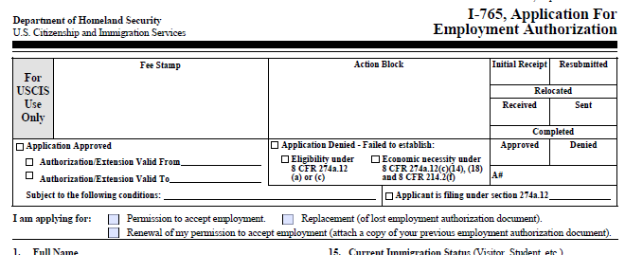
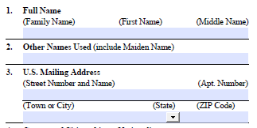
Completing Form I-765
Top Portion: Check the box for “Renewal of permission to accept employment.”
Item #1
  Enter your name as it appears on your I-20 and passport.
Item #3
  You should enter the address where you would like your Receipt Notice and EAD card mailed to. This address should be valid while your application is pending with USCIS (at least 3 months)

Slide 13
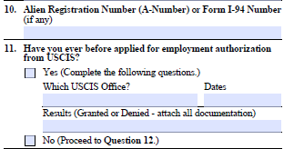
Completing Form I-765
Item #10
  Enter your current I-94 number. To access your I-94 number, please go to the U.S. Customs and Border Protection website.
Item #11
  Check yes
  Complete the information needed based of your previous 12-month OPT EAD card.
California
01/01/2016-12/31/2016
Granted

Slide 14
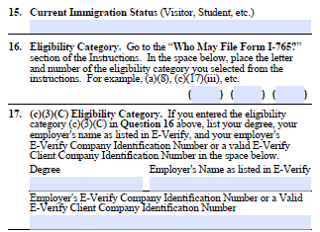
Completing Form I-765
Item #15
  Current immigration status is “F-1 student.”
Item #16
  Use the following code for the STEM OPT Extension:
    (c) (3) (c)
Item #17
  Degree: Enter the SEVIS degree name as it is listed on your I-20. Also enter the CIP Code found next to your degree name.
F-1 Student
C 3 C
Degree Major as listed on I-20 & CIP code
Employer’s Name
Employer’s E-verify Number

Slide 15
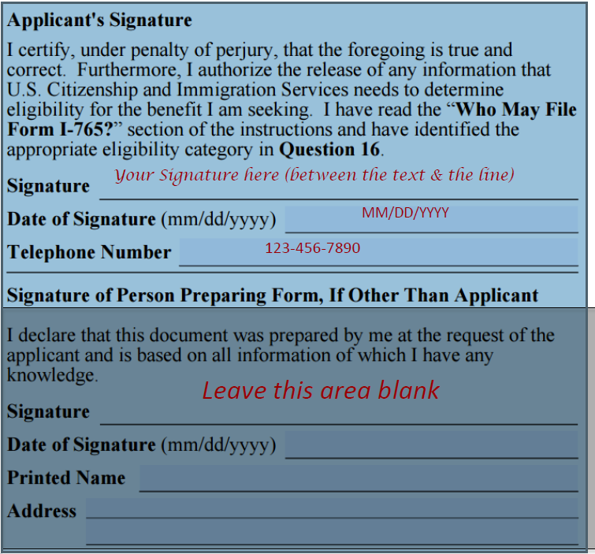
Completing Form I-765
Sign your name
Fill in the date of signature
Fill in your phone number

Slide 16
Completing Form I-983
The I-983 Form, Training Plan for STEM OPT Students must state the STEM OPT learning goals and confirm the employer’s obligation to helping you achieve those goals.
To fulfill this requirement, you and your employer must complete and sign the I-983 Form and submit pages 1-4 to AU ISSS.
For more information about the form, please see the Study in the States website.

Slide 17
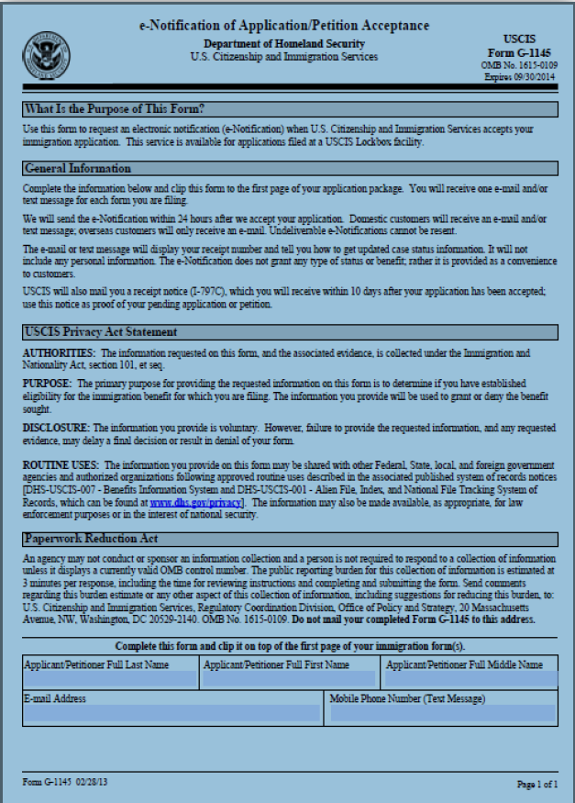
Form G-1145
Complete this form in order to request a text message and/or email when USCIS receives your STEM OPT application and when there are any updates in your case.
Attach this form to the top of the STEM OPT application packet.
You can access this form on the USCIS website.

Slide 18
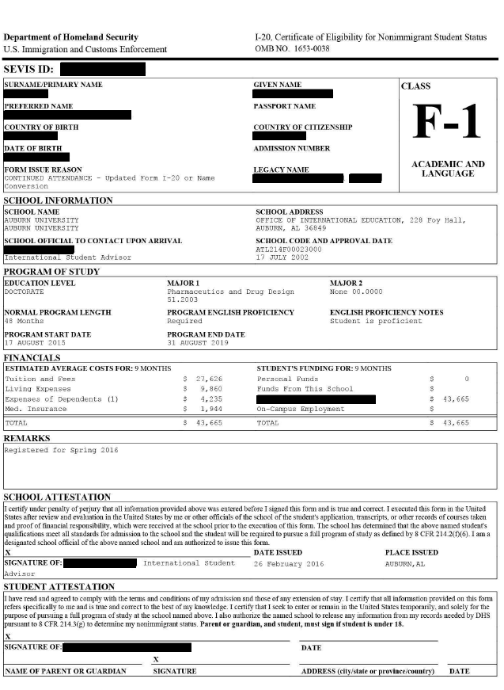
Application Deadline
You may apply up to 90 days before your current OPT end date.
No later than the end date of your current 12-month OPT EAD card. Please consider time for mailing application to USCIS.
No later than 60 days after the STEM OPT I-20 has been issued by the AU ISSS Office.
For more information about where to send your STEM OPT application once approved by ISSS, please go to the USCIS website.
Advisor Signature

Slide 19
OIP International Student Fee
MM/DD/YYYY
Auburn University
$780.00
Seven hundred and eighty dollars
AU Student ID #
Your signature
We will accept a check or money order in the amount of $780.00.
Make sure to include your AU Student ID # on the check.

Slide 20
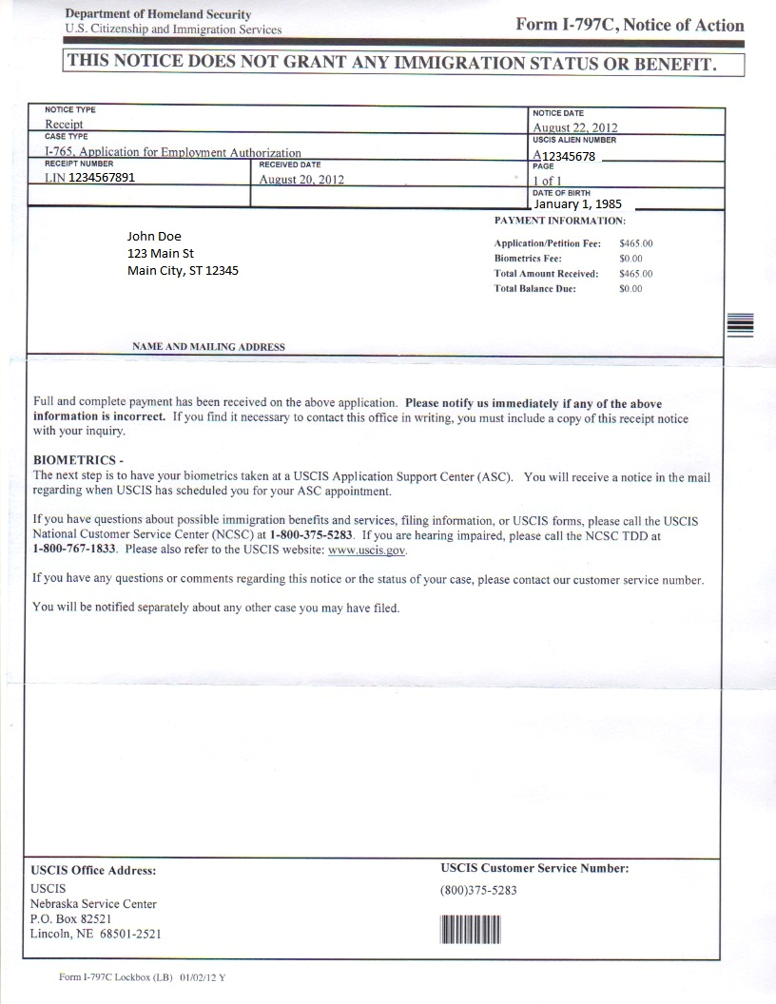
I-797, Notice of Action
You should receive the I-797 Receipt notice within 2-4 weeks after mailing the STEM OPT application to USCIS.
The I-797 is a very important document and is necessary if you want to inquire about the status of your application with USCIS.
The Receipt Number listed on the notice is your application case number at USCIS. You can check the status of your case at the USCIS website.

Slide 21
Request for Evidence (RFE)
If there is a problem with your application, USCIS will send you a notice by mail called a “Request for Evidence (RFE).”
An RFE means that you need to send in additional documents before your application can be approved.
To avoid delays, review your application materials and sign all of the forms before mailing them to USCIS.
Also make sure to make a copy of your entire application before mailing to USCIS.

Slide 22
OPT STEM Approval
Once the application is received by USCIS, it generally takes 60-90 days for your request to be processed.
If the student’s current EAD has expired and a STEM extension request has been filed with USCIS, the student may continue to work for up to 180 days while the extension is pending.
The STEM extension period will begin the day after the first OPT period expires (as listed on the EAD card), and will end 24 months after that. For example, if the current EAD expires on 10/01/2016, the STEM period will begin on 10/02/2016 and will end on 10/01/2018.

Slide 23
STEM OPT Approval
Once your STEM OPT Extension is approved by USCIS and you receive a new EAD card in the mail, please send a copy of your new EAD card (front and back) to your ISSS Advisor.
Your ISSS Advisor will issue and send you an updated I-20 indicating that your STEM OPT Extension has been approved.
If you need to renew your Alabama Driver’s License once your OPT STEM Extension is approved, please complete the Driver’s License Letter Request Form and submit the form to your ISSS Advisor.

Slide 24
Types of Employment Allowed During OPT STEM
Volunteer/unpaid, employment through employment agencies and self-employment are NOT allowed.
STEM-eligible employers must have e-Verify & EIN numbers and the student must have a “bona fide employer-employee relationship.”
Other types of employers are also problematic – including multiple employer arrangements, sole proprietorships, employment through “temp” agencies, employment through consulting firm arrangements that provide labor for hire, and other relationships that do not constitute a bona fide employer-employee relationship.
The Department of Homeland Security (DHS) confirms that students cannot qualify for STEM OPT extensions unless they will be bona fide employees of the employer signing the I-983 Training Plan Form, and the employer that signs the I-983 must be the same entity that employs the student and provides the practical training experience.

Slide 25
Periods of Unemployment
Students who are granted a 24-month STEM OPT extension are allowed an additional 60 days of unemployment beyond the initial post-completion OPT limit.
This means that students who obtain a 24-month STEM OPT extension will receive 90 days of allowable employment during the initial period of post-completion OPT, plus an additional 60 days during the extension period, for a total of 150 days.

Slide 26
STEM OPT Reporting Requirements
If you are approved for STEM OPT, you must:
  Report changes to your ISSS Advisor within 10 days of the change.
    Reportable changes include: legal name, residential or mailing address, email address, employer’s name and employer’s address.
    To report changes, please complete the OPT Reporting Form.
Report to your ISSS Advisor by email every 6 months the information listed in the previous bullet, even if non of your information has changed.
A new DHS I-983 Form must be completed and submitted to your ISSS Advisor within 10 days of:
  Beginning a new practical training opportunity with a new employer during the 24-month extension.
  Any time there is a material change in the terms and conditions of the original I-983 Form. Form more information about material changes, please go to the Study in the States website.

Slide 27
STEM OPT Reporting Requirements (cont.)
You must complete 2 self-evaluations during the course of your STEM OPT period.
  The first within 12 months of the STEM OPT start date and a second concluding evaluation at the end of your STEM OPT period.
  Self-Evaluation Forms can be found on the last page of the I-983 Form.
  You must complete the self-evaluation form and have them signed by your employer before submitting them to your ISSS Advisor. Once the self-evaluation forms are complete and signed, you can email them to your ISSS Advisor.
Failure to comply with these reporting requirements could result in your F-1 status being terminated.

Slide 28
STEM OPT Based on Previous STEM Degree
The new 24-month STEM OPT rules permit student to use a previously obtained STEM degree from an accredited U.S. educational institution as a basis to apply for a STEM OPT extension, even if it did not serve as the basis for the student’s current standard 12-month post-completion OPT, under the following conditions:
  The prior degree was conferred no more than 10 years before the ISSS Advisor recommend a STEM OPT extension in SEVIS based on that degree;
  The prior degree was conferred by a U.S. education institution that is accredited and SEVP-certified at the time the student’s ISSS Advisor recommends the student for the 24-month OPT extension;
  The prior degree is in a degree program category included on the current STEM Designated Degree Program List at the time of the ISSS Advisor STEM OPT recommendation;
  The practical training opportunity that is the basis for the 24-month STEM OPT extension must directly relate to the prior degree.
  The prior degree was actually eared (i.e. a student who uses a prior degree cannot take advantage of the “all but thesis or dissertation” exception).
Please go to the Study in the States website for more information.

Slide 29
Additional Information
If a student transfers to another school or begins another program during OPT STEM, the OPT work authorization will automatically end, even though the EAD card will still appear valid.
Students may travel outside the U.S. during OPT STEM, but may return only if they have a job. Students must have proof of employment, a valid F-1 visa, a valid passport and an I-20 signed for travel on page 2 within the last 6 months in order to return to the U.S. Please send a completed Travel Request Form and your current I-20 to your ISSS Advisor when you are in need of an updated travel signature. Travel signature requests must be submitted to ISSS at least two weeks in advance of travel.

Slide 30
After OPT STEM
During the 60 days following the expiration of OPT, student must do one of the following:
    Depart the U.S.,
    Become accepted into and receive an initial-status I-20 for a new degree program or educational level at Auburn University or another SEVIS-approved school in the U.S.,
    Transfer from Auburn University to begin another degree program at a SEVIS-approved school in the U.S., or
    Apply for a change of status from F-1 to another visa status

Slide 31
FAQs
What is considered full-time employment on the 24-month OPT STEM Extension?
  Students must work more than 20 hours per week for an E-Verify employer in a position directly related to the STEM degree, following the goals and objectives stated in the I-983 training plan.
I have two part-time jobs. One of the employers is enrolled in E-Verify but the other is not. Is this allowed?
  No, only full time employment is allowed at your STEM-eligible E-Verify registered employer. You may have 2 jobs, but both employers must be E-Verifed.
Can I continue to work while my 24-month STEM Extension OPT is pending?
  If a student’s EAD expires while the STEM Extension application is pending, the student is authorized to work until USCIS makes a decision about the application, but not more than 180 days from the date the student’s initial OPT EAD expires.
What documents should I present to my employer once my 12-month OPT expires and my OPT STEM is pending?
  The student should present the employer with the expired EAD card, the form I-20 recommending the student for STEM Extension, and proof of the timely filing with USCIS.

Slide 32
FAQs
How many days of unemployment am I allowed while on the 24-month STEM Extension?
  Students who receive a 24-month OPT STEM extension are given an additional 60 days of unemployment for a total of 150 days over their entire post-completion OPT period.
What counts as unemployment?
  Each day during the period when OPT authorization begins and ends that the student does not have qualifying employment counts as a day of unemployment.

Slide 33
FAQs
What if my H-1B is denied after my original OPT has ended?
  Students will have a 60 day grace period from the notification date of the denial to depart the U.S., obtain admission to a new F-1 SEVIS-approved school, or file an application for a change of status.
What should I do if I am not a STEM student and did not file for the H-1B?
  Students will have a 60 day grace period from the notification date of the denial to depart the U.S., obtain admission to a new F-1 SEVIS-approved school, or file an application for a change of status.

Slide 34
ISSS Advisors
If you have any questions or need to report any updated information to your ISSS Advisor, please send an email to:
  F-1 students
  Carol Lovvorn (lovvocs@auburn.edu)
  Suzanne Furrow (srf0020@auburn.edu)
  Swati Kukreja (ssk0010@auburn.edu)
  If you are unsure of your ISSS advisor, please contact the OIP Front Desk by phone (334-844-5001) or by email (intledu@auburn.edu).

