Slide 1
OPT
Optional Practical Training

Slide 2
What is OPT
  Optional practical training (OPT) is temporary employment for practical training directly related to the student’s major area of study.
  OPT allows for off campus work authorization in a student’s filed of study.

Slide 3
Types of OPT
Pre‐Completion OPT
Post‐Completion OPT
Pre meaning before-
You may apply for pre‐completion OPT, if you have not graduated and you want to start your OPT before you graduate.
.
Post means after-
You may apply for post‐completion OPT, if you want your OPT to start after you graduate or have completed all your coursework

Slide 4
Pre‐Completion OPT
Pre-Completion OPT can be used before and up to Graduation, or Completion of degree. If coursework is still being done, Pre-Completion OPT is limited to Part Time (20 hours per week).
Student may have full time Pre-OPT only if coursework has been completed and just Thesis/Dissertation or Project remain.

Slide 5
Post Completion OPT
Standard 12 month post‐completion OPT can be filed with USCIS up to 90 days before the program end date (graduation) and up to 60 days after the program end‐date.
Employment start date can be requested to start the day after graduation/ program completion and up to 60 days after the program has ended.

Slide 6
Points to Consider
If you depart the US after graduation or program completion during your 60-day grace period and you haven’t applied for OPT, you lose the opportunity to apply for OPT.
For students who apply late into their grace period and whose EADs are approved more than 60 days after the program end date, the OPT period will be truncated, and the student will lose practical training time.

Slide 7
Certificate of Completion
Student may request a Certificate of Completion before the actual graduation date. Student must check with their academic advisor if this is an option for their specific situation.
Certificate of completion date will become program end date for immigration purposes. I-20 end date will be shortened to that date.
Concerns when on an Assistantship at the time of request for certificate of completion:
    As a part of an assistantship program you must work through the last day of class in order to have you tuition waived. Receiving a certificate of completion is your end date instead of graduation day, therefore ending the assistantship. Doing so may cause you to incur a balance for tuition.

Slide 8
Characteristics of F-1 OPT
(Optional Practical Training)
Preconditions
Location
Duration
Field & Level of Work
Hours
How CPT can effect OPT
Offer of Employment
Grace Period
Approval Process
Miscellaneous

Slide 9
Preconditions
Student must have been lawfully enrolled on a full‐ time basis at a DHS‐approved school for one full academic year before being eligible for OPT. Available both before and after completion of the educational objective, but different rules apply to pre‐ and post‐ completion OPT.
OPT employment must be “directly related to the student’s major area of study.”

Slide 10
Location
Students may engage in OPT for any employer in the U.S. for the duration of OPT authorization, as long as the employment qualifies under OPT standards.
Your SEVIS record must be updated for every place you live and every place you work during OPT. Student must contact immigration advisor with this information/change.
An updated I-20 will be printed for changes to employment.

Slide 11
Duration
Standard OPT is available for a cumulative maximum of 12 months per educational level (including both pre‐completion OPT and post‐completion OPT)
EXAMPLE:
participating in 6 month of Pre-Completion OPT prior to graduation will leave you only eligible for only 6 month of Post-Completion OPT.

Slide 12
Field & Level of Work
In its OPT Policy Guidance [7.2.4], SEVP recommends that students keep documentation showing that their OPT employment is directly related to their degree program:
SEVP recommends that the student maintain evidence for each job documenting the position held, proof of the duration of that position, the job title, contact information for the student's supervisor or manager, and a description of the work.
If it is not clear from the job description that the work is related to the student's degree, SEVP recommends that the student obtain a signed letter from his or her hiring official, supervisor, or manager stating how the student's degree is related to the work performed

Slide 13
Hours
20 hours/week limit for pre‐completion OPT done while school is in session and student still has coursework to complete.
Full‐time employment can be requested for pre‐completion OPT done during official school breaks, and for students who have completed all requirements for their degree except for thesis or dissertation.
For post‐completion OPT a student must be adequately employed to avoid limits on unemployment for 20 hours a week as a volunteer or paid employee.

Slide 14
How CPT can effect OPT
Prior uses of full‐time( 40 hours per week or more) Curricular Practical Training(CPT) for one year or more eliminates eligibility for Optional Practical Training

Slide 15
Offer of Employment
No offer of employment is required to apply for standard OPT, but the student is expected to work during the OPT EAD validity period. Students on post‐completion OPT are limited to a maximum of 90 days of unemployment.
To apply for a 24‐month STEM extension, student must have an offer of employment from an employer registered with E‐Verify. If more than 90 days of unemployment is used during the first 12 months of OPT, the 24 Month Extension will be Denied.

Slide 16
Grace Period
The practical consequence of these provisions is that the latest expiration date on a standard post‐completion OPT EAD will be 14 months after the program end date.
  For students whose EADs begin shortly after the program end date, a full 12 months can easily fit into the 14 month window.
  For students whose EADs are approved more than 60 days after the program end date, though, a full 12 months cannot fit into the 14 month window. In that case, the OPT period will be truncated, and the student will lose practical training time.
Students should bear this in mind when deciding when to apply for OPT.

Slide 17
Approval Process
During the OPT period, the student remain in F-1 status.
DSO must process an I-20 to accompany OPT application. USCIS must received this application within 30 days of receiving the I-20 from the Office of International Programs.
USCIS processing time is 90 days, so plan early to allow time for application to be approved.
NOTE: Work can begin only after receiving EAD issued by USCIS and on the day or after the start date printed on the EAD card.

Slide 18
How to apply to
OPT Cont.
OPT Request Form
Form I-765
Form I-765 filing fee ($410.00)
International Student Fee ($390.00)
2 passport style photos
Copy of I-94
Copy of passport info pages, including any extensions
Copy of U.S. Visa
Offer Letter of Employment (if available)
Copy of previous EAD card (if applicable)

Slide 19
International Student Fee
While on OPT, your immigration status will remain F1 student visa under Auburn University. Therefore, Auburn University is responsible for reporting your OPT information and all updates to Department of Homeland Security.
As of September 1, 2013 the Office of International Programs has implemented the continuation of the international student fee during the duration of OPT & OPT S.T.E.M. Extension
$390- OPT ( 12 months or $130 per semester)
$780- OPT S.T.E.M. Extension(24 months or $130 per semester)
Notes:
While student are still enrolled they will have the option of adding the fee added to their ebill. Once the student has graduated the fee must be paid in full when the application is being processed.

Slide 20
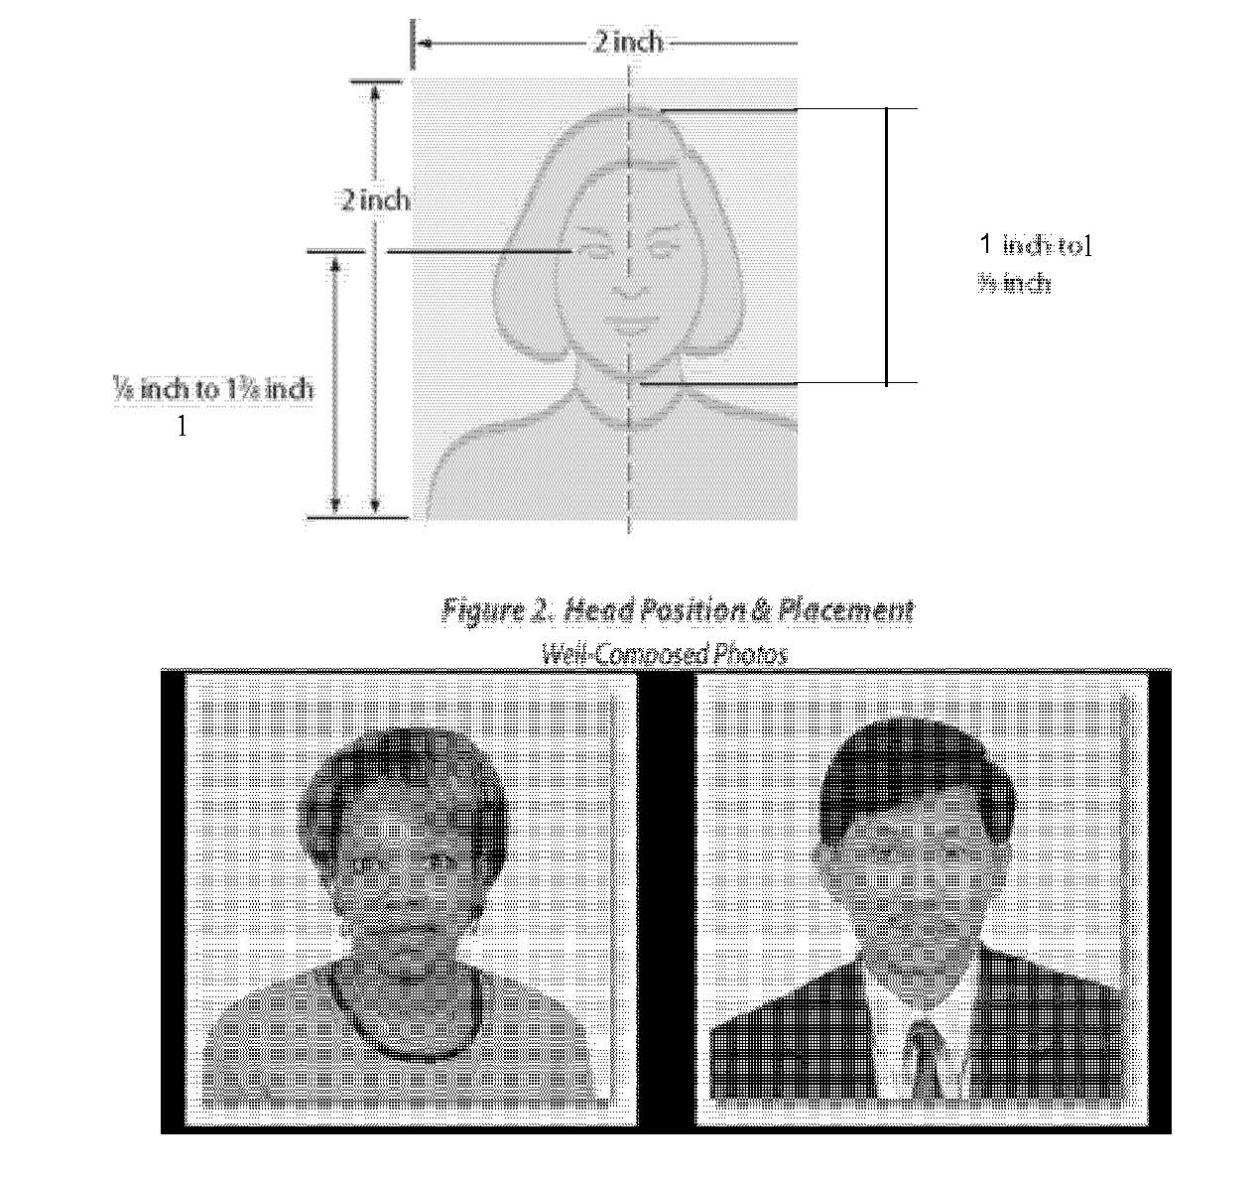
Photos
F‐1 students are required to submit 2 passport photos for OPT.
•The photos must be 2 x2 (U.S. passport
picture size) with a head size of 1 inch to 1 3/8
inches.
These must have been made within the past 6 months and not ever used on any other document.
•The background of the pictures must be white.
•Please write your name, SEVIS number and birth date on the back of the pictures.

Slide 21
FYI
For your information
It will take USCIS an estimated 3 months to process your OPT application.
If you have an assistantship, you must work until the last class day to receive your tuition waiver.
No counter checks or personal checks without your name and address on it will be accepted by USCIS. Check should be payable to the Department of Homeland Security
You must have 6 months remaining on your I‐20 and passport in order to renew your driver’s license. So renew your driver’s license before we shorten your program end date on your I‐20 to apply for OPT. Especially if you are applying for post‐completion OPT.

Slide 22
Periods of Unemployment
Each day (including weekends) during the period when OPT authorization begins and ends that the student does not have qualifying employment counts as a day of unemployment.
OPT authorization begins on the employment start date shown on the student’s EAD.

Slide 23
Travel on OPT
An F‐1 student engaged in pre‐completion OPT follows the same procedure for visits abroad and re‐entry as all F‐1 students.
An F‐1 student who is approved and engaging in post‐completion OPT who travels outside the United States temporarily (i.e., less than 5 months) can be readmitted to resume employment. You will need to have the following documents with you when you travel?
    Form I‐20 endorsed by the DSO within the last 6 months
    Valid passport
    Valid F1 visa
    Valid EAD card
    Letter from employer to verify employment

Slide 24
Travel on OPT cont.
While on OPT your are still required to submit a Travel Request Form and your current I-20. If you are out of the Auburn area this can be done via mail and/or email. See travel request form or contact your DSO at least 15 days prior to travel.

Slide 25
Travel & Reentry and
Job Requirement
Can I reenter if my request for OPT is pending?
  Yes, you may reenter to search for employment, but this is risky. Being denied entry is more probable when OPT is pending. Please see your DSO prior to travel.
Can I reenter if I left while on OPT?
  If your OPT has been approved and you depart before you get a job, your OPT ends and you cannot reenter unless you have a written job offer.
  If you have a job, you may travel and reenter to resume work at the same job or you have a written offer for another job.

Slide 26
Miscellaneous
Please contact the insurance coordination at insurance@auburn.edu with any questions about health insurance.
Your SEVIS record has to be updated for every place you live and every place you work. Please contact your DSO/ immigration advisor. You will receive a new I‐20 for each employer.
Advisors Recommendation Letter must be printed on Department Letterhead with your departments name and address on it.

