Slide 1

Welcome !
Innovative Ways to Recognize and Support Faculty Work
14 August 2018

Slide 2
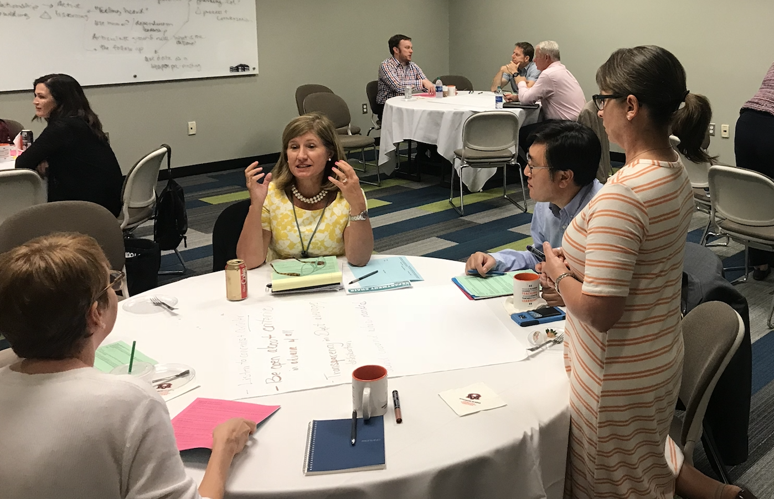
Session Goals
Review current best practices for recognizing/supporting faculty work.
Explore research on motivation theory and building a recognition-rich culture.
Create 1 or 2 innovative approaches you are willing to attempt this academic year.

Slide 3
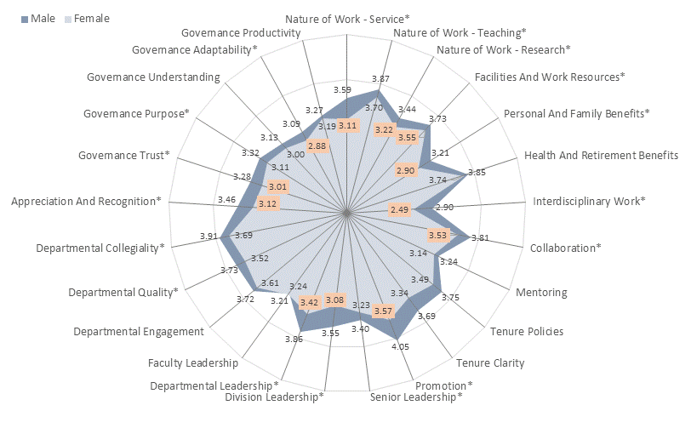
2013

Slide 4
2017
Notes:
Purple is 2013 + 2017 where they overlap Purple is “no difference” between 13 and 17 For our women colleagues we are below our COACHE peers averages.

Slide 5
2017
Notes:
Purple is 2013 + 2017 where they overlap Purple is “no difference” between 13 and 17

Slide 6
Opening Table Discussion
How do you recognize faculty achievement in your department/college?
How do you support faculty work in your department/college?
What are some of the current barriers to recognizing and supporting faculty work?
See your responses here: aub.ie/facultywork

Slide 7
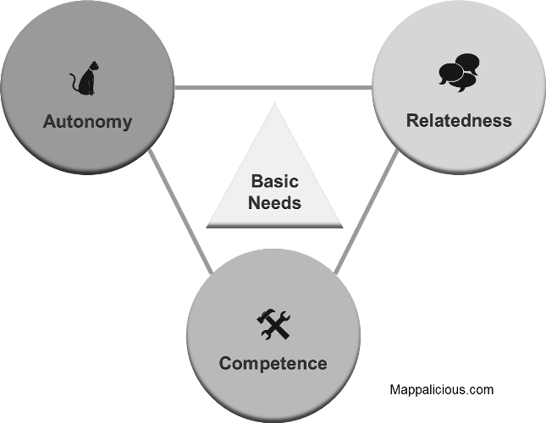
Motivating Humans
COMPETENCE
Sense of efficacy & confidence in one’s
context
AUTONOMY
Behave in accordance with abiding
values & interests; actions are self-endorsed
RELATEDNESS
Feeling cared for by and caring for
others (mutuality is key);
Sense of Belonging
Notes:
On the other hand, choice and the opportunity for self-direction (e.g., Zuckerman, Porac, Lathin, Smith, & Deci, 1978) appear to enhance intrinsic motivation, as they afford a greater sense of autonomy. Most extrinsic rewards focus on autonomy—not competence or relatedness.

Slide 8
Creating a Recognition-Rich Departmental Culture
Reward specific actions or behaviors:
  Do your current recognition systems recognize specific actions, behaviors, or competence?
Encourage peer-peer recognition:
  How can you encourage colleagues to recognize each other’s accomplishments/milestones and appreciate their relatedness?
Encourage storytelling:
  How can existing communication networks be leveraged to amplify story-telling and autonomy?
Notes:
Organizations that scored in the for 20% for building a recognition-rich culture had 31% lower voluntary turnover rates. (Bersin, 2012)

Slide 9
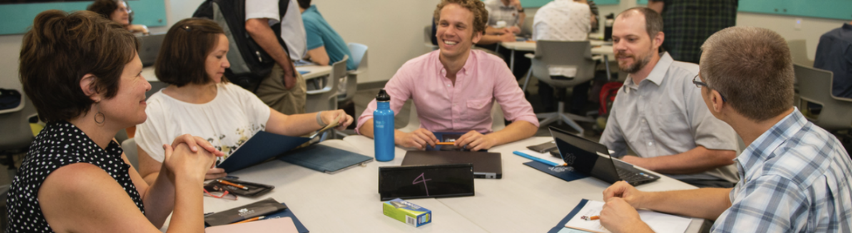
Closing Table Discussion
What new ideas do you have to recognize and support faculty work?

Slide 10
References
Ryan, R. M., & Deci, E. L. (2000). Intrinsic and extrinsic motivations: Classic definitions and new directions. Contemporary educational psychology, 25(1), 54-67.
https://www.forbes.com/sites/joshbersin/2012/06/13/new-research-unlocks-the-secret-of-employee-recognition/#3483f26e5276

