Slide 1
WINGS Account Creation
Registration & Establishment

Slide 2
WINGs Application Web Address
All new cadets will go to the following website to create a WINGS account:
https://wings.holmcenter.com/applyforafrotc

Slide 3
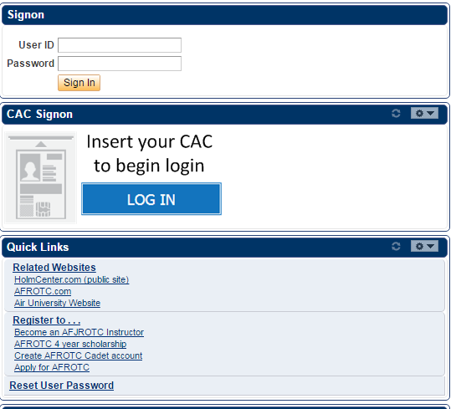
Create a WINGS account
Click
“Apply for AFROTC”

Slide 4
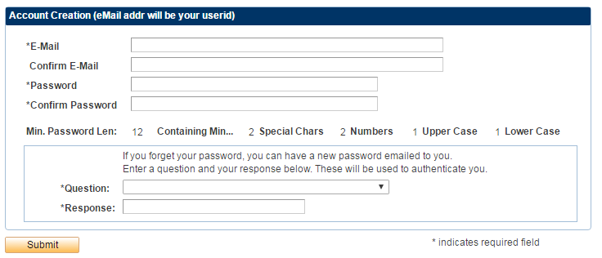
Create Username / Password
Use your University E-mail when you create your account, this will also be your User ID
After you click submit close this window and wait for the activation email
You must safeguard your username/password as you will continue to use this account until your commissioning

Slide 5
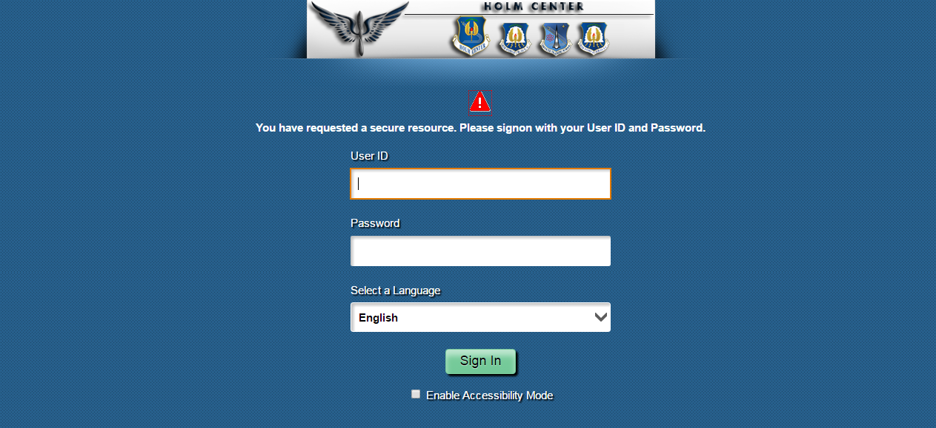
First Time User Login
Login using Username/Password just created
User ID is your full university E-mail address

Slide 6
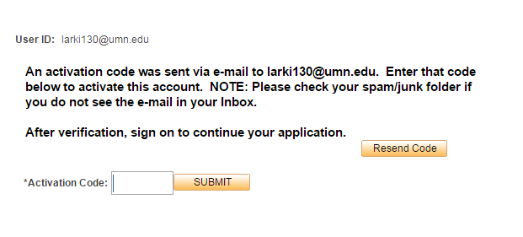
Activate Account
jdoe123
Enter activation code from your e-mail.
Email may take a few minutes.

Slide 7
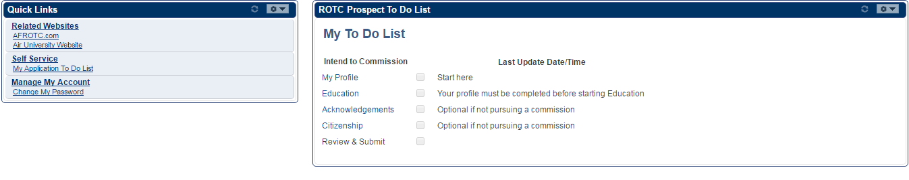
Create Profile
Click Here
Now that your account is created you need to complete your to do list to finish your application.

Slide 8
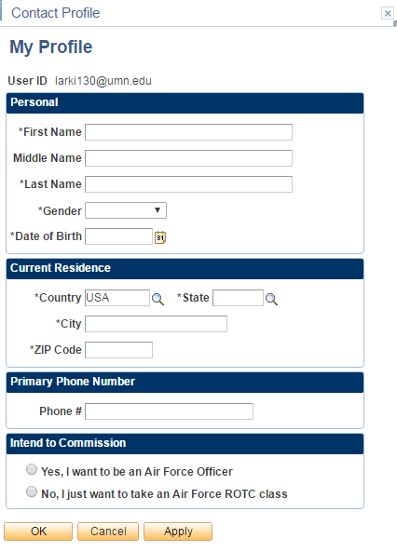
Create Profile Cont’
Fill in your information, click Apply to save and OK to continue

Slide 9
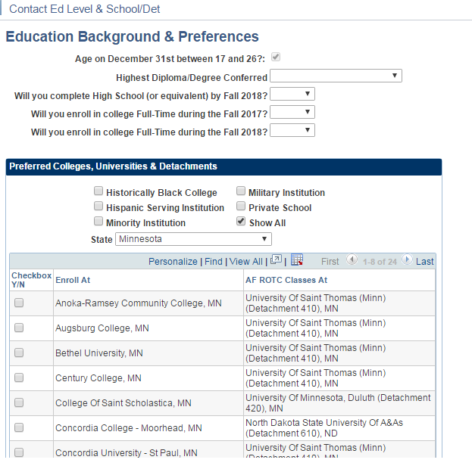
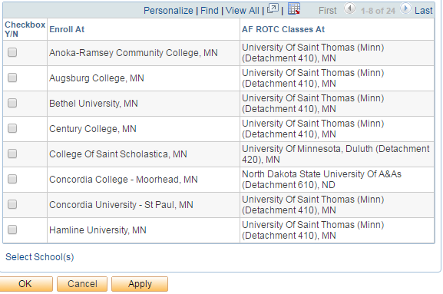
Education Preferences

Slide 10
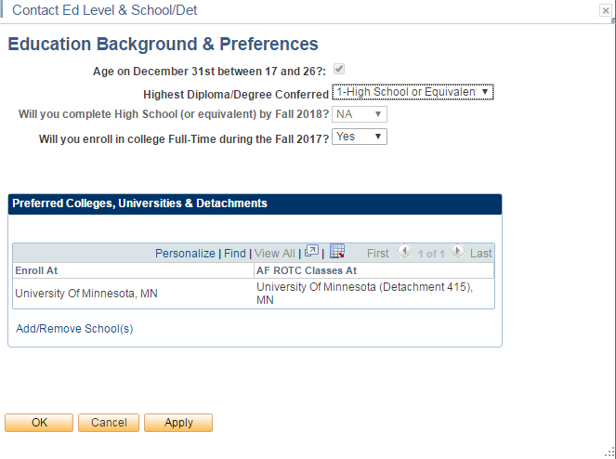
Education Preferences Cont’

Slide 11
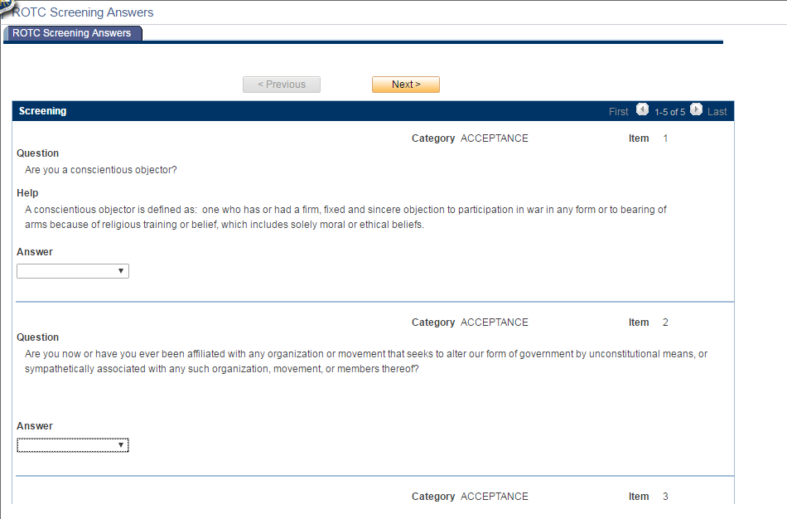
AFROTC Screening
Use the drop down options to answer or acknowledge statements

Slide 12
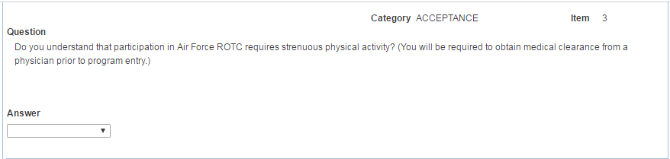
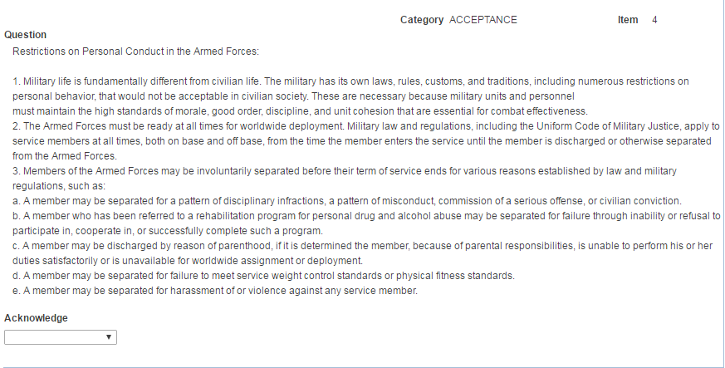
AFROTC Screening Cont’

Slide 13
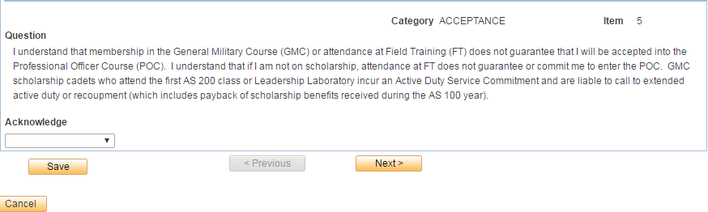
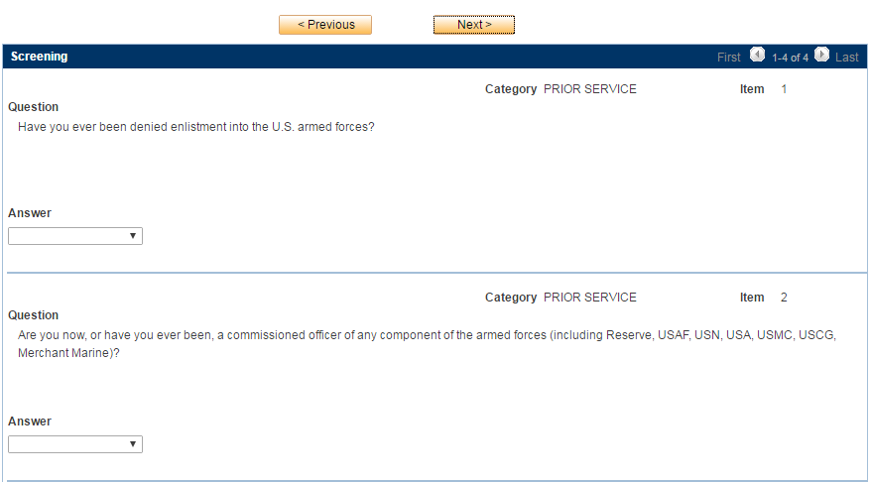
AFROTC Screening Cont’

Slide 14
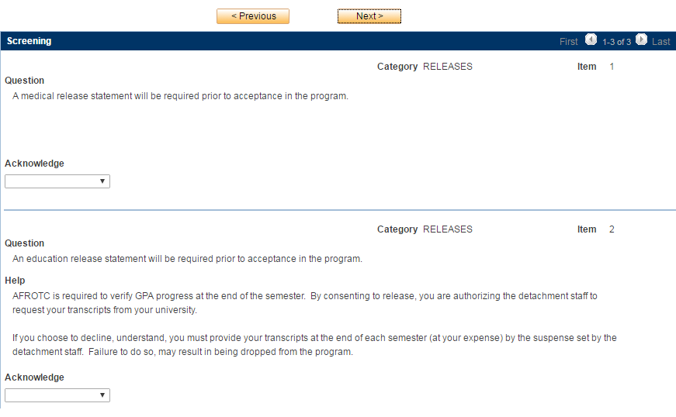
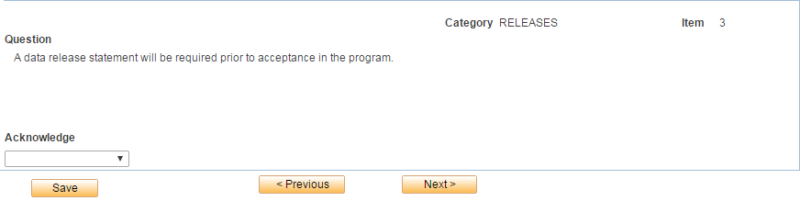
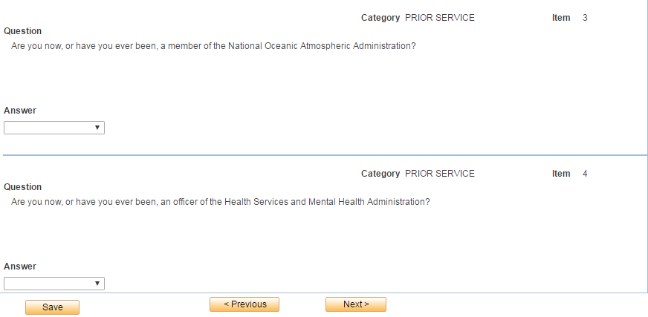
AFROTC Screening Cont’
Acknowledge these sections, hard copies of the release statement will be available to sign during NSOP

Slide 15
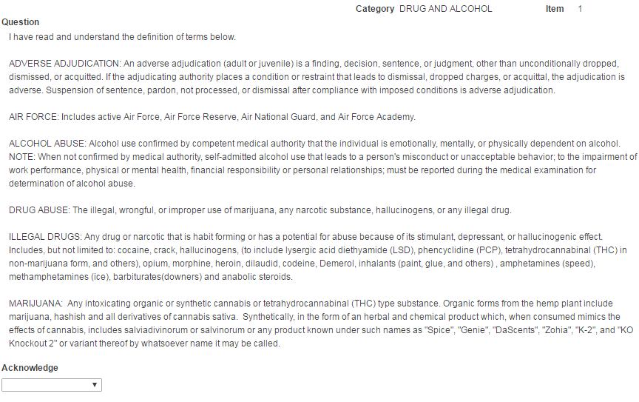
AFROTC Screening Cont’
Read these terms carefully and acknowledge you understand them, you will be asked questions referencing these terms next.

Slide 16
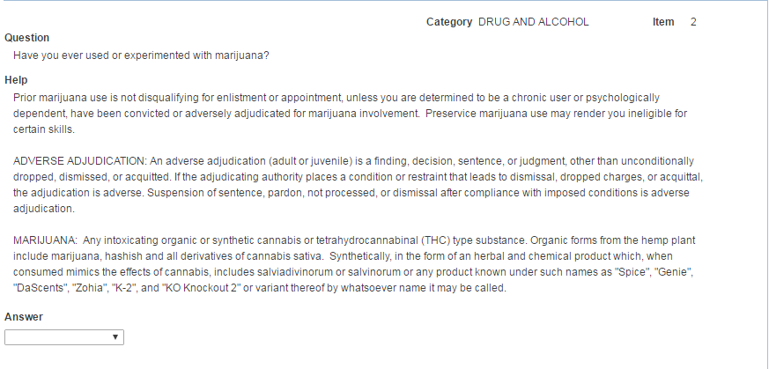
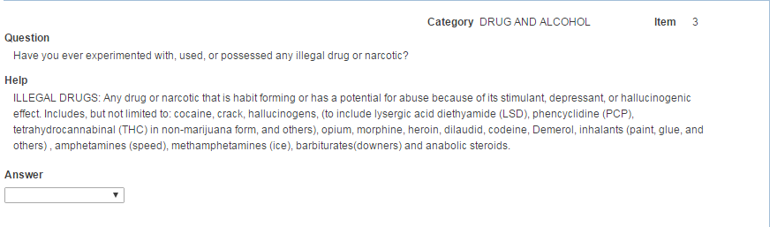
AFROTC Screening Cont’
Please note, illegal drugs/narcotics do not include marijuana

Slide 17
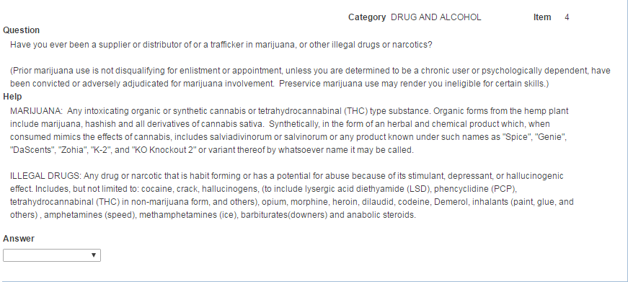
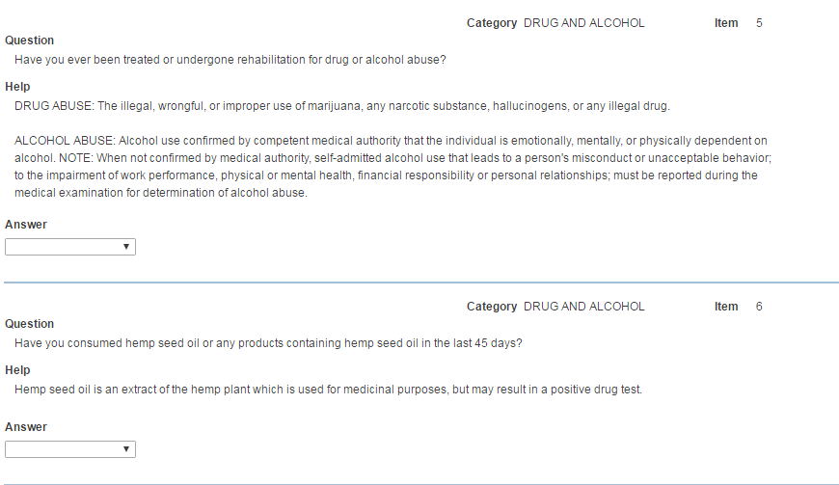
AFROTC Screening Cont’

Slide 18
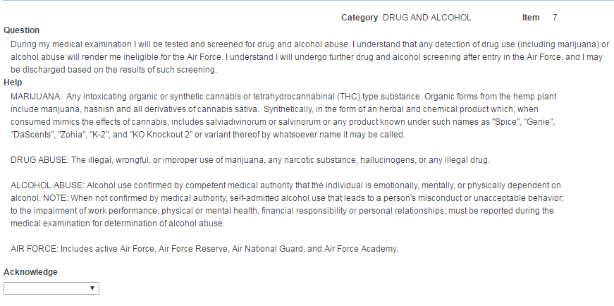
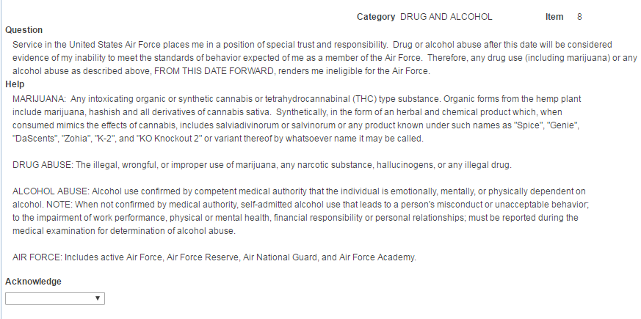
AFROTC Screening Cont’

Slide 19
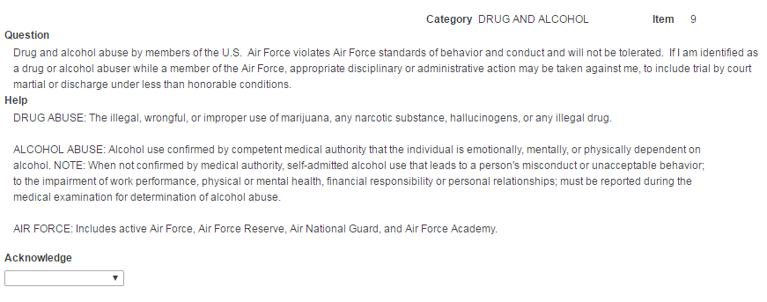
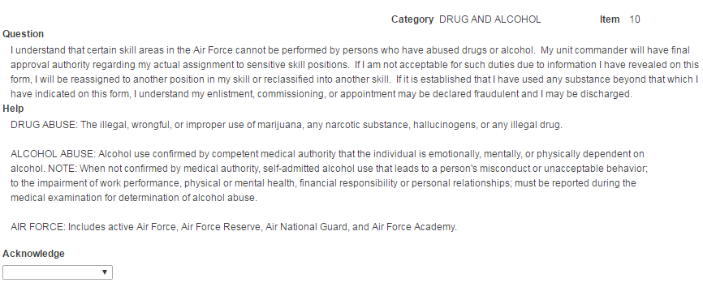
AFROTC Screening Cont’

Slide 20
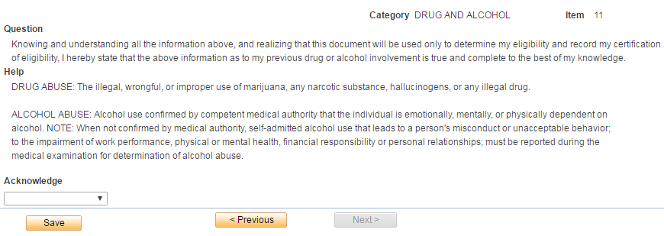
AFROTC Screening Cont’
If the Next button is gray-out when you complete this section, click save and exit the dialogue by clicking the “x” in the upper corner.

Slide 21
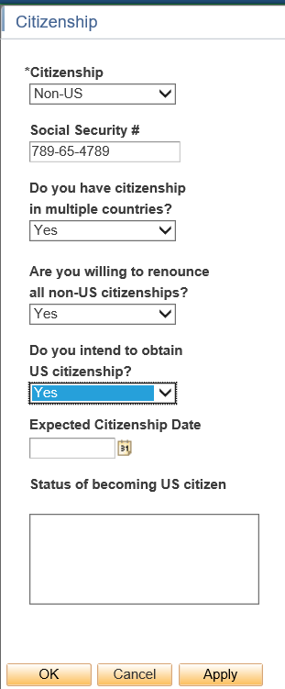
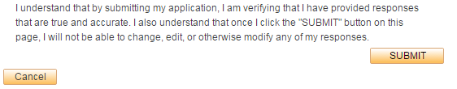
AFROTC Screening Cont’
Enter your full SSN here, we will still need to see the original of your Social Security Card and original birth certificate during in-processing. They will be returned to you the same day.

