Slide 1

DEIB, Title IX, & Sex-Based Misconduct
Office of AA/EEO & Title IX

Slide 2



WARNING
    Some of the content can be traumatic or triggering.
    If you find the content offensive, such as the video examples, please remember this training discussion today is taken serious by Auburn University and it is not intended to upset anyone but meant to educate everyone on what to do and what not to do, such as some of the examples in the videos.
    Please be respectful of each other’s feelings. We don’t know what we have all experienced in life so be supportive and don’t judge others.
Notes:
As a reminder, this presentation is a safe space and topics of sex, domestic violence, and stalking will come up. This content is meant to be engaging and informative and not intended to upset anyone. Please be respectful of your peers as this will be an interactive presentation.

Slide 3

TRAINING OUTLINE
DIVERSITY, EQUITY, INCLUSION, & BELONGING
TITLE IX / PROHIBITED CONDUCT
BYSTANDER INTERVENTION
REPORTING/RESOURCES
RETALIATION
SUPPORTIVE / INTERIM MEASURES
PROCESS
SANCTIONS
PRESERVATION OF EVIDENCE AND MEDICAL SUPPORT

Slide 4

· Diversity·Equity·Inclusion·Belonging·
· SEX · · AGE· · DISABILITY ·
· GENETIC INFO · · RELIGION ·
· NATIONAL ORIGIN · · RACE·
· COLOR · ·VETERAN STATUS ·
Notes:
What does diversity mean to you? A variety of people with differences such as the ones you mentioned. Yes. And these qualifications listed are considered protected statuses. Our office investigates allegations of discrimination and harassment based on protected statuses.

Slide 5

DISCRIMINATION AND HARASSMENT
Discrimination – Conduct directed at a specific individual or a group of identifiable individuals that subjects the individual or group to treatment that adversely affects their education or employment because of their Protected Status.
Harassment – Verbal and/or physical conduct that is severe or pervasive, that is based on an individual’s Protected Status, and that unreasonably interferes with the individual’s work or academic activities, or that creates an environment that a reasonable person would consider intimidating, hostile, or offensive.
Notes:
These definitions are taken straight out of Auburn’s Policy against Discrimination and Harassment.

Slide 6
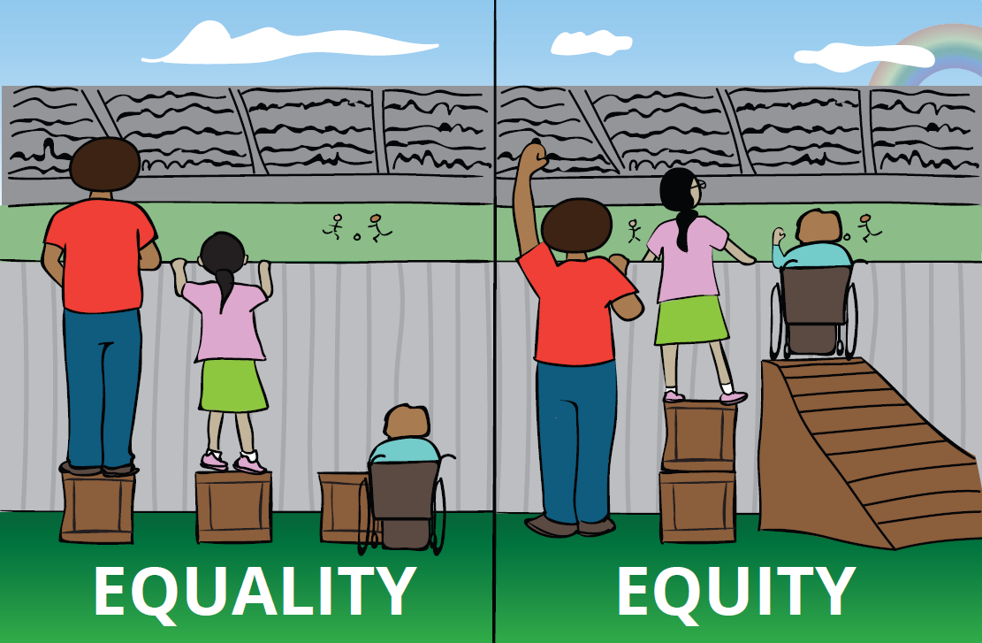
· Diversity·Equity·Inclusion·Belonging·
Equality=Sameness
Equality tries to promote fairness by providing everyone with the same thing
But…it only works if everyone starts from the same place (like the same height)
Equity=Fairness
Equity is about providing everyone with access to the same opportunities
Our differences and personal history sometimes create barriers but ensuring equity first allows us to then enjoy equality
Notes:
What do you think of when we talk about “equity”?

Slide 7
· Diversity·Equity·Inclusion·Belonging·
Inclusion: Including or of being included within a group or structure
Belonging: Belonging is the feeling of security and support when there is a sense of acceptance, inclusion, and identity for a member of a certain group
Think about your own team.
Notes:
Think about the purpose of athletics, sports. You want to win, yes, but what else? Is it also about being a team, working together to a common goal? Inclusion and belonging is about growth. Can you all play the same position? No! Do you all have the same skills? No. You need diversity, but you also need to have inclusion and belonging.

Slide 8




    Engaged
    Respected
    Valued
    Welcomed
    The Bare Minimum is not discriminating , not harassing, and overall, just not doing anything.
Notes:
What's the purpose of athletics and sports? To win. Yes, but what else? What will help you win? To grow and develop! Yes. Can you grow and develop with all of the same players on your team playing the same positions from the same backgrounds? No. So you need diversity!
Diversity brings unique perspectives and strengths that can enhance your team's performance. But diversity alone isn't enough. To truly benefit from a diverse team, we must ensure everyone feels welcomed, valued, respected, and engaged.
Welcomed: Think about how you felt when you first joined a team or a group of people. Did someone greet you, show you around, and make you feel like you belonged? That’s what it means to be welcomed. It's about creating an environment where everyone feels like they’re part of the team from day one.
Valued: Every player brings something unique to the team. Recognizing and appreciating each person’s contributions makes them feel valued. It’s not just about the star player; it's about acknowledging the effort and skills of everyone, whether they're on the field or supporting from the sidelines.
Respected: Respect is fundamental in any team. It's about listening to each other, valuing different opinions, and treating everyone with dignity. When we respect each other, we build trust and create a stronger, more cohesive team.
Engaged: Engagement means being involved and enthusiastic. Encourage each other to participate, share ideas, and take initiative. When everyone is engaged, the team thrives because everyone is contributing their best.
So, to grow and develop, we need to create a team culture where everyone feels welcomed, valued, respected, and engaged. That’s how we not only win games but also build a legacy of excellence and unity.

Slide 9

Consensual Relationships Policy
Consensual relationships that are of concern to Auburn University are those romantic, intimate, or sexual relationships in which both parties appear to have consented, but where there is a reporting or evaluation relationship between the two parties. This prohibits relationships like:
Athletics Staff to Student Athletes
Coaches/Faculty to their Graduate Assistants
Faculty to their students
Graduate Assistants to the students they oversee/mentor
Supervisors to their Direct Reports
*It is best to avoid your entire department, to avoid issues later.*
Notes:
Other examples of stalking include:

Slide 10
TITLE IX
FEDERAL LAW PROHIBITING DISCRIMINATION BASED ON SEX / GENDER IN AN EDUCATIONAL SETTING (PROGRAMS AND ACTIVITIES)
  ATHLETICS
  CLASSROOM
  EMPLOYMENT
  FINANCIAL AID
  ENROLLMENT

Slide 11
TITLE IX / SEX-BASED MISCONDUCT
SEXUAL HARASSMENT
INTIMATE PARTNER VIOLENCE (DATING / DOMESTIC VIOLENCE)
STALKING
NON-CONSENSUAL SEXUAL CONTACT / INTERCOURSE (SEXUAL ASSAULT)
SEXUAL EXPLOITATION
OTHER FORMS OF DISCRIMINATION
BULLYING AND HAZING

Slide 12
CAN YOU VIOLATE TITLE IX OR BE RESPONSIBLE FOR SEX-BASED MISCONDUCT:
On campus?
&
Off campus?

Slide 13
SEXUAL HARASSMENT (UNWELCOME CONDUCT)
Unwelcome conduct determined by a reasonable person to be so severe, pervasive, and objectively offensive that it effectively denies a person equal access to the University’s education programs and activities.
Unwelcome sexual advances
Requests for sexual favors
Unwanted touching / rubbing of a sexual nature
Comments about physical appearance
Sexual gestures or images
Sexual “jokes”
Notes:
What are other examples of unwelcome conduct that could be considered sexual harassment?

Slide 14
STALKING
Engaging in a course of conduct directed at a specific person that would cause a reasonable person to fear for the person’s safety or the safety of others; or suffer substantial emotional distress.
Following someone
Showing up un-invited
Watching someone
Constant messages
Making comments perceived as threatening
Notes:
Other examples of stalking include:

Slide 15

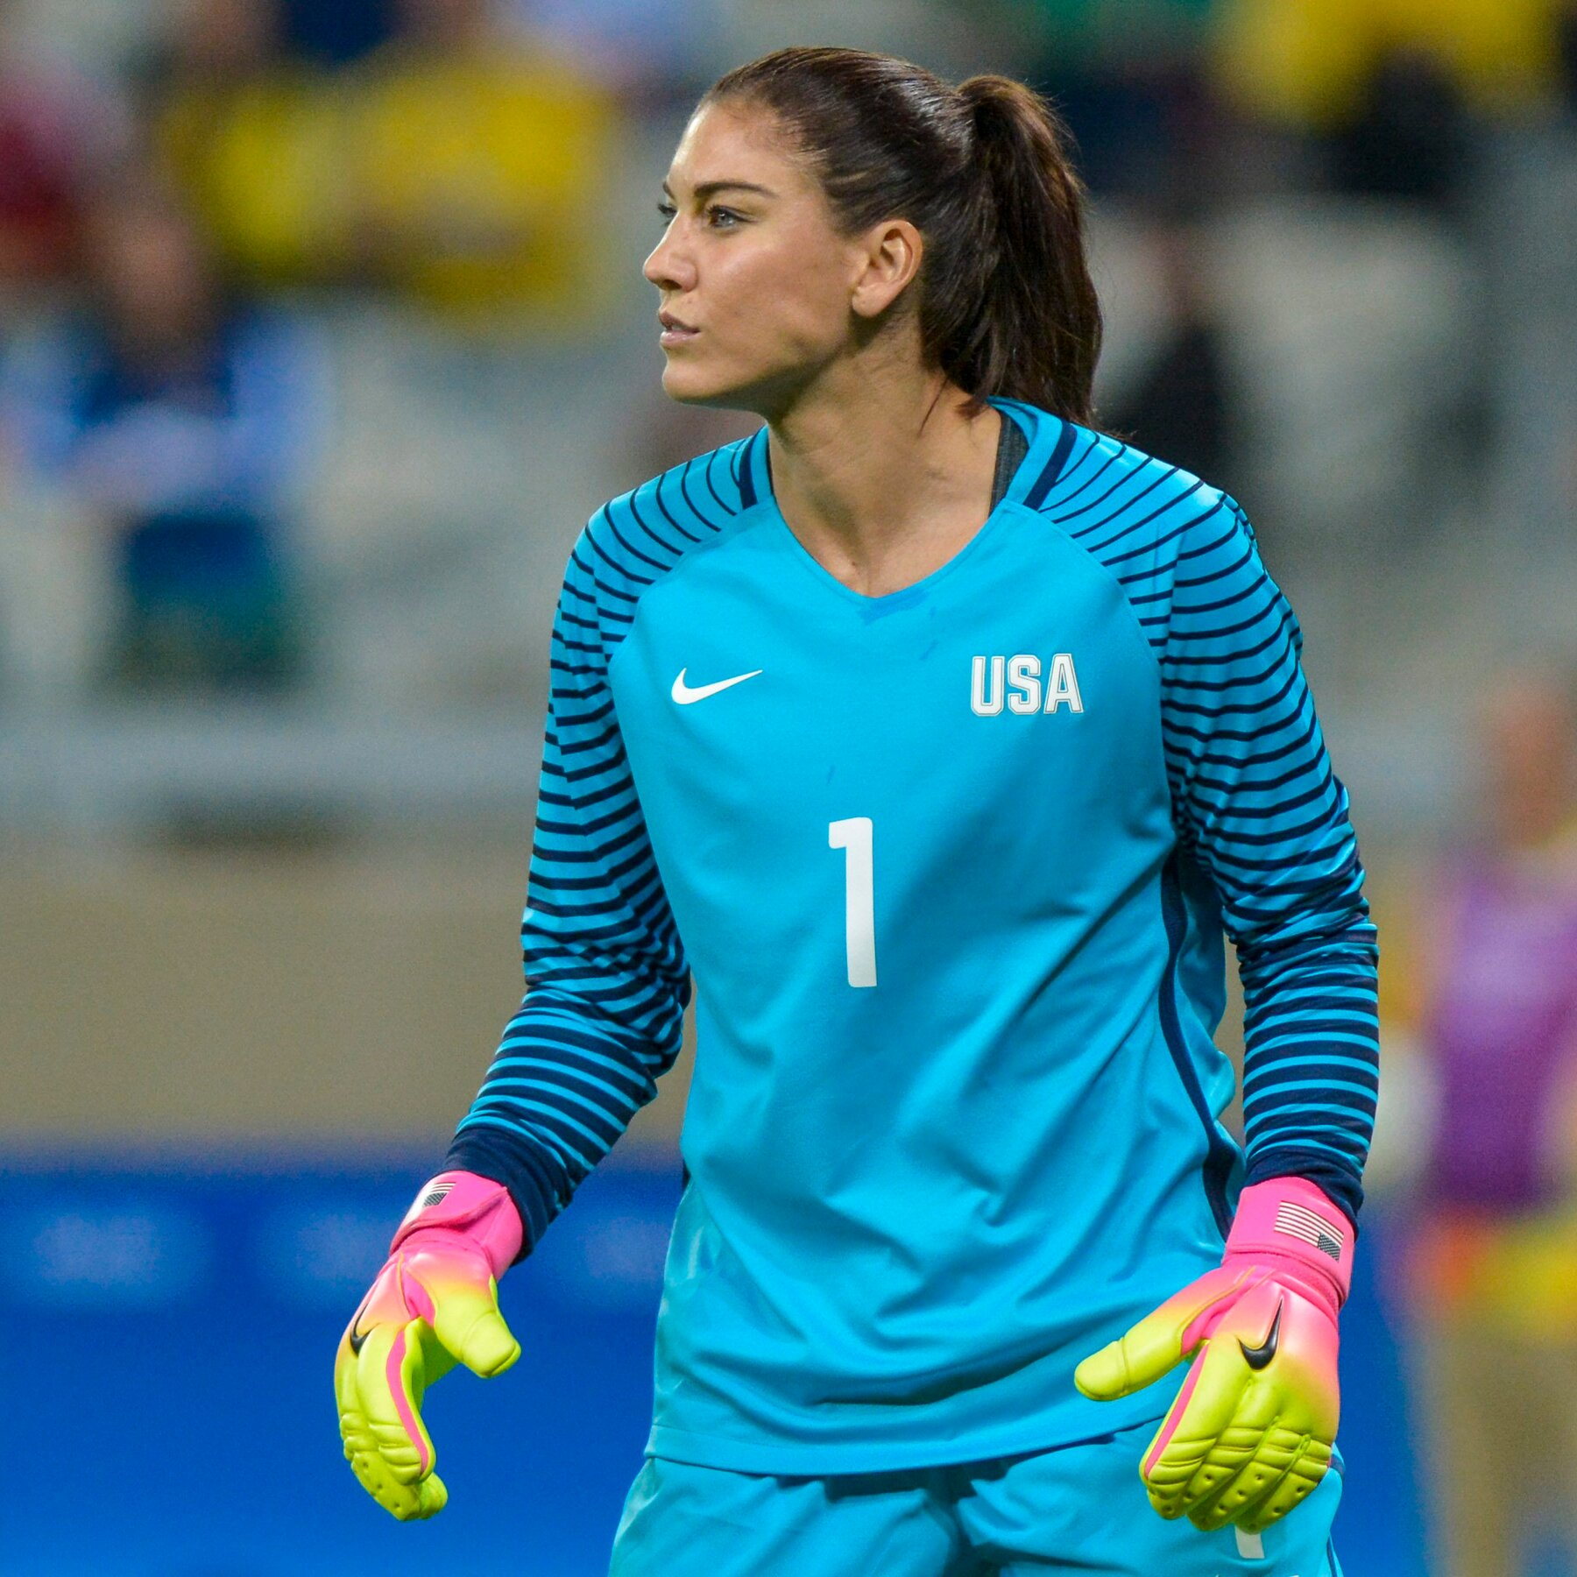




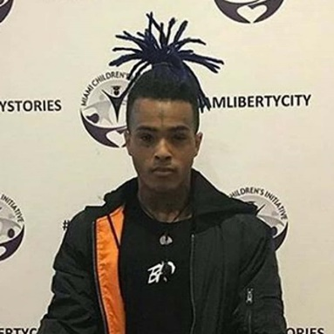



Hope Solo
Ray Rice
Trevor Bauer
INTIMATE PARTNER VIOLENCE
(DATING/DOMESTIC VIOLENCE)
Notes:
Who can name anyone on this screen?........................ These celebrities have all been alleged to have committed intimate partner violence which is violence committed against a romantic or intimate partner or a spouse. As you see, these individuals display diversity in age, race, sex, profession and their victims display an array of diverse traits as well. Intimate partner violence could happen to any of us, but we can make sure that we are engaging in healthy relationships practices and watching out for warning signs of unhealthy relationships.

Slide 16
SIGNS OF UNHEALTHY RELATIONSHIPS
Physical Abuse
Verbal Abuse
Extreme Jealousy
Isolation
Controlling
Electronic
(pushing, shoving, grabbing, hitting)
(name calling, put downs, insults, threats)
(upset about you having friends of the same sex as them)
(prevent you from doing any activities with friends/family)
(deciding when and where you can do anything)
(access to cell, email, social media to monitor)

Slide 17
HOW DO YOU KNOW IF
YOU HAVE CONSENT?
NON-VERBAL
VERBAL
Body Language!
  Are they leaning in vs pulling away?
  Are they smiling vs is their face blank or uncomfortable?
  Are they kissing you back vs staying still or frozen?
Consent Can Be SEXY!
  “Do you want to show me your bedroom?”
  “Show me where you want me to touch you?”
  “Do you want to help me take my clothes off?”

Slide 18

CONSENT IS SIMPLE AS TEA!
https://youtu.be/fGoWLWS4-kU

Slide 19
SEXUAL EXPLOITATION
Sharing or posting images of private sexual activity and/or nude pictures of someone without consent
Causing or attempting to cause someone to get incapacitated for sexual purposes
Watching sexual activity or someone nude without consent
Exposing someone to an STD
Sextortion

Slide 20
RETALIATION
PROHIBITED
  INITIMIDATION
  THREATING
  MAKING FUN OF PERSON
  MAKING A FALSE COMPLAINT

Slide 21
PRESERVATION OF EVIDENCE
MEDICAL EXAM RIGHT AWAY
DON’T SHOWER
DON’T THROWING AWAY ITEMS (CONDOMS)
DON’T WASH CLOTHES OR SHEETS
SAVE ELECTRONIC EVIDENCE
TEXT
SOCIAL MEDIA
EMAIL MESSAGES
REPORT IT!

Slide 22
BYSTANDER INTERVENTION
If you see something wrong, you can make a difference with bystander intervention. Don’t sit back and do nothing, intervene and help prevent something from happening.
DIRECT
DELEGATE
DISTRACT

Slide 23
INCIDENT REPORTED, OBSERVED,
OR SUSPECTED
If it is an emergency, call 911.
Employees (including coaches and faculty) are required to report (make a referral to Title IX office)
Reason for the report is to offer support (not force anyone to participate in an investigation)

Slide 24
SUPPORTIVE / INTERIM MEASURES
NO CONTACT DIRECTIVES
SAFETY PLANNING
SCHEDULE CHANGES (ACADEMIC OR WORK)
ON CAMPUS HOUSING CHANGES
RESTRICTIONS
EMERGENCY REMOVAL / SUSPENSIONS

Slide 25
PROCESS
hearing
determination
determination
investigation
informal / formal
assessment
appeal

Slide 26
SANCTIONS
WARNING
TRAINING
PERMANENT NO CONTACT
PROBATION/LOSS OF SPECIFIC JOB DUTIES
PERMANENT RESTRICTION/REASSIGNMENT
SUSPENSION/UNPAID LEAVE
EXPULSION/TERMINATION

Slide 27

REPORTING / REFERRAL OBLIGATIONS
Mandatory Reporters are required to report disclosures of Sex-Based Misconduct and any form of discrimination based on sex and retaliation to Auburn University’s Title IX Coordinator immediately.
Mandatory Reporters = Every Employee who is not a designated Confidential Employee.
Confidential Employees are those Employees who are permitted to engage in confidential communications under Alabama law. This includes medical and clinical care provides, mental health providers, licensed professional counselors, and ordained clergy.
If it is an emergency, call 911.

Slide 28
ON CAMPUS-CONFIDENTIAL RESOURCES
Safe Harbor (334-844-7233)
Student Counseling and Psychological Services (334-844-5123)
Counseling and Sports Psychology (Athletics)
Auburn University Medical Clinic
Ombudsperson (334-844-7170)
Employee Assistance Program (EAP)

Slide 29
NON-CONFIDENTIAL / PRIVATE RESOURCES
Office of Affirmative Action / Equal Employment Opportunity & Title IX
Office of Human Resources
Office of Provost
Office of Student Affairs
Campus Safety and Security

Slide 30
WHAT TO INCLUDE IN THE REPORT
Sexual Misconduct/Discrimination or Harassment Based on Protected Class Incident Reporting Form (aub.ie/report)
Include your name.
Include the names of involved parties (Complainant and Respondent).
Complainant is person that allegedly experienced misconduct.
Respondent is person that is alleged to have engaged in the misconduct.

Slide 31
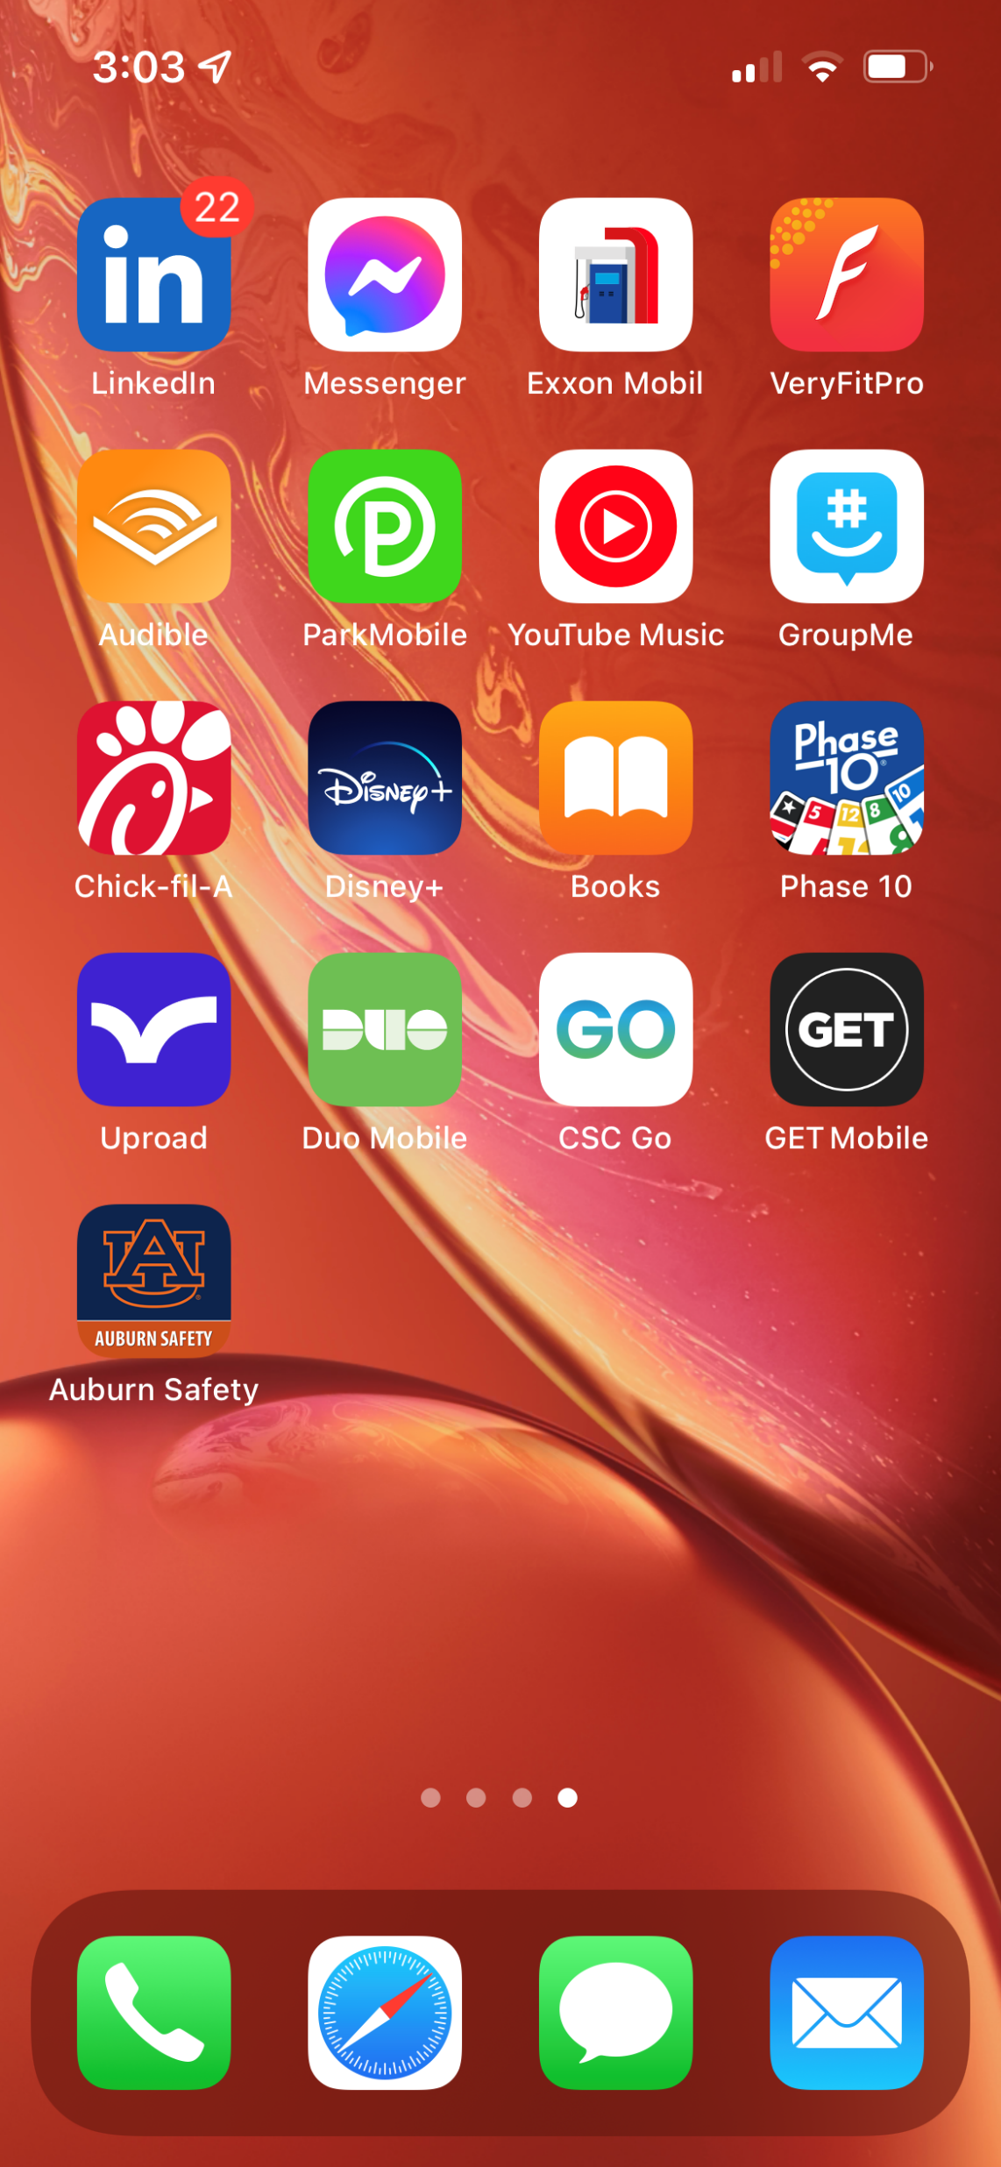
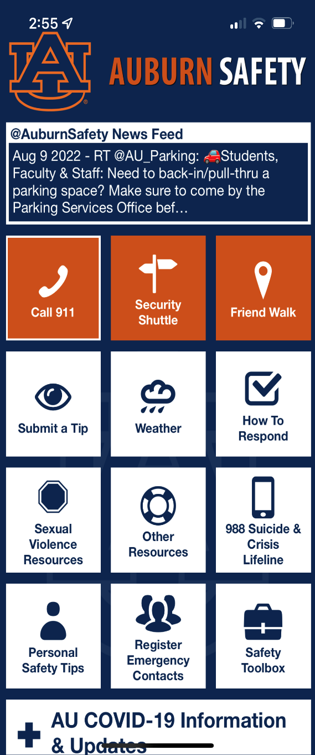
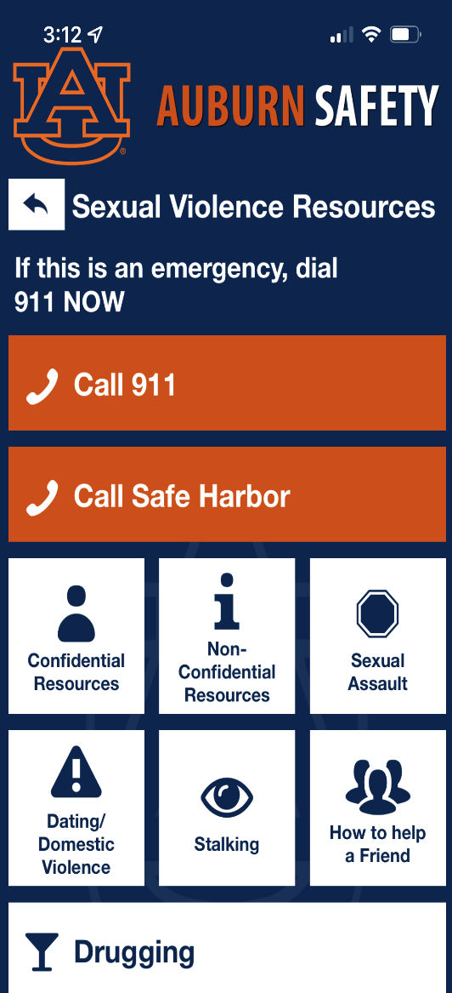
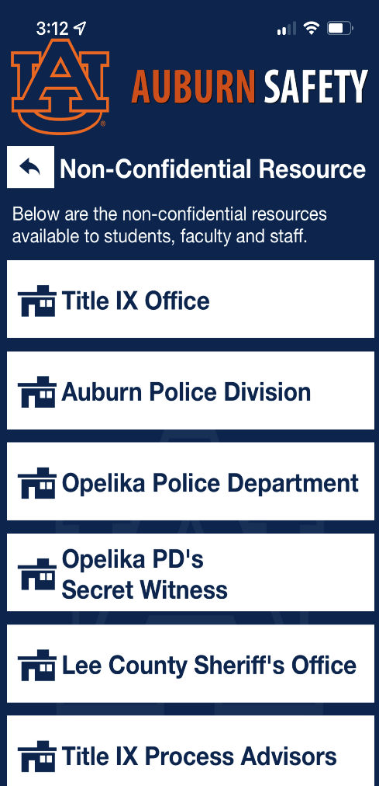

REPORTING
Notes:
How many of you in here have the Auburn Safety app? You can report incidents to us find our resources through the app.

Slide 32
REPORTING SCENARIO #1
A student contacts you and discloses that they missed an assignment/workout because over the weekend they were sexually assaulted. They tell you they reported it already but are having a difficult time focusing.
Do you have to report / make the referral?
How should you handle that situation?

Slide 33
REPORTING SCENARIO #1
Do you have to report / make the referral? YES. You must make the referral even if they tell you they have reported it because we need to make sure they are receiving the support and we are required by law to do so.
How should you handle that situation? Show compassion and advise the student that you are required to make a referral to the Title IX office so that they get connected with resources. Let them know they will not be required to participate in a process if they don’t want to because the main goal is to support them.

Slide 34
REPORTING SCENARIO #2
You are talking with a student, and they share that another student is making them feel uncomfortable because the other student is repeatedly messaging them even though they are not interested in that other student. The student tells you that they don’t want you to report this to Title IX.
Do you have to report?

Slide 35
REPORTING SCENARIO #2
Do you have to report? YES, because this could be sexual harassment and any time it may be a type of prohibited conduct you are required to report.
Even though they don’t want you to report, let the student know you are not a confidential resource and are required to make a referral to the Title IX office. But let them know they will not be required to file a complaint or participate in an investigation. The main purpose of the referral is to get them connected with resources.

Slide 36
REPORTING SCENARIO #3
A co-worker shares with you that they heard that another employee was in an abusive relationship.
Do you have to report?
What if it is your full-time staff supervisor?
What if it is your professor?

Slide 37
REPORTING SCENARIO #3
Do you have to report? Yes.
Any time information is shared with you either by the Complainant themselves, a third party, or you overhear, you are required to make that referral and report it.

Slide 38
REPORTING SCENARIO #4
A staff member (Aubie) had an intimate relationship with another staff member (WarEagle) but their relationship ended. Aubie no longer wants to have contact with WarEagle, but WarEagle keeps flying over Aubie watching Aubie every where Aubie goes. Aubie is feeling WarEagle will not leave them alone since they ended their relationship.
Is WarEagle engaging in any type of misconduct?
Are you required to report this?

Slide 39
REPORTING SCENARIO #4
Is WarEagle engaging in any type of misconduct? YES, this is a form of sexual harassment and could be stalking or dating violence.
Are you required to report this? YES, you are a mandatory reporter.

Slide 40
REPORTING SCENARIO #5
You are interested in asking a student on a date, but you are concerned about the power dynamic position you have and don’t want to violate policy. What should you do?
What concerns are there for this employee?

Slide 41
REPORTING SCENARIO #5
These relationships are strongly discouraged for several reasons including but not limited to;
  students can feel coerced into the relationship (Sexual Harassment); potential conflicts of interest; use of university resources (cell phones).
Staff/Student Relationships
  Prohibited if the staff members has any authority or control over the student.
Talk to your supervisor and/or the Title IX Coordinator for advice.

Slide 42
REPORTING SCENARIO #6
If you were to experience any type of Title IX / Sex-Based Misconduct, do you, as a mandatory reporter, have to report your own situation?

Slide 43
REPORTING SCENARIO #6
No. It is personal to you.
If you share with someone else, know that they may be a mandatory reporter themselves.
If that person who is alleged to have done the inappropriate conduct towards you is/has done it to someone else, you need to report it.

Slide 44
QUESTIONS?
Office of AA/EEO & Title IX (317 Foy Hall)
titleix@auburn.edu
aba0061@auburn.edu

Slide 45
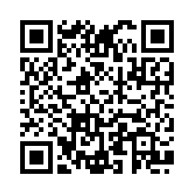
SCAN FOR CREDIT

