Slide 1
Financial Liaison Meeting
Presented by the AU Business Office
March 28, 2011

Slide 2
Management Reporting

Slide 3
Focus Group-Chairs & Dept Heads
Initiated by Provost late Nov. 2010
Focus groups conducted Dec 2010
Results recapped Jan 2011
Review Business Office Feb 2011 forward
Input from Liaisons requested
    What can we do to assist your Faculty/Chairs?
    What can you do to assist them?

Slide 4
Focus Group Recap
Training
  New Reading Budget Balances CT270 being taught by Kathy Bugg for Chairs, Dept Heads and Faculty (first offering March 30). Encourage you faculty/heads to sign up today or watch for next session next semester
  Controller’s Office – looking into new fund accounting type class
  Potential OIT Xtender training

Slide 5
Focus Group Recap
Training (continued)
  Length of sessions (Kathy’s new session is 1 hour)
  Hands-on
On-line Training
  Snip-Its (questions and answers)
  Adobe Presenter PowerPoint with voice over
  E~Print report dictionary update

Slide 6
Role of Liaisons
When role was established this is how we defined for Deans:
Be the primary financial contact (connecting link) between the Business Office and the college or college-level unit
Facilitate enhanced communication and feedback to Business Office of immediate needs and concerns in unit
Participate in quarterly meetings where new financial concepts, policies & procedures will be discussed
Assist the Business Office with suggestions for streamlining and automating systems within Banner
Disseminate financial information, new policies, procedures and reporting tools back to unit.

Slide 7
Disseminate financial information
What Method Do You Use?
  Call meetings with all Admins in area
  Provide copies of PowerPoint presentations from last Liaison meeting
  Detailed discussion on key points with your college/unit
Can we assist with a different type recap of meeting?

Slide 8
Banner Month End e~Print Reports
Focus - Chart A

Slide 9
FZODOS1 Operating Summary
Management report designed to provide organizational summary by fund type. Best practice: extract at appropriate level (college, school or department).
  Who should use this report? Deans, department heads, financial administrators
  Provides view of all fund-org combinations separated by fund type: unrestricted, restricted, contract/grant, auxiliary, and plant
  Allows user to view budget, current month and YTD allocations, encumbrances and end of period balance available
  Can download by fund type into excel
FZODOS2 – same format limiting access to grants & cost share funds only

Slide 10
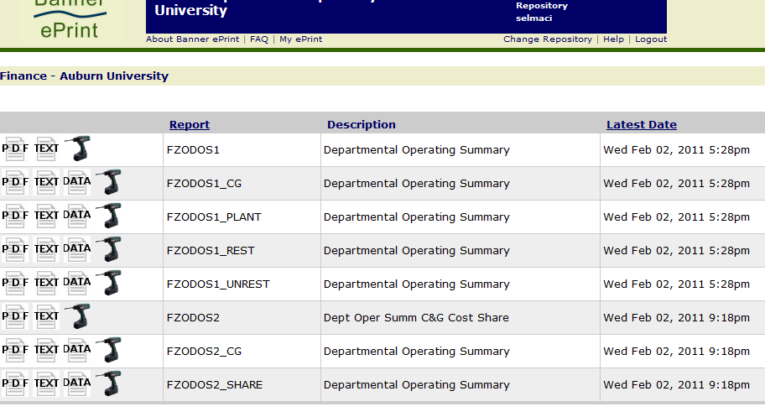
E~Print View
Data icon means you can download to excel

Slide 11
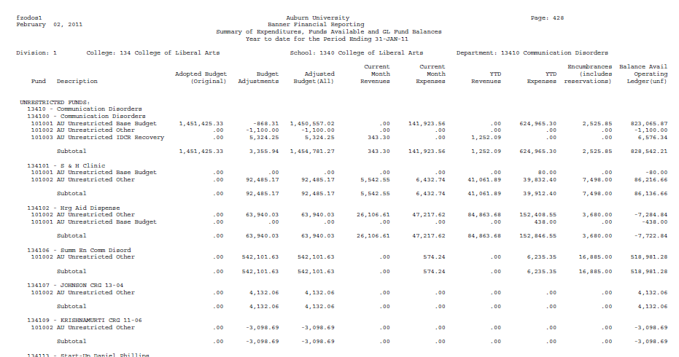
FZODOS1 Report Example

Slide 12
F?RBDSC Budget Status
Detailed review by fund or organization providing user with all F-O combinations listing account activity (current month/YTD and encumbrances) compared to budget.
Who should use this report? Financial Administrator and business office administrators. More detail than manager might want to view on monthly basis.
FZRBDSC vs FGRBDSC
FGR- original system report. Query by one fund or org or a range of funds or orgs. No hierarchy extract so gaps in range can create issues.
FZR – in-house report. Query by org hierarchy – can pull by college, department, range of orgs or single org. Great for extracting when you have gaps in range.

Slide 13
F?RODTA Detail Activity
FGRODTA and FZRODTA
Both query by single or range of funds or organizations. No hierarchy extract.
BUT only the FZRODTA offers program code information and you should be reviewing program codes.

Slide 14
FZRFATE Potential Errors
Report created to identify potential errors in fund-org combinations
Two places to look:
  First few pages where there are divisional errors (pull entire pdf file)
  Your college, school or department.
Correct using DEC (if error in actuals) or BCO (if error in budget transfer)

Slide 15
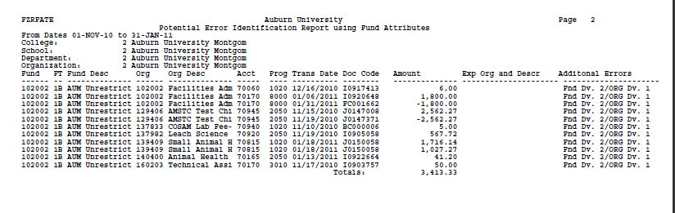
FZRFATE Potential Errors
Example of incorrect fund and organizational use found in divisional pages at beginning of report.

Slide 16
Optional Month-end Reports
FZOFRFC – Financial Report for Organization College level view of unrestricted funds. Isolates base from other unrestricted by division providing budget compared to actuals to date (previously used by Deans for Provost presentation).
FZOREMC – Revenue/Expense Month By Month College level review showing revenues and expenses by major account pools, providing spending, encumbrances and available balance. Pulls all fund types for the college and combines. High level look at position.
FZOREMM - Revenue/Expense Month by Month by FOP Report format like REMC except you can pull data by department, school or college

Slide 17
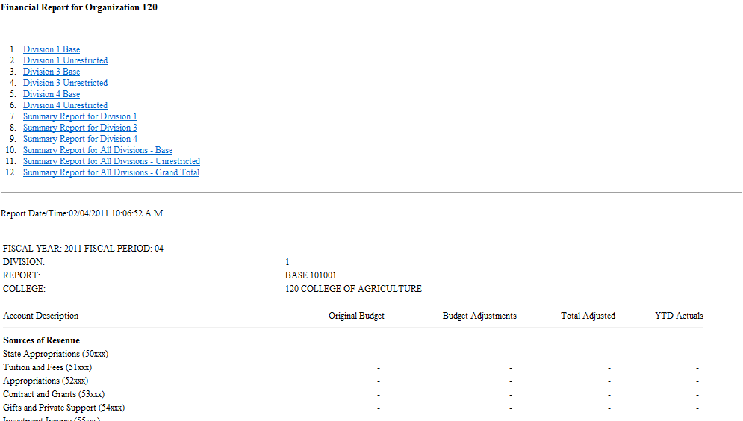
FZOFRFC – Financial Report for Organization

Slide 18
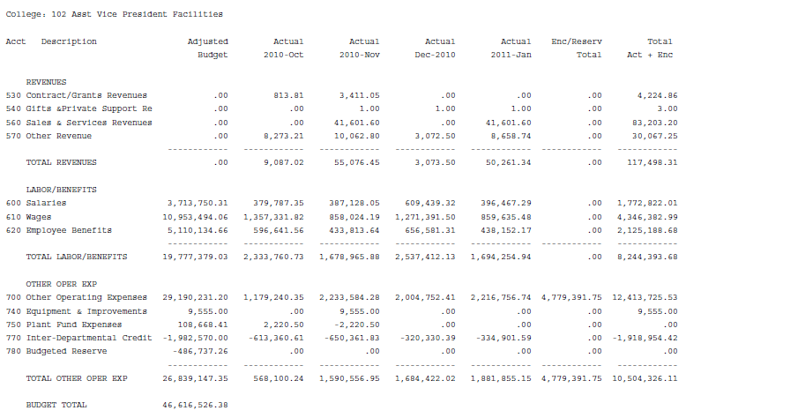
FZOREMC – Revenue/Expense Month By Month by College (xxx org hierarchy)

Slide 19
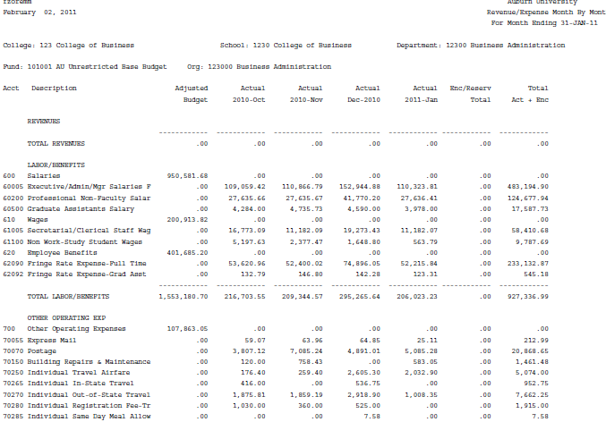
FZOREMM - Revenue/Expense Month by Month (Dept, School, or College org level)

Slide 20
Unrestricted Reports by Fund
Per your request reports have been added that will show
10x001
10x002
10x003
10x004
Extract by college, executive or divisional level

Slide 21
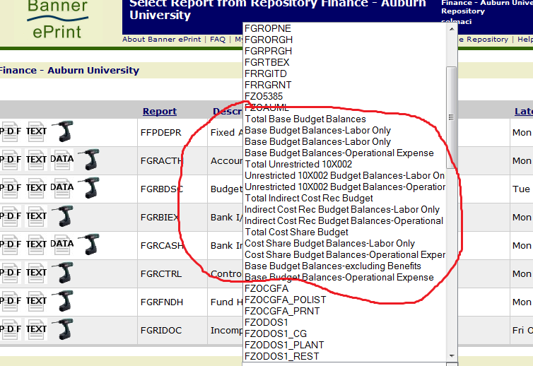
Various Looks at Unrestricted Funds
View details on Base, Cost Share, ICRE or other Unrestricted. College or Divisional view

Slide 22
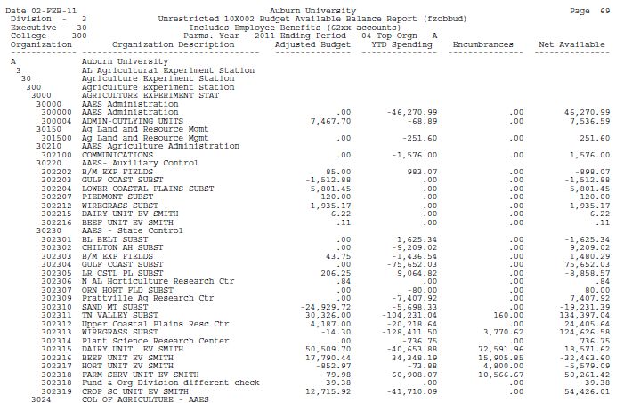
Example: Unrestricted Other for Division 3

Slide 23
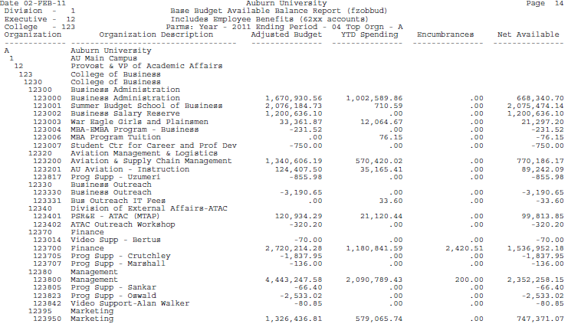
Example: Base Balance College of Business

Slide 24
Controller’s Office

Slide 25
Activity Codes
What is an Activity Code
FOAPAL
Purpose of Activity Codes
New Committee Formed
Naming Scheme
Forms to Update
New Reports Created/Modified
Budgeting
no specific budgeting for activity codes

Slide 26
Fringe Benefit Rate
Currently working on FY 2012 rate
Based on FY 2010 actual costs and anticipated increases and decreases in FY 2012
Supplemental pay is subject to Fringe Benefit Rate

Slide 27
Electronic Effort Certification

Slide 28
Effort Certification
Effort Certification is required with receipt of Federal funding.
If any portion of salary/pay comes from a sponsored project, the entire salary/pay must be certified.
Federal Government wants assurance that if they pay an individual, the individual worked on the sponsored project.

Slide 29
Current Effort Certification
Printed reports are hand delivered for signatures to/from departments, Principal Investigators, etc
Reports are sent to Contracts & Grants and scanned into digital storage
Not 100% compliant
Paper and labor intensive
Unsure of document status
Manual collection and monitoring

Slide 30
Highlights of e~Certs
Increase Efficiency
Increase Compliance (in an increasing audit environment)
Allows Simultaneous Certification
Paper Reduction-Printing will be rare
System developed internally (external costs ~ $1 Million)
Automatic email notification
Implementation to begin with quarter ending 3/31/11
New Online system will be accessed through Banner Self Service
Automatic digital Storage

Slide 31
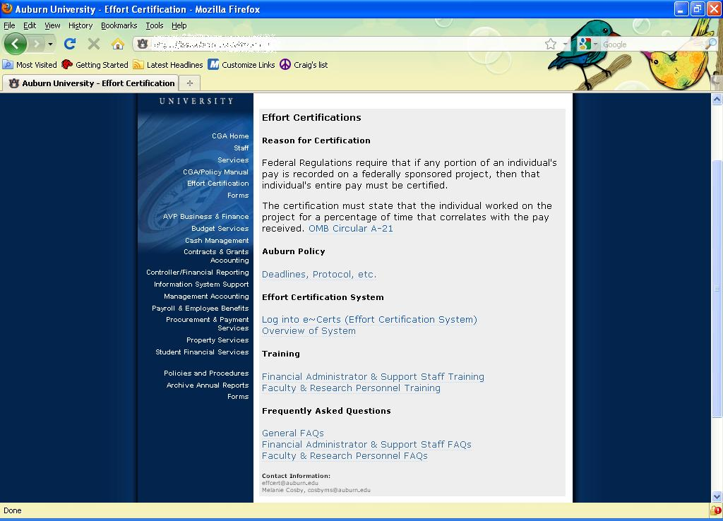
Effort Reporting Webpage

Slide 32
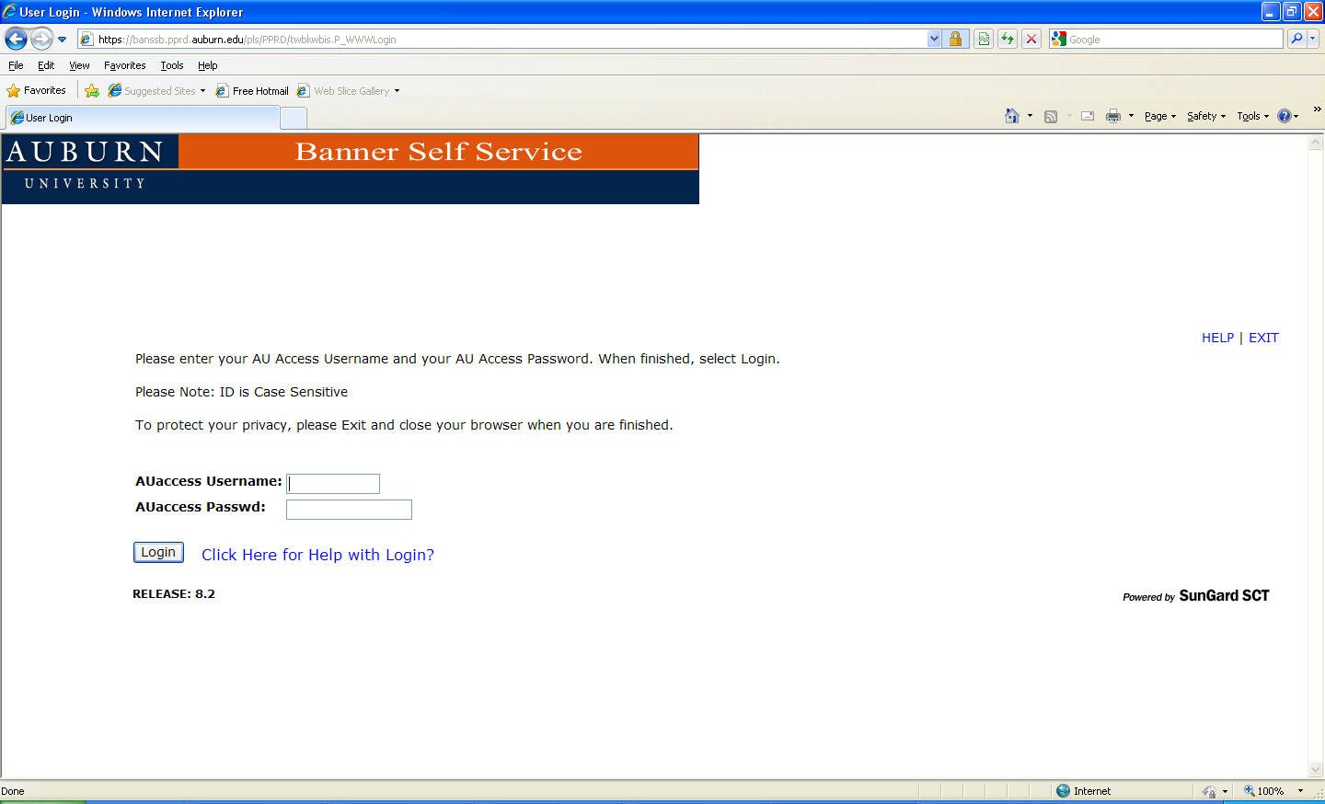
Log into the Training System
BANNER ID # (902xxxxxx)
Last 6 digits of your SSN

Slide 33
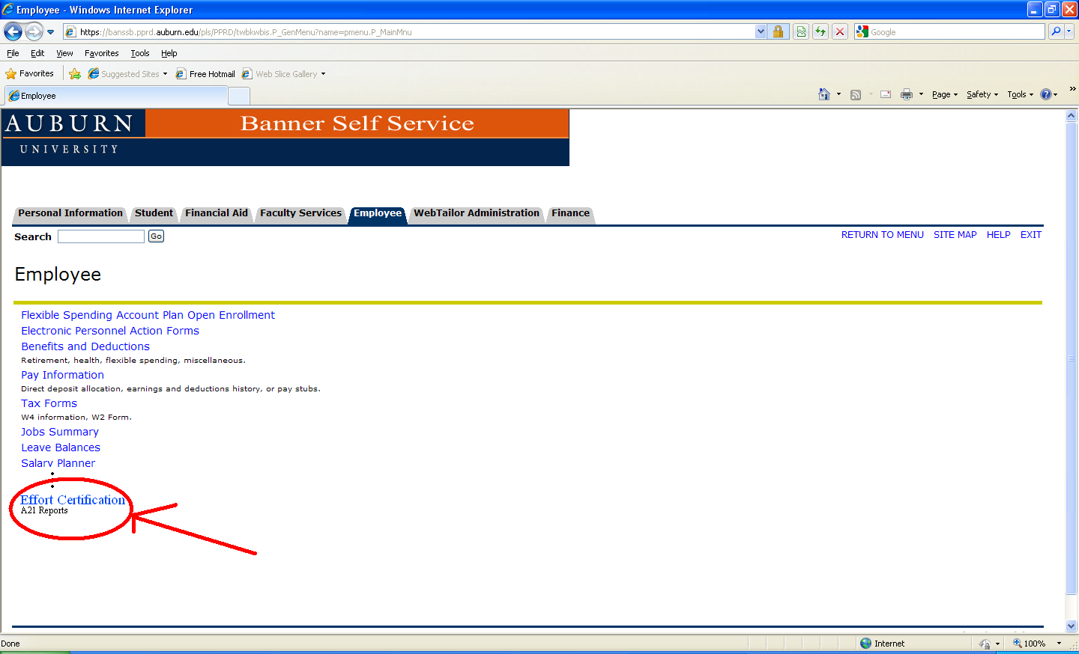
Banner Self Service

Slide 34
Email Notification System
Automatic notifications to be emailed:
1. 5th day after quarter end
-PAR Administrators; Dept. Financial Administrators
2. 10th day after quarter end
-PI, Co-PI, Faculty, Research Personnel, Dept Head, ADR, Dean’s Contact
3. 30th day after quarter end
-PI, Co-PI, Faculty, Research Personnel, PAR Administrator
4. 35th day after quarter end
-PI, Co-PI, Faculty, Research Personnel, PAR Administrator, Dept Financial Administrator, Dept Head, ADR, Dean’s Contact, Dean
5. 40th day after quarter end
-End of business day: System is closed

Slide 35
Consequence of Not Certifying an Effort Report within 40 Days of Quarter End
Expense related to the effort recorded on a sponsored or cost share FOP will be transferred to an unrestricted departmental funding source.

Slide 36
Questions?
Contact information:
Melanie Cosby cosbyms@auburn.edu 844-6183
David Hennessey hennedw@auburn.edu 844-6184
Robert Campbell campbr1@auburn.edu 844-3612
Effort Certification effcert@auburn.edu 844-4847

Slide 37
Payroll

Slide 38
Kronos Workforce Timekeeper
Automated Timekeeping

Slide 39
Kronos - What is it?
Automated Timekeeping System
Already used by Facilities, Library and Clinical Sciences on main campus; Facilities, Police and Library at AUM
Currently being rolled out to ITS at AUM

Slide 40
Why implement Kronos?
The overriding purpose for automating timekeeping is to pay employees accurately for the work they perform.
Will be a more “green” process – eliminating paper timesheets and the need for storage
Reduce the manual work done today to capture and data enter time worked.

Slide 41
Who will be affected by Kronos?
Non-exempt employees
  “Clock-in” at either terminals or their PC
  Request leave (vacation/sick time) using same systems
Supervisors/Managers
  Edit time as needed (training, missed punches)
  Approve time worked
  Approve leave requests
  Request their own leave time within the system
Timekeepers
  Review time collected for pay period to ensure processes are completed

Slide 42
What are the steps for implementation of Kronos?
Communicate about Kronos
Data gathering to prepare for configuration
System build
Testing
Installation of clocks around campus
Training and communications
Begin phased rollout this summer, with completion by year end
Notes:
Communicate – what we are doing now.
Data gathering – will involve many of you in the process to determine the needs of your schools/colleges/departments
System build – based on the processes used University wide today
Testing – may involve some of you or the timekeepers within your areas
Installation – have about 30 clocks installed today, with 115 more strategically placed throughout campus
Training and communications – for those who will use the system to capture time/request leave and those who will be approvers
Roll-out – will accommodate departmental needs (ex., athletics can’t conflict with football)

Slide 43
Who do I contact for more information?
Brittany Johnson Saliba Project Manager
E-mail: kronos@auburn.edu; johns@auburn.edu
Webpage: Coming soon

Slide 44
Procurement & Payment Services

Slide 45
PPS Updates
Additions to Purchasing Card Allowable Transactions
E Vendor Voucher System

Slide 46
Open Encumbrances
Felicia Roberson
Information Systems Support
Roberfe@auburn.edu
334-844-3660

Slide 47
Reviewing Open Encumbrances
Req’s – PO’s – General Enc.
Problem:
Many Departments have Encumbrances open from previous years that are no longer in use. This is reducing the available budget. The encumbrance amount is not rolled over into the budget reserve account.
Solution:
Provide information on how to identify the open encumbrances and procedures to request closure. This will increase available budget and reduce year end roll processing.

Slide 48
Reports and Forms
SSB –Encumbrance Query (Known issue with drill down )
Admin – FGIOENC Form
FGROPNE Report
FGRBDSC Report (Budget Reservation column)
Eprint – FGROPNE (Known issue with page layout)
FGRBDSC (Budget Reservation column)

