Slide 1

Auburn University
Student Financial Services

Slide 2

Where and How to Access eBill
  Add Direct Deposit Information
  Complete Release of Information Statement
  Complete PACT Notification
Add Authorized User
Make a Payment
eBill Mobile

Slide 3

Where and How to Access eBill
Click AU Access

Slide 4
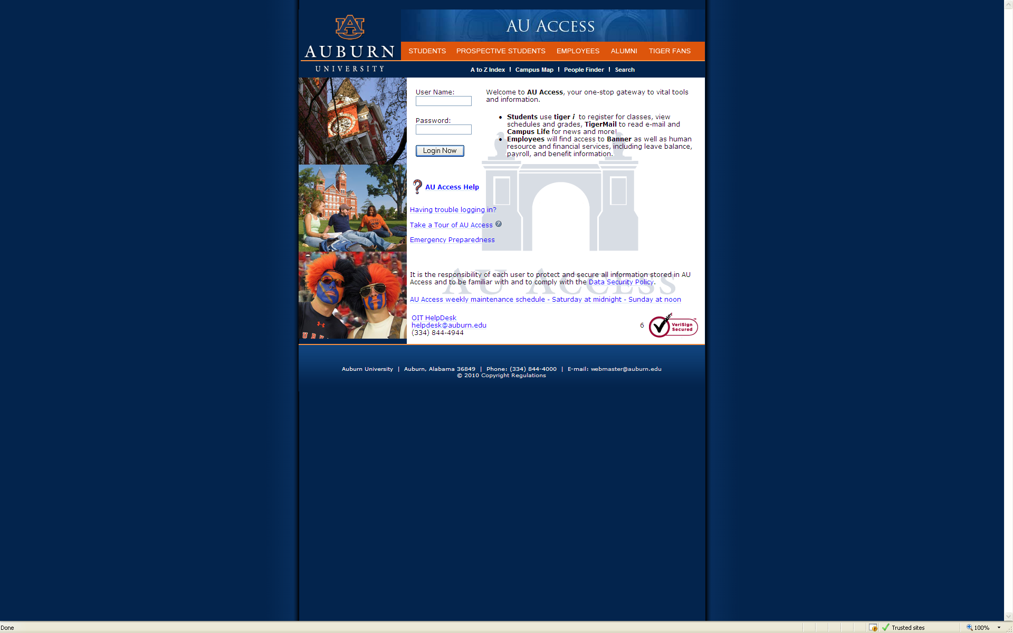
Where and How to Access eBill
Fill in User Name and Password

Slide 5
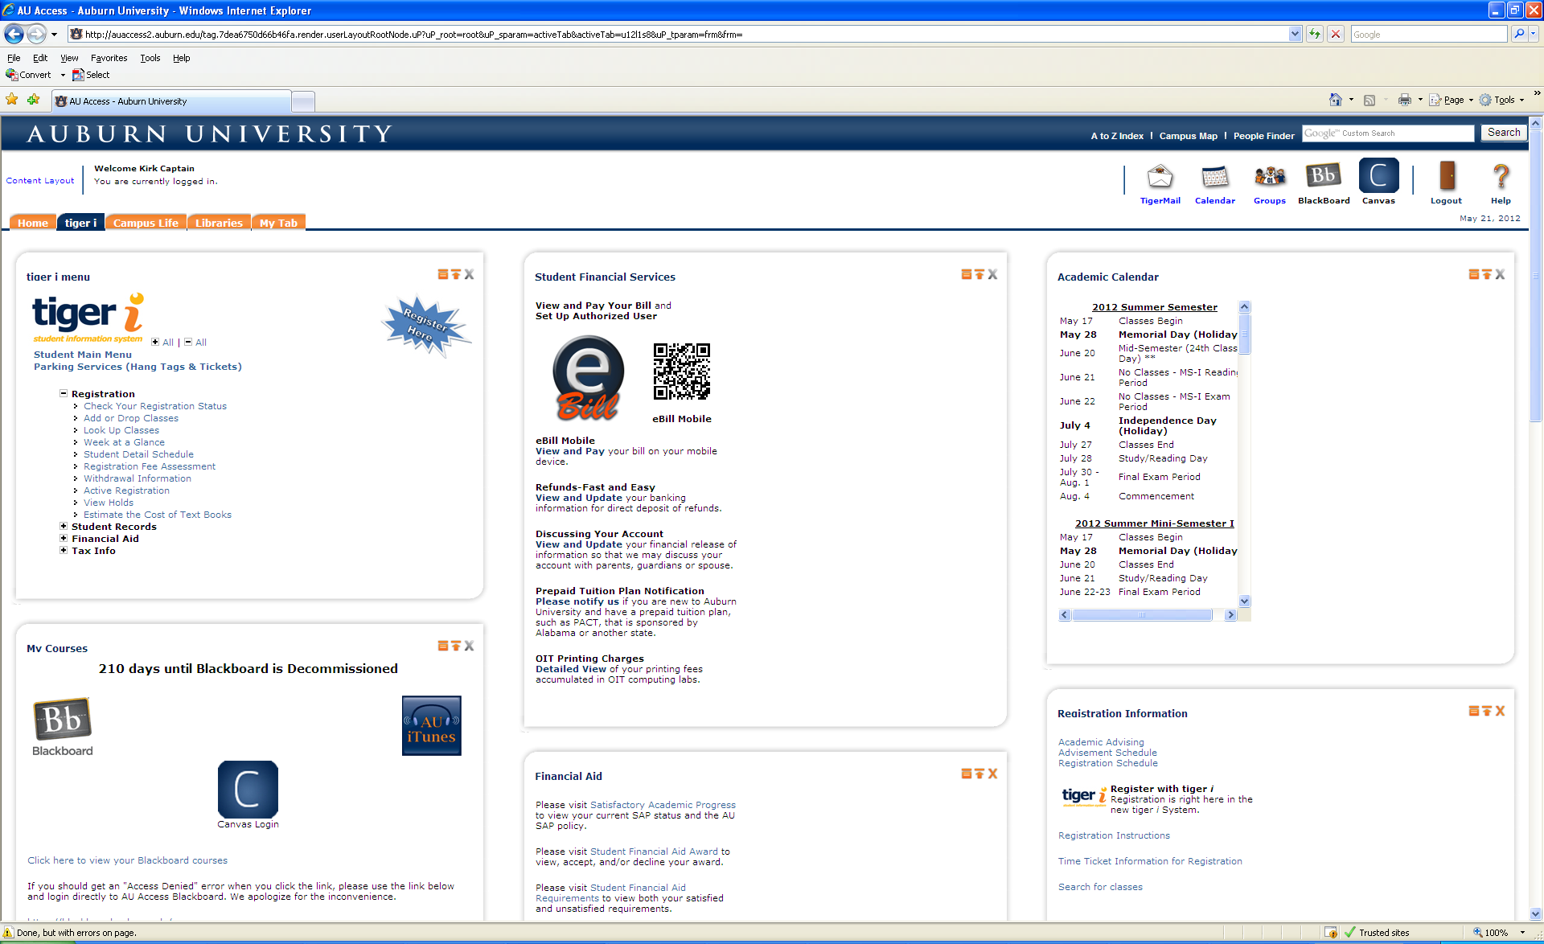
Where and How to Access eBill
Click eBill

Slide 6
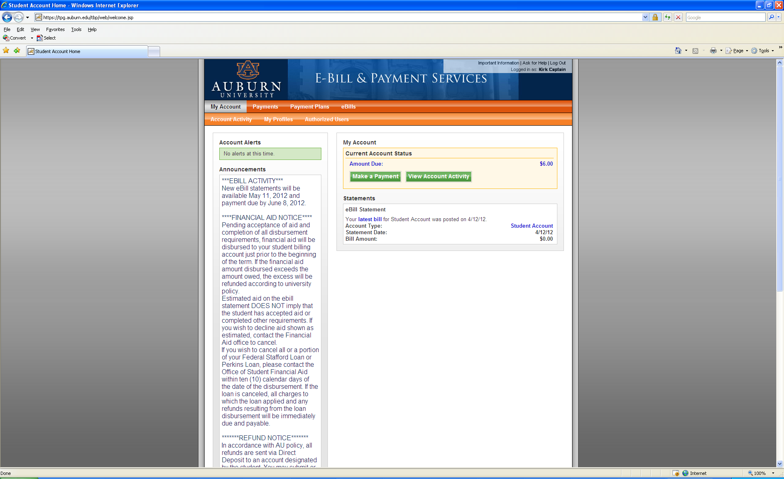
Where and How to Access eBill
Click eBills
Click eBills

Slide 7
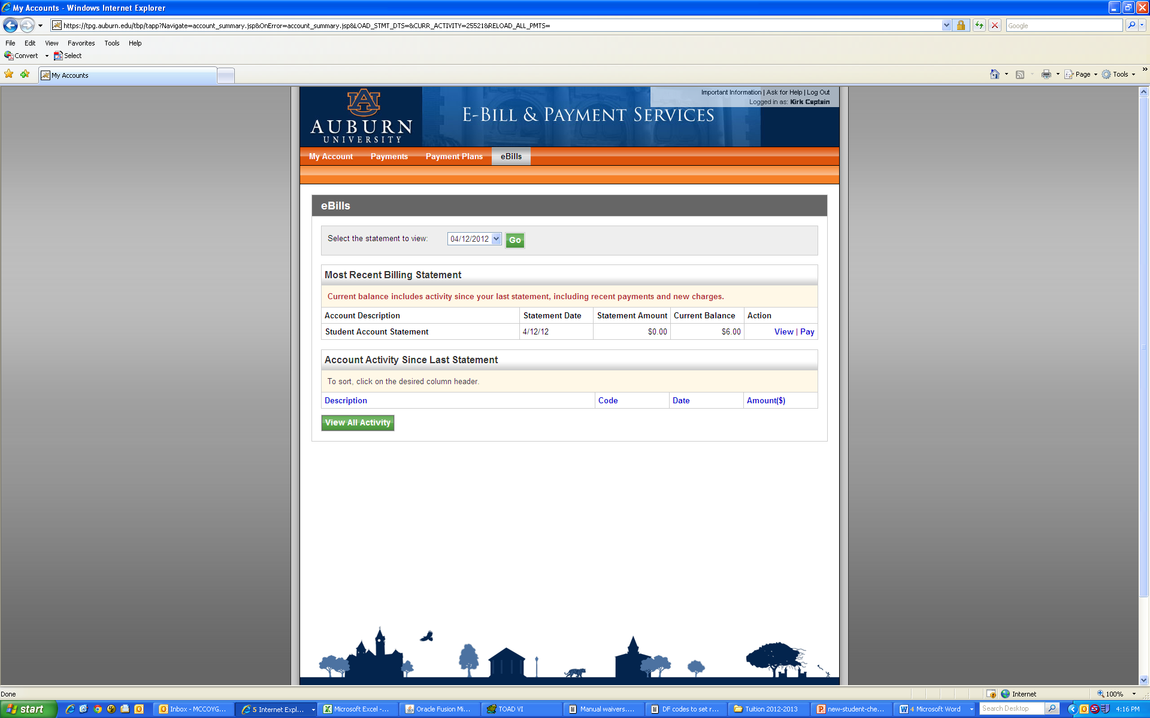
Where and How to Access eBill
Click eBills
Click Go

Slide 8
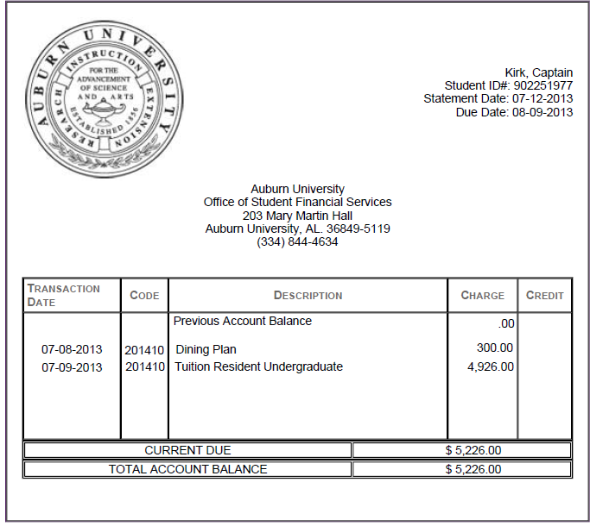
eBill Example - Resident

Slide 9
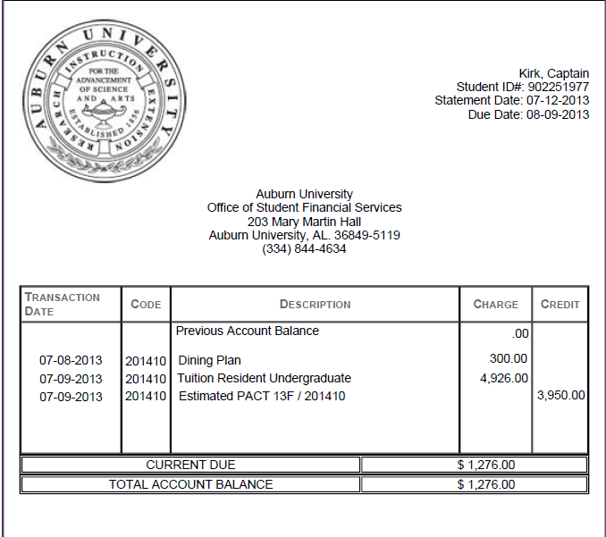
eBill Example - Resident with PACT

Slide 10
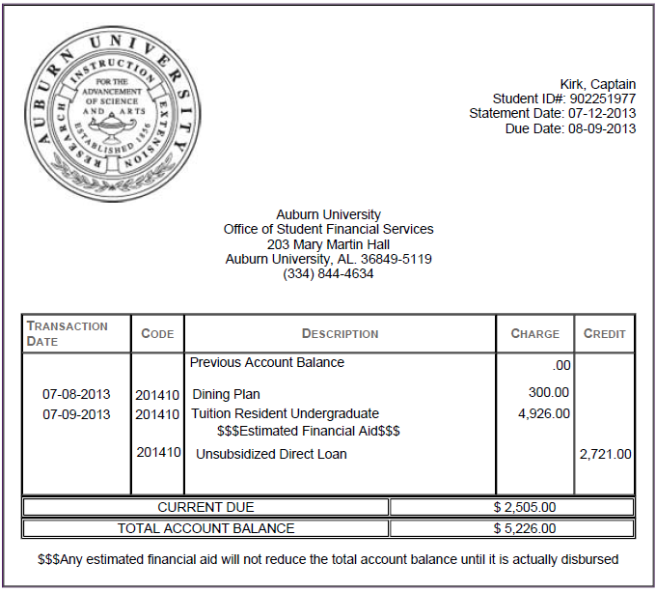
eBill Example - with Financial Aid

Slide 11
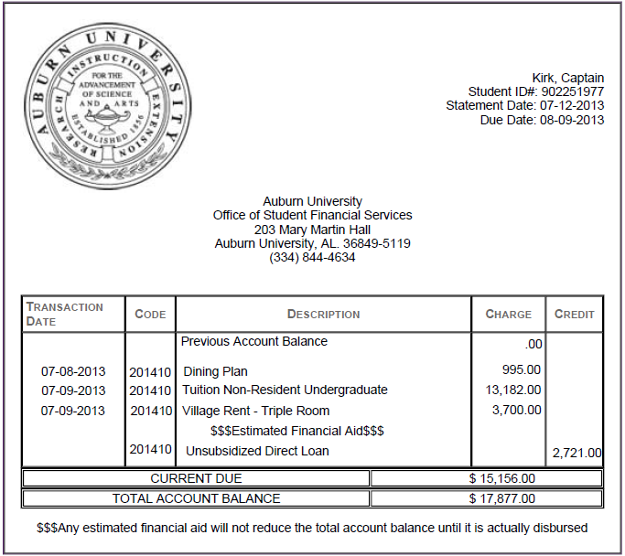
eBill Example – Non Resident

Slide 12
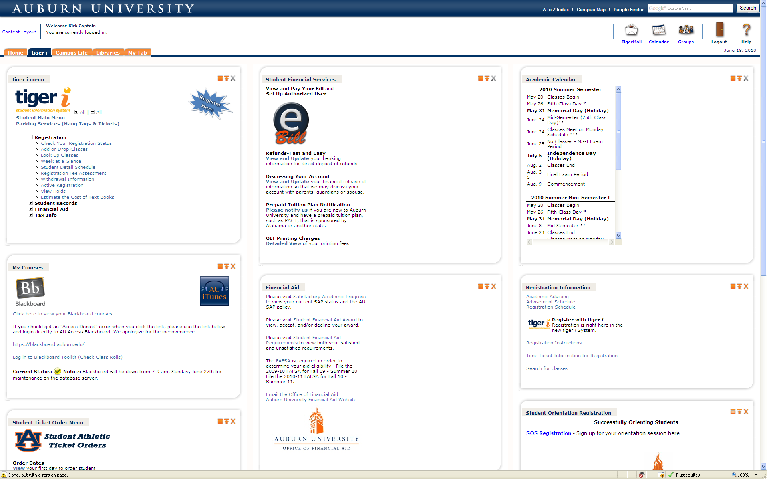
Add Direct Deposit Information
Click to Add Direct Deposit Information

Slide 13
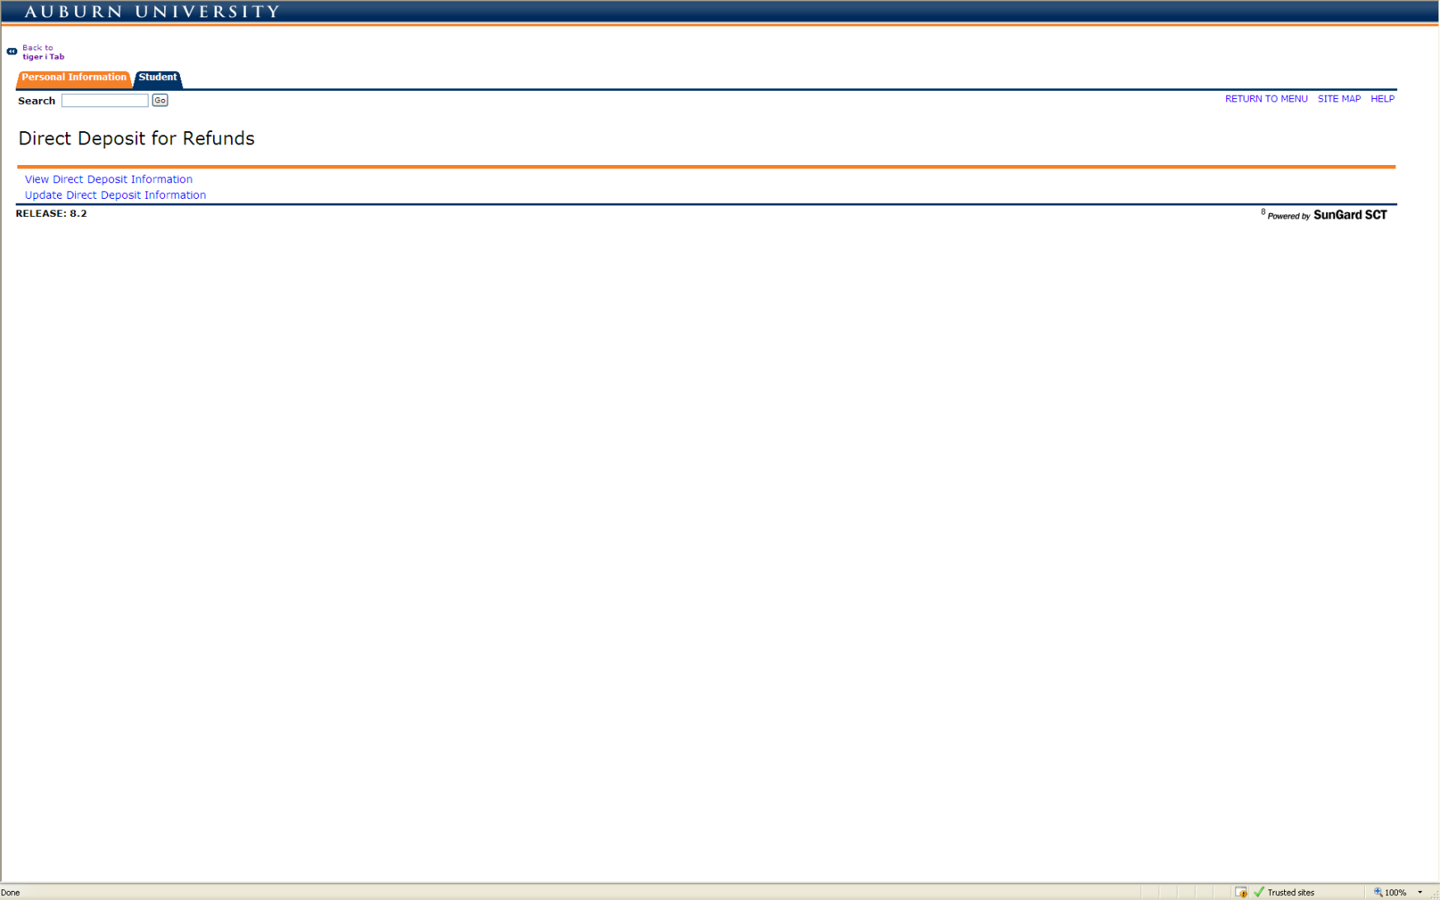
Add Direct Deposit Information
Click Update Direct Deposit Information

Slide 14
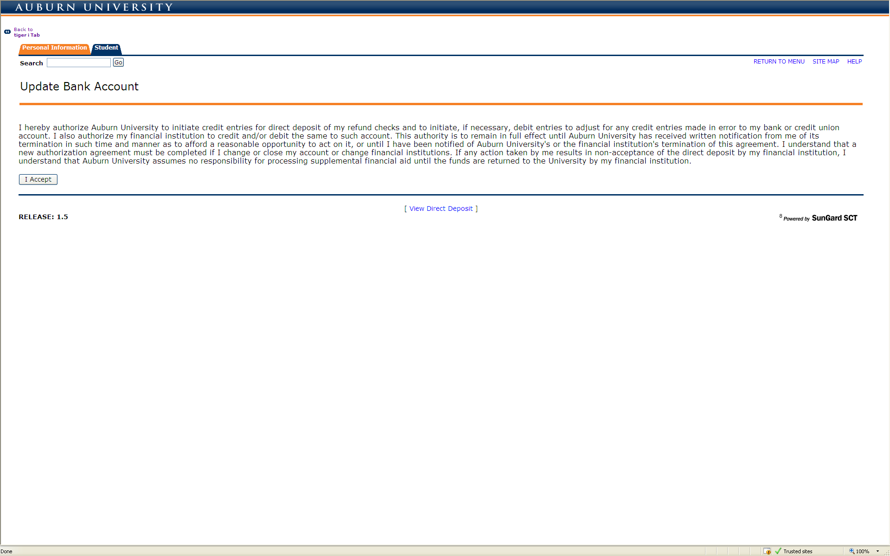
Add Direct Deposit Information
Read and Click I Accept

Slide 15
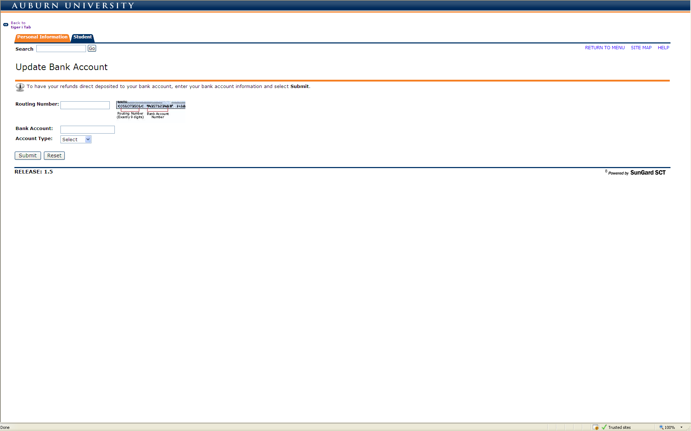
Add Direct Deposit Information
Enter Account Information

Slide 16
Complete Release of Information Statement
Click to Complete Release of Information Statement

Slide 17
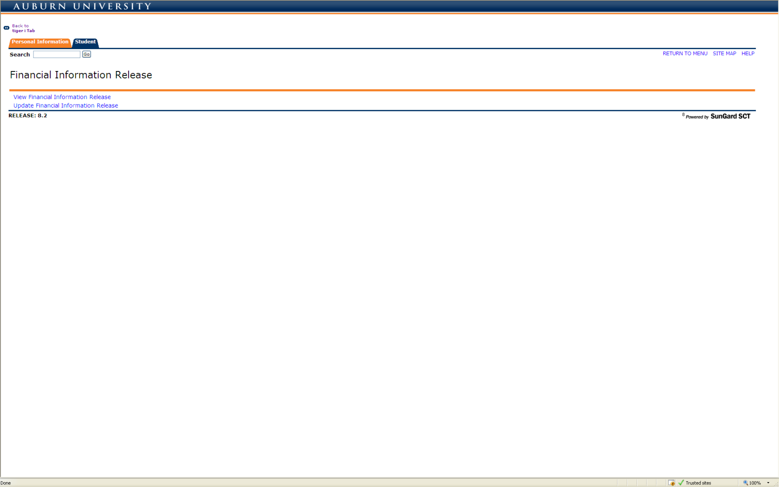
Complete Release of Information Statement
Click Update Financial Information Release

Slide 18
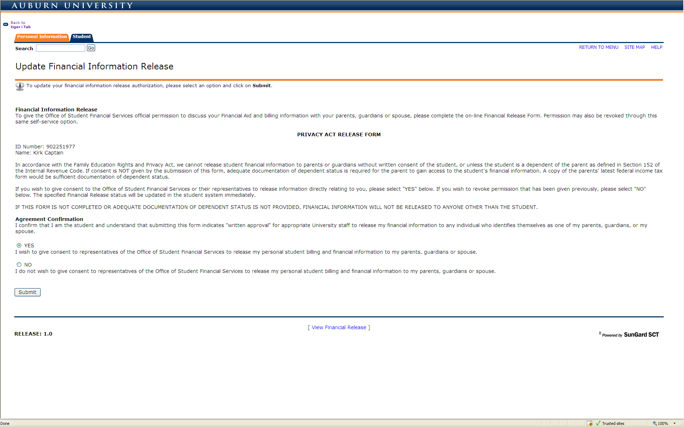
Complete Release of Information Statement
Click Yes and Submit

Slide 19
Complete PACT Notification
Click to Complete PACT Notification

Slide 20
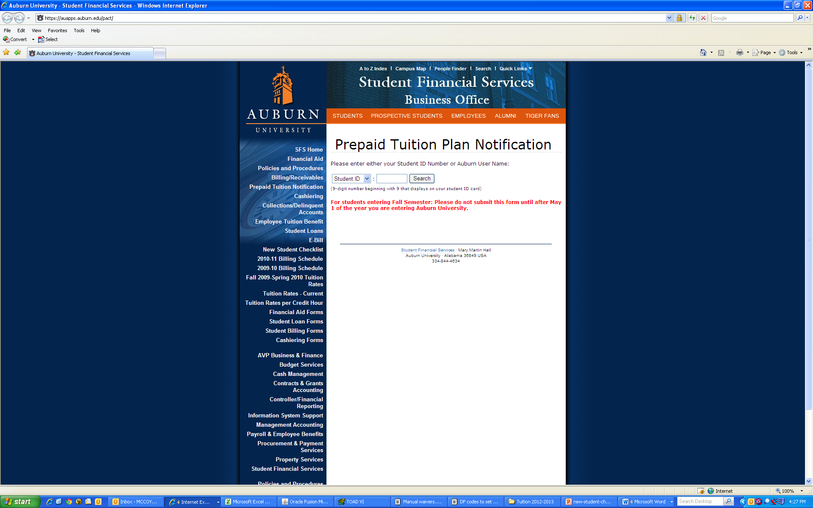

Complete PACT Notification

Slide 21
PACT Rates
Credit Hours | 2013-2014 Tuition/Fees | PACT Rates | Student Balance
1 | 1,142.00 | 738.00 | 404.00
2 | 1,486.00 | 1,030.00 | 456.00
3 | 1,830.00 | 1,322.00 | 508.00
4 | 2,174.00 | 1,614.00 | 560.00
5 | 2,518.00 | 1,906.00 | 612.00
6 | 2,862.00 | 2,198.00 | 664.00
7 | 3,206.00 | 2,490.00 | 716.00
8 | 3,550.00 | 2,782.00 | 768.00
9 | 3,894.00 | 3,074.00 | 820.00
10 | 4,238.00 | 3,366.00 | 872.00
11 | 4,582.00 | 3,658.00 | 924.00
12 or more | 4,926.00 | 3,950.00 | 976.00

Slide 22
Add Authorized User
Click eBill

Slide 23
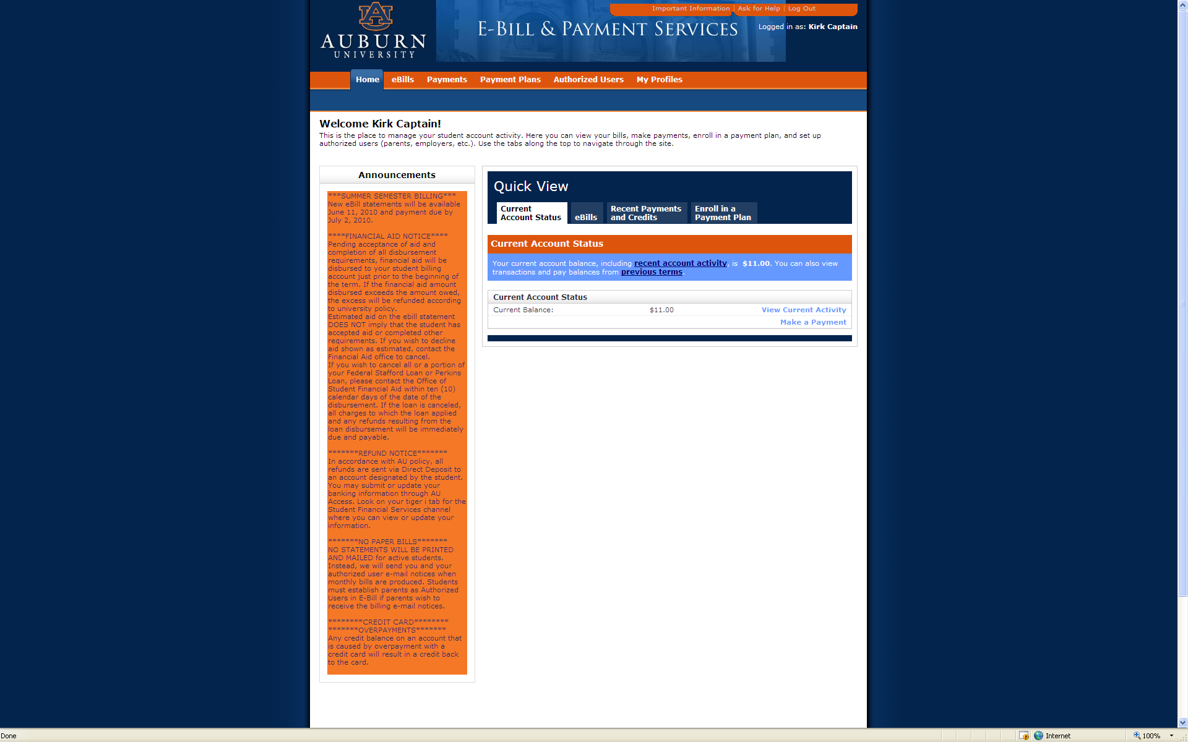
Add Authorized User
Click Authorized Users

Slide 24
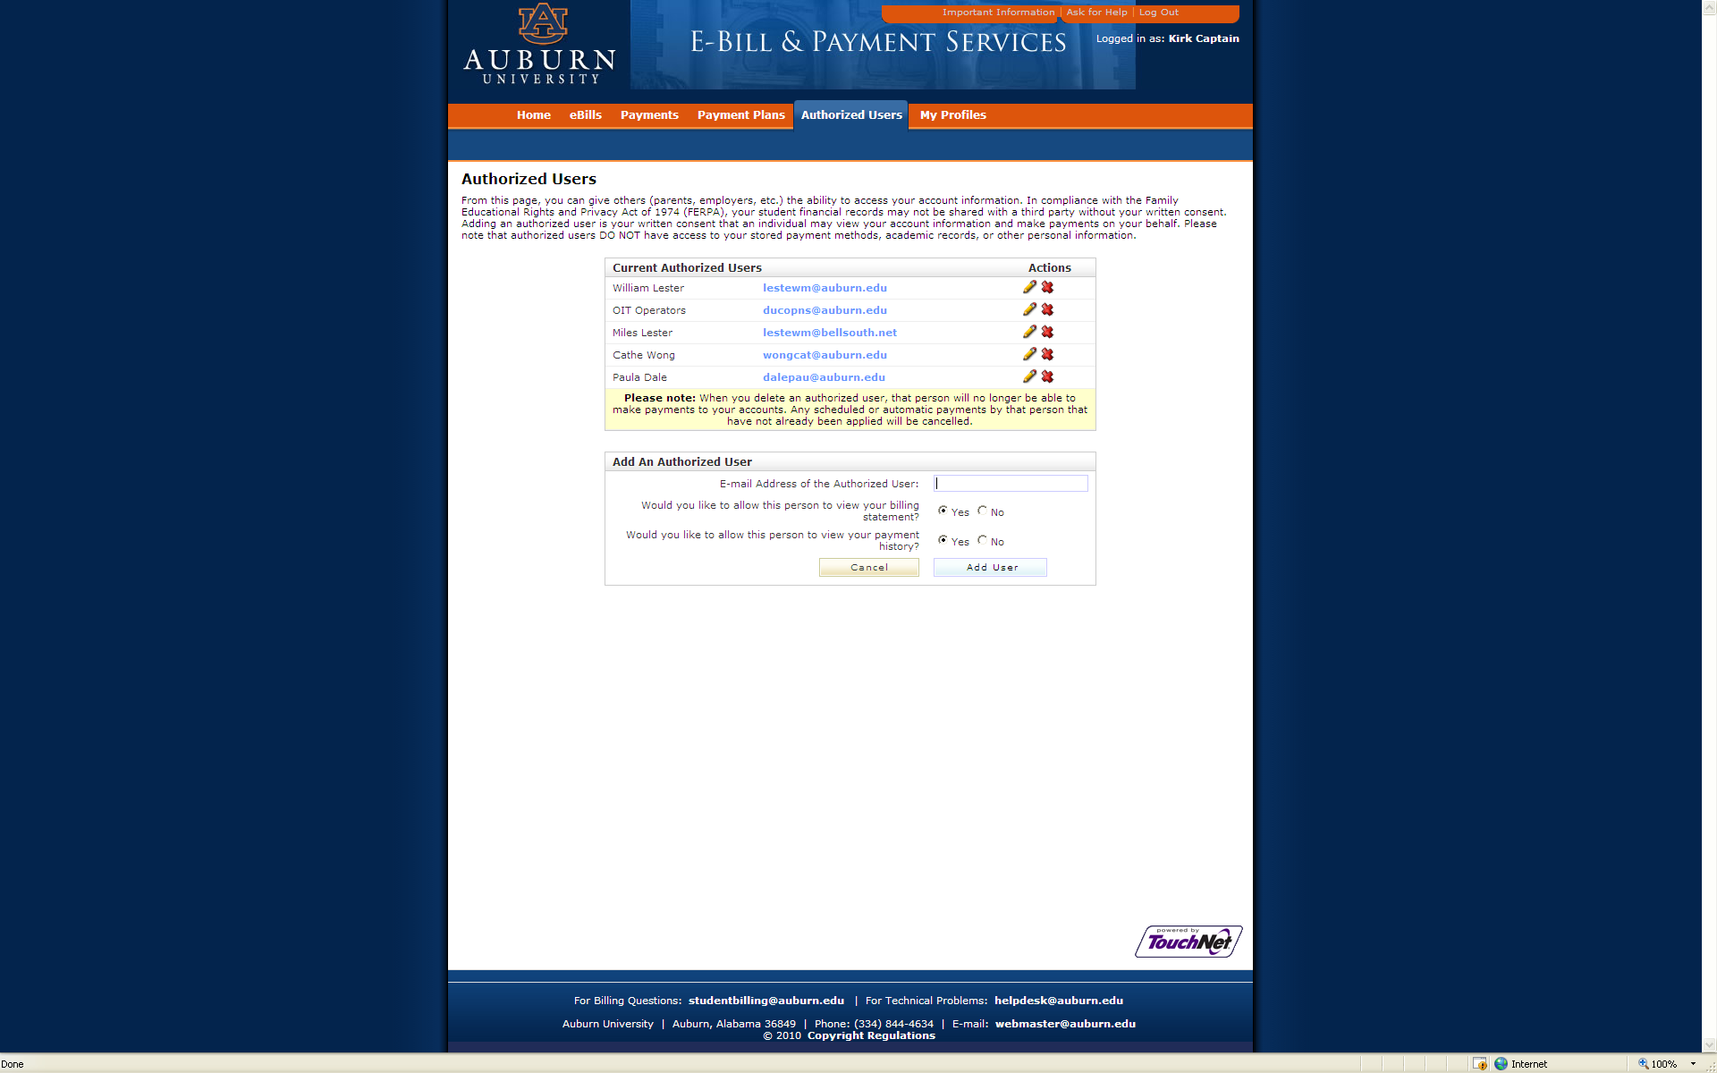
Add Authorized User
Fill in E-mail Address

Slide 25
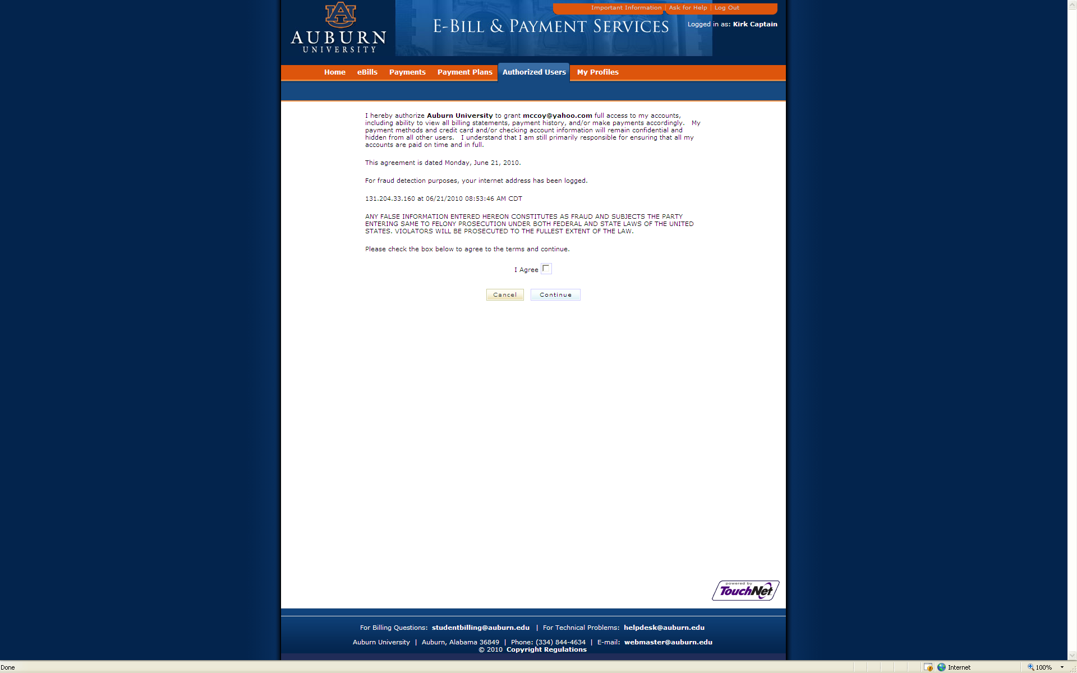
Add Authorized User
Click I Agree and Continue

Slide 26
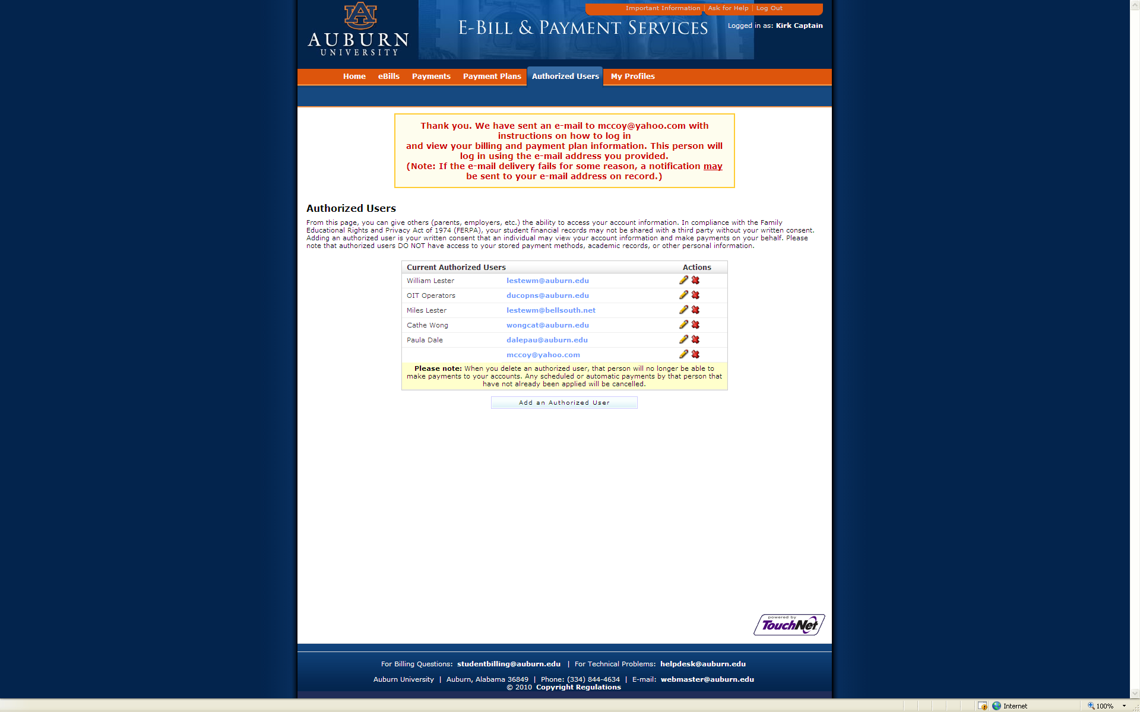
Add Authorized User
Confirmation That Authorized User Will Be Sent an E-mail

Slide 27
Add Authorized User
You Have Been Given Access
This is an automated message to inform you that the student listed below has granted you access to his or her online billing information. You now have the ability to make payments on behalf of this student, schedule or automate future payments, and more. You will log in with the username shown below. For security, the initial password for this account is sent in a separate message.
======= ACCESS INFORMATION =======
Student Name --- [ Kirk Captain ]
Username --- [ yyyyyyy@zzzz.com ]
==================================
Sincerely,
Auburn University Billing Department
For questions, e-mail to: studentbilling@auburn.edu

Slide 28
Add Authorized User
Your access information
This is an automated message to inform you that the student listed below has granted you access to his or her online billing information. You now have the ability to make payments on behalf of this student, schedule or automate future payments, and more. For your first login, you will use the password shown below. For security, your username for this account is sent in a separate message.
======= ACCESS INFORMATION =======
Student Name --- [ Kirk Captain ]
Password --- [ lzmjtzfamz ]
==================================
Sincerely,
Auburn University Billing Department
For questions, e-mail to: ebill@auburn.edu

Slide 29
Authorized User Access
Click Parents

Slide 30
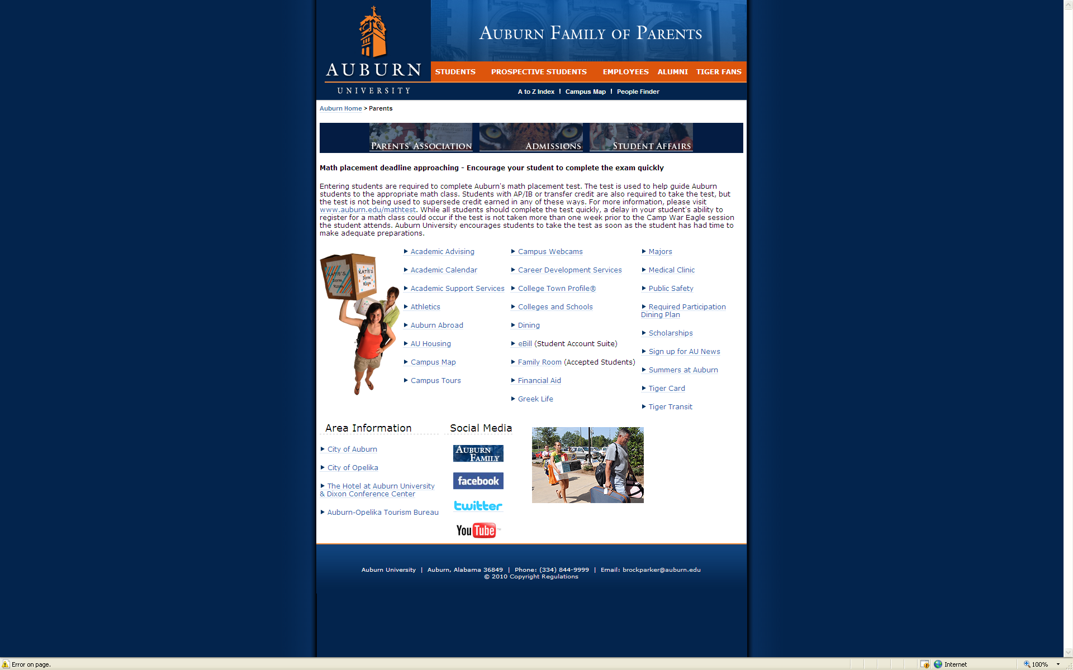
Authorized User Access
Click eBill

Slide 31
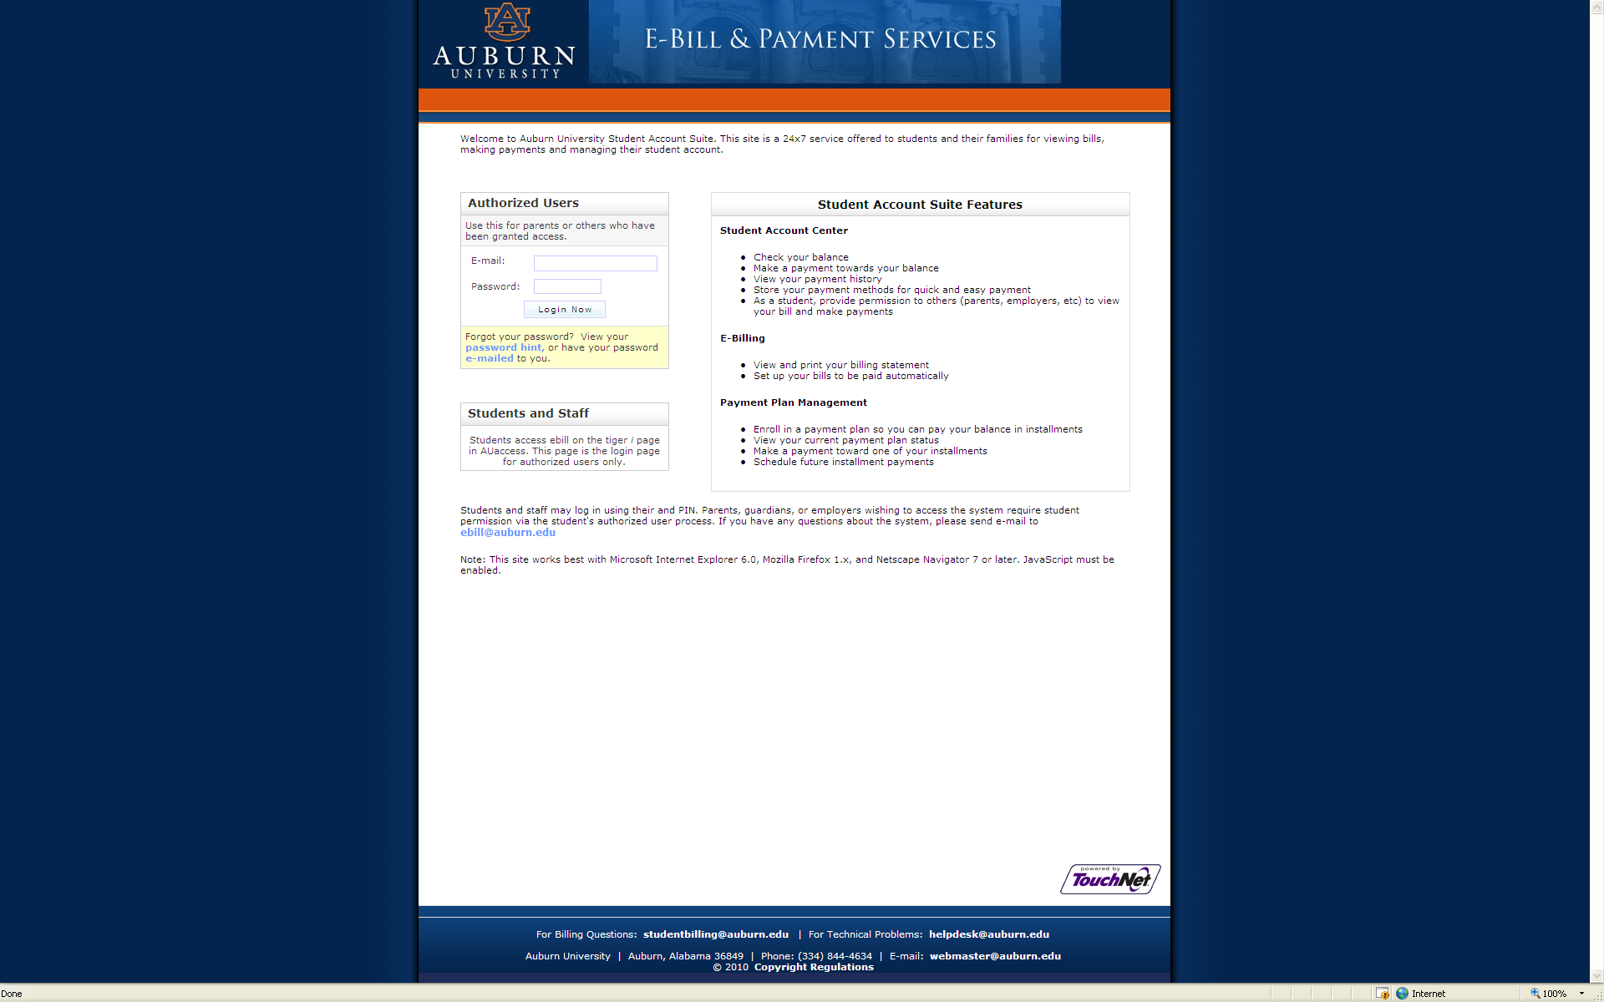
Authorized User Access
Fill in E-mail Address and Password

Slide 32
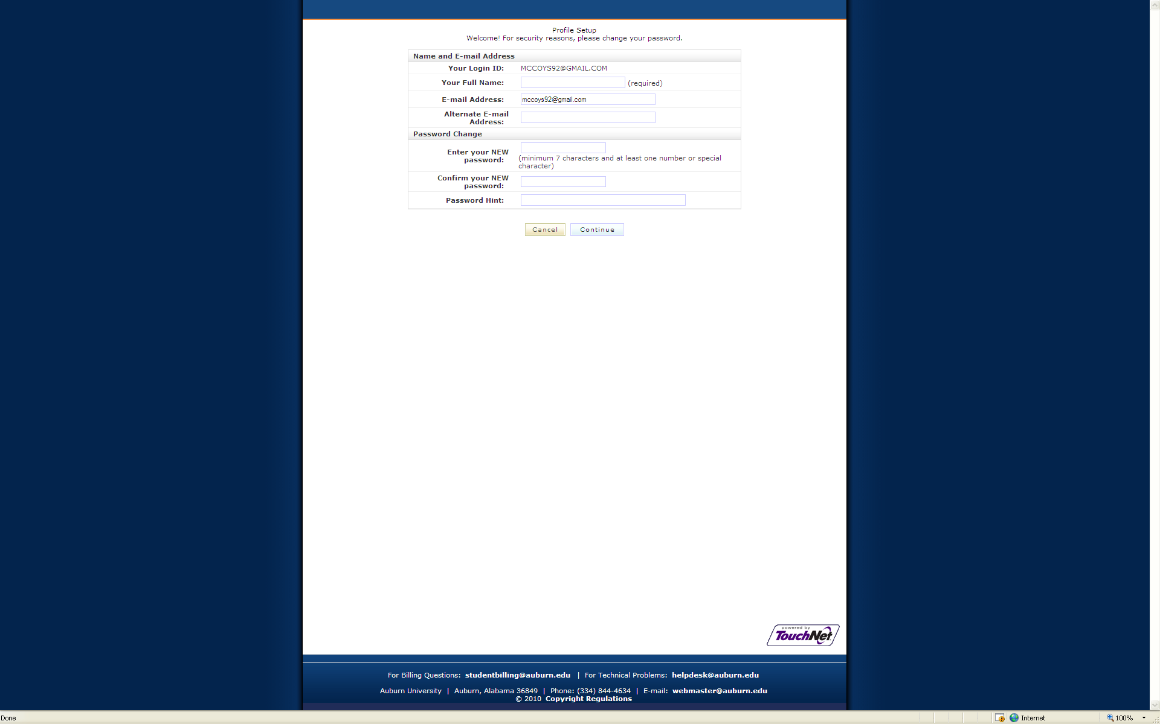
Authorized User Access
Fill in Your Full Name and Enter NEW password

Slide 33
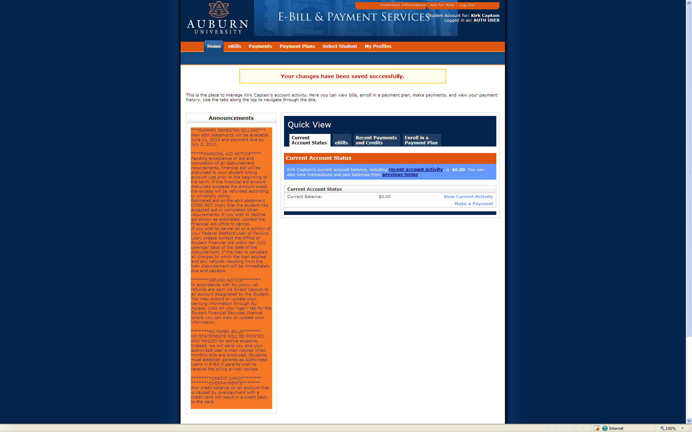
Authorized User Access
Now in eBill as Authorized User

Slide 34
Make a Payment
Click Make a Payment

Slide 35
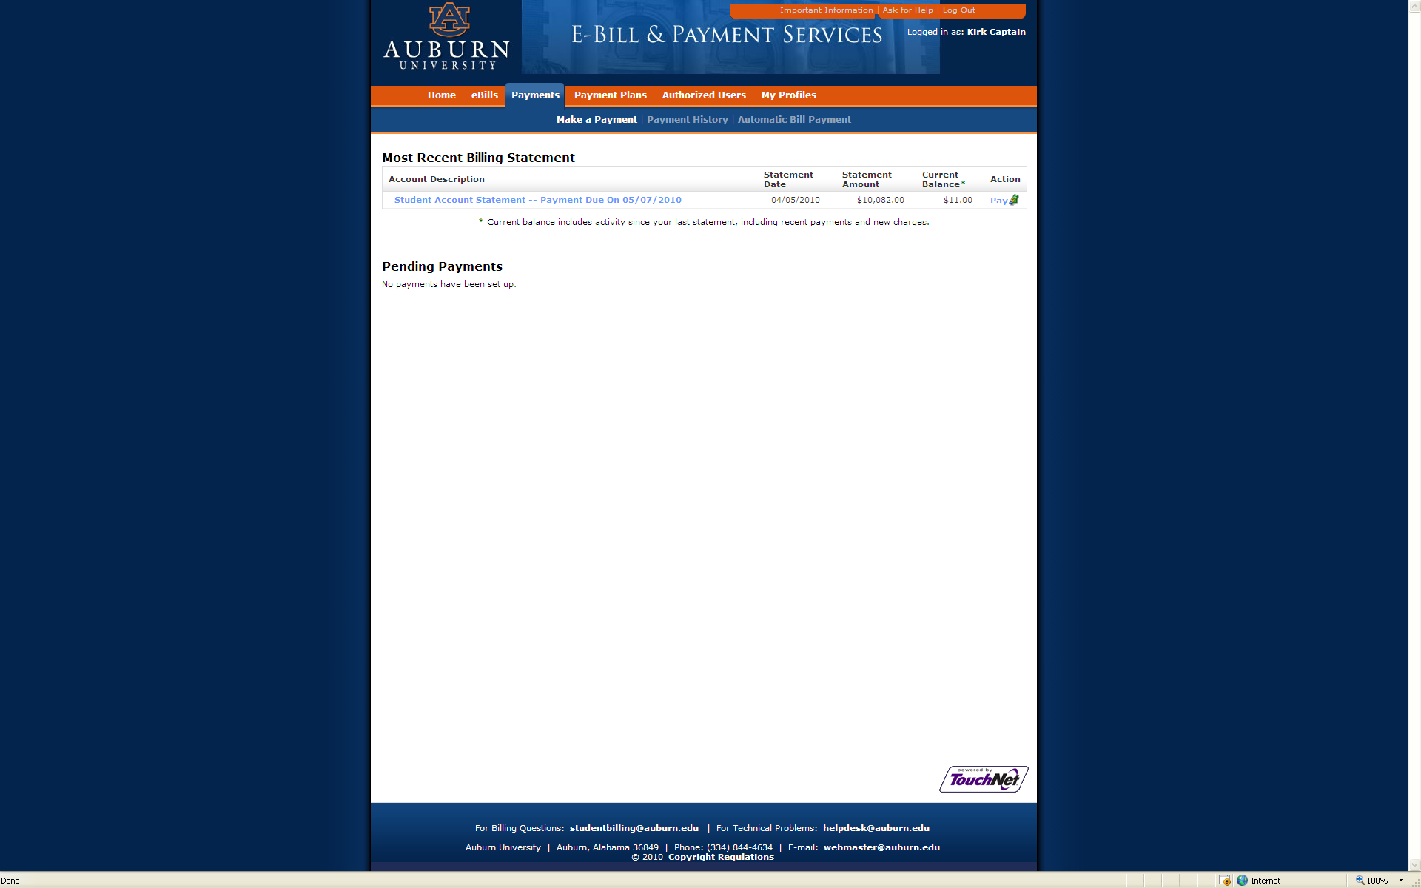
Make a Payment
Click Pay

Slide 36
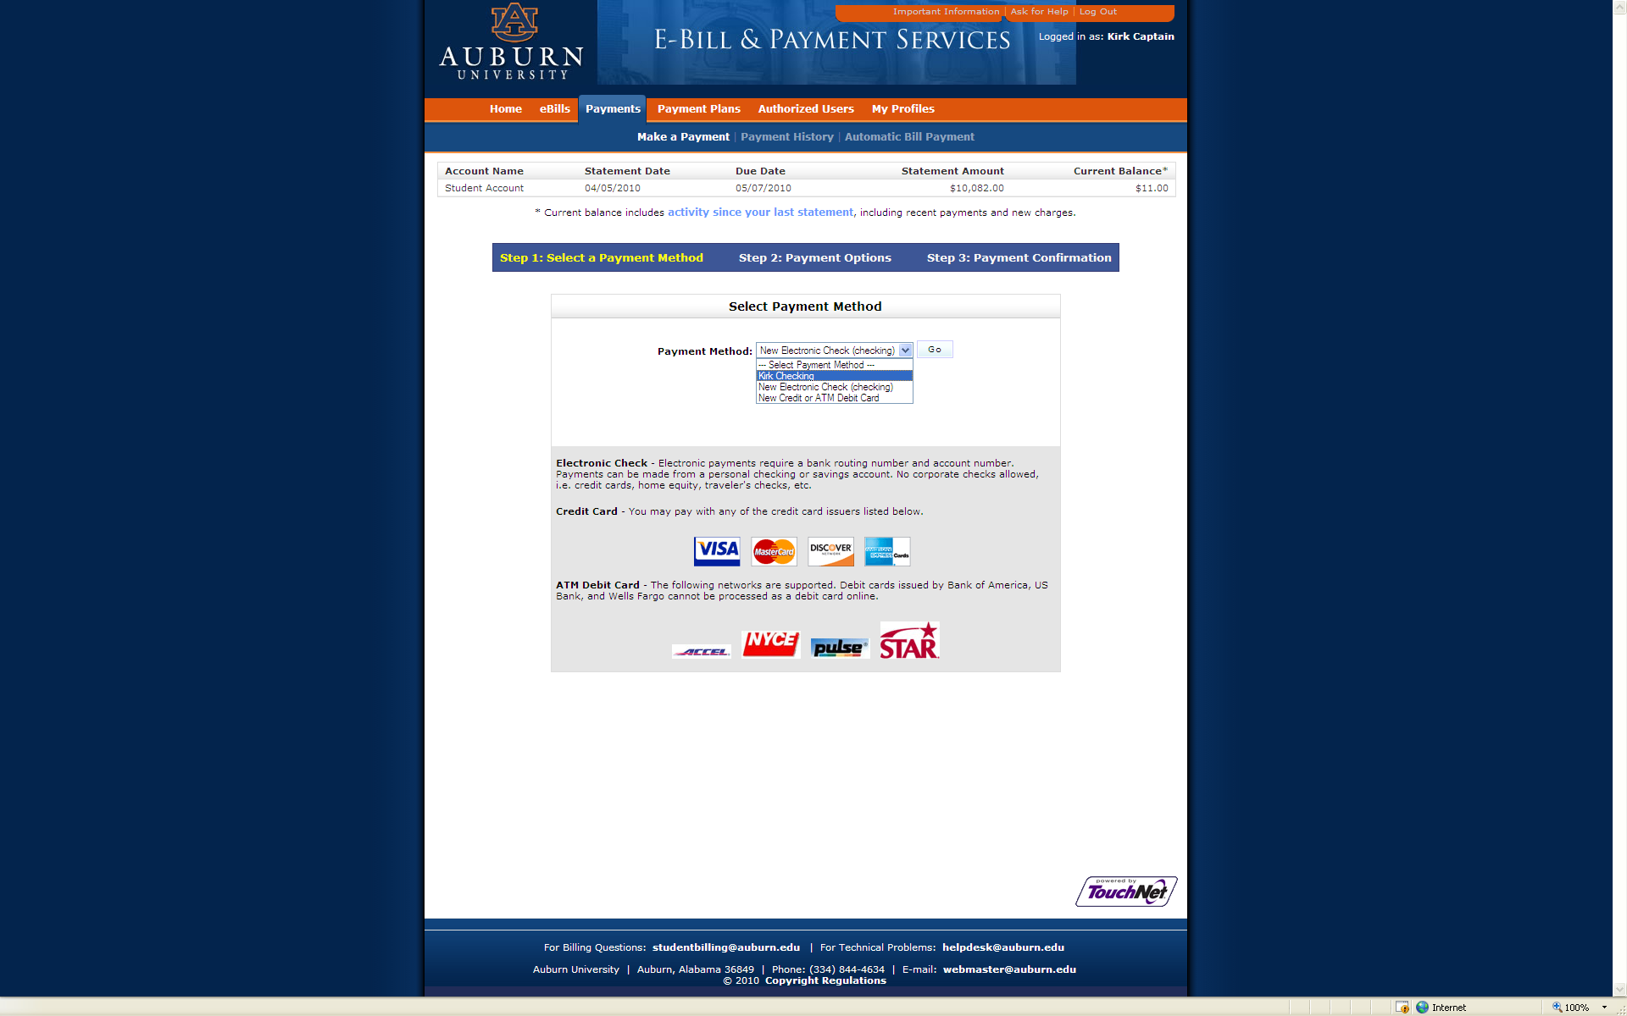
Make a Payment
Select Method from Menu

Slide 37
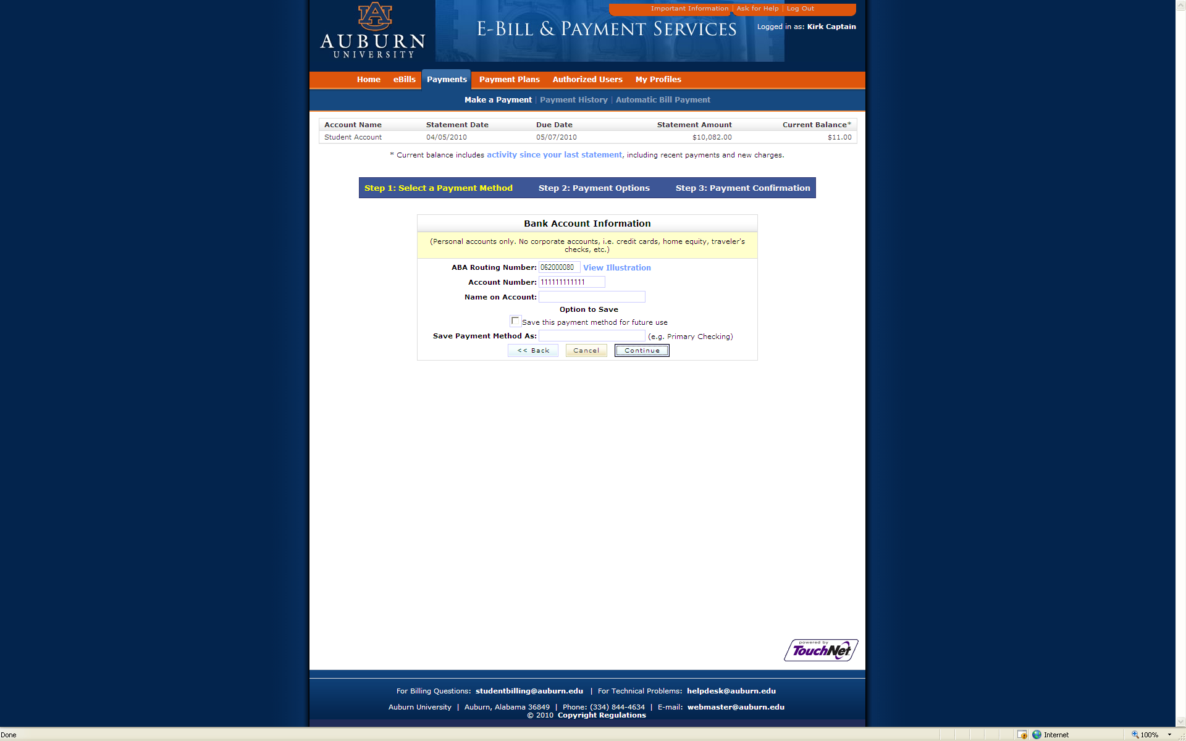
Make a Payment
Complete Routing and Account Information

Slide 38
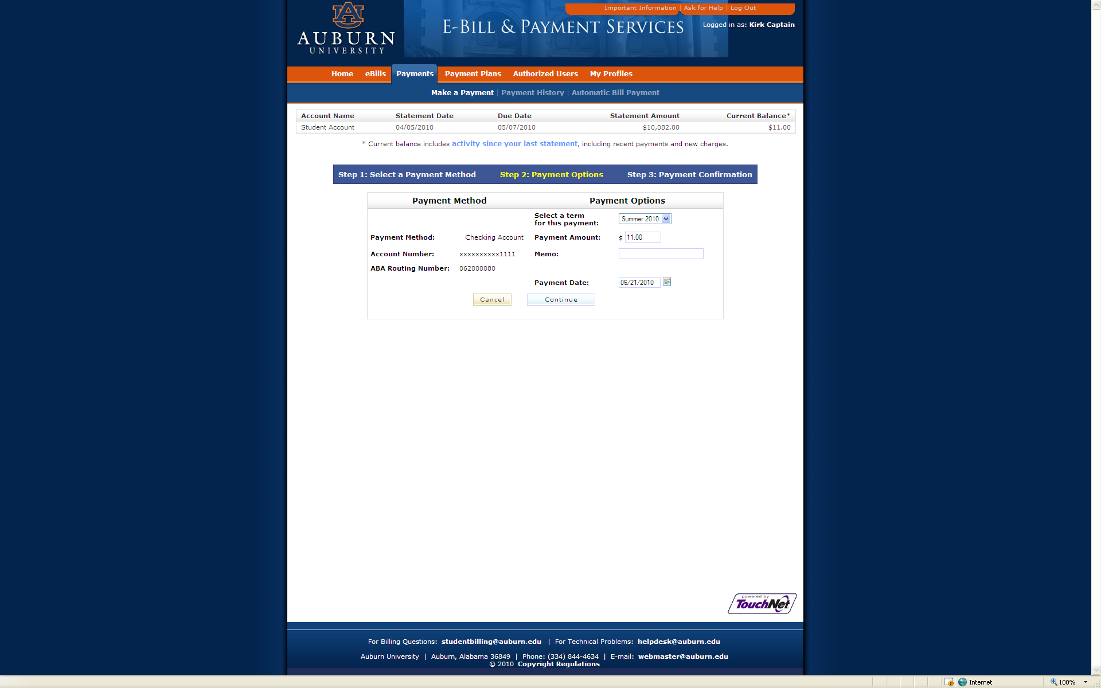
Make a Payment
Fill in Amount

Slide 39
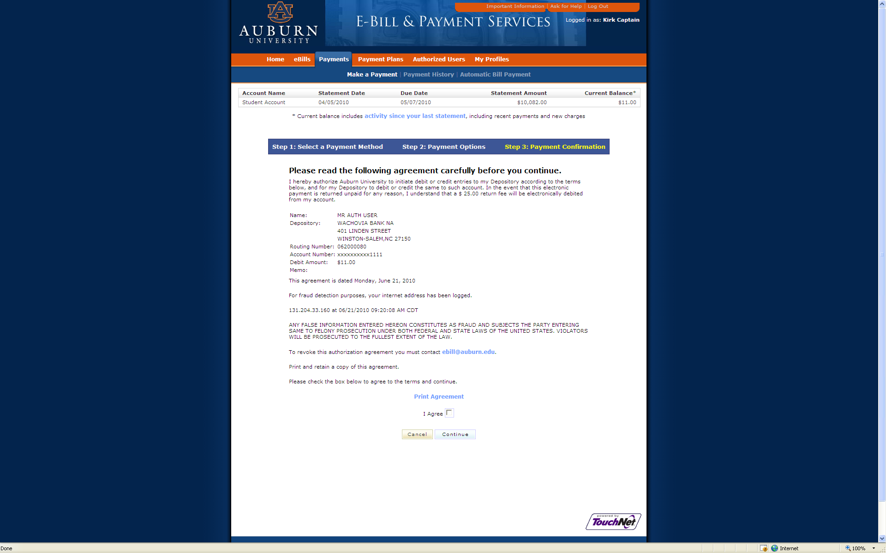
Make a Payment
Click I Agree and Continue

Slide 40
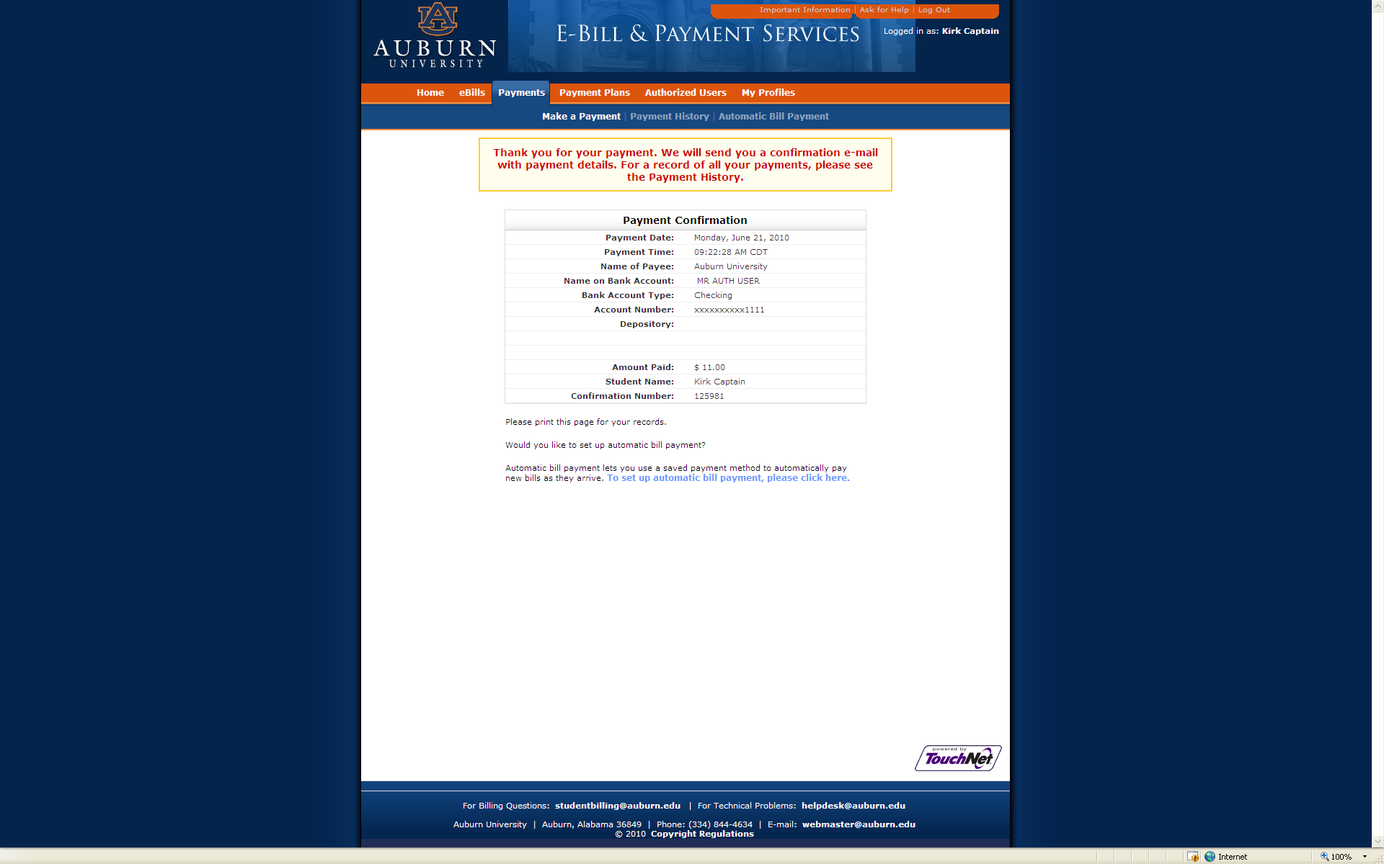
Make a Payment
Confirmation of Payment

Slide 41
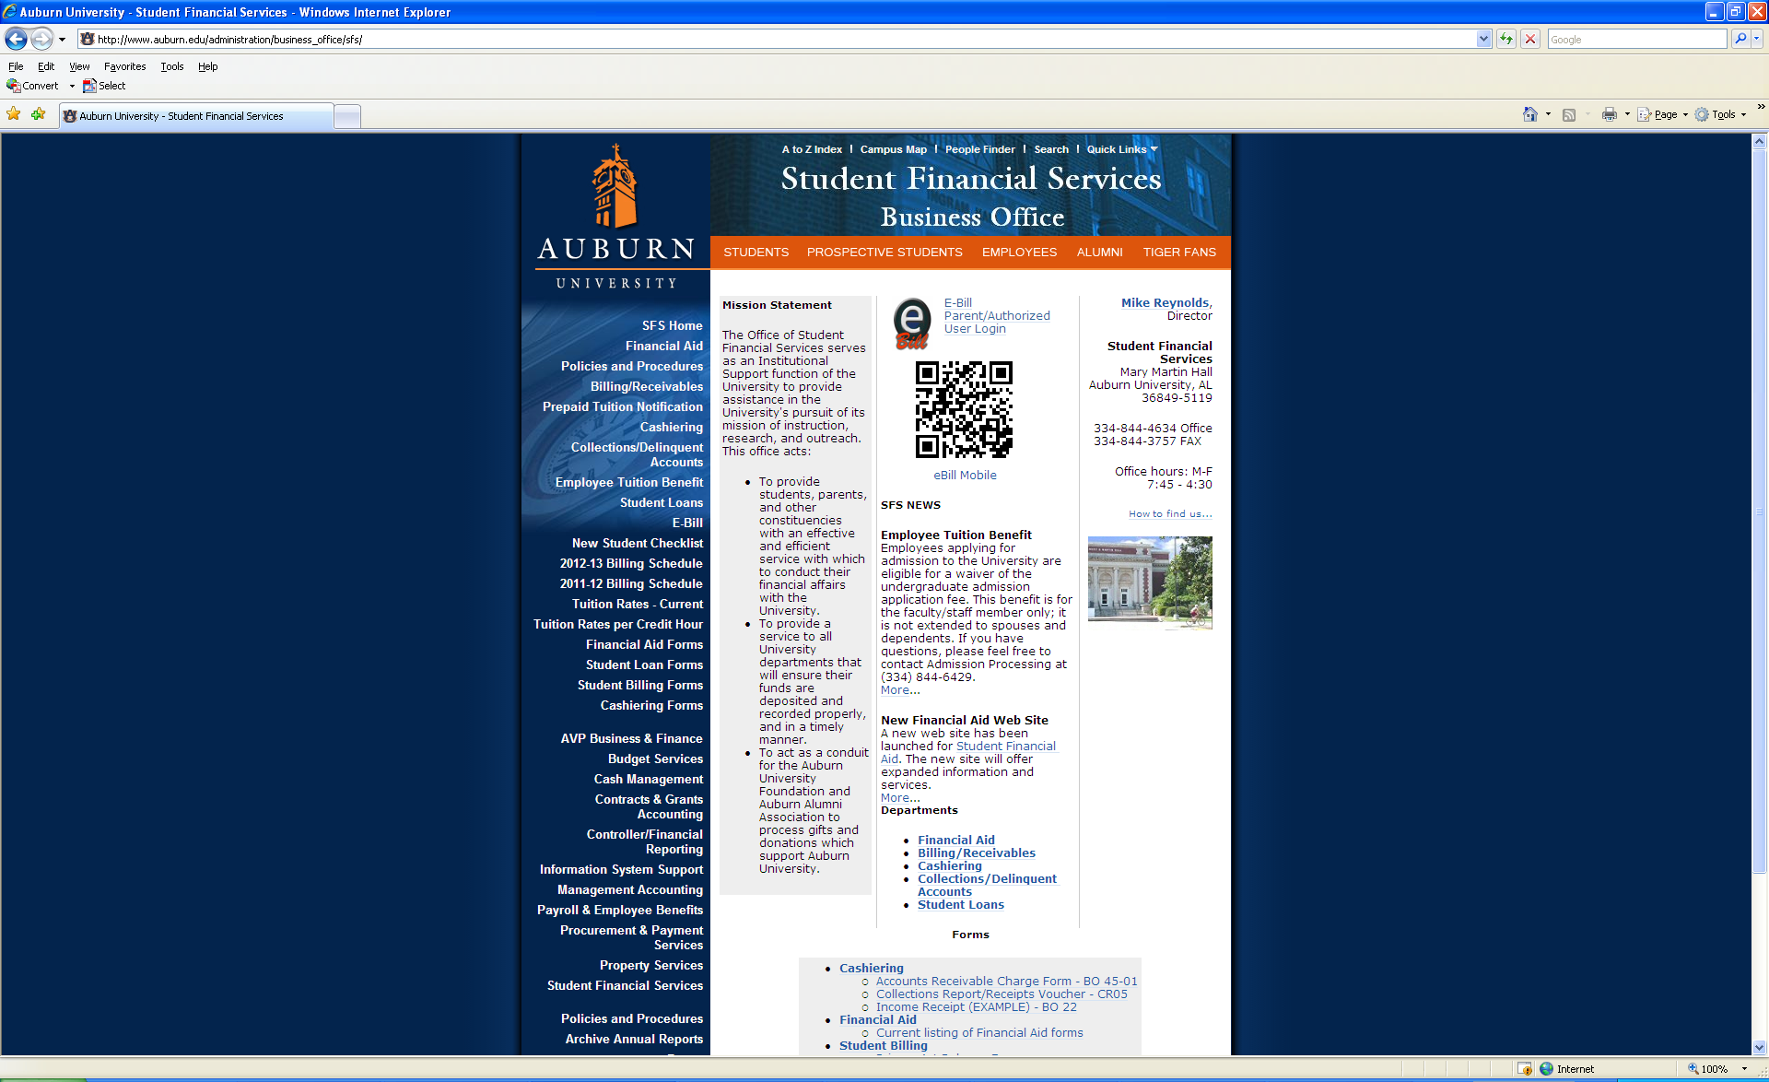
eBill Mobile

Slide 42
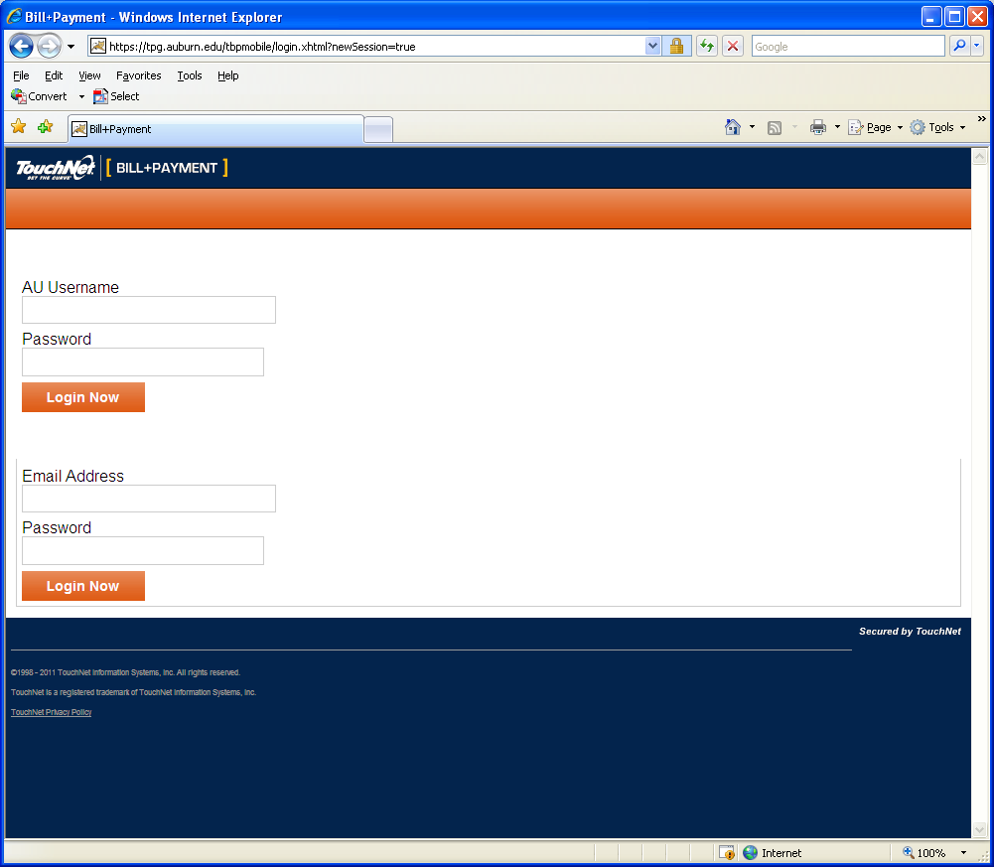

Slide 43
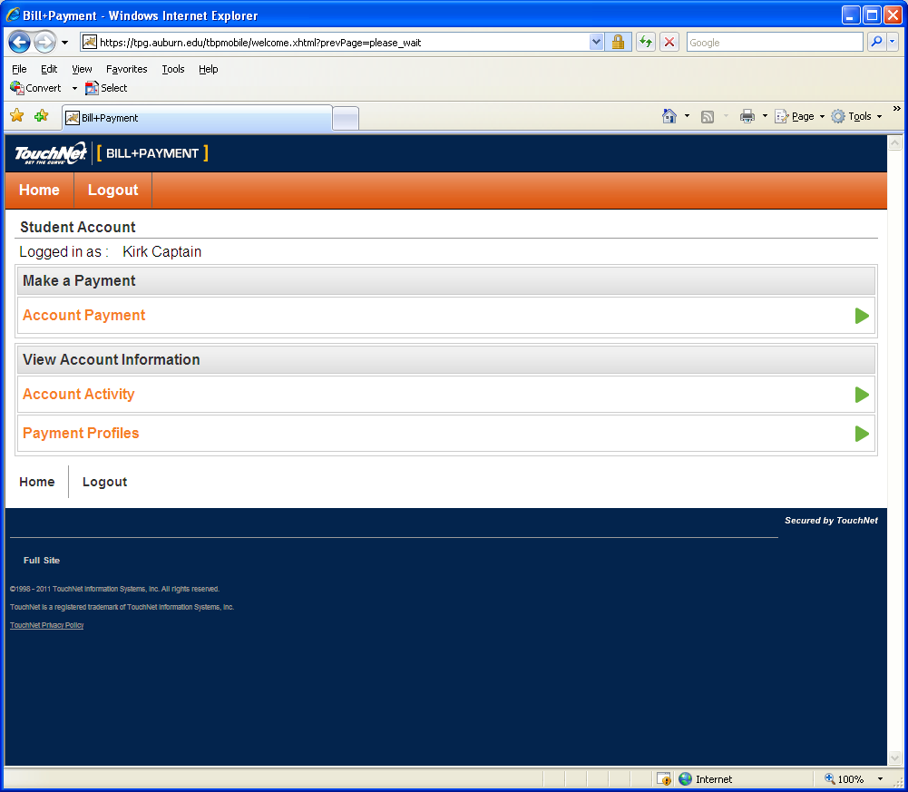

Slide 44
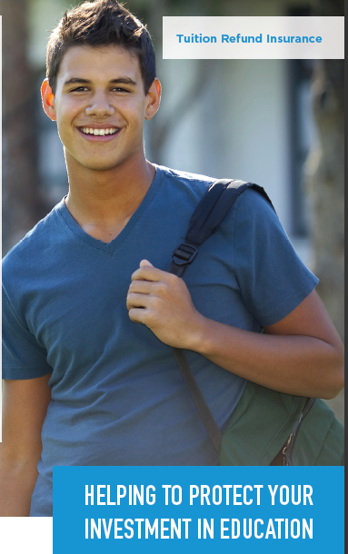
Tuition Insurance Plan
Protection against the unexpected
Tuition Refund Insurance helps reimburse the following expenses if you can’t complete classes due to an illness or injury
  ☑ Tuition
  ☑ Room and Board
  ☑ Books and other academic expenses
Annual cost starting at $73
www.TuitionInsurancePlan.com/auburn

