Slide 1

Student Financial Services

Slide 2
Where and How to Access eBill
Add Authorized User
Add Direct Deposit Information
Financial Release of Information Permission
PACT Notification
Payment Plan
eBill Examples
Important Dates
Tuition Insurance

Slide 3
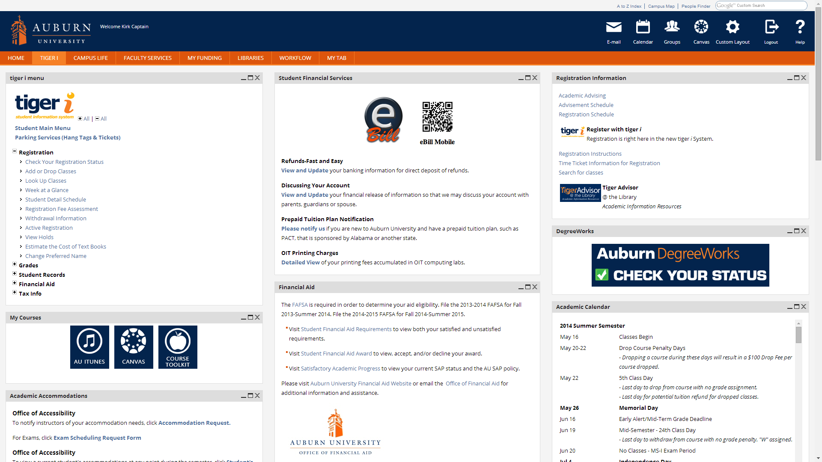

Slide 4
2015-16 PACT rates
Credit Hours | Fall 2015-2016 Tuition/Fees | PACT Rates | Student Balance
1 | 1,175.00 | 738.00 | 437.00
2 | 1,542.00 | 1,030.00 | 512.00
3 | 1,909.00 | 1,322.00 | 587.00
4 | 2,276.00 | 1,614.00 | 662.00
5 | 2,643.00 | 1,906.00 | 737.00
6 | 3,010.00 | 2,198.00 | 812.00
7 | 3,377.00 | 2,490.00 | 887.00
8 | 3,744.00 | 2,782.00 | 962.00
9 | 4,111.00 | 3,074.00 | 1,037.00
10 | 4,478.00 | 3,366.00 | 1,112.00
11 | 4,845.00 | 3,658.00 | 1,187.00
11 or more | 5,212.00 | 3,950.00 | 1,262.00

Slide 5
Payment Plan
Deferred Payment Plan Option - You can divide the FIRST bill of the semester into two half payments. First bills of the semester are issued in July (fall semester), November (spring semester), and April (summer semester).
Prepayment Plan Option – in partnership with Tuition Management Systems (TMS) you can pre-pay your semester charges. Visit auburn.afford.com or call 800-722-4867 for more information.

Slide 6

eBill Examples
Captain, Kirk
Student ID# 902251977
Statement Date: 07-17-2015
Due Date: 08-07-2015
Transaction Date | Code | Description | Charge | Credit
07-13-2015 07-13-2015 | 201610 201610 | Previous Account Balance ---CURRENT CHARGES/PAYMENTS--- Dining Plan Tuition Resident Undergraduate | 25.00 300.00 5,212.00
Current Due | 5,537.00
Total Account Balance | 5,537.00

Slide 7
eBill Examples
Captain, Kirk
Student ID# 902251977
Statement Date: 07-17-2015
Due Date: 08-07-2015
Transaction Date | Code | Description | Charge | Credit
07-13-2015 07-13-2015 07-13-2015 07-13-2015 | 201610 201610 201610 201610 | Previous Account Balance ---CURRENT CHARGES/PAYMENTS--- Dining Plan Tuition Resident Undergraduate $$$ESTIMATED FINANCIAL AID$$$ Unsubsidized Direct Loan Federal Pell Grant | 25.00 300.00 5,212.00 | 990.00 2,887.00
Current Due | 1,660.00
Total Account Balance | 5,537.00

Slide 8
eBill Examples
Captain, Kirk
Student ID# 902251977
Statement Date: 07-17-2015
Due Date: 08-07-2015
Transaction Date | Code | Description | Charge | Credit
07-13-2015 07-13-2015 07-13-2015 07-13-2015 | 201610 201610 201610 201610 | Previous Account Balance ---CURRENT CHARGES/PAYMENTS--- Dining Plan Tuition Non-Resident Undergraduate Village Rent - Double Room $$$ESTIMATED FINANCIAL AID$$$ AU Board of Trustees Scholarship | 25.00 995.00 14,020.00 4,400.00 | 750.00
Current Due | 18,690.00
Total Account Balance | 19,440.00

Slide 9
Important Dates
Bill Date - July 17
Due Date - August 7
  Must pay at least 50% by August 7 or class schedule will be dropped

Slide 10

GradGuard Tuition Insurance
Tuition Insurance Plan
Protection against the unexpected
Tuition Refund Insurance helps reimburse the following expenses if you can’t complete classes due to an illness or injury. It covers:
  ☑ Tuition
  ☑ Room and Board
  ☑ Other academic expenses
Annual Cost starting at $163.50.
www.gradguard.com/Insurance

