Slide 1

Auburn University
Student Financial Services

Slide 2

Agenda
Student Financial Services
Where to Access E-Bill
eBill Examples
Direct Deposit Information
Prepaid tuition notification (such as PACT)
Financial Release of Information
Authorized User for ebill system
Important Dates
Payment Plan
Tuition Insurance
Dropping classes after semester starts
I Wish My Parents Had Known

Slide 3

Student Financial Services
Student Financial Services (SFS) departments
  Financial Aid
  Billing Department
  Cashiering
  Third party billing
  Account Services

Slide 4
Student Financial Services
The Billing Department is a centralized billing office. Charges are received from various departments for student billing purposes.
Items charged to the student’s billing account other than tuition:
  Housing (and housing related fees), meal plans, parking passes, parking tickets, OIT charges, Panhellenic fees, ID cards, pharmacy prescriptions, football tickets, counseling services fees, Student Alumni Association, CWE fees, etc
  Questions on charges other than tuition should be directed to the appropriate department

Slide 5
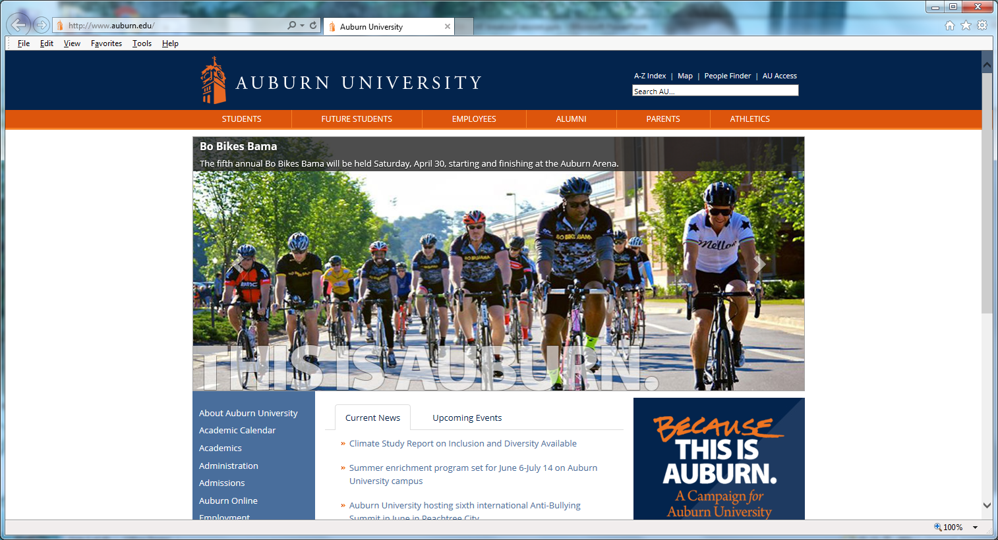
Where and How Students Access eBill
Go to: www.auburn.edu
Click AU Access

Slide 6
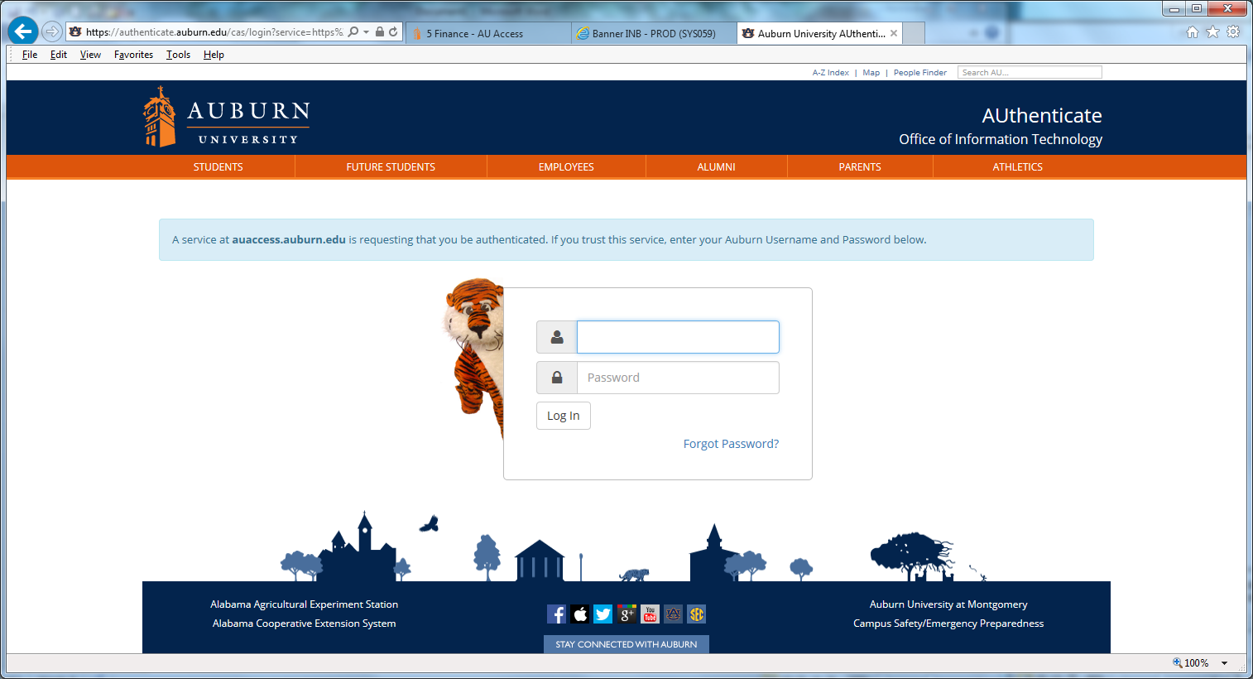
Where and How Students Access eBill
Fill in User Name and Password

Slide 7
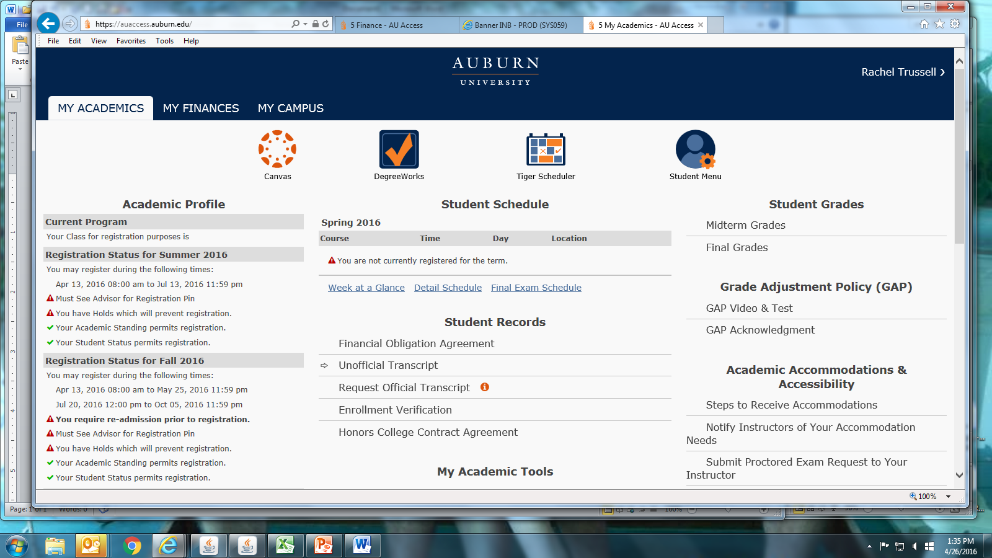
Where and How Students Access eBill
Click on My Finances

Slide 8
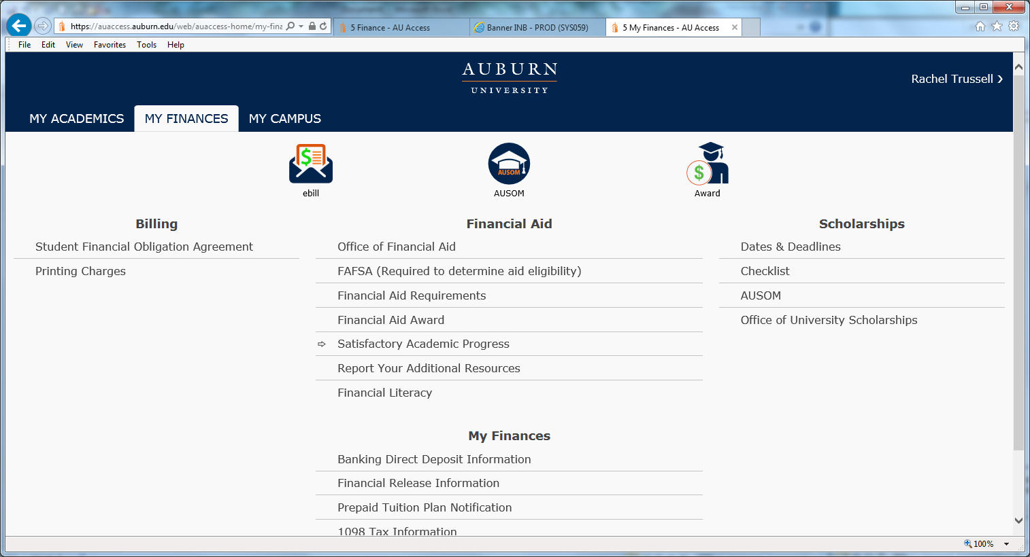
Where and How Students Access eBill
Click eBill

Slide 9
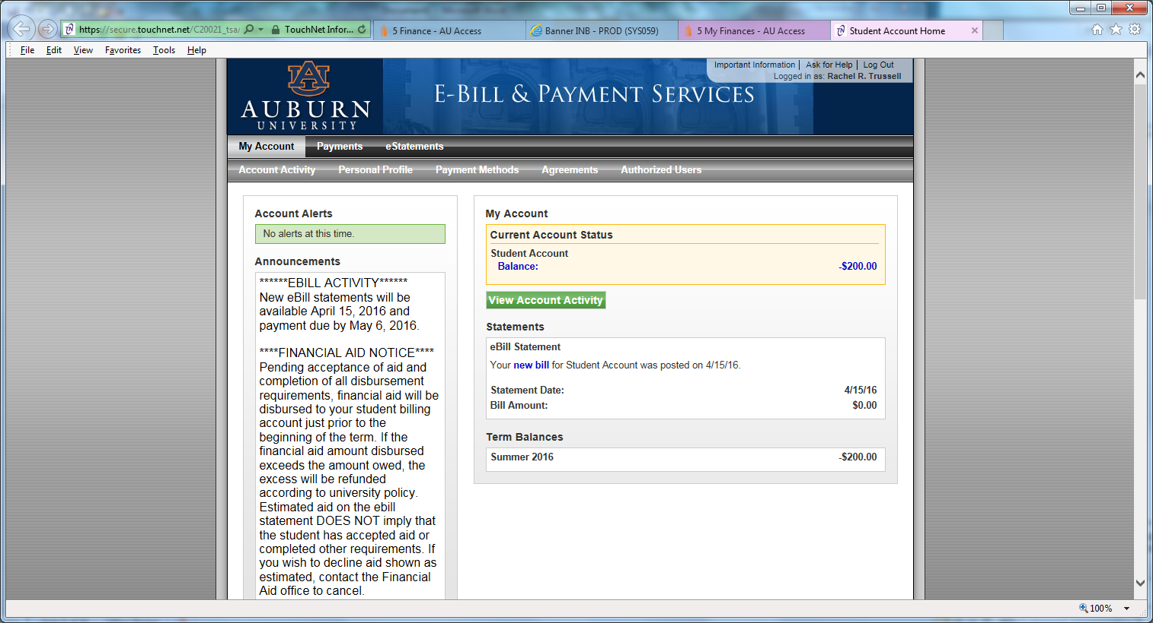
Where and How Students Access eBill
Click eStatements
OR Click new bill

Slide 10
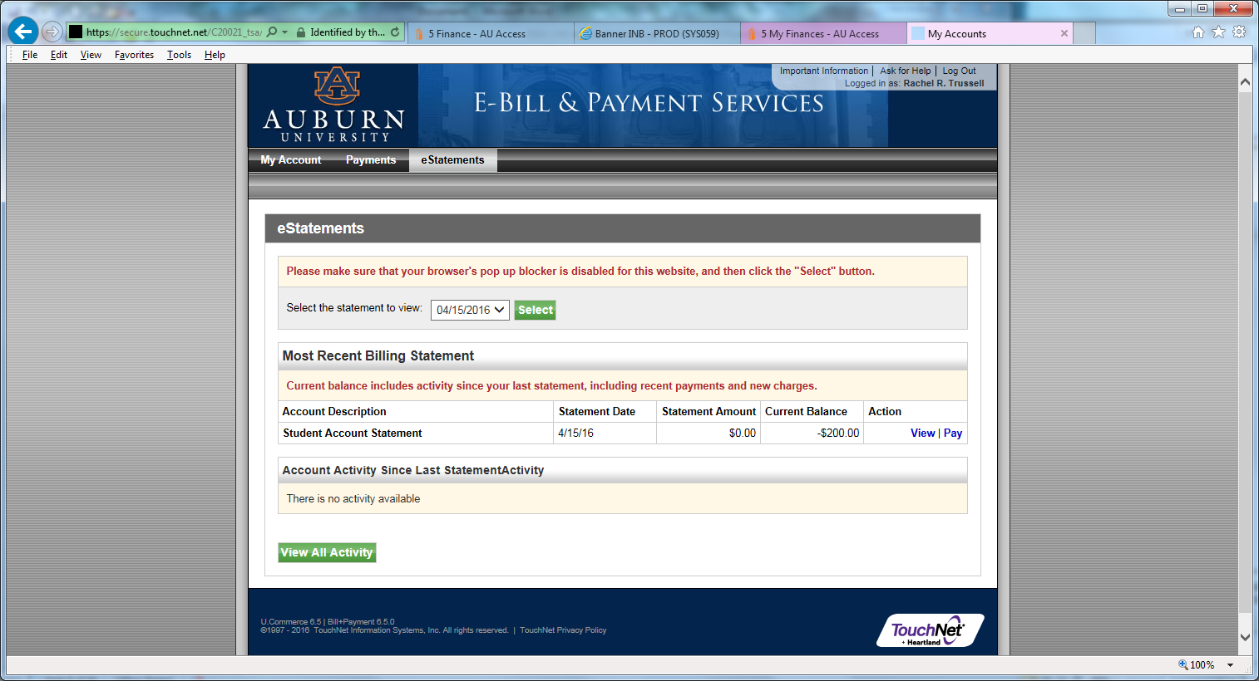
Where and How Students Access eBill
Click Select

Slide 11

eBill Examples
Captain, Kirk
Student ID# 902251977
Statement Date: 07-15-2016
Due Date: 08-05-2016
Transaction Date | Code | Description | Charge | Credit
07-13-2016 07-13-2016 | 201710 201710 | Previous Account Balance ---CURRENT CHARGES/PAYMENTS--- Dining Plan Tuition Resident Undergraduate | 25.00 300.00 5,348.00
Current Due | 5,673.00
Total Account Balance | 5,673.00

Slide 12
eBill Examples
Captain, Kirk
Student ID# 902251977
Statement Date: 07-15-2016
Due Date: 08-05-2016
Transaction Date | Code | Description | Charge | Credit
07-13-2016 07-13-2016 07-13-2016 07-13-2016 | 201710 201710 201710 201710 | Previous Account Balance ---CURRENT CHARGES/PAYMENTS--- Dining Plan Tuition Resident Undergraduate $$$ESTIMATED FINANCIAL AID$$$ Unsubsidized Direct Loan Federal Pell Grant | 25.00 300.00 5,348.00 | 990.00 2,887.00
Current Due | 1,796.00
Total Account Balance | 5,673.00

Slide 13
eBill Examples
Captain, Kirk
Student ID# 902251977
Statement Date: 07-15-2016
Due Date: 08-05-2016
Transaction Date | Code | Description | Charge | Credit
07-13-2016 07-13-2016 07-13-2016 07-13-2016 | 201710 201710 201710 201710 | Previous Account Balance ---CURRENT CHARGES/PAYMENTS--- Dining Plan Tuition Non-Resident Undergraduate Village Rent - Double Room $$$ESTIMATED FINANCIAL AID$$$ AU Board of Trustees Scholarship | 25.00 995.00 14,420.00 4,600.00 | 750.00
Current Due | 19,290.00
Total Account Balance | 20,040.00

Slide 14
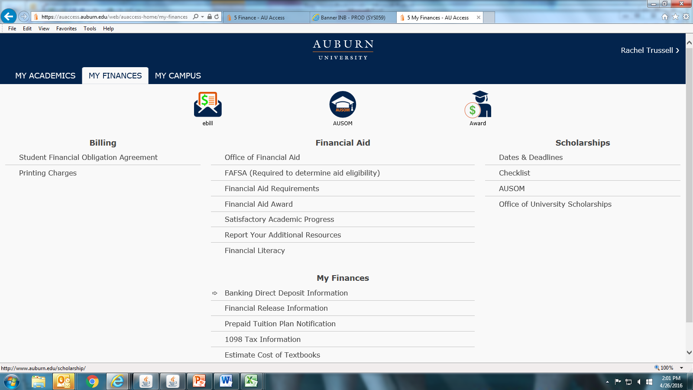
Add Direct Deposit Information
Click to Add Direct Deposit Information

Slide 15
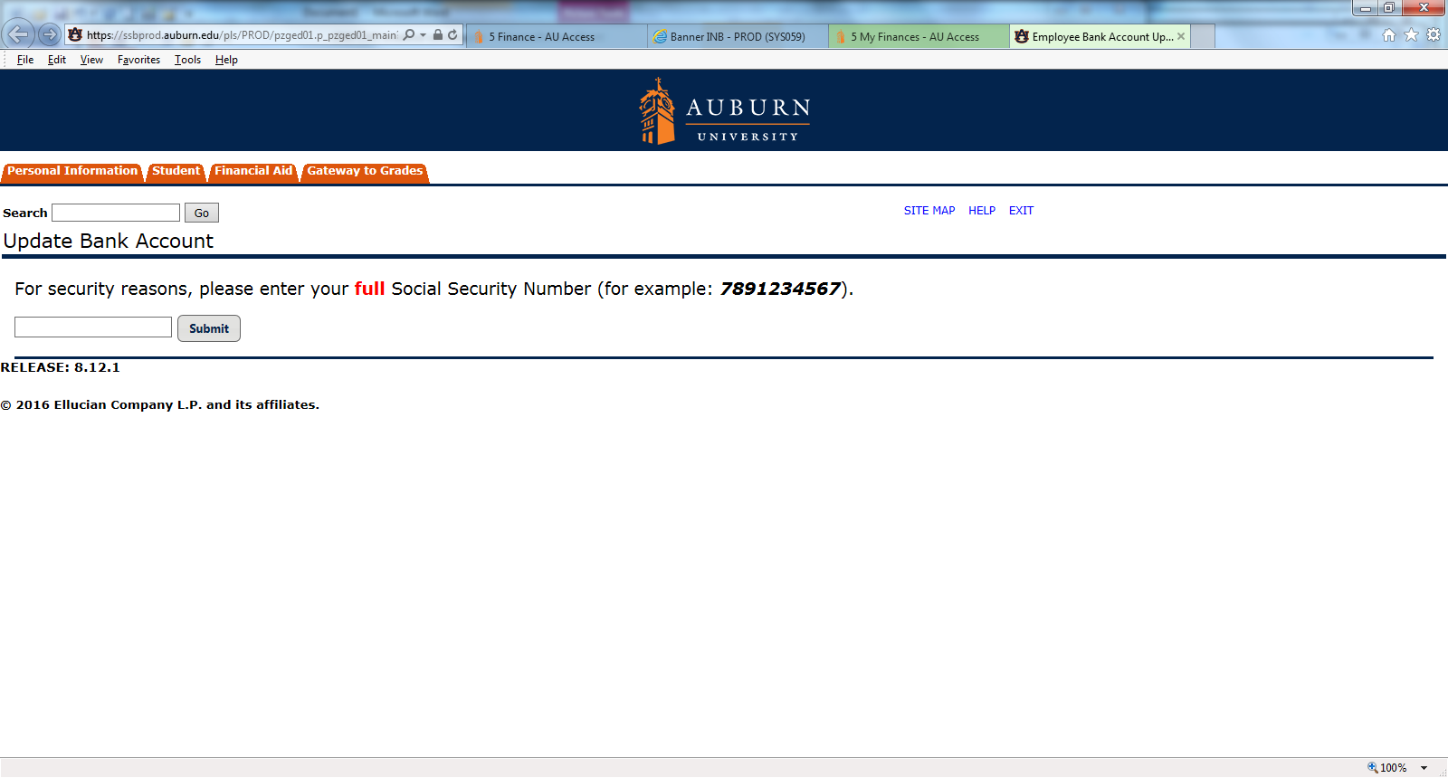
Add Direct Deposit Information

Slide 16
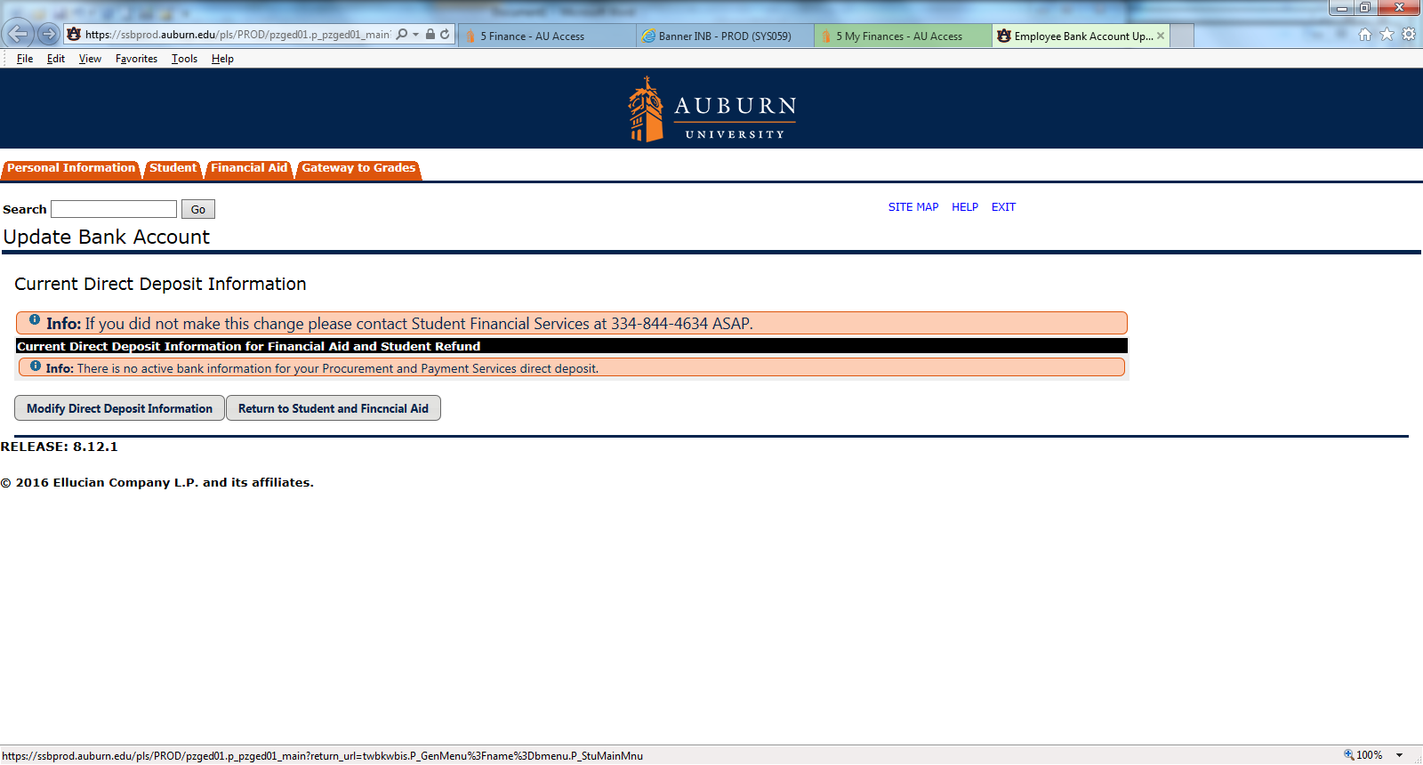
Add Direct Deposit Information
Click Modify Direct Deposit Information

Slide 17
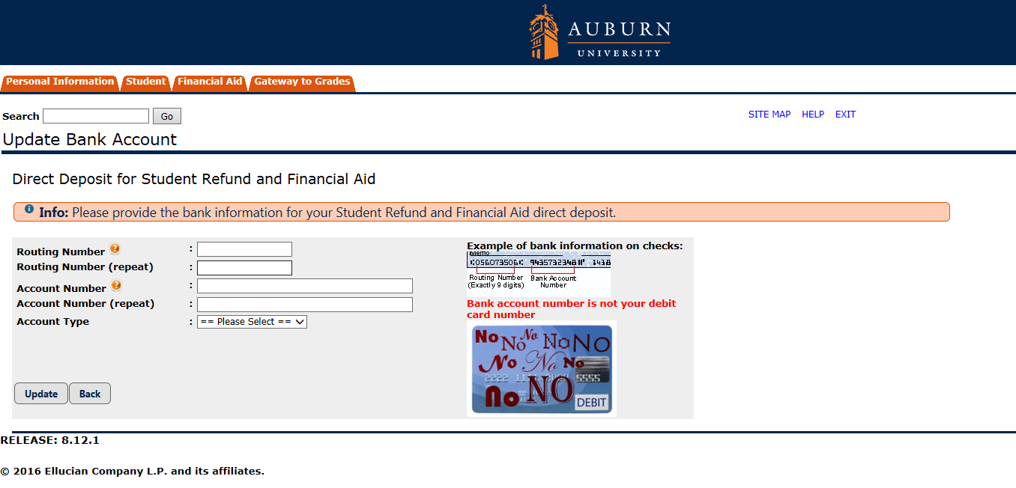
Add Direct Deposit Information
Enter Account Information This is not your debit card number! Click Update

Slide 18
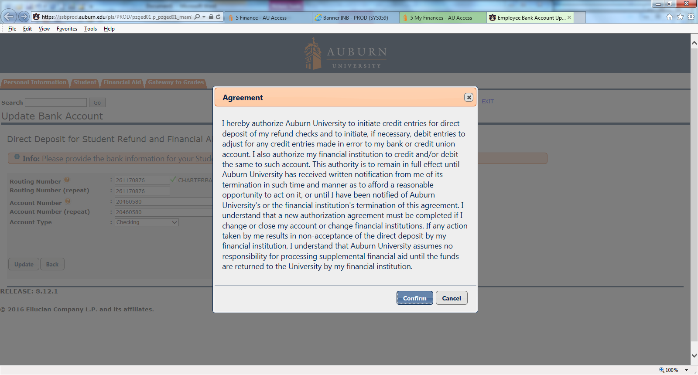
Add Direct Deposit Information
Read and Click “Confirm”

Slide 19
Complete Prepaid Tuition Plan Notification
Click to Complete Prepaid Tuition Notification Plan

Slide 20
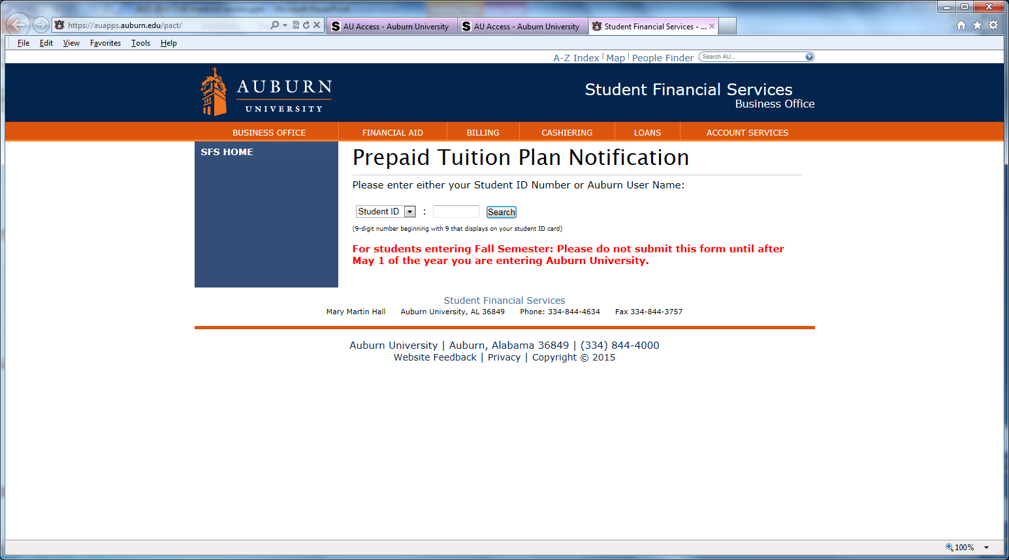
Complete Prepaid Tuition Plan Notification
Complete All Fields and Submit

Slide 21
2016-17 PACT rates
Pact will only pay 2010 rates
Credit Hours | Fall 2016-2017 Tuition/Fees | 2010 PACT Rates | Student Balance
1 | 1,190.00 | 760.14 | 429.86
2 | 1,568.00 | 1,060.90 | 507.10
3 | 1,946.00 | 1,361.66 | 584.34
4 | 2,324.00 | 1,662.42 | 661.58
5 | 2,702.00 | 1,963.18 | 738.82
6 | 3,080.00 | 2,263.94 | 816.06
7 | 3,458.00 | 2,564.70 | 893.30
8 | 3,836.00 | 2,865.46 | 970.54
9 | 4,214.00 | 3,166.22 | 1,047.78
10 | 4,592.00 | 3,466.98 | 1,125.02
11 | 4,970.00 | 3,767.74 | 1,202.26
12 or more | 5,348.00 | 4,068.50 | 1,279.50

Slide 22

Authorizations
Student gives to parents
There are two authorizations for Student Financial Services. Giving access to one does not give you access to the other. Student must do both!
1. Financial Information Release
Authorizes SFS to discuss eBill/
financial aid
2. Authorized user in eBill system
Gives authorized user access to
student’s eBill account

Slide 23
Complete Release of Information Statement
Click to Complete Financial Release Information

Slide 24
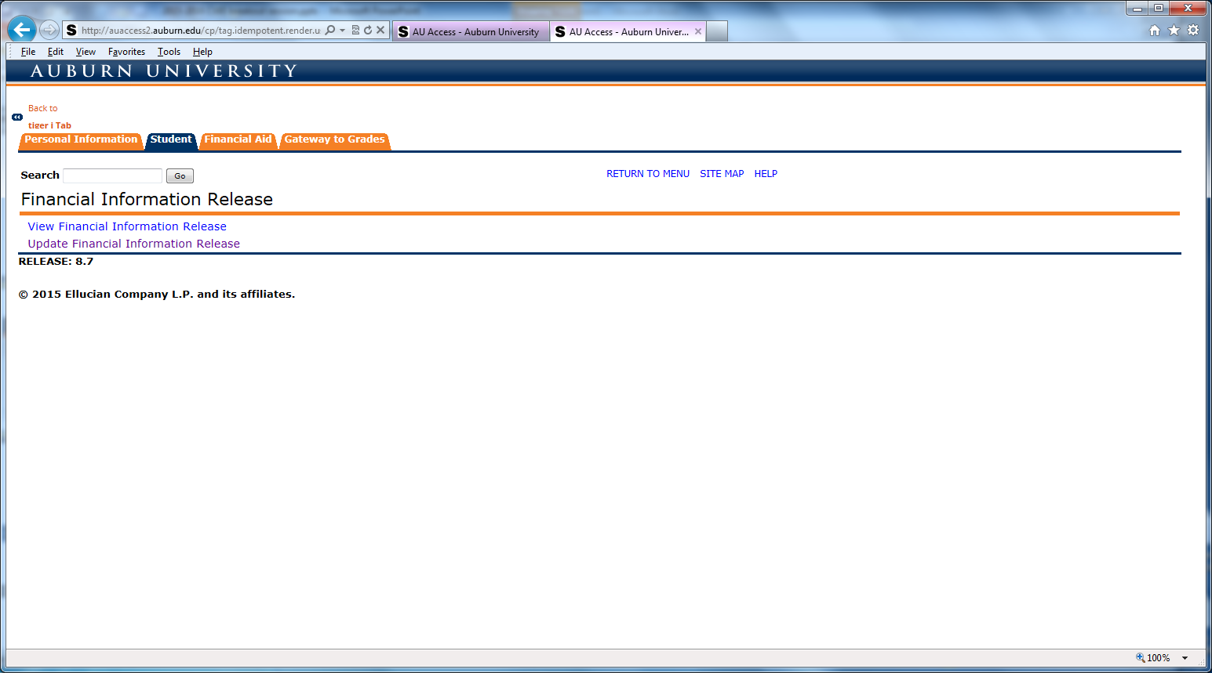
Complete Release of Information Statement
Click Update Financial Information Release

Slide 25
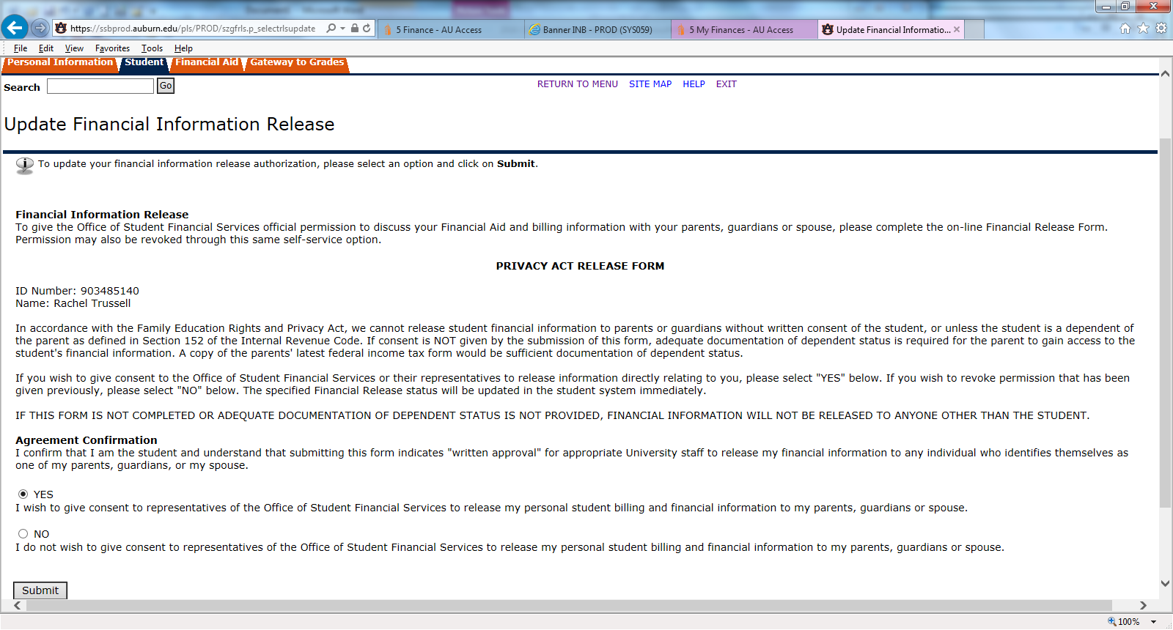
Complete Release of Information Statement
It is already checked “Yes”. Click Submit.

Slide 26
Add Authorized User
Click eBill

Slide 27
Add Authorized User
Click Authorized Users

Slide 28
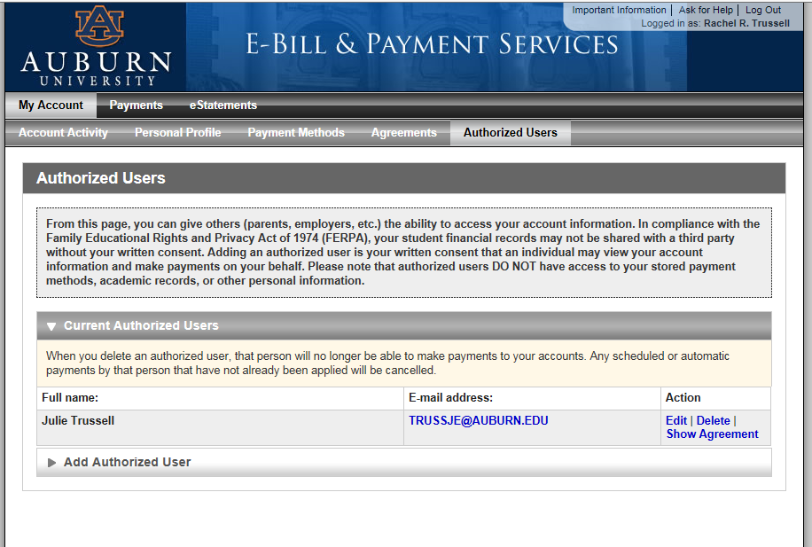
Add Authorized User
Click on ‘Add Authorized User’

Slide 29
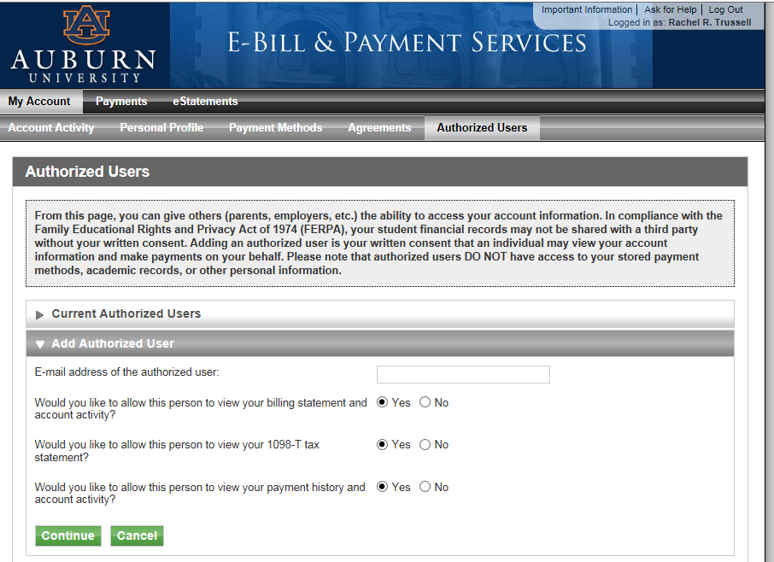
Add Authorized User
Fill in E-mail Address
Review to see if you want authorized user access to all three. Click Continue.

Slide 30
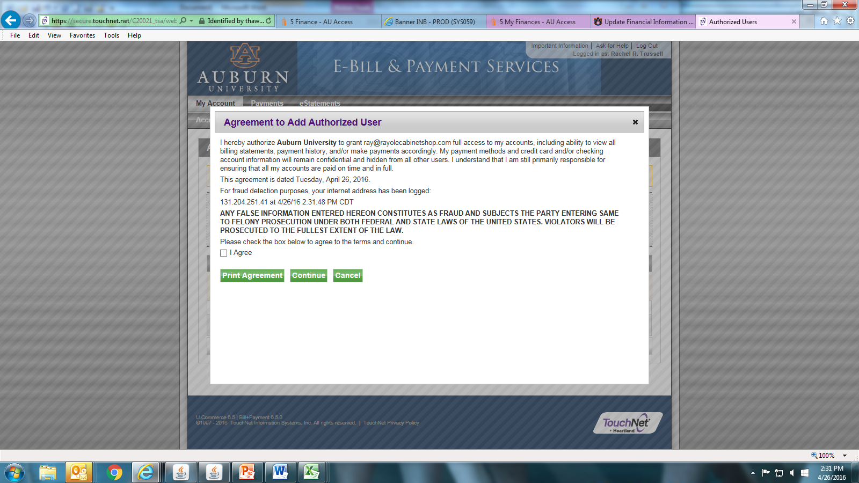
Add Authorized User
Click “I Agree” and “Continue”

Slide 31
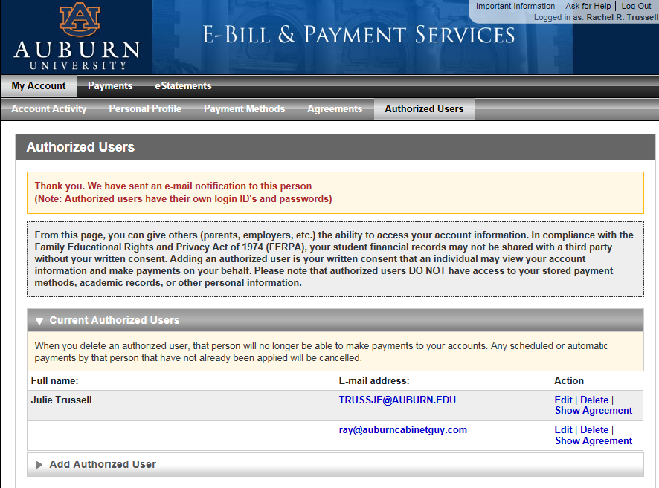
Add Authorized User
Confirmation that Authorized User Will Be Sent an E-mail

Slide 32
Add Authorized User
1st email to authorized user
This is an automated message to inform you that the student listed below has granted you access to his or her online billing information. You now have the ability to make payments on behalf of this student, schedule or automate future payments, and more. You will log in with the username shown below. For security, the initial password for this account is sent in a separate message.
You may log in at http://ebill.auburn.edu
======= ACCESS INFORMATION =======
Student Name --- [ Raymond C. Trussell ]
Username --- [ notarywiz15@gmail.com ]
==================================
Sincerely,
Auburn University Billing Department
For questions, e-mail to: studentbilling@auburn.edu

Slide 33
Add Authorized User
2nd email to authorized user
This is an automated message to inform you that the student listed below has granted you access to his or her online billing information. You now have the ability to make payments on behalf of this student, schedule or automate future payments, and more. For your first login, you will use the password shown below. For security, your username for this account is sent in a separate message.
You may log in at http://ebill.auburn.edu
======= ACCESS INFORMATION =======
Student Name --- [ Raymond C. Trussell ]
Password --- [ xbuvownyvz ]
==================================
Sincerely,
Auburn University Billing Department
For questions, e-mail to: studentbilling@auburn.edu
Temporary password – can copy and paste

Slide 34
Authorized User
Authorized User in e-bill system
  Access to e-bill
  When bills are generated student gets email and any authorized user gets email
    Check SPAM
    Mark anything from Auburn University (@auburn.edu) as “Never Block Senders Domain”
  If you change emails…. Your student needs to update this information through e-bill

Slide 35
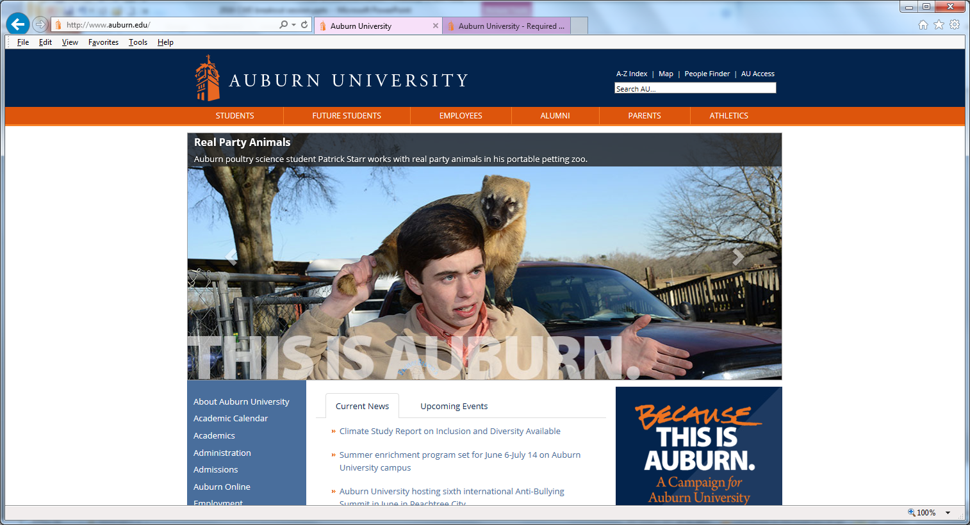
Authorized User Access
Click Parents

Slide 36
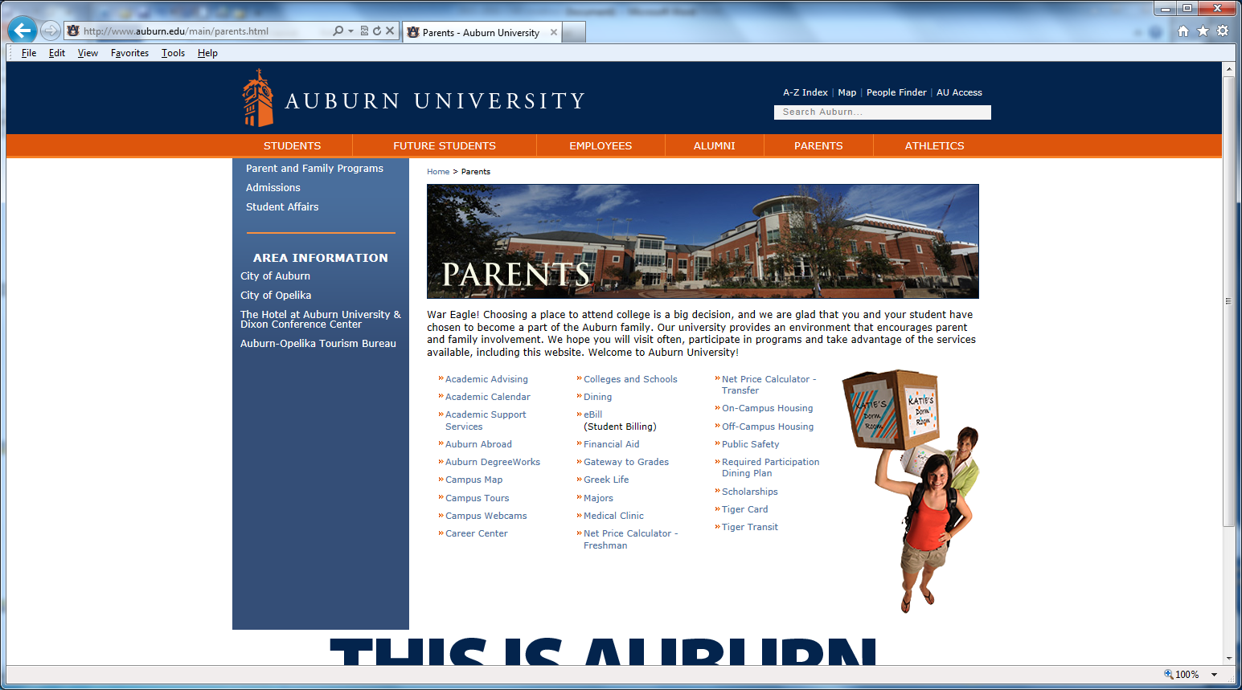
Authorized User Access
Click eBill

Slide 37
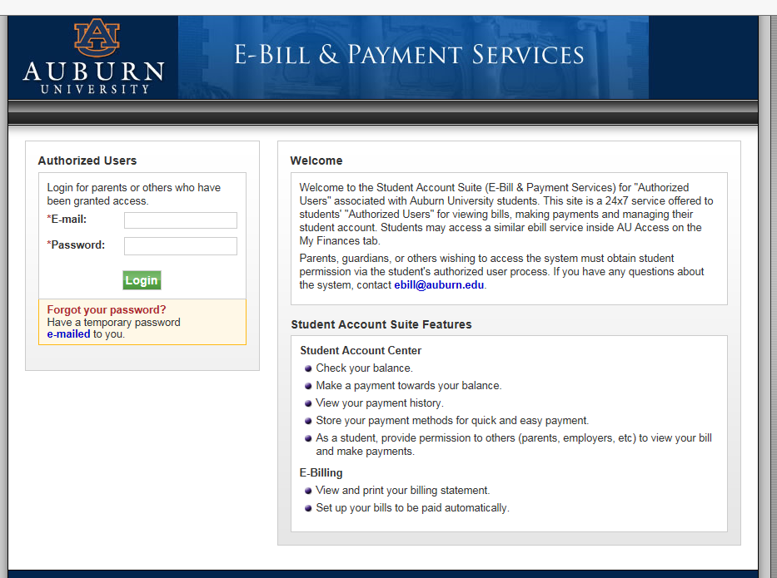
Authorized User Access
Fill in E-mail Address and Password

Slide 38
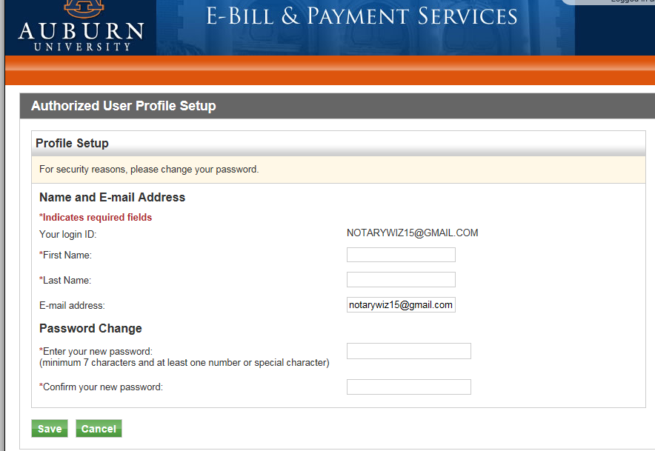
Authorized User Access
Fill in Your Full Name and enter NEW password. Click Save

Slide 39
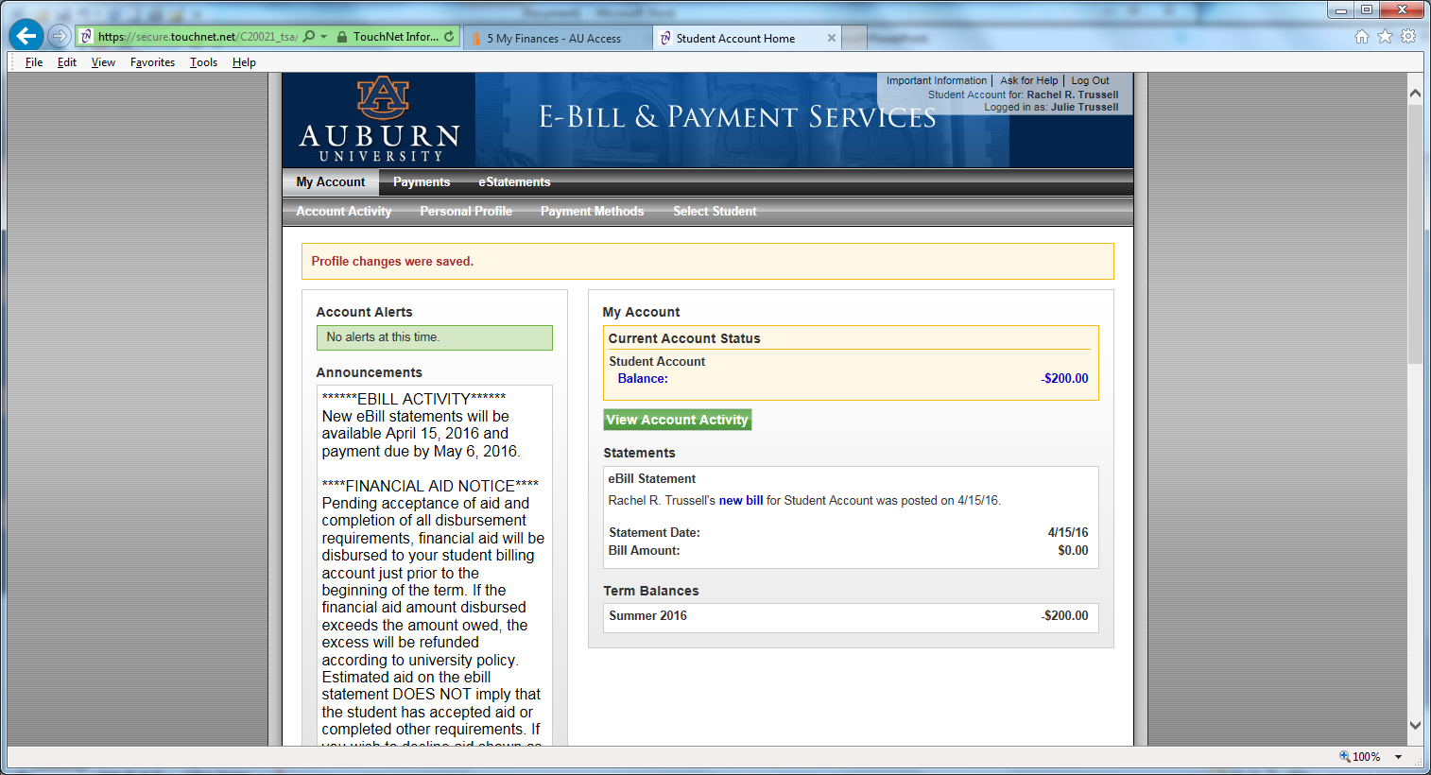
Authorized User Access
Authorized User’s view

Slide 40
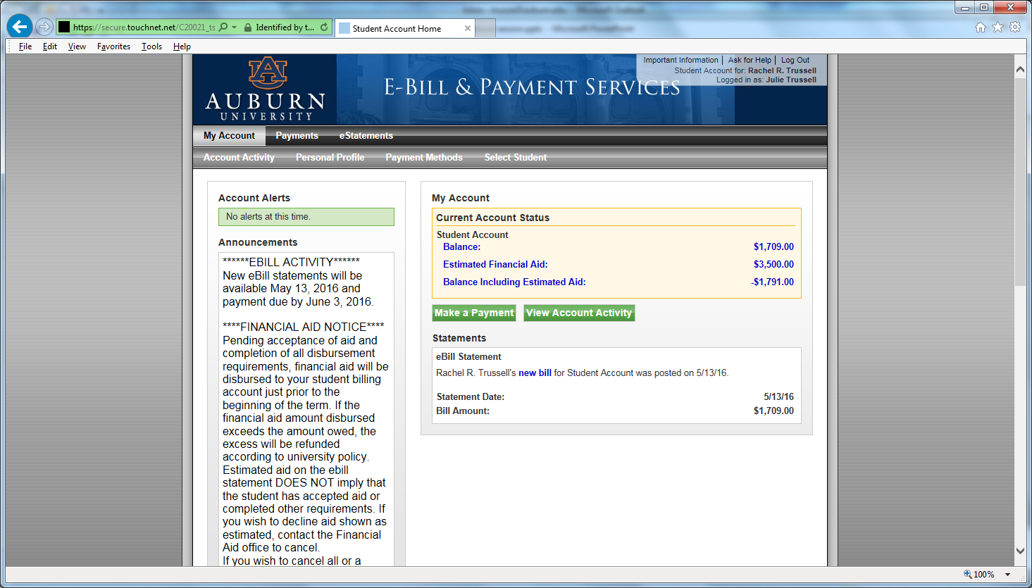
Make A Payment
Click Make a Payment

Slide 41
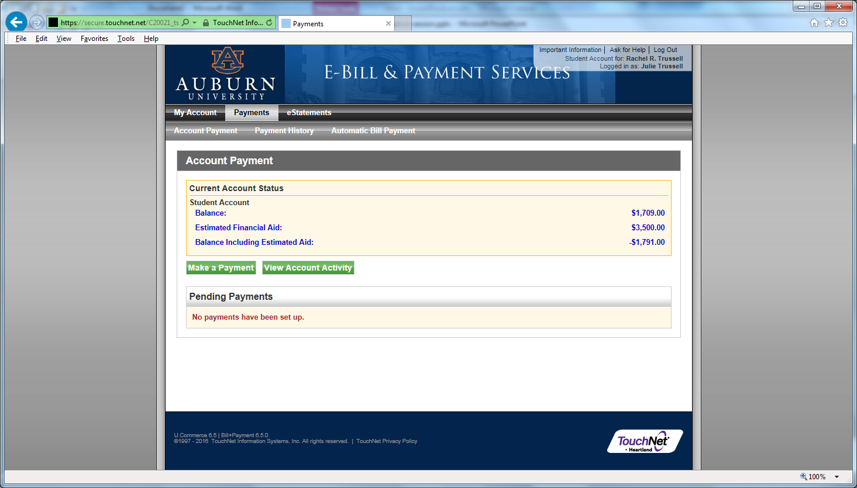
Make a Payment
Click Make a Payment

Slide 42
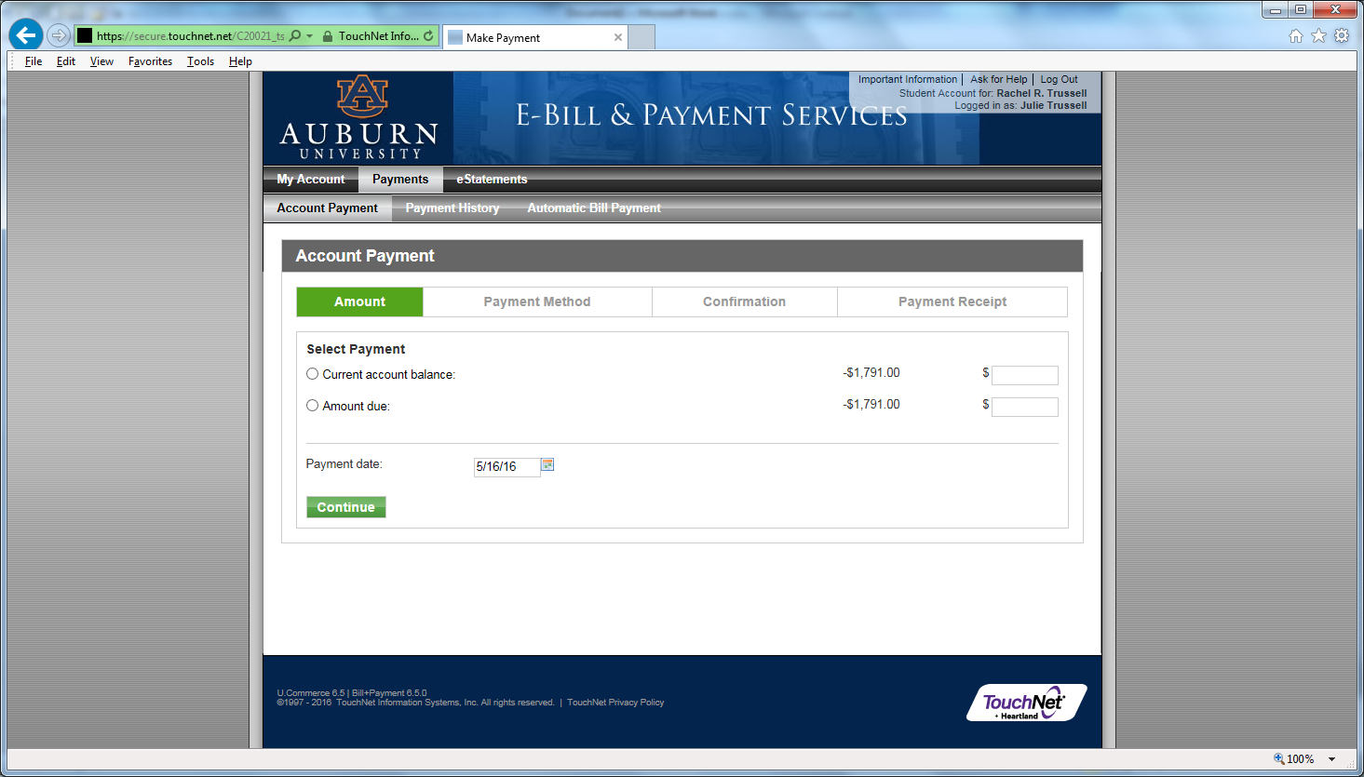
Make a Payment
Click which radio button you want.
To Change amount – click radio button: “amount due” – tab to box and insert dollar amount

Slide 43
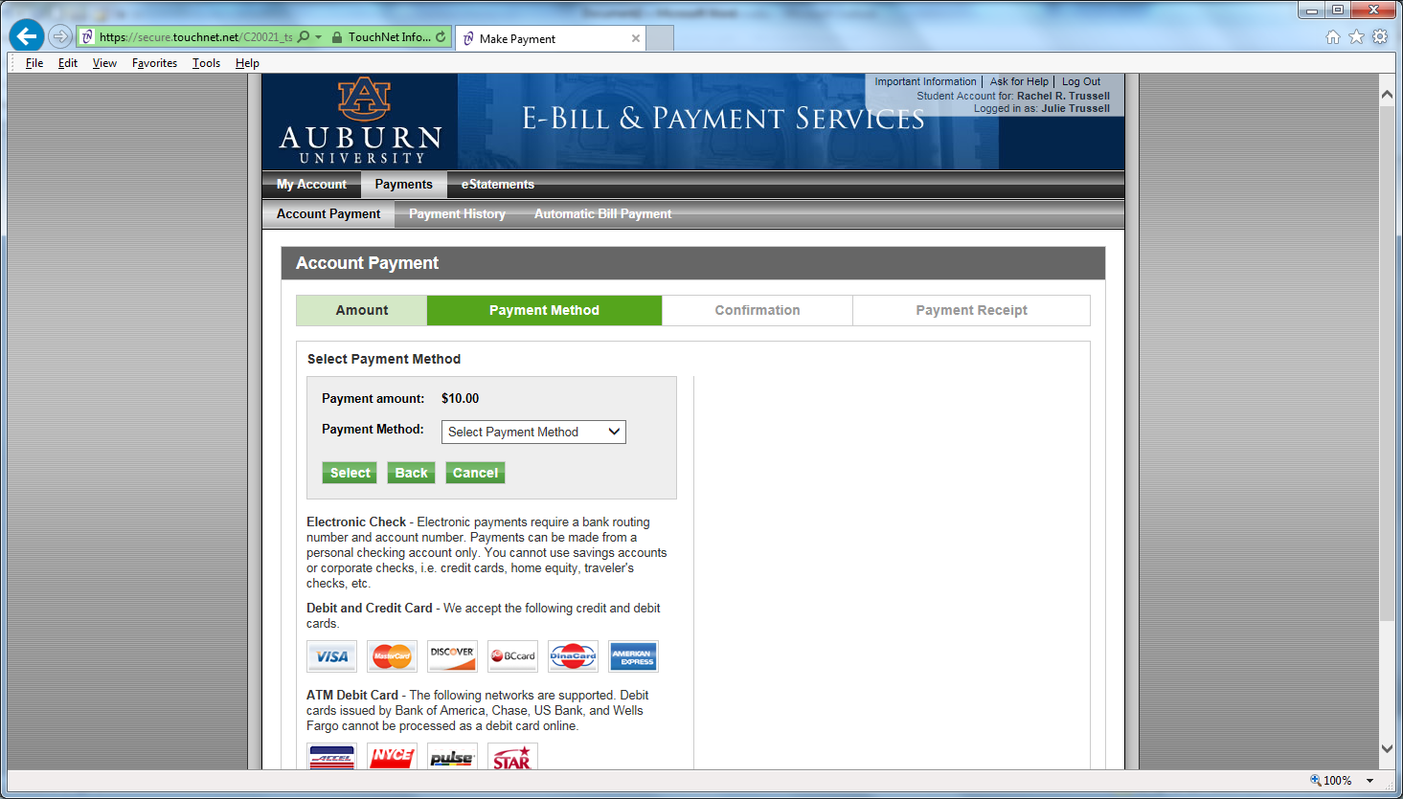
Make a Payment
Select Method from Menu

Slide 44
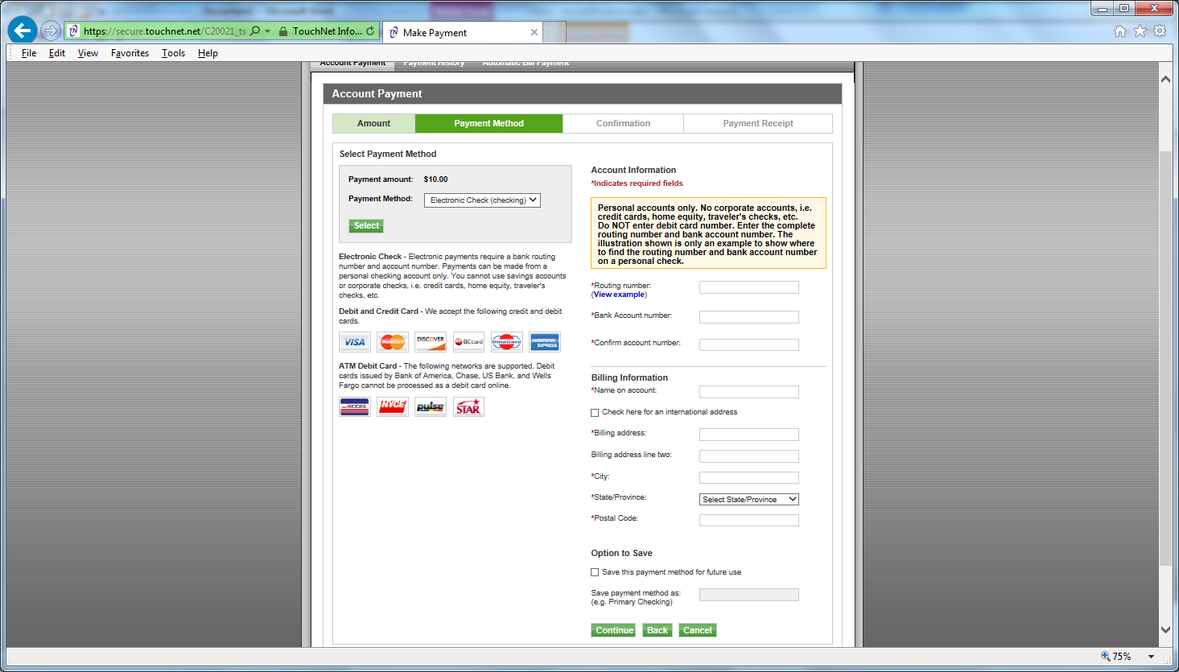
Make a Payment
Complete Routing and Account Information
Option to save information

Slide 45
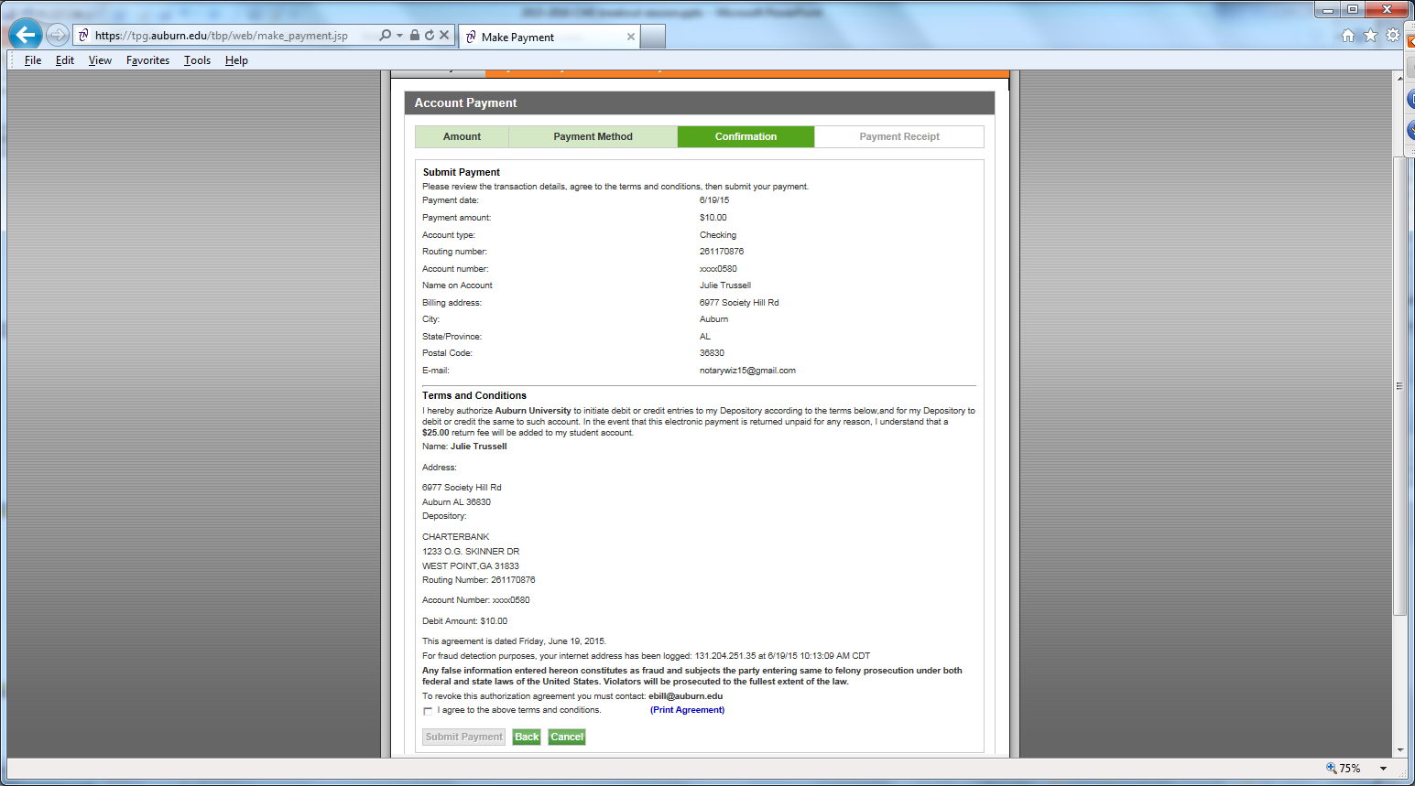
Make a Payment
Review and then click “I agree…”. Then click “submit payment”. You will get a confirmation email.

Slide 46
Important Dates
First Fall Bill Date - July 15, 2016
First Fall Due Date - August 5, 2016
  Must pay at least 50% by August 5, 2016 or class schedule will be dropped
Second Fall bill date – August 11, 2016
Second Fall due date – September 9, 2016
Annual Billing Schedule can be found on www.auburn.edu/billing

Slide 47
Payment Plan
Deferred Payment Plan Option
You can divide the FIRST official bill of the semester into two half payments. First bills of the semester are issued in July (Fall semester), November (Spring semester), and April (Summer semester).

Slide 48
Payment Plan
Prepayment Plan Option
In partnership with Tuition Management Systems (TMS) you can pre-pay your semester charges. Visit auburn.afford.com or call 800-722-4867 for more information.

Slide 49

GradGuard Tuition Insurance
Tuition Insurance Plan
Protection against the unexpected
Tuition Refund Insurance helps reimburse the following expenses if you can’t complete classes due to an illness or injury. It covers:
  ☑ Tuition
  ☑ Room and Board
  ☑ Other academic expenses
Annual Cost starting at $163.50.
www.gradguard.com/Insurance

Slide 50
What if student drops classes after the semester starts?
Students may add/drop a class through the 5th class day (Fall/Spring) with no financial penalty.
If a student drops between the 6th -15th class day a $100 Course Drop Fee per class will be assessed. Tuition is reimbursable.
If a student drops a class after the 15th class day, no tuition will be reimbursed.
If a student drops their entire schedule between the 1st through 15th class day, there will be a $100 resignation fee.

Slide 51
I Wish Parents had known….
Reflections from SFS
As far as the government is concerned, once a child starts college, they are considered an adult and fall under the federal privacy regulations. Therefore, SFS has to abide by federal regulations.
The e-bill is in the student’s name, not the parents.
We understand that a number of parents help their students with paying for school. However, without the financial release, we cannot talk about your student’s e-bill or financial aid.
It is the student’s responsibility to make sure they check their e-bill statement monthly.

Slide 52
I Wish Parents had known….
Reflections from SFS
Your student’s Auburn email is the OFFICIAL form of communication.
We know it can be scary as a parent to let your son/daughter go off to college on their own, however, this is a time when your sons and daughters need to learn to become mature, responsible adults. Help them to achieve this goal by letting them handle their financial affairs as much as possible.
As one parent reflected during Camp War Eagle “prepare yourself for the letting go process. The journey can be bittersweet for what could have been, for what will ever be, and for what was.”

Slide 53

Contact Info
Student Financial Services
203 Mary Martin Hall
Auburn AL 36849
334-844-4634
Hours: 7:45 am-4:45 pm M-F
www.auburn.edu/sfs
Questions?

