Slide 1

Auburn University
Student Financial Services

Slide 2

Agenda
Student Financial Services
Where to Access E-Bill
New Student Checklist
eBill Examples
Direct Deposit Information
Prepaid tuition notification (such as PACT, FL Prepaid)
Financial Release of Information

Slide 3
Agenda (cont)
Authorized User for ebill system
Important Dates
Payment Plan
Tuition Calculator
Tuition Insurance
Dropping classes after semester starts
What We Wish Parents Had Known

Slide 4

Student Financial Services
Student Financial Services (SFS) departments
  Financial Aid
  Billing Department
  Cashiering
  Third party billing
  Account Services

Slide 5
Student Financial Services
The Billing Department is a centralized billing office. Charges are received from various departments for student billing purposes.
Items charged to the student’s billing account other than tuition:
  Housing (and housing related fees), meal plans, parking passes, parking tickets, printing charges from some Departments, Panhellenic fees, pharmacy prescriptions, football tickets (not billed until the September bill!), counseling services fees, Student Alumni Association, All Access Course bookstore charges, CWE fees, ID cards, etc
  Questions on charges other than tuition should be directed to the appropriate department

Slide 6
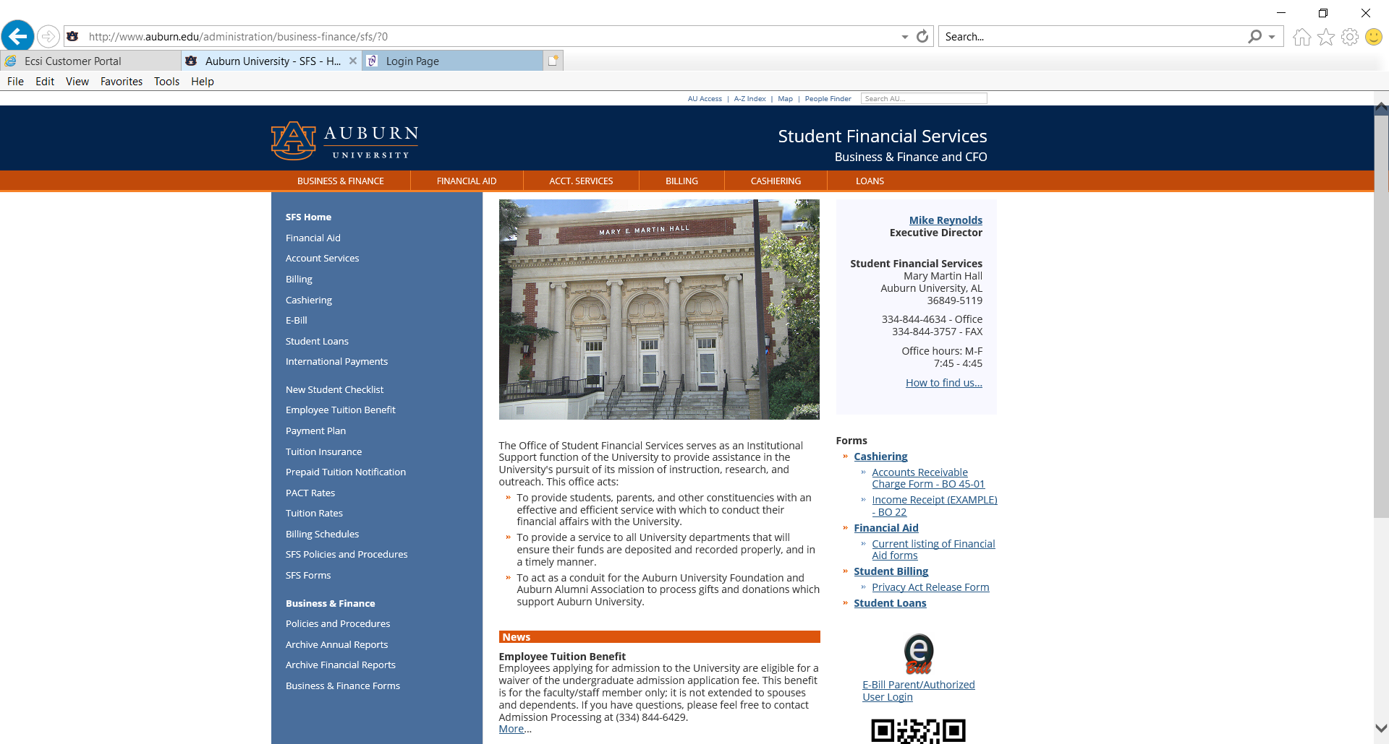
New Student Checklist auburn.edu/sfs

Slide 7
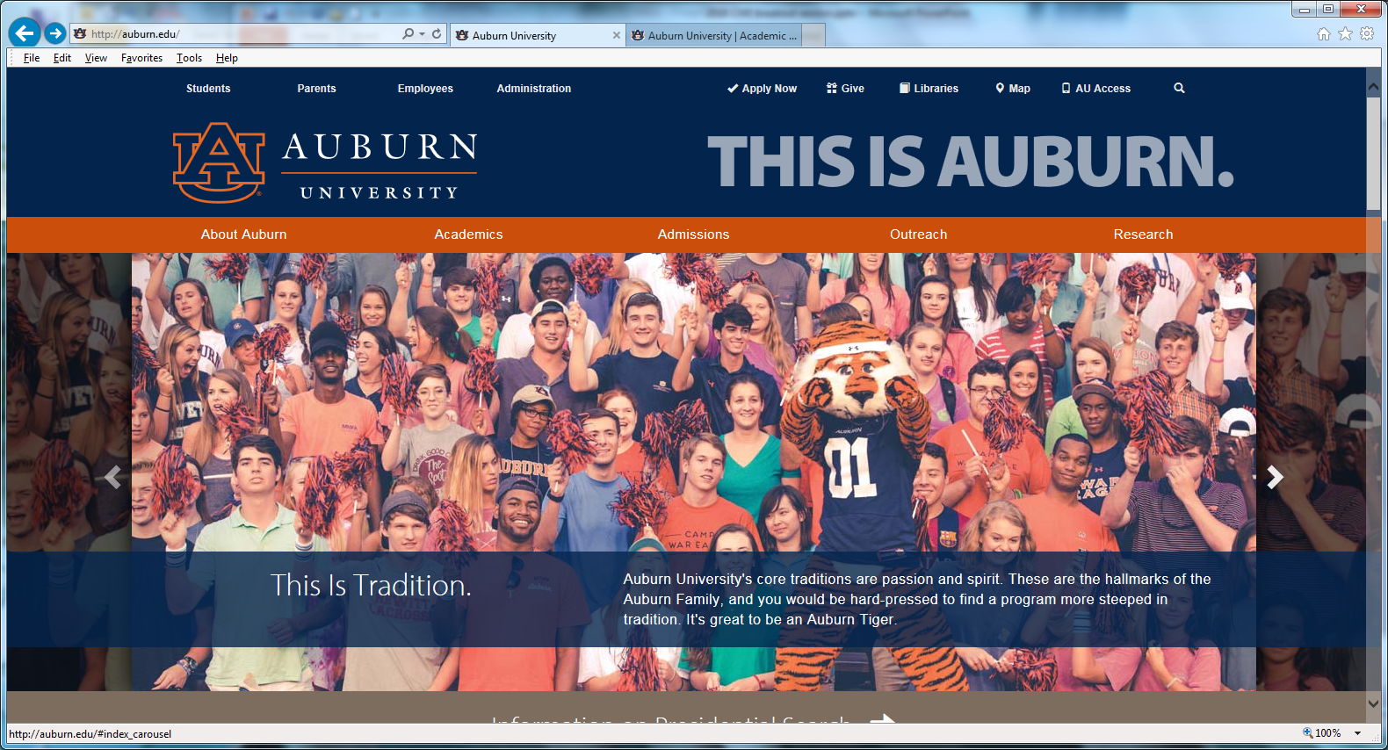
Where and How Students Access eBill
Go to: www.auburn.edu
Click AU Access

Slide 8
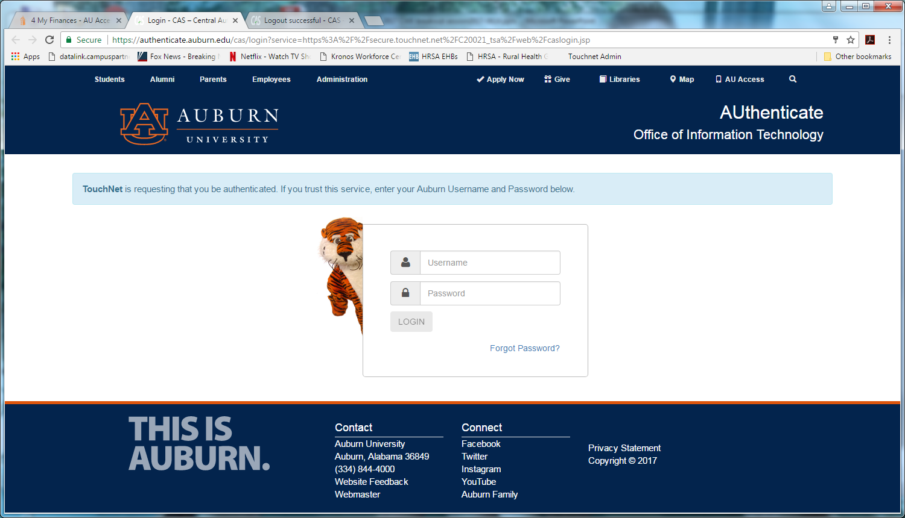
Where and How Students Access eBill
Fill in User Name and Password

Slide 9
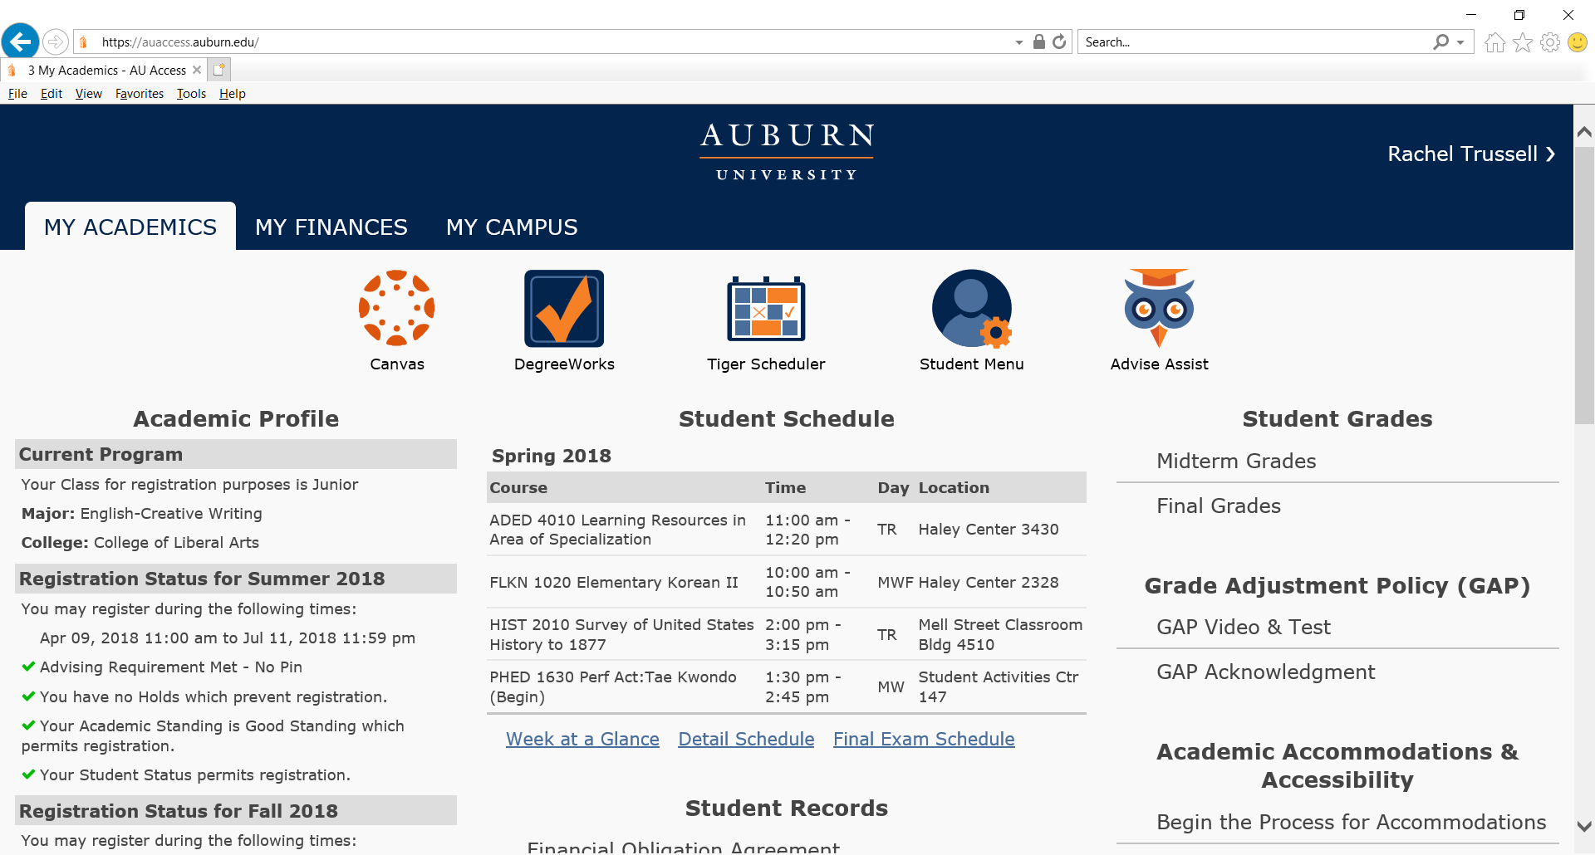
Where and How Students Access eBill
Click on My Finances

Slide 10
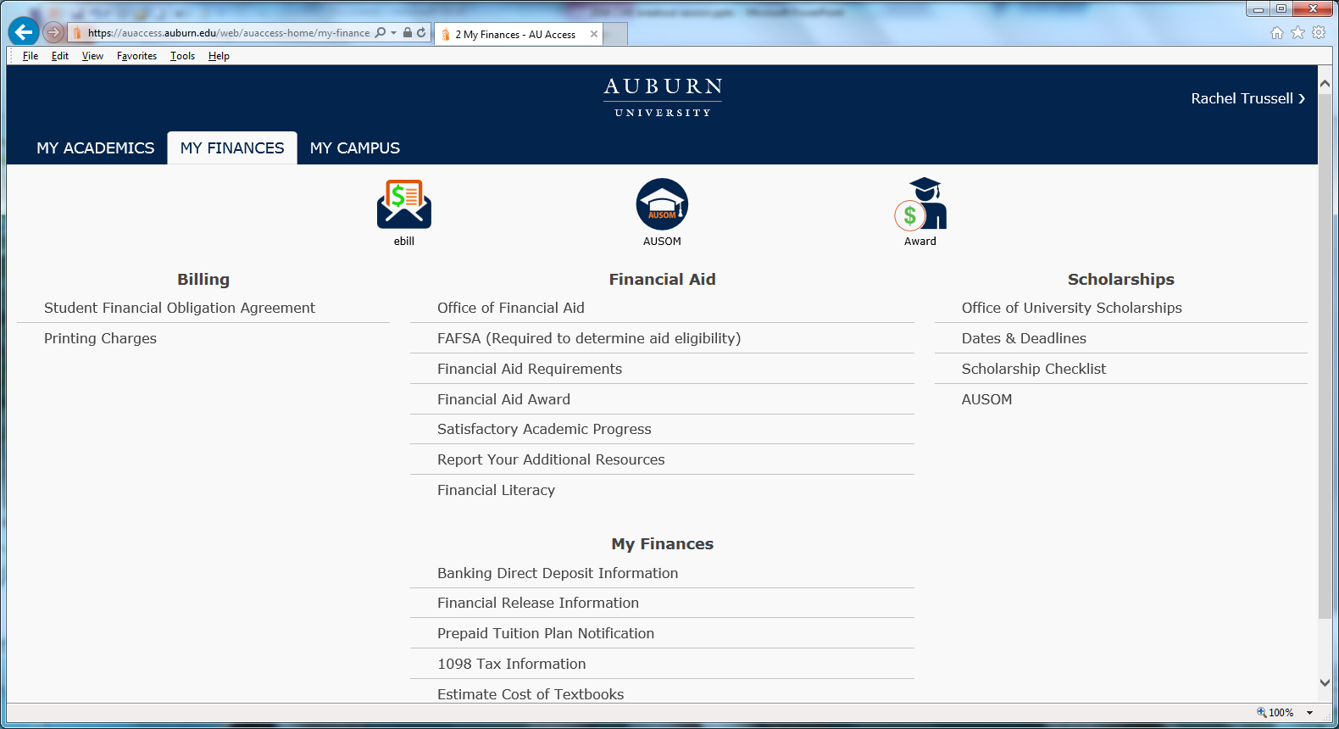
Where and How Students Access eBill
Click eBill

Slide 11
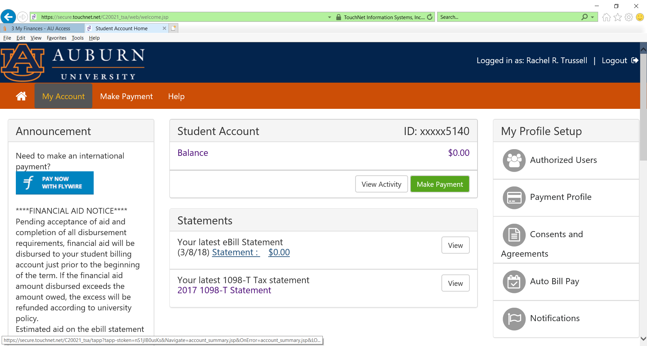
Where and How Students Access eBill
Viewing Statement
Click Statement

Slide 12
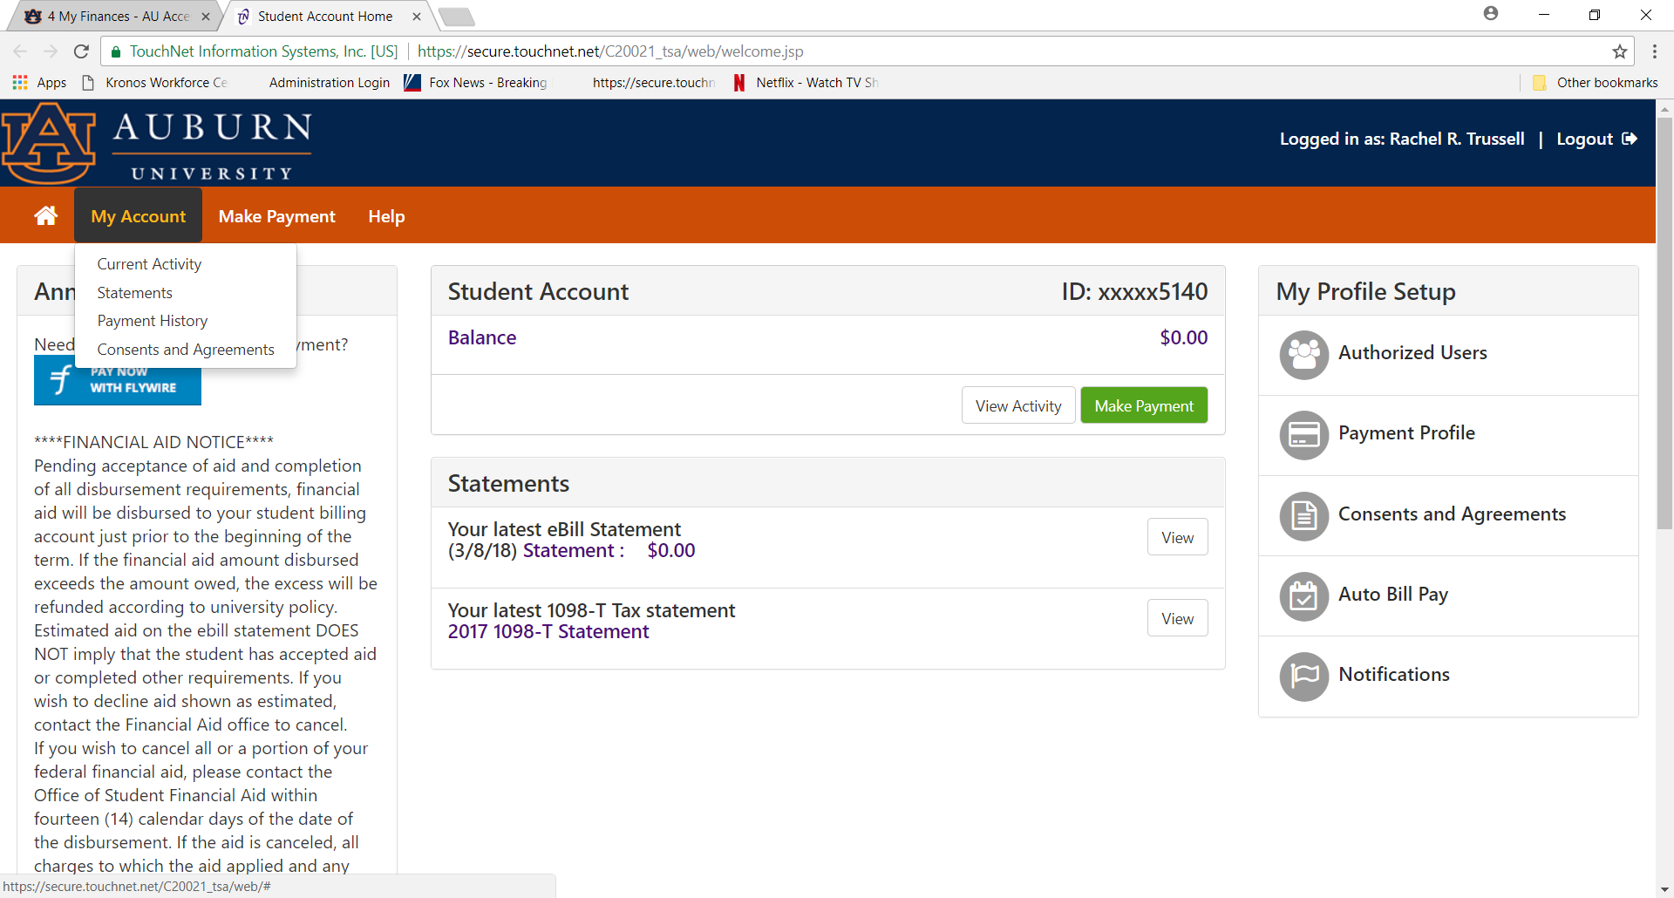
Where and How Students Access eBill
Another way to view Statement
Click My Account for drop down box, then click on Statements.

Slide 13
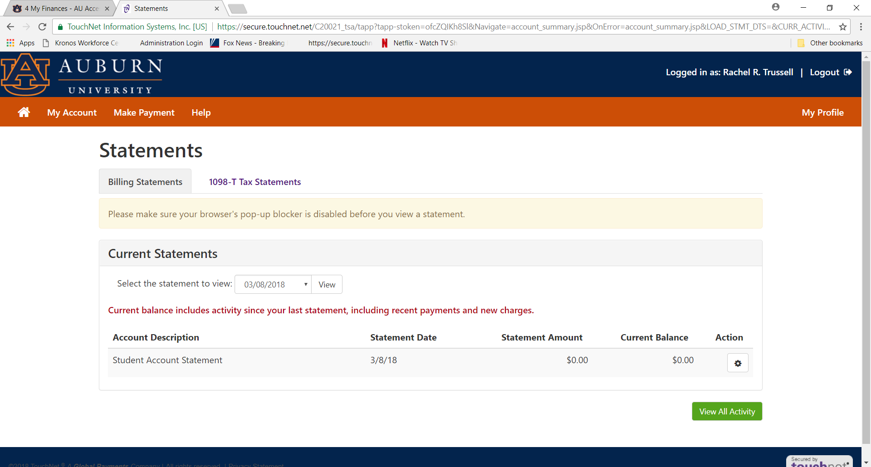
Where and How Students Access eBill
Viewing Statements
Click statement date you want to view and then click “View”

Slide 14
Terms codes
Term codes:
  201910 = Fall 2018
  201920 = Spring 2019
  201930 = Summer 2019

Slide 15

eBill Examples
Reynolds, Mike
Student ID# 902251977
Statement Date: 07-13-2018
Due Date: 08-10-2018
Auburn University
Office of Student Financial Services
203 Mary Martin Hall
Auburn University, AL. 36849-5119
(334) 844-4634
Transaction Date | Code | Description |  | Charge | Credit
 |  | Previous Account Balance
 |  | ---CURRENT CHARGES/PAYMENTS---
07-13-2018 | 201910 | Dining Plan |  | 350.00
07-13-2018 | 201910 | Tuition Resident Undergraduate |  | 5,638.00
CURRENT DUE |  |  | $5,988.00
TOTAL ACCOUNT BALANCE |  |  | $5,988.00

Slide 16
eBill Examples
Reynolds, Mike
Student ID# 902251977
Statement Date: 07-13-2018
Due Date: 08-10-2018
Auburn University
Office of Student Financial Services
203 Mary Martin Hall
Auburn University, AL. 36849-5119
(334) 844-4634
Transaction Date | Code | Description |  | Charge | Credit
 |  | Previous Account Balance |  | 25.00
 |  | ---CURRENT CHARGES/PAYMENTS---
07-13-2018 | 201910 | Dining Plan |  | 1,100.00
07-13-2018 | 201910 | Tuition Non-Resident Undergraduate |  | 15,262.00
07-13-2018 | 201910 | Village Rent - Double Room |  | 4,800.00
 |  | $$$ESTIMATED FINANCIAL AID$$$
07-13-2018 | 201910 | AU Board of Trustees Scholarship |  |  | 750.00
CURRENT DUE |  |  | $20,437.00
TOTAL ACCOUNT BALANCE |  |  | $21,187.00

Slide 17
eBill Examples
Reynolds, Mike
Student ID# 902251977
Statement Date: 07-13-2018
Due Date: 08-10-2018
Auburn University
Office of Student Financial Services
203 Mary Martin Hall
Auburn University, AL. 36849-5119
(334) 844-4634
Transaction Date | Code | Description |  | Charge | Credit
 |  | Previous Account Balance
 |  | ---CURRENT CHARGES/PAYMENTS---
07-13-2018 | 201910 | Dining Plan |  | 350.00
07-13-2018 | 201910 | Tuition Resident Undergraduate |  | 5,638.00
07-13-2018 | 201910 | PACT 18F / 201910 |  |  | 4,983.65
CURRENT DUE |  |  | $1,004.35
TOTAL ACCOUNT BALANCE |  |  | $5,988.00

Slide 18
eBill Examples
Reynolds, Mike
Student ID# 902251977
Statement Date: 07-13-2018
Due Date: 08-10-2018
Auburn University
Office of Student Financial Services
203 Mary Martin Hall
Auburn University, AL. 36849-5119
(334) 844-4634
Transaction Date | Code | Description |  | Charge | Credit
 |  | Previous Account Balance |  | 25.00
 |  | ---CURRENT CHARGES/PAYMENTS---
07-13-2018 | 201910 | Dining Plan |  | 350.00
07-13-2018 | 201910 | Tuition Resident Undergraduate |  | 5,638.00
 |  | $$$ESTIMATED FINANCIAL AID$$$
07-13-2018 | 201910 | Unsubsidized Direct Loan |  |  | 990.00
07-13-2018 | 201910 | Federal Pell Grant |  |  | 2,887.00
CURRENT DUE |  |  | $2,136.00
TOTAL ACCOUNT BALANCE |  |  | $6,013.00

Slide 19
eBill Examples
IMPORTANT!!!!
  Student loans will stay under Estimated Financial Aid on the statements until after they are transferred to the e-Bill (about a week before school starts).
  They will only transfer IF the student has ….
    Accepted the loan(s) on Auburn’s system AND
    Completed the Entrance Counseling AND Master Promissory Note at www.studentloans.gov
  If student loan requirements not completed within a reasonable time frame, they will drop off “Estimated Financial Aid” on statement.
  By filling out the FAFSA, any eligible aid including loans are posted on the financial aid award. If students knows that they don’t want the loans, go ahead and decline them.

Slide 20
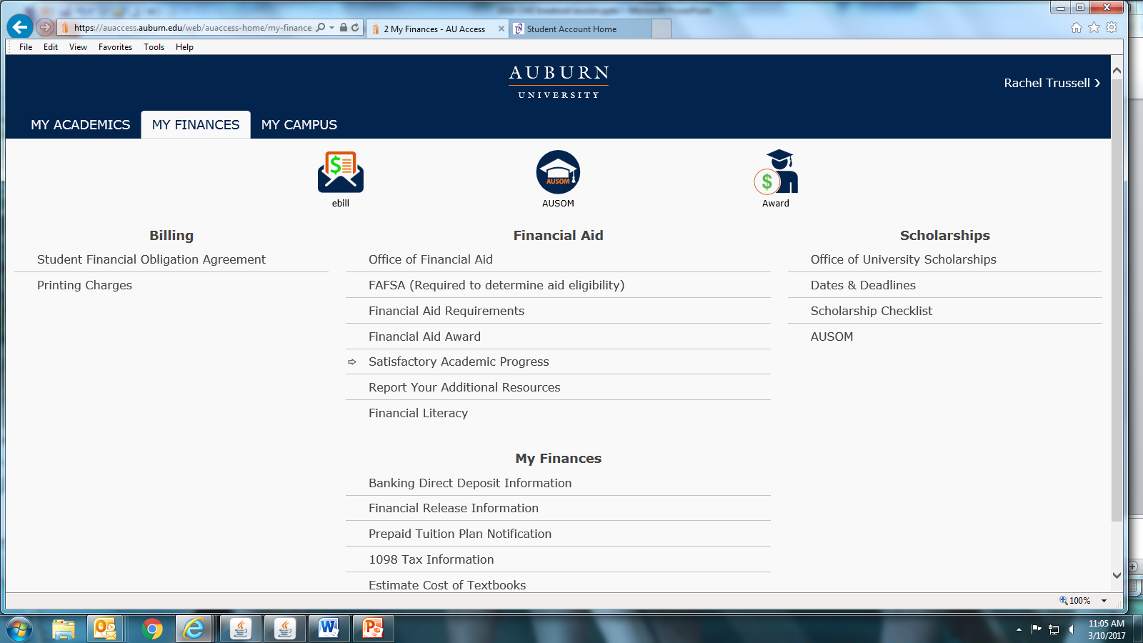
Add Direct Deposit Information
Click to Add Direct Deposit Information

Slide 21
Add Direct Deposit Information
VPN two-factor authentication
To enhance security for Auburn University data, students and employees, Auburn has implemented a high-security login process referred to as two-factor authentication. Auburn uses Duo Security to ask individuals for a secondary confirmation of their identity at log in using a physical device in their possession. The physical device may be a smartphone or tablet using an app, a text message to a phone, pressing a hardware token device or an automated voice call to a landline or cell phone.
Users connecting to the Virtual Private Network, or VPN, must select the 2FACTOR VPN profile, which requires two-factor authentication.
Some web applications with visibility to sensitive information have already implemented two-factor authentication and over time more web resources will adopt this kind of authentication.
More information about two-factor authentication with Duo Security is available at http://www.auburn.edu/oit/2factor/#online
Questions about two-factor authentication, device registration and VPN support should be sent to your IT Provider or the OIT HelpDesk.

Slide 22
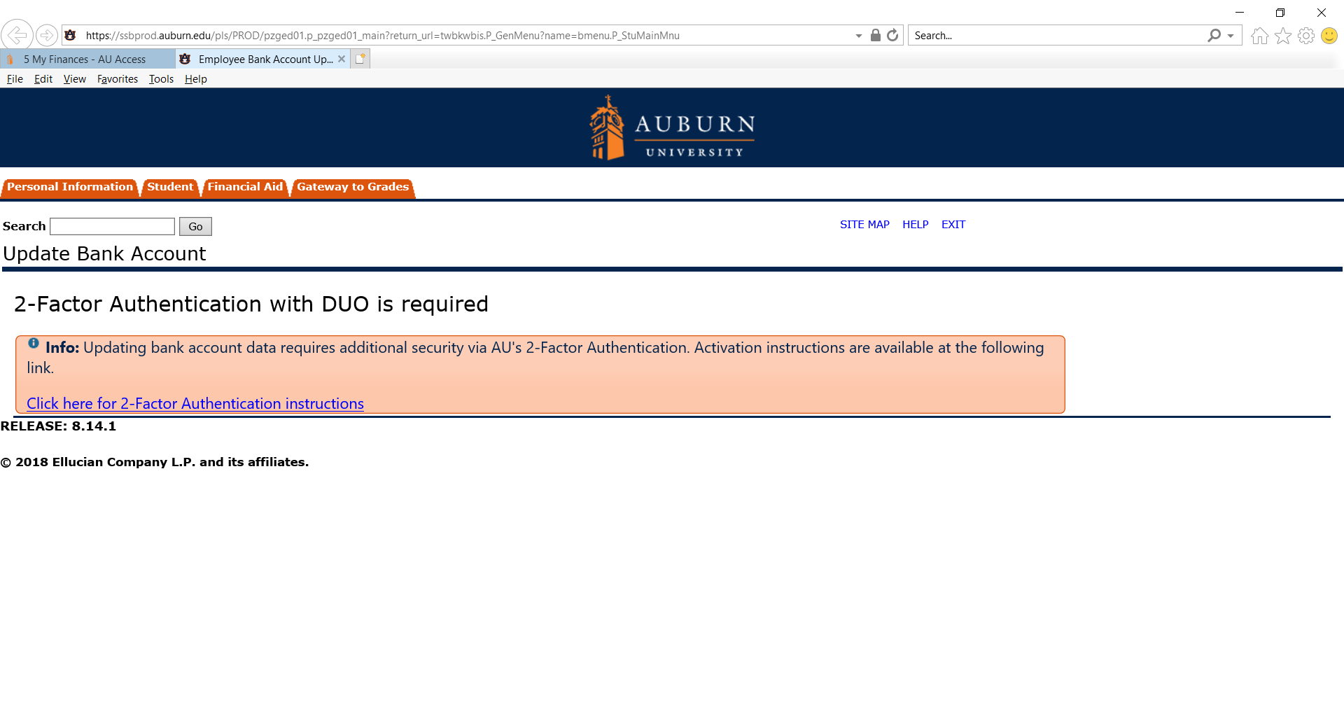
Add Direct Deposit Information
Click for instructions for 2-Factor Authentication Instructions

Slide 23
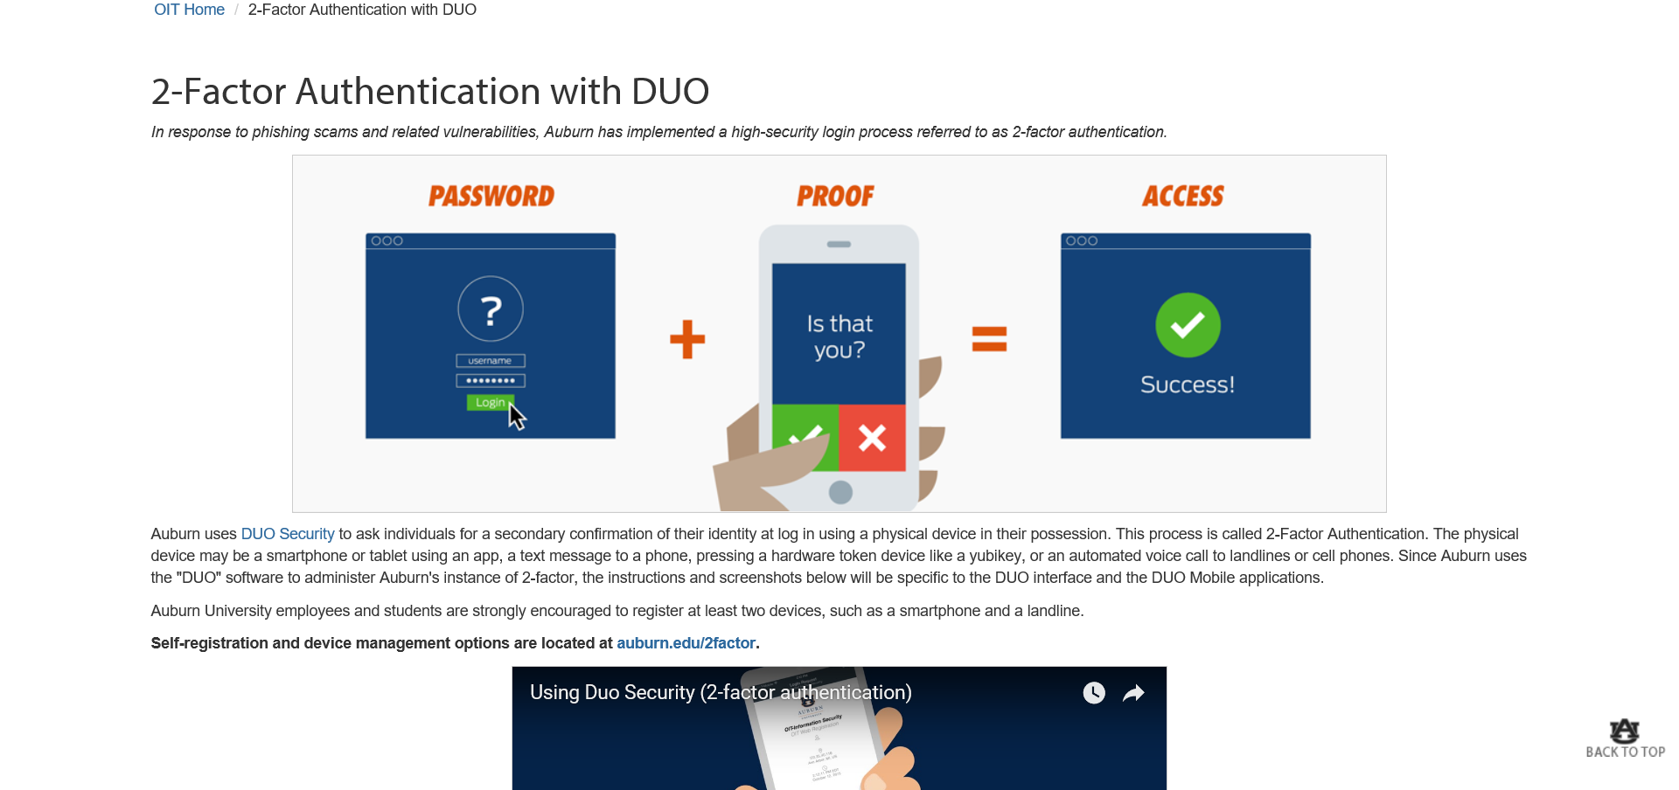
Add Direct Deposit Information
IMPORTANT – STUDENT MUST COMPLETE – NOT PARENT. Students must activate the 2-Factor Authentication.

Slide 24
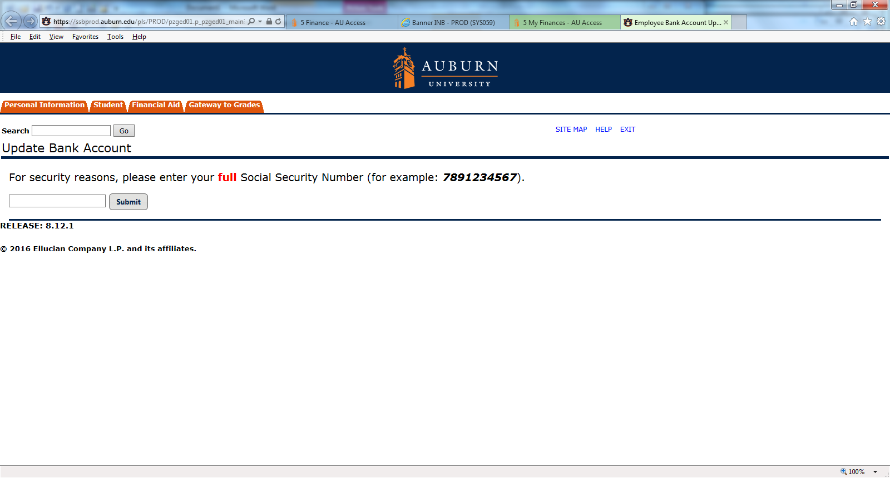
Add Direct Deposit Information

Slide 25
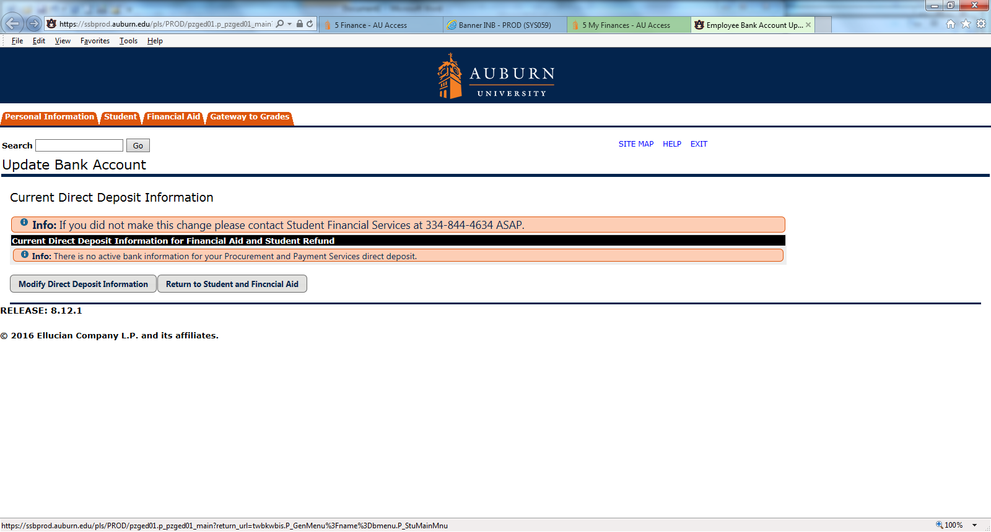
Add Direct Deposit Information
Click Modify Direct Deposit Information

Slide 26
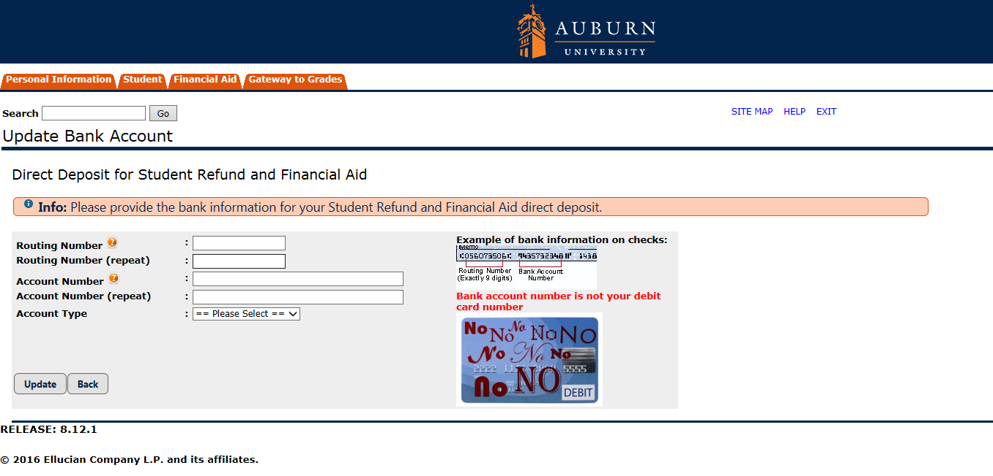
Add Direct Deposit Information
Enter Account Information This is not the debit card number! Click Update

Slide 27
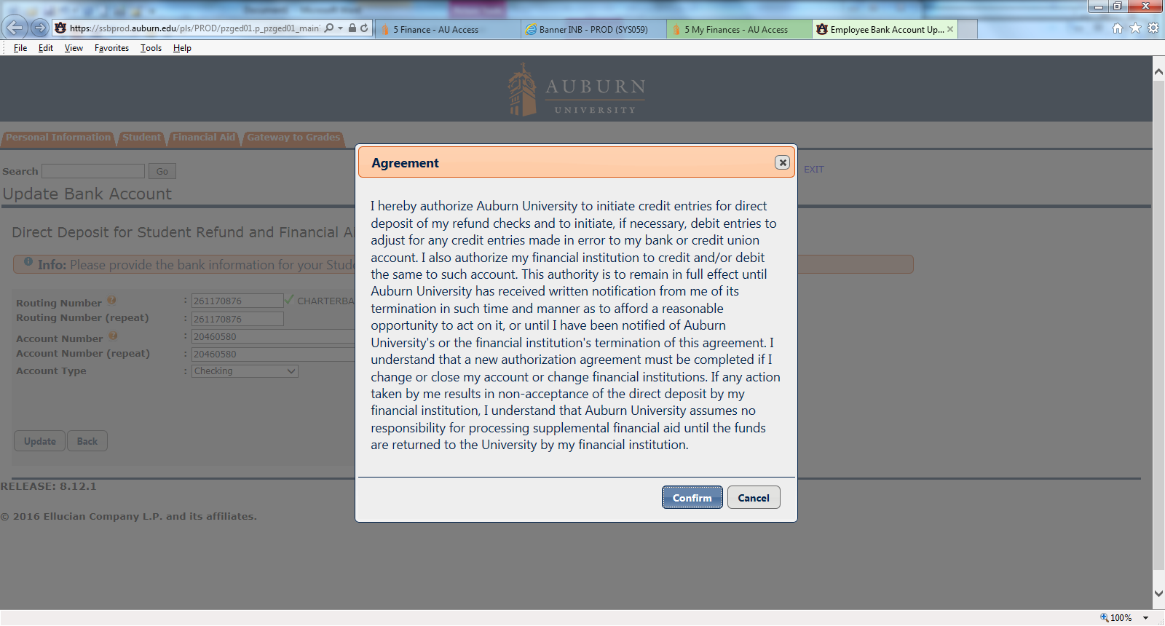
Add Direct Deposit Information
Read and Click “Confirm”

Slide 28
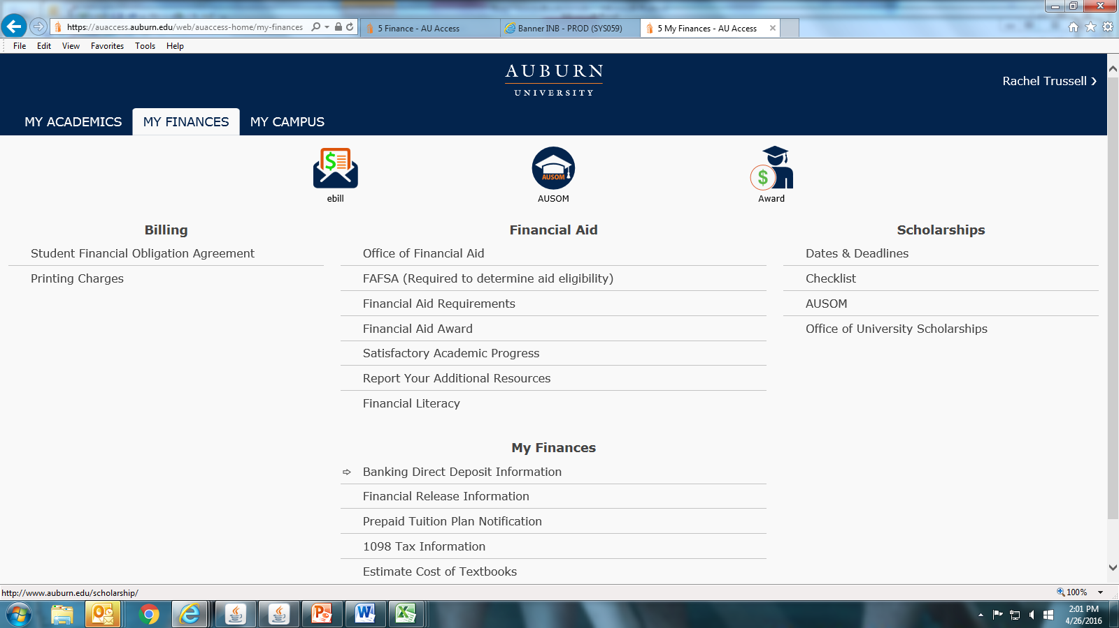
Complete Prepaid Tuition Plan Notification
Student’s Access
Click to Complete Prepaid Tuition Notification Plan

Slide 29
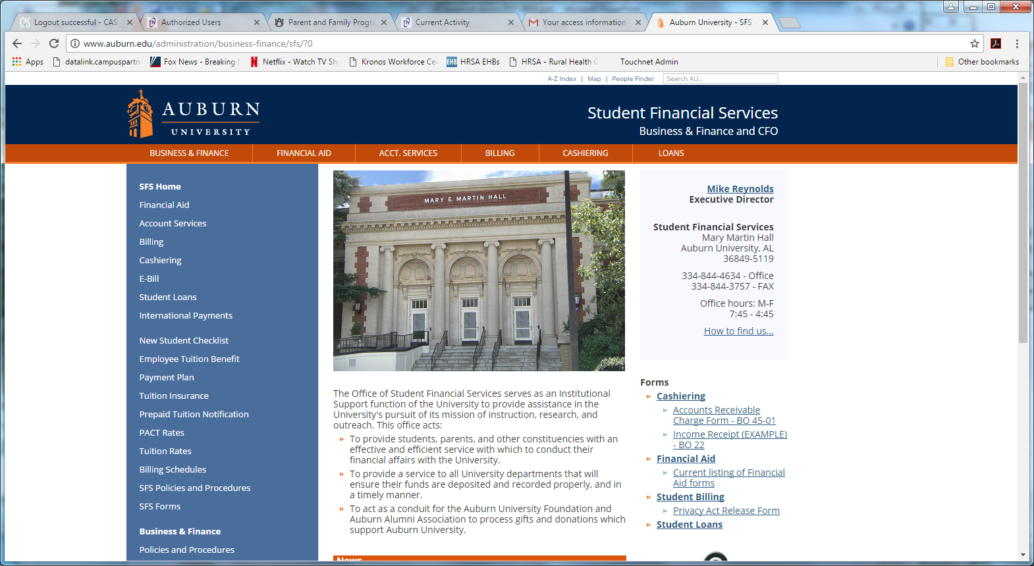
Another way to access: Prepaid Tuition Plan Notification – parents and others www.auburn.edu/sfs
Click to Complete Prepaid Tuition Notification Plan

Slide 30
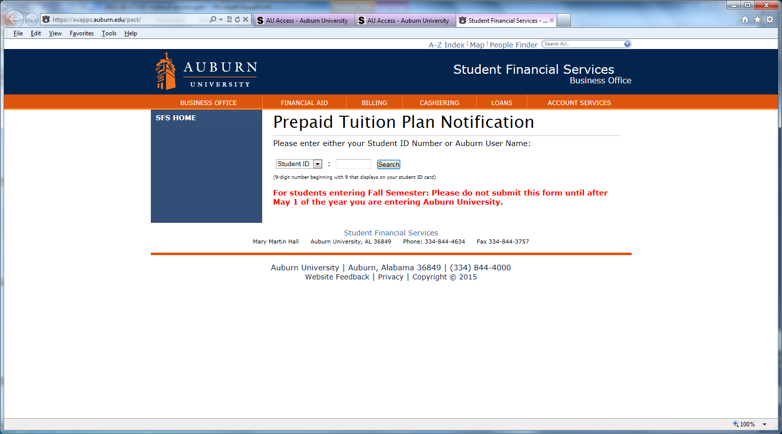
Complete Prepaid Tuition Plan Notification
Complete All Fields and Submit

Slide 31
2018-19 PACT rates
PACT 2017 Benefit Rates + 7%
Credit Hours | 2018-2019 Tuition/Fees | PACT Rates | Student Balance
1 | 1,227.00 | 931.12 | 295.88
2 | 1,628.00 | 1,299.53 | 328.47
3 | 2,029.00 | 1,667.95 | 361.05
4 | 2,430.00 | 2,036.36 | 393.64
5 | 2,831.00 | 2,404.77 | 426.23
6 | 3,232.00 | 2,773.18 | 458.82
7 | 3,633.00 | 3,141.59 | 491.41
8 | 4,034.00 | 3,510.01 | 523.99
9 | 4,435.00 | 3,878.42 | 556.58
10 | 4,836.00 | 4,246.83 | 589.17
11 | 5,237.00 | 4,615.23 | 621.77
12 or more | 5,638.00 | 4,983.65 | 654.35

Slide 32
Auburn Family Portal
https://familyportal.auburn.edu/
Your one-stop shop for:
Access to important campus news and deadlines
Insight into your student's progress and financial details
Personalized newsletters on your schedule
Announcements via email and text message
Sharing of updates with friends and family

Slide 33
Auburn Family Portal
Allows parents to request access to:
  Academic Information:
    Class Schedule/Enrollment
    Graduation information
    Grade information
  Financial information
    Financial Aid Information
    Holds on Account
    Account Balance

Slide 34
Auburn Family Portal
Though students can request to see the account balance through this portal, they cannot pay the bill directly from the Family Portal website. When a bill is due, it will link them to the eBill Authorized User sign in. Because of this, students must also grant access through eBill Authorized User.

Slide 35

Authorizations
Student gives to parents
There are two authorizations for Student Financial Services. Giving access to one does not give you access to the other. Student must do both!
1. Financial Information Release
Authorizes SFS to discuss eBill/
financial aid
2. Authorized user in eBill system
Gives authorized user access to
student’s eBill account

Slide 36
Complete Financial Release Information
Click to Complete Financial Release Information

Slide 37
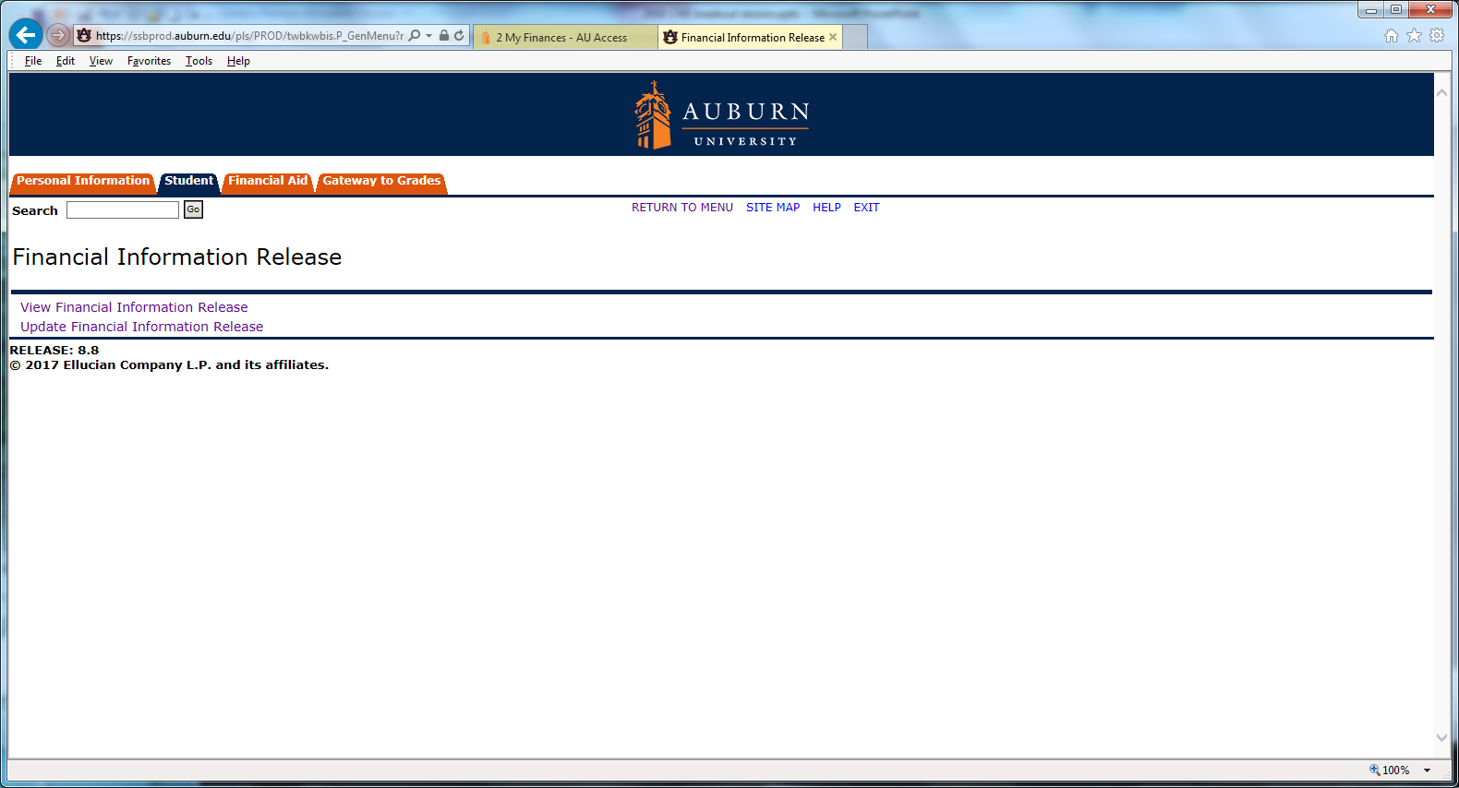
Complete Financial Release Information
Click Update Financial Information Release

Slide 38
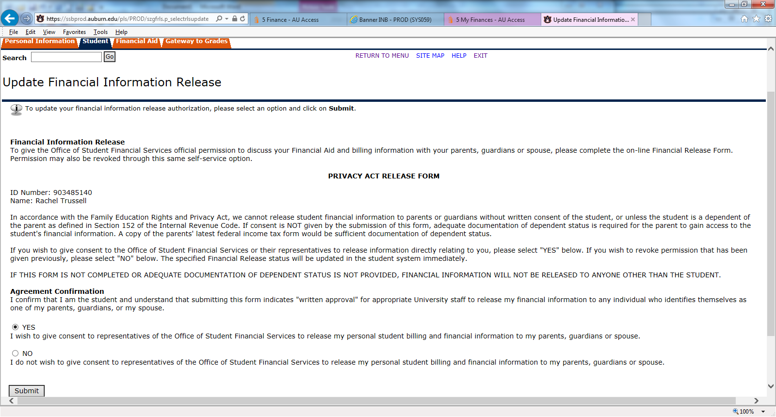
Complete Release of Information Statement
It is already checked “Yes”. Click Submit.

Slide 39
Add Authorized User
Click eBill

Slide 40
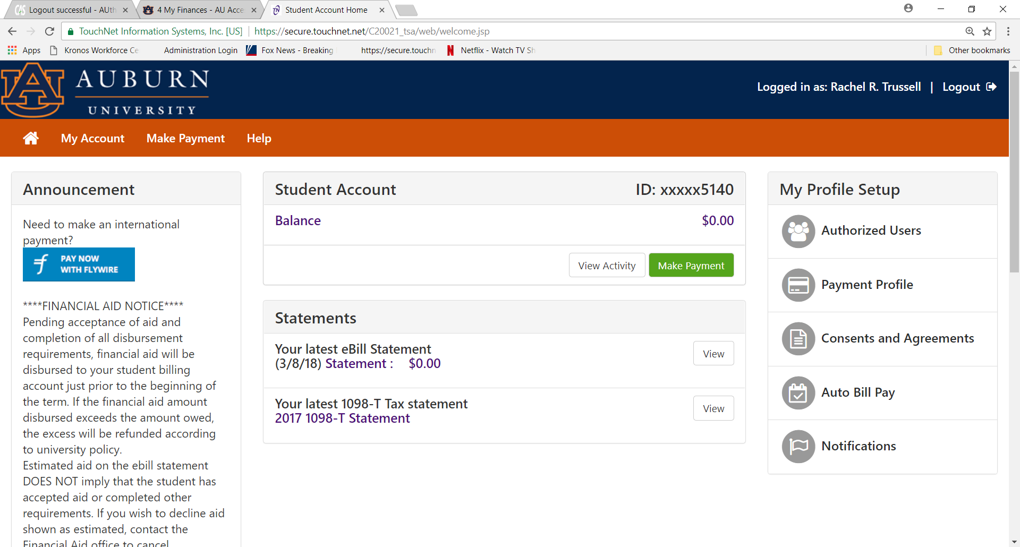
Add Authorized User
Click Authorized Users

Slide 41
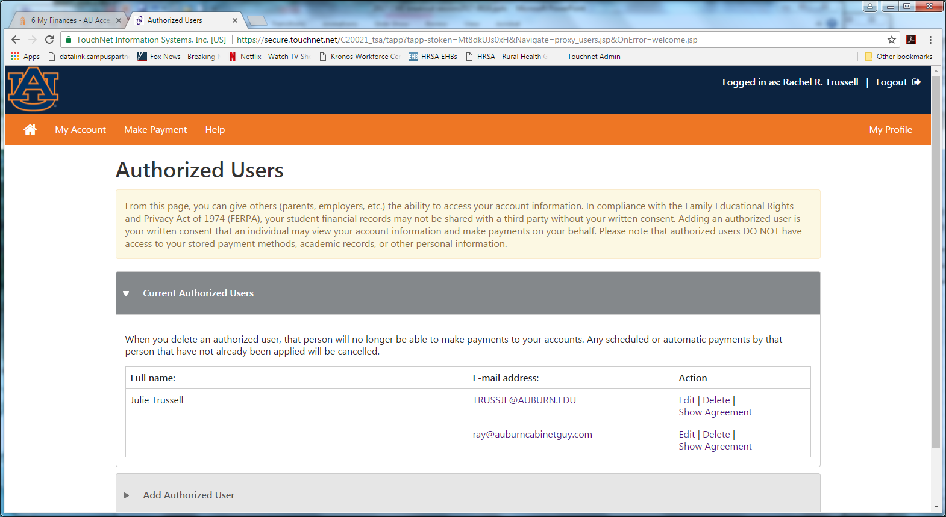
Add Authorized User
Click on ‘Add Authorized User’

Slide 42
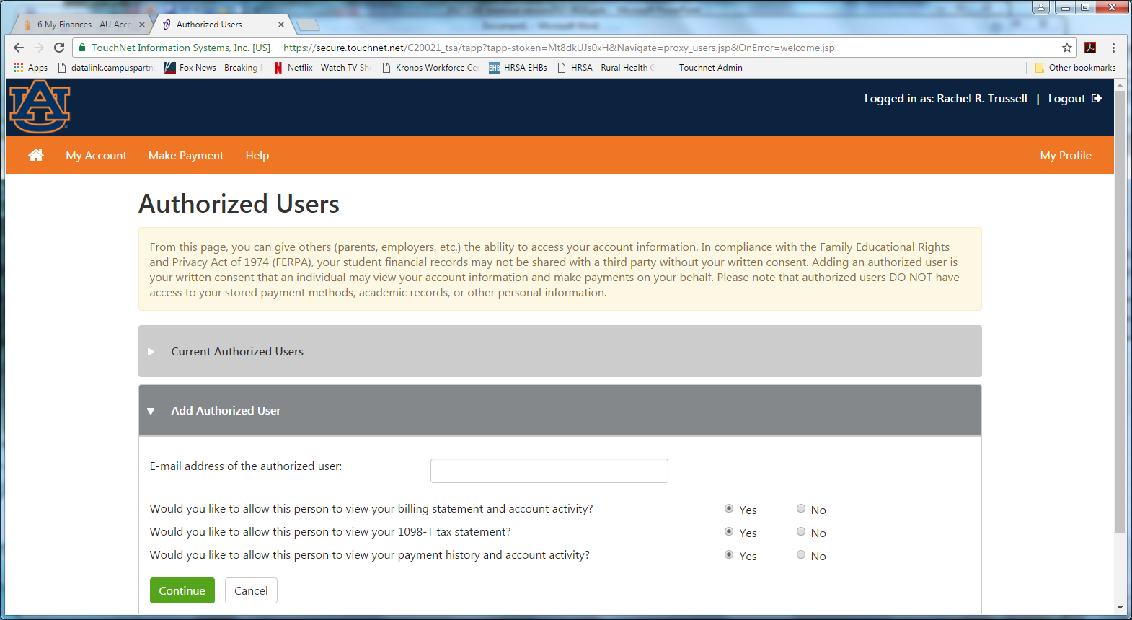
Add Authorized User
Fill in E-mail Address
Review to see if you want authorized user access to all three. Click Continue.

Slide 43
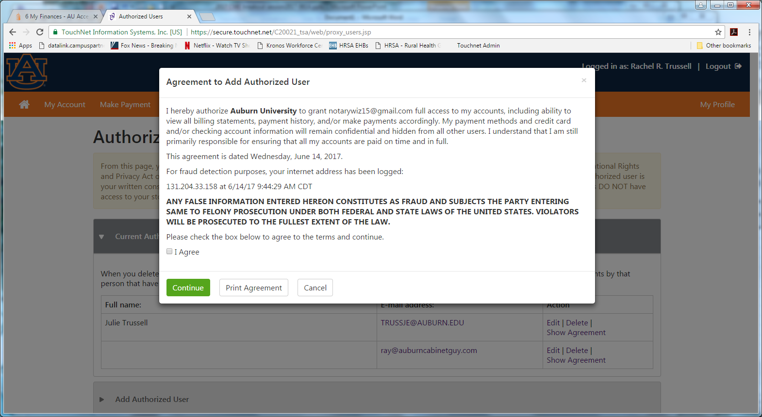
Add Authorized User
Click “I Agree” and “Continue”

Slide 44
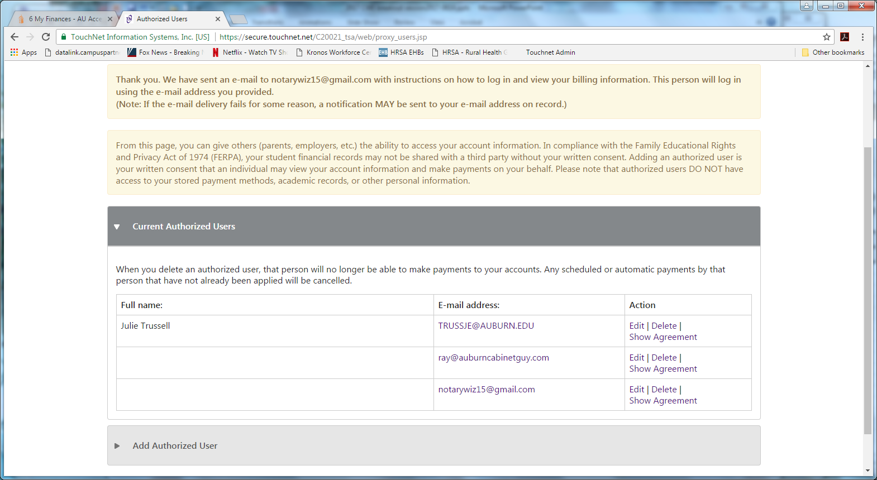
Add Authorized User
Confirmation that Authorized User Will Be Sent an E-mail.
Student can also edit/delete Authorized Users.

Slide 45
Add Authorized User
1st email to authorized user
Hello and welcome!
The student listed below has granted you online access to his or her billing information.
You can now make payments on behalf of this student, schedule, automate future payments, and more. To access the student’s account, please visit ebill.auburn.edu and log in using the username shown below. For security, we are sending the initial password for this account in a separate message.
Note: Please email helpdesk@auburn.edu for username and/or password issues.
ACCESS INFORMATION
Student Name: Rachel R. Trussell
Username: trussje@auburn.edu
Sincerely,
Auburn University Billing Department
Office of Student Financial Services
203 Mary Martin Hall
Auburn University, AL 36849-5119
(334) 844-4634
ebill@auburn.edu
www.auburn.edu/sfs

Slide 46
Add Authorized User
2nd email to authorized user
Hello and welcome!
The student listed below has granted you online access to his or her billing information.
You can now make, schedule, and automate payments on behalf of this student.
To access the student’s account, please visit ebill.auburn.edu and log in using the password shown below. For security, the other login information for this account is sent in a separate message.
Note: Please email helpdesk@auburn.edu for username and/or password issues.
ACCESS INFORMATION
Student Name: Rachel R. Trussell
Temporary Password: usuqhbrdaq
Sincerely,
Auburn University Billing Department
Office of Student Financial Services
203 Mary Martin Hall
Auburn University, AL 36849-5119
(334) 844-4634
ebill@auburn.edu
www.auburn.edu/sfs
Temporary password – can copy and paste

Slide 47
Authorized User
Authorized User in e-bill system
  Access to e-bill
  When bills are generated student gets email and any authorized user gets email
    Check SPAM
    Mark anything from Auburn University (@auburn.edu) as “Never Block Senders Domain”
  If you change emails…. Your student needs to update this information through e-bill

Slide 48
Authorized User Access #1
Three ways to get to E-bill system.
1. Type in URL:
  ebill.auburn.edu
  There is a link in your statement notification email.

Slide 49
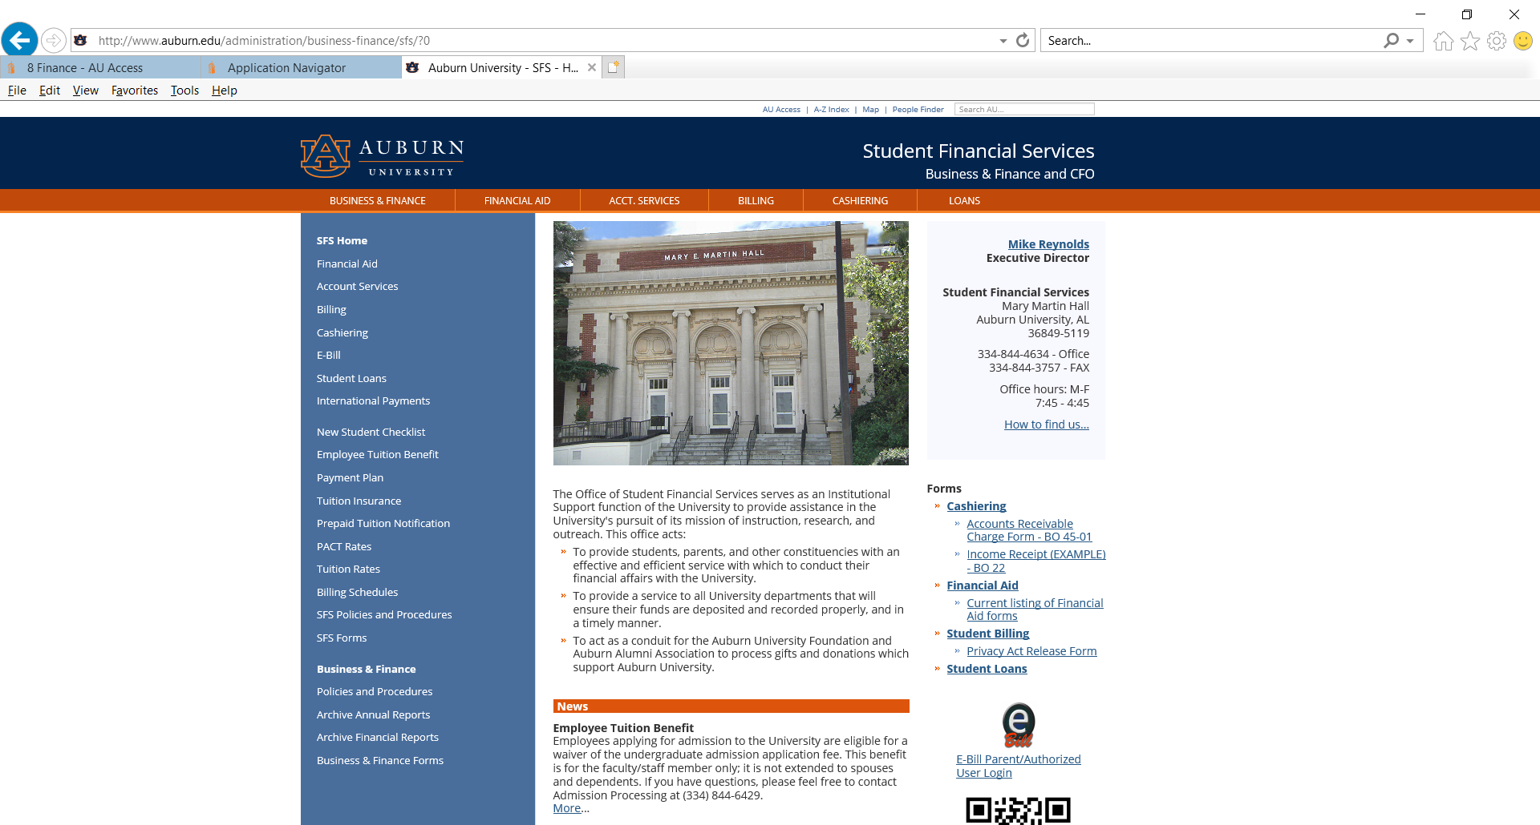
Authorized User Access #2
#2 – Go to www.auburn.edu/sfs
Click on ebill logo on main auburn.edu/sfs webpage

Slide 50
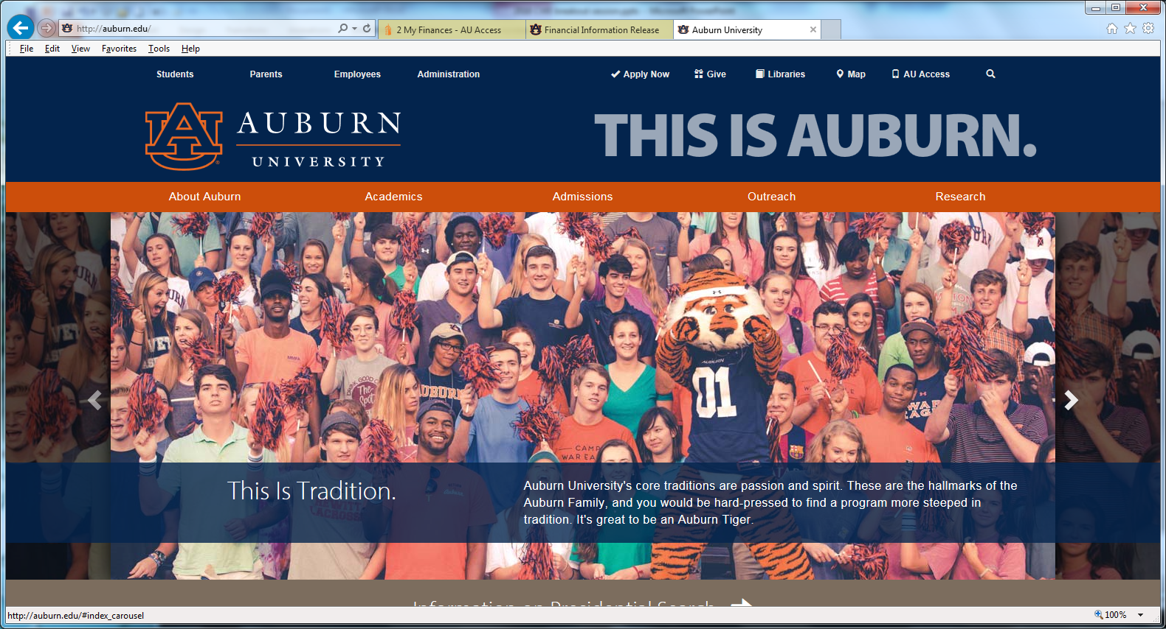
Authorized User Access #3 www.auburn.edu
Click Parents

Slide 51
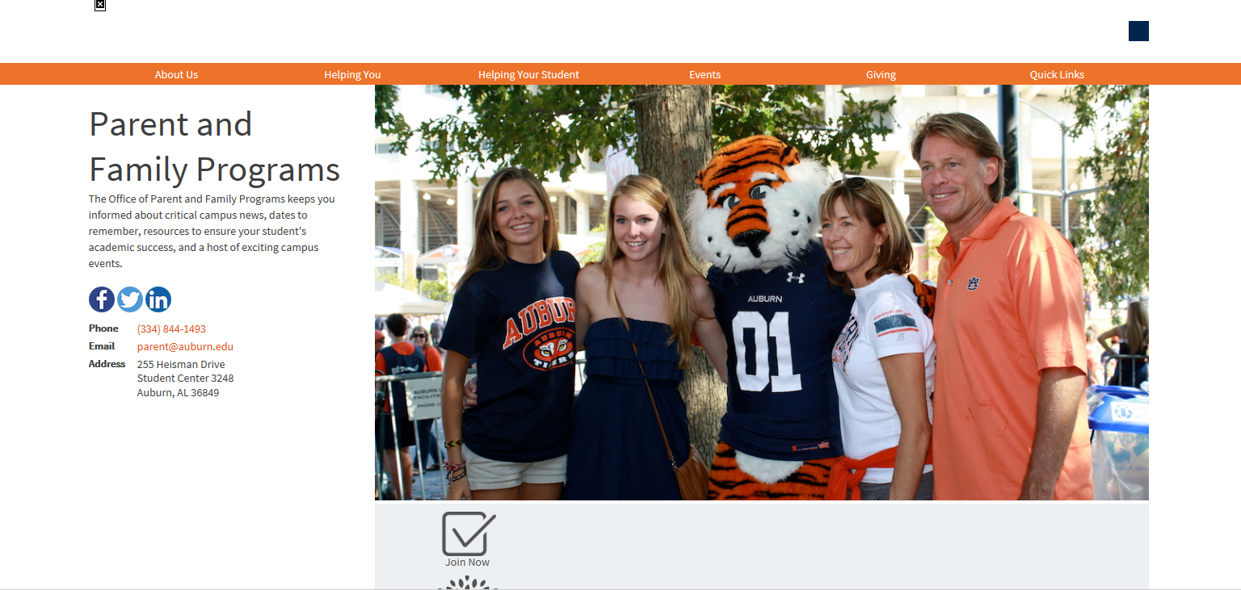
Authorized User Access #3 (cont)
Hover over “Quick Links”

Slide 52
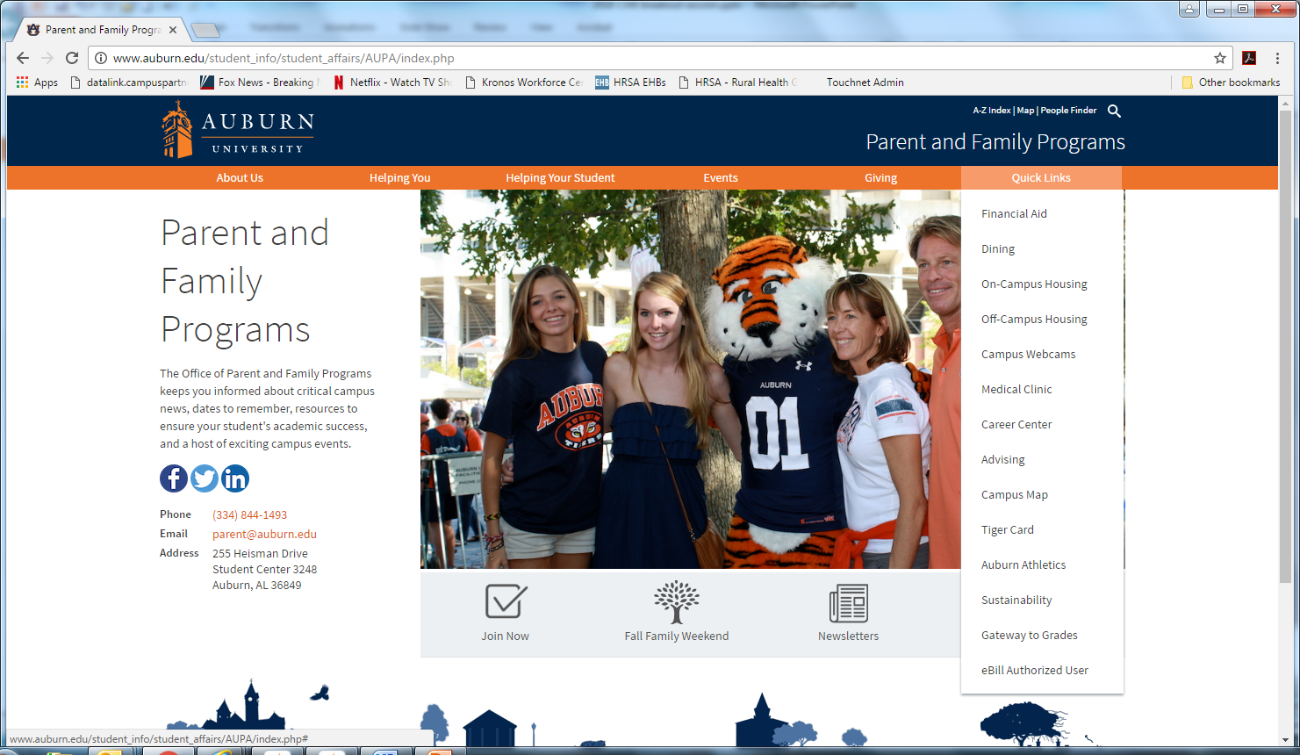
Authorized User Access #3 (cont)
Click on eBill Authorized User

Slide 53
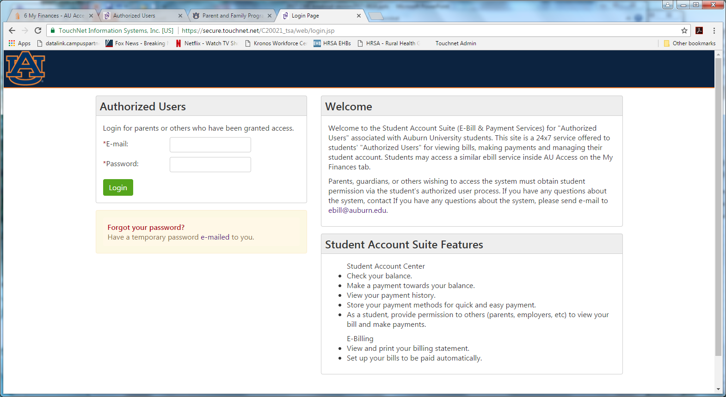
Authorized User Access ebill.auburn.edu
Fill in E-mail Address and Password

Slide 54
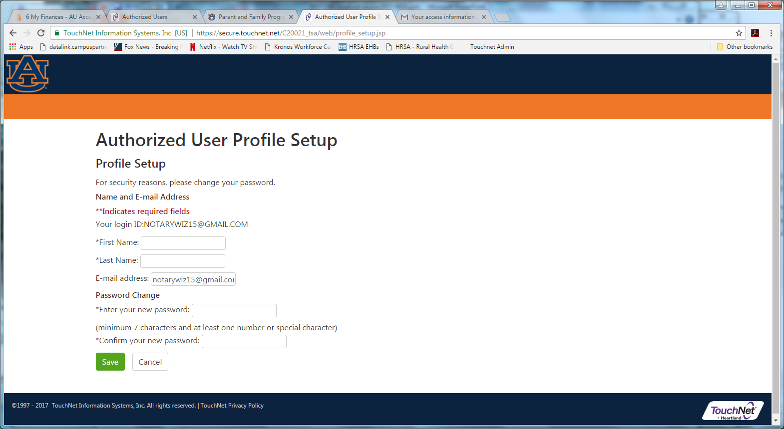
Authorized User Access ebill.auburn.edu
Fill in Your Full Name and enter NEW password. Click Save

Slide 55
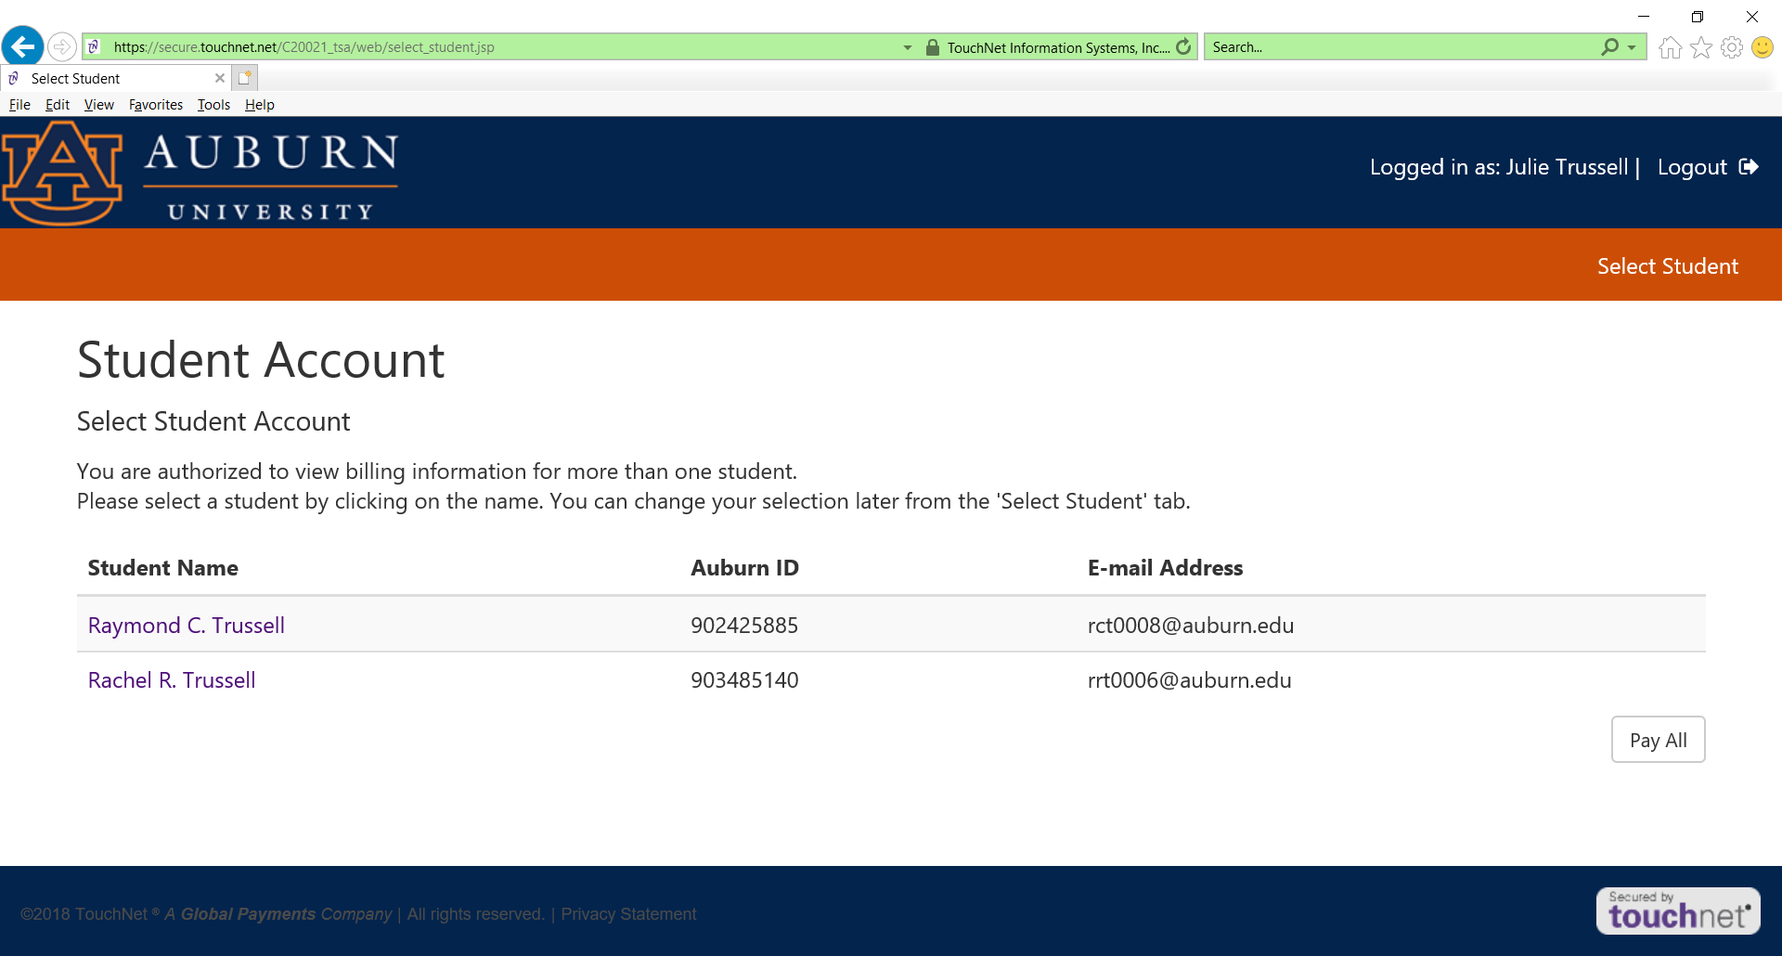
Authorized User Access
(more than one student)
Click on the student you want to view or if your can click on Pay All

Slide 56
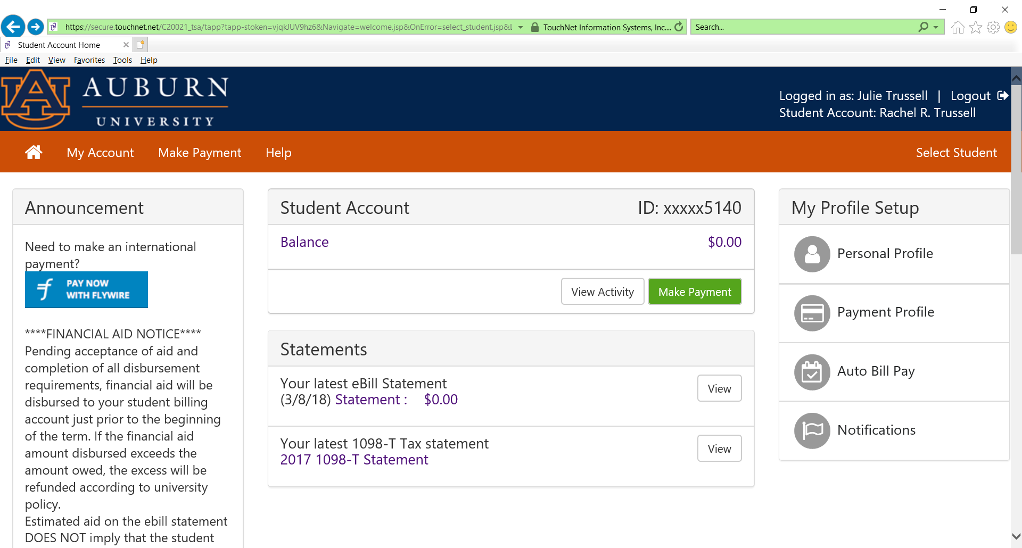
Authorized User Access ebill.auburn.edu
Authorized User’s view.
Very similar to Student View.
To make a payment, click on Make Payment

Slide 57
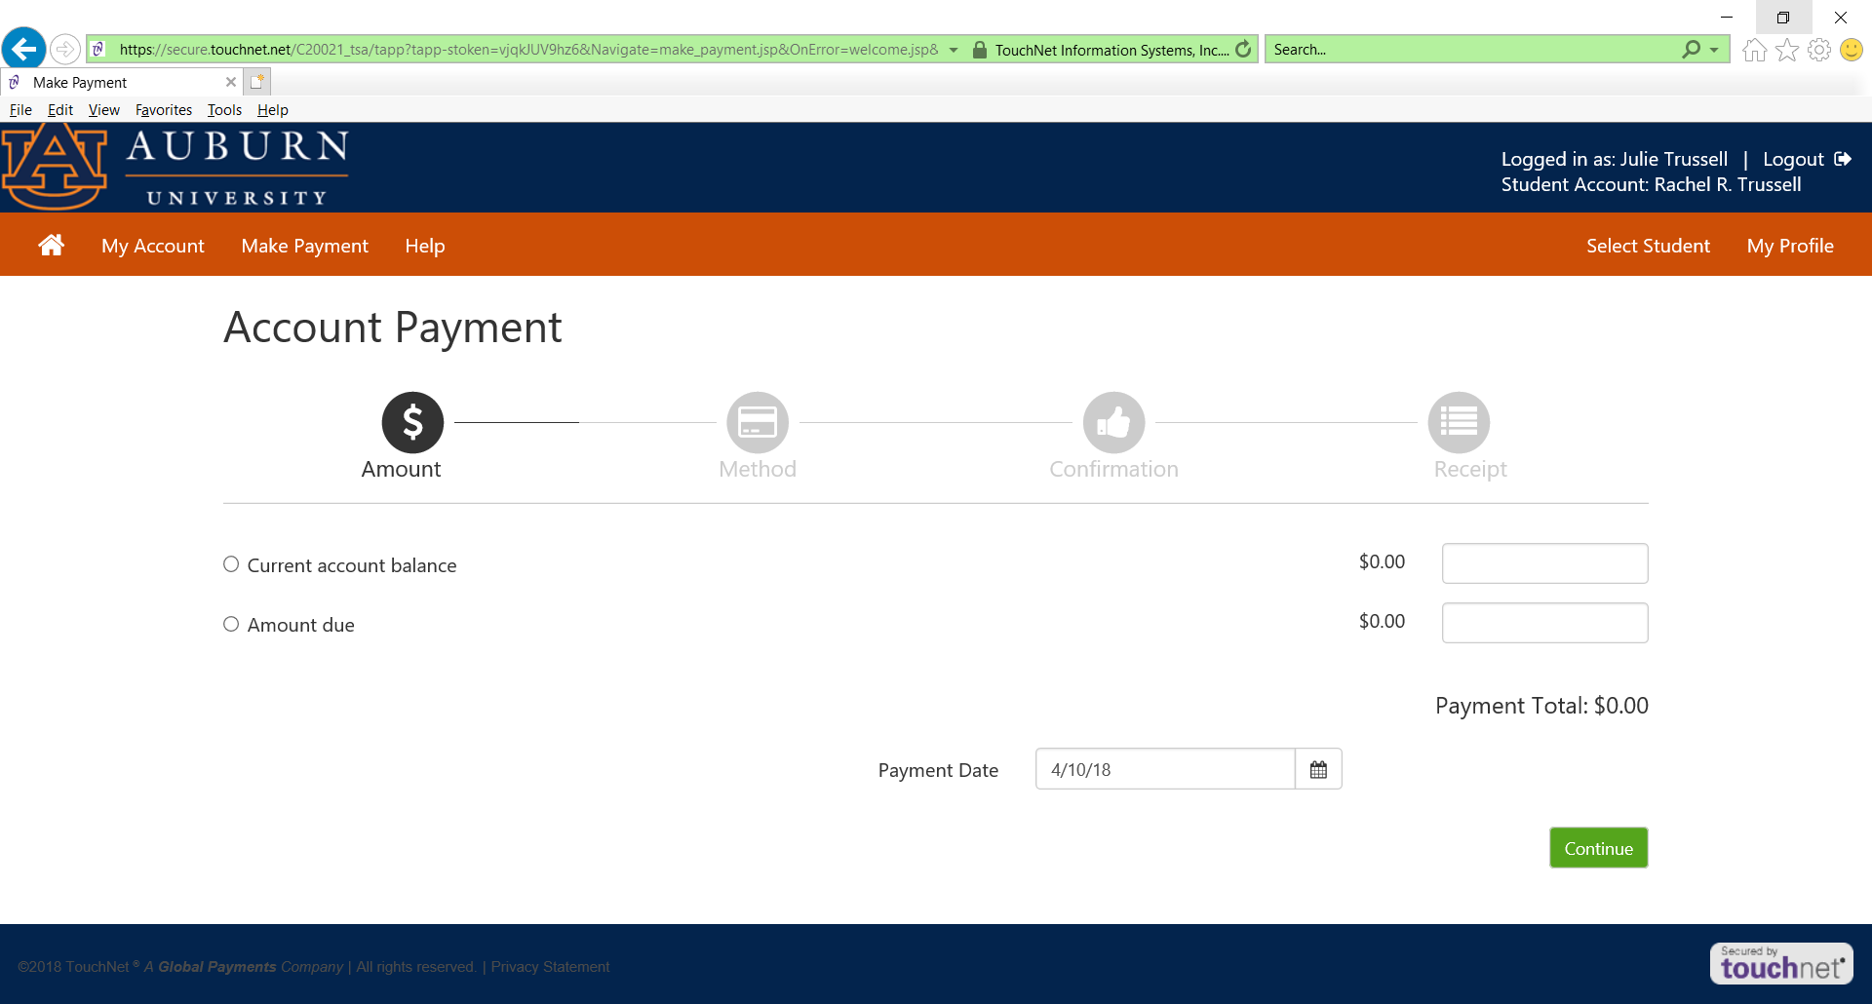
Make a Payment ebill.auburn.edu
Click which radio button you want.
Can specify future date.
To make half payment click radio button: “Amount due” – tab to box and type in dollar amount

Slide 58
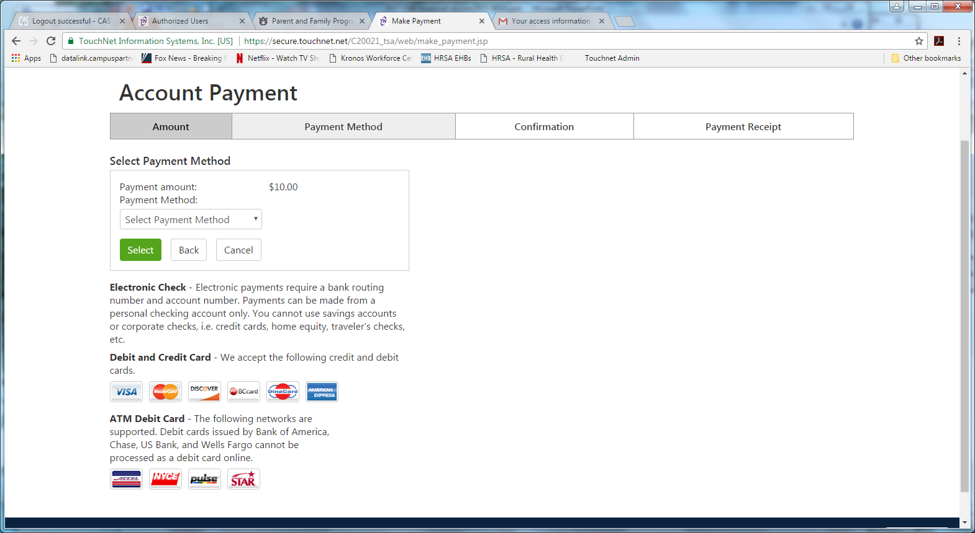
Make a Payment ebill.auburn.edu
Select Method from Menu

Slide 59
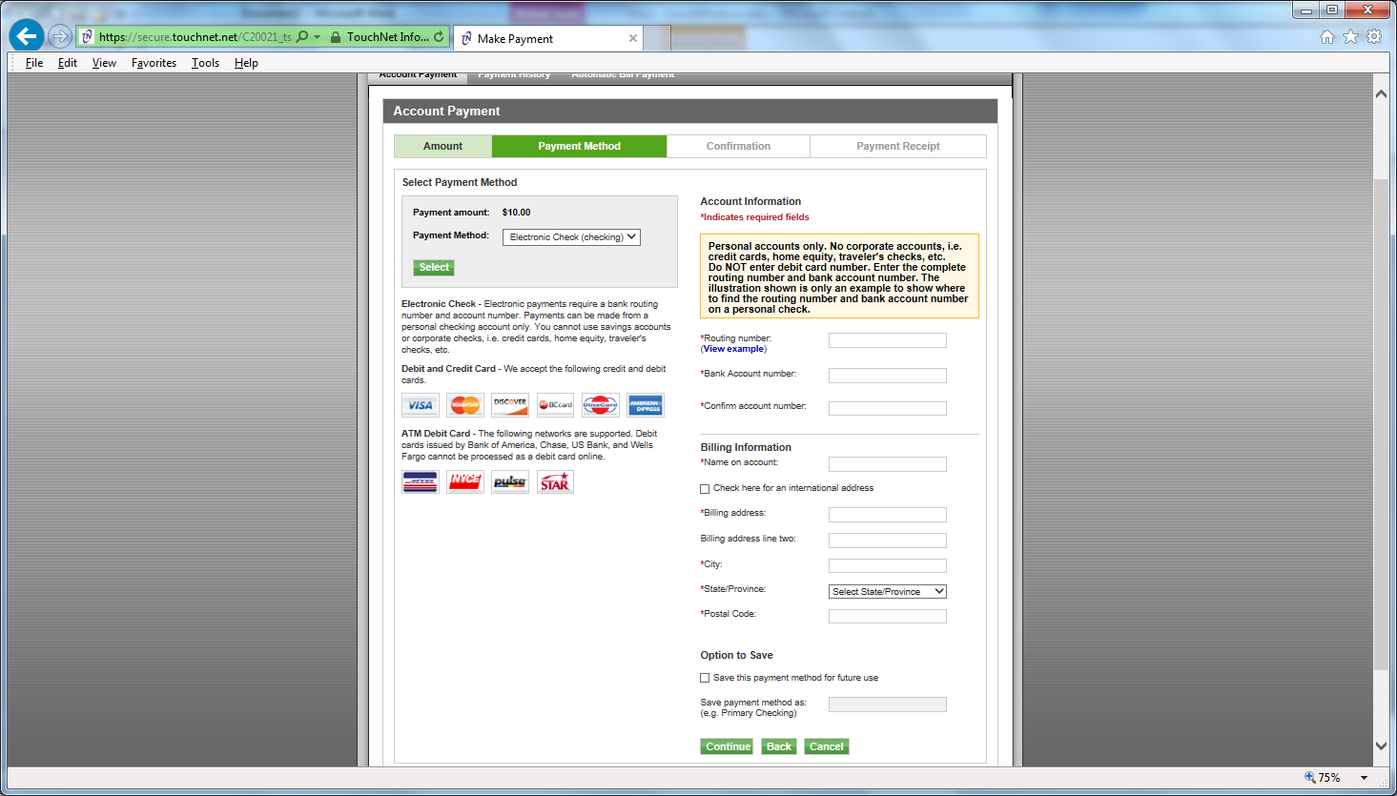
Make a Payment ebill.auburn.edu
Complete Routing and Account Information
Option to save information

Slide 60
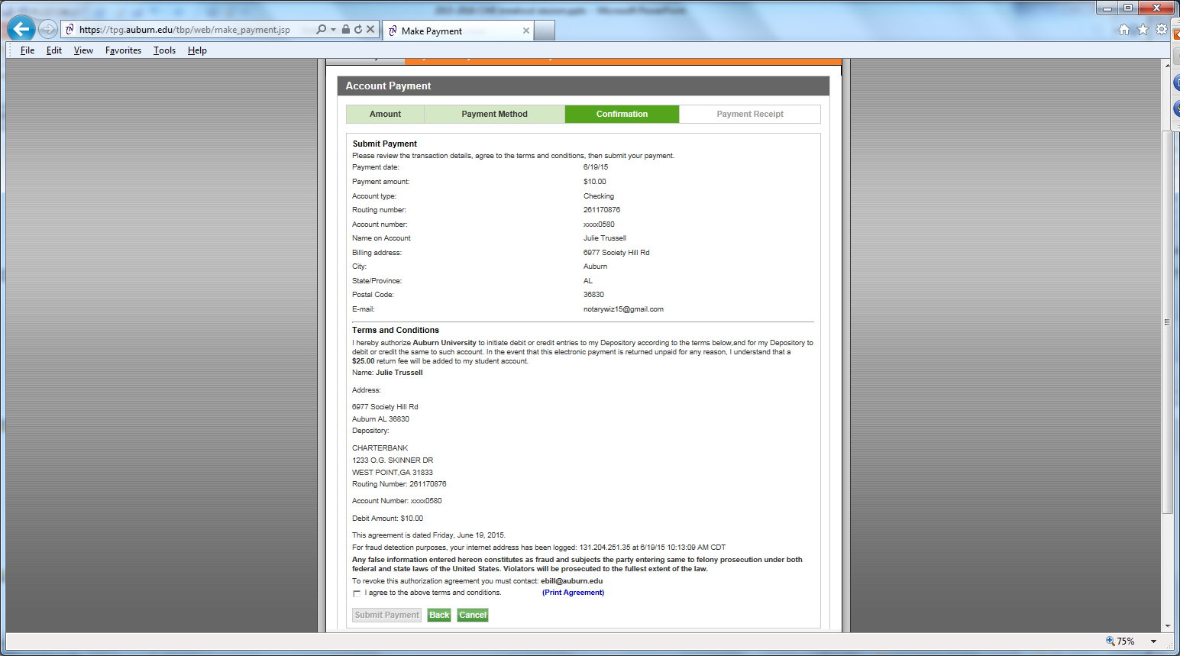
Make a Payment ebill.auburn.edu
Review and then click “I agree…”. Then click “submit payment”. You will get a confirmation email.

Slide 61

Auto Bill Pay ebill.auburn.edu
Click Auto Bill Pay

Slide 62
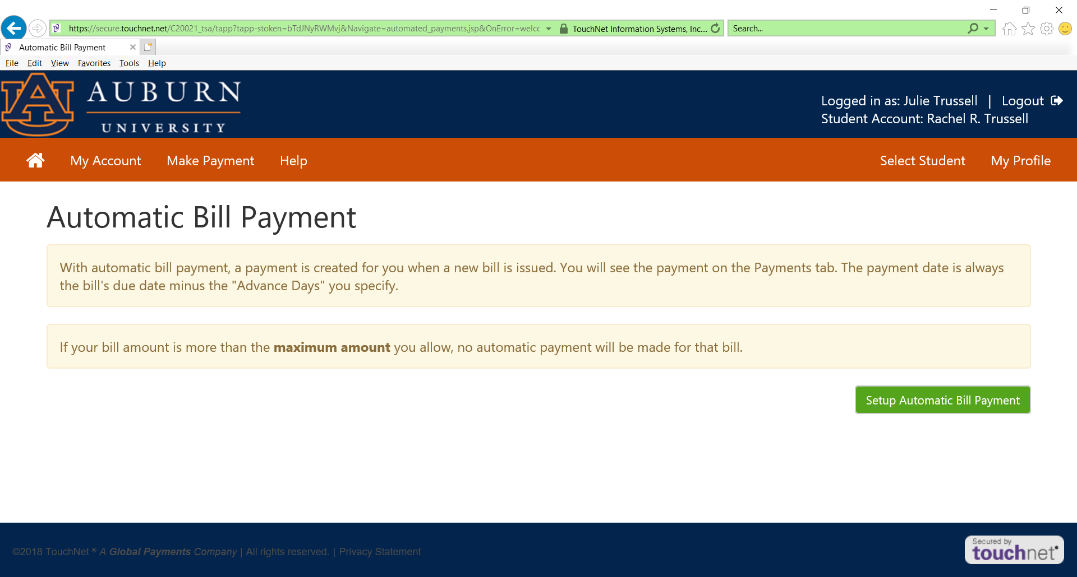
Auto Bill Pay ebill.auburn.edu

Slide 63
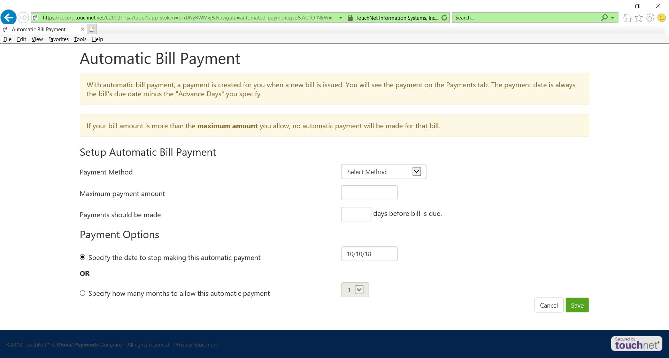
Auto Bill Pay ebill.auburn.edu
Should be used for small bills, not paying tuition and fees.

Slide 64
Important Dates
First Fall Bill Date - July 13, 2018
First Fall Due Date - August 10, 2018
  Must pay at least 50% by August 10, 2018 or class schedule will be dropped
Second Fall Bill date – August 16, 2018
Second Fall Due date – September 7, 2018
Annual Billing Schedule can be found at www.auburn.edu/billing

Slide 65
Payment Plan
Deferred Payment Plan Option through Auburn University
  You can divide the FIRST official bill of the semester into two half payments. First bills of the semester are issued in July (Fall semester), November (Spring semester), and April (Summer semester).
There is no notification of this. When you make a payment, just divide amount in half and that is what you will type in.

Slide 66
Payment Plan
Optional Prepayment Plan Option through TMS
  In partnership with Tuition Management Systems (TMS) you can pre-pay your semester charges. Visit auburn.afford.com or call 800-722-4867 for more information.

Slide 67
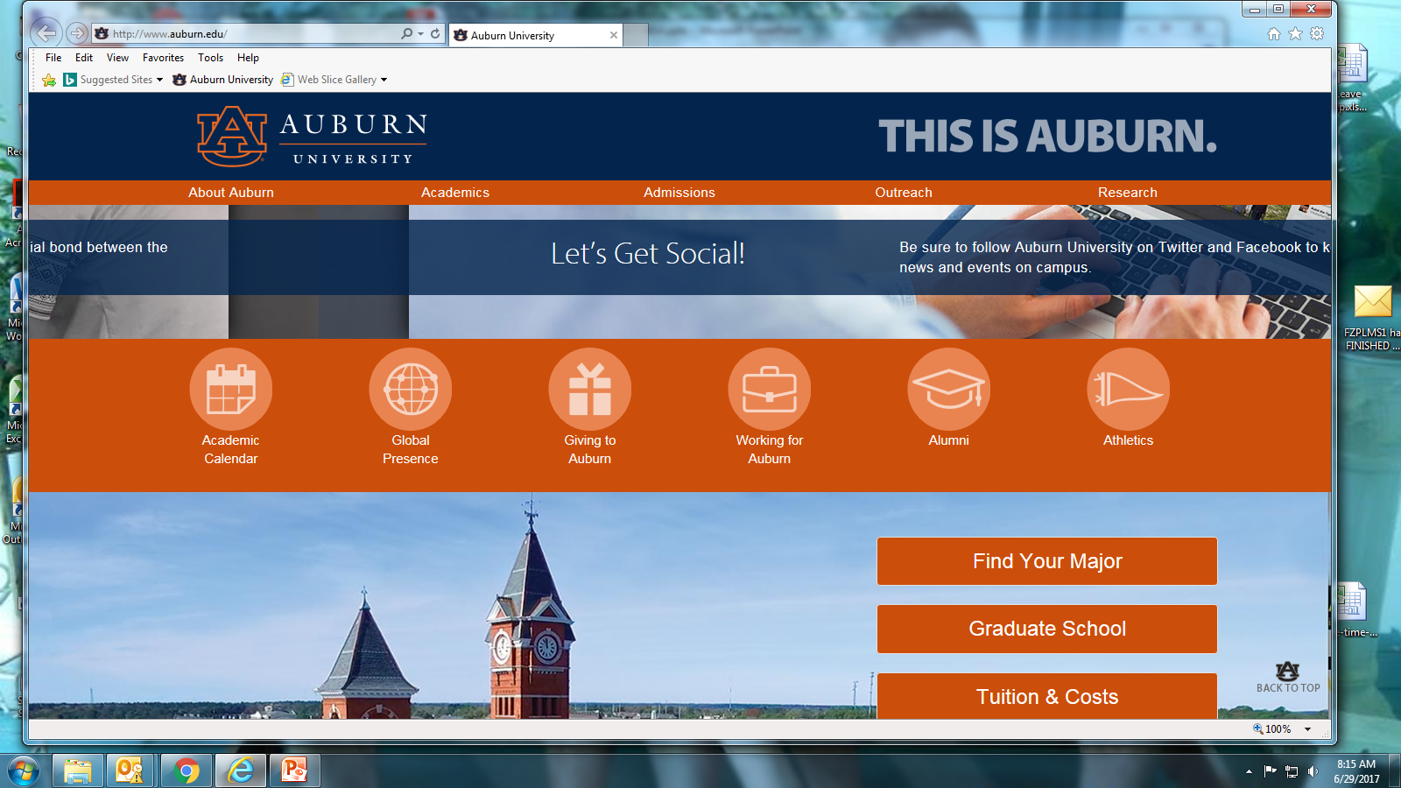
Tuition Calculator www.auburn.edu
Scroll down main Auburn website until you see Tuition & Costs. Click on it.

Slide 68
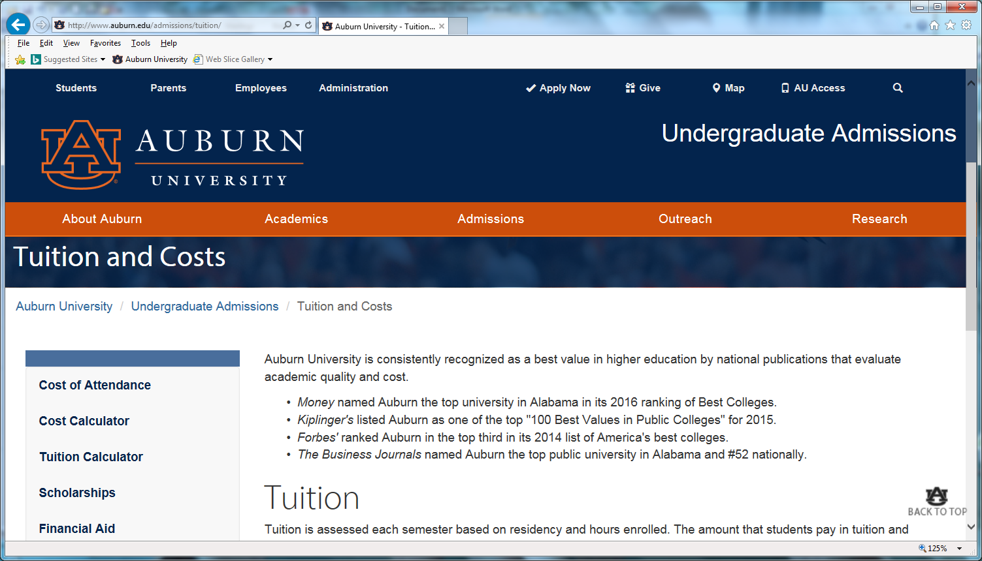
Tuition Calculator www.auburn.edu
Click on Tuition Calculator

Slide 69

GradGuard Tuition Insurance
Tuition Insurance Plan
Protection against the unexpected
Tuition Refund Insurance helps reimburse the following expenses if you can’t complete classes due to an illness or injury. It covers:
  ☑ Tuition
  ☑ Room and Board
  ☑ Other academic expenses
Annual Cost starting at $199.00
www.gradguard.com/Insurance

Slide 70
What if student drops classes after the semester starts?
Students may add/drop a class through the 5th class day (Fall/Spring) with no financial penalty (Summer through 2nd class day). Tuition is reimbursable.
If a student drops between the 6th -15th class day (Summer 3rd-5th class day) a $100 Course Drop Fee per class will be assessed. Tuition is reimbursable.
If a student drops a class after the 15th (5th for Summer) class day, no tuition will be reimbursed.
If a student drops their entire schedule between the 1st through 15th class day (5th for summer), there will be a $100 resignation fee. Tuition is reimbursable.

Slide 71
I Wish Parents had known….
Reflections from SFS
As far as the government is concerned, once a child starts college, they are considered an adult and fall under the federal privacy regulations. Therefore, SFS has to abide by federal regulations.
The e-bill is in the student’s name, not the parents.
We understand that a number of parents help their students with paying for school. However, without the financial release, we cannot talk about your student’s e-bill or financial aid.
It is the student’s responsibility to make sure they check their e-bill statement monthly.

Slide 72
I Wish Parents had known….
Reflections from SFS
Your student’s Auburn email is the OFFICIAL form of communication.
We know it can be scary as a parent to let your son/daughter go off to college on their own, however, this is a time when your sons and daughters need to learn to become mature, responsible adults. Help them to achieve this goal by letting them handle their financial affairs as much as possible.
As one parent reflected during Camp War Eagle “prepare yourself for the letting go process. The journey can be bittersweet for what could have been, for what will ever be, and for what was.”

Slide 73

Contact Info
Student Financial Services
203 Mary Martin Hall
Auburn AL 36849
334-844-4634
Hours: 7:45 am-4:45 pm M-F
Open during lunch hours for your convenience!
www.auburn.edu/sfs
Questions?

