Slide 1

Auburn University
Student Financial Services

Slide 2

Agenda
Student Financial Services
New Student Checklist
Where to Access E-Bill
eBill Examples
Important Dates
Payment Plan
Financial Release of Information
Authorized User for ebill system
Making Payments

Slide 3
Agenda (cont)
Direct Deposit Information
Prepaid tuition notification (such as PACT, FL Prepaid)
Auburn Family Portal
Tuition Calculator
Tuition Insurance
Dropping classes after semester starts
What We Wish Parents Had Known

Slide 4

Student Financial Services
Student Financial Services (SFS) departments
  Financial Aid
  Billing Department
  Cashiering
  Third party billing
  Account Services

Slide 5
Student Financial Services
The Billing Department is a centralized billing office. Charges are received from various departments for student billing purposes.
Items charged to the student’s billing account other than tuition:
  Housing (and housing related fees), meal plans, parking passes, parking tickets, printing charges from some Departments, Panhellenic fees, pharmacy prescriptions, football tickets (not billed until the September bill!), counseling services fees, Student Alumni Association, All Access Course bookstore charges, CWE fees, ID cards, etc
  Questions on charges other than tuition should be directed to the appropriate department

Slide 6
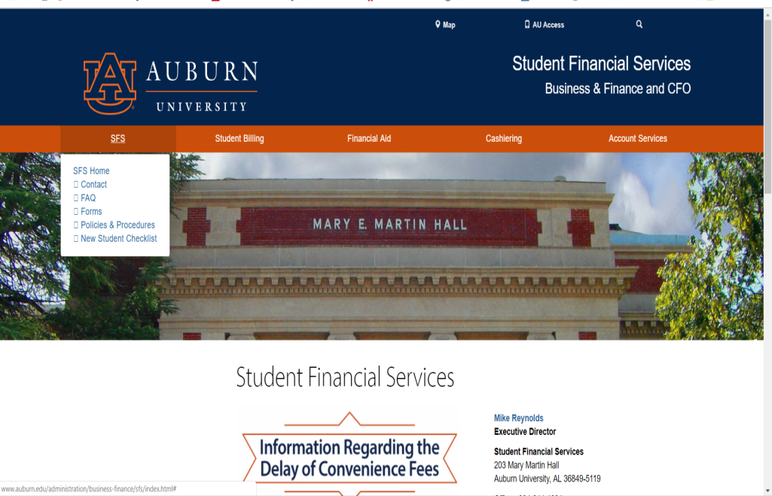
New Student Checklist auburn.edu/sfs

Slide 7

Where and How Students Access eBill
Go to: www.auburn.edu
Click AU Access

Slide 8
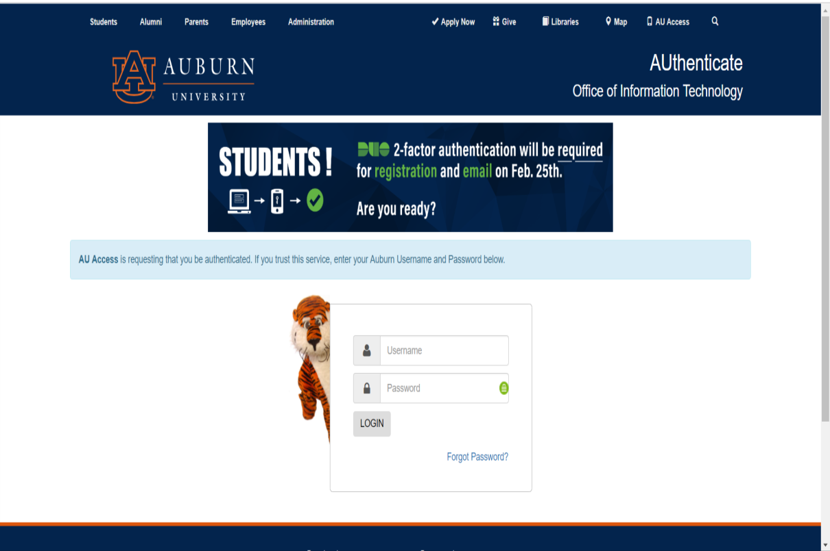
Where and How Students Access eBill
Fill in User Name and Password

Slide 9
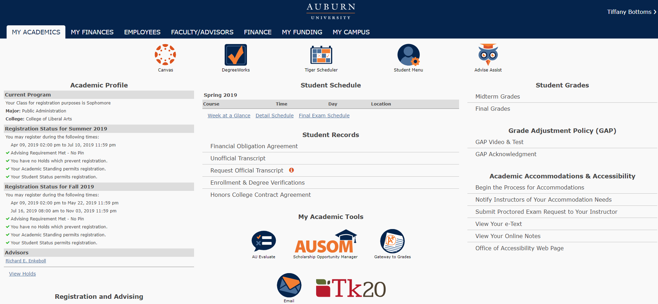
Where and How Students Access eBill
Click on My Finances

Slide 10
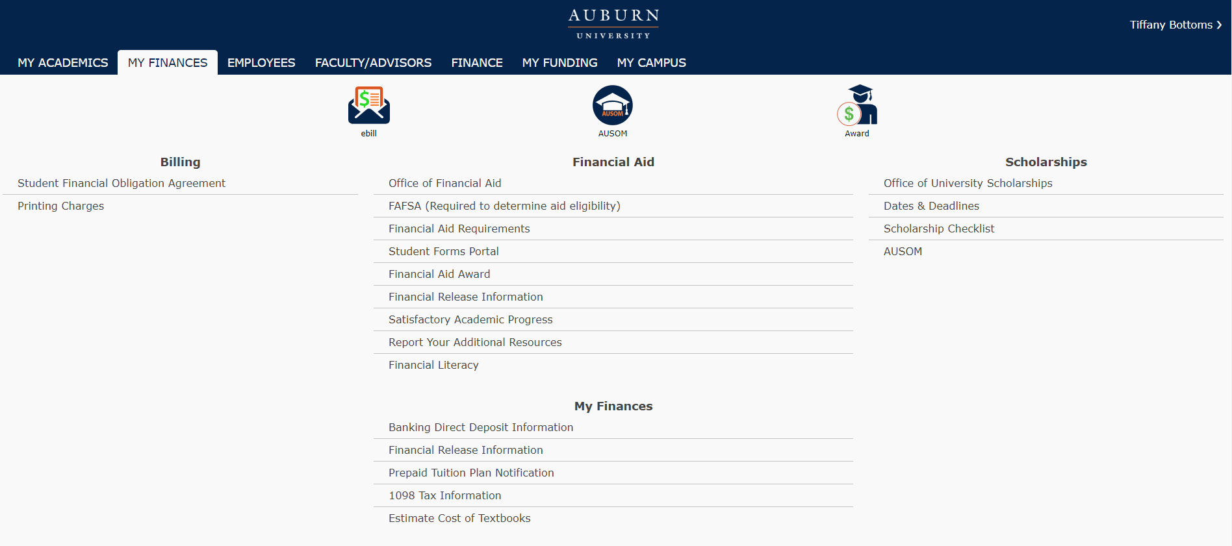
Where and How Students Access eBill
Click eBill

Slide 11
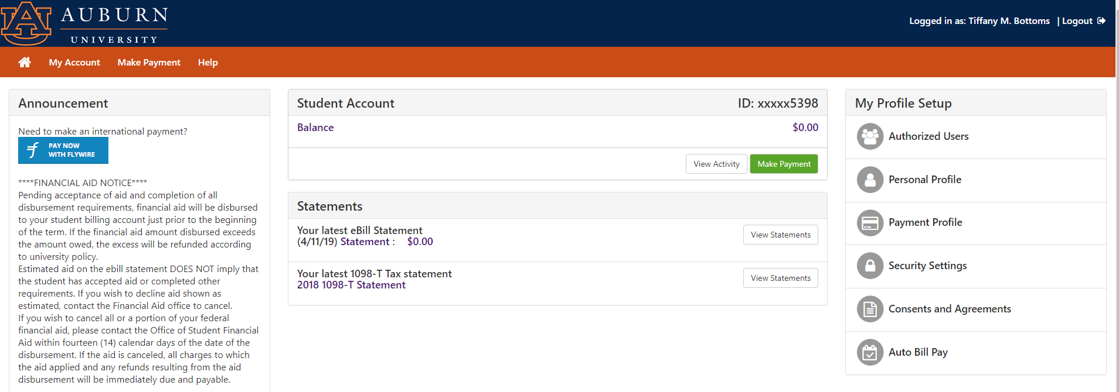
Where and How Students Access eBill
Viewing Statement
Click Statement

Slide 12
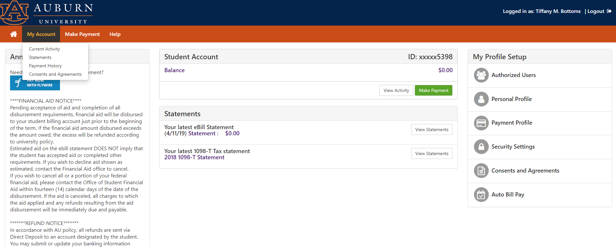
Where and How Students Access eBill
Another way to view Statement
Click My Account for drop down box, then click on Statements.

Slide 13
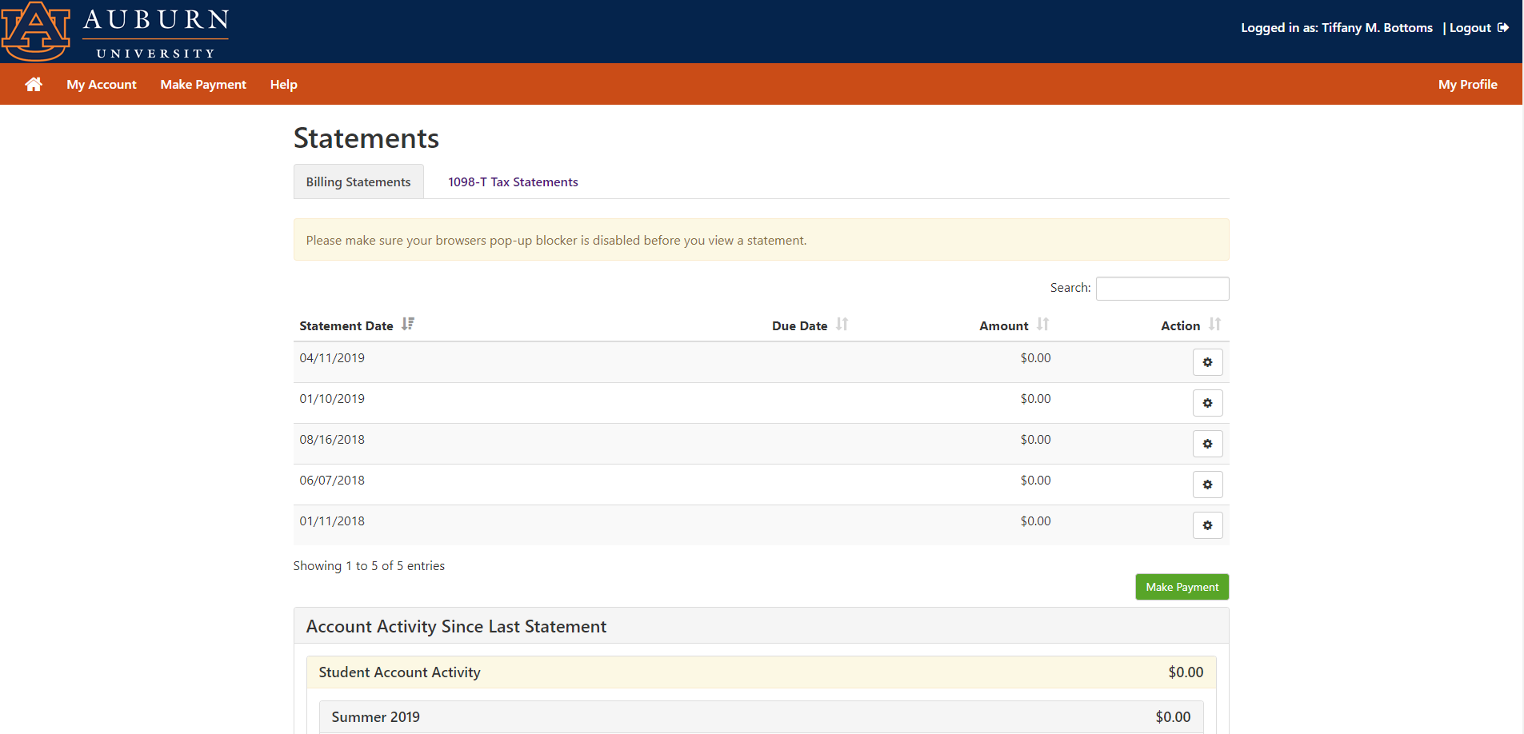
Where and How Students Access eBill
Viewing Statements
Click statement date you want to view and then click the Gear Box and click “View”

Slide 14
eBill Examples
IMPORTANT!!!!
  Student loans will stay under Estimated Financial Aid on the statements until after they are transferred to the e-Bill (about a week before school starts).
  They will only transfer IF the student has ….
    Accepted the loan(s) on Auburn’s system AND
    Completed the Entrance Counseling AND Master Promissory Note at www.studentloans.gov
  If student loan requirements not completed within a reasonable time frame, they will drop off “Estimated Financial Aid” on statement.
  By filling out the FAFSA, any eligible aid including loans are posted on the financial aid award. If students know that they don’t want the loans, go ahead and decline them.

Slide 15
Terms codes
Term codes:
  202010 = Fall 2019
  202020 = Spring 2020
  202030 = Summer 2020

Slide 16

eBill Examples
Reynolds, Mike
Student ID# 902251977
Statement Date: 07-12-2019
Due Date: 08-09-2019
Auburn University
Office of Student Financial Services
203 Mary Martin Hall
Auburn University, AL. 36849-5119
(334) 844-4634
Transaction Date | Code | Description |  | Charge | Credit
 |  | Previous Account Balance
 |  | ---CURRENT CHARGES/PAYMENTS---
07-12-2019 | 202010 | Dining Plan |  | 350.00
07-12-2019 | 202010 | Tuition Resident Undergraduate |  | 5,746.00
CURRENT DUE |  |  | $6,096.00
TOTAL ACCOUNT BALANCE |  |  | $6,096.00

Slide 17
eBill Examples
Reynolds, Mike
Student ID# 902251977
Statement Date: 07-12-2019
Due Date: 08-09-2019
Auburn University
Office of Student Financial Services
203 Mary Martin Hall
Auburn University, AL. 36849-5119
(334) 844-4634
Transaction Date | Code | Description |  | Charge | Credit
 |  | Previous Account Balance |  | 25.00
 |  | ---CURRENT CHARGES/PAYMENTS---
07-12-2019 | 202010 | Dining Plan |  | 1,100.00
07-12-2019 | 202010 | Tuition Non-Resident Undergraduate |  | 15,562.00
07-12-2019 | 202010 | Village Rent - Double Room |  | 4,900.00
 |  | $$$ESTIMATED FINANCIAL AID$$$
07-12-2019 | 202010 | AU Board of Trustees Scholarship |  |  | 750.00
CURRENT DUE |  |  | $20,837.00
TOTAL ACCOUNT BALANCE |  |  | $21,587.00

Slide 18
eBill Examples
Reynolds, Mike
Student ID# 902251977
Statement Date: 07-12-2019
Due Date: 08-09-2019
Auburn University
Office of Student Financial Services
203 Mary Martin Hall
Auburn University, AL. 36849-5119
(334) 844-4634
Transaction Date | Code | Description |  | Charge | Credit
 |  | Previous Account Balance
 |  | ---CURRENT CHARGES/PAYMENTS---
07-12-2019 | 202010 | Dining Plan |  | 350.00
07-12-2019 | 202010 | Tuition Resident Undergraduate |  | 5,746.00
07-12-2019 | 202010 | PACT 19F / 202010 |  |  | 4,983.65
CURRENT DUE |  |  | $1,112.35
TOTAL ACCOUNT BALANCE |  |  | $6,096.00

Slide 19
eBill Examples
Reynolds, Mike
Student ID# 902251977
Statement Date: 07-12-2019
Due Date: 08-09-2019
Auburn University
Office of Student Financial Services
203 Mary Martin Hall
Auburn University, AL. 36849-5119
(334) 844-4634
Transaction Date | Code | Description |  | Charge | Credit
 |  | Previous Account Balance |  | 25.00
 |  | ---CURRENT CHARGES/PAYMENTS---
07-12-2019 | 202010 | Dining Plan |  | 350.00
07-12-2019 | 202010 | Tuition Resident Undergraduate |  | 5,746.00
 |  | $$$ESTIMATED FINANCIAL AID$$$
07-12-2019 | 202010 | Subsidized Direct Loan |  |  | 2,723.00
07-12-2019 | 202010 | Federal Pell Grant |  |  | 2,887.00
CURRENT DUE |  |  | $511.00
TOTAL ACCOUNT BALANCE |  |  | $6,121.00

Slide 20
Important Dates
First Fall Bill Date - July 12, 2019
First Fall Due Date - August 09, 2019
  Must pay at least 50% by August 9, 2019 or class schedule will be dropped
Second Fall Bill date – August 15, 2019
Second Fall Due date – September 6, 2019
Annual Billing Schedule can be found at www.auburn.edu/billing

Slide 21
Types of Payments accepted
Online
  E-check
  Debit/Credit (VISA/MC/AM EX/DISCOVER)
In office
  Check or cash
  EFFECTIVE 12/1/2019 – For payments made by debit/credit cards, a 2.85% convenience fee will be paid to our payment servicer (TouchNet).

Slide 22
Payment Plan
Deferred Payment Plan Option through Auburn University
  You can divide the FIRST official bill of the semester into two half payments. First bills of the semester are issued in July (Fall semester), November (Spring semester), and April (Summer semester).
There is no notification of this. When you make a payment, just divide amount in half and that is what you will type in.

Slide 23
Payment Plan
Optional Prepayment Plan Option through TMS
  In partnership with Nelnet Campus Commerce [formerly Tuition Management Systems (TMS)] you can pre-pay your semester charges. Visit auburn.afford.com or call 800-722-4867 for more information.

Slide 24

Authorizations
Student gives to parents
There are two authorizations for Student Financial Services. Giving access to one does not give you access to the other. Student must do both!
1. Financial Information Release
Authorizes SFS to discuss eBill/
financial aid
2. Authorized user in eBill system
Gives authorized user access to
student’s eBill account

Slide 25
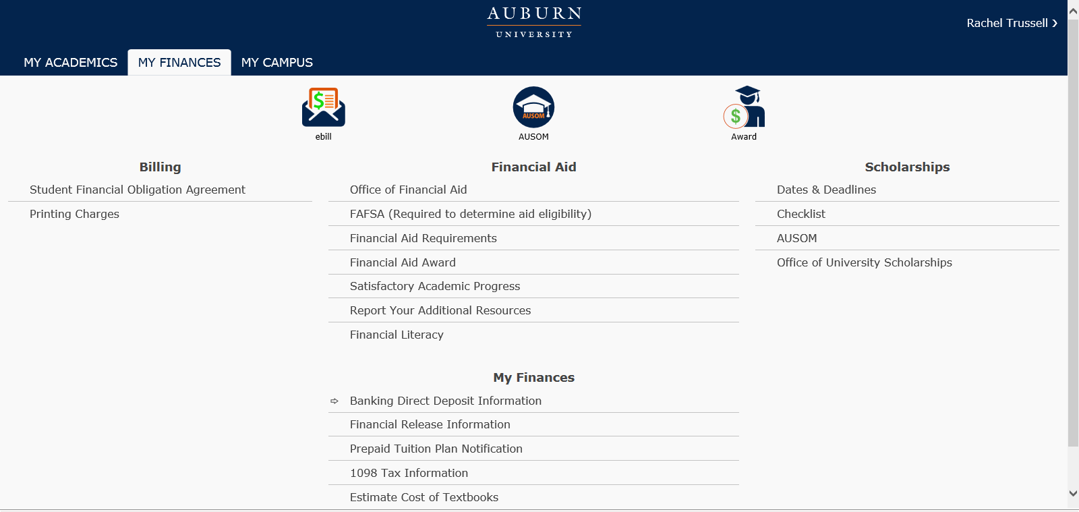
Complete Financial Release Information
Click to Complete Financial Release Information

Slide 26
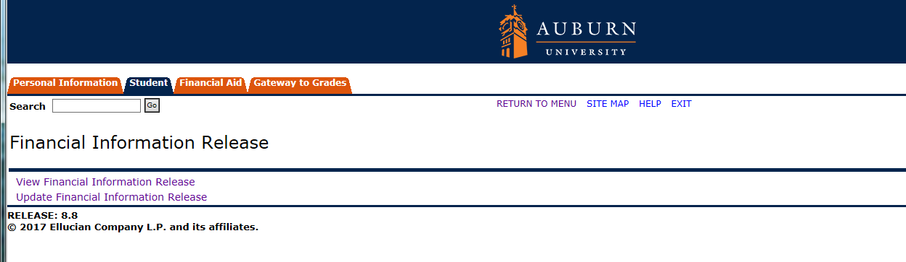
Complete Financial Release Information
Click Update Financial Information Release

Slide 27
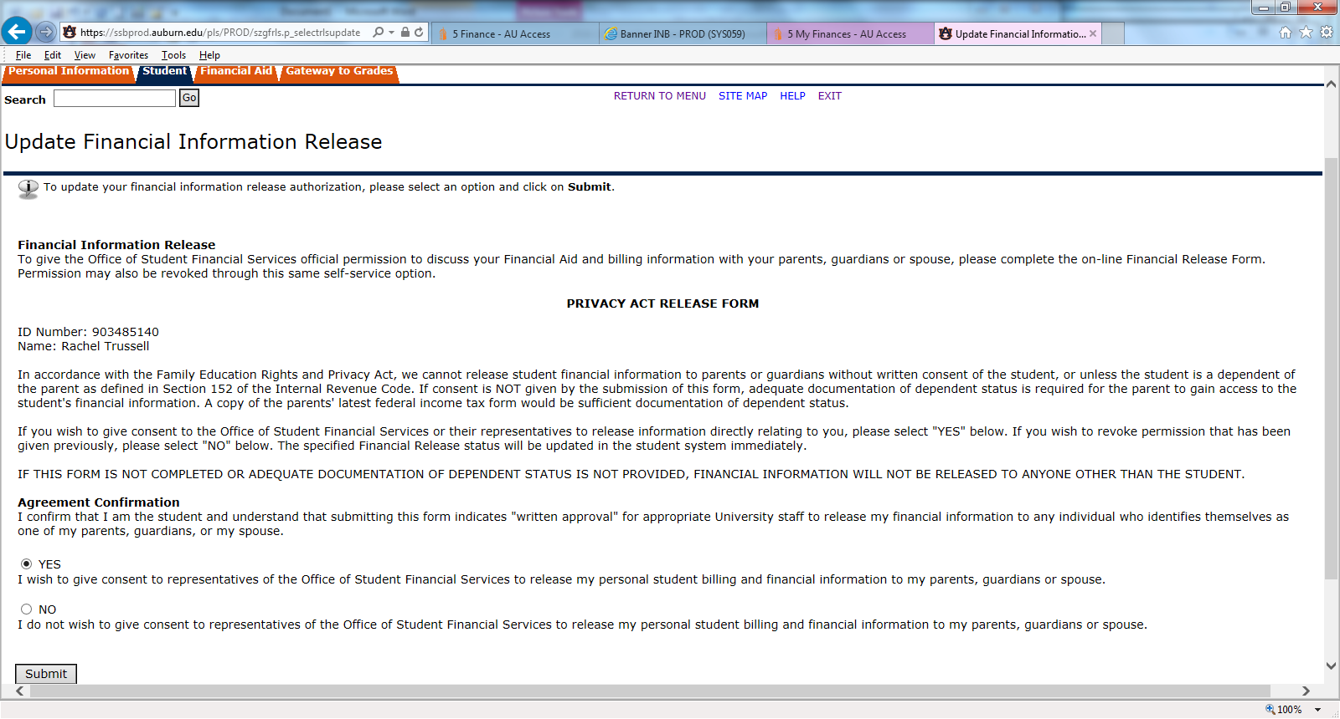
Complete Release of Information Statement
It is already checked “Yes”. Click Submit.

Slide 28
Add Authorized User
Click eBill

Slide 29
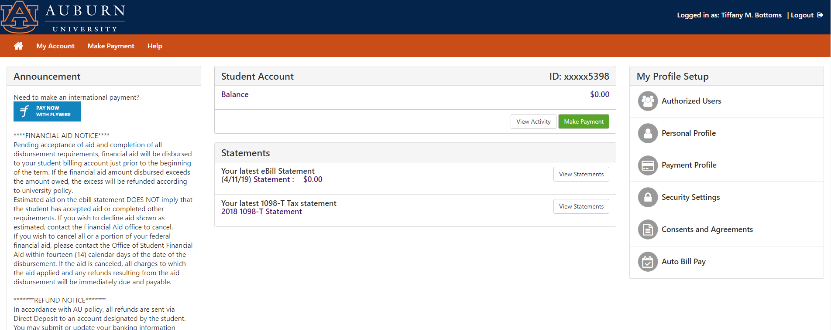
Add Authorized User
Click Authorized Users

Slide 30
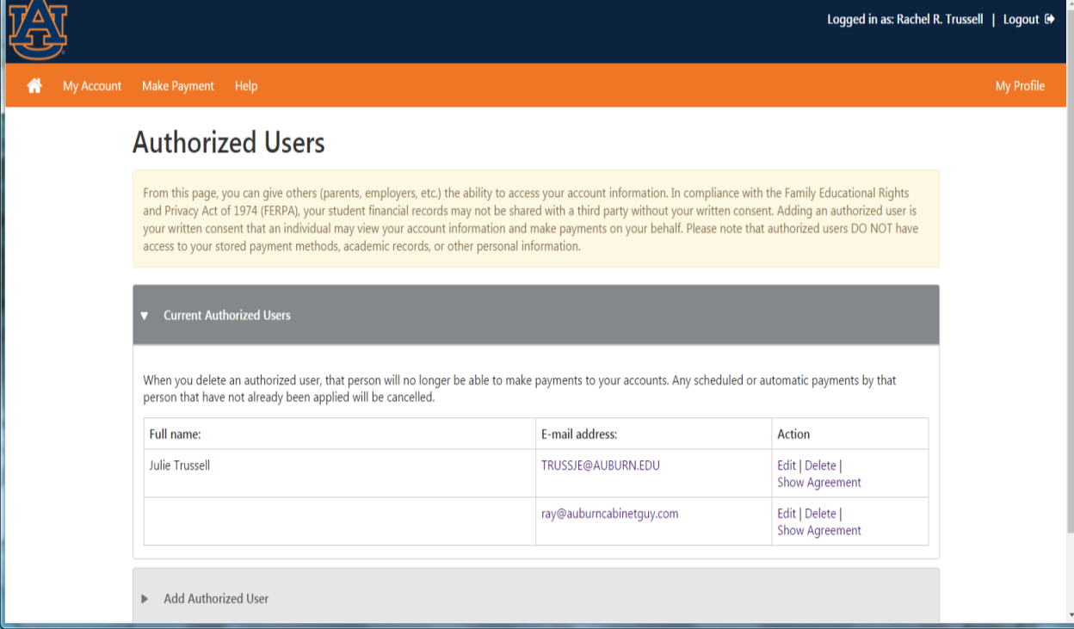
Add Authorized User
Click on ‘Add Authorized User’

Slide 31
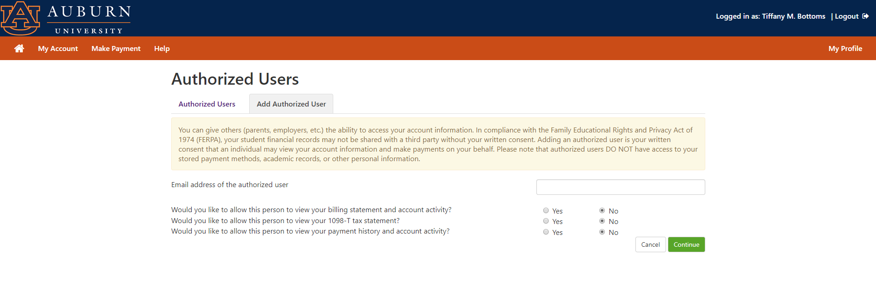
Add Authorized User
Fill in E-mail Address
Review to see if you want authorized user access to all three. Click Continue.

Slide 32
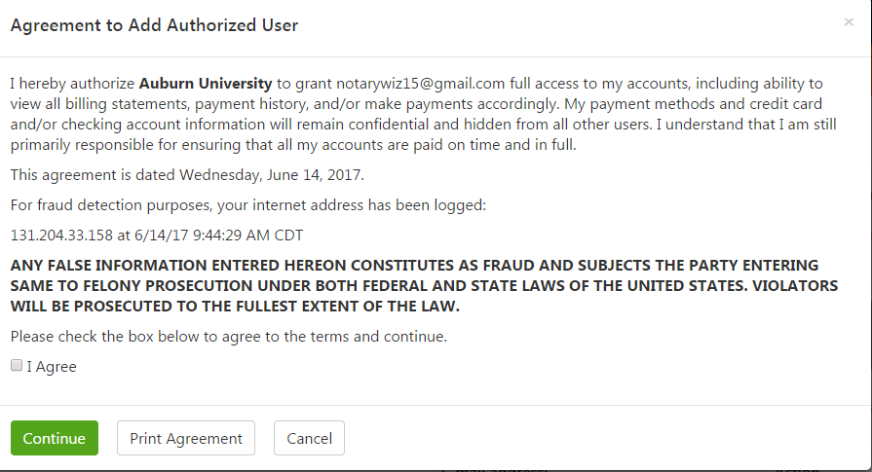
Add Authorized User
Click “I Agree” and “Continue”

Slide 33
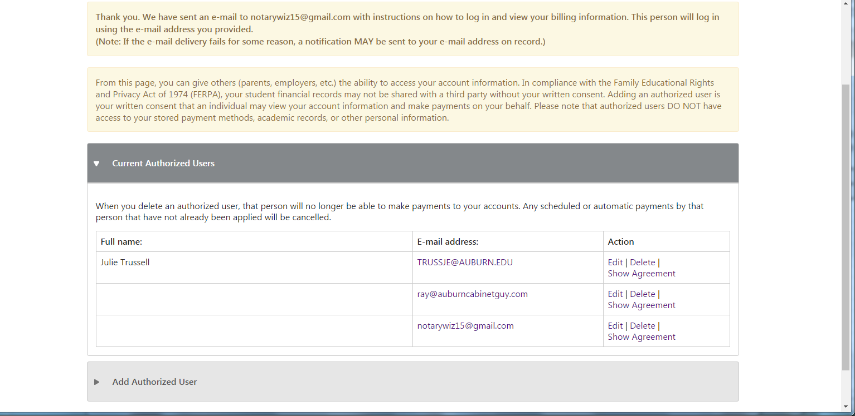
Add Authorized User
Confirmation that Authorized User Will Be Sent an E-mail.
Student can also edit/delete Authorized Users.

Slide 34
Add Authorized User
1st email to authorized user
Hello and welcome!
The student listed below has granted you online access to his or her billing information.
You can now make payments on behalf of this student, schedule, automate future payments, and more. To access the student’s account, please visit ebill.auburn.edu and log in using the username shown below. For security, we are sending the initial password for this account in a separate message.
Note: Please email itservicedesk@auburn.edu for username and/or password issues.
ACCESS INFORMATION
Student Name: Rachel R. Trussell
Username: trussje@auburn.edu
Sincerely,
Auburn University Billing Department
Office of Student Financial Services
203 Mary Martin Hall
Auburn University, AL 36849-5119
(334) 844-4634
ebill@auburn.edu
www.auburn.edu/sfs

Slide 35
Add Authorized User
2nd email to authorized user
Hello and welcome!
The student listed below has granted you online access to his or her billing information.
You can now make, schedule, and automate payments on behalf of this student.
To access the student’s account, please visit ebill.auburn.edu and log in using the password shown below. For security, the other login information for this account is sent in a separate message.
Note: Please email itservicedesk@auburn.edu for username and/or password issues.
ACCESS INFORMATION
Student Name: Rachel R. Trussell
Temporary Password: usuqhbrdaq
Sincerely,
Auburn University Billing Department
Office of Student Financial Services
203 Mary Martin Hall
Auburn University, AL 36849-5119
(334) 844-4634
ebill@auburn.edu
www.auburn.edu/sfs
Temporary password – can copy and paste

Slide 36
Authorized User
Authorized User in e-bill system
  Access to e-bill
  When bills are generated student gets email and any authorized user gets email
    Check SPAM
    Mark anything from Auburn University (@auburn.edu) as “Never Block Senders Domain”
  If you change emails…. Your student needs to update this information through e-bill

Slide 37
Authorized User Access #1
Two ways to get to E-bill system.
1. Type in URL:
  ebill.auburn.edu
  There is a link in your statement notification email.

Slide 38
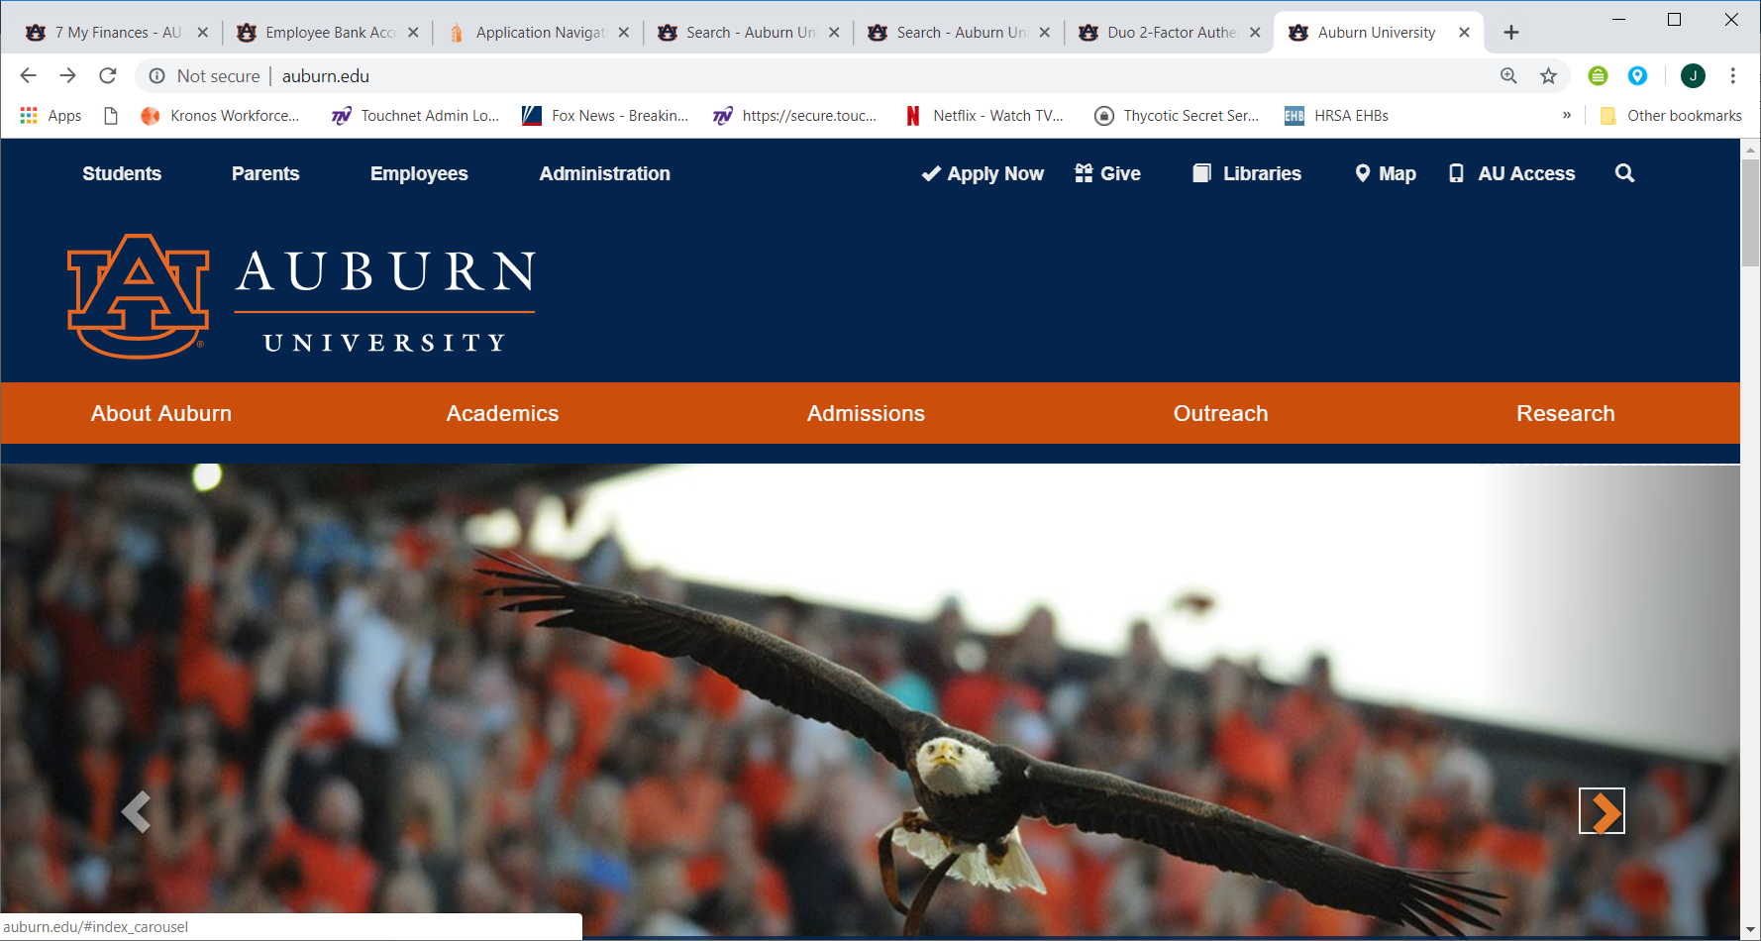
Authorized User Access #2 www.auburn.edu
Click Parents

Slide 39
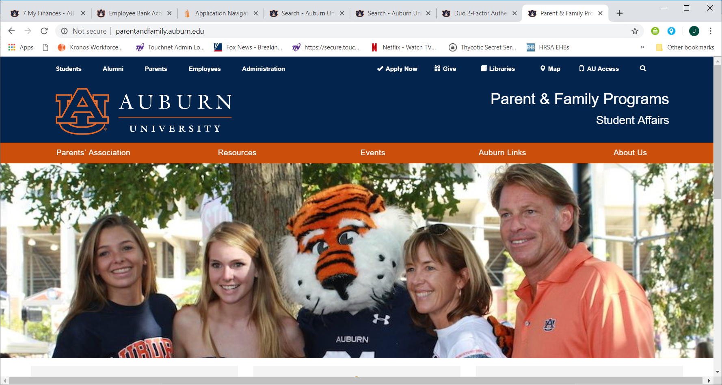
Authorized User Access #2
(cont)
Click “Auburn Links”

Slide 40
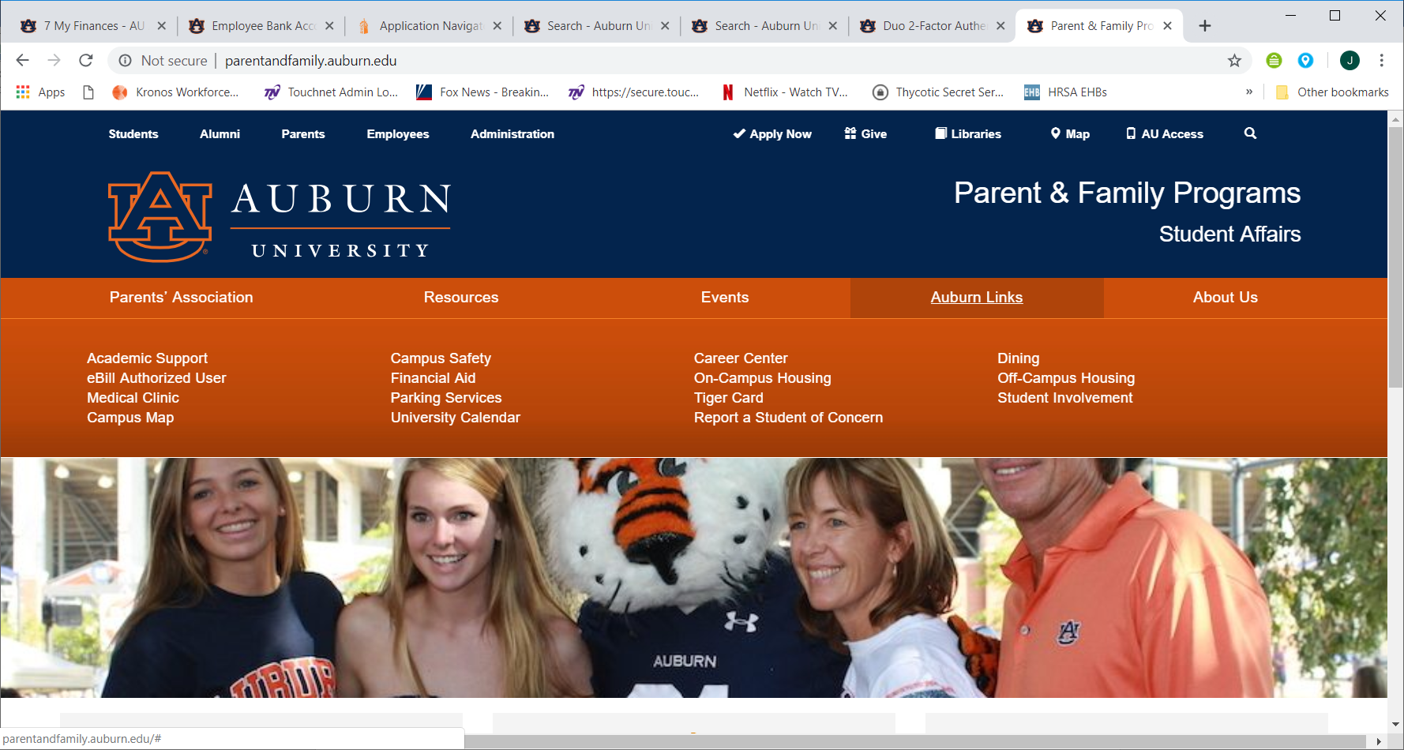
Authorized User Access #2 (cont)
Click on eBill Authorized User

Slide 41
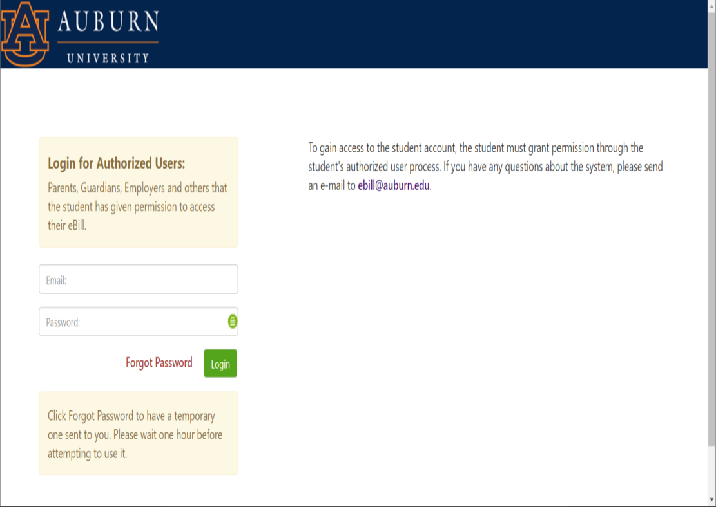
Authorized User Access ebill.auburn.edu
Fill in E-mail Address and Password

Slide 42
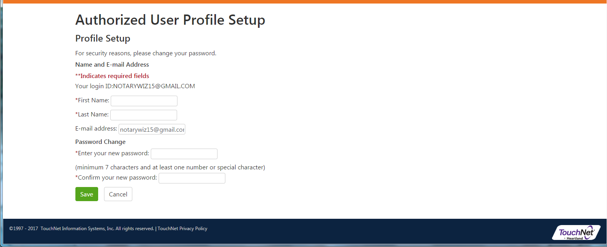
Authorized User Access ebill.auburn.edu
Fill in Your Full Name and enter NEW password. Click Save

Slide 43
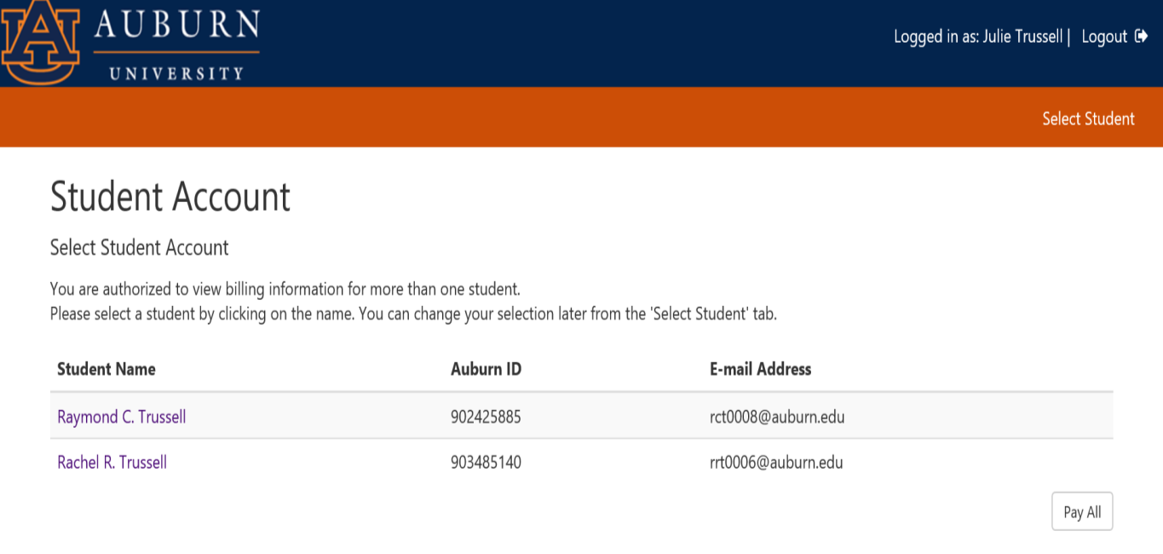
Authorized User Access
(more than one student)
Click on the student you want to view or if your can click on Pay All

Slide 44
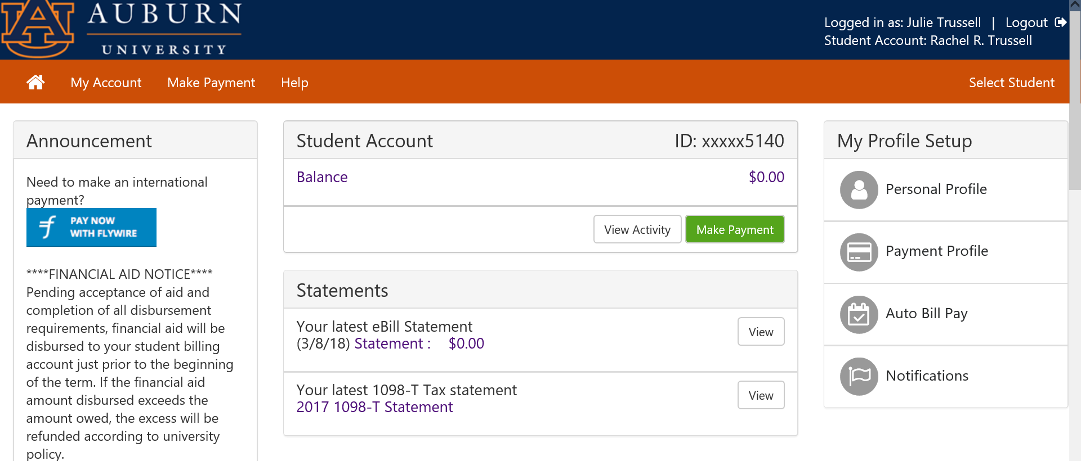
Authorized User Access ebill.auburn.edu
Authorized User’s view.
Very similar to Student View.
To make a payment, click on Make Payment

Slide 45
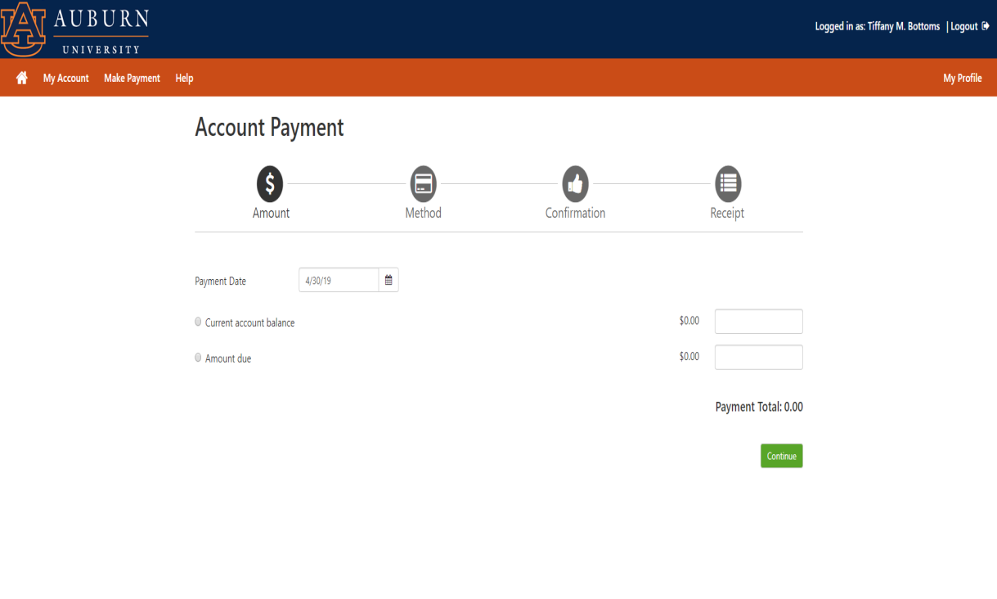
Make a Payment ebill.auburn.edu
Click which radio button you want.
Can specify future date.
To make half payment click radio button: “Amount due” – tab to box and type in dollar amount

Slide 46
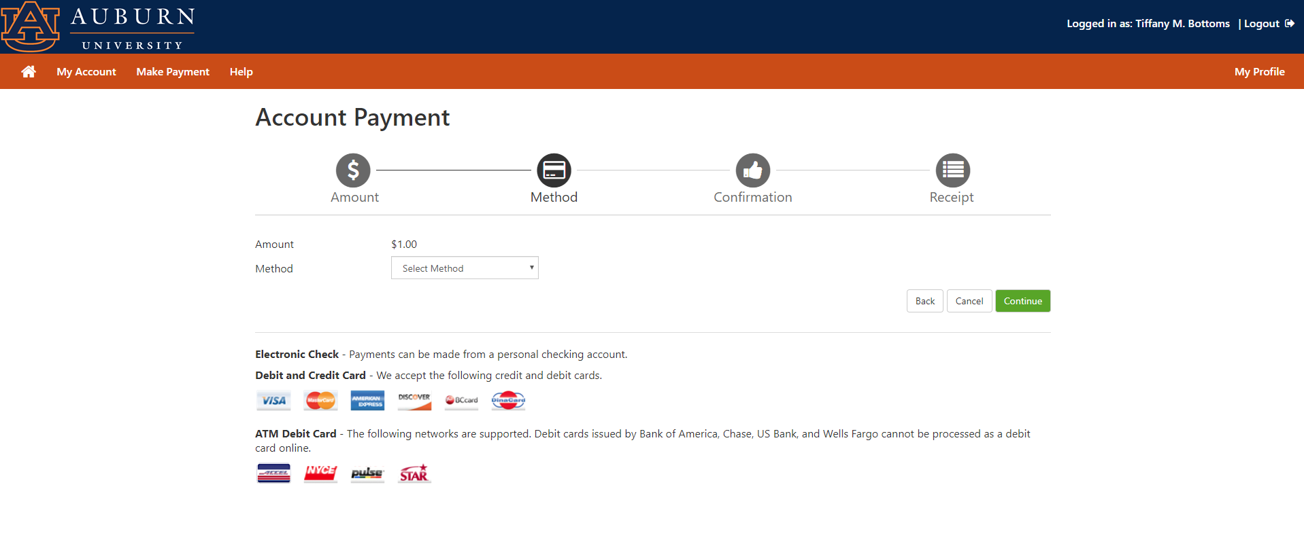
Make a Payment ebill.auburn.edu
Select Method from Menu

Slide 47
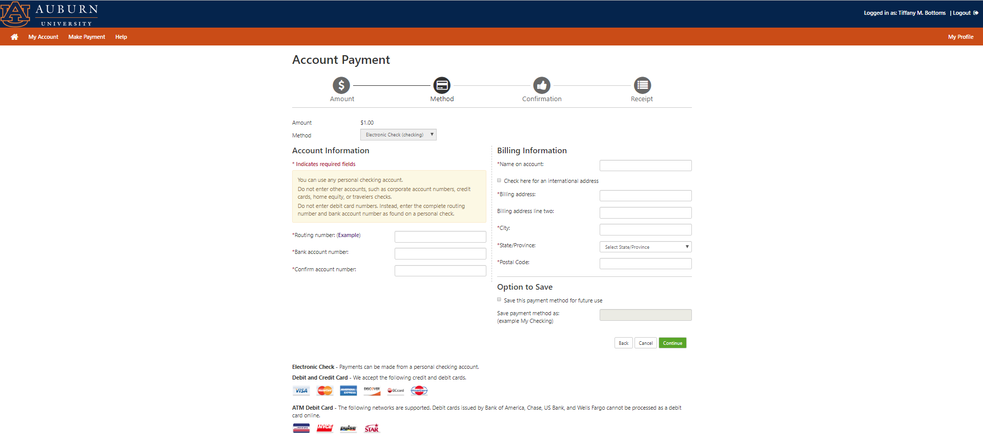
Make a Payment ebill.auburn.edu
Complete Routing and Account Information
Option to save information

Slide 48
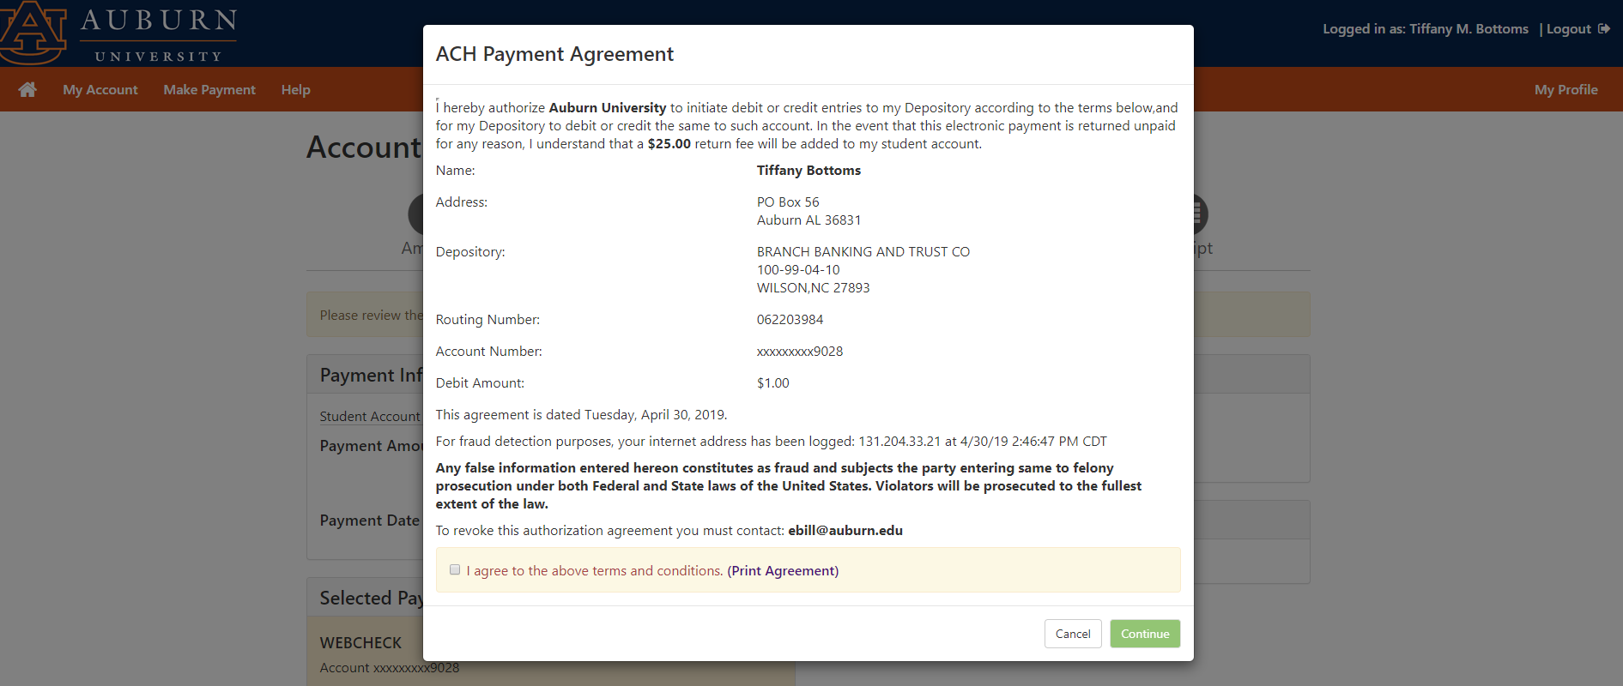
Make a Payment ebill.auburn.edu
Review and then click “I agree…”. Then click “submit payment”. You will get a confirmation email.

Slide 49
Auto Bill Pay ebill.auburn.edu
Click Auto Bill Pay

Slide 50
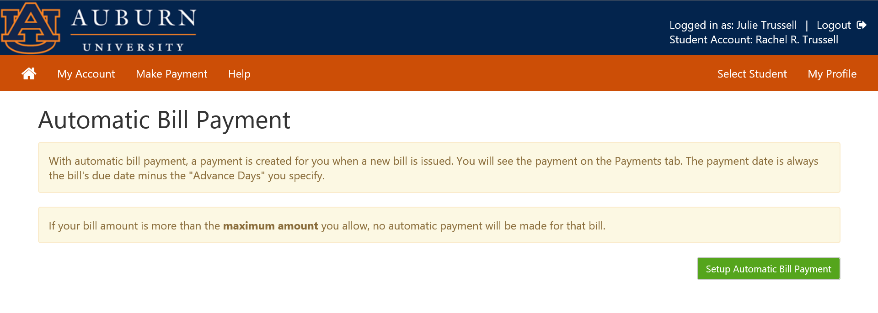
Auto Bill Pay ebill.auburn.edu

Slide 51
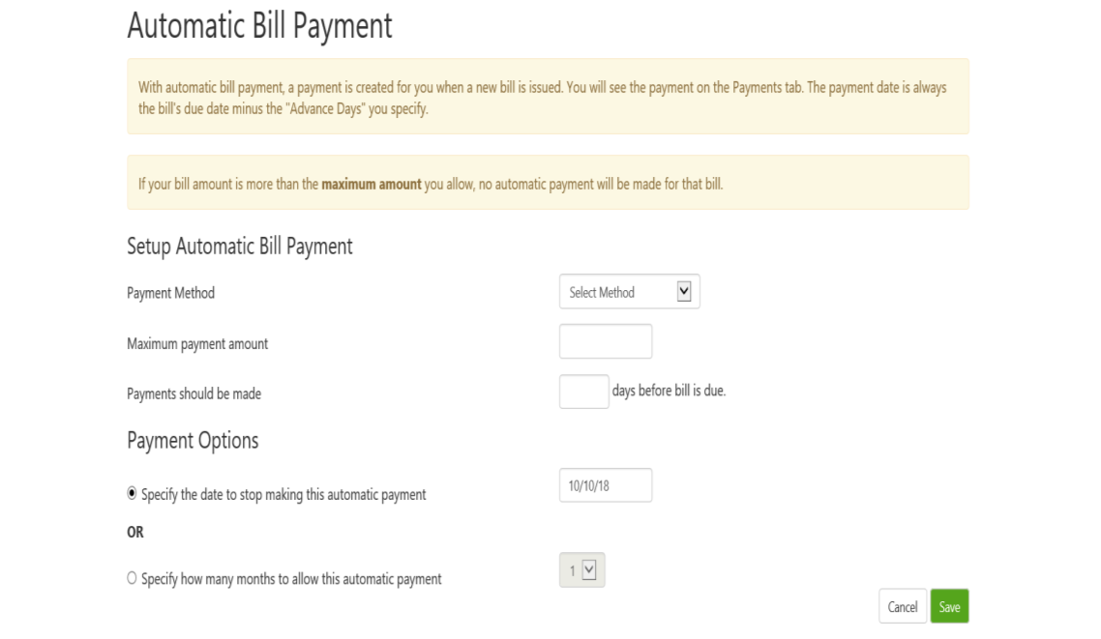
Auto Bill Pay ebill.auburn.edu
Should be used for small bills, not paying tuition and fees.

Slide 52
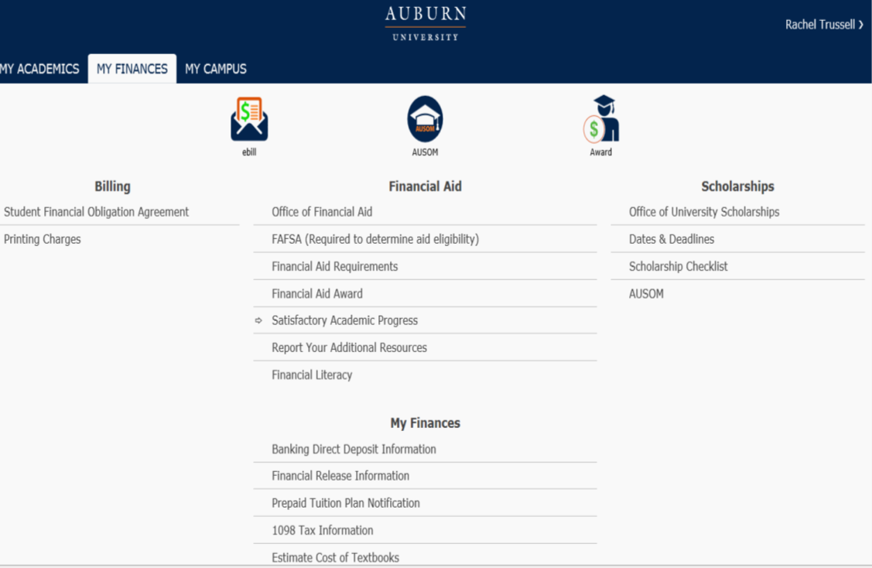
Add Direct Deposit Information
Click to Add Direct Deposit Information

Slide 53
Add Direct Deposit Information
VPN two-factor authentication
To enhance security for Auburn University data, students and employees, Auburn has implemented a high-security login process referred to as two-factor authentication. Auburn uses Duo Security to ask individuals for a secondary confirmation of their identity at log in using a physical device in their possession. The physical device may be a smartphone or tablet using an app, a text message to a phone, pressing a hardware token device or an automated voice call to a landline or cell phone.
Users connecting to the Virtual Private Network, or VPN, must select the 2FACTOR VPN profile, which requires two-factor authentication.
Some web applications with visibility to sensitive information have already implemented two-factor authentication and over time more web resources will adopt this kind of authentication.
More information about two-factor authentication with Duo Security is available at http://www.auburn.edu/oit/2factor/#online
Questions about two-factor authentication, device registration and VPN support should be sent to your IT Provider or the OIT HelpDesk.

Slide 54
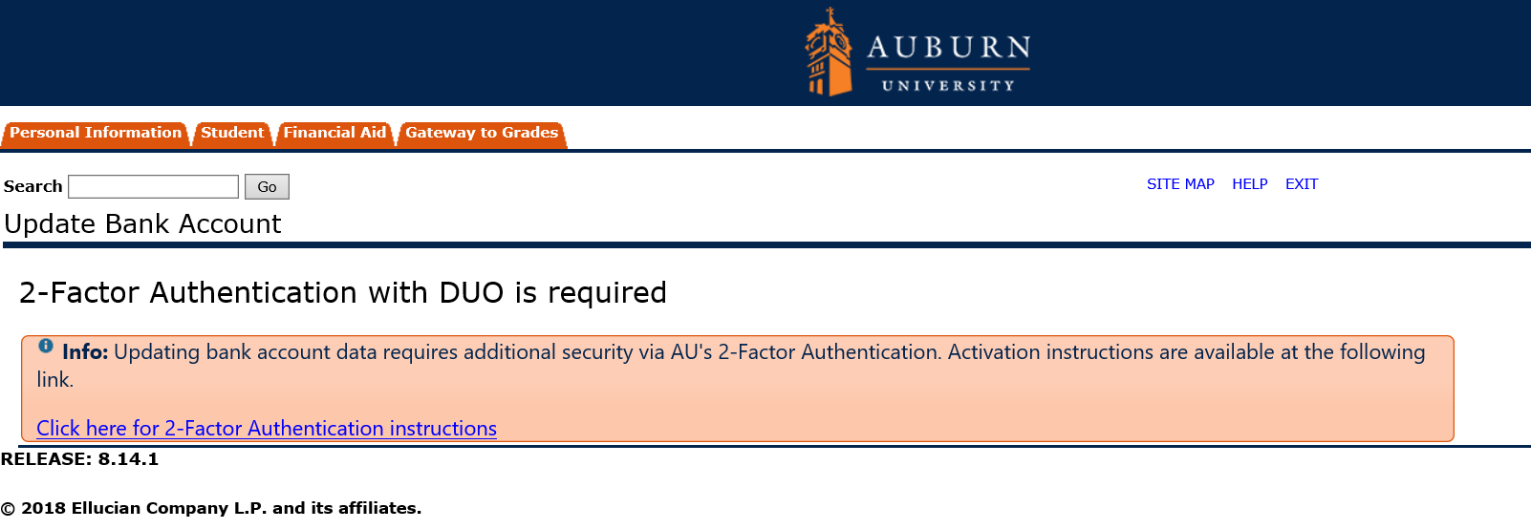
Add Direct Deposit Information
Click for instructions for 2-Factor Authentication Instructions

Slide 55
Add Direct Deposit Information
IMPORTANT – STUDENT MUST COMPLETE – NOT PARENT. Students must activate the 2-Factor Authentication.

Slide 56
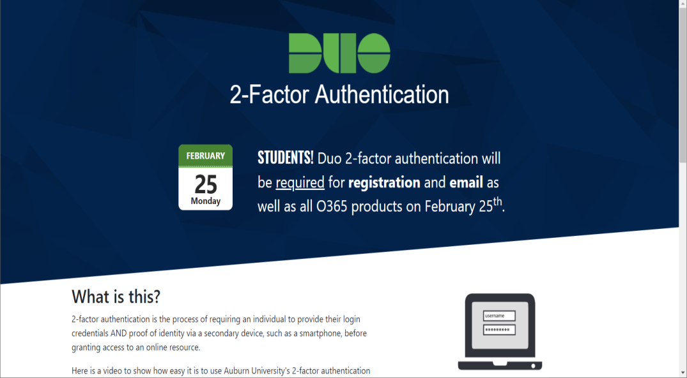
Add Direct Deposit Information
duo.auburn.edu

Slide 57
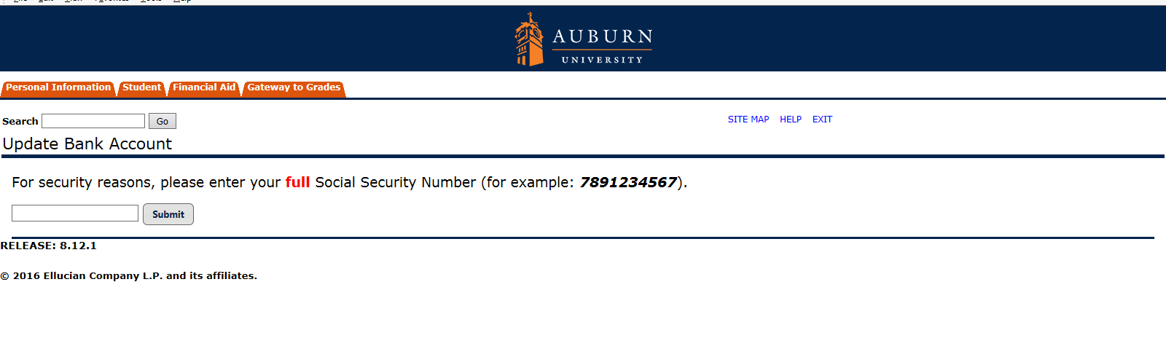
Add Direct Deposit Information

Slide 58
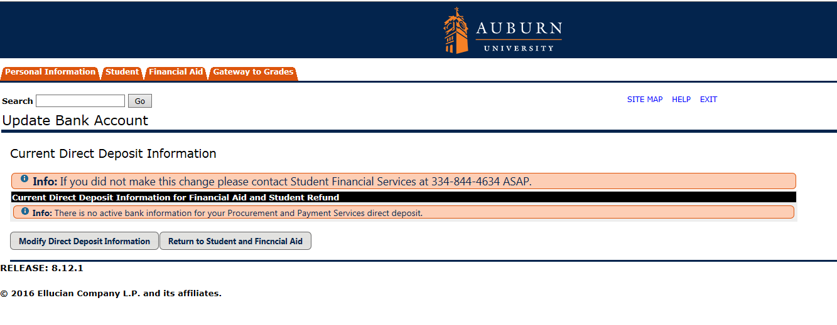
Add Direct Deposit Information
Click Modify Direct Deposit Information

Slide 59
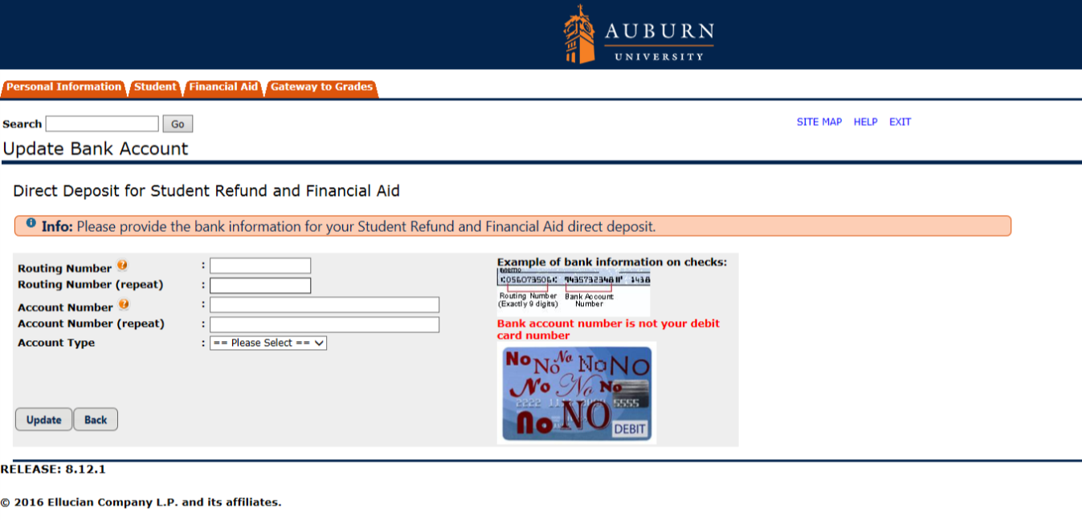
Add Direct Deposit Information
Enter Account Information This is not the debit card number! Click Update

Slide 60
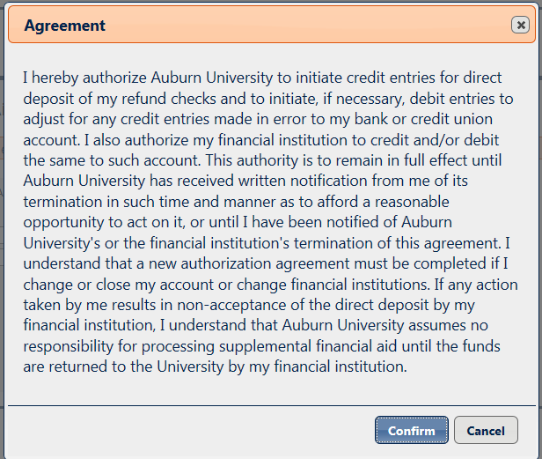
Add Direct Deposit Information
Read and Click “Confirm”

Slide 61
Complete Prepaid Tuition Plan Notification
Student’s Access
Click to Complete Prepaid Tuition Notification Plan

Slide 62
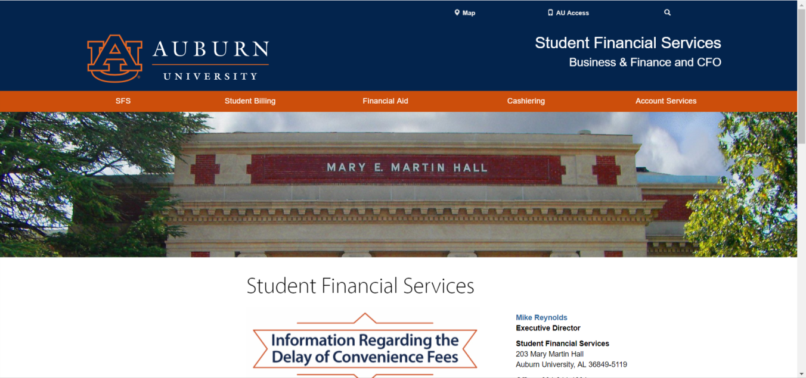
Another way to access: Prepaid Tuition Plan Notification – parents and others www.auburn.edu/sfs
Click Student Billing

Slide 63
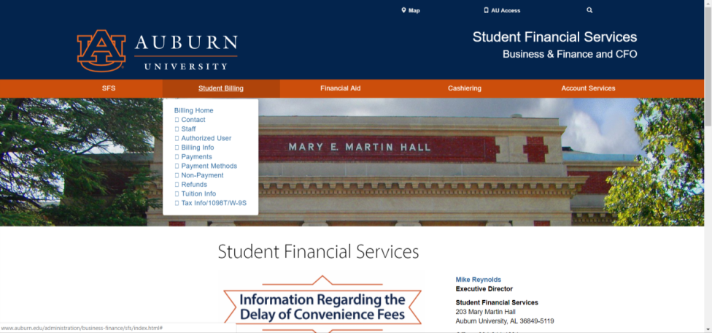
Another way to access: Prepaid Tuition Plan Notification – parents and others www.auburn.edu/sfs
Click on Tuition Info

Slide 64
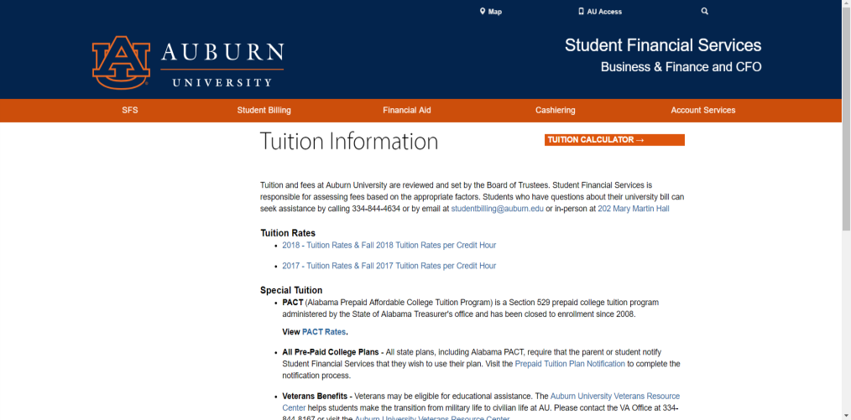
Another way to access: Prepaid Tuition Plan Notification – parents and others www.auburn.edu/sfs
Click to Complete Prepaid Tuition Notification Plan

Slide 65
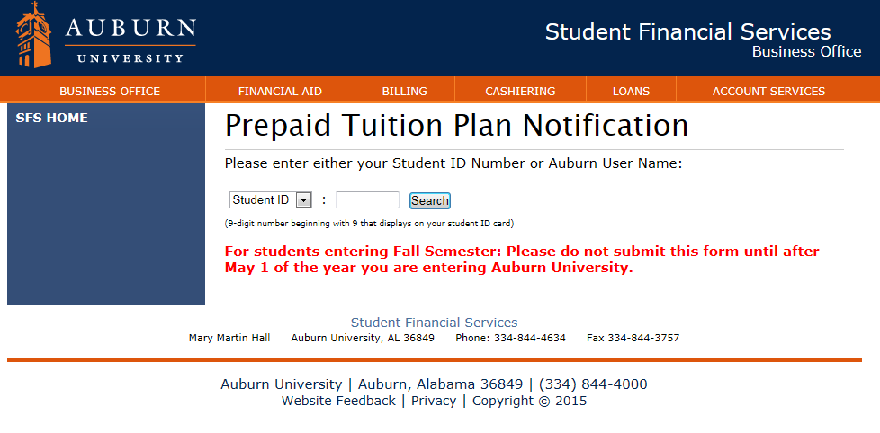
Complete Prepaid Tuition Plan Notification
Complete All Fields and Submit

Slide 66
2019-20 PACT rates
PACT 2018 Benefit Rates + 7%
Credit Hours | 2019-2020 Tuition/Fees | PACT Rates | Student Balance
1 | 1,247.00 | 996.30 | 250.70
2 | 1,656.00 | 1,390.50 | 265.50
3 | 2,065.00 | 1,784.71 | 280.29
4 | 2,474.00 | 2,178.91 | 295.09
5 | 2,883.00 | 2,573.10 | 309.90
6 | 3,292.00 | 2,967.30 | 324.70
7 | 3,701.00 | 3,361.50 | 339.50
8 | 4,110.00 | 3,755.71 | 354.29
9 | 4,519.00 | 4,149.91 | 369.09
10 | 4,928.00 | 4,544.11 | 383.89
11 | 5,337.00 | 4,938.30 | 398.70
12 or more | 5,746.00 | 5,332.51 | 413.49

Slide 67
Auburn Family Portal
https://familyportal.auburn.edu/
Your one-stop shop for:
Access to important campus news and deadlines
Insight into your student's progress and financial details
Personalized newsletters on your schedule
Announcements via email and text message
Sharing of updates with friends and family

Slide 68
Auburn Family Portal
Allows parents to request access to:
  Academic Information:
    Class Schedule/Enrollment
    Graduation information
    Grade information
  Financial information
    Financial Aid Information
    Holds on Account
    Account Balance

Slide 69
Auburn Family Portal
Though students can request to see the account balance through this portal, they cannot pay the bill directly from the Family Portal website. When a bill is due, it will link them to the eBill Authorized User sign in. Because of this, students must also grant access through eBill Authorized User.

Slide 70

Tuition Calculator www.auburn.edu
Scroll down main Auburn website until you see Tuition & Costs. Click on it.

Slide 71
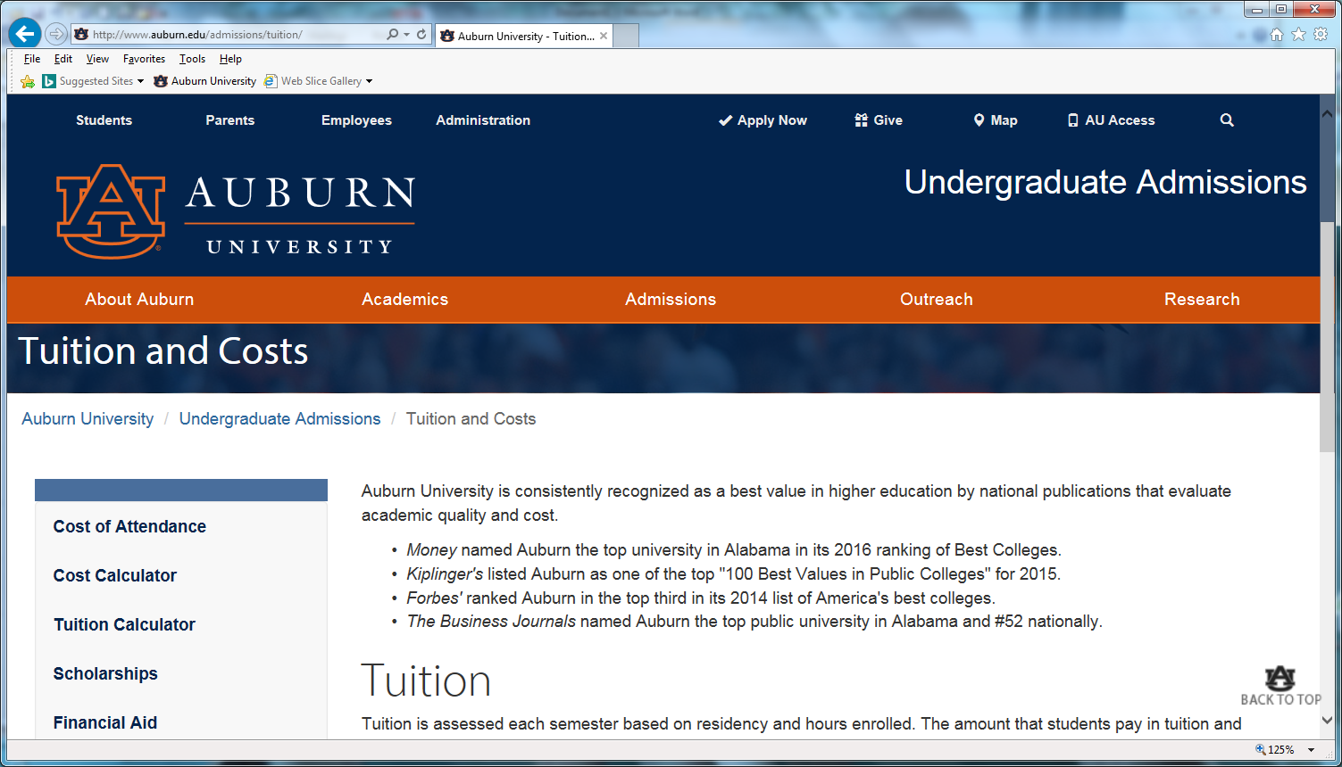
Tuition Calculator www.auburn.edu
Click on Tuition Calculator

Slide 72

GradGuard Tuition Insurance
Tuition Insurance Plan
Protection against the unexpected
Tuition Refund Insurance helps reimburse the following expenses if you can’t complete classes due to an illness or injury. It covers:
  ☑ Tuition
  ☑ Room and Board
  ☑ Other academic expenses
Annual Cost starting at $199.00
www.gradguard.com/Insurance

Slide 73
What if student drops classes after the semester starts?
Students may add/drop a class through the 5th class day (Fall/Spring) with no financial penalty (Summer through 2nd class day). Tuition is reimbursable.
If a student drops between the 6th -15th class day (Summer 3rd-5th class day) a $100 Course Drop Fee per class will be assessed. Tuition is reimbursable.
If a student drops a class after the 15th (5th for Summer) class day, no tuition will be reimbursed.
If a student drops their entire schedule between the 1st through 15th class day (5th for summer), there will be a $100 resignation fee. Tuition is reimbursable.

Slide 74
I Wish Parents had known….
Reflections from SFS
As far as the government is concerned, once a child starts college, they are considered an adult and fall under the federal privacy regulations. Therefore, SFS has to abide by federal regulations.
The e-bill is in the student’s name, not the parents.
We understand that a number of parents help their students with paying for school. However, without the financial release, we cannot talk about your student’s e-bill or financial aid.
It is the student’s responsibility to make sure they check their e-bill statement monthly.

Slide 75
I Wish Parents had known….
Reflections from SFS
Your student’s Auburn email is the OFFICIAL form of communication.
We know it can be scary as a parent to let your son/daughter go off to college on their own, however, this is a time when your sons and daughters need to learn to become mature, responsible adults. Help them to achieve this goal by letting them handle their financial affairs as much as possible.
As one parent reflected during Camp War Eagle “prepare yourself for the letting go process. The journey can be bittersweet for what could have been, for what will ever be, and for what was.”

Slide 76

Contact Info
Student Financial Services
203 Mary Martin Hall
Auburn AL 36849
334-844-4634
Hours: 7:45 am-4:45 pm M-F
Open during lunch hours for your convenience!
www.auburn.edu/sfs
Questions?

