Slide 1
Instructure CANVAS
January 9, 2012

Slide 2
Need & Process
Blackboard Vista’s demise
LMSWG
  December 2012 – May 2011
Implementation
  June 2011 – October 2011

Slide 3
Canvas @ AU (Nov. 2011)
Hosted
Branded
Authenticated
Banner integrated
Admin & Support: IMG

Slide 4
Implementation Timeline
Canvas beta: Fall 2011
Canvas live: Spring 2012
Training: Fall 2011
  24 workshops
Blackboard/Canvas running simultaneously through 12/31/12

Slide 5
Canvas Beta - 201210
24 faculty members
  recruited/trained SU 2011
52 courses
  math, engineering, accounting, education, composition, communications, music, theater, forestry, philosophy, finance
1600-ish students

Slide 6
Training & Support
IMG Workshops
Online
  Transitioning to Canvas
  Canvas Help Center

Slide 7
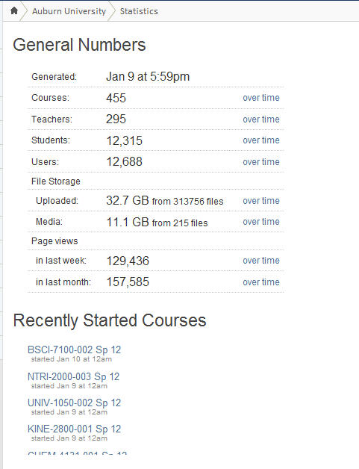
As of 5:59 pm yesterday
Blackboard Courses
  1247 w/content

Slide 8
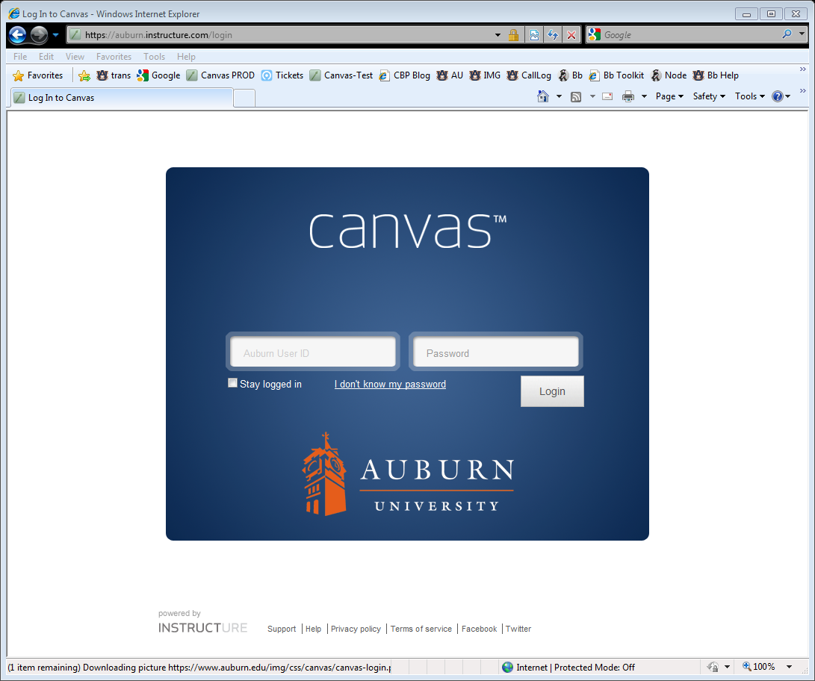
If there’s time/you’re interested:

