Slide 1

Auburn Connects 2011 http://www.auburn.edu/auburnconnects

Slide 2

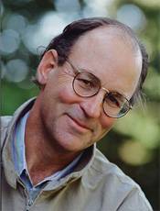
Mountains Beyond Mountains by
Tracy Kidder

Slide 3
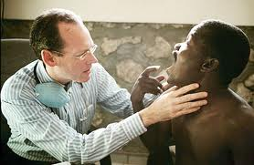
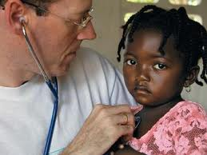
Dr. Paul Farmer
Working Toward Global Health Equity

Slide 4
Goals of Auburn Connects!
Promote intellectual community on campus;
Help students gain a global perspective;
Promote a culture of service;
Emphasize individual empowerment and the need for hard work;
Set the stage for the intellectual engagement students will need throughout their Auburn careers;
Link to diverse programming.

Slide 5
http://video.pbs.org/video/2073764815
Haitian Proverb:
Beyond mountains there are mountains.
“As you solve one problem, another problem presents itself, and so you go on and try to solve that one too.” Paul Farmer

Slide 6
Central Discussion Themes
Global Awareness
Public Health
Structural Violence
Infection and Disease (TB / HIV/AIDS/Cholera)
History/Culture/Life of Haiti
Ethical/Moral Obligation to Self vs. Others
Globalization and Health Care
Multicultural Awareness and Understanding
Catastrophic events and Consequences
Architectural
Human Rights
Comparisons/contrasts between cultures
Identity and Power
Nutrition, Water and Food Production
Personal Determination
Political Structures
Building Infrastructure

Slide 7
Central Themes Related to Various Majors
  Health Occupations
  Public Health and Medicine
  Sciences
  Engineering and Technology
  Agriculture
  Fisheries
  Transportation Systems
  Anthropology
  Social Work
  Political Sciences
  Economics
  Water Filtration Systems
  Human Sciences, Family systems and Nutrition
  World Hunger Studies
  Education
  Architecture/Building Science
  Business and Ethics
  Nursing and Medical Care
  Pharmacy and Medical Mgt.
  Rehabilitation
  Sustainability
  Communications

Slide 8
Auburn University Programming
Integrating the themes of the book in English Composition, First Year Seminars, Book Clubs, academic courses in various disciplines;
Small formal and informal discussion groups;
Public lectures, panels of experts;
Student engagement in service learning;
Engagement through the Arts;
Campus and community service through IMPACT, Alternative Student Break, OLLI, Alumni Book Club, Extension, Residence Life and Outreach.

Slide 9
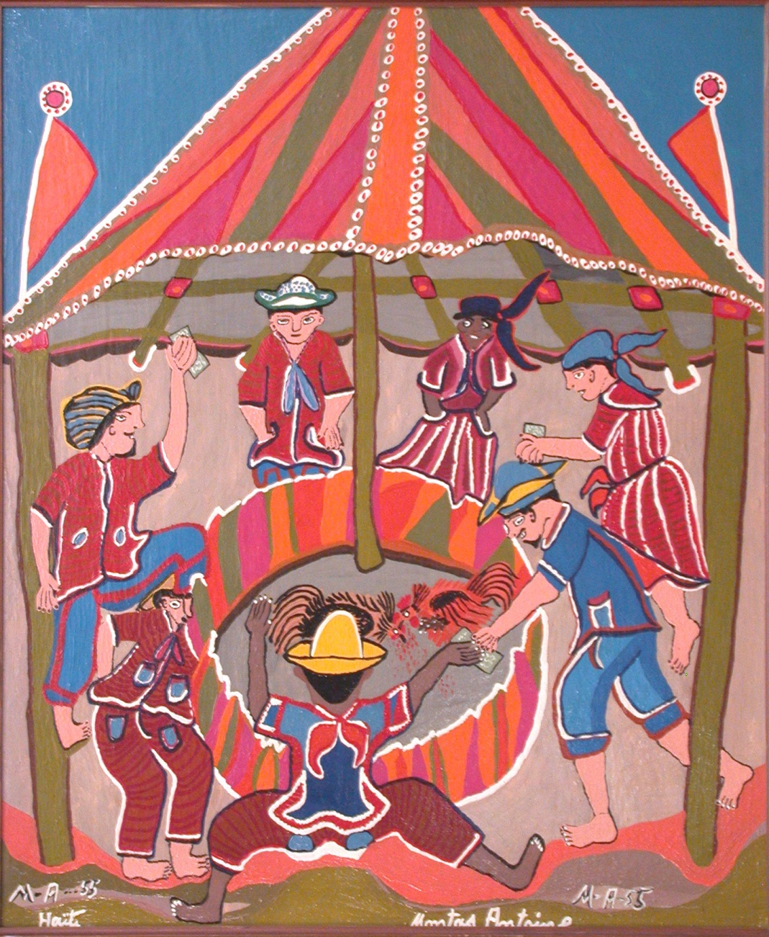
Jule Collins Smith Museum of Fine Art
An Exhibit of Haitian Art
Lespri Endonptabl: Selected Works from the Winslow Anderson Collection of Haitian Art at the Huntington Museum of Art
August 20 - October 29, 2011

Slide 10


QUESIMPUCO, BOLIVIA
August 4-11, 2011
Engineers Without Borders
Dr. Steve Duke, and Student Members of the Auburn Chapter
Samuel Ginn College of Engineering
September 29, 2011
3:30 PM
2227 AUSC

Slide 11

The College of Liberal Arts’ Community and Civic Engagement Initiative
Opening Feature Film for The Francophone Film Festival
Poto Mitan
October 3, 2011
5:00 PM
AUHCC Auditorium

Slide 12
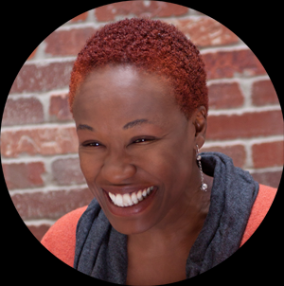

Dr. Gina Athena Ulysse: Professor, Wesleyan University, anthropologist, poet/performer, and multimedia artist. October 6-7, 2011
Auburn Connects! presents:
“Because When God Is Too Busy”
Telfair Peet Theatre October 6, 7:30 PM
“Performance Workshop”
Telfair Peet Theatre
October 7, 10:00 AM
Lecture: “Why Feminist Analysis Matters to Haiti Now More Than Ever”
Langdon Hall
October 7, 3:00 PM

Slide 13
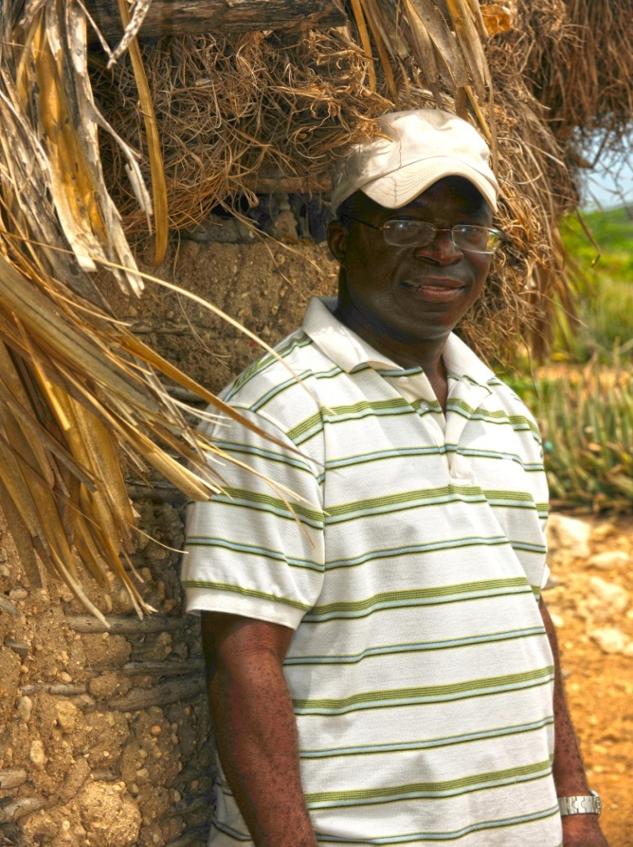
Valentin Abe, Auburn Alum ’91, ‘95 http://www.time.com/time/specials/packages/printout/0,29239,1984685_1984949_1985272,00.html
The College of Agriculture and
Auburn Connects!
“Auburn Works in Haiti”
Valentin Abe,
Drs. Dennis Shannon and Kevin McBride
October 13, 2011
3:30 pm
Science Center 115

Slide 14
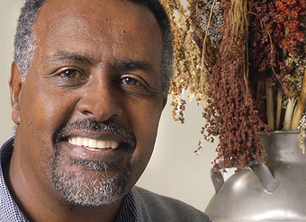
Dr. Gebisa Ejeta, Distinguished Professor, Purdue University &
2009 World Food Prize Laureate
E.T. York Distinguished Lecturer, Sponsored by the College of Agriculture
“World Food Demand: Research and Education Needs”
November 3, 2011
AUHCC Auditorium
7:00 PM

Slide 15
Making Connections Series
Thursdays @ 3:30
Drs. Hale, Crutchley and Jon Waggoner: “Financial Accountability, Professional Ethics and Non-Profits: What the Case of Greg Mortenson May Teach Us” (8/25).
Drs. McDaniel and Payne: “Climbing into Mountains Beyond Mountains” (9/1).
Dr. Tina Zappile: “ The Political Dimensions of Mountains Beyond Mountains” (9/15-3:30, 2225 AUSC).
Dr. Kathleen Tajeu: Discussant: “Haiti Cherie” by Director Claudio Del Punta (6:00-JCSM).
Drs. Morris and Acevedo: History, Histoire, Historia: Talking Story in Caribbean Literature” (10/6,-2227 AUSC).

Slide 16
Additional Programming Fall
Mark Kurlansky, “Haitian Noir”, Auburn Writers Conference (10/8, 2:45, AUHCC).
Dr. Holly Lavenstein, Discussant, Film: “The Living Gods of Haiti” (10/18,6:00, JCSM).
Carol Duncan, Haitian Cooking, (9/29, 5:30, AUSC).
Dr. Joyce DeVries: Moderator, Women’s Studies Panel: “Women’s Studies Response to Mountains Beyond Mountains”, 10/27, 3:30, 2227 AUSC).
Dr. Fred Kam: “Socialization of Medicine and Healthcare in Haiti”, 11/3, 3:30, 2227 AUSC).

Slide 17
Announcement
Hold The Date
Coming to the Auburn Arena
April 2, 2012
7:00 PM
Auburn Arena
Auburn University Campus
Tracy Kidder, Author
Mountains Beyond Mountains

