Slide 1


Slide 2

John M. Mason, Jr. PhD, PE
Associate Provost and
Vice President for Research
John M. Mason, Jr. PhD, PE
President,
John D. Weete, PhD
Executive Director,
Auburn Research & Technology Foundation (ARTF)
Research Advisory Board
Carl A. Pinkert, PhD
Associate VPR
  -Interface w/ ADR’s &
  AU Academic Affairs
  -Strategic Planning/Budgets
  -Interdisciplinary Research
  -University Core Facilities
Sherri Fulford
Executive Director, Governmental Affairs
Brian Keeter
Director of Public Affairs
  -Alabama Agricultural Experiment Station
  -Alabama Cooperative Extension System
  -Federal Relations
  -State Relations
  -Legal Counsel
  -Economic Development
Giovana Brannan
Business Manager
Martha M. Taylor
Assistant VPR
Administration
-Sponsored Programs
-Research Compliance
-Research Security
Laura J. Tambrallo, DVM
University Veterinarian
Partnered with:
-AU Institutional Official
-AU Institutional Animal Care and Use Committee
John D. Weete, PhD
Assistant VPR (acting)
-Office of Technology Transfer
-Business Incubator
Rodney L. Robertson, PhD
Executive Director
Huntsville Research Center
-External Sponsors Development
-Cyber Systems Initiative
-Huntsville Advisory Council
Larry Fillmer
Executive Director
Program Development Office
-Marketing & Communications
-Development
-Research Advisory Board

Slide 3
Vision/Direction for Research
Enhance disciplinary scholarly efforts
Interdisciplinary and collaborative
  Linking disciplines across campus
  Assist in transforming industries and creating economic opportunities for communities across the state, the region and the nation
Align AU expertise with long-term national priorities
  Cyber Systems
  Energy & the Environment
  Health Sciences
    Food Systems Initiative
    MRI Research Center
    Military Health Sciences
  Transportation
  Science, Technology, Engineering and Mathematics (STEM)
  Economic Development – Putting Research to Work

Slide 4
Auburn University Research
Strategic Interdisciplinary Initiatives
NSF/NIH/USDA
Mission Agencies
Corporations
Foundations
Public Agencies
Alliances
Development
Associations
University Facilities
MRI
CASIC
Energy Labs
NCAT
ARTF
ACES
AAES
Outreach
Huntsville Research
Center
Funding/Sponsors
Cyber Systems
Energy & Environment
Gulf of Mexico
Health Sciences
S.T.E.M.
Transportation
Enablers
Faculty Expertise
Academic Programs
Undergraduate/Graduate Students
Research Staff
Research Facilities
Intramural Grants Program
Foundation

Slide 5
Ongoing Research Initiatives
Energy & the Environment Task Force (E&E)
  Chaired by Dr. Christopher Roberts
  Meeting regularly to determine the optimal and appropriate administrative structure for organizing and supporting research in these areas
AU Health Sciences Initiative
  Chaired by Dr. Calvin Johnson
  Charged with developing a strategic plan
  Will collaborate with Food Systems Initiative on areas that include:
    Detection and elimination of microbes in agricultural products
    Environmental Health/Water Quality
    Management and logistical support for distribution systems
AU Food Systems Initiative (AUFSI)
  Dr. Patricia Curtis named director
  AUFSI working groups (17 to date) are responding to requests for proposals from a number of agencies
  Proposal submissions related to:
    Electronic traceability of seafood
    Long term health effects of the oil spill
    Safe transportation of foods

Slide 6
Ongoing Research Initiatives (continued)
AU Gulf of Mexico Initiative
  Coordination/facilitation by Dr. Ken Halanych
  Researchers from a variety of disciplines have received funding from multiple sources including but not limited to:
    NSF
    BP (through the Marine Environmental Science Consortium)
    Orange Beach, Alabama
  Dr. Ash Bullard of the Department of Fisheries recently received $132,000 from BP through the Gulf of Mexico Alliance’s Gulf Research Initiative to enable him to conduct time-sensitive sampling and related studies
  Five teams responded to the recent RFP from BP (through the Gulf of Mexico Alliance)
    Focused on: deepwater issues, near-shore issues, and long-term health
    Funding announcements were made August 30, 2011—no Alabama-led consortia were selected

Slide 7
Ongoing Research Initiatives (continued)
Auburn University Huntsville Research Center (AUHRC)
  Dr. Rodney Robertson, Executive Director
  AUHRC Research Advisory Council Formed
    26 members from industry and government
    Establishing contract vehicles for Auburn/government agencies
  Conducting Symposia highlighting Auburn researchers and students
    Cyber Information and Assurance
    Advanced Materials, Polymers and Composites
  Hosted visits to Auburn to review research capabilities for:
    Missile Defense Agency
    Lockheed Martin
    Boeing
    NASA

Slide 8
Ongoing Research Initiatives (continued)
Auburn University Internal Grants Program
  Facilitated with active input from the Faculty Research Committee
  Administered through the OVPR (Dr. Carl A. Pinkert)
  Comprehensive, coordinated grants program initiated in 2010
  60 proposals received in the inaugural year; all 60 were funded
  OVPR provided approximately $1.6 M
  Matching support from departments, schools and colleges resulted in approximately $3M total internal funding
  Program description can be found at: https://fp.auburn.edu/vpr/iga/igp/default.aspx

Slide 9
Auburn University
Intramural Grants Program
Four levels of competition (OVPR contribution):
  Level 1 – Seed Research/Scholarship Proposals ($2000) Individual investigator driven projects working on a new research program or scholarly initiative.
  Level 2 – Exploratory Interdisciplinary Research/Scholarship Proposals ($3750) Faculty from at least two departments/schools/ colleges working on a new research program or scholarly initiative.
  Level 3 – Developmental Interdisciplinary Research/Scholarship Proposals ($25,000-$100,000) Faculty from at least two schools/colleges working on a new research program or scholarly initiative.
  Level 4 – Interdisciplinary Equipment Proposals ($25,000-$100,000) Faculty from at least two schools/colleges must demonstrate need.

Slide 10
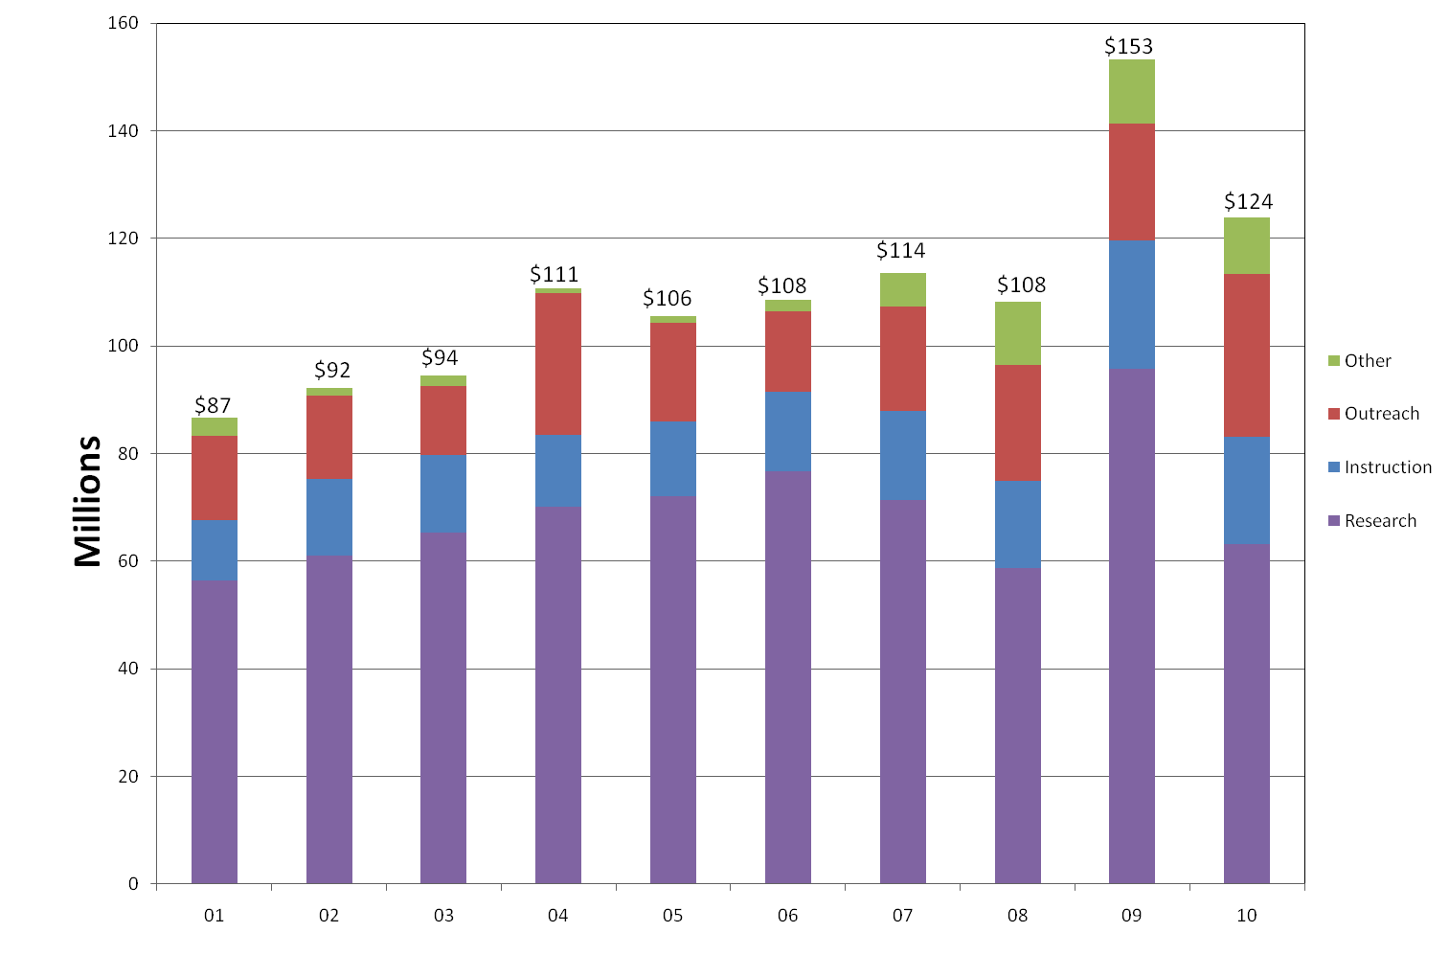
All Sponsored Awards
FISCAL YEAR

Slide 11
Office of Technology Transfer
Managing the intellectual property portfolio for Auburn University
 | FY2006 | FY2007 | FY2008 | FY2009 | FY2010
Invention Disclosures | 93 | 110 | 84 | 87 | 105
U.S. Patent Applications Filed:
Standard | 16 | 5 | 26 | 15 | 17
Provisional | 80 | 121 | 120 | 65 | 91
Other (Div., CIP, Cont.) | 6 | 10 | 7 | 1 | 2
U.S. Patents Granted | 10 | 19 | 12 | 14 | 23
U.S. Patents Active | 106 | 125 | 137 | 126 | 149
Licenses/Options Executed | 20 | 13 | 16 | 15 | 25
Active Licenses/Options | 64 | 42 | 54 | 66 | 63
Start-up Companies Formed | 0 | 3 | 1 | 0 | 1
Total Active Startup Companies | 11 | 12 | 14 | 14 | 14
Option and License Income | $699,810 | $553,614 | $675,132 | $693,452 | $770,135

Slide 12
Research Marketing Update
AU Research Annual Update—produced in Summer 2011
AU Research Website www.auburn.edu/research/
Auburn Speaks
  Annual book publication highlighting Auburn Research for a lay audience
  First issue to be released April 2012 focused oil spill related activity
  Second issue to be released in 2013 will focus on water quality/quantity issues
    Peer Reviewed
    Edited by Dr. Graeme Lockaby
AU Research “30 Second” Promotion
  Will be featured on the Jordan-Hare “Jumbotron” for all of the 2011 home games
  Focus on AU MRI Research Center
AU Research in Social Media
  AU ranked #3 among national universities for effective use of social media behind Harvard and Stanford
  Auburn Presence on Facebook
    Auburn University Research
    Office of Undergraduate Research
    Auburn University Food Safety Initiative

Slide 13

Auburn University Research Week 2012
April 2 ^{nd} – 5 ^{th}, 2012
  Dr. Paula Bobrowski, Associate Dean for Research, College of Liberal Arts serving as Chair of the Research Week 2012 Organizing Committee
  Activities include:
    Undergraduate Research Forum
    Graduate Research Symposium
    Faculty Research Forum
    Grantsmanship Workshops
    Awards Gala
Notes:
Our Research Orientation…

Slide 14
Summary
Near-term objective – Grow Auburn University’s research portfolio and increase funding through contracts, grants, investments and contributions
Long-term objective – Measurably increase Auburn University’s reputation as a premier land-grant, research institution

Slide 16
Auburn University Research
Interdisciplinary Achievement
The Center for Forest Sustainability (CFS), directed by Dr. Graeme Lockaby supports teaching research and outreach related to urbanization and natural resources. The CFS has:
  Received the Presidents Outstanding Collaborative Unit Award – July 2011
  Supported 75 graduate students
  Collaborated with faculty and graduate students from 14 academic departments within 8 of the Universities Schools and Colleges
  Generated over $18M in extramural funding for a variety of academic units on campus
AU Detection and Food Safety Center, directed by Dr. Bryan Chin
  Recurring (annual) USDA NIFA - $1.6 M
  Includes researchers from 5 of the Universities Colleges (Agriculture, Engineering, Human Sciences, Sciences and Mathematics, and Veterinary Medicine)
  USDA NIFA - $1.4M - Magnetoelastic biosensors for detection of pathogens on globe fruits diagnostics
  Receives additional funding from federal agencies (including, FDA and NSF), and food-related industries in the form of sponsored projects and
  industrial participation

Slide 17
Auburn University Research
Interdisciplinary Achievement
Cogongrass and ecologically-based weed management strategies: insect diversity and pine decline in the Southeastern United States
  USDA NIFA - $493K
  Dr. Stephen Enloe, Agronomy and Soils; Dr. David Held, Entomology and Plant Pathology; Dr. Lori Eckhardt and Dr. Nancy Loewenstein; School of Forestry and Wildlife Sciences
Eco-morphological stream design
  US EPA $300K
  Dr. Eve Brantley, ACES; Dr. Chris Anderson, School of Forestry and Wildlife Sciences; Dr. Brian Helms, Biological Sciences; Dr. Joey Shaw, Agronomy and Soils; Dr. James Stoeckel, Fisheries and Allied Aquacultures
II-new: a compute and storage cluster for multidisciplinary research computer systems and scientific simulations
  NSF - $400K
  Dr. Weikuan Yu, Computer Science and Software Engineering; Dr. Michael Pindzola, Physics; Dr. Cheryl Seals, Computer
  Science and Software Engineering; Dr. Hanqin Tian,
  School of Forestry and Wildlife Sciences

Slide 18
Auburn University Research
Interdisciplinary Achievement
Molecular diagnostics & biological control of disease in channel catfish
  NSF/Lucigen Corporation - $250K
  Dr. Mark Liles, Biological Sciences; Dr. Paul Cobine, Biological Sciences; Dr. Joe Kloepper, Entomology and Plant Pathology; Dr. Joe Newton, Pathobiology; Dr. Jeff Terhune, Fisheries and Allied Aquacultures
Precision Agriculture: Management approaches toward environmental stewardship for Alabama
  USDA NIFA - $390K (annually)
  Dr. Brenda Ortiz, Agronomy and Soils; Dr. Joey Shaw, Agronomy and Soils; Dr. John Fulton, Biosystems Engineering; Dr. Tim McDonald, Biosystems Engineering; Dr. Paul Mask, ACES
East Alabama Partnership for the Improvement of Mathematics Education
  NSF - $1.68M (annually)
  Dr. Gary Martin, Curriculum and Teaching; Dr. Marilyn Strutchen, Curriculum and Teaching; Dr. Stephen Stuckwisch, Math and Statistics; Dr. Phillip Zenor, Math and Statistics
Alternative Fuel for Cement Processing
  DOE - $1.43M
  Dr. Tomas Burch, Mechanical Engineering; Dr. David Bransby, Agronomy and Soils; Dr. Steve Duke, Chemical Engineering; Dr. Anton Schindler,
  Highway Research Center; Dr. Ralph Zee, Associate Dean for
  Research, College of Engineering

Slide 19
Interdisciplinary Achievement
Energy
($18M+ in extramural funding)
Congressionally Directed Funding to Center for Bioenergy and Bioproducts
  US Department of Energy – 3 awards totaling $3M—led by CBB with involvement of faculty in Biosystems Engineering, Chemical Engineering, Forestry and Wildlife Sciences, and Horticulture
  USDA – 1 award totaling $250K –led by CBB with involvement of faculty in Biosystems Engineering, Chemical Engineering, and Forestry and Wildlife Sciences
Industry Funding
  Electric Power Research Institute - $375K led by CBB with involvement of faculty in Biosystems Engineering and Chemical Engineering
Competitive Funding
  Alabama Department of Economic and Community Affairs – 2 awards for $150K—led by CBB with involvement of faculty in Alabama Cooperative Extension System, Biosystems Engineering, and School of Forestry
  Sungrant – 2 recent awards for $500K—one led by Chemical Engineering with involvement from Biosystems Engineering and Forestry and Wildlife Sciences; another led by Biosystems Engineering with involvement from Chemical Engineering
  U.S. Department of Energy - $4.9 M award with additional $5 M industry cost share led by CBB with involvement of faculty in Biosystems Engineering and Forestry and Wildlife Sciences along with USDA Forest Service and Corley Land Services (a central Alabama company)
  USDA – Agriculture and Food Research Initiative - $1 M– led by Chemical Engineering and Biosystems Engineering with heavy involvement of CBB
  NSF IGERT for graduate fellowships in the area of biorefining - $3.0 M– led by Chemical Engineering with involvement from Biological Sciences, Biosystems Engineering, Forestry and Wildlife Sciences, and Mechanical Engineering
Related Award
  NSF grant for renovation of Biological Engineering Research Laboratory
  – $4.6 M—led by Biosystems Engineering, but involves a significant bioenergy
  component that relates to CBB activities

