Slide 1

History of AU Ombuds Office
2004 Resolutions by University Senate A&P Assembly, Staff Council
2007 2nd Resolution, funding approved by President Gogue
September 2, 2008: Launch of Ombuds services
Summer 2010: Decision to continue Ombuds Office beyond trial
2011: services expanded to students

Slide 2

IOA Standards of Practice
Confidential
Independent
Neutral/Impartial
Informal
www.auburn.edu\ombuds
Brochure

Slide 3
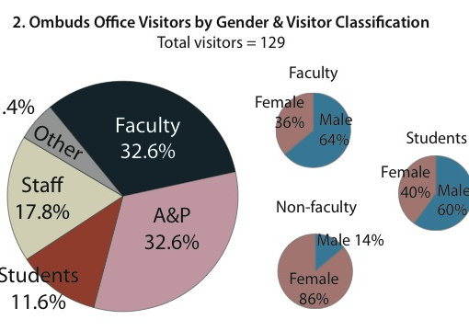
Annual Report Presentation

Slide 4
Contact Information:
Jim Wohl, DVM, MPA
University Ombudsperson
Suite 005 Quad Center
Tel: 334 – 844-7170
Fax: 334 – 844-7089
www.auburn.edu\ombuds
*ombuds@auburn.edu
*Email is not a secure or confidential method of communication

