Slide 1

Ad Hoc Committee to Review and Establish University Policies Regarding Minors
(Children) on Campus
Dean Bonnie MacEwan
Committee Chairman

Slide 2

Committee Charge
Clarify the requirements placed on administrators, faculty, staff, students, volunteers and others working with minor children in an effort to promote their protection
To fulfill our obligation as mandated by Alabama State Law
To provide the safest possible experience for any minor visiting our campus or participating in university-related programs

Slide 3
The Committee
Nearly 30 members
from many (most?) areas of the University with programs with minors
began meeting soon after we were charged by Provost Boosinger in early April 2012
with the goal of submitting a report by October 31, 2012.

Slide 4
Committee Scope & Initial Findings
Focused on unenrolled minors
Alabama’s age of majority is 19. Anyone below that age is considered a minor.
Did not find any serious problems
at Auburn
We did find areas where Auburn could do better or practices were not consistent

Slide 5
Four Subcommittees
Benchmarking
Survey
Policy Draft
Children In The Workplace

Slide 6
Benchmarking Subcommittee
Contacted 57 peer institutions,
20 institutions responded,
many universities about where we are – creating policies
Webinair and articles in journals such as University Risk Management and Insurance Association Journal

Slide 7
Survey
Subcommittee
214 responses
The responses came from across the Auburn and AUM campuses
A wide diversity of programs
Very decentralized
Although the benchmarking and research indicates diversity and decentralization as a risk, the Committee recommended against changing this.

Slide 8
Policy Draft
Subcommittee
A registration system for all programs for non-enrolled minors
A rule of three that requires at least two representatives of the university be present during nearly all contacts with non-enrolled minors
A requirement that all university representatives (employees, volunteers, interns and university students) who have contact with minors have a background check on file with human resources, those background checks be updated on a regular schedule, and they attend a training session
The policy requires every unit to establish desk procedures that provides direction for anyone who has knowledge of any abuse on campus including the direction to call 911 and then notify their immediate supervisor.

Slide 9
Children In The Workplace
Subcommittee
Children are not allowed in high-risk areas under any circumstances. Examples include: laboratories, shops, studios, mechanical rooms, power plants, garages, food preparation areas, or any areas containing power tools or machinery with exposed moving parts.

Slide 10
Children In The Workplace
Subcommittee (cont.)
Employees who bring children to the workplace are responsible for all aspects of the child's behavior.
The department’s supervisor may direct the employee to remove the child (or visitors) from the workplace at any time
Questions regarding bringing children in the workplace should be directed to your department head and/or a human resources representative.

Slide 11
In Addition
the Committee:
Recommends a small implementation team made up of members of the university community who can put in place the recommendations in the report.
Notes that communication of the policies and follow up will be key
Struggled over the exception in the policy that allows a prospective student to spend time with a host who is an enrolled student. We recommend this exception be monitored closely by enrollment management and the student hosts be carefully instructed and monitored.

Slide 12
Final Observations
I was continually impressed by the good will and dedication of the many faculty, staff and students on campus who plan and implement the rich array of programs at Auburn
Members of the committee learned from each other and there may be some benefit in providing an occasional opportunity for these program providers to talk with each other unrelated to the charge of this committee
It was a real struggle to balance the policies and procedures we wanted to recommend with the realities of the 4-H program. There are some fundamental risk management versus the reality of the challenges of continuing the very good work of the 4-H.

Slide 13
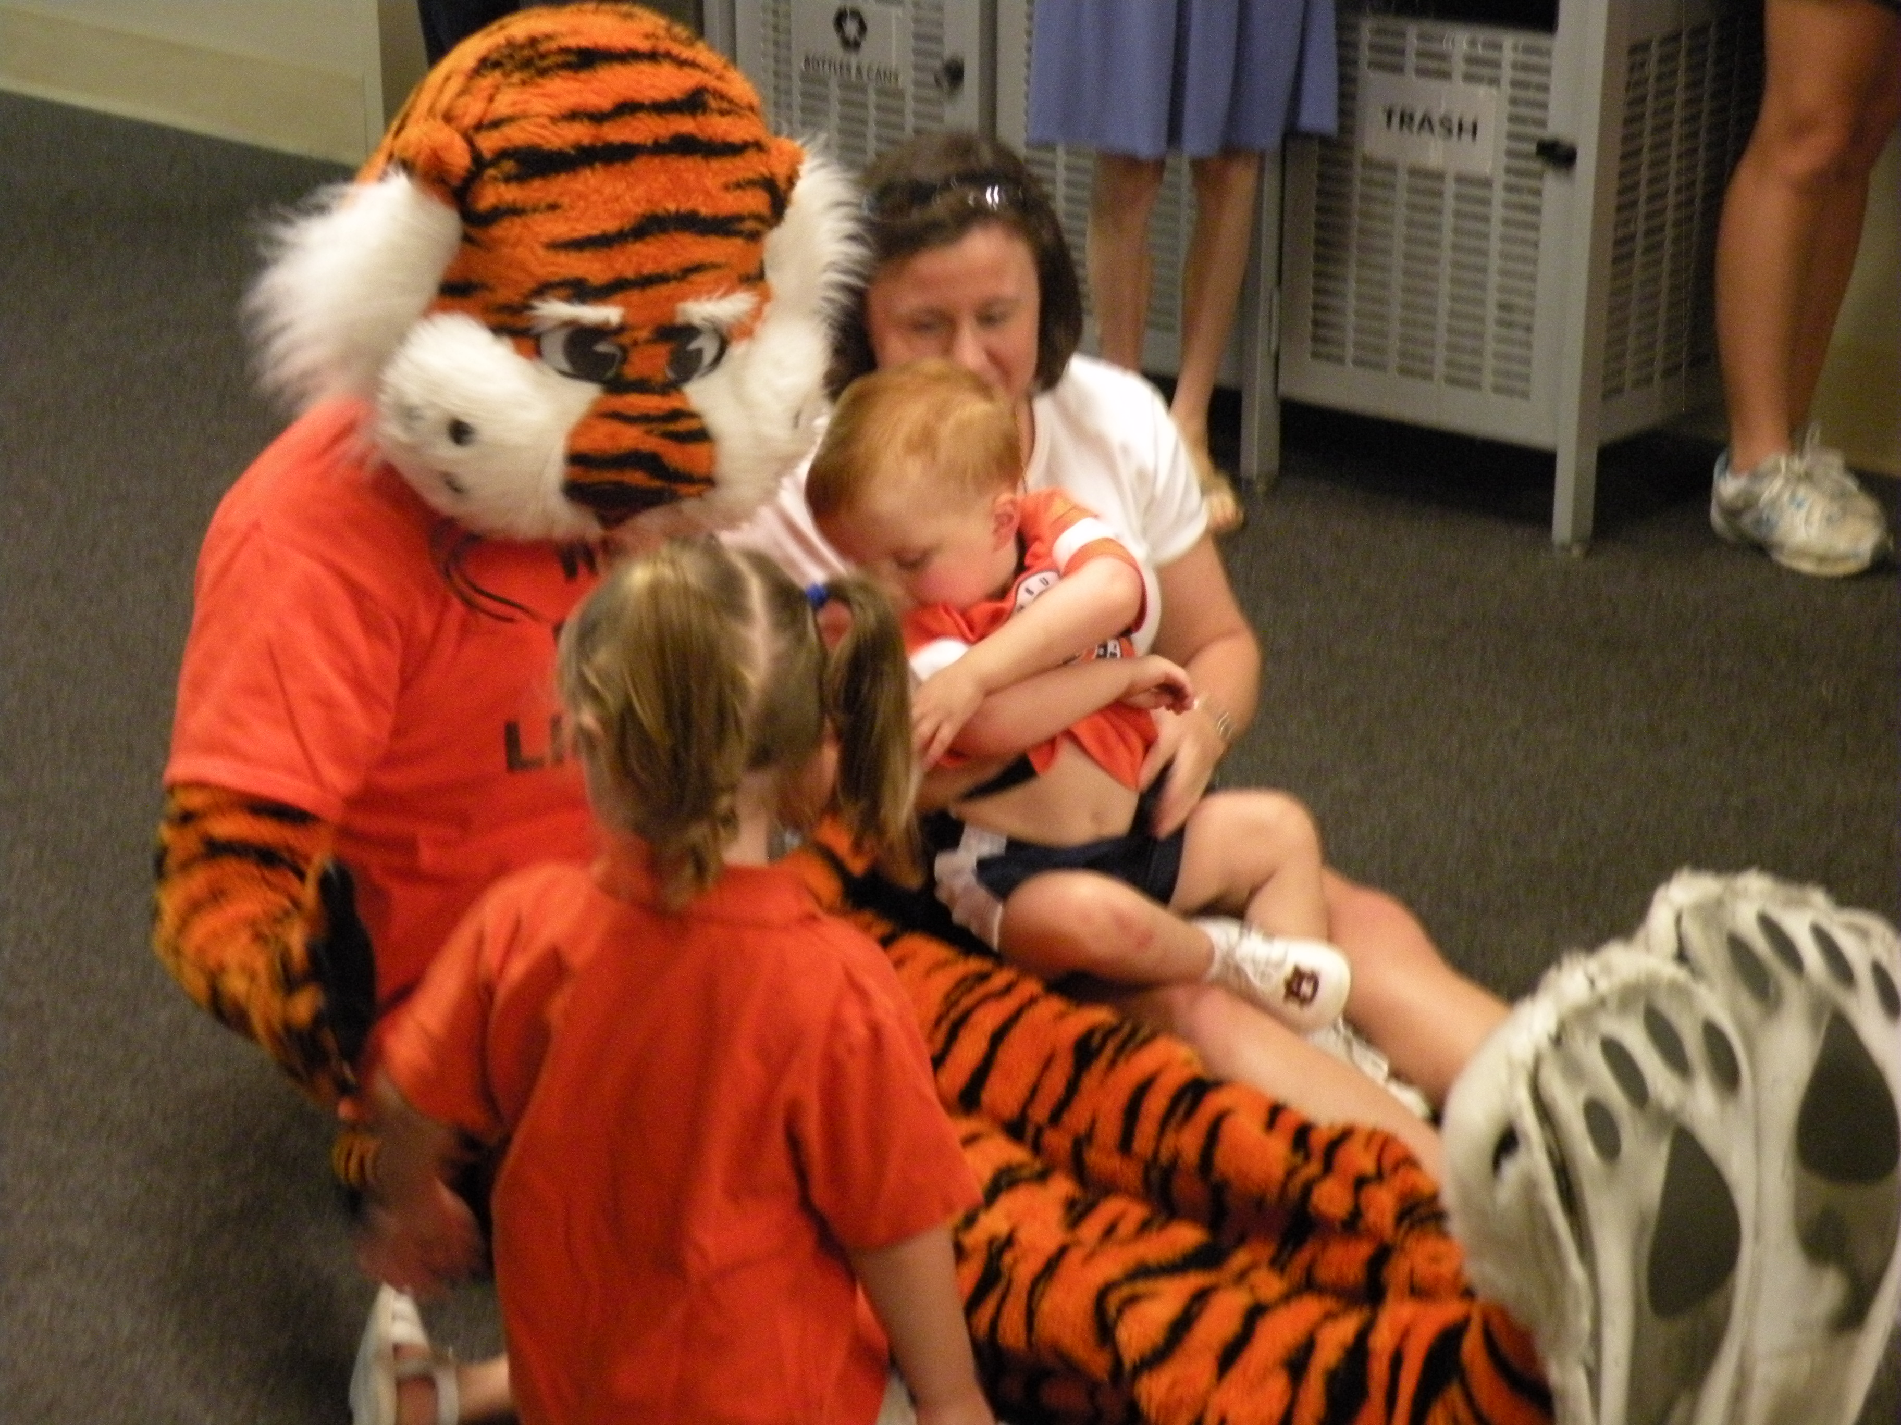
Full Report
The full report is available at: http://www.auburn.edu/academic/provost/
It is listed under “Task Force Reports”

