Slide 1
Sustainability Initiatives on Campus
Michael Kensler
Director, Office of Sustainability
Nanette Chadwick
Director of Academic Sustainability Programs
Office of the Provost
Planet
Prosperity
People

Slide 2
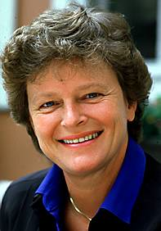
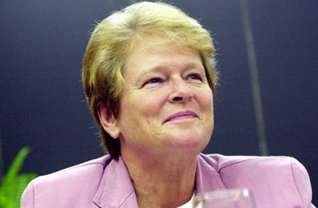
What is Sustainability?
“Meeting the needs of the present generation without compromising the ability of future generations to meet their own needs.”
United Nations Commission on Sustainable Development (1987)
Dr. Gro Brundtland
W.H.O. Director, Norway Prime Minister

Slide 3
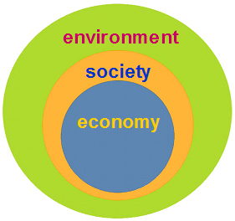
Sustainability recognizes 3 nested systems:
For business: More than just an economic bottom line
“Triple Bottom Line”

Slide 4


894 Member Institutions

Slide 5

Sustainability Tracking Assessment & Rating System
399 Participating Institutions
252 Rated Institutions

Slide 6

What gets measured?
Education and Research
Operations
Planning, Administration, & Engagement
Innovation

Slide 7
Performance Rating Levels
Platinum 0
Gold 45
Silver 125
Bronze 62
Reporting 20

Slide 8
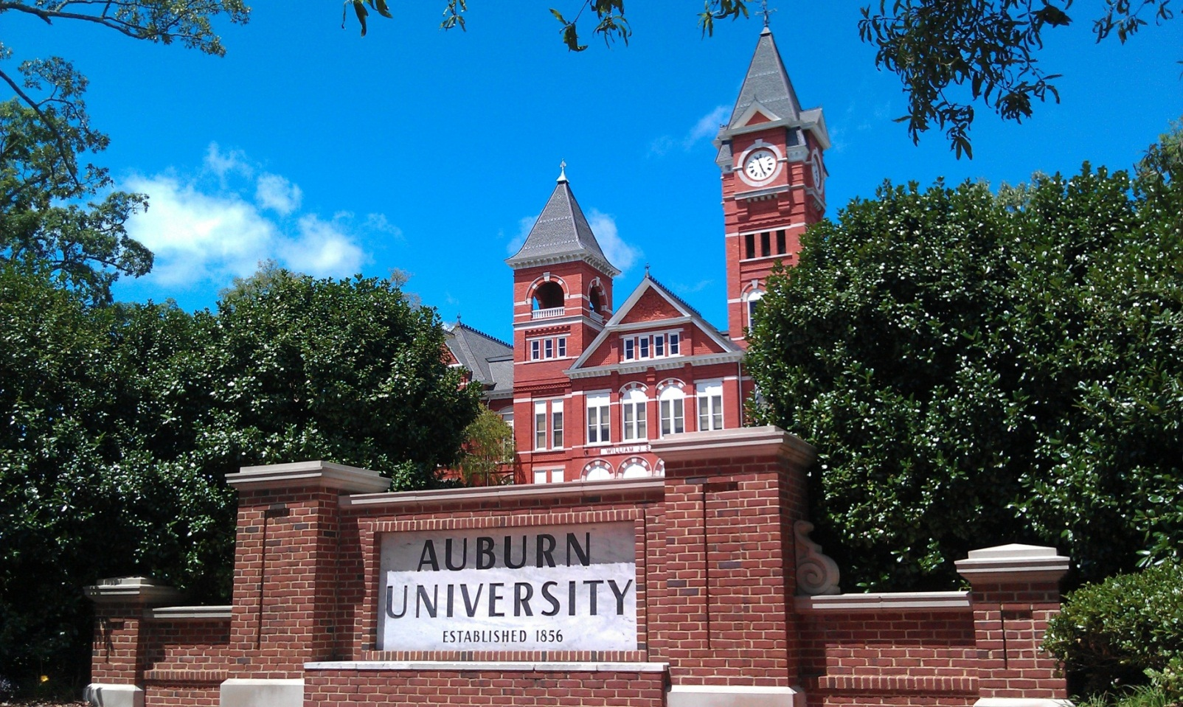
So… Where are we?

Slide 9
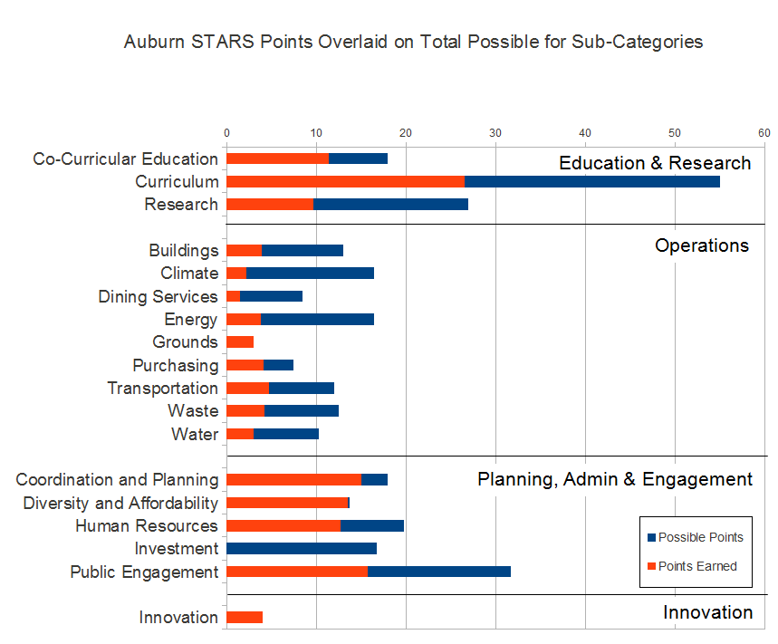

Slide 10
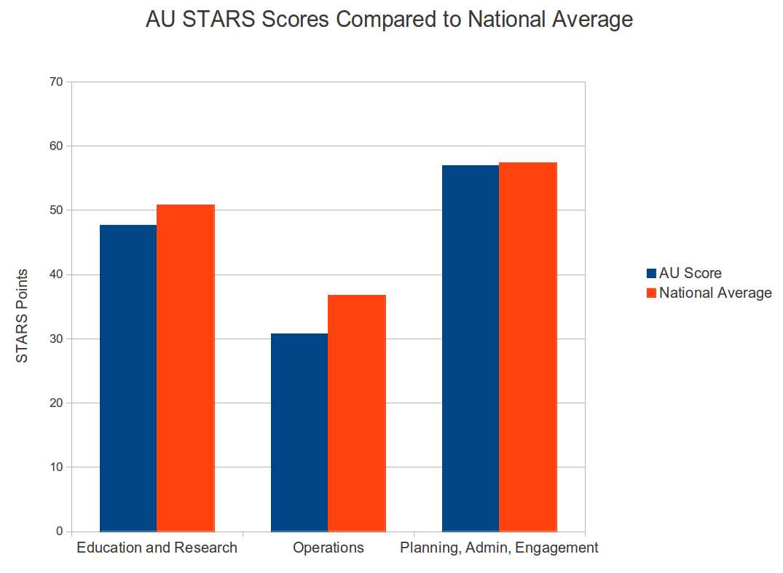

Slide 11
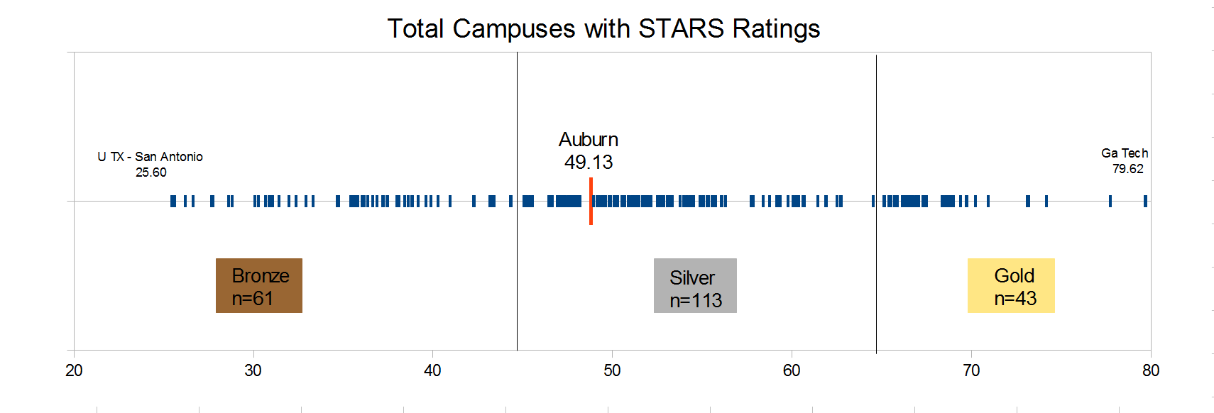


Auburn
49.13
U TX – San Antonio
25.60
Georgia Tech
79.62
www.stars.aashe.org

Slide 12

Achievements and Opportunities
Operations
Planning, Administration, & Engagement

Slide 13
Achievements and Opportunities
Education and Research
Minor in Sustainability Studies: Established 2008, rapid growth
Diverse students: 43 majors in 10 colleges
45 graduated so far + ~50 current
140 in intro courses this year

Slide 14
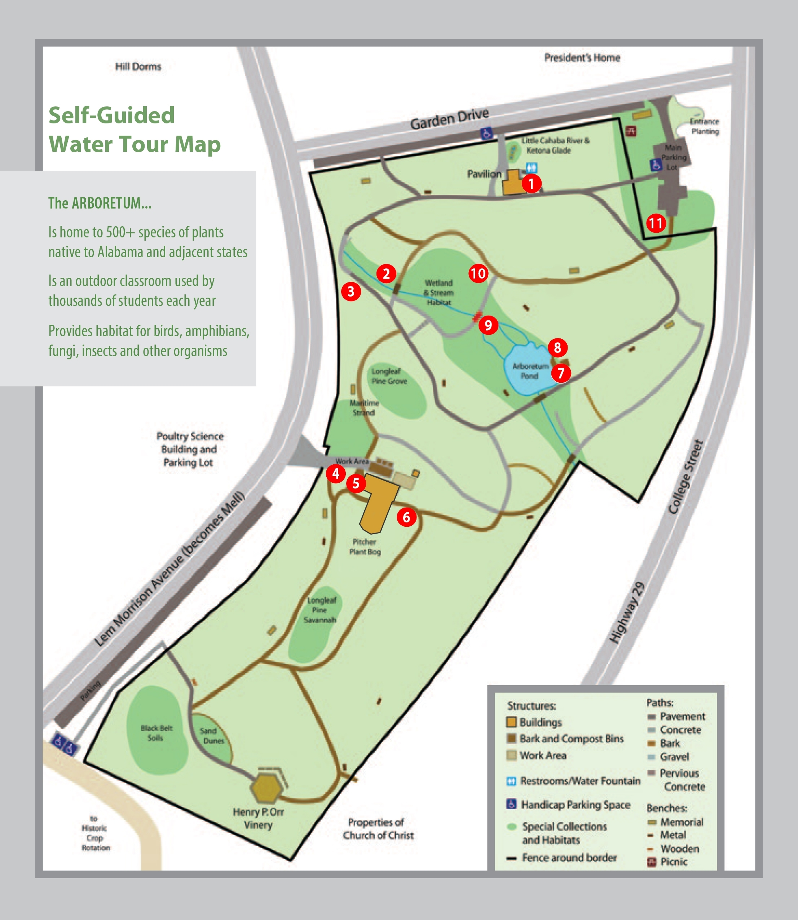
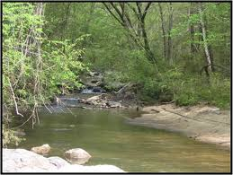
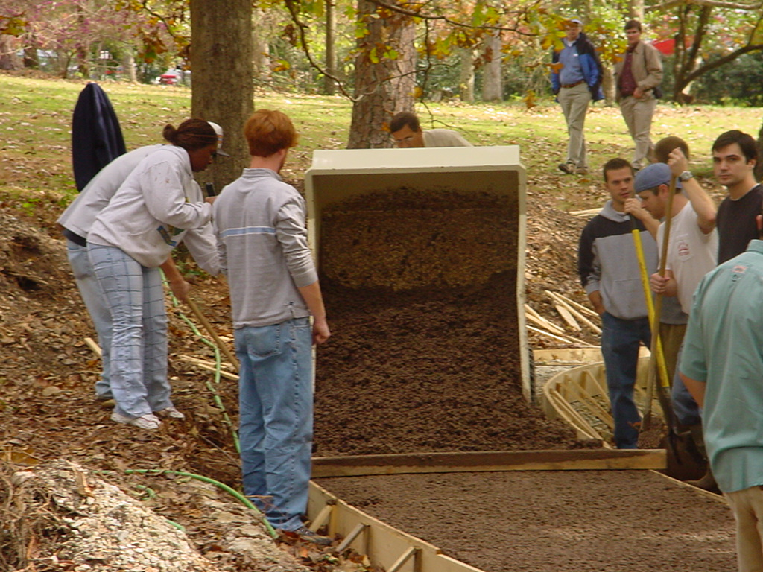
Campus as a living laboratory
Use campus & city systems to give students hands-on, local experience with real-world sustainability issues.
In-class tours offered:
(1) Water Systems – Arboretum cell phone tour, stream, rain gardens, new Dudley Hall tank

Slide 15
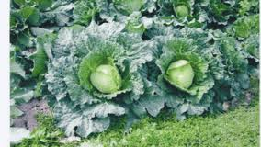
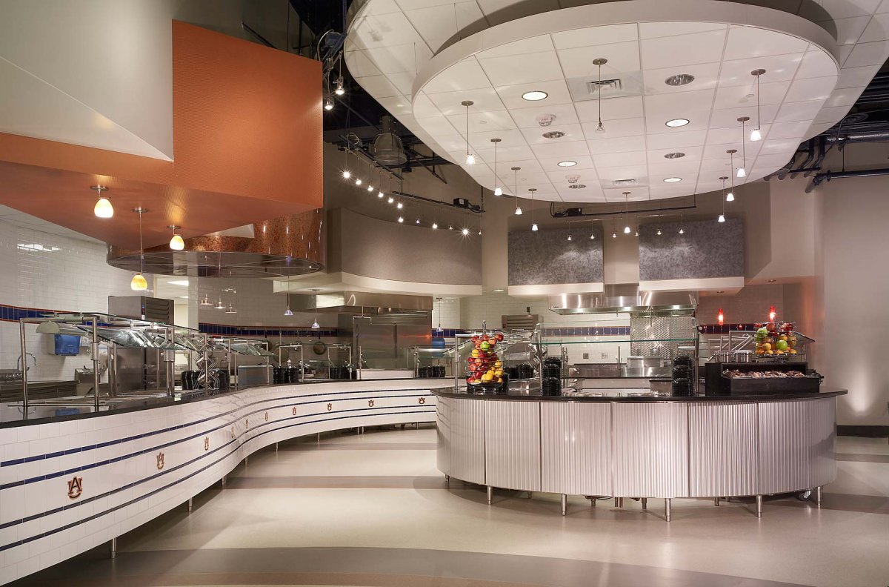
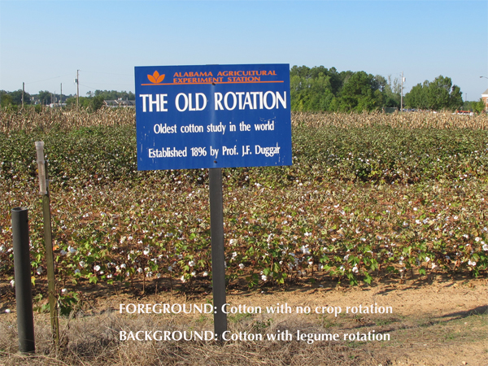

(2) Food Systems – Old Rotation, food gardens, campus dining, head chef Emil Topel

Slide 16
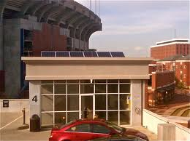
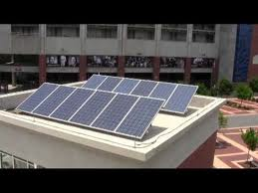
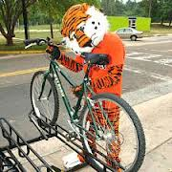
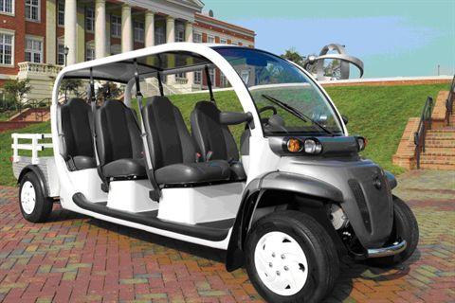
(3) Transportation – solar panels to electric cars, solar cars, pedestrian/bicycle systems

Slide 17
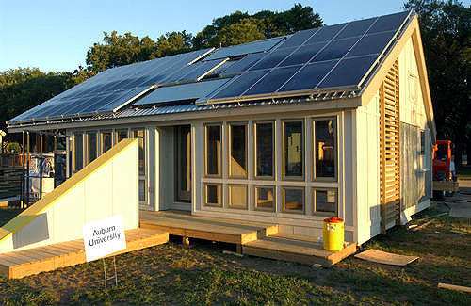
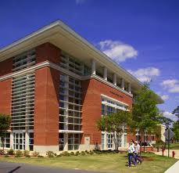
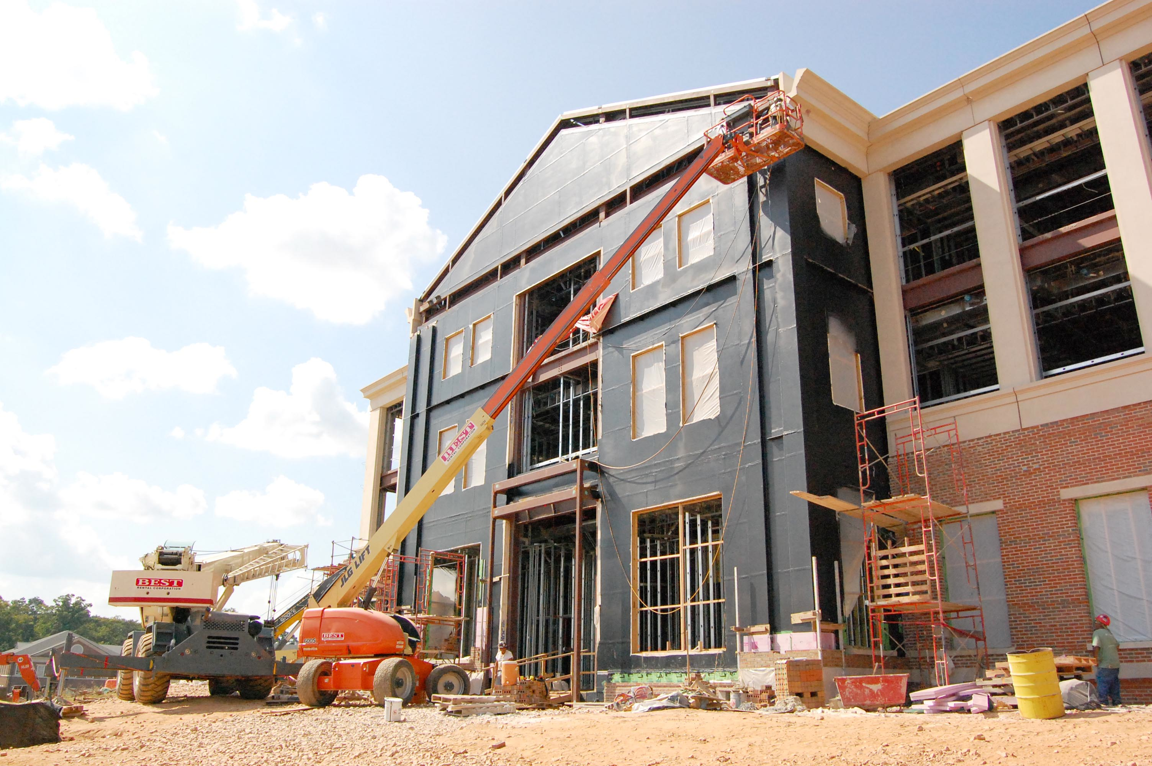
(4) Buildings and Energy Use – LEED buildings: Gorie Center, new OIT Bldg, Solar House

Slide 18
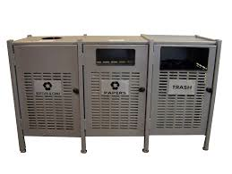
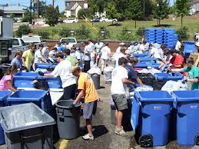
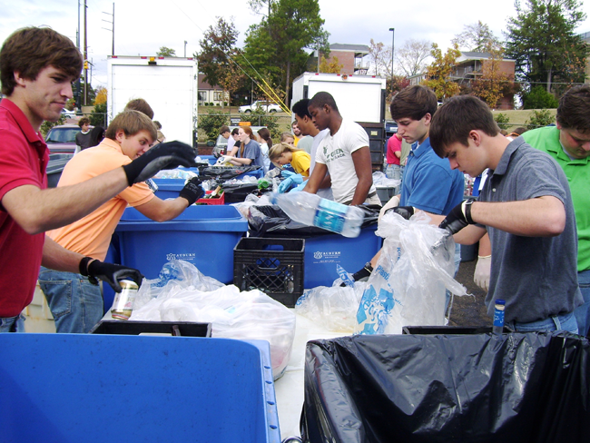

(5) Materials Consumption and Waste – follow the waste stream; Student Center, Recycling

Slide 19
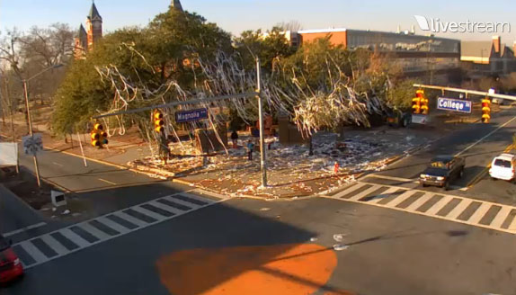
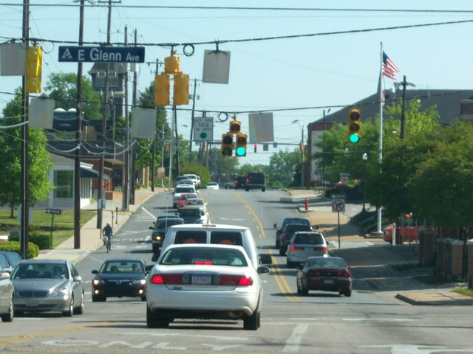
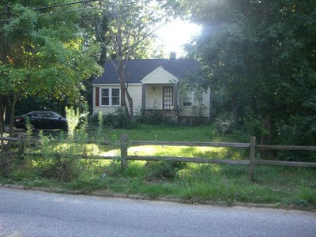
(6) Walkability – downtown area (public health, engineering, city planning, new urbanism)
Other options: Connect with community programs
(food bank, day care centers, churches, city government, etc.)

Slide 20
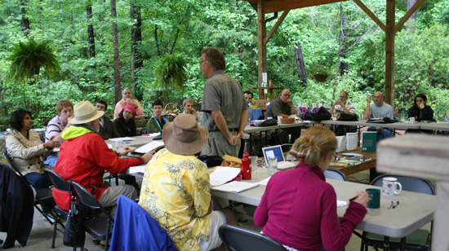
Faculty Training Workshops in Sustainability
-- Annual at Forest Ecology Preserve
~ 85 faculty trained from >30 depts, ~20 each year
-- $$ awards for participation and syllabus development
-- Benefits: interact with faculty across campus, update courses

Slide 21
Campus-wide course inventory
All 9 colleges have some content
About half of depts. include content
(N = 71)
No Sustainability Literacy Assessment or SLOs in core curriculum
College | # Courses with sustainability content | Total # courses | Percent
Agriculture | 81 | 250 | 32.4%
Architecture | 9 | 155 | 5.8%
Business | 3 | 275 | 1.1%
Education | 2 | 285 | 7.0%
Engineering | 46 | 610 | 7.5%
Forestry & Wildlife | 38 | 74 | 51.3%
Human Sciences | 24 | 137 | 17.5%
Liberal Arts | 30 | 756 | 4.0%
Sciences & Math | 56 | 342 | 16.4%
Total | 289 | 2884 | 10.0%

Slide 22
Current Sustainability Research
Faculty engagement: >72 faculty in 11 colleges engaged in sustainability-related research (~6% of 1176 faculty on campus)
Departmental engagement: 22 departments with sustainability-related research (~16% of 140 depts total)
Interdisciplinary research incentives: Intramural Grants Program
New for Research Week 2013: Sustainability sessions
Opportunities for growth
Interdisciplinary research in tenure and promotion: Recognition only on a per-unit basis. Many units encourage faculty to focus activities only inside unit: Silo Effect
Incentives for sustainability-focused research: None yet
Institutional framework: No institute or umbrella program
But newly-formed by OVPR: Council for Energy, Environment & Economic Research (CEEER)

Slide 23
Lessons Learned
Meaningful and substantial
Triggered a lot of worthwhile conversations
Identified opportunities for progress
Some schools’ self-assessments are more rigorous than others
Colleagues were very responsive to our requests (in most cases)

Slide 24




Moving forward from here:
Vision: What does a sustainable Auburn University look like?
Establish Long-term sustainability goals
  “Auburn will establish long-term sustainability goals…”
2012

