Slide 1

Core Campus Parking Analysis
Executive Facilities Committee: Discussion
FEB 7 2013

Slide 2
Summary of Parking Issues
Campus Master Plan 2012 Update
Issue: The total quantity of parking on campus is sufficient to serve the campus population; however, the demand for parking in some areas of campus exceeds the supply.
Issue: Future shifts in the distribution of faculty and staff will affect the availability of parking on a per-capita basis – mostly for the better.
Issue: In the long term, with the campus developed to maximum capacity, new access solutions will be needed: more parking or reduced reliance on solitary auto commuting.
Issue: Additional student parking will be required to meet growth in enrollment, potential increases in resident students, and the loss of parking spaces to development.
How should additional parking be provided in response to the need?

Slide 3
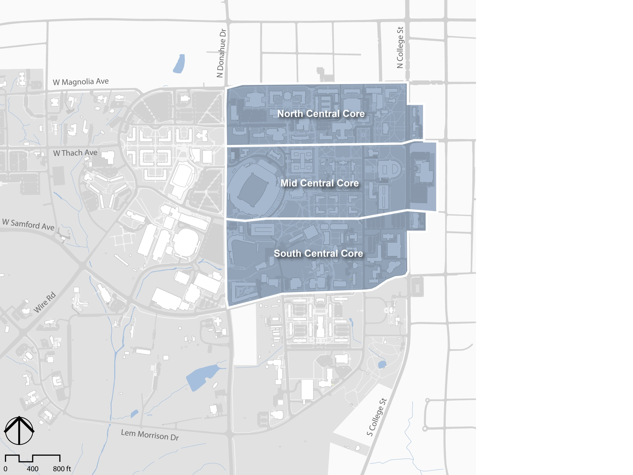
Central Core Faculty & Staff Parking
For the purposes of this assessment, the data zones from 2011-2012 Parking Update are aggregated
Central Core Campus
Central Core
3
Notes:
Original Image path: G:\16601.00\Graphics\03_Illustrator\Diagram\exports\2013-01-07\simple base2_PPT.jpg
Original Size: 0.6MB W:1,680px H:1,260px
Compressed Size: 125KB W:1,280px H:960px (78.1% using JPEG compression of 80)
Last Updated: 1/9/2013 3:05:04 PM by mreagan via Sasaki PPT Image Manager

Slide 4
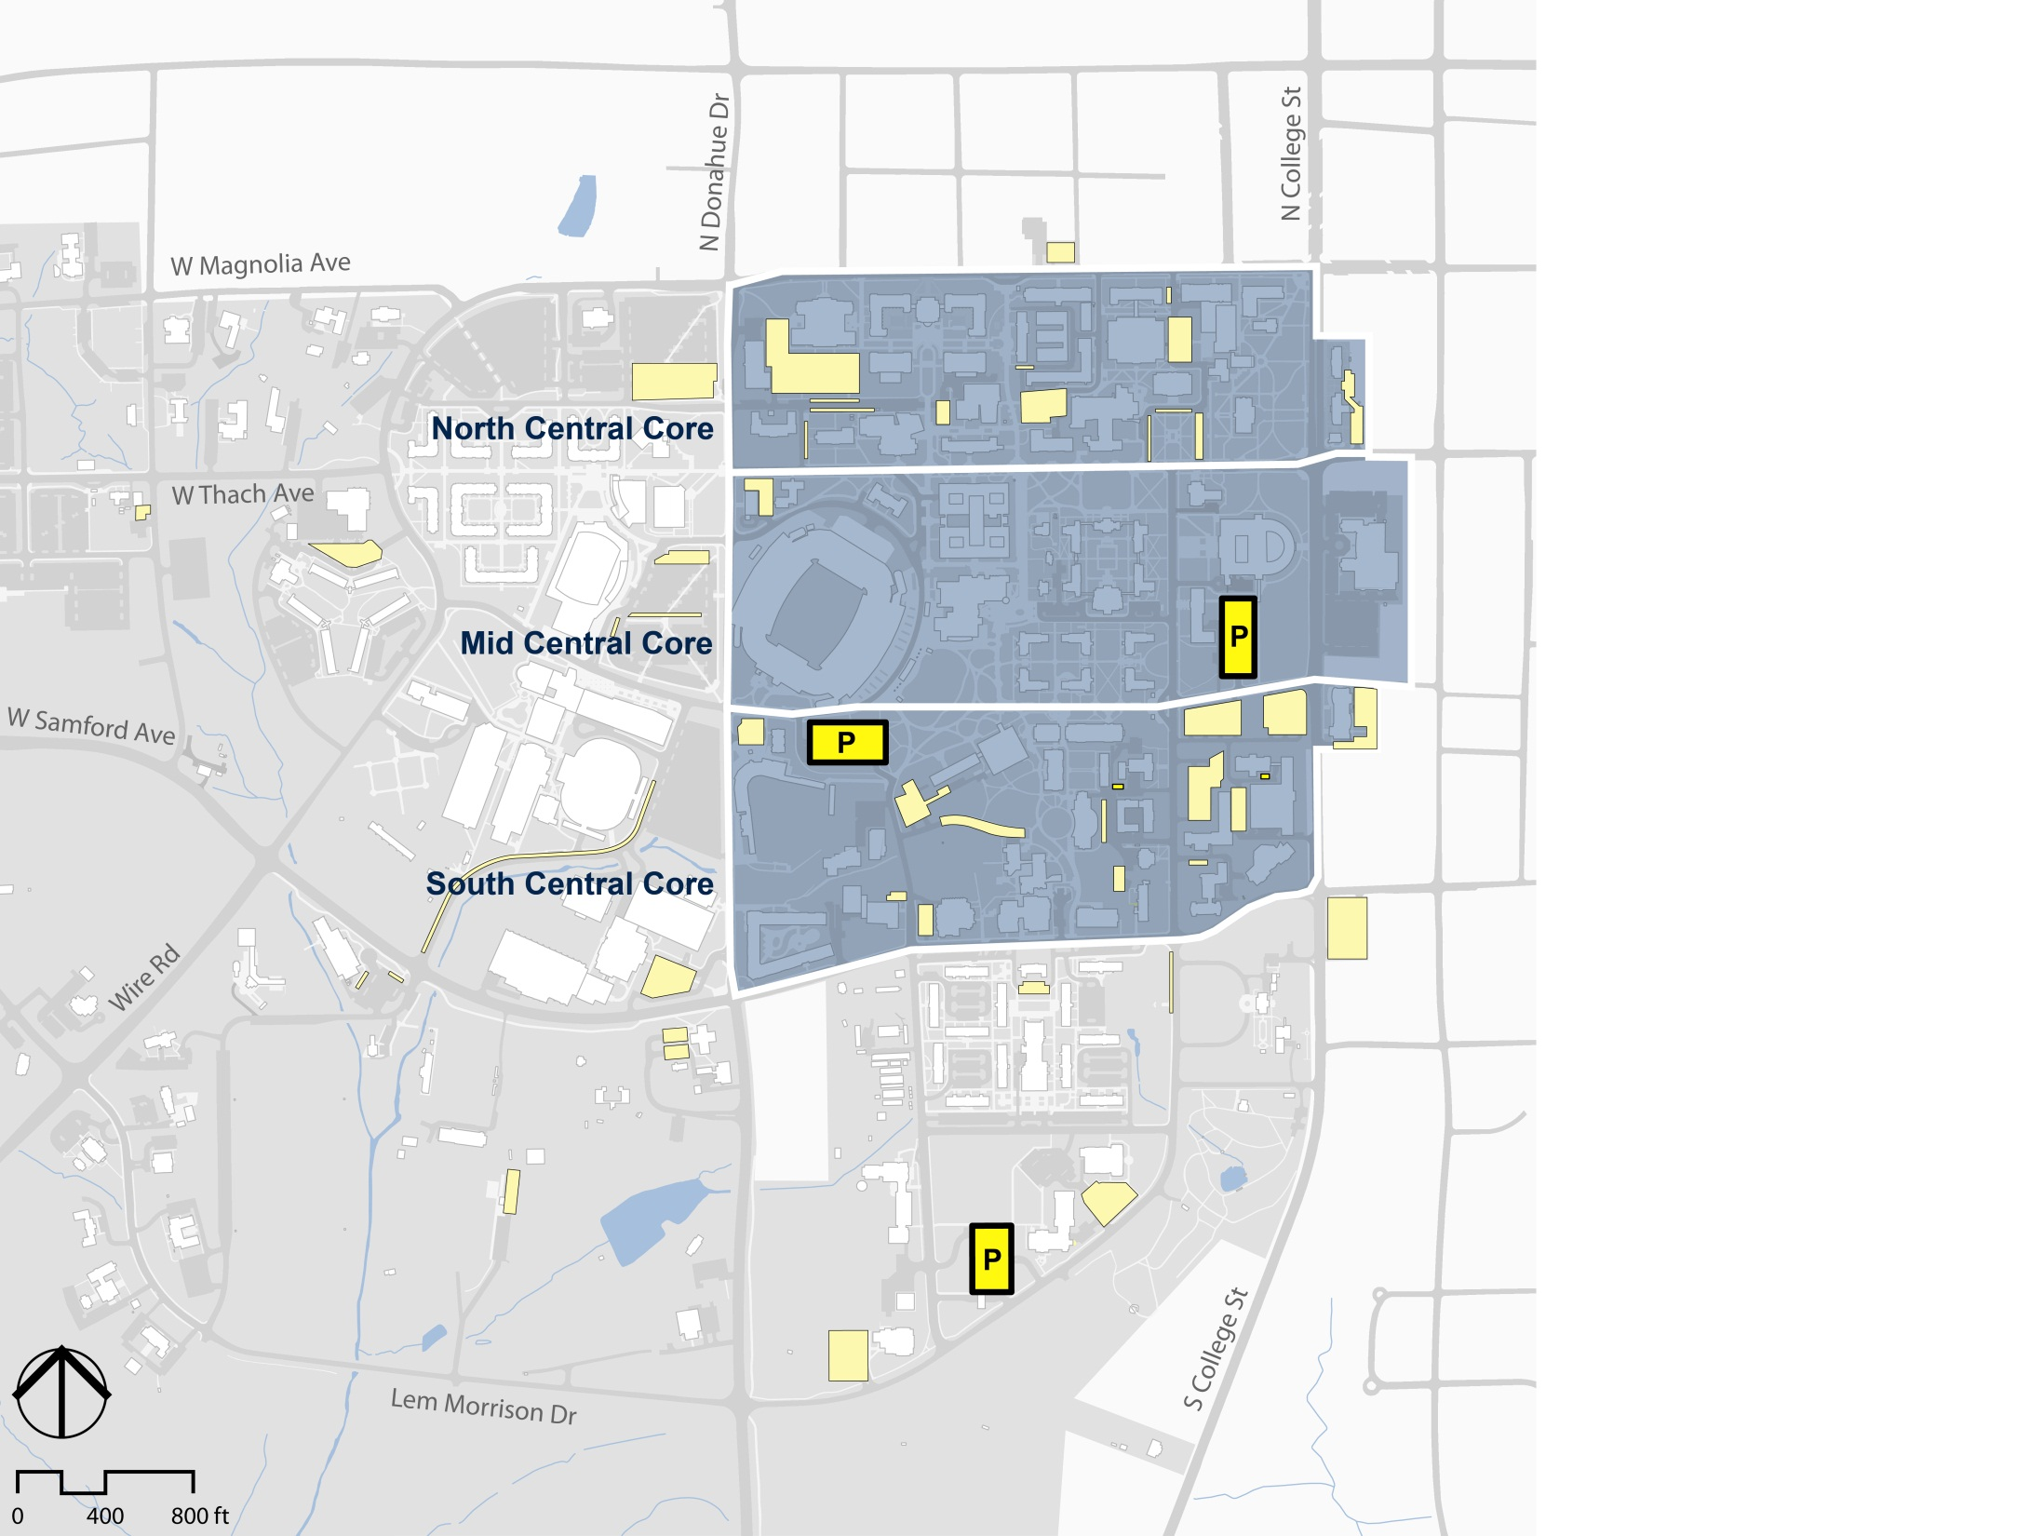


Existing Parking Supply: Faculty & Staff
533
Spaces
2,115
446
Spaces
Total faculty & staff parking spaces in the Central Core
1,136
The majority of Central Core A/B spaces are in the South
Spaces
Central Core
Surface parking
Existing Garage
Parking inventory and utilization statistics adapted from Carl Walker Inc. Parking Update – 2011-12 Academic Year
Notes:
Original Image path: G:\16601.00\Graphics\03_Illustrator\Diagram\exports\2012-11-28\Garage_existing_PPT.jpg
Original Size: 4.3MB
No compression. WARNING: this is a large image, please consider optimizing.
Cropping: Left:0% Right:0% Top:9% Bottom:0%
Last Updated: 11/28/2012 4:48:55 PM by apenniman via Sasaki PPT Image Manager

Slide 5
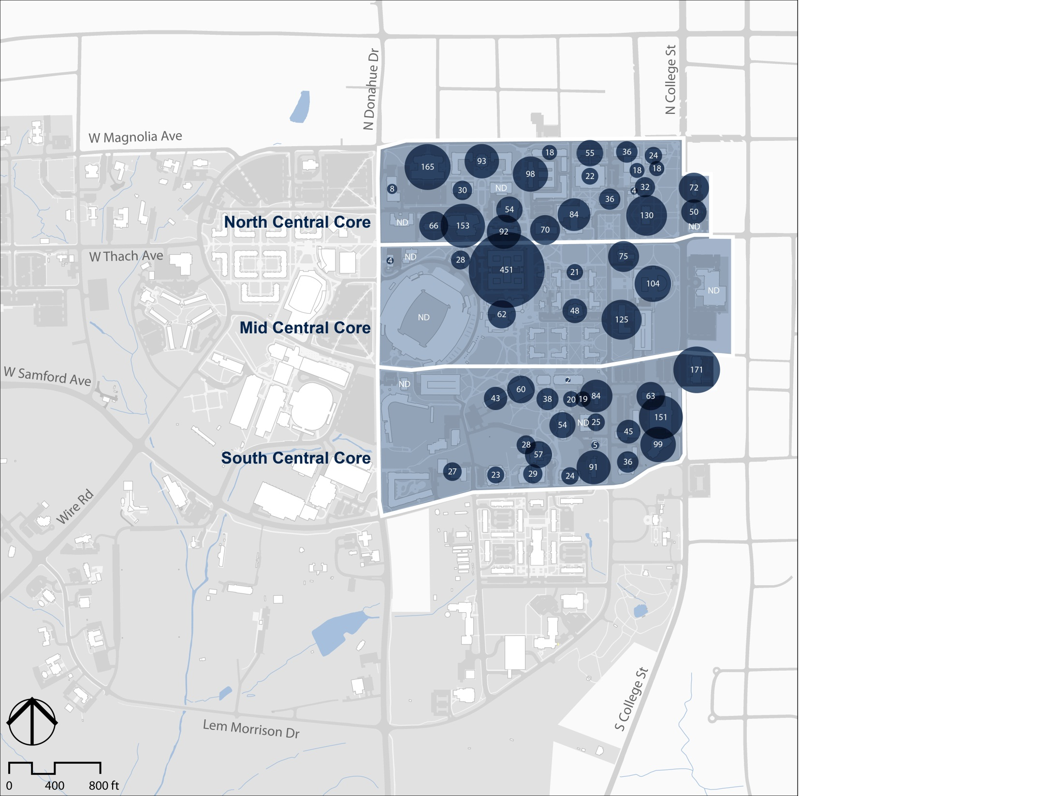


Existing Employee Distribution – Central Core
1,424 .
FTE
3,600
918 .
Permanent, temporary and part-time employees
FTE
1,258 .
FTE based on assumed 50% for part-time
FTE
In existing buildings
Employee location data adapted from spreadsheet “Employees by Building.xlsx”, Richard Guether, Auburn 1/14/13
5
Notes:
Original Image path: G:\16601.00\Graphics\03_Illustrator\Diagram\exports\p_garage options\employee pop_v2_existing_PPT.jpg
Original Size: 4.8MB
No compression. WARNING: this is a large image, please consider optimizing.
Cropping: Left:0% Right:0% Top:0% Bottom:0%
Last Updated: 1/16/2013 6:55:55 PM by apenniman via Sasaki PPT Image Manager

Slide 6
Existing Employee Distribution – Central Core
533 1,424
446 918
1,136 1,258
In existing buildings
FTE based on assumed 50% for part-time
2,115
3,600
Employee location data adapted from spreadsheet “Employees by Building.xlsx”, Richard Guether, Auburn 1/14/13
Total faculty & staff parking spaces in the Central Core
Permanent, temporary and part-time employees located in Central Core
6
Notes:
Original Image path: G:\16601.00\Graphics\03_Illustrator\Diagram\exports\p_garage options\employee pop_v2_existing_PPT.jpg
Original Size: 4.8MB
No compression. WARNING: this is a large image, please consider optimizing.
Cropping: Left:0% Right:0% Top:0% Bottom:0%
Last Updated: 1/16/2013 6:55:55 PM by apenniman via Sasaki PPT Image Manager

Slide 7



Existing Parking Spaces per Employee
.37
Spaces
FTE
.49
Spaces
According to the Eno Foundation for Transportation, Faculty & Staff parking needs range from 0.50 to 0.95 spaces per employee, with an average of 0.70 and an 85th percentile value of .92. Source: Weant & Levinson, Parking.
FTE
.90
Spaces
FTE
Core of Campus
.59
Spaces
FTE
Central Core
Surface parking
Existing Garage
National Standard: Average
.70
Spaces
FTE
Notes:
Original Image path: G:\16601.00\Graphics\04_FLAT OUTPUT\2012_11_20\X-COND-ILLUSTRATIVE-200-scale.jpg
Original Size: 29.3MB W:6,998px H:7,004px
Compressed Size: 311KB W:1,023px H:1,024px (99% using JPEG compression of 80)
Last Updated: 11/29/2012 3:08:50 PM by amcclurg via Sasaki PPT Image Manager

Slide 8
Existing Peak Faculty(A) & Staff(B) Occupancy
96% occupied
A rule of thumb in the parking industry is that 95% is the ‘functional capacity’ of a parking facility
91% occupied
93% occupied
Overall Campus
84% occupied
Central Core
Surface parking
Existing Garage
Parking inventory and utilization statistics adapted from Carl Walker Inc. Parking Update – 2011-12 Academic Year
Notes:
Original Image path: G:\16601.00\Graphics\04_FLAT OUTPUT\2012_11_20\X-COND-ILLUSTRATIVE-200-scale.jpg
Original Size: 29.3MB W:6,998px H:7,004px
Compressed Size: 311KB W:1,023px H:1,024px (99% using JPEG compression of 80)
Last Updated: 11/29/2012 3:08:50 PM by amcclurg via Sasaki PPT Image Manager

Slide 9
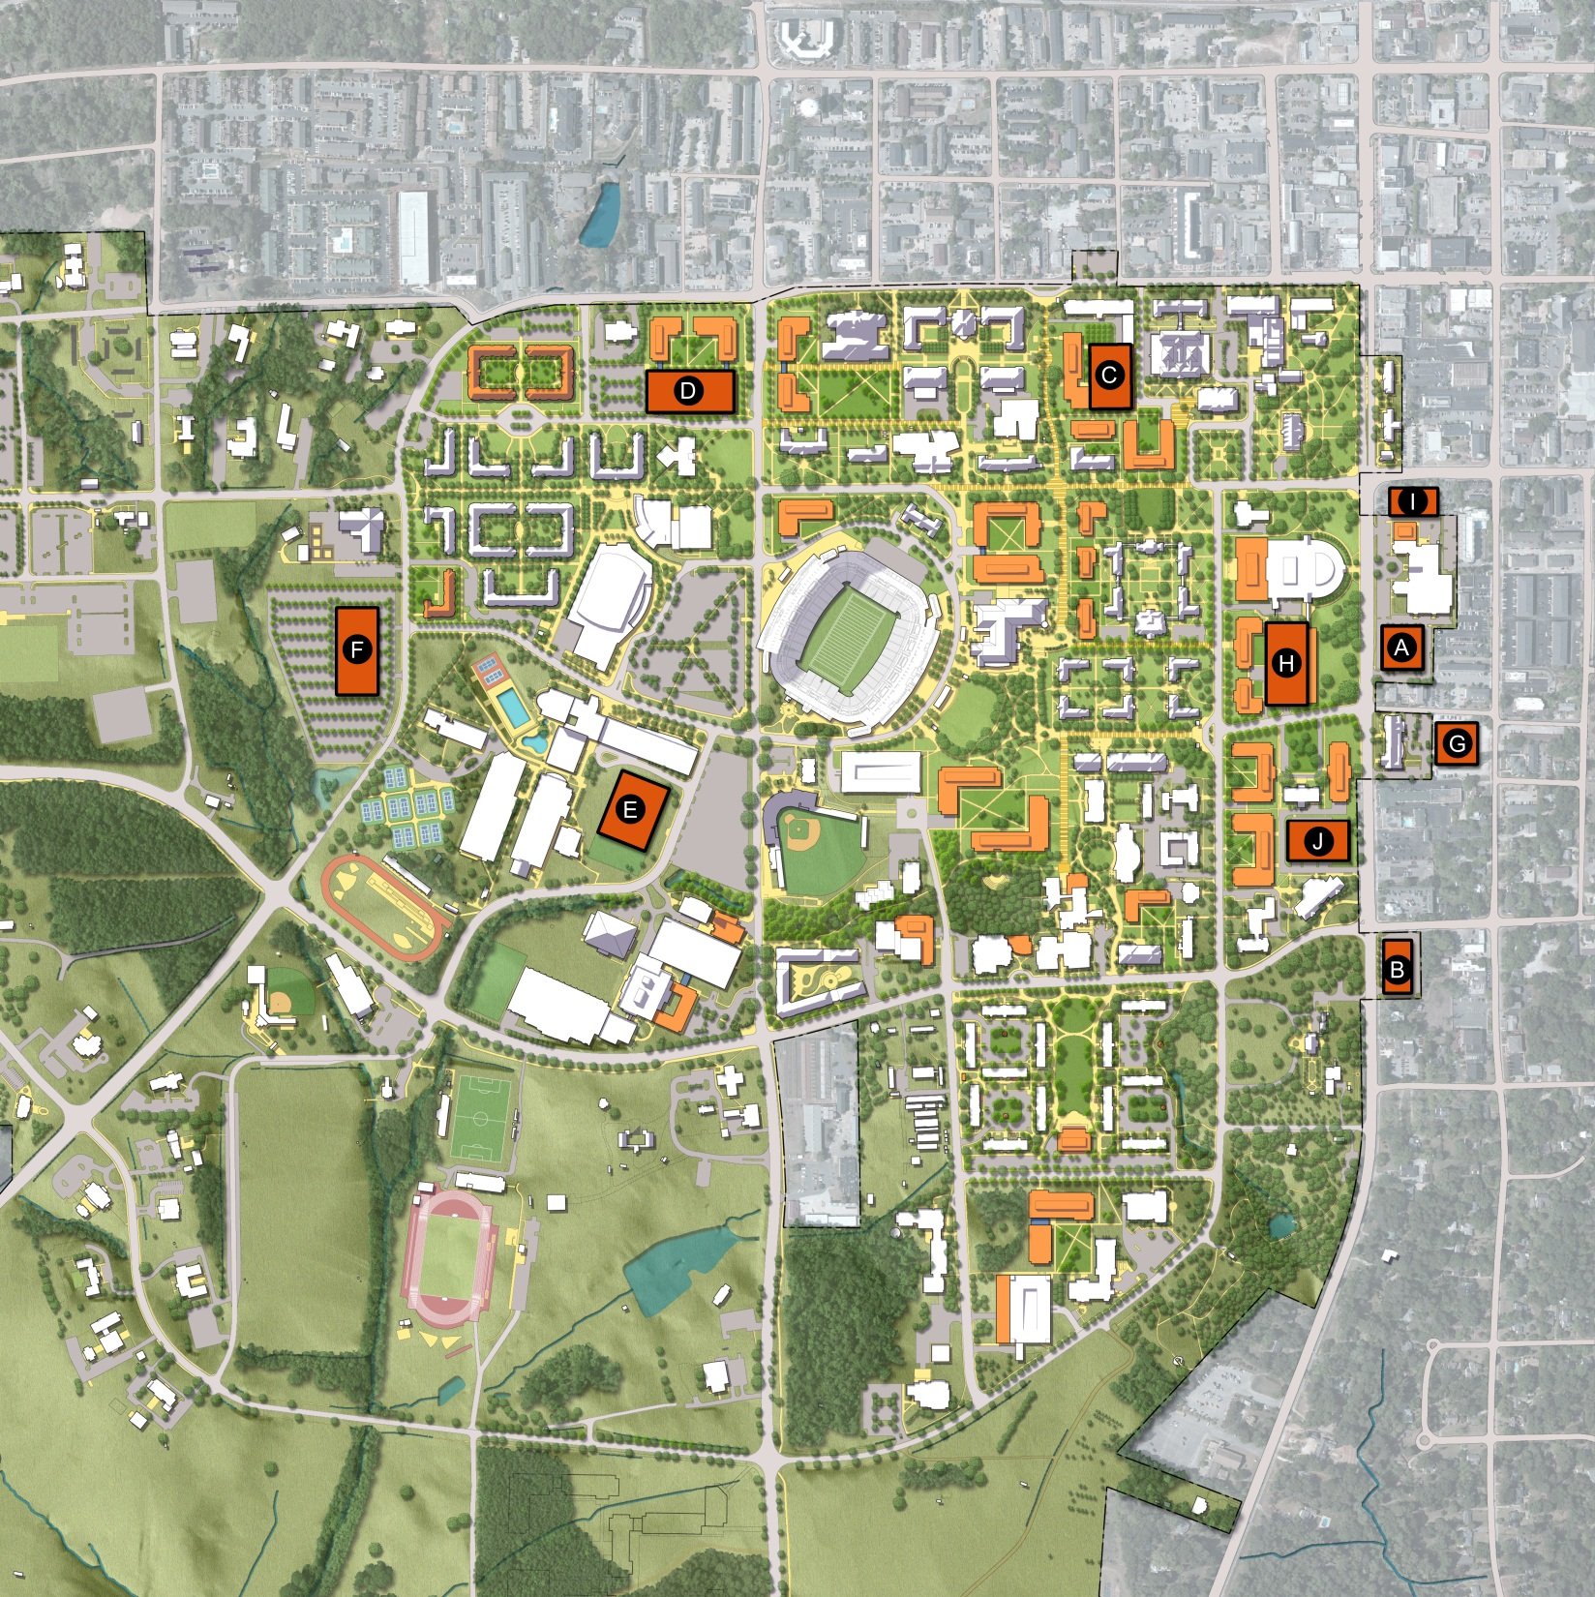
Potential Garage Sites
 | SITE | CAPACITY (SPACES)
A | Auburn Hotel | 390
B | College & Samford | 315
C | Northeast Quad | 576
D | East Village | 841
E | Coliseum | 1181
F | CDV | 841
G | Alumni Center | 370
H | Library Garage Reconstruction | 797
I | The Cambridge | 288
J | AG Hill | 550
Assumptions:
Four levels per garage
325 GSF per space if length > 300’
350 GSF per space if length <300’
Notes:
Original Image path: G:\16601.00\Graphics\04_FLAT OUTPUT\2013_01-14\garage options_master.jpg
Original Size: 0.9MB
No compression.
Cropping: Left:0% Right:73% Top:21% Bottom:64%
Last Updated: 1/16/2013 9:25:21 AM by ghavens via Sasaki PPT Image Manager

Slide 10
Parking Structure Evaluation Summary
 | Total Spaces | Net New Spaces | Potential Users | Pedestrian Access to Central Core | Total Cost | Cost Per New Space | Cost Factors / Considerations
1. Auburn Hotel | 390 | 208 | Visitors Commuters |  | $5.9M | $28K | Displaces Parking Inefficient layout
2. College / Samford | 315 | 188 | Commuters Faculty / Staff |  | $4.7M | $25K | Displaces Parking Inefficient layout
3. Northeast Quad* | 576 | 576 | Faculty / Staff |  | $8.6M | $15K | Demolition Costs
4. East Village | 841 | 607 | Faculty / Staff Commuters Res. Students Visitors |  | $12.6M | $21K | Displaces Parking
5. Coliseum | 1,181 | 1,181 | Commuters Res. Students Visitors |  | $17.7M | $16K | Demolition Costs
6. CDV | 841 | 803 | Commuters Res. Students Visitors |  | $12.6M | $15K | Demolition Costs Displaces Parking
7. Alumni Center | 370 | 278 | Commuters Visitors |  | $5.5M | $20K | Inefficient layout
8. Library Garage* (reconstruction) | 797 | 453 | Faculty / Staff |  | $12.0M | $26K | Demolition Costs Displaces Garage
9. The Cambridge | 288 | 216 | Faculty / Staff Commuters |  | $4.3M | $20K | Land Acquisition Inefficient layout
10. AG Hill* | 550 | 507 | Faculty / Staff |  | $8.3M | $16K | Demolition Costs
X
X
X
X
X
*Garage locations in the Central Core primarily are reserved for Faculty / Staff Use

Slide 11
Campus Parking Recommendation
Campus Master Plan 2012 Update
Recommendations to Improve Faculty and Staff Parking:
Build NorthEast Quad Parking Structure
  Time Frame: Near Term 2015-2016
  Provides parking spaces for North Central Core.
  Adds 576 spaces at $15K/space
  Cost: $8.6 million.
Replace Library Parking Structure:
  Time Frame: Near Term: 2015-2020
  Provides parking spaces for Mid Central Core.
  Adds 473 spaces at $26K/space
  Cost: $12 million.
Construct Parking Structure on AG Hill:
  Time Frame: Long Term: 2020+
  Replaces surface parking lost due to replacement of Funchess and Upchurch Halls
  Provides parking spaces for South Central Core.
  Adds 507 spaces at $16K/space
  Cost: $8.3 million.
Construct Parking Structure at East Village:
  Time Frame: Long Term: 2020+
  Will be needed if College of Business expands or academic facility is located at Magnolia and Donahue
  Provides parking spaces for North Central Core.
  Adds 607 spaces at $26K/space
  Cost: $12.6 million.

Slide 12
Campus Parking Recommendation
Campus Master Plan 2012 Update
Recommendations to Improve Commuter/Special Event Parking:
Build Surface Parking at Coliseum:
  Time Frame: Near Term: 2015-2016
  Provides parking spaces for commuters, Gameday, and special events
  Adds 300 spaces at $6K/space
  Cost: $1.8 million.
Build Surface Parking Lot at CDV
  Time Frame: Near Term 2015-2016
  Provides parking spaces for commuters and residents.
  Adds 400 spaces at $6K/space
  Cost: $2.4 million.
Construct Parking Structure at Coliseum:
  Time Frame: Mid Term to Long Term: 2020+
  Provides parking spaces for commuters, Gameday, and special events
  Adds 1,181 spaces at $16K/space
  Cost: $17.7 million.

Slide 13
Backup

Slide 14
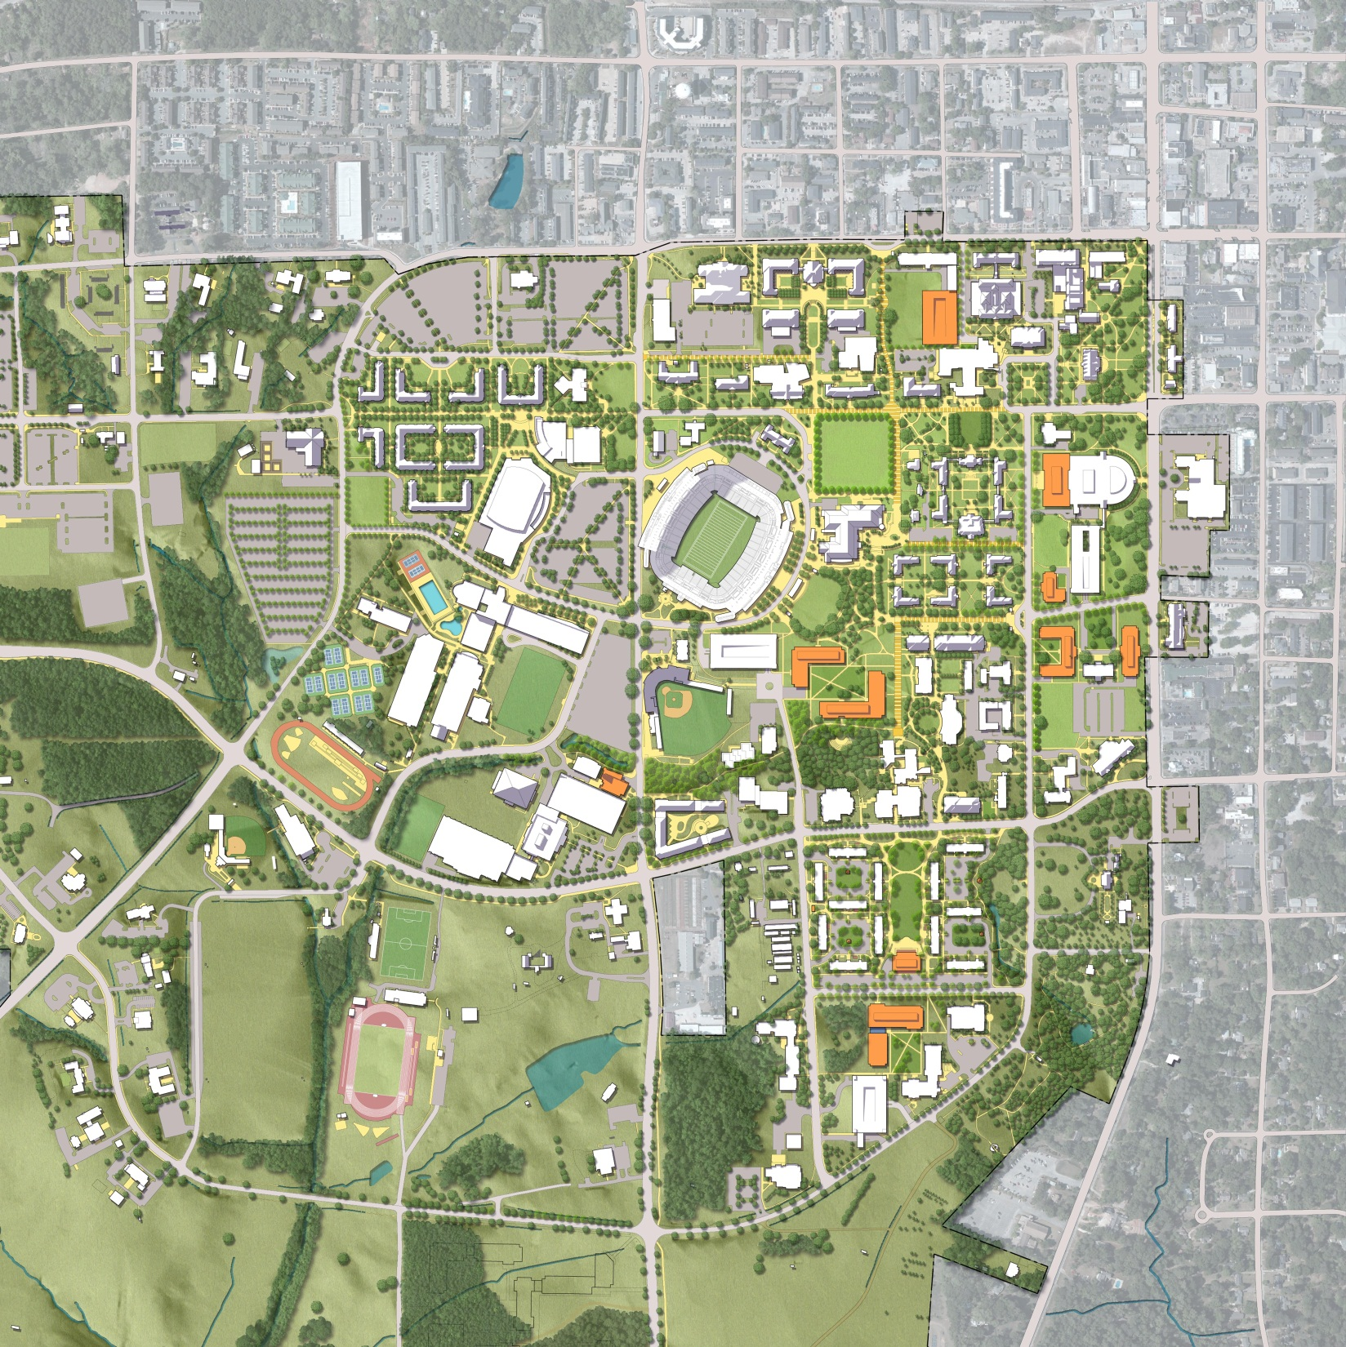
The Campus: 2023 Plan
 | Capital Project
1 | Central Classroom Facility 2
2 | College of Human Sciences
3 | Central Classroom Facility
4 | COSAM
5 | College of Agriculture
6 | College of Education
1
2
3
5
Following the completion of the Capital Projects Plan, parking demand in the Central Core is expected to decrease as a result of the relocation of Pharmacy, Nursing and Education employees.
4
6
Note: Subject to revision based on CCF configuration decisions.
Notes:
Original Image path: G:\16601.00\Graphics\04_FLAT OUTPUT\__DIAGRAMS FOR PPT\_01-14-13\INTERIM_PHASING_200_scale.jpg
Last Updated: 1/16/2013 1:11:05 PM by ghavens via Sasaki PPT Image Manager

Slide 15
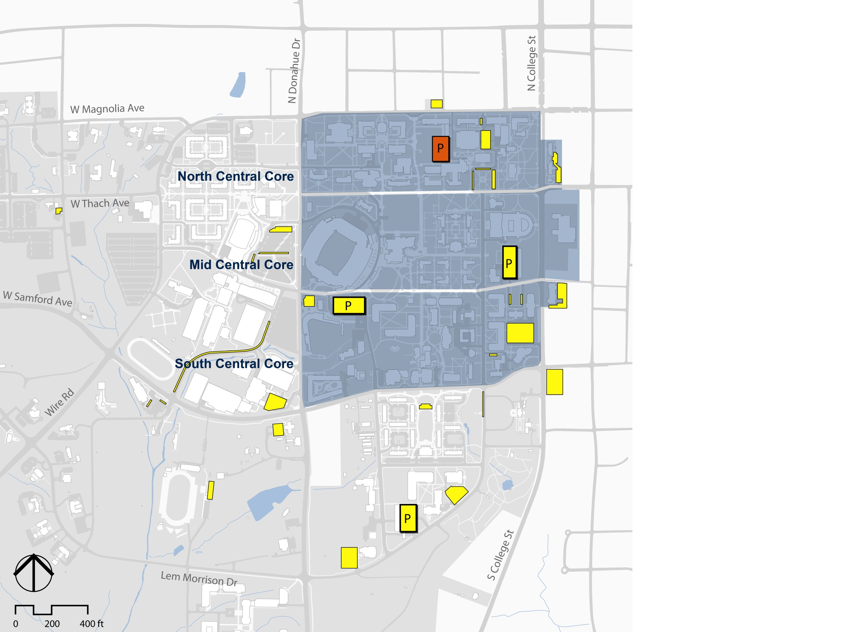
2023 Faculty & Staff Parking Supply
Central Core Campus – 576 Spaces added
1,079
Engineering
Garage:
+576 spaces
Spaces
2,354
446
Spaces
Total staff & faculty spaces in the Central Core (2,115 currently)
829
Spaces
Central Core
Proposed garage
Existing garage
Surface parking
Parking inventory and utilization statistics adapted from Carl Walker Inc. Parking Update – 2011-12 Academic Year
Notes:
Original Image path: G:\16601.00\Graphics\03_Illustrator\Diagram\exports\2012-11-28\Garage_existing_PPT.jpg
Original Size: 4.3MB
No compression. WARNING: this is a large image, please consider optimizing.
Cropping: Left:0% Right:0% Top:9% Bottom:0%
Last Updated: 11/28/2012 4:48:55 PM by apenniman via Sasaki PPT Image Manager

Slide 16
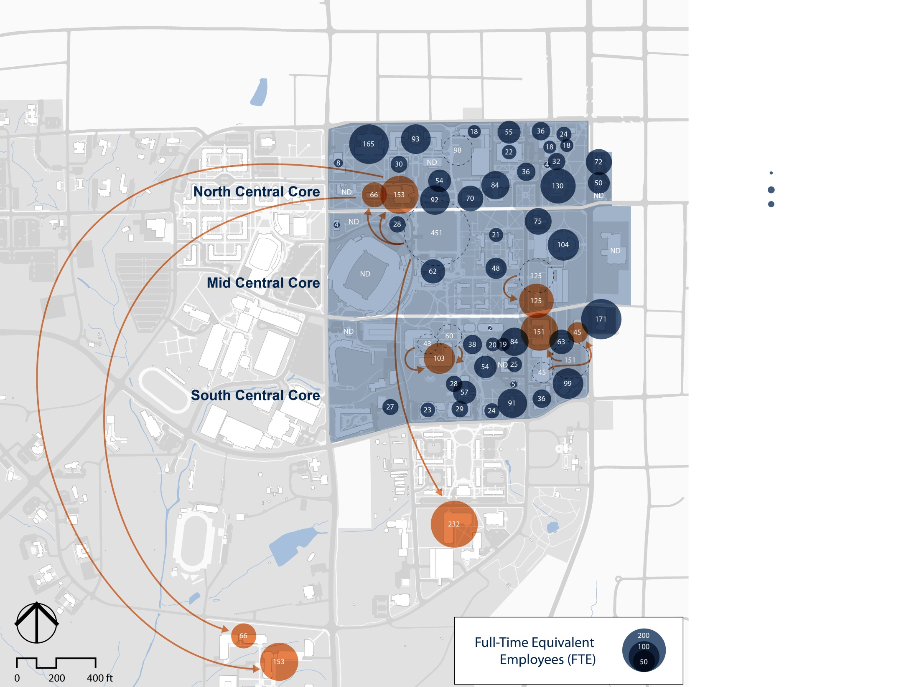
2023 Employee Population
Assumes relocation of Pharmacy, Nursing and Education faculty / staff and construction of the Engineering Garage
1,424 .
FTE
3,149
467 .
FTE
Permanent FTE employees in the Central Core assuming the relocation of Pharmacy, Nursing and Education
1,258 .
FTE
Employee location data adapted from spreadsheet “Employees by Building.xlsx”, Richard Guether, Auburn
Notes:
Original Image path: G:\16601.00\Graphics\03_Illustrator\Diagram\exports\2012-11-28\Garage_existing_PPT.jpg
Original Size: 4.3MB
No compression. WARNING: this is a large image, please consider optimizing.
Cropping: Left:0% Right:0% Top:9% Bottom:0%
Last Updated: 11/28/2012 4:48:55 PM by apenniman via Sasaki PPT Image Manager

Slide 17
2023 Employee Distribution – Central Core
1,079 1,424
446 467
829 1,258
In existing buildings
FTE based on assumed 50% for part-time
2,354
3,149
Employee location data adapted from spreadsheet “Employees by Building.xlsx”, Richard Guether, Auburn 1/14/13
Total faculty & staff parking spaces in the Central Core
Permanent, temporary and part-time employees located in Central Core
17
Notes:
Original Image path: G:\16601.00\Graphics\03_Illustrator\Diagram\exports\p_garage options\employee pop_v2_existing_PPT.jpg
Original Size: 4.8MB
No compression. WARNING: this is a large image, please consider optimizing.
Cropping: Left:0% Right:0% Top:0% Bottom:0%
Last Updated: 1/16/2013 6:55:55 PM by apenniman via Sasaki PPT Image Manager

Slide 18


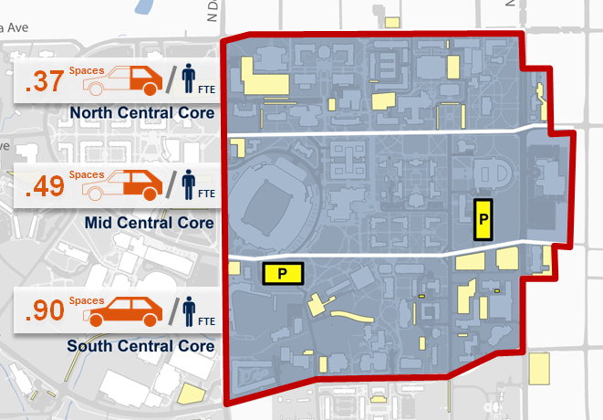

2023 Spaces per Employee
Assumes relocation of Pharmacy, Nursing and Education faculty / staff and construction of the Engineering Garage
.76
Spaces
FTE
.96
Spaces
FTE
Existing
.66
Spaces
FTE
Central Core
Proposed garage
Existing garage
Surface parking
Notes:
Original Image path: G:\16601.00\Graphics\04_FLAT OUTPUT\2012_11_20\X-COND-ILLUSTRATIVE-200-scale.jpg
Original Size: 29.3MB W:6,998px H:7,004px
Compressed Size: 311KB W:1,023px H:1,024px (99% using JPEG compression of 80)
Last Updated: 11/29/2012 3:08:50 PM by amcclurg via Sasaki PPT Image Manager

