Slide 1

Progress Toward Degree Requirements
Bylaw 14.4
Putting the Eligibility Pieces Together

Slide 2

Credit-Hour Requirements
14.4.3
First-year student-athletes must earn 24 semester credits (may include summer).
ALL student-athletes must earn 18 semester hours (Fall and Spring only!)

Slide 3
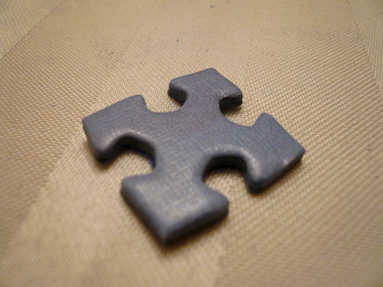
Six-Hour Rule
14.4.3.1-(c)
ALL student-athletes must earn at least six credit hours during the preceding semester of full-time enrollment.

Slide 4

Percentage of Degree Requirements
14.4.3.2
A student-athlete entering his or her third year (fifth semester), must have completed 40% of the declared degree program.
A student-athlete entering his or her fourth year must have earned 60%.
A student-athlete entering his or her fifth year must have earned 80%.

Slide 5

GPA Requirements
14.4.3.3
A student-athlete entering his or her second year of enrollment must have a cumulative GPA of at least 90% of the minimum GPA required to graduate. At Auburn, that is 1.800.
Third year = 95% (1.900).
Fourth year and beyond = 100% or 2.000.

Slide 6

Questions?

