Slide 1

Campus Master Plan 2012 Update
University Senate
November 6, 2012
Notes:
Original Image path: M:\16601.96\Proposal\Cover\Auburn Cover FINAL.jpg
Original Size: 2MB W:2,738px H:3,338px
Compressed Size: 80KB W:839px H:1,024px (96.1% using JPEG compression of 95)
Last Updated: 1/11/2012 9:16:54 AM by mlewey via Sasaki PPT Image Manager

Slide 2
Campus Master Update for University Senate Outline
Central Classroom Facility Location
Replacement of Older Academic Buildings in the Core of Campus
Health Science Campus
Land Use

Slide 3
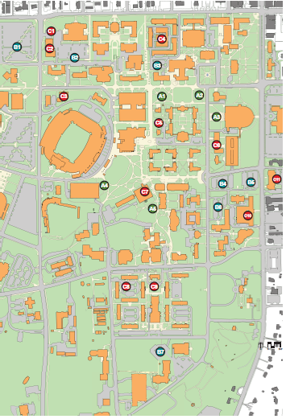
Where To Locate the Central Classroom Facility?
Over 20 Potential Site Locations Were Analyzed

Slide 4
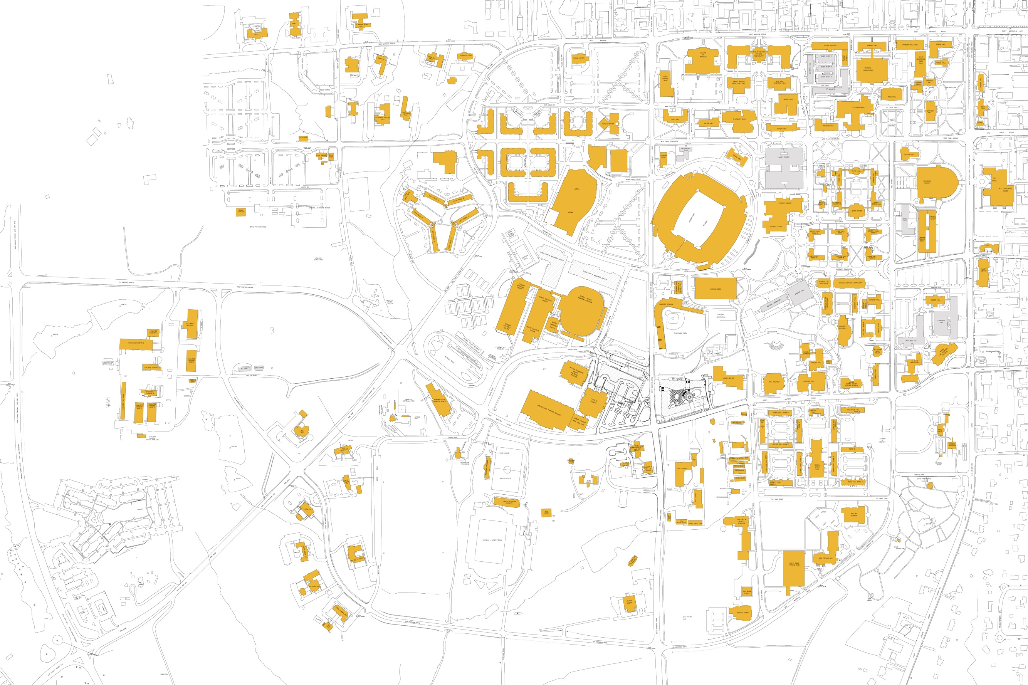
Central Classroom Facility Site Locations
  Dunstan/”L” Bldg/
  Engineering Shops
  Library
  Parker-Allison
Notes:
Original Image path: G:\16601.00\Cad\3DM\Tasks\02-AUGUST\render\AU_OPTIONS-_CCF_1cam-toEngineering2.jpg
Original Size: 0.5MB W:2,400px H:1,350px
Compressed Size: 312KB W:1,600px H:900px (41.6% using JPEG compression of 80)
Cropping: Left:0% Right:0% Top:0% Bottom:0%
Last Updated: 8/27/2012 1:53:09 PM by pbrigham via Sasaki PPT Image Manager

Slide 5
Option 1: Single CCF Facility @ Parker/Allison
Impact on Overall Campus Core
CCF Building A
  105,000 GSF
  Contains 2 Large Lecture Halls
      170 seats
      300 seats
  Contains 21 Flexible Classrooms
    CCF Building B
  60,000 GSF
  Contains 2 Large Lecture Halls
      170 seats
      300 seats
  Contains 2 Large Classrooms
      120 seats each
  Contains 12 Flexible Classrooms
COSAM Replacement Building
(at Parker/Allison)
  128,000 GSF
COSAM Expansion Building
  140,000 GSF required
  (from CPSM space model)
CCF - A
COSAM
Replacement
CCF - B
Notes:
Original Image path: G:\16601.00\Cad\3DM\Tasks\02-AUGUST\render\AU_OPTIONS-__OPT1v2cam-toEngineering2.jpg
Original Size: 0.5MB W:2,400px H:1,350px
Compressed Size: 309KB W:1,600px H:900px (41.5% using JPEG compression of 80)
Cropping: Left:0% Right:0% Top:0% Bottom:0%
Last Updated: 8/27/2012 1:53:10 PM by pbrigham via Sasaki PPT Image Manager

Slide 6
Option 5: Split CCF Facility @ Parker/Allison + Library
Impact on Overall Campus Core
CCF Building A
(at Parker/Allison)
  107,000 GSF
  Contains 2 Large Lecture Halls
      170 seats
      300 seats
  Contains 2 Large Classrooms
      120 seats each
  Contains 20 Flexible Classrooms
    CCF Building C
    (at Library)
  60,000 GSF
  Contains 2 Large Lecture Halls
      170 seats
      300 seats
  Contains 10 Flexible Classrooms
COSAM Replacement Building
(at Parker/Allison)
  128,000 GSF
COSAM Expansion Building
  140,000 GSF required
  (from CPSM space model)
CCF - C
CCF - A
COSAM
Replacement
Notes:
Original Image path: G:\16601.00\Cad\3DM\Tasks\02-AUGUST\render\AU_OPTIONS-__OPT1v2cam-toEngineering2.jpg
Original Size: 0.5MB W:2,400px H:1,350px
Compressed Size: 309KB W:1,600px H:900px (41.5% using JPEG compression of 80)
Cropping: Left:0% Right:0% Top:0% Bottom:0%
Last Updated: 8/27/2012 1:53:10 PM by pbrigham via Sasaki PPT Image Manager

Slide 7
Option 5: Split CCF Facility @ Parker/Allison + Library
Impact on Overall Campus Core
CCF Building A
(at Parker/Allison)
  107,000 GSF
  Contains 2 Large Lecture Halls
      170 seats
      300 seats
  Contains 2 Large Classrooms
      120 seats each
  Contains 20 Flexible Classrooms
    CCF Building C
    (at Library)
  60,000 GSF
  Contains 2 Large Lecture Halls
      170 seats
      300 seats
  Contains 10 Flexible Classrooms
COSAM Replacement Building
(at Parker/Allison)
  128,000 GSF
COSAM Expansion Building
  140,000 GSF required
  (from CPSM space model)
CCF - C
CCF - A
COSAM
Replacement
COSAM
Expansion
Notes:
Original Image path: G:\16601.00\Cad\3DM\Tasks\02-AUGUST\render\AU_OPTIONS-__OPT1v2cam-toEngineering2.jpg
Original Size: 0.5MB W:2,400px H:1,350px
Compressed Size: 309KB W:1,600px H:900px (41.5% using JPEG compression of 80)
Cropping: Left:0% Right:0% Top:0% Bottom:0%
Last Updated: 8/27/2012 1:53:10 PM by pbrigham via Sasaki PPT Image Manager

Slide 8
Replacement of Older Academic Buildings in the Core of Campus
College of Liberal Arts
Relocation
Spidle
Replacement
Funchess-Upchurch
Replacement
Notes:
Original Image path: G:\16601.00\Cad\3DM\Tasks\02-AUGUST\render\AU_OPTIONS-__OPT1v2cam-toEngineering2.jpg
Original Size: 0.5MB W:2,400px H:1,350px
Compressed Size: 309KB W:1,600px H:900px (41.5% using JPEG compression of 80)
Cropping: Left:0% Right:0% Top:0% Bottom:0%
Last Updated: 8/27/2012 1:53:10 PM by pbrigham via Sasaki PPT Image Manager

Slide 9
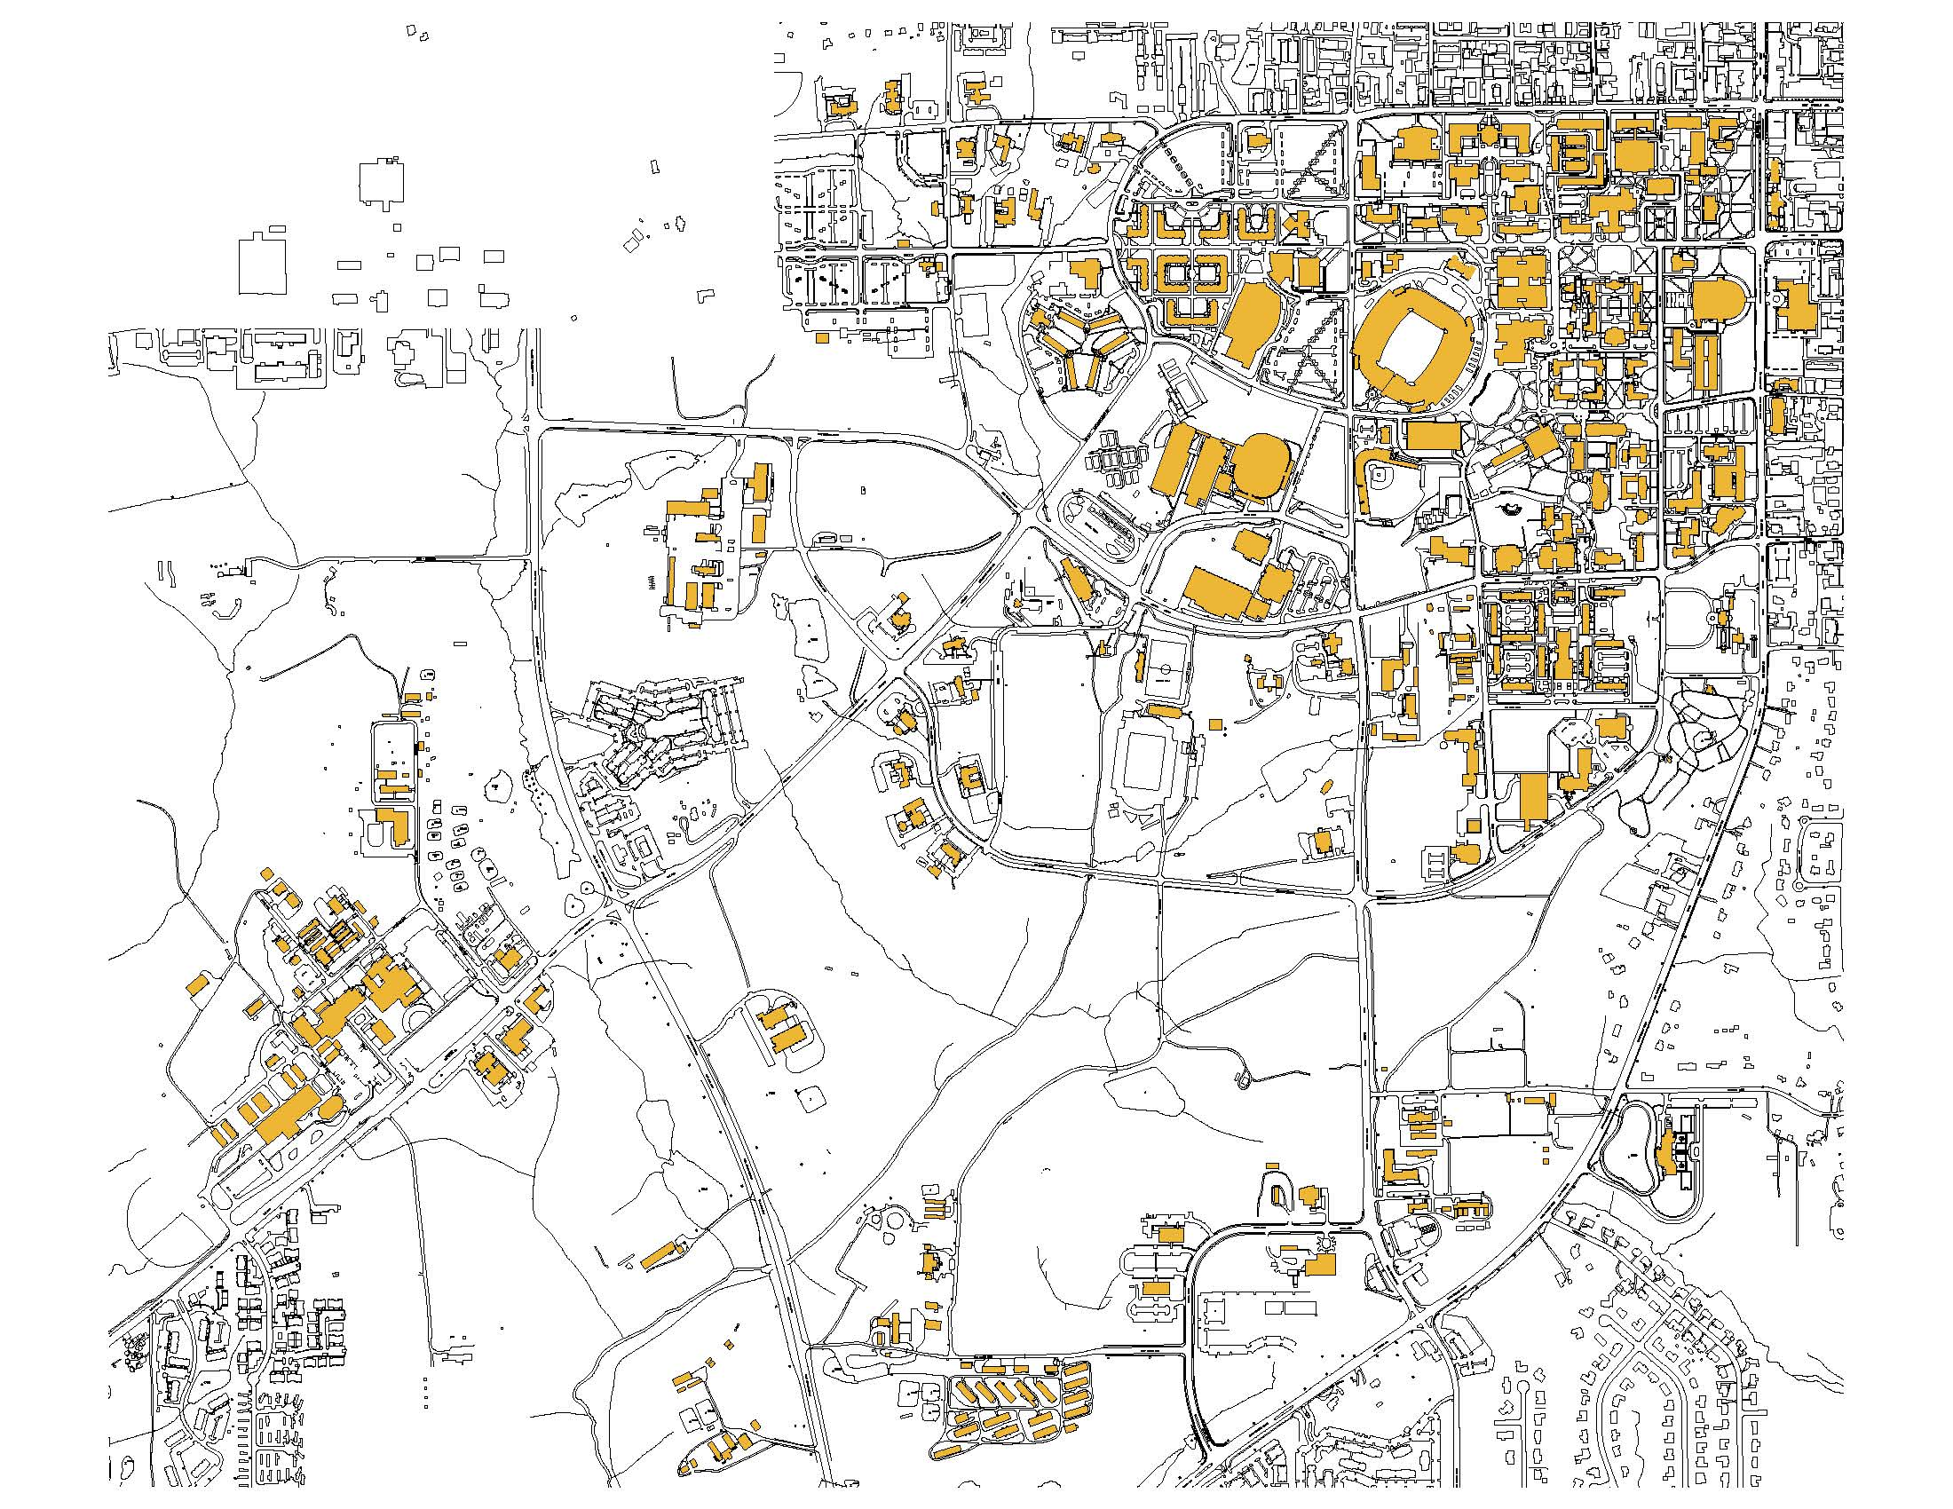
Replacement of Older Academic Buildings in the Core of Campus
College of Education
Relocation
School of Pharmacy
School of Nursing
Relocation
Notes:
Original Image path: G:\16601.00\Cad\3DM\Tasks\02-AUGUST\render\AU_OPTIONS-__OPT1v2cam-toEngineering2.jpg
Original Size: 0.5MB W:2,400px H:1,350px
Compressed Size: 309KB W:1,600px H:900px (41.5% using JPEG compression of 80)
Cropping: Left:0% Right:0% Top:0% Bottom:0%
Last Updated: 8/27/2012 1:53:10 PM by pbrigham via Sasaki PPT Image Manager

Slide 10
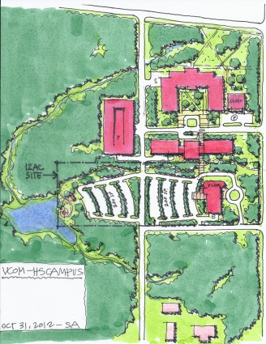
Health Science Campus
Proposed Location
Health Science Campus
AU Research Facilities
VCOM

Slide 11
Health Science Campus
Proposed Location

Slide 12

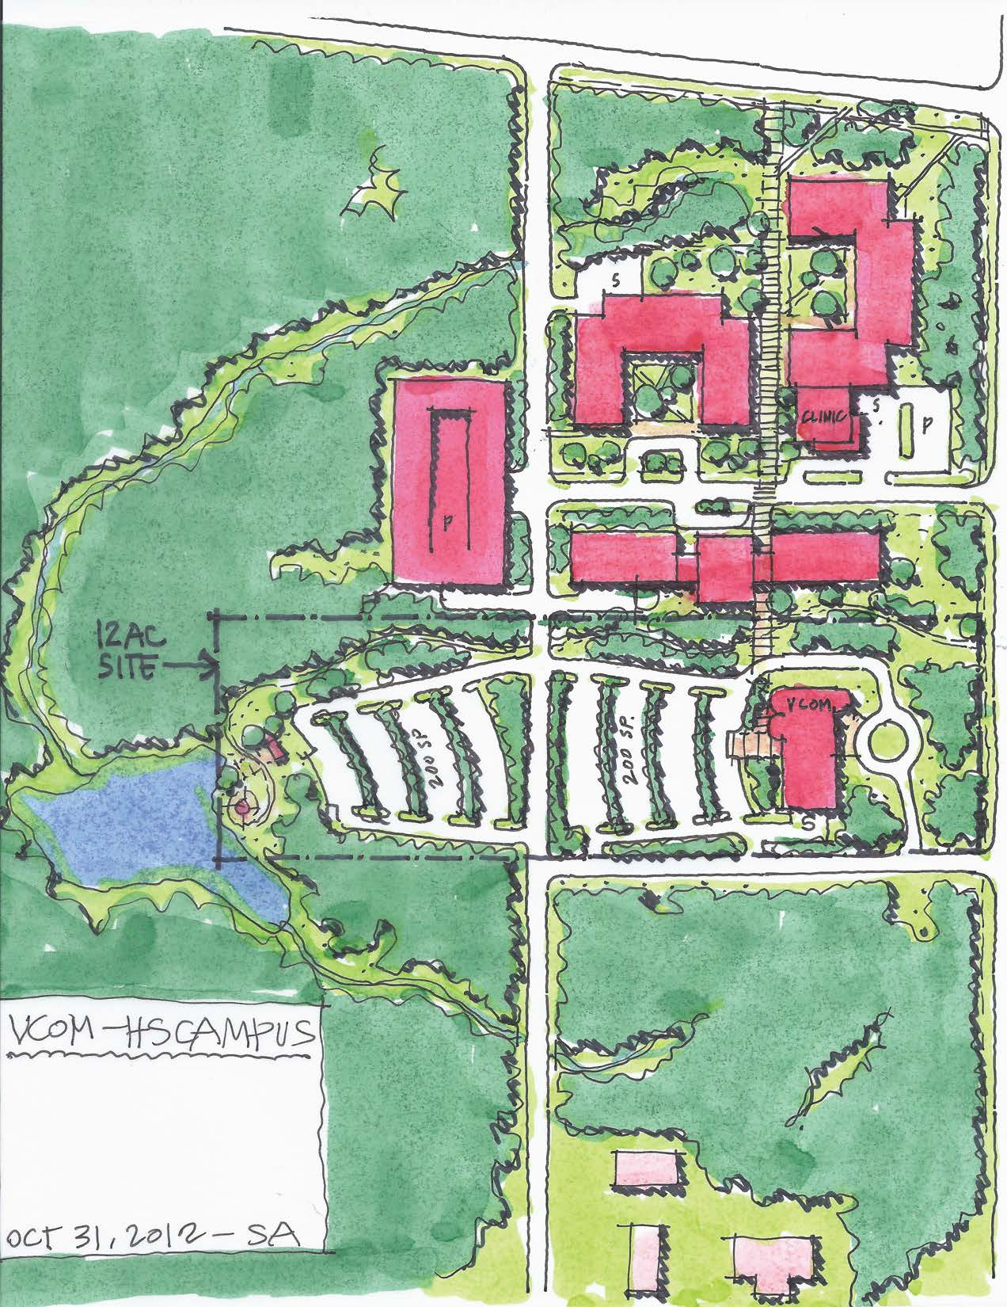
Health Science Campus
Proposed Location
Preliminary Site Layout A
Preliminary Site Layout B

Slide 13
Options for Proposed Land Use
Requirements Being Addressed in the Campus Master Plan 2012 Update
Based on input provided by AU University organizations, the following land use requirements for the future are being addressed in the Campus Master Plan 2012 Update. These land use requirements are in addition to the already existing land uses.
  Health Science Campus
  College of Osteopathy Medicine
  Performing Arts Center & Welcome Center
  Expansion of Recreational Fields
  Field Laboratories
  Athletics Complex Expansion
  Consolidation of Service Functions
  Game Day Activities

Slide 14
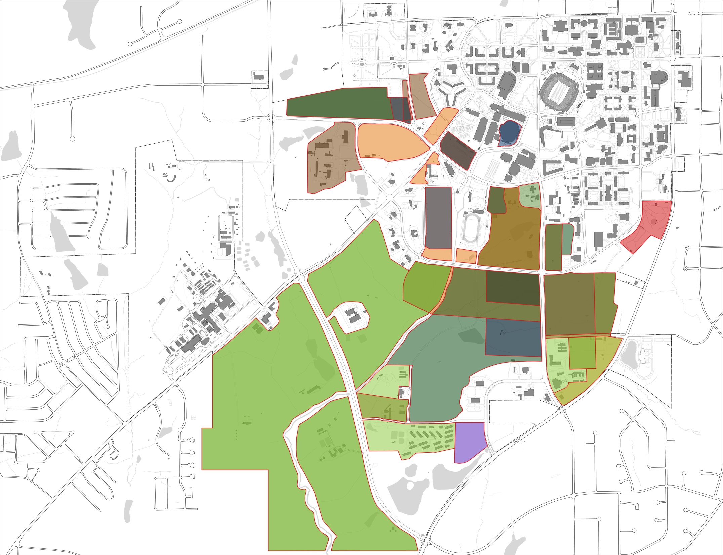
Many Competing Demands for Land
Athletics Expansion
Game Day Expansion
Service Expansion
FORESTED AREA
Game Day Expansion
CAMPUS GARDENS
Intramurals Expansion
Athletics Expansion
Game Day Expansion
Service Consolidation
“HAYFIELD”
Intramural Expansion
Game Day Expansion
Health Science / VCOM
Agronomy Plots
AG HERITAGE PARK
Athletics Expansion
Game Day Expansion
INTRAMURAL FIELDS
Athletics Expansion
Game Day Expansion
PASTURE
Athletics Expansion
Intramural Expansion
Game Day Expansion
FORESTED AREA
Athletics Expansion
Intramural Expansion
Game Day Expansion
Health Campus/VCOM
“WOODFIELD AVE”
Plant Science Complex
Agronomy Plots
Greenhouses
Performing Arts Center
POULTRY FARM
Research Park Expand
Service Expansion
FORESTED AREA
Health Campus/VCOM
Notes:
Original Image path: G:\16601.00\Graphics\00_PPT\05_WS5\Future Land Use Diagrams\_0010_OVERLAPS.jpg
Last Updated: 10/15/2012 4:22:31 PM by ryork via Sasaki PPT Image Manager

Slide 15
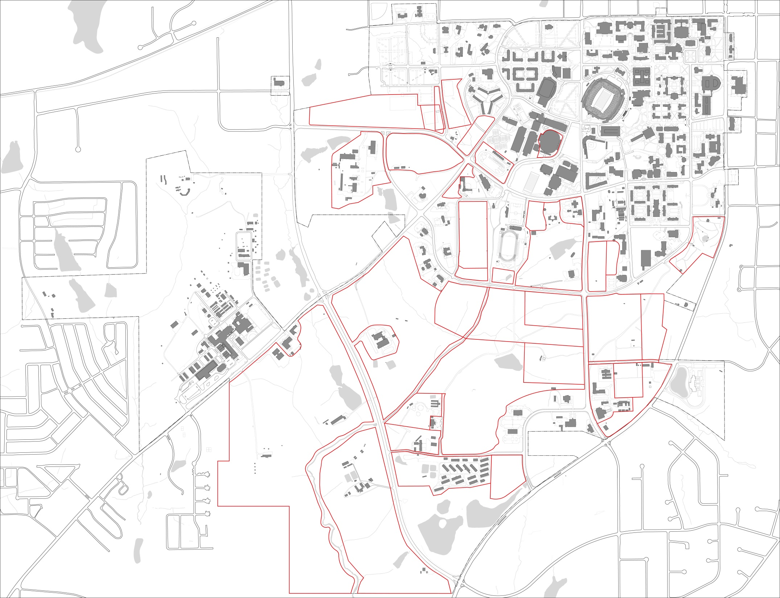
Land Use Areas Under Consideration
Notes:
Original Image path: G:\16601.00\Graphics\00_PPT\05_WS5\Future Land Use Diagrams\_0009_OUTLINES.jpg
Last Updated: 10/15/2012 4:22:19 PM by ryork via Sasaki PPT Image Manager

Slide 16
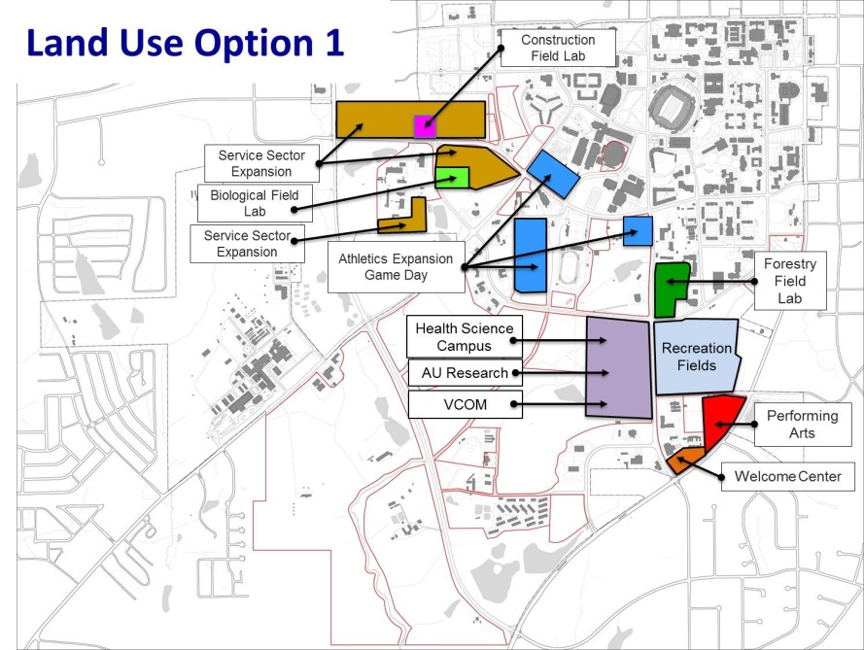
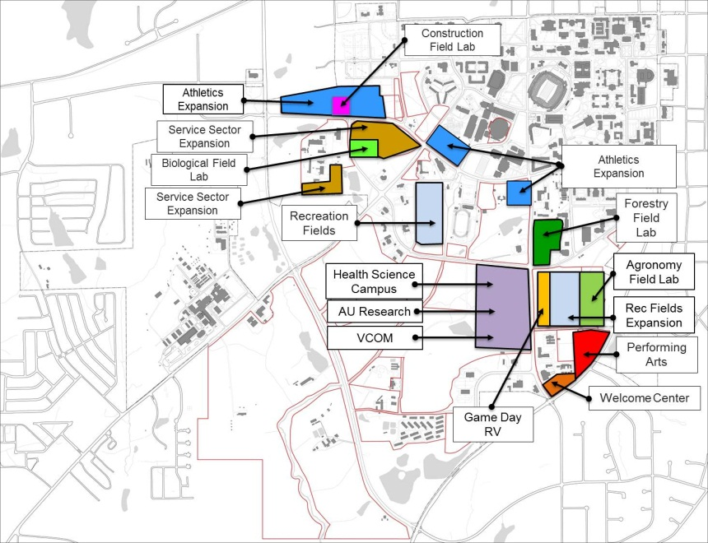
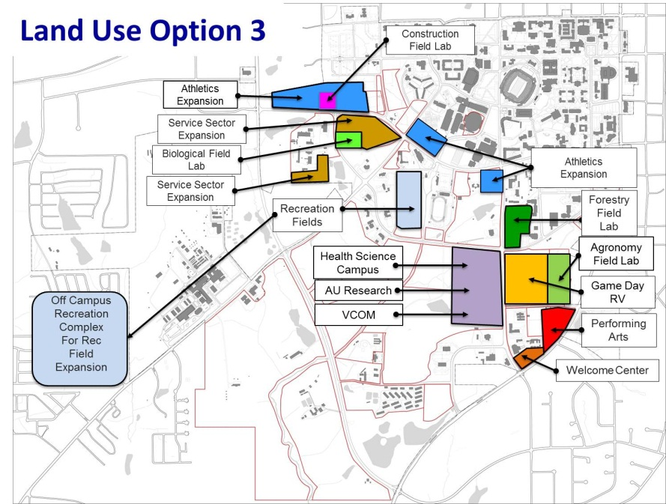
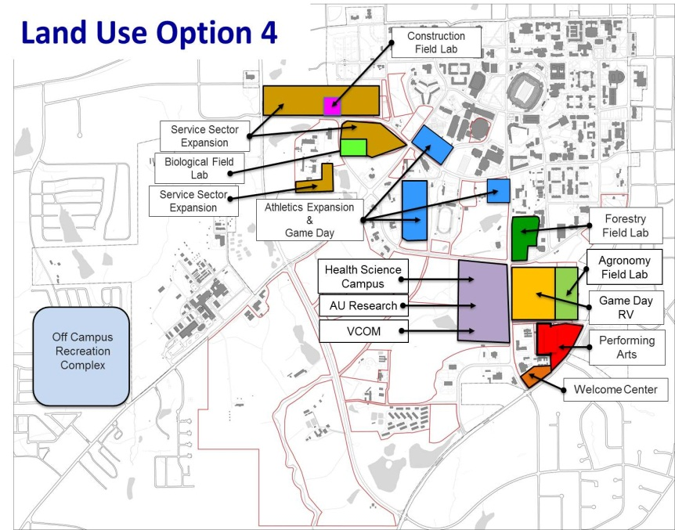
Options for Proposed Land Use
Land Use Option 2
Notes:
Original Image path: G:\16601.00\Graphics\00_PPT\05_WS5\Future Land Use Diagrams\_0009_OUTLINES.jpg
Last Updated: 10/15/2012 4:22:19 PM by ryork via Sasaki PPT Image Manager

Slide 17
Field Laboratories
Plan is to Designate Land Involved in Instruction as Field Laboratories.
Notes:
Original Image path: G:\16601.00\Graphics\00_PPT\05_WS5\Future Land Use Diagrams\_0009_OUTLINES.jpg
Last Updated: 10/15/2012 4:22:19 PM by ryork via Sasaki PPT Image Manager

Slide 18
Backup Slides

Slide 19
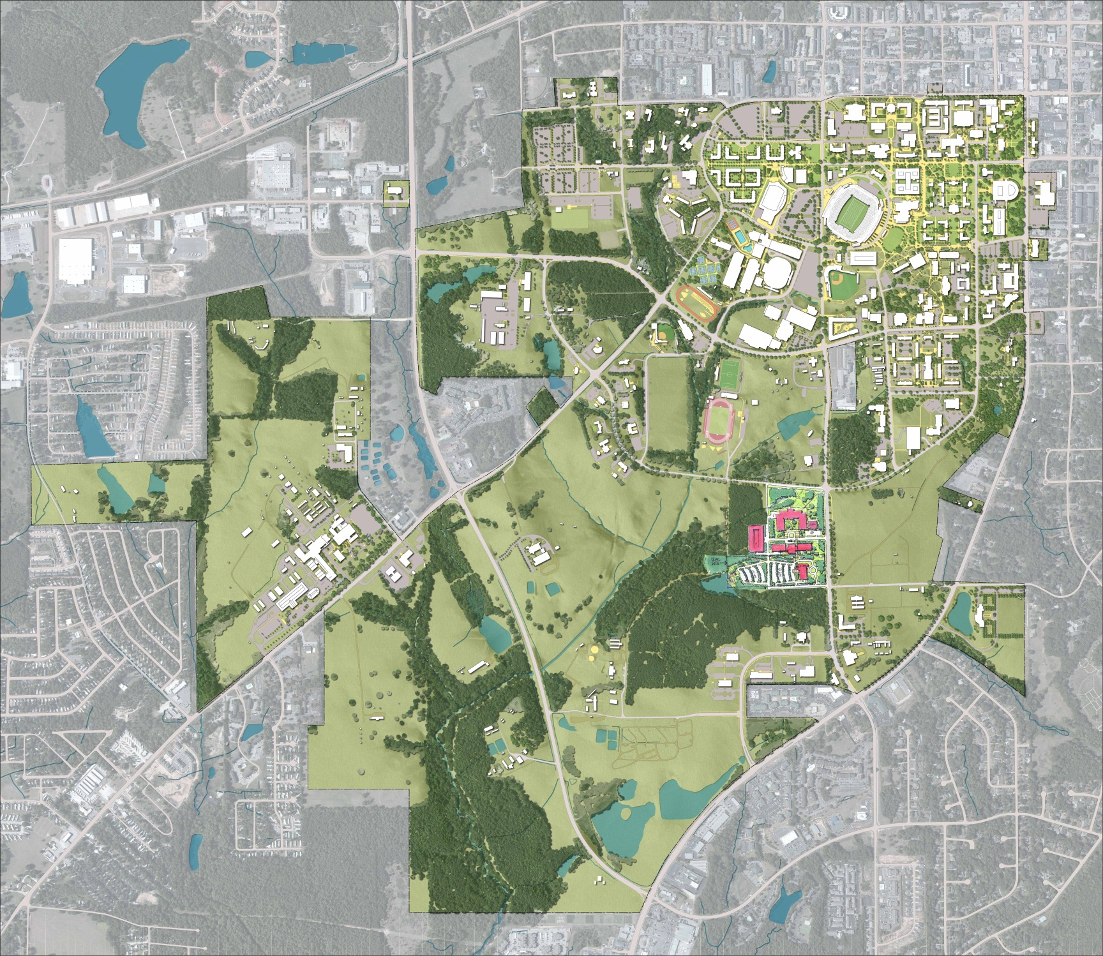
Notes:
Original Image path: G:\16601.00\Graphics\00_PPT\05_WS5\Future Land Use Diagrams\_0009_OUTLINES.jpg
Last Updated: 10/15/2012 4:22:19 PM by ryork via Sasaki PPT Image Manager

Slide 20
Land Use Option 1
Construction Field Lab
Service Sector Expansion
Biological Field Lab
Service Sector Expansion
Athletics Expansion
Game Day
Forestry
Field Lab
Health Science
Campus
Recreation Fields
AU Research
VCOM
Performing Arts
Welcome Center
Notes:
Original Image path: G:\16601.00\Graphics\00_PPT\05_WS5\Future Land Use Diagrams\_0009_OUTLINES.jpg
Last Updated: 10/15/2012 4:22:19 PM by ryork via Sasaki PPT Image Manager

Slide 21
Space Requirement Summary:
Auburn Main Campus
¹Revision: Special Labs moved from Research to Open Laboratory space

Slide 22
Space Requirement Summary:
By College/School

Slide 23
College/School Space Priority Areas
Replace outdated buildings and provide higher quality replacement space:
  Funchess and Upchurch Halls (Agriculture and COSAM)
  Parker and Allison (COSAM)
  Spidle Hall (Human Sciences)
  Haley Center (Liberal Arts and Education)
Address large deficits with new buildings and/or facilities:
  COSAM (approx. 78,000 sf deficit)
  Nursing (approx. 22,000 sf deficit)

Slide 24
College/School Space Priority Areas (cont.)
Renovate buildings to improve quality of space
  Comer Hall (Agriculture)
  Textile Building (Engineering)
  Dudley Hall and Dudley Commons (CADC)
  Mary Martin Hall
  Greene Hall (CVM)
Expand existing buildings:
  Dudley Hall (CADC)
New or renovated space to meet research needs
  Agriculture
  Pharmacy
  Veterinary Medicine

Slide 25
College/School Space Priority Areas (cont.)
Add new space for program expansion
  Business
Resolve adjacency issues (or preserve adjacencies) for departments within the Colleges
  CADC
  COSAM
  Education
  Engineering (preserve)
Encourage facility sharing
  Animal containment and housing
  Clinical care laboratories

