Slide 1

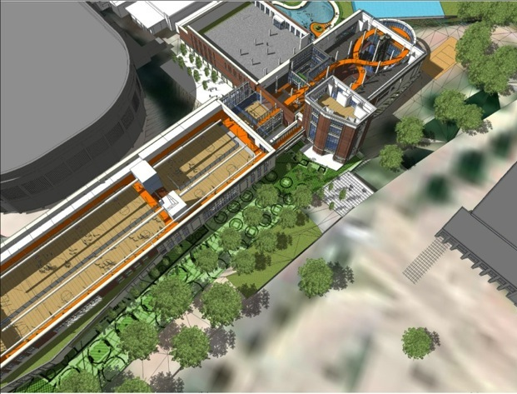

Campus Recreation
Approximately 100,000 square feet.
15 acre Intramural Field.
2 Multipurpose Court Gyms.
Personal Training and Group Exercise Rooms.
Equipment Checkout.
Registered Dietitian Office.
240,000
Square
Feet
Opening Spring 2013

Slide 2

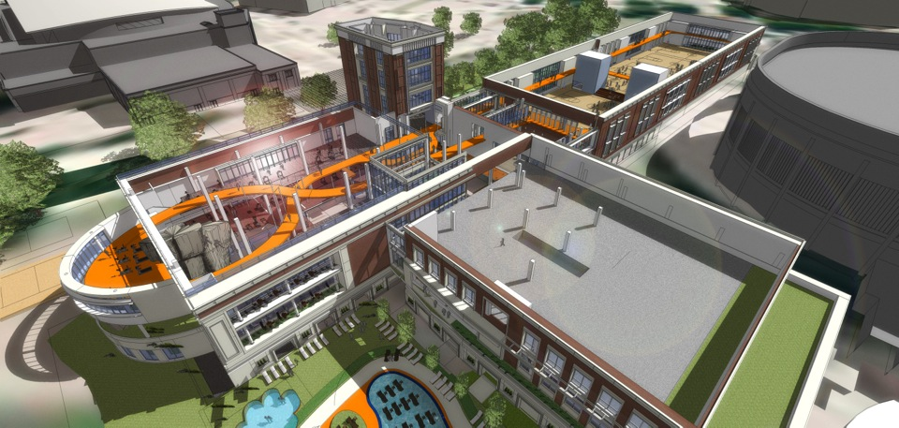
Campus Recreation
1/3 Mile Corkscrew Track

Slide 3
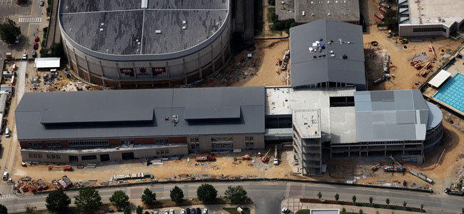
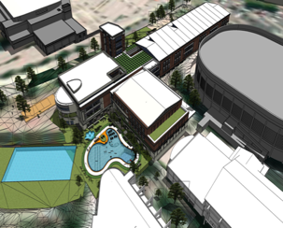
CAMPUS RECREATION

Slide 4
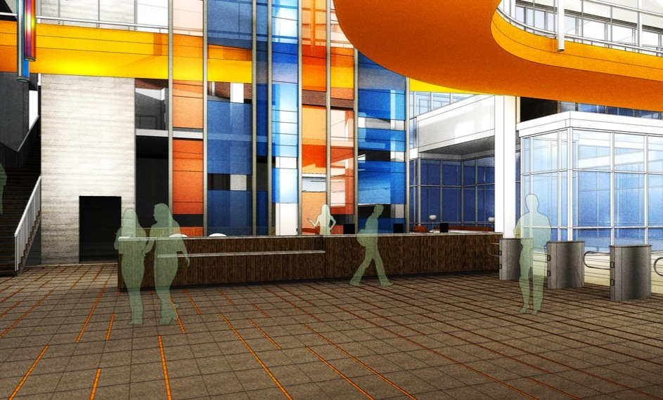
Campus Recreation

Slide 5
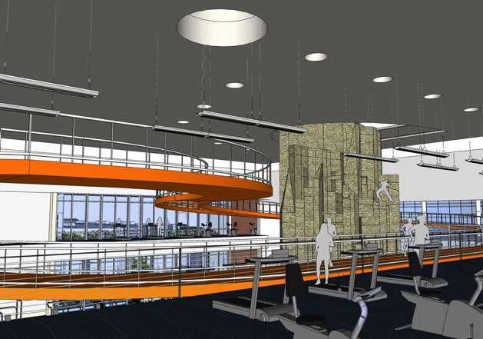
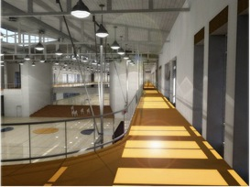
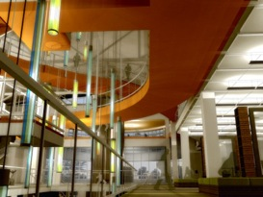
Campus Recreation
50+ Foot Climbing Wall

Slide 6
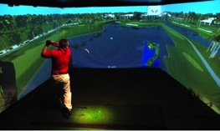
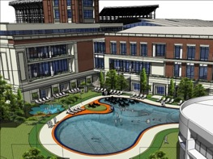
Faculty/Staff Features
PGA Golf Simulator.
1/3 Mile Corkscrew Track.
Racquetball/Squash Courts.
Dedicated Faculty/Staff Group Fitness Classes.
Outdoor Recreation.
Personal Training.
Outdoor Pool.
…and Many More!

Slide 7
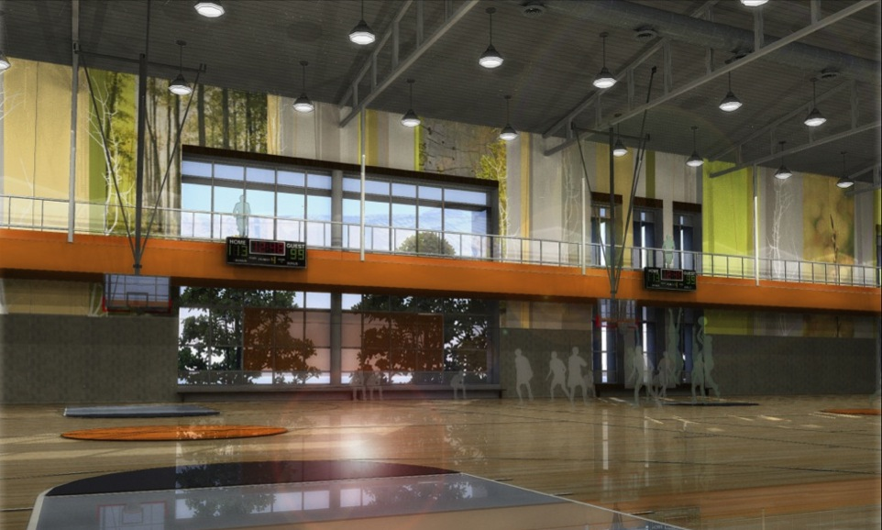
Campus Recreation

Slide 8
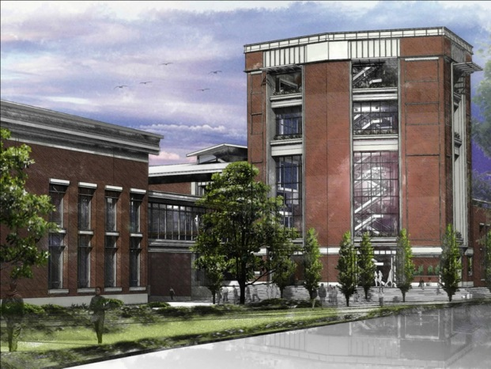
Campus Recreation
Personal & Small Group
Training
Group Fitness
  100 student instructors
  5 Studios
  Cycling, Mind/Body
  TRX, GTS, ViPR
  Step, BOSU & more
Tower of Fitness

Slide 9
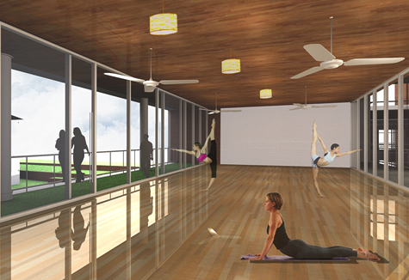
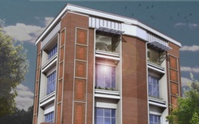
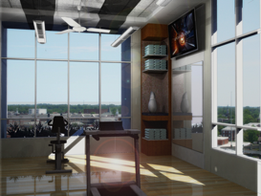
Campus Recreation

Slide 10
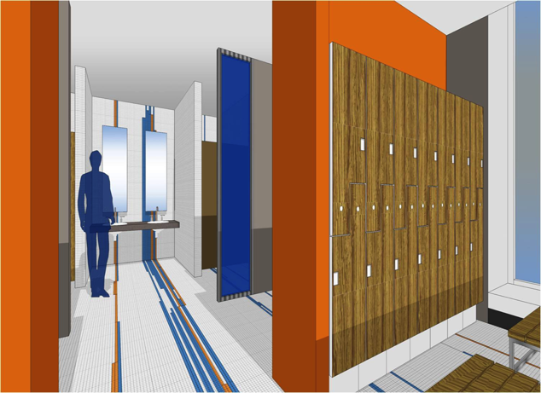
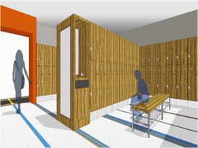
Campus Recreation

Slide 11
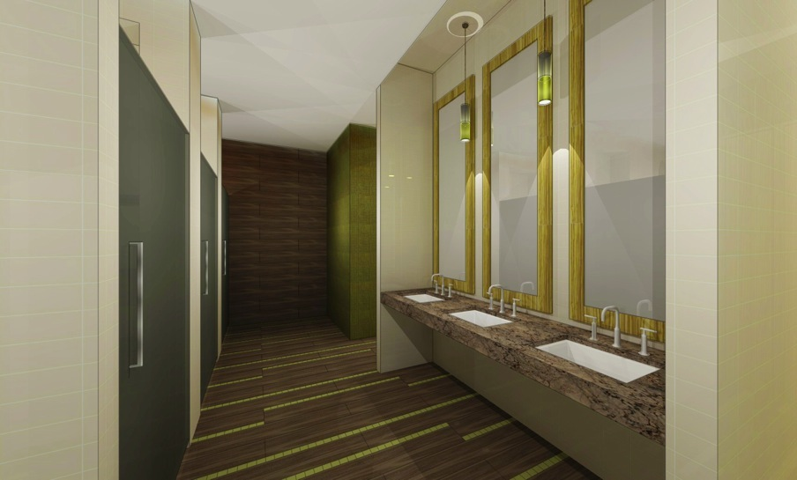
Campus Recreation

Slide 12
AUBURN/OPELIKA MEMBERSHIP PRICES
 | Annual | Monthly
Campus Recreation Pre-sale rate Includes Group Fitness on Fri. and Sat. only | $300.00 | $25.00
Health Plus with 12 mo. Contract including group fitness | $588.00 | $49.00
World’s Gym no group fitness | $239.40 | $19.95
AC Fitness for Women Without group fitness/with group fitness | $119.40/$239.40 | $9.95/$19.95
SportsPlex Resident/Nonresident | $366.00/$474.00 | $33.00/$44.00
Max Fitness with 24 mo. Contract without group fitness/with group fitness | $239.40/$359.40 | $19.95/$29.95
Moores Mill Club including pool, restaurant, tennis.etc. (everything but golf) | $2,220 +$3,500 initiation fee | $185.00 +$3,500 initiation fee
Pure Barre | $2,700 | $225.00

Slide 13
Campus Recreation
 | Total # of AU Employees | Average % of SEC Employee Members | Est. of AU Employee Members | Team Membership’s GOAL | Hallelujah GOAL
Auburn University | 4100 | 9.4% | 385 | 500 | 1000
Auburn University 10/30/12 | 4100 | 7.4% | 305 | 500 | 1000

Slide 14
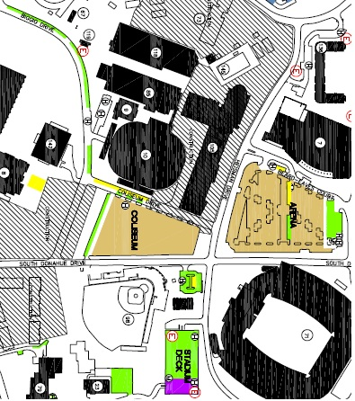
PARKING

Slide 15



Campus Recreation
facebook.com/AUCampusRec
twitter.com/campusrecau

Slide 16
CONTACT
For questions, please feel free to contact:
Tim Gore
Assistant Director, Memberships
tpg0006@auburn.edu
334-844-4716
Jessica Large
Coordinator, Memberships
largejm@auburn.edu
334-844-4716

