Slide 1
Auburn University
Parking and Traffic

Slide 2
Presenters
Catherine Love, P.E., JD – Traffic & Parking Committee
Don Andrae – Parking Services Department
Jeffrey Dumars, ASLA, LEED® AP BD+C – Office of Campus Planning

Slide 3
Parking Policies and Regulations
How they are made
Who makes them
How faculty can have input into the process

Slide 4
Parking Services
Implements and enforces rules and regulations.
AU Traffic & Parking Committee
Makes rules and regulations for efficient and equitable use of existing parking resources.
Campus Planning
Develops plans for future land use, including locations and sizes of parking facilities.

Slide 5
Auburn University
Parking and Traffic Committee

Slide 6
Committee Charge
Standing University Committee
Appointed by and advisory to the President through the Executive Vice President
Charge
The committee shall accept suggestions, comments, and complaints relative to the parking of vehicles and the movement of vehicular/pedestrian traffic on campus. It primary concerns shall the safety and well-being of students, faculty, staff, vendors, and visitors and the orderly and efficient parking/movement of vehicles and persons. The committee shall be expected to make recommendations regarding parking lot zoning, zone enforcement procedures, costs and procedures for vehicle registration; procedures and regulations for parking and traffic movement during athletic events, pavement markings, signage, signalization, site lighting, handicapped parking/access, pedestrian malls, shuttle-bus systems, and bicycles/skateboards, etc. It is recommended that an appointee to this committee not serve on any traffic appeals board.

Slide 7
Typical Activities of Committee
Zoning
Rules and Regulations
Requests for exception/special consideration
Annual Parking Occupancy Study
Meets 4-5 times per year
Minutes and annual report

Slide 8
Agenda Set by Chair
  Unfinished business
  Topics raised by committee members
  Topics addressed to the Committee Chair by the President’s office and/or other university constituents

Slide 9
Traffic and Parking Committee – FY 2012-2013
Continuing/Ex Officio
University Engineer, Facilities Management - Chair | Catherine Love
Unversity Architect, Facilities Managemnt - Vice-Chair | Greg Parsons
University Planner, Facilities Management | Tom Tillman
Director, Athletics Facilities | Keith Bagwell
Assoc Director , Public Safety and Security | Randy Cerovsky
Director, Parking and Transit Services | David George
Manager, Parking Services | Don Andrae
Director, AA/EEO | Kelley Taylor
Faculty | Jennifer Adams (Communications and Journalism) - 2013
Faculty | Song-Yul Choe (Mechanical Engineering)- 2013
Faculty | Jeffrey LaMondia (Civil Engineering) - 2014
A&P | Vivian Miller (Business Outreach) - 2013
 | Matt Williams (Office of Sustainability)-2013
Staff | Jennifer Richardson (Property Services) - 2014
 | Mary Sinnott (Student Financial Services) - 2013
Graduate Student | Michael Pukish - 2013
Undergraduate Students | Walter Whatley - 2013
 | Rob Garcia - 2013
 | Wilson Yeilding - 2013
 | Sloane Bell - 2013
 | Williams Whittlesey - alternate - 2013

Slide 10
Appeals
Three (3) appeals committees
Not affiliated with Parking Services Department
Appointed by and advisory to the President through the Executive VP
Meet Tuesday, Wednesday, & Thursday

Slide 11
Auburn University Parking & Traffic Committee Contact Information
Chair – Catherine Love phone: (334) 844-9579
email: lovecat@auburn.edu
Faculty Representatives
Jennifer Adams: (Communications and Journalism) adamsj1@auburn.edu
Song-Yul Choe: (Mechanical Engineering) choeson@auburn.edu
Jeffrey LaMondia: (Civil Engineering) jjl0006@auburn.edu

Slide 12
Auburn University
Parking Services

Slide 13
Mission Statement
Facilitate safe and convenient access to Auburn University while encouraging alternative modes of transportation.

Slide 14
Responsibilities
Implementation and enforcement of parking rules and regulations
Compilation and distribution of Rules and Regulations pertaining to traffic and parking on property belonging to AU
Sale of parking permits
Collection of parking fines (no moving violations)
Discretion to deal with emergencies, special events, service and delivery issues, etc.
Signage and Pavement Markings handled by Facilities Management per work-orders from Parking Services
Notes:
Rules and regulations available in hard-copy and on Parking Services website

Slide 15
Parking at AU
Faculty and Staff - “Broad Zone System”
  All Faculty (and Staff with > 10 yrs of service) entitled to park in any area zoned “A”, “B”, or “C”
  Staff with < 10 years of services entitled to park in any area zoned “B” or “C”
Students – “Assigned Lot” System
- Residents (since 2008) – RH, RQ, RW, RO
“Proximate Lots” by lottery with up-charge
“Overflow” in South Quad Deck and West Campus
-Commuters (started Fall 2012) – CP, C
  “Proximate Lots” (Donahue Dr.) by lottery with up-charge.
  “Overflow” in West Campus Parking

Slide 16
Permit Sales
Permit Type | Permits Sold
 | 2011'-2012' | 2012'-2013'
A | 3538 | 3115
RH-RESIDENT HILL | 812 | 764
RQ-RESIDENT QUAD | 207 | 342
RO-RESIDENT OVERFLOW | 1521 | 1052
TEMP A | 222 | 38
TEMP B | 1322 | 352
B | 1071 | 902
C | 11196 | 5302
PC | 0 | 1823
C-AUM STUDENT | 40 | 4
RW-RESIDENT VILLAGE | 796 | 815
G-GRAD STUDENT | 144 | 231
MOTORCYCLE- FACULTY | 113 | 104
MOTORCYLE- STUDENT | 310 | 231
K-BICYCLE | 429 | 2589
CONVERTIBLE- FACULTY | 18 | 14
CONVERTIBLE- STUDENT | 16 | 8
Total Permits: | 21755 | 17686
A + B zone permits:
  3604 parking spaces
  2012 : 1.28 permits/space
  2013: 1.12 permits/space to date
Bicycles:
  Permit enforcement began 2013
  1,984 spaces
  2589 permits sold to date

Slide 17
Impact of Change to Assigned Lot System for Commuting Students
Less traffic on Donahue Drive
No idling/circling for vacant parking spaces
Carpooling!
Greater than 20,000 rides per day on Tiger Transit
Less complaints from students – especially complaints that they couldn’t find a parking space and were late for class, missed an exam, etc.
Notes:
Less traffic on Donahue based on anecdotal evidence. Pre vs Post traffic counts to be analyzed this year

Slide 18
Impact of Change to Assigned Lot System for Commuting Students
Faculty reported difficulty in finding available parking spaces since prohibited from “parking down” into PC
  Committee had rezoned @ 80 spaces from PC to B in early summer 2012
  Committee recently rezoned 99 more spaces from PC to B (to be complete in Oct 2012)
  40 A spaces to re-open in Lowder Lot when construction finished

Slide 19
Contact Information
Don Andrae – Manager of Parking Services
Telephone #: 844-4143
Email: dza0015@auburn.edu

Slide 20
Auburn University
Campus Planning

Slide 21
University Master Plan
The Facilities Management Office of Campus Planning & Space Management maintains and revises the Comprehensive Campus Master Plan, adopted in June 2002, for the main campus; and development and maintenance of master plans for other properties, as necessary, to serve as frameworks for the preservation of existing assets and for guiding physical development.

Slide 22
Master Plan Governance Structure
Auburn University
Board of Trustees
Auburn University President
Auburn University
Executive Facilities Committee
Auburn University Community
University Master Plan Committee
AU Facilities Management
Master Planning Team
Campus Master Plan Issues

Slide 23
Master Plan Priorities: Campus Survey Faculty Responses

Slide 24
Master Plan 2012 Update Planning Elements
  Replace Academic Buildings in the Campus Core
  Space Needs of College and Schools
  Campus Transportation – plan to address campus traffic flow, the pedestrian nature of the campus, transit capability, non-motorized modes of transportation, and parking in a coordinated and comprehensive manner
  Long Range Land Use Plan
  Research Capability
  Campus Landscape
  Sustainable Practices
  Campus Quality of Life
  Health Science Sector at Auburn University Main Campus
  Student Housing on Campus
  Sports and Athletics Facilities
  Campus Security

Slide 25
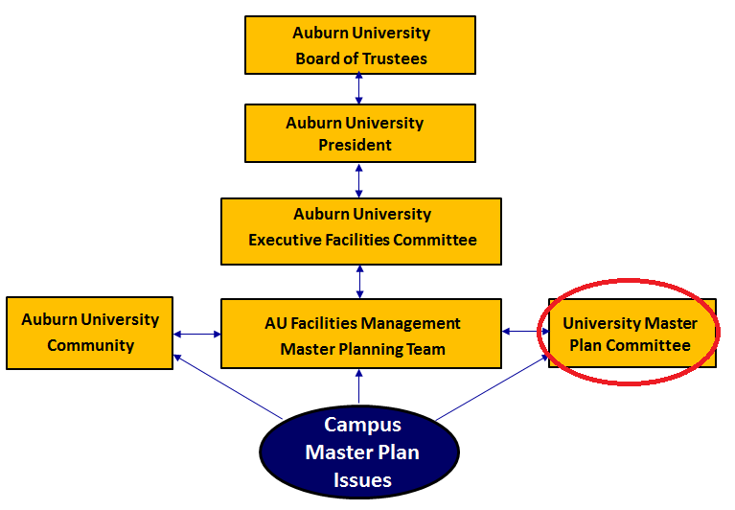
University Master Plan Update Committee
  Tom Tillman, Facilities Management, Chair
  Greg Parson, Facilities Management, Vice-Chair
  Emmett Winn, Office of the Provost
  Catherine Love, Facilities Management
  Mike Kensler, Office of Sustainability
  Steven Nelson, Administrative and
  Professional Assembly
  Rod Turochy, Faculty
  Joseph Kemble, Faculty
  John Pittari, Faculty
  Charlene LeBleu, Faculty
  Additional Ad Hoc Representation: AVP-Facilities/AVP-Research/AVP-Aux. Serv./AVP-Student Aff./Dir. OIRA/Dir. Real Est./AAES/Assoc. Dir. Ath./University Senate Represenatative/A&P Assembly/Staff Council/Grad. Sch. Council/SGA/Div. & Multicultural Affairs/Alumni Assoc./City of Auburn

Slide 26
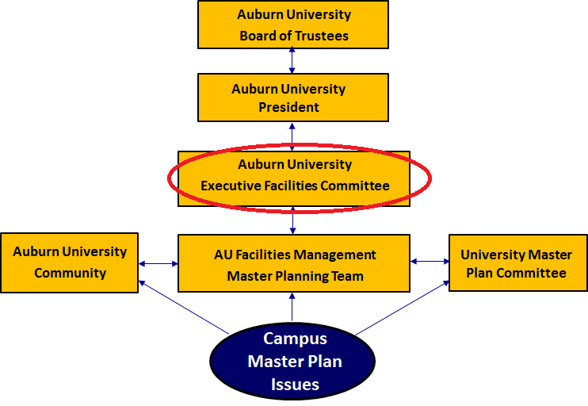
Executive Facilities Committee
  Provost, Chair
  Assistant VP for Facilities, Co-Chair
  Executive Vice President
  University Senate Leadership
  Representative
  Associate Provost
  Vice President for Research
  Vice President for Student Affairs
  Athletic Director
  Assistant Vice President for Auxiliary Services
  Student Government Association Representative
  College/School Dean’s Representative (2 year appointment)
  College School Dean’s Representative (2 year appointment)

Slide 27
Ways Faculty Can Participate
and Influence the Master Plan Update
Participant in Provost Open Forums on topics of interest :
  October 17: Parking, Circulation & Mobility
  For full schedule see: http://www.auburn.edu/academic/provost/announcement/ 2012-2013_ProvostForums.html
Visit the Master Plan Website and draft work products and offer comments:
  http://www.auburn.edu/administration/facilities/
  Click on MASTER PLAN 2012 Update

Slide 28
Ways Faculty Can Participate
and Influence the Master Plan Update
Full University Senate Presentation(s): Facilities Management has offered to present draft options for the various planning elements to the full University Senate
Faculty can contact their representative on the Master Plan Update and the Executive Facilities Committees
  University Senate Chair, Bill Sauser, 844-2498, sausewi@auburn.edu
  Rod Turochy, Faculty
  Rebecca Retzlaff, Faculty
  Joseph Kemble, Faculty
  Charlene LeBleu, Faculty

Slide 29
Ways Faculty Can Participate
and Influence the Master Plan Update
Faculty can contact the planning team directly
  Director Campus Planning, Tom Tillman, 844-9586, tillmte@auburn.edu
  Project Manager, Jeffrey Dumars, 844-1132, jkd0006@auburn.edu
  Campus Planner II, Richard Guether, 844-7454
  rcg0011@auburn.edu

Slide 30
End

Slide 31
