Slide 1
Report from the Committee on Intercollegiate Athletics (CIA)
Mary K Boudreaux, DVM, PhD
Faculty Athletics Representative
CIA – Charge, Composition, Subcommittees
Student Athlete Eligibility – Initial Eligibility changes
Student Athlete Eligibility – Progress Towards Degree requirements
Graduation Success Rate (GSR) – data released in Fall 2013
Academic Progress Rate (APR) – data released in Spring 2013
Accolades – Rhodes Scholars
1A FAR Academic Excellence Award
NCAA Postgraduate Scholarships
Scholar All-Americans/C S C A A
SEC Academic Honor Roll
H. Boyd McWhorter Academic Awards
Brad Davis Community Service Awards
Auburn University Student Athletes 2013 Statistics
SEC FAR members
Visit NCAA.org

Slide 2
Charge of the Committee on Intercollegiate Athletics
The Committee on Intercollegiate Athletics shall:
recommend to the President the policies for the operation of the Intercollegiate
Athletics program at Auburn University,
(2) monitor for the President all aspects of the Intercollegiate Athletics Program at
Auburn University for compliance with University policies, and with NCAA and SEC
legislation.
(3) assist the President and the Director of Athletics on any aspect of the
Intercollegiate Athletics Program for which advice or assistance is requested.
The Committee on Intercollegiate Athletics shall meet once per quarter and
additionally as called by the President of Auburn University.

Slide 3
Composition of the Committee on Intercollegiate Athletics
Mary K Boudreaux, Pathobiology, Chair
Barbara Struempler, CHS Nutrition and Dietetics
Larry Teeter, Forestry & Wildlife Sciences
James Barbaree, Biological Sciences
Daniel Svyantek, Psychology
Ann Beth Presley, CHS Consumer and Design Sciences
Brian Connelly, Management-Business
Don Large, Executive Vice-President
Jon Waggoner, Interim Vice President of Student Affairs
C. Wayne Alderman, Dean of Enrollment Management
Kevin Robinson, Executive Director of Internal Auditing
Bryan Elmore, A & P Chair
Jennifer Richardson Holt, Staff Council Chair
Harrison Mills, SGA President
Ex-Officio Members
Jay Gogue, President
Timothy Boosinger and Constance Relihan, Office of the Provost
Jay Jacobs, Athletics Director
Rich McGlynn, Senior Associate Athletics Director

Slide 4
Subcommittees of the Committee on Intercollegiate Athletics
Academic Standards Subcommittee—Larry Teeter, Chair
Awards Subcommittee—James Barbaree, Chair
Compliance Subcommittee—Mary K Boudreaux, Chair
Drug Education/Testing Advisory Group—Randall Clark, Chair
Equity, Welfare, and Sportsmanship —James Barbaree, Chair
Priority and Seating Subcommittee—Larry Teeter, Chair
Athletics Department Seminar Series – Barbara Struempler, Chair

Slide 5
New NCAA Division I Initial-Eligibility Academic Requirements
For college-bound student-athletes enrolling full time at an NCAA
Division I college or university on or after August 1, 2016, there are
three possible academic outcomes:
Full qualifier = competition, athletics aid (scholarship), and practice
the first year.
2. Academic redshirt = athletics aid the first year, practice in first
regular academic term (semester or quarter).
3. Nonqualifier = no athletics aid, practice or competition the first year.

Slide 6
High School students will need to meet the following requirements
to receive athletics aid, practice and compete their first year:
16 core courses in the following areas:
4 years English
3 years math at Algebra I level or higher
2 years natural or physical science
(one lab if offered at any high school attended)
1 year additional English, math or natural/physical science
2 years social science
4 years additional from areas above or foreign language, philosophy
or comparative religion.
Minimum GPA of 2.300 required in those 16 core courses.
Graduate from high school.

Slide 7
Core-course progression
Must complete 10 core courses before seventh semester of
high school (e.g., senior year).
Of the 10 core courses completed, seven must be in the
area of English, math, or science.
These 10 core courses become “locked in” for the purpose
of core-course GPA calculation.
A repeat of one of the “locked in” courses will not be used
if taken after the seventh semester begins.

Slide 8
Student Athlete Eligibility 40-60-80 Rule
Once in college, student-athletes must make steady progress toward
degrees. Student-athletes must complete coursework
required for a degree in the following time frame:
40 percent by the end of their second year,
60 percent by the end of their third year,
80 percent by the end of their fourth year.
Student-athletes are allowed five years to graduate while receiving
athletically related financial aid.
All student-athletes must earn a minimum of six hours each term to be
eligible the next semester.
From NCAA.org

Slide 9
Graduation Success Rate (GSR)
The NCAA developed the Division I Graduation Success Rate in response to
college and university presidents who wanted graduation data that more accurately
reflect the mobility among all college students today.
The rate measures graduation rates at Division I institutions and includes
student-athletes transferring into the institutions.
It differs from the rate mandated by the federal government, which does not
count incoming transfer student-athletes and counts student-athletes who
transfer out as not having graduated, regardless of whether they actually did.
The Graduation Success Rate also allows institutions to exclude from the computation
student-athletes who leave their institutions before graduation, so long as they would
have been academically eligible to compete had they remained.
From NCAA.org

Slide 10
Federal Graduation Rate (FGR) vs. Graduation Success Rate (GSR)
•FGR assesses only first-time full-time freshmen in a given cohort and only counts
them as academic successes if they graduate from their institution of initial
enrollment within a six-year period. It makes no accommodation for transfers into
or out of an institution.
The rate is very limited because it ignores the large number of transfer students in
higher education, but it is still the only rate that allows a direct comparison between
student-athletes and the general student body.
•GSR begins with the federal cohort, and adds transfer students, mid-year enrollees,
and non-scholarship students (in specified cases) to the sample. Student-athletes
who leave an institution while in good academic standing before exhausting athletics
eligibility are removed from the cohort of their initial institution.
This rate provides a more complete and accurate look at actual student-athlete
success by taking into account the full variety of participants in Division I athletics
and tracking their academic outcomes.
From NCAA.org

Slide 11
Comparison of Graduation-Success Rates and Federal
Graduation-Rate Cohorts (2003-2006 Entering Classes)
Federal Rate GSR
Enrolled (Under Federal Definition) 82,552 82,552
Enrolled as Frosh in January 0 2,549
Two-Year College Transfers 0 9,604
Four-Year College Transfers 0 8,364
Non-Scholarship Athletes
(Only at Schools Not Offering Aid) 0 11,617
Total Enrolled 82,552 114,686 (+38.9%)
Allowable Exclusions
(Death, Military, Church Mission, etc.) 326 427
Left Eligible 0 20,949
Participants No Longer Sponsored By 0 1,609
Institution
Total Denominator 82,226 91,701 (+11.5%)
Both the GSR and FR evaluate a six-year graduation rate (% of students graduating
by end of their sixth year – or before the 7th Fall)
From NCAA.org

Slide 12
Auburn University GSR Historical Trends
2013 = 2003 to 2006 cohort
M &W Golf = 57%/100%
Gymnastics = 90%
M & W Basketball = 58%/92%
Equestrian = 88%
M & W Tennis = 100%/86%
Football = 70%
Soccer = 86%
Volleyball = 60%
M & W Tennis = 100%/86%
Football = 70%
Soccer = 86%
Volleyball = 60%

Slide 13
2013 Average GSR Rate (%) of Last 4 Cohorts
Division I and SEC Student-Athletes

Slide 14
Graduation Success Rate by Sport 2003 – 2006 cohorts (n = 324)
Men’s Sports GSR FR Women’s Sports GSR FR
Baseball 48 27 Basketball 92 69
Basketball 58 50 C/C Track 70 69
CC/Track 70 54 Equestrian 88 68
Football 70 61 Golf 100 83
Golf 57 80 Gymnastics 90 62
Swimming 74 58 Soccer 86 74
Tennis 100 100 Softball 88 68
Swimming 88 70
Tennis 86 43
Volleyball 60 23
Graduation Rates All Students (%) 2003 – 2006/6 cohorts (FED Rate)
Division I (n = 2,963,437) Auburn (n = 15,522) AU Student Athletes (n = 324)
Men 61 Men 64 Men 54
Women 65 Women 70 Women 65
Combined 63 Combined 67 Combined 60

Slide 15
Student Athletes Graduation Rates (GSR %) 2003 – 2006
Division I (n = 82,223) Auburn (n = 324)
Men 75 Men 68
Women 88 Women 84
Combined 81 Combined 75

Slide 16
Academic Progress Rate (APR)
While eligibility requirements make the individual student-athlete
accountable, the Academic Progress Rate (APR) creates a level of
institutional responsibility.
The Academic Progress Rate is a Division I metric developed to track
the academic achievement of teams each academic term.
Each student-athlete receiving athletically related financial aid earns
one retention point for staying in school and one eligibility point for
being academically eligible.
A team’s total points are divided by points possible and then
multiplied by one thousand to equal the team’s APR.
From NCAA.org

Slide 17
Academic Progress Rate Calculation Example
A Division I Football Bowl Subdivision team awards the full complement of 85
grants-in-aid. If 80 student-athletes remain in school and academically eligible,
3 remain in school but are academically ineligible and 2 drop out academically
ineligible, the team earns 163 of 170 possible points for that term.
Divide 163 by 170 and multiply by 1,000 - team’s APR that term is 959.
The NCAA calculates the rate as a rolling, four-year figure that takes into account all
the points student-athletes could earn for remaining in school and academically
eligible during that period. Teams that do not earn an APR above specific benchmarks
face penalties ranging from scholarship reductions to more severe sanctions.
Teams that score below 925 and have a student-athlete who both failed academically
and left school (0 for 2) can lose scholarships (up to 10 percent of their scholarships
each year) under the immediate (contemporaneous) penalty structure.
From NCAA.org

Slide 18
The APR penalty structure was significantly revamped in 2011, effective with the 2012-13 academic year.
After sitting at a 900 APR for the first five years of the
program, the penalty benchmark will slowly increase
over the next several years.
Teams are required to earn a 900 four-year APR
in 2012-13 and 2013-14.
The benchmark is raised to 930 for 2014-15 and beyond.
From NCAA.org

Slide 19
Penalty Structure for multi-year APR of less than 900/930
Level 1 – Practice penalties (4 hours/day/week of practice in season resulting in 16
hours per week rather than 20 and 5 days per week rather than 6, to be replaced
with academic activities.
Level 2 – Adds out of season practice restrictions (4 hours per week), cancellation of
nontraditional season or spring football and for sports without a nontraditional
season, a 10% reduction in contests and length of season.
Level 3 – Menu of options including financial penalties, restricted NCAA membership,
coaching suspensions for a designated number of contests and/or recruiting,
restricted access to practice for incoming student-athletes that fall below
predetermined academic standards and multi-year postseason competition bans.
Teams will be subject to Level 3 penalties until APR improves. The Committee on
Academic Performance has the discretion to apply appropriate penalties once
teams have fallen below the benchmark for three consecutive years.
From NCAA.org

Slide 20
Minimum APR changed from 925 to 930 for Division I postseason competition
Postseason Multiyear APR for Two most recent years average
Competition for Postseason Eligibility APR for Postseason Eligibility
Year
2012 – 2013 Four year APR of 900 OR Two most recent years average
at or above 930
2013 – 2014 Four year APR of 900 OR Two most recent years average
at or above 930
2014 – 2015 Four year APR of 930 OR Two most recent years average
at or above 940
2015 – 2016 Four year APR of 930 NA
and beyond

Slide 21
Sport | APR Multi-Year (4 year) Rate Posted Spring 2013
Baseball | 943
Football | 950
Men's Basketball | 940
Men's Cross Country | 984
Men's Golf | 990
Men's Swimming | 961
Men's Tennis | 957
Men's Track, Indoor | 988
Men's Track, Outdoor | 988
Softball | 984
Women's Basketball | 990
Women's Cross Country | 992
Women's Golf | 984
Women's Gymnastics | 982
Women's Soccer | 995
Women's Swimming | 976
Women's Tennis | 985
Women's Track, Indoor | 966
Women's Track, Outdoor | 966
Women's Volleyball | 945
From NCAA.org

Slide 22
Accolades
Rhodes Scholars
In 2009 Jordan Anderson, the men’s swimming and diving captain, was awarded a
Rhodes Scholarship.
In 2010 Erica Meissner, the women’s swimming and diving team captain, and
gymnast Krissy Voss were Rhodes Scholar finalists.
In 2011 Dan Mazzaferro, the men’s swimming and diving captain, was a Rhodes
Scholar finalist.
In 2012 and 2013 Ashton Richardson, football, was a Rhodes Scholar Finalist.
Auburn is the only SEC institution to have 5 student-athletes as finalists in the
last 5 years.
Special thanks to Paul Harris
From NCAA.org

Slide 23
1A FAR Academic Excellence Award
Student-Athlete GPA Major Sport
Mackenzy Harper 4.0 Accounting Volleyball
Ashton Richardson 3.91 Animal Sciences, Pre-Vet Football
Katherine Culwell 3.80 Finance Volleyball
Leslie Roper 3.81 Finance Equestrian
Kyle Owens 3.87 Biomedical Sciences, Pre-Med Swimming
Lindsey Norberg 3.86 Animal Sciences, Pre-Vet Swimming
Lauren Norberg 3.88 Animal Sciences, Pre-Vet Swimming
Criteria for the award:
Awarded a BS in the previous year (9-1-2012 to 8-31-2013)
Cumulative GPA of 3.8 or above upon graduation
3. Participated in at least 2 years of intercollegiate athletics at a Football Bowl
Subdivision (FBS) institution in a sport sponsored by an FBS conference.

Slide 24
NCAA Postgraduate Scholarship winners in 2013
Stuart Ferguson – Swimming & Diving
Kyle Owens – Swimming & Diving
The NCAA Postgraduate Scholarship is considered one of the highest
academic honors a student-athlete can receive.
The award measures success beyond the playing field, encompassing
academic accomplishments, campus involvement, community service,
volunteer activities and demonstrated leadership.
174 NCAA senior athletes across all sports and divisions are chosen
each year and receive a $7,500 grant to pursue post-graduate education.

Slide 25
Auburn Student-Athletes 2012 -2013
5 student-athletes were awarded NCAA Postgraduate Scholarships
3 student-athletes were NCAA Walter Byers Scholarship finalists
Walter Byers Scholarship –NCAA’s highest Academic Award
One male and one female student-athlete are annually awarded.
The stipend for each Byers Scholarship is $24,000 for an academic year.
The grant may be renewed for a second year with evidence of the scholar's satisfactory performance and progress.
Recognizes outstanding academic achievement and potential for success in
postgraduate study.
A Byers Scholar will be recognized as one who has combined the best elements of mind
and body to achieve national distinction for his or her achievements, and promises
to be a future leader in his or her chosen field of career service.
From NCAA.org

Slide 26
The Auburn Swimming and Diving Team had 20 student-athletes,
the most in the SEC, selected as Scholar All-Americans by the
College Swimming Coaches Association of America.
The Auburn women were named to the CSCAA Team Scholar
All- America list with a 3.23 GPA.
The men's team also earned national honors with a 3.02 overall GPA.
Founded in 1922, the College Swimming Coaches Association of America
is the oldest professional organization of college coaches in America.
The CSCAA is dedicated to serving and providing leadership for the
advancement of the sport of swimming and diving at the collegiate level.

Slide 27
Criteria for SEC Academic Honor Roll
A student-athlete must have a grade point average of 3.00 or above for
either the preceding academic year (two semesters or three quarters) or have a
cumulative grade point average of 3.00 or above at the nominating institution.
(2) If a student-athlete attends summer school, his/her grade point average during
the summer academic term must be included in the calculation used to determine
eligibility for the Academic Honor Roll.
(3) Student-athletes eligible for the Honor Roll include those receiving an athletics
scholarship, recipients of an athletics award (i.e., letter winner), and non-scholarship
student-athletes who have been on a varsity team for two seasons.
(4) Prior to being nominated, a student-athlete must have successfully completed
24 semester or 36 quarter hours of non-remedial academic credit toward a
baccalaureate degree at the nominating institution.
(5) The student-athlete must have been a member of a varsity team for the sport’s
entire NCAA Championship segment.

Slide 28
219 Auburn Student-Athletes SEC Academic Honor Roll
The 2012-13 Winter SEC Academic Honor Roll
2012 Spring, Summer and Fall terms
1 M. Basketball, 3 W. Basketball, 12 Gymnastics,
15 M. Swimming, 12 W. Swimming
The 2013 Spring SEC Academic Honor Roll
2012 Summer, 2012 Fall and 2013 Spring terms
12 Baseball, 31 Equestrian, 9 M. Golf, 7 W. Golf, 11 Softball,
4 M. Tennis, 8 W. Tennis, 25 M. Track and Field, 24 W. Track and Field
The 2013 Fall SEC Academic Honor Roll
2013 Spring, Summer and Fall terms
22 Football, 11 Soccer, 12 Volleyball

Slide 29
SEC H. Boyd McWhorter Postgraduate Scholarship
Recognizes student-athletes, one male and one female, for outstanding and
meritorious academic and athletic achievements during their entire college career.
Two from each SEC school, $7500 each
Minimum cumulative undergraduate GPA of 3.2
Demonstrated qualities of leadership that bring credit to the student-athlete, the
Institution, intercollegiate athletics and the goals and objectives of higher education.
The 28 SEC student-athletes compete for SEC Scholar Athlete of the Year.
FARs evaluate and rank all 28 students. Based on FAR rankings the list is
narrowed to 3 to 4 Finalists per category.
National award winners are determined from the Finalist list by the SEC FARs at
their March meeting. 2 students chosen - $15,000

Slide 30
Brad Davis SEC Community Service Postgraduate Scholarship
Recognizes outstanding and meritorious community service achievements by one
male and one female student-athlete during their entire college career.
Two from each SEC school, $5000 each
Minimum cumulative undergraduate GPA of 2.75
Demonstrated a commitment to serving others in the university or other communities
through participation in various service projects and activities, demonstrated qualities
of leadership bringing credit to the student-athlete, their institution, intercollegiate
athletics, and the goals and objectives of higher education.
The 28 SEC student-athletes compete for Service Leader of the Year.
FARs evaluate and rank all 28 students. Based on FAR rankings the list is
narrowed to 3 to 4 Finalists per category.
National award winners are determined from the Finalist list by the SEC FARs at
their March meeting. 2 students chosen - $10,000 each

Slide 31
Auburn University Student Athletes Fall Semester 2013
Average Team GPA for Semester 3.09
Average Team Cumulative GPA 3.12
Average Individual Student Athlete GPA for Semester 2.85
Average Individual Student Athlete Cumulative GPA 2.91
Total Student Athletes with 3.00+ 278 (54.51%)
Top Team GPA for the Semester Volleyball 3.46
Top Team Cumulative GPA Volleyball 3.46
Team with most 3.00+ GPAs Football 37
Team with Highest % 3.00+ GPAs Women’s Golf 88.89%
Student-Athletes on Track to Graduate with Honors 156
Statistics provided by Dr. Gary Waters, Senior Associate Athletics Director, Student Services

Slide 32
Enrollment of Student-Athletes by College/School
College/School Number of Student Athletes (%)
Agriculture 10 (2)
Architecture, Design, & Construction 12 (3)
Business 122 (22)
Education 90 (17)
Ginn/Engineering 35 (6)
Forestry & Wildlife Sciences 1 (0.2)
Human Sciences 26 (5)
Liberal Arts 175 (32)
Nursing 6 (1)
Pharmacy 1 (0.2)
Sciences & Mathematics 56 (10)
Inter-Disciplinary Studies 9 (2)

Slide 33
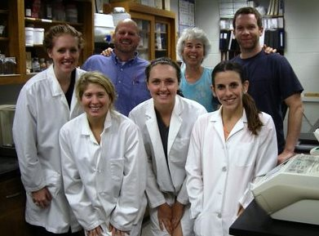
Summer 2013 – 3 student-athletes and 1 veterinary student working in the lab.
Maddie Barnes – Soccer; Melena Smith – Equestrian; Erica Kolakowski – Track and Field/XC
Spring Semester 2014 Jason Miller – Track and Field/XC; Caitlin Moran – Equestrian

Slide 34
SEC Faculty Athletics Representatives
Provosts 1 Vanderbilt
Associate Deans 2 Alabama, University of Mississippi
Department Heads/Chairs 3 Arkansas, Florida, Mississippi State
Professors 8 Auburn, Georgia, LSU, Kentucky, S. Carolina,
Tennessee, Missouri, Texas A&M
Engineering 1
Kinesiology 1
Sports Management 1
Law 3
English 1
Ag Economics 1
Economics 1
Educational Leadership 1
Psychology 1
Veterinary Medicine 1
Management 1
Physics 1

Slide 35
Kevin Whitaker, University of Alabama, Assoc Dean for Academic Programs, Assoc Professor of
Aerospace Engineering and Mechanics
Sharon Hunt, University of Arkansas, Depart Head, Depart of Health Science, Kinesiology,
Recreation and Dance
Michael Sagas , University of Florida, Prof and Chair, Depart of Tourism, Recreation, and Sport Management
David Shipley, University of Georgia, Former Law School Dean, Professor of Law
Joseph Fink, University of Kentucky, Prof of Pharmacy Law and Policy (Pharmacy degree and Law degree)
Bill Demastes, Louisiana State University, Alumni Professor of English
Ron Rychlak, University of Mississippi, Associate Dean for Academic Affairs and Professor of Law
Steve Turner, Mississippi State, Department Head and Professor, Department of Agricultural Economics
Zach Kelehear, University of South Carolina, Professor of Educational Leadership and Policies
Don Bruce, University of Tennessee, Professor, Center for Business and Economic Research
Richard McCarty, Vanderbilt, Provost and Vice Chancellor for Academic Affairs and Professor of Psychology
Tom Adair, Texas A&M, Professor, Department of Physics and Astronomy
Lori Franz , University of Missouri, Professor, Management, Trulaske College of Business

Slide 36
Auburn student-athletes not only become well-educated, they also develop excellent time management skills and a sense of community that is unique to Auburn University.
Their success relies on the cooperation of faculty, counselors, coaches, sport administrators, and the students themselves.
Student athletes cannot succeed without being both academically
and athletically prepared.
For the faculty and staff who have helped and continue to help inspire our students to be the best that they can be, in the classroom and on the playing field (court, track, pool, horse):
THANK YOU!

Slide 37
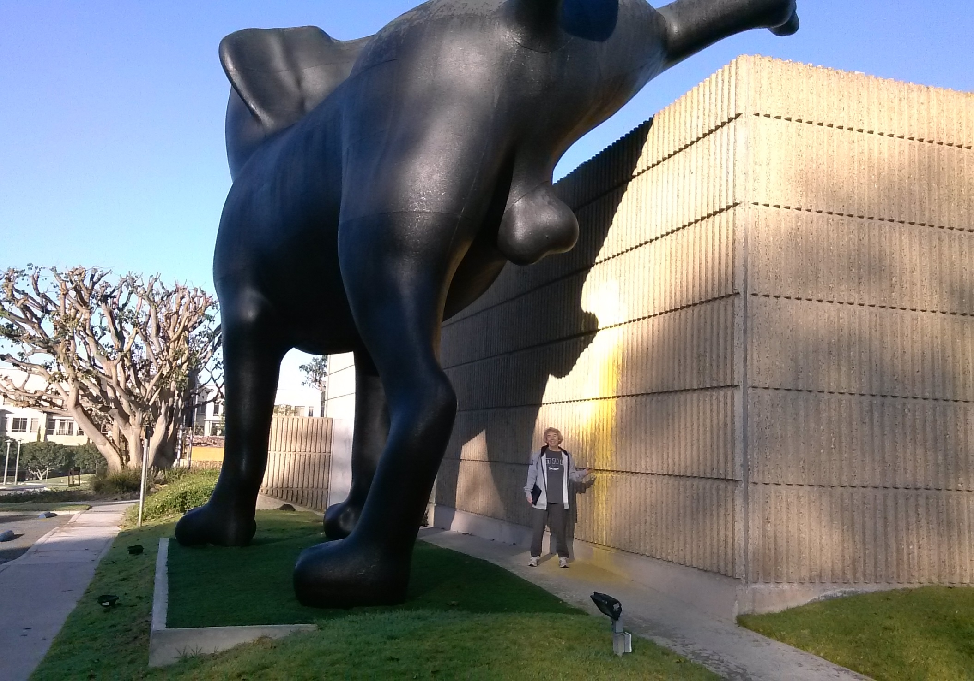
Orange County California Museum of Art

Slide 38


