Slide 1
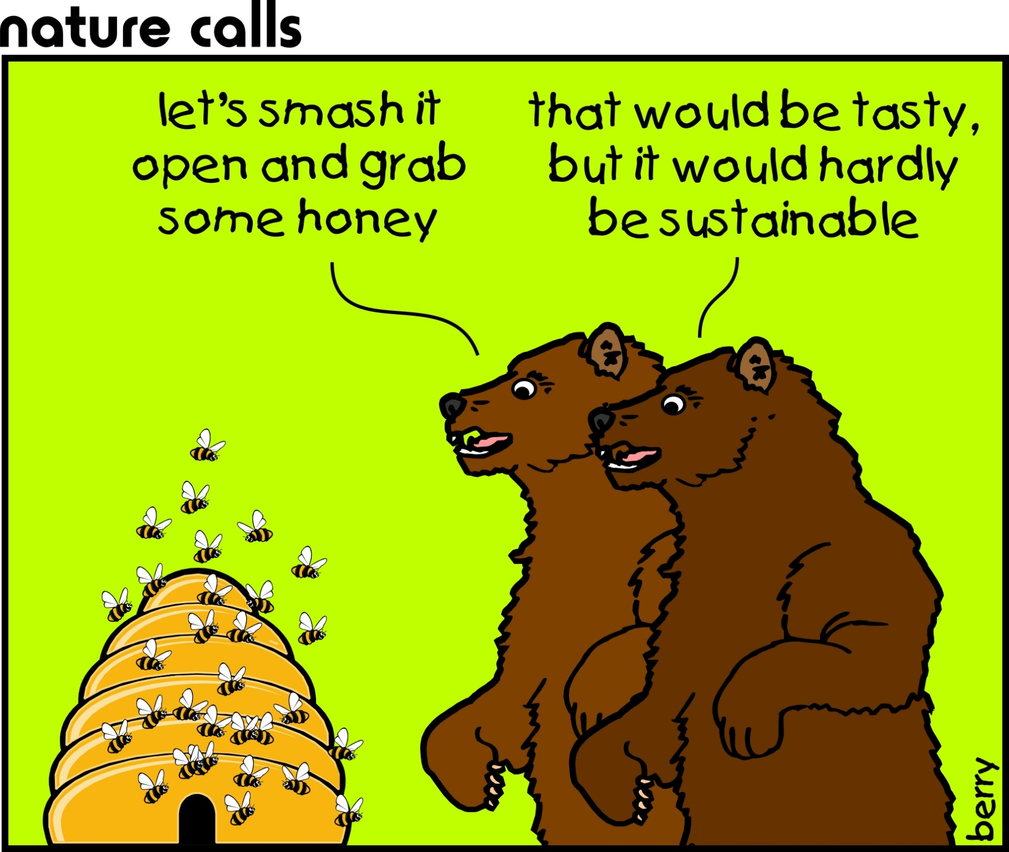

Slide 2

Sustainability Update
Sustainability Imagery
Auburn University Sustainability Stories/Report
STARS

Slide 3

Chris Reidy

Slide 4
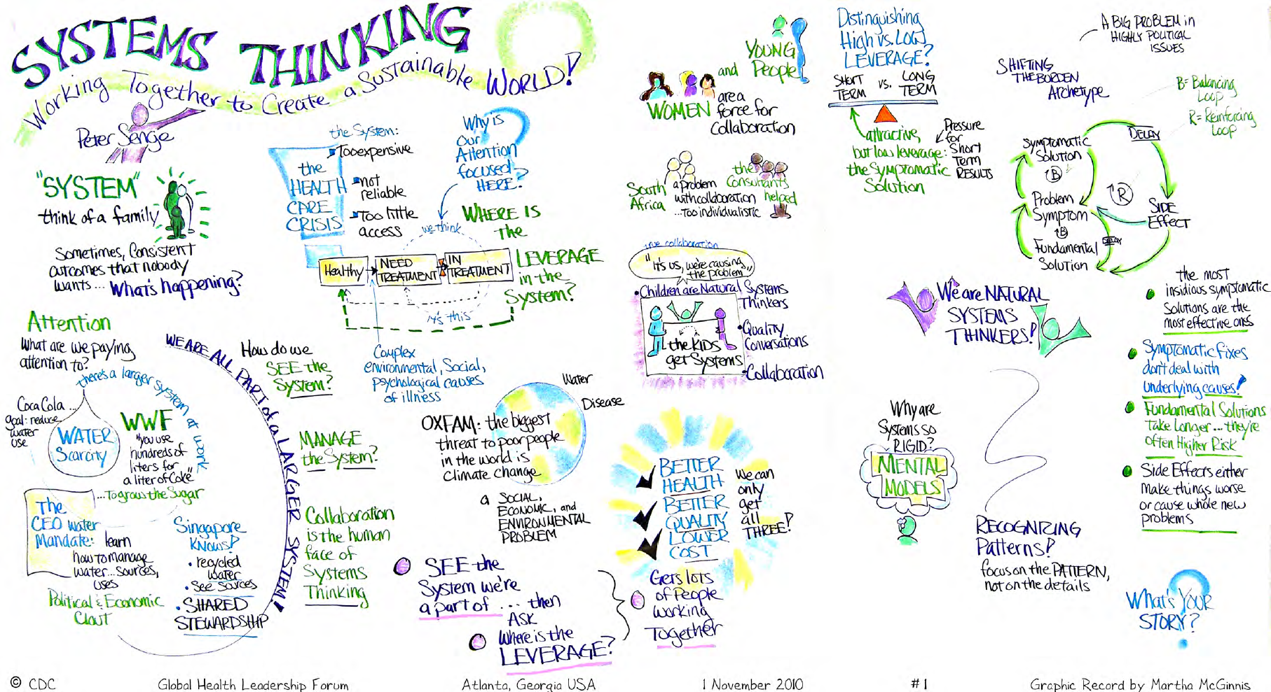

Slide 5

Ralph Clevinger

Slide 6
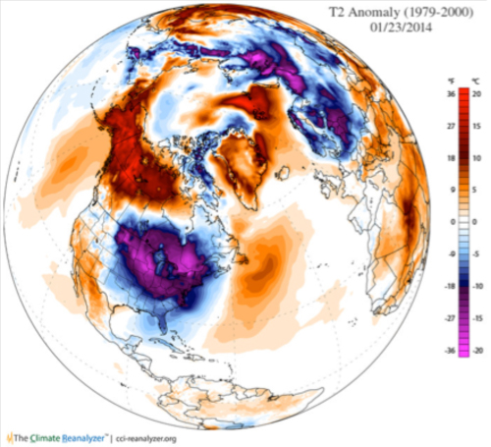
Temperature Impact of the Polar Vortex compared to 1979-2000 average temperature
Michael Mann

Slide 7
Temperature Impact of the Polar Vortex compared to 1979-2000 average temperature
Eastern U.S.
20° Colder
Alaska
20° Warmer
January 26, 2014
Homer, Alaska: 54°
Only Southern CA and
Southern FL warmer
Michael Mann

Slide 8

Sustainability Frameworks
Triple Bottom Line
The Natural Step
The Daly Triangle
“Meeting human needs…”
Chris Reidy

Slide 9
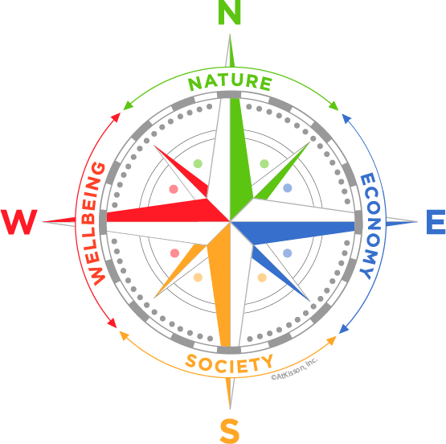


Sustainability Compass
Designs by Courtney Windham
Assistant Professor, Graphic Design

Slide 10

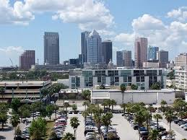

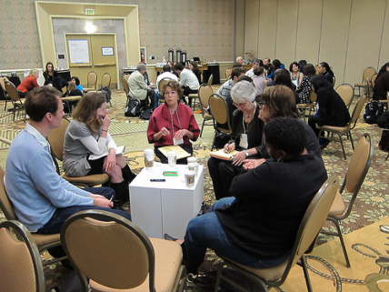

Sustainability Compass
Conditions for a Flourishing World
N
Live in accord with the laws of Nature
Maintain a prosperous Economy that is viable, fair, and inclusive
Cultivate Social connectedness, caring, equity, and engagement
Make individual opportunity, fulfillment, happiness and Wellbeing possible.
E
S
W
Robert Steele

Slide 11
Sustainability Update
Sustainability Imagery
Auburn University Sustainability Stories/Report
STARS

Slide 12
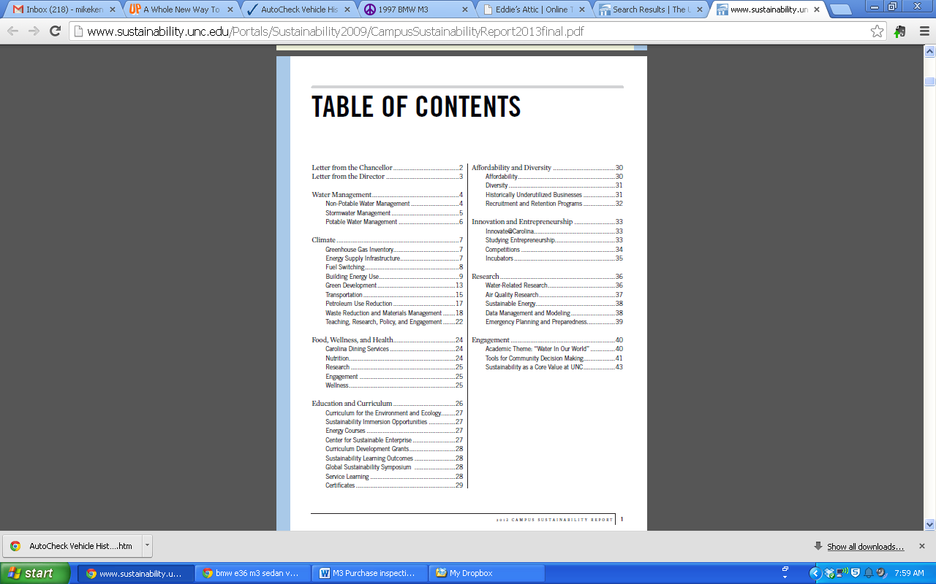
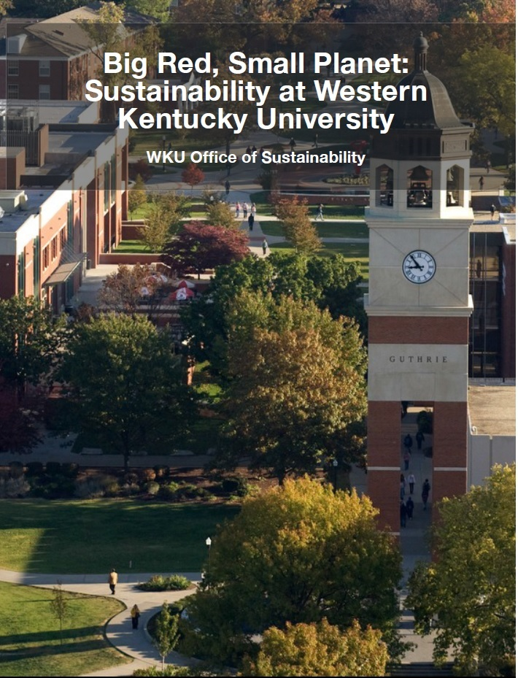
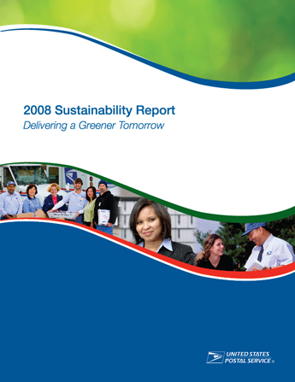
Telling Auburn’s Story/Sustainability Reports

Slide 13
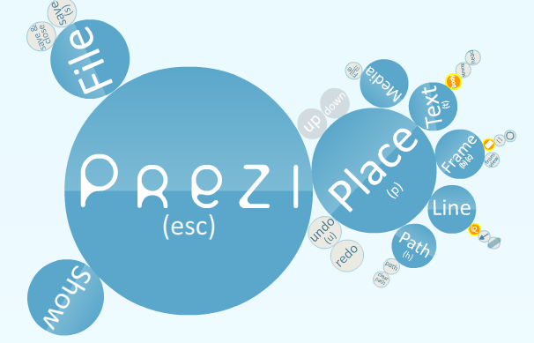
Telling Auburn’s Story/Sustainability Reports
http://prezi.com/0afwzy7q_hue/we-are-uc-berkeley/

Slide 14
Telling Auburn’s Story/Sustainability Reports
The Big Picture:
Academics, Engagement, Operations, Planning & Administration
Subsequent Stories:
Energy
Transportation
Student Engagement
Academics
Food
Buildings
Community
Landscape
Wellbeing
……..

Slide 15
Sustainability Update
Sustainability Imagery
Auburn University Sustainability Stories/Report
STARS

Slide 16

Sustainability Tracking Assessment & Rating System
477 Participating Institutions
303 Rated Institutions

Slide 17
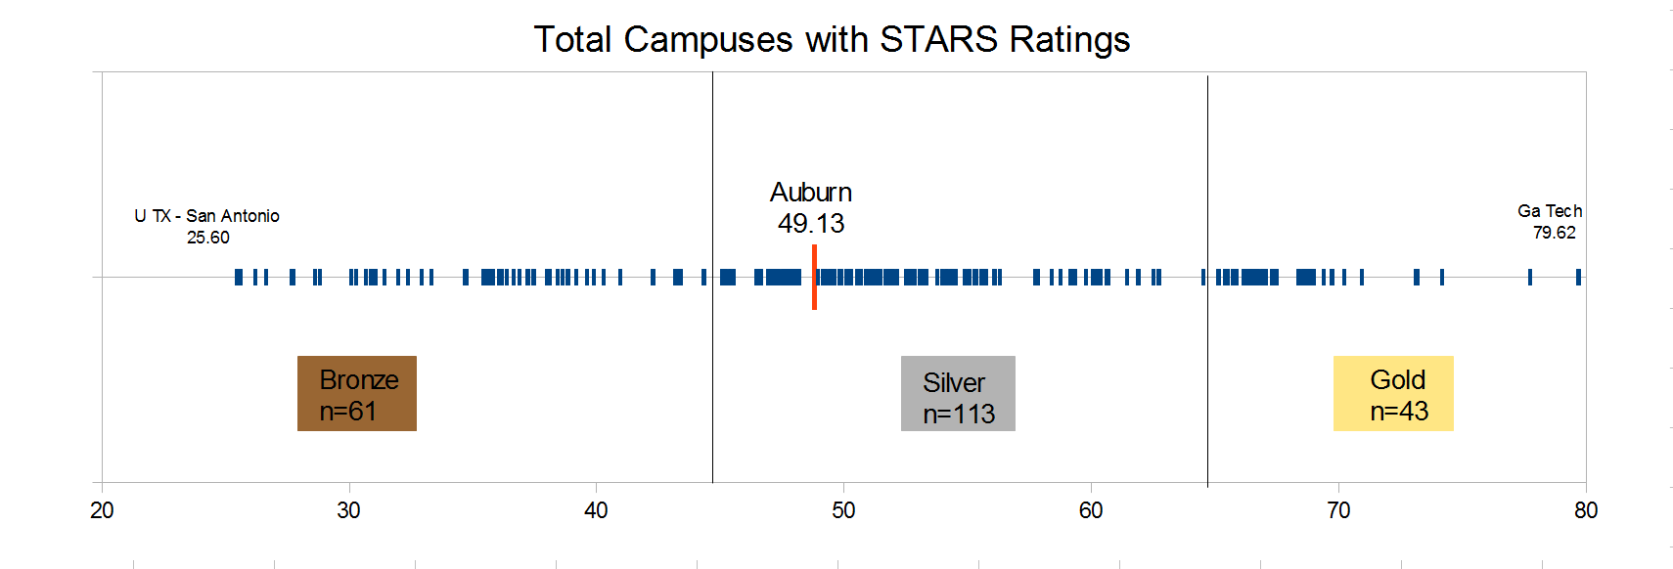
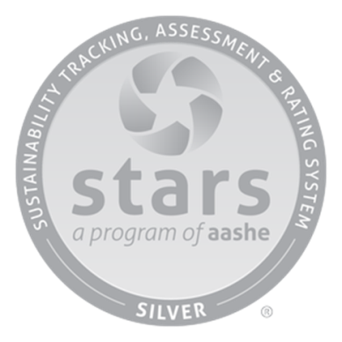

Auburn’s Performance Rating, 2012
Auburn
49.13
U TX – San Antonio
25.60
Georgia Tech
79.62
January, 2013
www.stars.aashe.org

Slide 18

STARS in the 2013-2018 Strategic Plan
“Enhance the commitment to sustainability in our educational programs, research, operations, engagement, and innovation, improving our AASHE sustainability score from 49 to 60.”

Slide 19
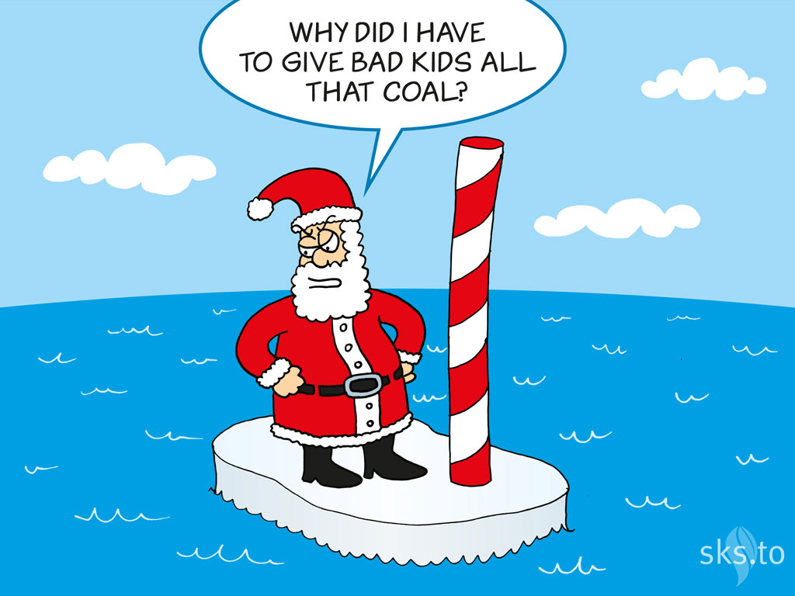

Slide 20


