Slide 1

S. Raj Chaudhury: schaudhury@auburn.edu
Stacey Nickson: snickson@auburn.edu
Gisela Buschle-Diller: buschgi@auburn.edu

Slide 2
Locations: Foy 136, Foy 118
Mission: Promote the professional development of all
Instructional, administrative and professional staff in support of excellent teaching & enhanced learning.
Programs: for faculty, for graduate students & University in general
Phone: 334-844-8530 http://wp.auburn.edu/biggio/

Slide 3
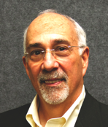
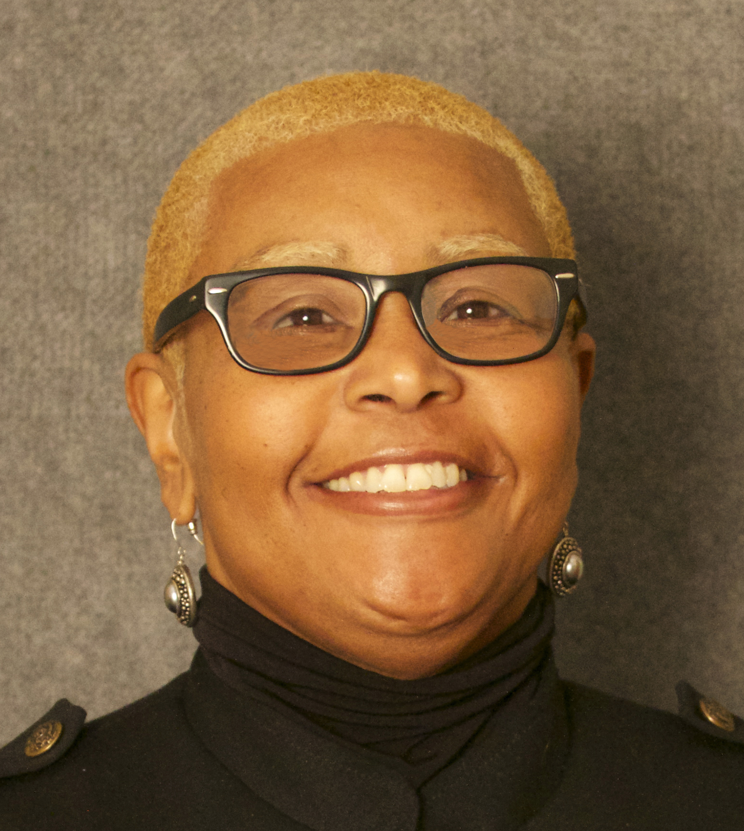
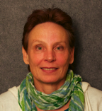
Biggio Center leadership
Director: James Groccia (2003-13*)
Associate Director: S. Raj Chaudhury (2009-)
Assistant Director: Stacey Nickson (2008-)
Faculty Fellows:
  Bill Buskist (Liberal Arts)
  Gisela Buschle-Diller (Eng.)
  Jared Russell (Education)
Distance Learning & Testing Services (2011)

Slide 4
Supporting Auburn’s priorities
#1 Enhance Student Success
  Student retention and achievement
  Innovations in eLearning (including distance ed.)
#2 Support Faculty Vitality
  Ongoing faculty development programs
  Strong environment for academic work
#3 Enhance Research & Scholarship
  Graduate Student professional development
  Grantsmanship & scholarship

Slide 5
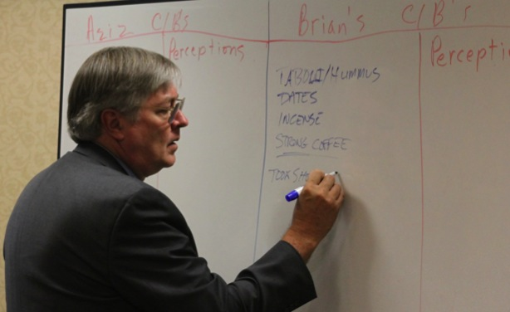
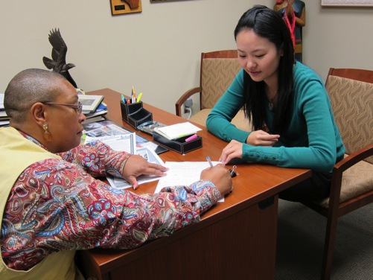
Priority 1. Enhance Student Success
Instructional feedback program
Mid semester formative assessments
  Helps students and faculty match expectations –

Slide 6
Data on Instructional Feedback
~60 in-person Small Group Instructional Feedback sessions/year
  ~2 hours per session (prep, data, write-up, consult)
~40+ electronic feedback surveys/year
Gathering feedback from ~5000 students/year
Faculty appreciate it, students appreciate it
Confidential process (not ‘teaching police’)

Slide 7
Priority 1. Enhance Student Success
Goal 3. The university will redefine its role in the development of eLearning programs (including distance education), meeting the needs of current and new Auburn students in ways that are consistent with the university's academic standards.
Supported development of 30+ new distance education courses in last 2 years (mainly undergrad.)
  Instructional design assistance
  Audio-video materials assistance
  Financial incentives
  Curriculum review and approval assistance
Parts of the core now available fully online

Slide 8
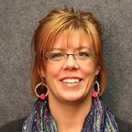

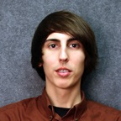
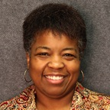
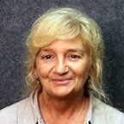
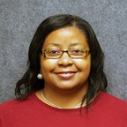
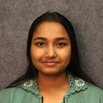
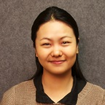
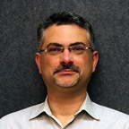
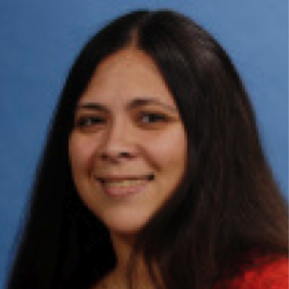
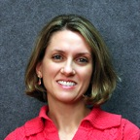
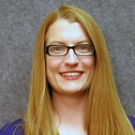

Support staff & Grad Assts.
Instructional Design/Technology/Multimedia
Distance Learning/Testing Services
Academic programs
Administrative support
Q

Slide 9

eLearning via online Testing
Biggin Hall Testing Center
100 seats for proctored online exams
~30 faculty users
5000+ exams administered

Slide 10
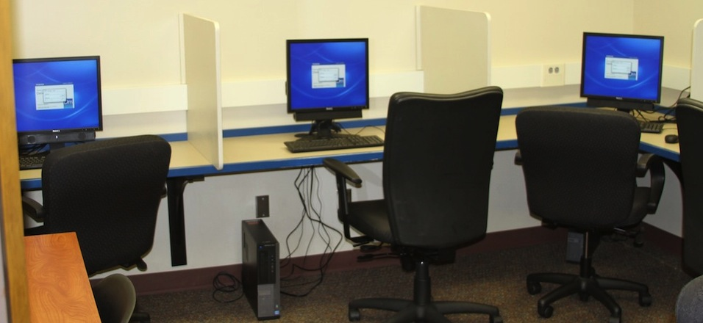
eLearning via online Testing
Foy Hall Testing Center
14 seats for proctored online exams
2012: 800 exams
2013: 1000+ exams
(MECH 2000/3000 assessments)

Slide 11
Bringing national exams to Auburn
GMAT
GED
MCAT (coming soon)
GRE Subject Tests (Spring)
Engineering FE exam

Slide 12
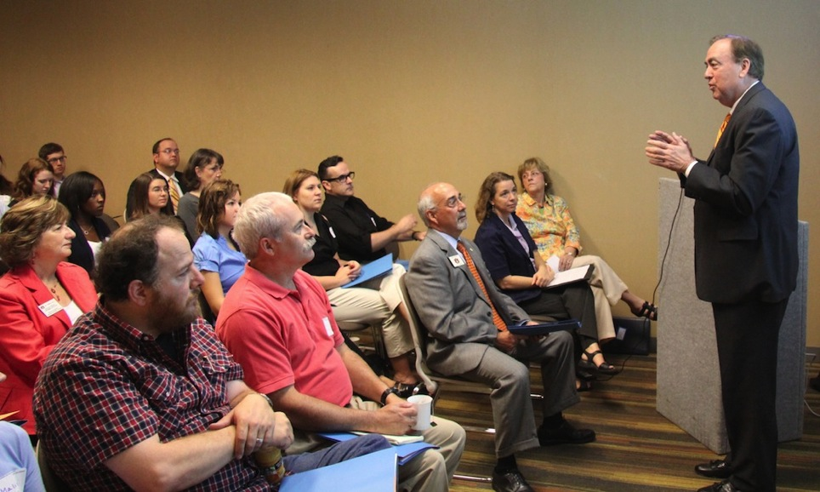
Priority 2. Support Faculty Vitality
Ongoing professional development
  New Faculty Orientation (45-70/Fall)
  New Faculty Scholars year-long program (25/year)
  Breeden Endowed Instructional grants (10-14/year)
  Professional Development Seminars (12/year)

Slide 13
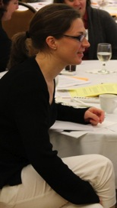
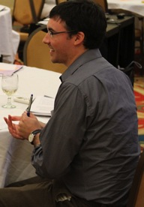
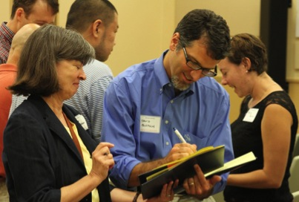
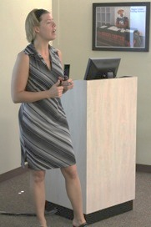
Supporting Faculty
Needs assessment survey (Fall ’12; N=215)
  Facilitating effective classroom discussions
  Incorporating active learning strategies**
  Designing effective lectures
  Developing critical thinking/problem solving skills
  Using technology to enhance learning

Slide 14
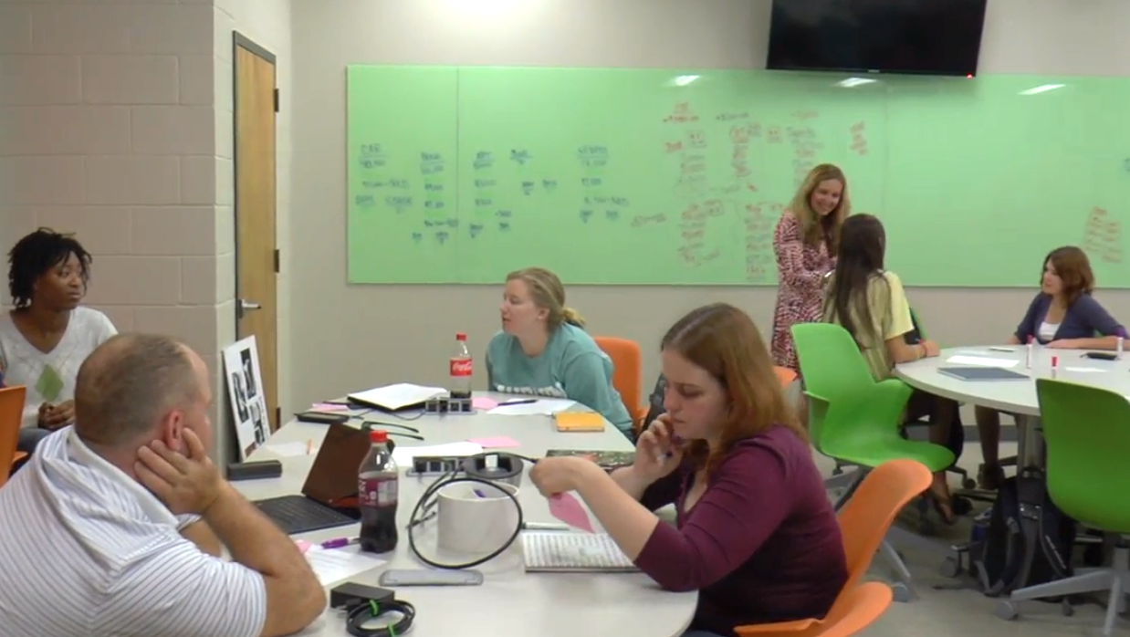
Supporting Active Learning
http://www.auburn.edu/easl
http://youtu.be/HllxkoEdlZA
“Incubator Classroom”

Slide 15
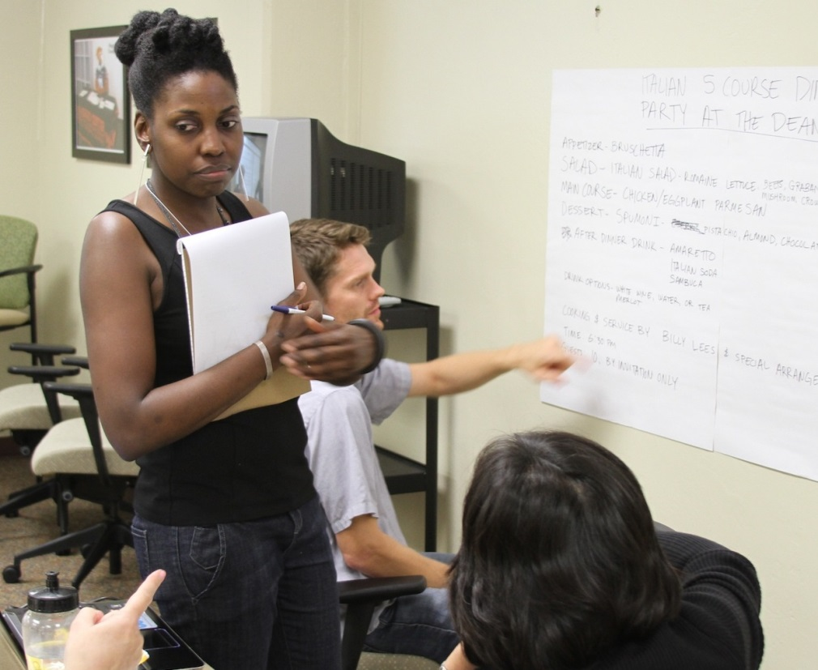
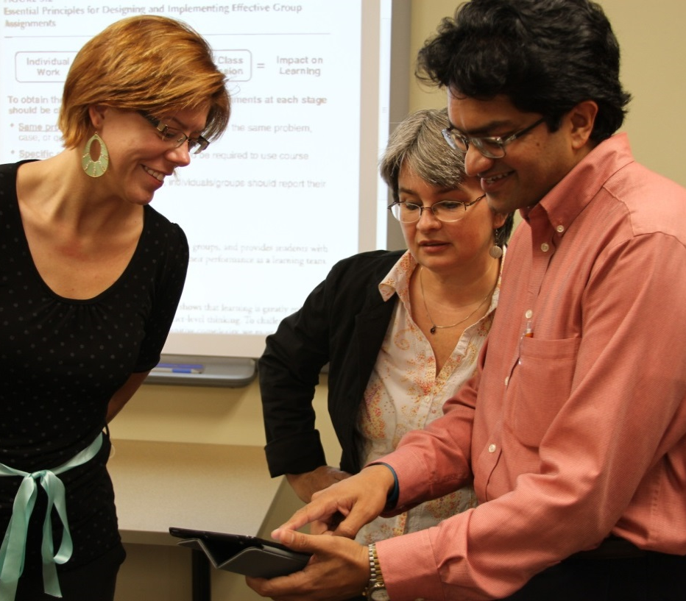
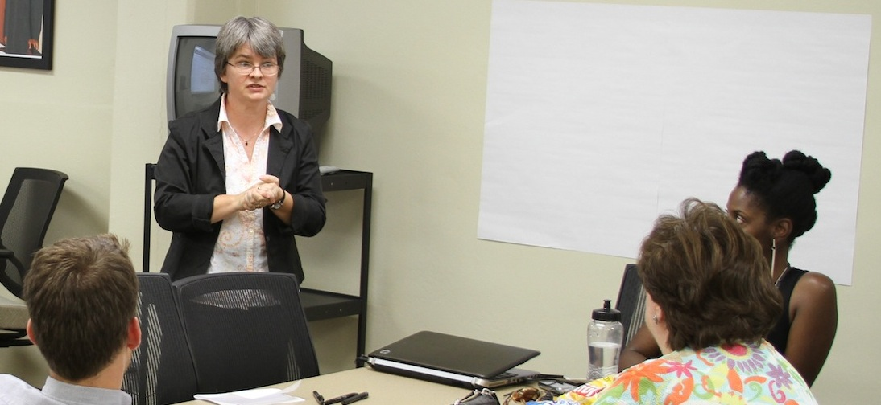

Slide 16
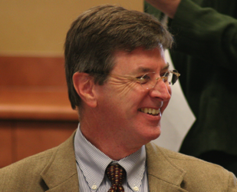
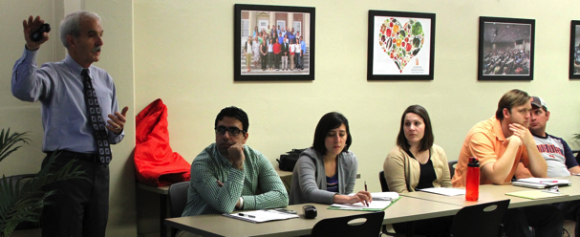
Strategic Commitment:
Intellectual Environment
“Cultivate an exciting intellectual environment by increasing opportunities for greater faculty dialogue and engagement.”
  Ongoing opportunities for faculty dialogue
  Special events focused on timely topics

Slide 17

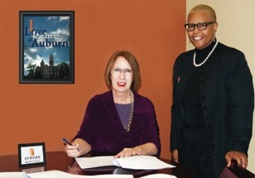
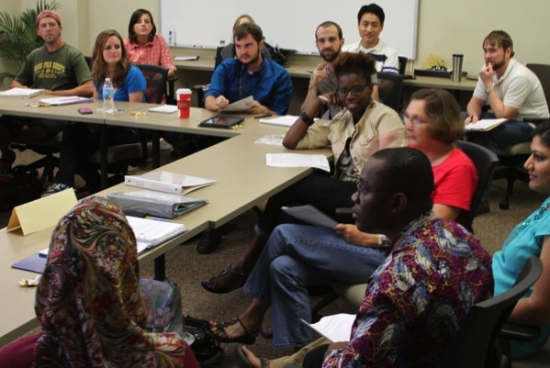

Trained 30+ Auburn faculty in Culture Bump
Train national/international external audiences
Support Study Abroad/International Experiences for students through pre-departure seminars
Contribute to scholarship in inter-cultural communication

Slide 18

2008; 2010; 2013

Slide 19
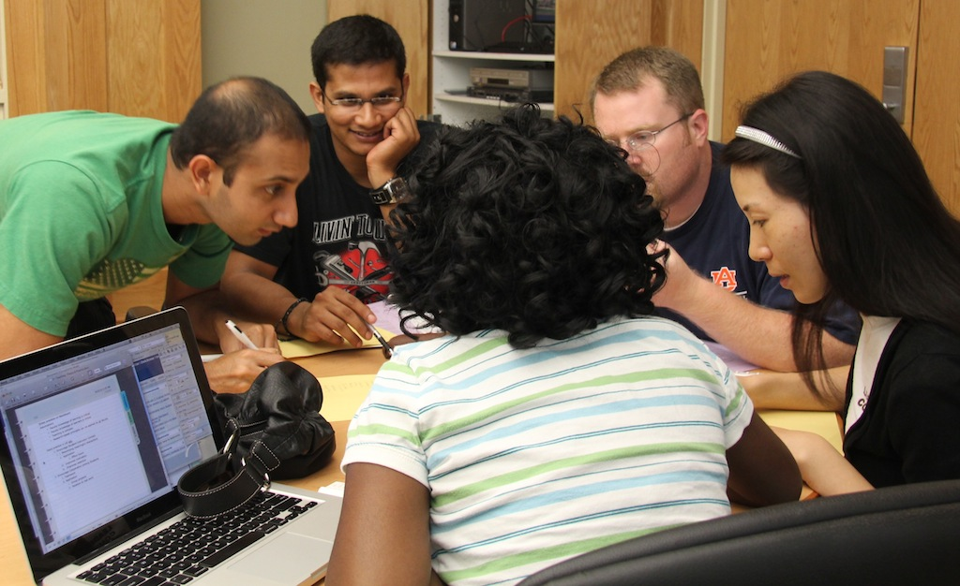
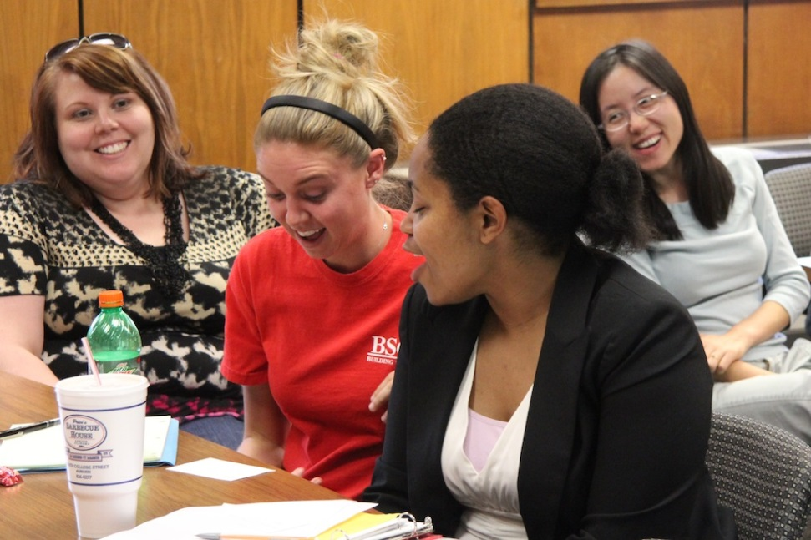
Priority 3. Enhance Research & Scholarship
Graduate Student Professional Development
  Preparing Future Faculty program (year long; 2 credits)
  10 years (over 200 students; 75-80% completion)
  ~30 doctoral students/year (since 2010); 12+ departments
  Engineering; CoSAM; Human Sciences; Education
  In collaboration with the Graduate School

Slide 20
PFF student comments
I would like to work in Industry and had never even thought of working as a faculty. But after taking PFF class, I have realized that if I do get a faculty job, I am ready for those challenges.
I was lost when writing my first teaching statement but after the class on teaching philosophies and research statements (and the acadmic eportfolio) I felt much more prepared for the job seeking process.
I enjoyed the different perspectives and opinions in the class that came from different disciplinary backgrounds (76% agreed)

Slide 21
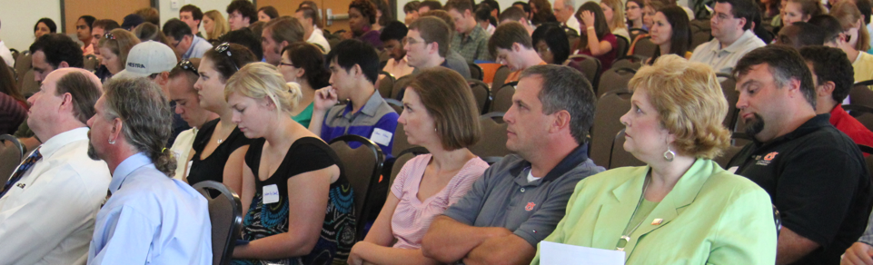
Graduate Teaching Assistants
Fall Orientation (half-day)
  200+ new GTAs
  GTA 101: First Day of Class; Etiquette; Trouble Students; Technology Usage; Teaching Labs etc.
Spring Orientation (since 2013)
  75+ GTAs (half-day)

Slide 22
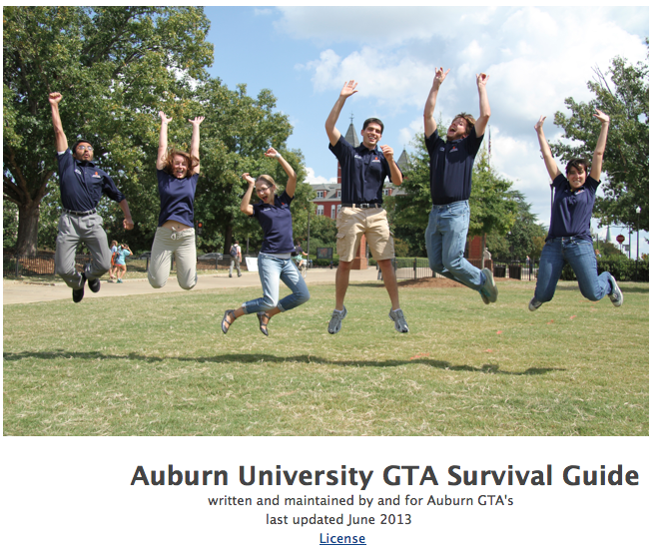
GTA Fellows Program
Leadership, professional dev. for experienced GTAs
Launched in 2012 (10 GTAs) – 1 year commitment
Applications due Nov. 10

Slide 23
Grantsmanship & Scholarship
STEM Education grants
  NSF CAREER Grants (letters of support)
  USDA (funded), NSF-REU (funded)
  NSF, NASA, HHMI
Publish and present on Teaching & Learning
  Books/Annual Journals
  Peer reviewed articles
  Book chapters
  Conference proceedings

Slide 24
Service
Senate Teaching Effectiveness Committee
Prestigious Scholarships Committee
Early Alert Grade Committee
Information Technology Council
College of Education DE Committee
SACS Reaffirmation review
SACS QEP Exploratory Committee
Strategic Plan implementation committee[s]

Slide 25

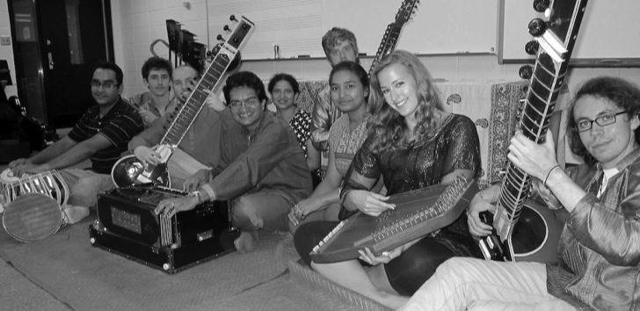
Zach
Watson
Auburn Indian Music Ensemble

Slide 26
Questions? http://wp.auburn.edu/biggio biggio1@auburn.edu

