Slide 1
Flight Education and Beyond
Wayne Ceynowa
Chief Flight Instructor

Slide 2
Overview
Recent flight program history
Flight training curriculum redesign
Course materials
Recent FAA approvals
Aviation Accreditation
Future opportunities

Slide 3
Recent Flight Program History
May 2010
  Chief Flight Instructor vacancy
August 2010
  Lost FAA pilot school certification
  Exceeded 60-day vacancy allowance
October 2010
  Chief Flight Instructor hired
  Efforts begin toward FAA reinstatement

Slide 4
Recent Flight Program History
July 2011
  Pilot school oversight transferred to ATL from BHM
August 2011
  Pilot school certificate reinstated
  All FAA courses and examining authority reinstated
  Pilot school certificate renewal next due September 2013

Slide 5
Flight Curriculum Redesign
From 2011, began a review and overhaul of flight curriculum
Previously using commercially-available, one-size-fits-all curriculum (Jeppesen)
Improved course structure, realistic lesson time allocations
Broadened scope of training to include more be more practical applications
Included a greater number of hours of simulation to lower overall training costs ($5,000)

Slide 6
Flight Curriculum Redesign
Recently submitted Professional Pilot curriculum for FAA approval
Non-traditional pilot training course
Eliminates training inefficiencies of traditionally structured courses
Possible to reduce training costs to students up to $10,000
Total savings up to $15,000 when simulation savings included

Slide 7
Flight Course Materials
Developed airline/professional pilot checklists, standard operating procedures (SOPs), flight operation manuals (FOM), and more
Replaced expensive texts with comparable FAA documents (low-cost or free on-line)
Recently introduced EFB (electronic flight bag)
ForeFlight - low-cost, discounted chart service offered through its Educational Licensing Program (ELP)

Slide 8
Recent FAA Approvals
Successfully renewed FAA-approved pilot school certificate September 2013 for another 2-year period
Renewal based on
  Minimum 1st pass rate for all pilot certificate-related and aeronautical knowledge tests taken (min. 80%, AU 90%)
Accuracy of training records and documentation
Safety Record (incidents/accidents) NONE

Slide 9
Recent FAA Approvals
Airline First Officer ATP hours reduction
September 2013
  60 credit hours of aviation-related courses receive FAA approval
  2 degree programs received FAA approval
    Aviation Management
    Professional Flight Management
  AU currently 1 of 9 schools currently approved
Allows 250-hour reduction of time required for ATP certification (1,500 hours)

Slide 10
Aviation Accreditation
Aviation Accreditation Board International (AABI)
Focuses on aviation-related programs
First accredited 2003
Recent challenges with the passing of Dr. Ray Hamilton and retirement of Dr. Randy Johnson
Added staff to cover Fall 2013 semester classes
2 faculty positions recently approved
Traditional staffing vs right-size staffing
Awaiting AU/AABI meeting for accreditation renewal

Slide 11
Possibilities
Attrition and growth in aviation industry = opportunities to attract domestic and international students
Out-of-state, out-of-country opportunities
Non-degree seeking student opportunities
Training provider for other collegiate programs
Greatest strengths:
  AU name, reputation, people

Slide 12
Possibilities
Attrition/growth in aviation industry = opportunities
Domestic and international students
Out-of-state, out-of-country opportunities
Non-degree seeking student opportunities
Be the training provider for other collegiate programs
Unmanned Aircraft Systems (UAS)
  Law enforcement
  Agricultural
  Forestry

Slide 13
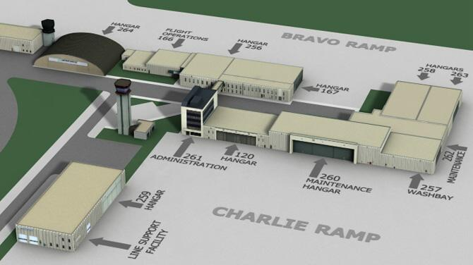
Possibilities: Vision

Slide 14
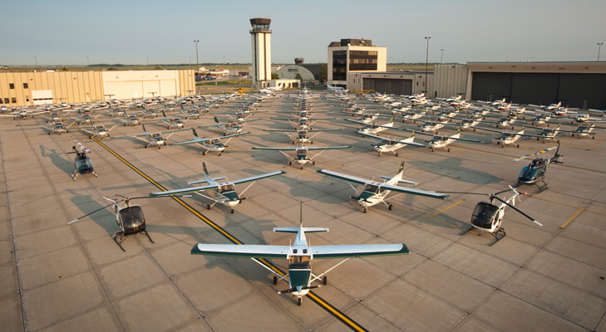
Possibilities: Where there is vision

Slide 15
  Questions ???
Answers???

