Slide 1
Research and Scholarly Works
Efforts to enhance Faculty engagement
Dr. John M. Mason
Vice President for Research and Economic Development
Martha M. Taylor
Assistant Vice President for Research Administration
Marcie C. Smith
Associate Vice President for Business and Finance

Slide 2
Organizational Chart
Office of the Vice President for Research
John M. Mason, PhD, PE
Vice President for Research &
Economic Development
Auburn Research &
Technology Foundation
Lt. Gen. (Ret) Ron Burgess
Sr. Counsel for National Security
and Cyber Programs & Military
Affairs
James H. Sanford
Chair
Carl Pinkert, PhD
Associate VPR
Research Advisory Board
John M. Mason, PhD, PE
President
Giovana Brannan
Business Manager
AAES, ACES, Federal Relations, State Relations, Legal Counsel, Economic Development
John D. Weete, PhD
Executive Director
Larry Fillmer
Executive Director
Research Program
Development
Rodney L.
Robertson, PhD
Executive Director
Huntsville Research
Center
Patricia E. Rynders, DVM
Interim
University Veterinarian
John D. Weete, PhD
Assistant VPR (Acting)
Technology Transfer
Martha Taylor
Assistant VPR
Research Administration

Slide 3
Auburn University Research
Strategic Interdisciplinary Initiatives
Strategic Interdisciplinary Initiatives
Cyber Systems
Energy and the Environment
Science, Technology, Engineering and Math
Gulf of Mexico Research and Restoration
Transportation
Health Sciences
(Includes Food Systems)

Slide 4
Auburn University Research
Strategic Interdisciplinary Initiatives
NSF/NIH/USDA
Mission Agencies
Corporations
Foundations
Public Agencies
Alliances
Development
Associations
University Facilities
MRI
CASIC
Energy Labs
NCAT
ARTF
ACES
AAES
Outreach
Huntsville Research
Center
Funding/Sponsors
Cyber Systems
Energy & Environment
Gulf of Mexico
Health Sciences
S.T.E.M.
Transportation
Enablers
Faculty Expertise
Academic Programs/Libraries/OIT
Undergraduate/Graduate Students
Research Staff
Research Facilities
Intramural Grants Program
Foundation

Slide 5
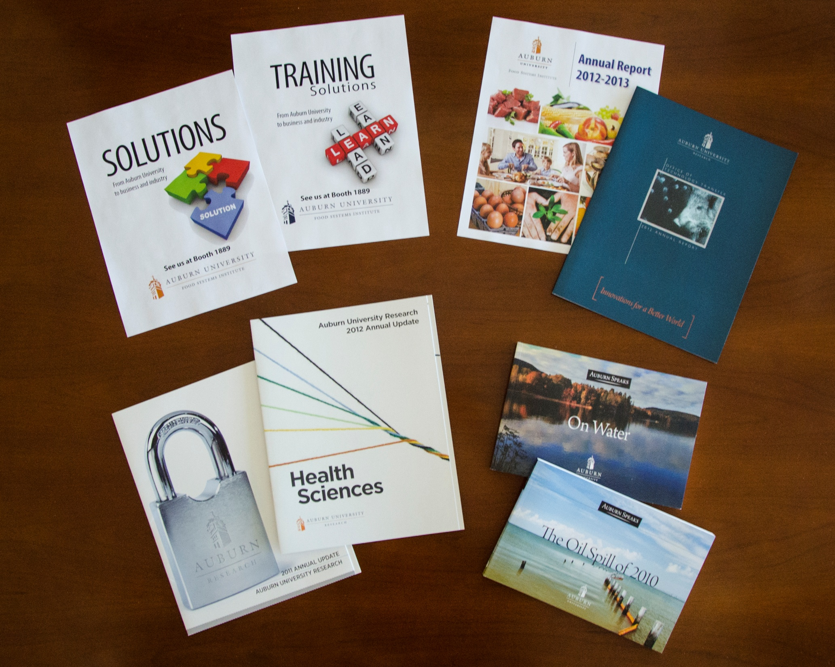

Slide 6
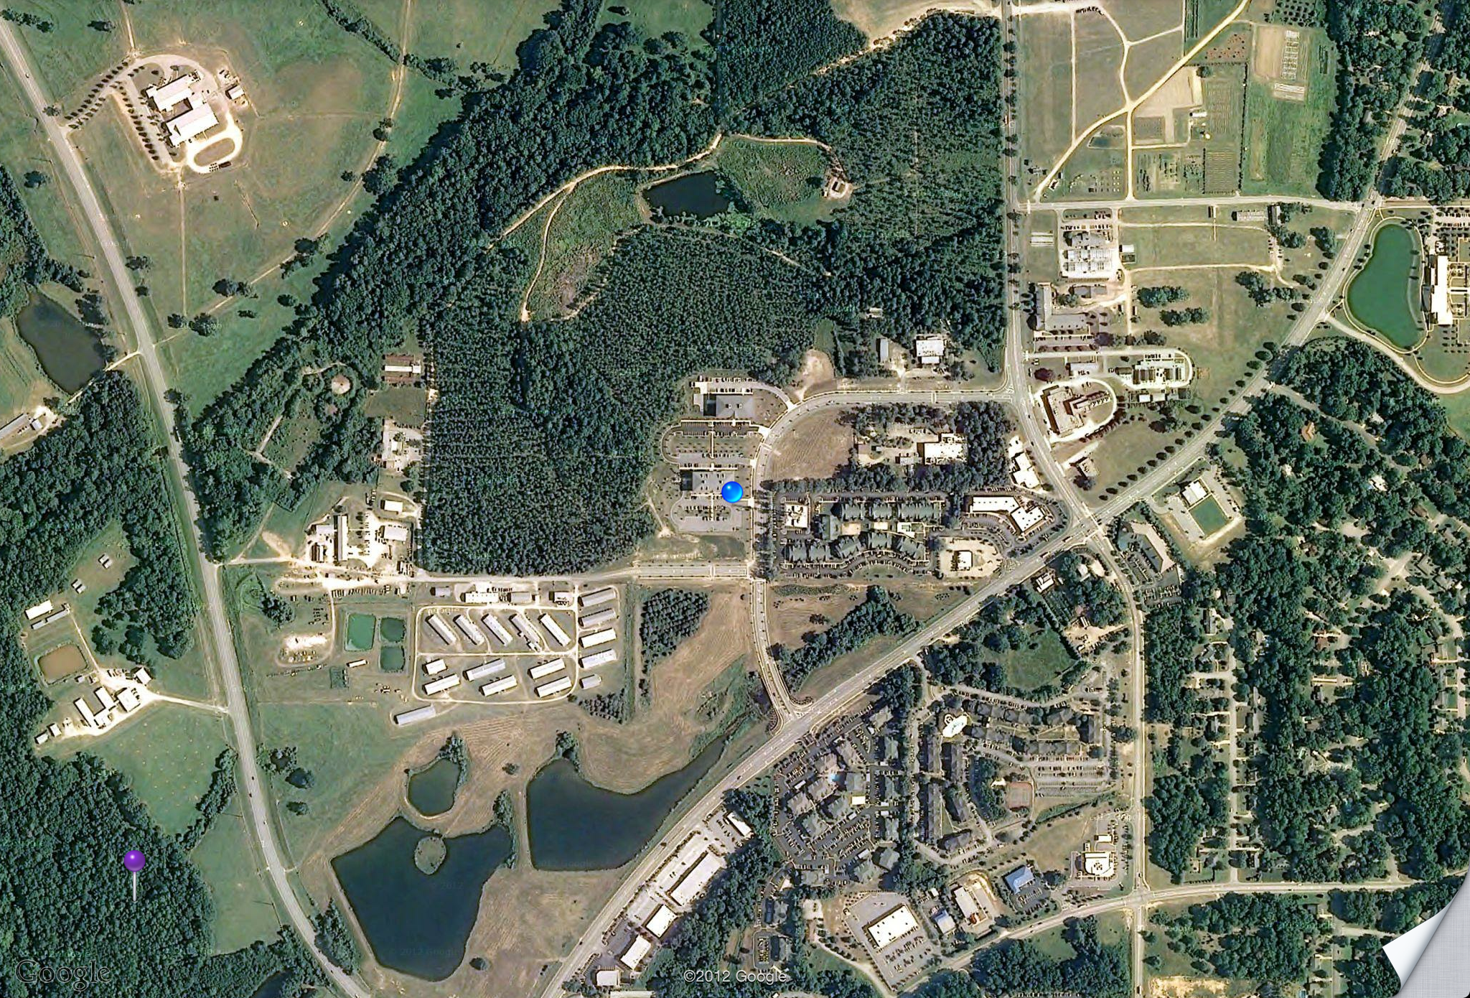

Slide 7

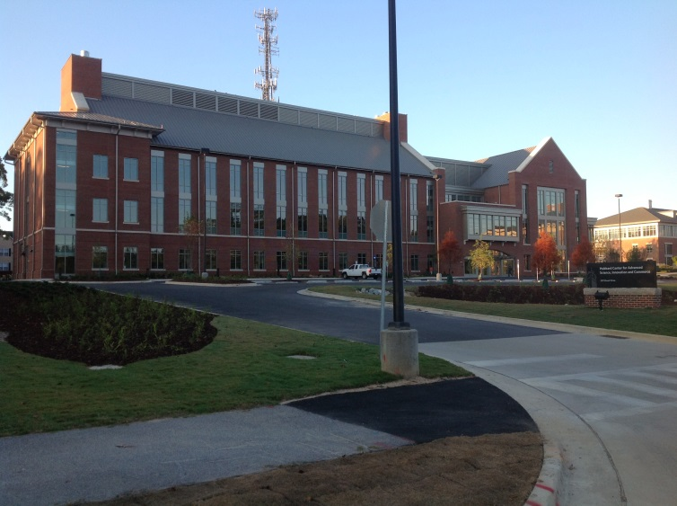
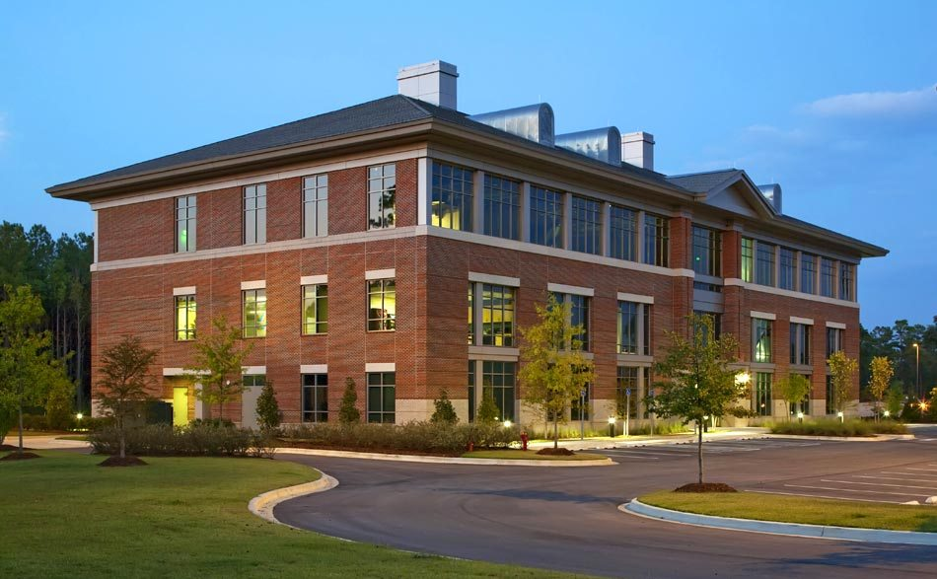
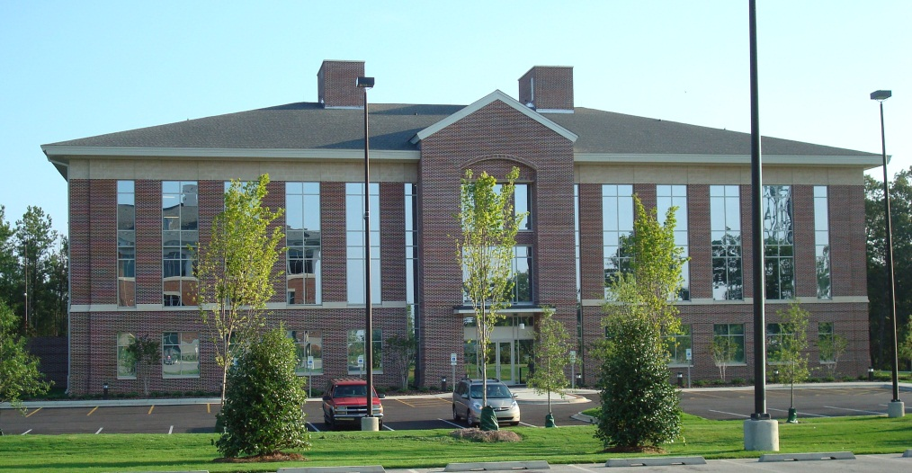
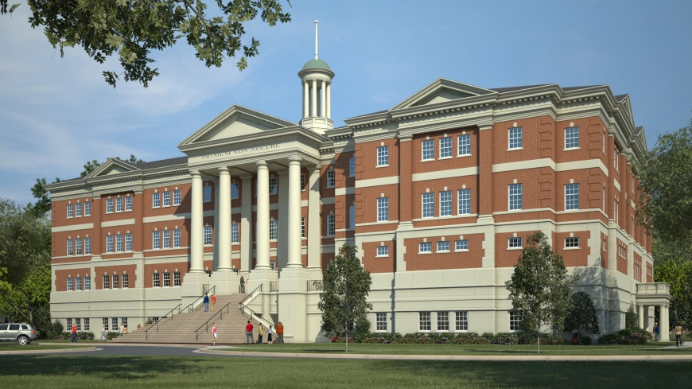
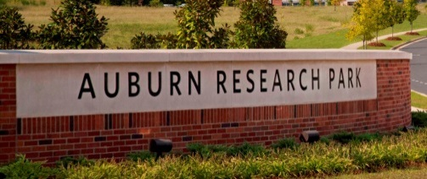
Auburn Research and Technology Foundation
Auburn Research Park
www.auburnrtf.com

Slide 8
Strategic Priorities from the 2013-2018 Strategic Plan
Strategic Priority 2
  Support Faculty Excellence and Strengthen Auburn’s Reputation
  Auburn’s academic achievements depend upon the expertise, engagement and success of the faculty.
  The vitality of our faculty can best be enhanced by building a strong intellectual community that depends on the continually advancing expertise of each faculty member.
  We will identify expectations for the productivity of our faculty in research and creative work, and we will support individual faculty members by taking into account their unique strengths and contributions.
  We will apply the yardstick of best practices to our academic work environment for faculty, and we will adopt new policies designed to sustain the health of that working environment.
Strategic Priority 3
Enhance Research, Scholarship and Creative Work
  Auburn will become increasingly competitive with the most productive universities in its research and creative scholarship activities.
  We will develop our strategic research initiatives by building on our existing strengths and developing programs that will translate our discoveries into practical solutions for the state, region, and world.
  To accomplish these goals, we will challenge the Auburn community to strengthen its research culture and increase research expectations.

Slide 9
Concerns-Solution Matrix
Concerns
  Difficulty in financial management of awards
Solutions
  My Funding Portal
  eCerts – Electronic effort certification system
  eSWTs – Electronic salary and wage transfer system
  Other electronic document processing – eVoucher and eTravel vouchers
  Compass course to certify the skills of Departmental Administrative staff

Slide 10
Concerns-Solution Matrix
Concerns
  Difficulty in financial management of awards
  Lack of support for proposal development and submission
Solutions
  Plus 6 Program
  1.5 day Grantsmanship workshop at Research Week; 1 hour Proposal workshop during new faculty orientation
  Compass Course
  PIVOT subscription and workshops
  Funding newsletters, Tiger tips, website enhancements, PI Handbook, AUSPAN

Slide 11
Concerns-Solution Matrix
Concerns
  Difficulty in financial management of awards
  Lack of support for Proposal development and Submission
  Complex process for IACUC and IRB and compliance activities
Solutions
  Revised forms to clarify questions and reduce revisions
  Electronic distribution of materials for committee review and meetings
  IRB divided into two committees for focused expertise and faster processing
  MRI Safety Advisory Council established to assist in risk management for protocols involving the AU MRI facility
  Online training for RCR, fCOI, IBC, IRB, IACUC

Slide 12
Concerns-Solution Matrix
Concerns
  Difficulty in financial management of awards
  Lack of support for Proposal development and Submission
  Complex process for IACUC and IRB and compliance activities
  Paper based systems
Solutions
  COI Smart for Conflict of interest disclosures, review and management
  Technology Transfer Sophia system for on-line disclosures and monitoring of technology transfer efforts
  All Contracts and Proposals scanned into Xtender for ease of access and dissemination
  Electronic distribution of processed proposals and awards from OSP to campus constituents

Slide 13
Concerns-Solution Matrix
Concerns
  Difficulty in financial management of awards
  Lack of support for Proposal development and Submission
  Complex process for IACUC and IRB and compliance activities
  Paper based systems
  Communications
Solutions
  FRC established to ensure Faculty engagement in policy and procedure development
  OSP Education program with multiple audiences and methodologies
  Plus 6/OSP joint staff meetings
  URC/ADR/AUSPAN meetings monthly or quarterly
  Quarterly updates at Provost Council meetings, annual reports and AU Speaks
  Presentations at Department Heads Retreat
  Website enhancements, newsletters, PI handbook, brown bag lunch seminars, new-faculty luncheons

Slide 14
Next steps
Future activities under development
  eCover Form in final stages of development
  Selection of Key Solutions for IACUC and IRB protocol development, processing, reporting and over-all management
  Renovation of space in Foy Union for team meetings for proposal development, policy and procedure improvement, education on special topics, interdisciplinary team building, lunch and learn seminars, and general rapport building
  Strategic plan implementation working group and subgroups established to begin:
    mapping commitments to goals;
    identifying benchmarks and performance indicators;
    identifying resources to accomplish goals; and
    establishing priorities for year 1 implementation

Slide 15
Summary
Investigators and others have expressed concern in the past couple of years regarding requirements for engaging in sponsored programs activities
The OVPR and the Business Office have implemented several new processes to facilitate Investigators in the financial and administrative management of their projects
New ERA and process improvement activities are underway and attempts are being made to map them to the strategic plan over the next 5 years

Slide 16
Questions?

