Slide 1

Reporting
Students of Concern
Auburn University Faculty Senate
June 16, 2015
Haven L. Hart
Division of Student Affairs
Student Conduct and Case Management/Student Advocacy

Slide 2
Student Advocacy & Case Management
Purpose:
Aid students in the successful navigation of challenging, personal life issues, critical incidents, hardships and emergencies that may impede a student's success and retention at Auburn University.
Serve as as an advocate, liaison or resource to students and families during times of student distress, need or emergency.

Slide 3
Reporting a concern or incident
www.auburn.edu/studentconduct
Click the “Report an Incident” tab
Report a Non-Academic Violation
Report a Student Academic Honesty Code Violation
Report Concerning or Threatening Behaviors

Slide 4
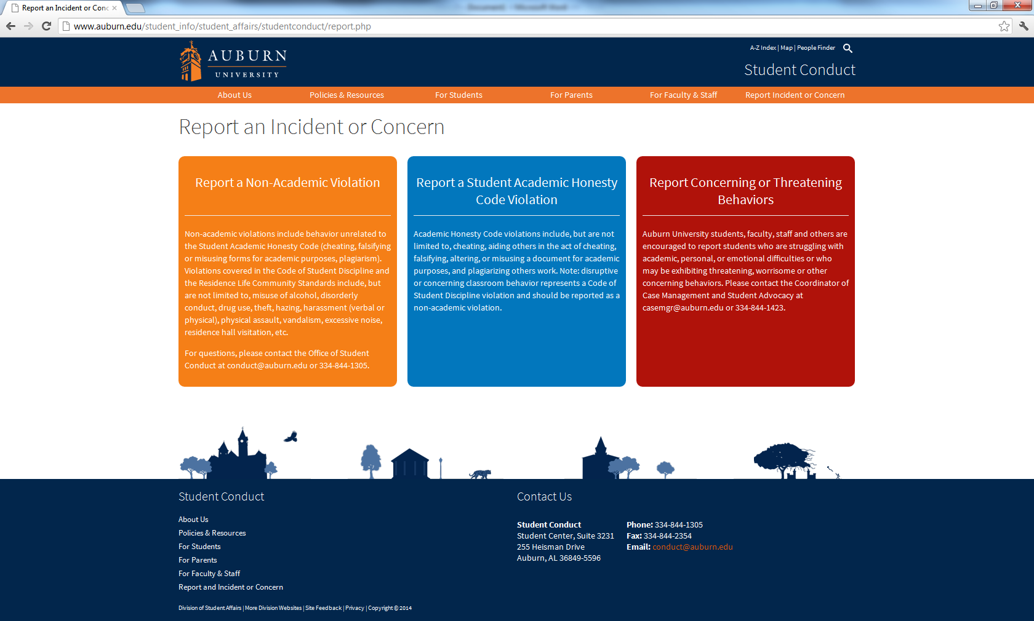

Slide 5
Important Numbers
Emergency: 911
(Auburn City Police will be dispatched to scene)
Non-emergency: 334-501-3100
(Auburn City Police – non-emergency)
Student Conduct/Student Concerns: 334-844-1305
(Students of Concern; Student Conduct)
Threat Assessment Team: 334-844-5010
(Threat to safety or well-being of others)

