Slide 1


Slide 2
CONSISTENT LOGO USAGE
Protects our federally registered trademarks
Builds our reputation and recognition through visual repetition
Creates a professional appearance for the university and those representing Auburn
Eliminates confusion about the legitimacy of information

Slide 3
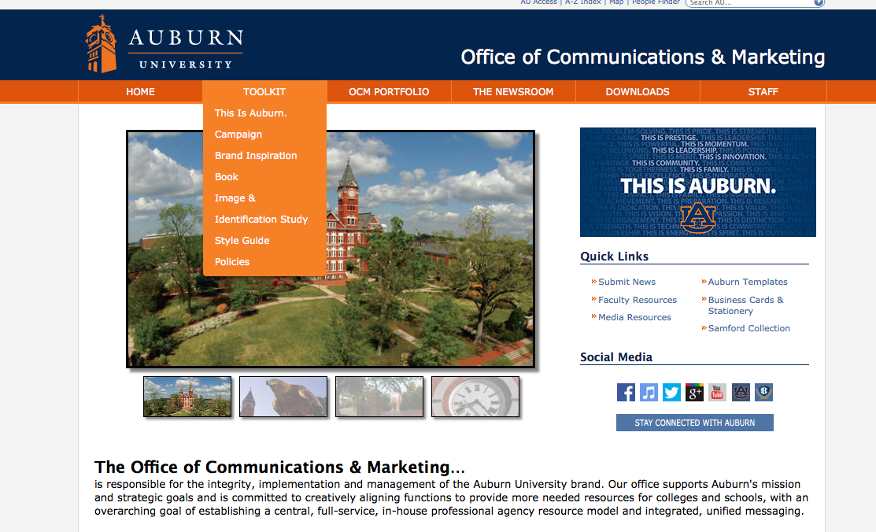
Visit auburn.edu/ocm for resources.

Slide 4


Slide 6
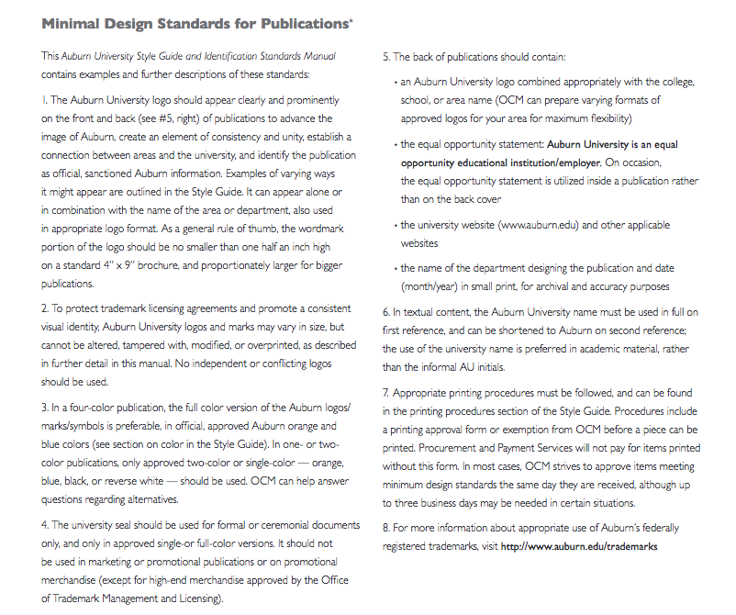
Page 8

Slide 7
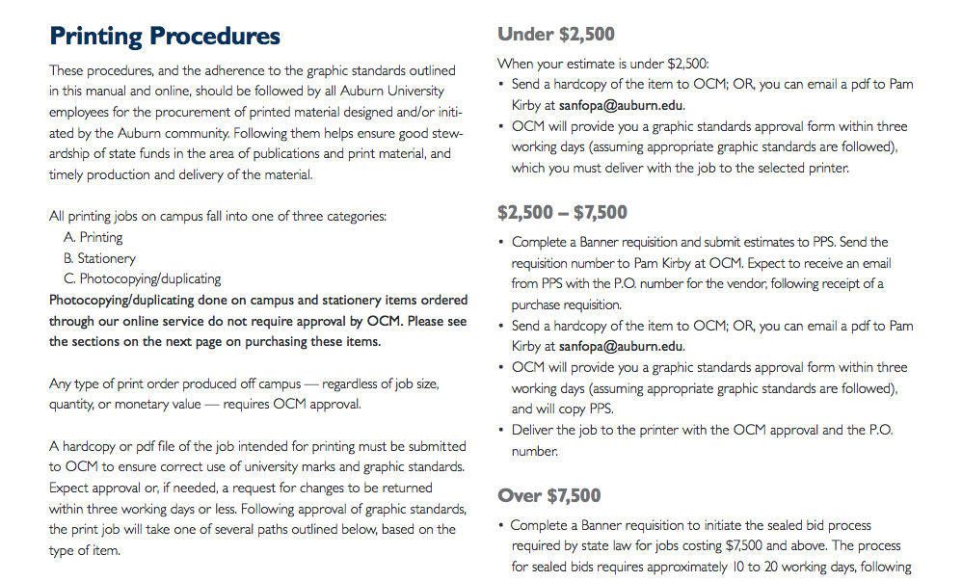
Pam Kirby sanfopa@auburn.edu
Page 34

Slide 8
COLLEGE COMMUNICATORS
Agriculture – Josh Woods
CADC – Colleen Boudreau
Business – Troy Johnson
Education – George Littleton
Engineering – Jim Killian
Forestry – Jessica Nelson
Grad School – Chris Anthony
Honors – Wade Berry
Human Sci – Jayne Kucera
Liberal Arts – Vicky Santos
Nursing – contact OCM
Pharmacy – Matt Crouch
COSAM – Candis Birchfield
Vet Med – Janet McCoy

Slide 9
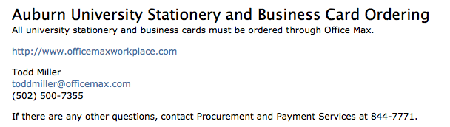

Slide 11
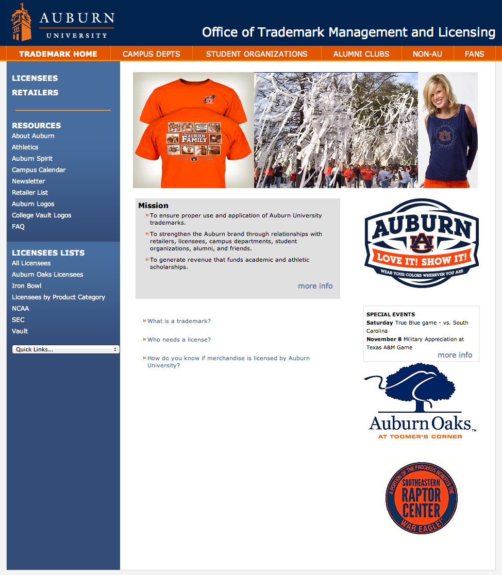
www.auburn.edu/
trademarks
Click
CAMPUS DEPTS
for policies, resources
and lists of AU
licensed vendors

Slide 12
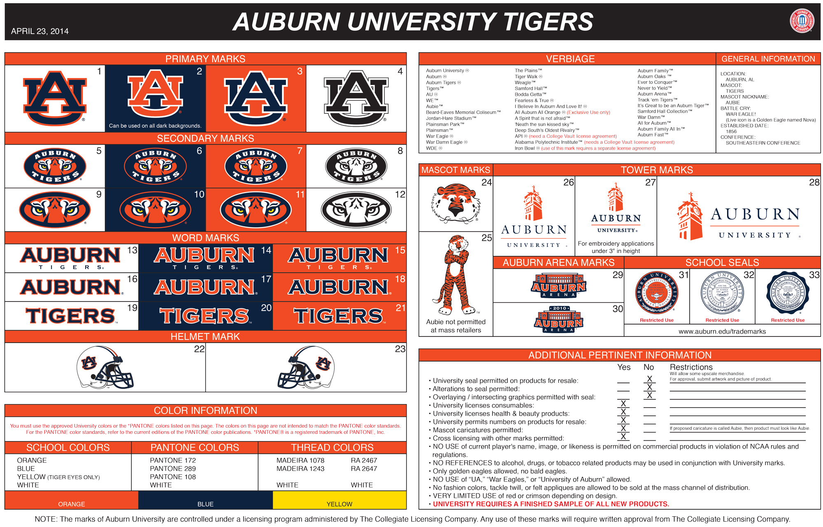
TRADEMARK LICENSING
Protects AU’s federally registered trademarks
Protects AU’s
valuable brand
through
consistent
use of marks
and colors

Slide 13
LICENSED VENDORS
Familiar with AU Trademark policies
Aware of what can be approved
Responsible for obtaining design approval
Required to carry product liability insurance naming Auburn University as an additional insured

Slide 14
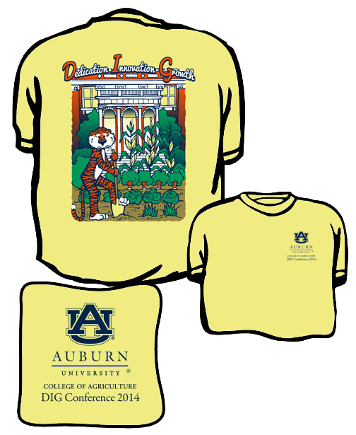
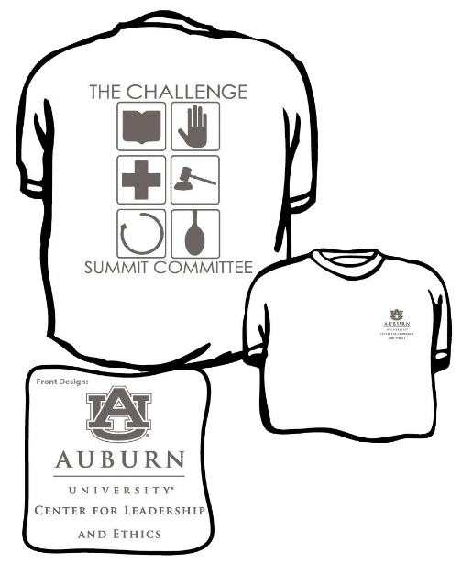

Slide 15
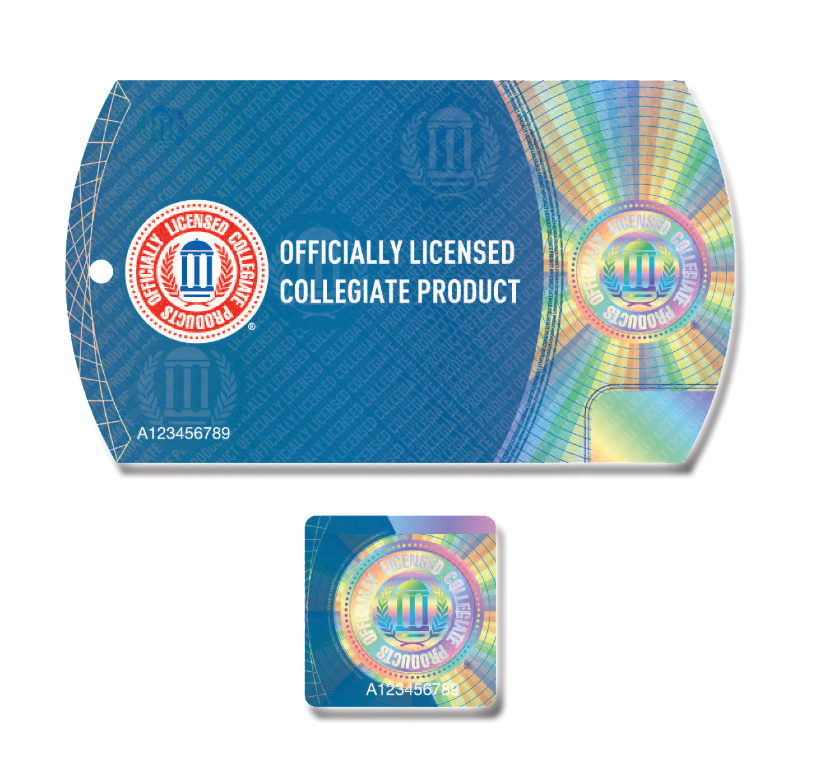

Slide 16
THIS IS AUBURN.
Questions:
Camille Barkley barklnc@auburn.edu
Susan Smith smithso@auburn.edu

